Slide 1
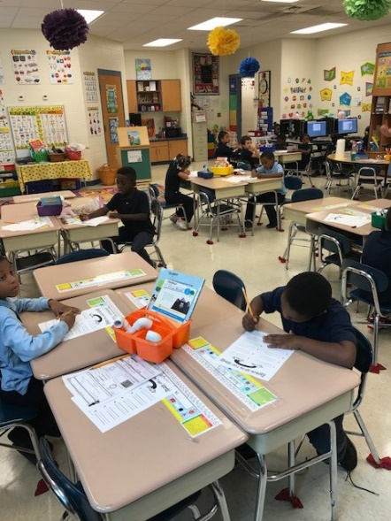
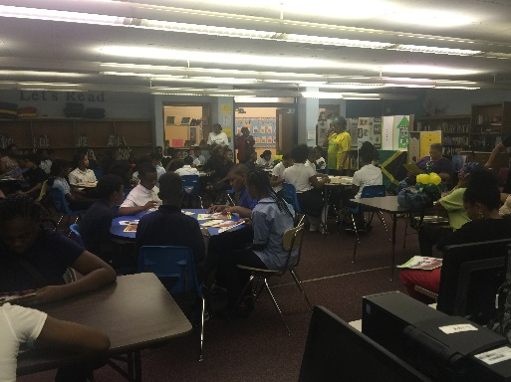
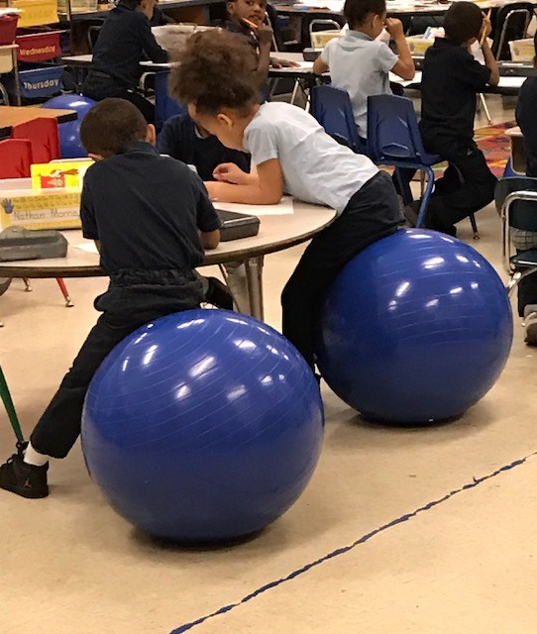
Turning Around Our Schools—Phase I
The Urgency, The Commitment, The Change
Gary Community school Corporation

Slide 2
Summary School Presentations
Jacques Marquette Elementary School and Beveridge Elementary School

Slide 3
Root Cause Analysis of Schools
Major Areas of Inquiry
Students
Foundational skills gaps in Math, Language Arts
Major process skill gaps in Math
Effects of trauma
Self-confidence, perseverance, “grit” lacking
High mobility rate noted
Teachers
Understanding of academic content
Evidence of effective instructional delivery lacking
Level of classroom differentiation
Overall teacher attendance concern

Slide 4
Root Cause Analysis of Schools, con’t.
Major Areas of Inquiry
Instructional Leadership
Daily focus on vision, instruction, high standards and expectations missing
Protecting time for classroom visits, conferencing inconsistent
Central Office Supports
Outdated instructional resources
District PD inconsistent, inadequate
Absence of new principal induction
Parents
Feelings toward school based on own schooling experience
Opinions of school’s customer service skills are less than desirable
F.A.C.E. Liaison—skill set and day-to-day activities need improvement

Slide 5
Findings
Curriculum
Depth and pacing of standards being taught does not match the rigor of the state assessment
Instruction and Assessment
Schools lack a coherent instructional structure
Major instructional resources are outdated
A plethora of instructional software has been competing for instructional time
Instructional delivery lacks coherence and commonality across grade levels

Slide 6
Findings
Organization
A six-hour instructional day, combined with teacher absences and student absences reduce the level of student engagement
Schools lack intensive intervention structure(s)
Leadership
Leadership needs fundamental support in establishing and maintaining a high- performing school
Professional Development
Professional development is insufficient for both school leadership and for teachers
Data is seldom used to inform instruction

Slide 7
Response to Schools with Persistently Low Achievement— Strategies
Curriculum
Grade-level Instructional Guides have been provided for grades K-8
Instructional Guides provide routine exposure to rigor
Children have a greater opportunity to learn due to access to properly paced curriculum
Instruction and Assessment
Implementation of the 8-Step Instructional Process has begun, with an emphasis on differentiation
Instructional resources, in the form of new textbooks in E/LA and Math for every child, are in place
Technology is being integrated into curriculum
District-wide formative assessment tool has been selected
Common approach to instructional delivery is being established
Demonstration Classrooms are under consideration

Slide 8
Response to Schools with Persistently Low Achievement— Strategies, con’t.
Organization
Reorganizing Instructional Day
30-minute Language Arts and Math Success Periods have been established
An additional 30 minutes have been designated for Math block
Reorganization has been accomplished by integrating Science, Social Studies into existing instructional blocks
Extended Day
Purpose: To provide more time for personalized learning for each child
This strategy will be implemented school-wide
Three days per week, two instructional hours per day
Math and Language Arts instruction will be at the center of the extended day
District is exploring partnering with local universities’ Education majors to provide core instructional supports during the extended day.
Together, these organizational strategies add more than 2 days’ worth of focused instructional time per week.

Slide 9
Response to Schools with Persistently Low Achievement— Strategies, con’t.
Leadership Development
Principal Mentor will support principals in establishing an effective teaching and learning environment
Literacy and Math Coaches will support principals in identifying effective instruction
Professional Development: District-level, Grade-Level, and Job-Embedded
Instructional Leadership
Principals’ capacity will be built to implement and monitor the 8-Step Instructional Process
Training of principals in the use of data will be emphasized
Strategies to address time management will be implemented
Training will be provided to support principals in engaging in effective organizational behavior
Teachers
Teachers’ capacity will be built to implement the 8-Step Instructional Process
Teachers will participate in training on the instructional guides
Training of teachers in the use of data will be emphasized
Professional development on effective instruction, best practices will be provided

Slide 10
Expected Outcomes
Curriculum
Greater student efficacy based on increased opportunity to learn and access to rigorous curriculum
Improved achievement in Language Arts and Math based on opportunity to learn and access to rigorous curriculum
Instruction and Assessment
Results from daily, 3-week short cycle, and other formative assessments will more accurately predict future ISTEP+ performance
Improved daily assessment results will be based on more coherent instructional delivery
Improved achievement will be based on regular use of updated textbook resources

Slide 11
Expected Outcomes
Organization
Based on additional time on task during the regular instructional day, students’ achievement on formative and summative assessment will improve
Additional time on targeted academic tasks via an extended day will result in students acquiring greater foundational skills, narrow skill gaps and increase students’ self-confidence in mastering academic content
Leadership
Principals will identify and protect greater amounts of time for observations, walk-throughs, data talks, and other conferencing
Principal observations will more accurately reflect actual professional practice

Slide 12
Expected Outcomes
Professional Development
The 8-Step Instructional Process will be implemented with fidelity
School leaders and teachers will improve their professional practice through district-level training, school- and grade-level training, and job-embedded professional development
Data will be used more often to inform instruction
The instructional guides will be used with fidelity

