Slide 1
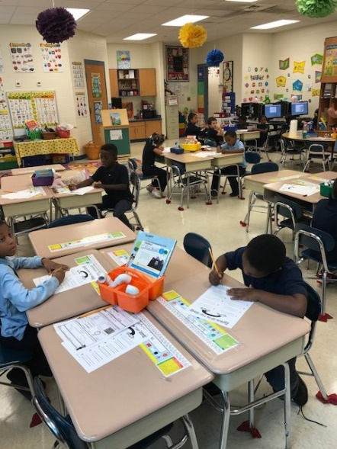
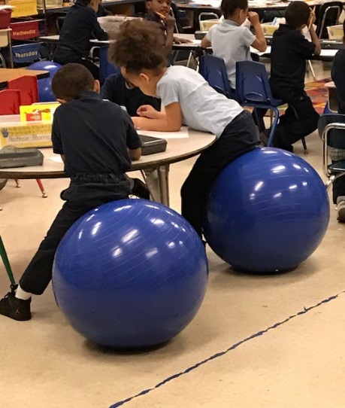
Turning Around Our School—Phase I
Jacques Marquette Elementary School
Gary Community School Corporation

Slide 2
Marquette Elementary School--
School Vision:
To provide a safe, supportive and nurturing environment where students will increase academic knowledge and develop appropriate social skills.
School Mission:
To prepare all students for college and careers by providing challenging instruction that connects learning to life.

Slide 3
Marquette Elementary School--
Introduction to School
K-6 school, 399 students enrolled in 2016-2017
75% Free, Reduced Lunch
11% Special Needs population
School has had 5 principals in the past 5 years
Located in Miller section of Gary, the easternmost school within the school corporation
Miller community enjoys a thriving business and arts strip, mixed-income population
Local citizens’ corporation has partnered with the school

Slide 4
Marquette Elementary School--
Most Current ISTEP+ Results:
Performance Domain:
Improved passing rates in Language Arts (34%) and Math (18.5%)
Passing rates remain below expectations
Growth Domain:
Growth point totals remain below what is needed to demonstrate acceleration

Slide 5
Marquette Elementary School--
The School-Based Goals and Objectives
Goal 1: By Spring 2018, Jacques Marquette Elementary students in grades 3-6 will achieve an increase in language arts (literacy) performance by 20% as measured by ISTEP+.
Objective 1: To increase student performance on Indiana Academic Standards by targeting specific learning outcomes in E/LA by increasing instructional time by adding an additional Success Period and Extended Day learning for two hours, three days per week

Slide 6
Marquette Elementary School--
The School-Based Goals and Objectives
Goal 2: By Spring 2018, Jacques Marquette Elementary students in grades 3-6 will achieve an increase in mathematics (numeracy) performance by 15% as measured by ISTEP+.
Objective 2: To increase student performance of Indiana Academic Standards by targeting specific learning outcomes in Math by teaching in a 90-minute block that will allow for targeted instruction in math processes, application and numeracy by increasing instructional time by adding an additional Success Period and Extended Day learning for two hours, three days per week.

Slide 7
Marquette Elementary School--
The School-Based Goals and Objectives
Goal 3: By Spring 2018, Jacques Marquette Elementary students in grades 4-6 will achieve an increase in mathematics (numeracy) growth performance by 10% and an increase in language arts (literacy) growth by 15% as measured by ISTEP+.
Objective 3: To increase test performance on ISTEP+ in E/LA and Math by increasing opportunities for remediation, maintenance, and enrichment of instruction through targeted instruction during two Success Periods.

Slide 8
Marquette Elementary School--
The School-Based Goals and Objectives
Goal 4: By Spring 2018, Jacques Marquette Elementary will increase the number of highly-qualified teachers in the classroom.
Objective 4: To increase the quality of instruction at Marquette by replacing Long-Term Assignment teachers with highly-qualified, certified teachers.

Slide 9
Intensive Intervention Strategy—Extended Day
Extended Day
Purpose: To provide more time for personalized learning for each child
This strategy will be implemented school-wide
Three days per week, two instructional hours per day
This strategy alone adds an additional day’s worth of focused instructional time per week
Math and Language Arts instruction will be at the center of the extended day
The District is exploring partnering with local universities’ Education majors to provide core instructional supports during the extended day.

Slide 10
Marquette Elementary School--
Professional Development
District-Level
The textbook representative will train teachers in using the core materials for reading and math.
Teachers will be trained in PIVOT to assess student learning and disaggregate data.
The principal mentor will train teachers and principals in the 8-Step Instructional Process: Plan, Do, Check, Act.
The principal will be trained on data inquiry.
Principal will be trained in school safety procedures.
Principal will be trained on teacher evaluation model.

Slide 11
Marquette Elementary School--
Professional Development
School-Level:
Train teachers to unpack standards by grade level .
Teachers will be trained on methods to improve the cultural competency and awareness of staff.
Director of Special Education will train teachers, administrator on requirements, guidelines and strategies for working with Special Needs population.
Teachers will be trained by Pat Davenport on implementing the 8-Step Process
Teachers will be trained in classroom management.
Teachers will be trained in curriculum map development.

Slide 12
Marquette Elementary School--
Professional Development
Grade-Level:
Teachers will learn how to scaffold instruction in ELA and Math.
Teachers will be trained in disaggregating data and analyzing data.
Social Worker will train teachers, administrator on educational and emotional needs for students of high poverty and high mobility families.
Teachers will be trained in the use of instructional technology.
Teachers will attend grade level workshops on ELA and Math.
Teachers will attend workshops on best practices in instruction.

Slide 13
Marquette Elementary School--
Professional Development
Job-Embedded:
Train a primary and intermediate teacher to develop a demonstration classroom to model instruction utilizing the math and literacy framework.
Math and E/LA Coaches will be assigned to buildings and grade levels to help teachers implement instructional strategies.

