Slide 1
Options Charter Schools
SBOE Appeal of the A-F Accountability Metric
June 3, 2020

Slide 2
Historical Timeline
The n-size workaround was first applied
Data showed catastrophic effects of workaround
SBOE ruled to offer 2 Alternative Schools null grade based on IC 20-31-8-4(c)
OCS shared a more precise data set to highlight the extreme student challenges
Carmel Noblesville
2011-12
2014-15
2017-18
2019-20

Slide 3
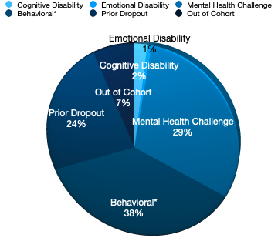
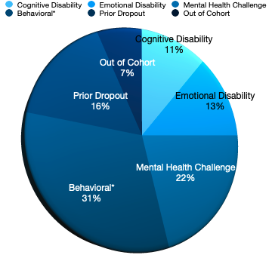
Highlights of the Newest Data Set
Definition of Categories
Options Charter School Carmel
Options Charter School Noblesville
Notes:
Definitions of Categories
Cognitive Disability: The student’s Individualized Education Plan (IEP) lists a cognitive disability as the student’s primary disability.
Emotional Disability: The student’s IEP lists a full-time emotional disability as the student’s primary disability.
Mental Health Challenge: The student has a medical, mental health diagnosis and is receiving treatment. Common diagnoses in this category include Anxiety Disorder, Mood Disorder, Stress Disorder, and Oppositional Defiance Disorder. Many of these students have demonstrated self-harm at some point or are at risk of self-harm.
Behavioral Challenge: The student has a medical diagnosis and is being treated for substance abuse, has been expelled from school, received a chronic absenteeism designation from the previous school as documented in the STN site, is involved with or being monitored by the Juvenile Justice Department, or is a Runaway child.
Prior Dropout: The student has previously dropped out of high school as recorded in the STN site.
Out of Cohort: The student is enrolling significantly behind in credits.

Slide 4
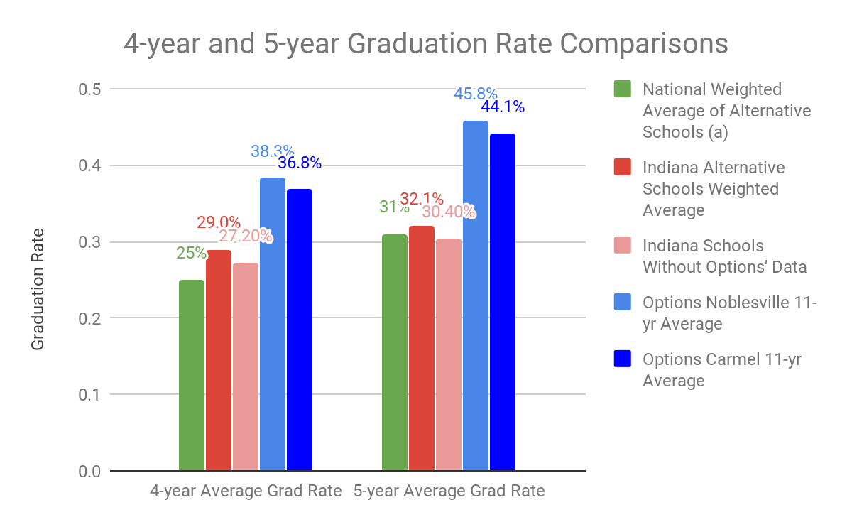
Evidence of Strong Practices
(a) Includes data for the following states (and number of years) Colorado (7 yrs), NYC (4 yrs), Ohio (2 yrs), & Utah (4 yrs) (Momentum Strategy & Research (2018), report forthcoming ).
Notes:
External Review IEQ Score for Options Charter Schools
AdvancED Network Average
Overall Score
280.77
280.21

Slide 5
Options Charter Schools’ Request
The data we have presented to the SBOE in this appeal along with historical references of former appeals highlights the Options’ mission of working primarily with students with developmental, intellectual and behavioral challenges.
Data has also been presented that highlight the performance of these students in spite of these challenges.
We ask
The SBOE offer OCS a null grade today and
The SBOE offer OCS a seat on the committee to develop an alternative rubric

