Slide 1
A Brief Introduction to Student Growth Analyses in Indiana
Dr. Damian Betebenner
Center for Assessment
Indiana State Board of Education Meeting
Gary, Indiana
October 2nd, 2019

Slide 2
History
Indiana has been at the forefront nationally in the use of student growth measures.
The Center for Assessment has been working with Indiana for 10 years in the development and support of the Indiana Growth Model.
Indiana has supported student growth analyses in ELA and Mathematics across 2 assessment transitions.
The most recent transition from ISTEP to ILEARN occurred from 2018 to 2019

Slide 3
Growth Model Approach
The current growth model used by Indiana calculated an individual student growth percentile (SGP) for each student, which is then associated with a point value that is averaged across all students for a given school.
An SGP ranges from 1-99 and is uncorrelated with the starting point of a student so that each student, regardless of where they start has the same chances of demonstrating the entire range of student growth.

Slide 4
Growth Model Approach
Based upon work of the Accountability System Review Panel, a growth-to-proficiency approach was recommended.
Target ranges are a key component for establishing points within the growth to proficiency table because these ranges create the thresholds for which points are to be assigned.
The target ranges summarize the observed growth associated with low, standard or high movement relative to Indiana’s achievement levels.

Slide 5
Growth Model Approach
The point values associated with the target ranges allow IN to establish policy priorities related to student growth at different levels of student achievement.
For example, low achieving students can be assigned higher weights for exemplary growth in an effort to reward student growth for that population.
Based upon Indiana’s new performance standards, the growth-to-proficiency table recommended for use is as follows

Slide 6
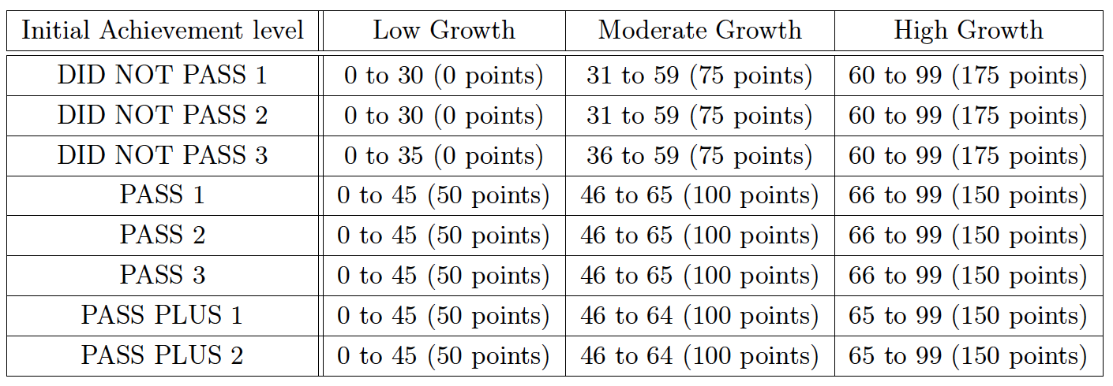
Growth to Proficiency Table

Slide 7
Bibliography
Betebenner, D. W. (2009). Norm- and criterion-referenced student growth. Educational Measurement: Issues and Practice, 28(4):42-51.

