Slide 1
Theodore Roosevelt College and Career Academy Innovation Network School & Transformation Zone
Dr. L’Tanya Simmons – School Transition Liaison
Mishawna Manning – Project Management Consultant

Slide 2
Key Project Benchmarks
AUGUST ● Recruit and select consultants
SEPTEMBER ● Data Collection/Comprehensive Review
OCTOBER ● Existing Agreements
NOVEMBER – DECEMBER ● Concrete Planning & Negotiations

Slide 3
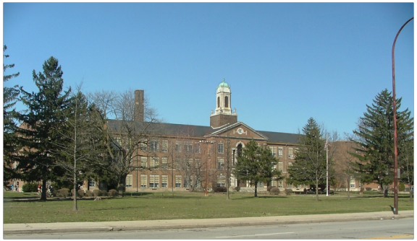
SEPTEMBER Data Collection/Comprehensive Review
Review of existing service agreements
Meetings with staff on the ground
Systems and processes audit
Facilities and maintenance audit
Notes:
A lot was working operationally at the school. Over the past two to three years, Edison and the Gary Community School Board had begun to develop mutual agreements for key operational components at TRCCA. Therefore, we started with identifying what works:
Service Agreements – The recent collaboration has resulted in a shared transportation agreement, maintenance and facilities agreement. We reviewed these existing agreements to better understand how the partnership is currently structured, and help inform ongoing planning.
Key Staff Members – After speaking with representatives from Indianapolis Public Schools (who have already established or reconstituted multiple innovation network schools), we learned that any planning must include the individuals who are on the ground, doing the work. While senior administrators will ultimately agree to the language of the agreement, one of our main goals is to ensure that they consider the practical implications of their decisions. For example, tech infrastructure and service is regulated by many federal rules in E-Rate. Any agreement made for these services will need to comply with existing regulations. The people on the ground help us ensure that is the case.
Systems and processes audit – Despite some pre-existing agreements, there was evidence of ongoing breakdowns in systems and processes meant to carry them out. We reviewed how existing plans are being executed to identify strengths, and areas that need to be improved. One example is building access for GCSC maintenance workers. Because the school has operated as its own LEA, maintenance employees from GCSC had to access the building through the main entrance. Security risks and always wanting to know who is in the building justify these types of policies; however, it sometimes interfered with routine maintenance, or at least made it more difficult than necessary.
Facilities/Maintenance Audit – We did multiple walk-throughs of the building to understand the current status of the facility in order to bring that knowledge to the negotiating table. The TRCCA campus is a historical landmark, and the facility is of upmost importance to the community. Given the role is plays in the community, and the recent history of heating issues, we wanted to get a clear sense of the current conditions at the facility and ensure that any issues that would interfere with student learning are addressed.

Slide 4
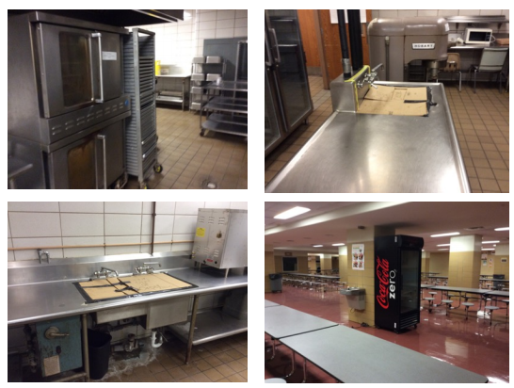
OCTOBER Existing Agreements
Transportation
Facilities and Maintenance
Food Service

Slide 5
NOVEMBER - DECEMBER Concrete Negotiations & Planning
Meetings with senior administrators
Analyzing/Presenting School Data
Defining Funding Structures
Outlining Academic & Special Programming
Establishing Performance Benchmarks
Notes:
Meeting w. Senior Admin – Leveraged existing resources to facilitate a conversation between senior leaders from GCSC and Edison Learning regarding key components of the innovation network school plan, and agreement. These issues include the ongoing recruitment and retention of a high-quality, diverse instructional staff, professional development programs, and any special curriculum or academic focus.
Analyze/Present School Data – Worked with the project liaison to collect and analyze data to help inform negotiations. These include data and information on funding history at TRCCA, sample performance benchmarks from other innovation network schools, longitudinal analysis of performance data from TRCCA and other schools in GCSC, etc.
Outlining Academic/Special Programming – discussions have included the most effective way to structure special education, ELL, and other instructional supports for students with special needs to ensure all needs are adequately met. Additionally, Edison and GCSC are looking to collaborate on a credit recovery program that would be incorporated into the high school.
Performance Benchmarks – One of the cornerstones of the agreement is that the local school board maintains oversight of the school through mutually agreed upon performance benchmarks. These benchmarks help ensure that the school is meeting the needs of all students, and outlines what happens if the school fails to meet those benchmarks.

Slide 6
Community & Stakeholder Engagement
SEPTEMBER ● Engaging School and City Leadership
OCTOBER ● Formal Communications Plan
NOVEMBER – DECEMBER ● Targeted Stakeholder Engagement
JANUARY ● Formal Project Launch & Campaign

Slide 7
SEPTEMBER Engaging School and City Leadership
Establishing touch points with key leadership throughout Gary
Creating an inclusive space for conversations
Generating innovative ways more leaders can be involved
Notes:
Establishing touch points – The first step in this project was to engage and build a relationship with key leaders in Gary, IN. This includes not only Dr. Pruitt (Superintendent of Gary Community Schools) and Tom Jackson (President of Edison Learning), but the Mayor of Gary, Karen Freeman-Wilson, the Executive Director of the Housing Authority, and other key city leaders.
Inclusive space for conversations – We have people sitting down and discussing their hopes and vision for Roosevelt and the Gary School Corporation as a whole who previously were not at the same table. For example, the Mayor is now regularly involved in conversations through her designee. She is exploring the option of hiring a full-time education director to help stay connected with the work.
Innovative ways to be involved – We have done this by creating innovative ways for people to be involved. I mentioned the ED of the Housing Authority. We intentionally engaged him to develop a better understanding of how many school-aged children were receiving housing assistance, and targeting those who may have disengaged from the school system to get them back in school, and on the right track. These innovative ideas help turn engagement into involvement, and help expand our coalition of leaders who want to see this succeed.

Slide 8
OCTOBER Formal Communications Plan
Regular communication with key stakeholders
Expanding the team of invested stakeholders
Notes:
In order to formalize my initial communications, we have established regular touch points with representatives from the Mayor’s Office, Dr. Cheryl Pruitt, Parent Organizations, and more.
Continued to build the coalition of invested stakeholders. Have engaged the president of the Steel Corporation. Although we are still determining how his organization can be involved, they have expressed interest in the work at TRCCA and are looking forward to making a meaningful contribution to the work.

Slide 9
NOVEMBER – DECEMBER Targeted Stakeholder Engagement
Aligned to ongoing planning and negotiations
Identifying critical perspectives to inform ongoing planning
Ensuring to engage members from diverse backgrounds
Notes:
Aligned to ongoing planning – As the team works to finalize aspects of the plan, we are working to strategically engage stakeholders who could contribute to that work specifically, or whose input we need to help shape the final agreement.
Critical perspectives – At the same time we are focusing on the ongoing planning conversations, we are working to ensure we proactively reach out to a diverse stakeholder group that is connected with this project. TRCCA has a rich history, and we are engaging people who are connected to that history including celebrities, alumni, and current students/families.

Slide 10
FEBRUARY & BEYOND Looking Forward
Shifting from planning to implementation
Working to articulate a clear, unified, and consistent message
Empowering allies to advocate on behalf of the plan
Build buy-in from local officials

Slide 11
QUESTIONS

