Slide 1
Department of Education Conceptual Framework for Accountability
Dr. John Keller
Chief Technology Officer
Maggie Paino
Director of Accountability
@EducateIN

Slide 2
Conceptual Framework
Concept One: Revise Accountability System
Concept Two: Streamline Indiana Diploma
Concept Three: Plan for Student Success
@EducateIN

Slide 3
Overview of Department’s First Concept
State Accountability
Federal Accountability
One Accountability System
@EducateIN

Slide 4
Concept One: Revise Accountability System
Create an accountability system that provides accessible data that is actionable and aligned to policy goals for the State
Increase overall literacy proficiency
Increase access to quality STEM opportunities
Increase the number of college & career ready graduates
@EducateIN

Slide 5
Concept One: Revise Accountability System
Federal Requirements:
Must annually measure, for all students and separately for each student group in public schools:
Academic Achievement, or proficiency on the annual assessments in English/language arts and mathematics
Measure of student growth or another valid and reliable statewide academic indicator that allows for meaningful differentiation
Four-year adjusted cohort graduation rate
Progress in achieving English language proficiency for all English learners
Not less than one indicator of school quality or student success that allows for meaningful differentiation in school performance; is valid, reliable, comparable, and statewide, and may include measures of student engagement, educator engagement, student access to and completion of advanced coursework, postsecondary readiness, school climate and safety
@EducateIN

Slide 6
Concept One: Revise Accountability System
Academic Achievement
Academic Growth
Graduation Rate
Addressing Chronic Absenteeism
English Learner Progress
Closing Achievement Gaps
On-Track in 9th Grade
Strength of Diploma
College/Career Readiness
@EducateIN

Slide 7
Concept One: Revise Accountability System
NEW INDICATOR: What is Ninth Grade On Track?
Measure of successful completion of standard course and credit requirements at the end of the ninth grade year
“On-Track” definition
Earn at least ten credits by the end of the ninth grade year; and
Do not receive a failing grade for any core subject areas (English/language arts, math, science, social studies)
Applies to grade 9
Measures the progress of students enrolled at least 90.0% of the school year with two consecutive valid test results
Must have at least 20 students to receive an indicator score
@EducateIN

Slide 8
Concept One: Revise Accountability System
NEW INDICATOR: What is College/Career Readiness?
Measure of successful completion of activities and/or courses contributing to college and career readiness
Utilizes an index to award points based on the measures of college and career readiness achieved by each student
Applies to grade 12 cohort
Must have at least 20 students to receive an indicator score
@EducateIN

Slide 9
Concept One: Revise Accountability System
DRAFT: College/Career Readiness Index
Index Points | Metric
175 | Four-year graduate plus three-four additional measures of postsecondary readiness
150 | Four-year graduate plus two-three additional measures of college/career readiness
125 | Four-year graduate plus one-two additional measures of college/career readiness
100 | Four-year graduate
75 | Five-year graduate
50 | Six-year graduate
25 | High School Equivalency
0 | Non-graduate
@EducateIN

Slide 10
Concept One: Revise Accountability System
Note on School Climate/Culture Surveys
Measure of school climate and culture, based on student survey responses
Currently piloting survey with comprehensive support schools; not yet included in accountability system
Requires one standardized tool to measure school climate/culture for the State in order to provide reliable and comparable responses for an accountability indicator
@EducateIN

Slide 11
Concept One: Revise Accountability System
Federal Requirements:
Must annually disseminate to the public an annual State report card that provides the public with general performance and achievement information on all public schools
What is INview?
INview shifts the primary audience from “All” to “Parent”
On INview, metrics/data points will be final adjusted rates rather than raw
Additional information about an organization may be supplied by the entity for display on INview (e.g., local programs and offerings)
Various tools within the INview platform allow users to compare schools
INview allows additional education organization types such as networks
@EducateIN

Slide 12
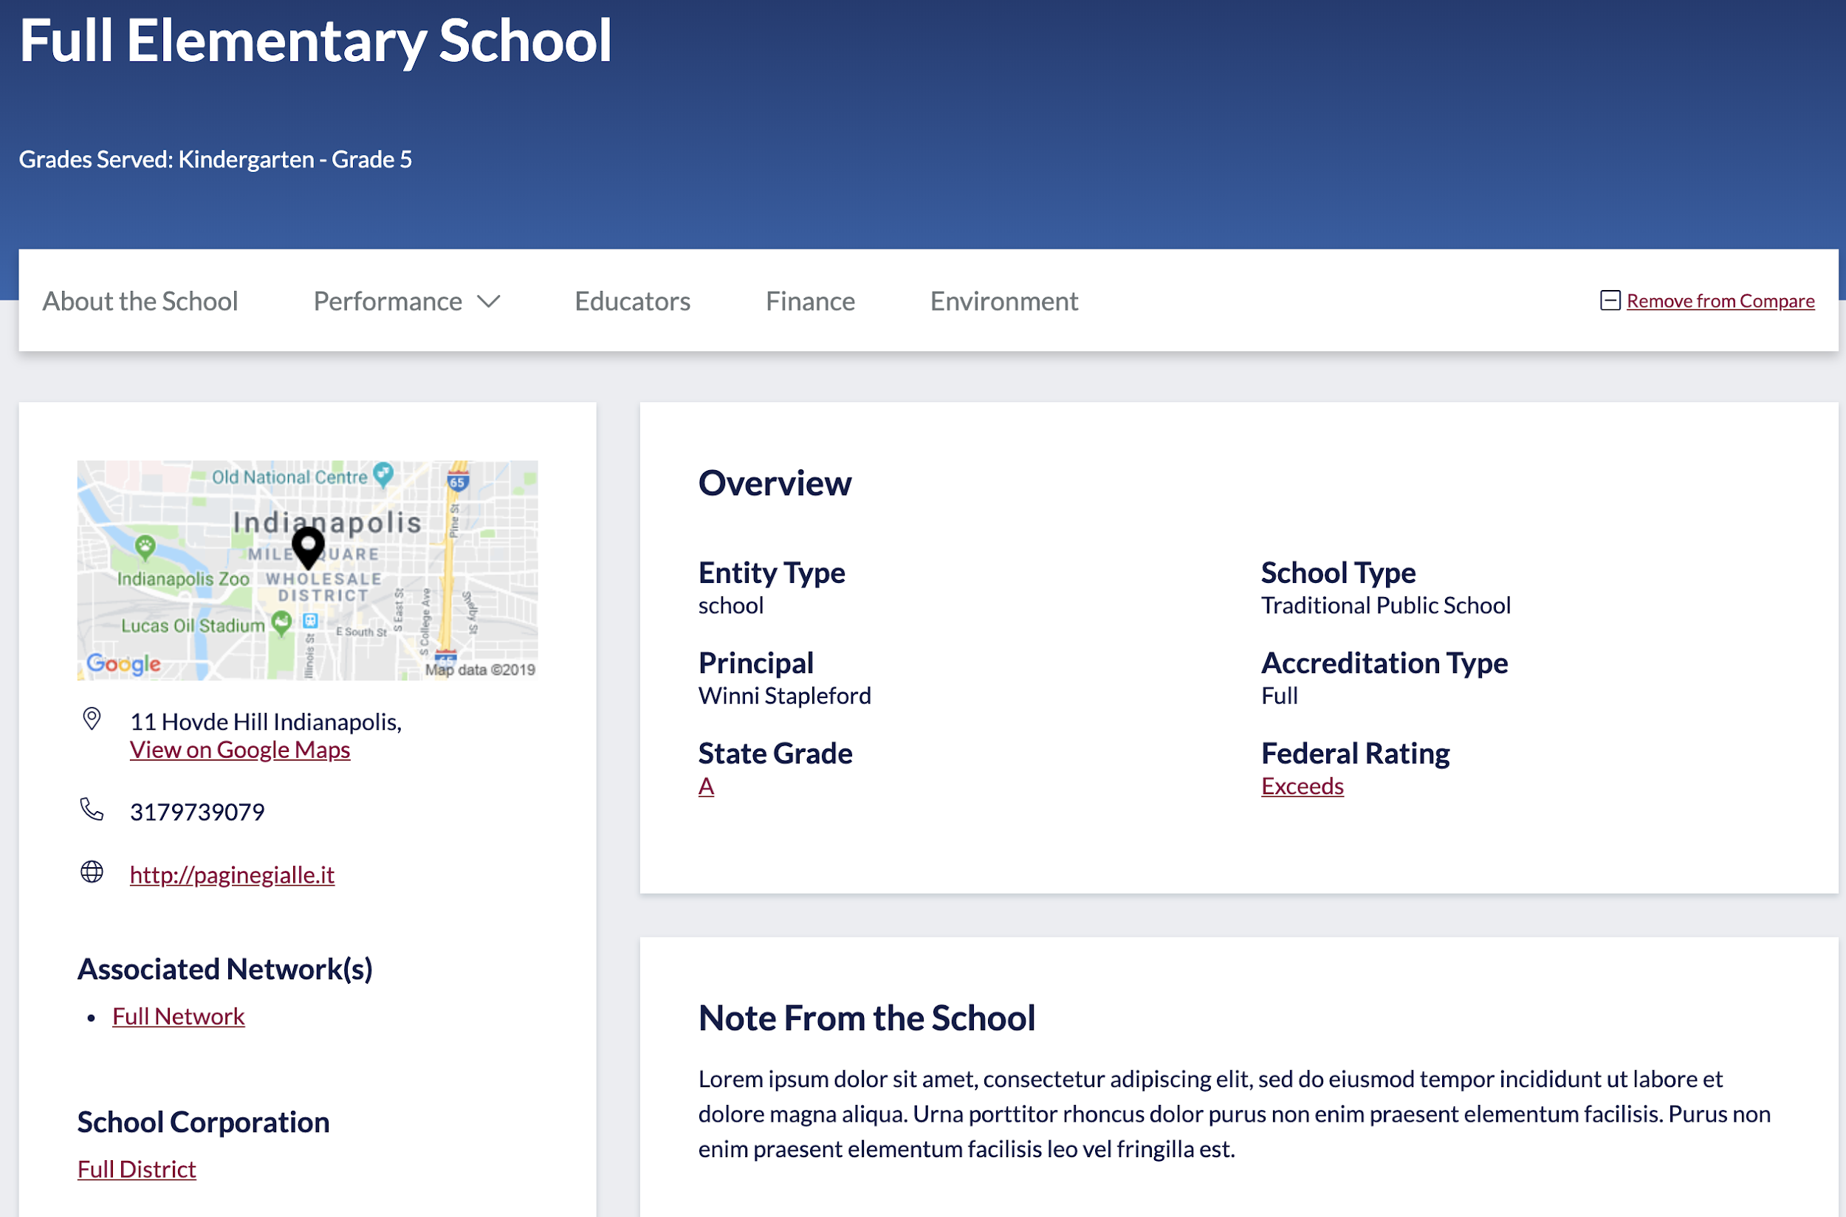
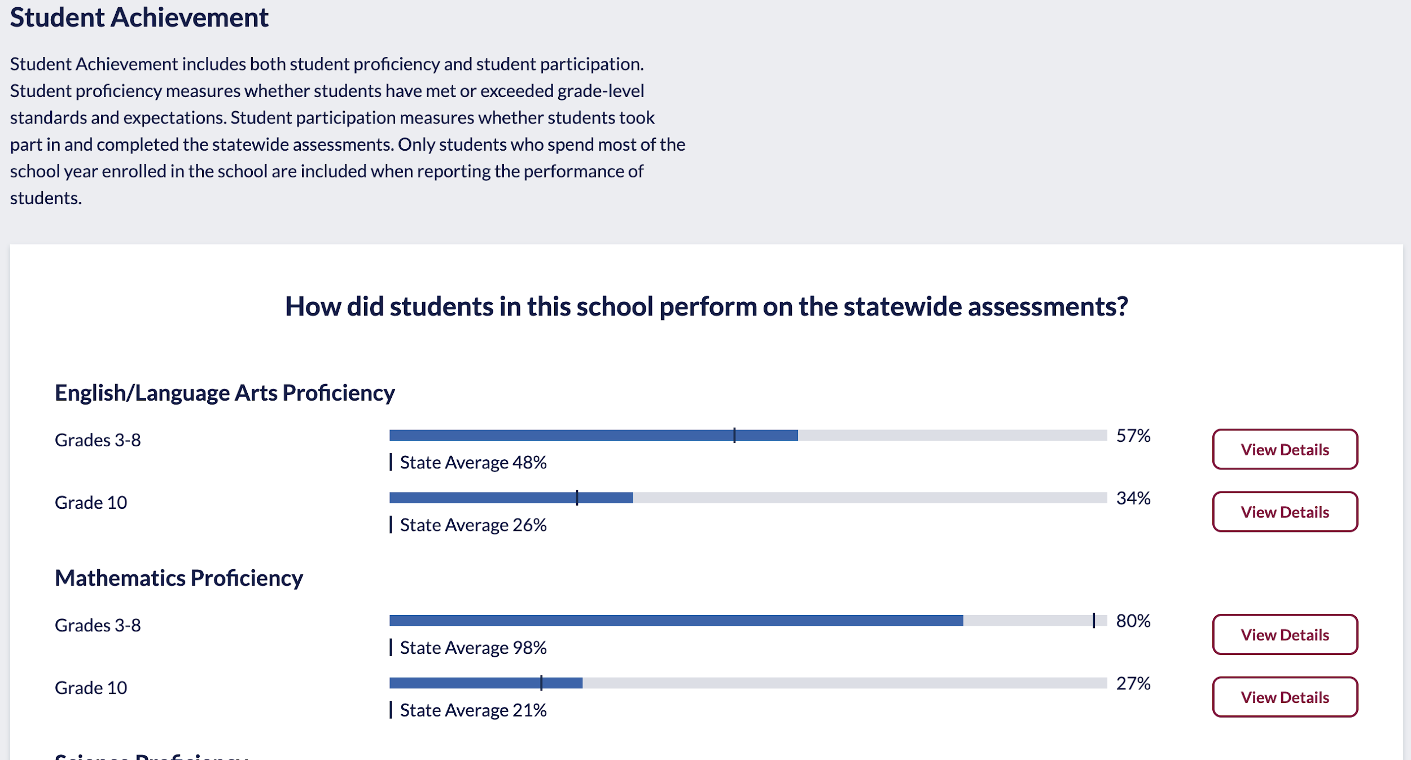
Concept One: Revise Accountability System
https://inview.doe.in.gov/
@EducateIN

Slide 13
Concept One: Revise Accountability System
Federal Requirements:
Statewide accountability system must be based on challenging State academic standards for English/language arts and mathematics to improve student academic achievement and school success
Must establish State-designed long-term goals, which include measurements of interim progress toward meeting such goals
Must establish a system of meaningfully differentiating, on an annual basis, all public schools in the State, which shall:
be based on all indicators of the accountability system for all students and for each student group
afford substantial weight to each academic indicator (achievement, progress/growth, graduation rate, English learner progress); and in the aggregate, afford much greater weight than is afforded to the indicators of school quality/student success
include differentiation of any school in which any student group is consistently underperforming
@EducateIN

Slide 14
Concept One: Revise Accountability System
Current Accountability Systems
State System
Federal System
Assigns A-F grade to indicate performance on each indicator and overall
A-F grades based on 0.0 – 100.0 point scale
All applicable indicators are weighted and aggregated to produce an overall letter grade for the school
Cuts for overall grades based on traditional A-F scale
No long-term goals set within accountability system
Assigns rating aligned to achievement of a long-term goal to indicate performance on each indicator and overall
Ratings based on a scale that considers individual indicator goals and baseline performance data
All applicable indicators are weighted and aggregated to produce an overall letter grade for the school
Cuts for overall ratings determined through standard setting process
Long-term goals set for all indicators measured by the system
@EducateIN

Slide 15
Concept One: Revise Accountability System
Current Accountability Systems
State System
Federal System
Achievement
Growth
@EducateIN

Slide 16
Concept One: Revise Accountability System
Current Accountability Systems
State System
Federal System
Achievement
Achievement
College/Career
Readiness
Growth
Attendance
Graduation Rate
Growth
Diploma
@EducateIN

Slide 17
Concept One: Revise Accountability System
Current Accountability Systems
State System
Federal System
A
90.0 – 100.0 Points
Exceeds
Expectations
Maximum Points
Long-Term Goal
B
80.0 – 89.9 Points
Meets
Expectations
C
Baseline State Average
70.0 – 79.9 Points
Approaches
Expectations
D
60.0 – 69.9 Points
Bottom Fifth Percentile + Two Years of Interim Progress
Does Not Meet
Expectations
F
00.0 – 59.9 Points
Minimum Points
@EducateIN

Slide 18
Concept One: Revise Accountability System
Current Accountability Systems
State System
Federal System
Academic Achievement:
Score = proficiency rate (e.g., 74.3% = 74.3 pts)
Academic Achievement:
Score = proficiency rate in relation to long-term goal
3-8 E/La goal = 74.0% proficiency rate
3-8 Math goal = 74.0% proficiency rate
Grade | Points
A | 90.0 – 100.0
B | 80.0 – 89.9
C | 70.0 – 79.9
D | 60.0 – 69.9
F | 00.0 – 59.9
 | 3-8 E/La Points | 3-8 Math Points
Exceeds Expectations | 100.00 – 135.00 | 100.00 – 135.00
Meets Expectations | 64.67 – 99.99 | 64.53 – 99.99
Approaches Expectations | 33.48 – 64.66 | 34.16 – 64.52
Does Not Meet Expectations | 0.00 – 33.47 | 0.00 – 34.15
@EducateIN

Slide 19
Concept One: Revise Accountability System
Current Accountability Systems
Preliminary Federal Achievement Indicator
third – eighth grade
Preliminary State Achievement Indicator
third – eighth grade
ELA
MATH
@EducateIN

Slide 20
Concept One: Revise Accountability System
Current Accountability Systems
Preliminary Federal Graduation Rate Indicator
Preliminary State Graduation Rate Indicator
@EducateIN

Slide 21
Concept One: Revise Accountability System
Policy Definitions
Concise statements of intended outcomes, interpretations, and implications of each overall rating
School Performance Level Descriptors
Broad-based panel of leaders and stakeholders to evaluate information and make recommendations regarding performance expectations for the accountability system
Standard Setting
Detailed descriptions of performance profiles of each rating level with sufficient clarity to guide standard setting
Valid and Reliable Accountability System
@EducateIN

Slide 22
Concept One: Revise Accountability System
Proposed Implementation Timeline
2020/2021 School Year
Address course completion data collections with schools
Address college and career readiness data collections with third parties
2021/2022 School Year
Publicly report course completion data for schools, but do not include data in accountability determinations
Continue to address college and career readiness data collections with third parties
2022/2023 School Year
Publicly report course completion data for schools, but do not include data in accountability determinations
Continue to address college and career readiness data collections with third parties
2023/2024 School Year
Utilize course completion data in accountability determinations for 9th grade on-track indicator
Utilize college and career readiness data in accountability determinations for college and career readiness indicator, in alignment with the first cohort graduating with pathways requirements
@EducateIN

Slide 23
Overview of Department’s Second Concept
Current Graduation Requirements
Graduation Requirements | Graduation Pathway Options
1) High School Diploma | Meet statutorily defined diploma credit and curricular requirements
2) Learn and Demonstrate Employability Skills (Students must complete at least one of the following) | Learn employability skills standards through locally developed programs. Employability skills are demonstrated by one of the following: Project-Based Learning Experience; OR Service-Based Learning Experience; OR Work-Based Learning Experience
3) Postsecondary-Ready Competencies (Students must complete at least one of the following) | Honors Diploma: Fulfill all requirements of either the Academic or Technical Honors diploma; OR ACT: College-ready benchmarks; OR SAT: College-ready benchmarks; OR ASVAB: Earn at least a minimum AFQT score to qualify for placement into one of the branches of the US military; OR State- and Industry-recognized Credential or Certification; OR Federally-recognized Apprenticeship; OR Career-Technical Education Concentrator: Must earn a C average in at least two non-duplicative advanced courses (courses beyond an introductory course) within a particular program or program of student; OR AP/IB/Dual Credit/Cambridge International courses or CLEP Exams: Must earn a C average or higher in at least three courses; OR Locally created pathway that meets the framework from and earns the approval of the State Board of Education
Complete course and curricular requirements to receive an Indiana Diploma
@EducateIN

Slide 24
Concept Two: Streamline Indiana Diploma
Move from four diploma designations to two diploma designations
Build employability skills into course requirements (“CCR Preparation”)
Build postsecondary competencies into course requirements
For designation 1, directed electives must include an approved CTE concentrator, and include an industry-based certification or credential, federally recognized apprenticeship, or dual credit that is part of a defined CTE sequence; student must have a “C” average in the CTE concentrator
For designation 2, student must have a “C” average in at least 3 advanced placement, dual credit, international baccalaureate, or Cambridge International courses in a core content area that corresponds with the Core Transfer Library
DRAFT: Credit Requirements for Indiana Diploma
Subject Areas | Designation 1 (Career Direct) | Designation 2 (Career Prep)
English/Language Arts | 8 credits | 8 credits
Mathematics | 8 credits | 8 credits
Science | 6 credits | 8 credits
Social Studies | 4 credits | 6 credits
Physical Education/Health | 3 credits | 3 credits
World Languages | 4 credits | 6 credits
Fine Arts | 2 credits | 2 credits
Directed Electives | 10-12 credits | 6 credits
CCR Preparation | 1 credit | 1 credit
@EducateIN

Slide 25
Concept Two: Streamline Indiana Diploma
DRAFT: OPTIONS TO SATISFY MATH CREDIT REQUIREMENTS
Designation #1: Career Direct |  | Designation #2: Career Prep
6 credits from the following | Geometry Algebra II Business Math Algebra III Quantitative Reasoning Advanced Math Functions Pre-Calculus Probability & Statistics Trigonometry Calculus Computer Science Dual Credit Math … | 2 credits from the following | Algebra III Quantitative Reasoning Advanced Math Functions Pre-Calculus Probability & Statistics Trigonometry Calculus AP Calculus IB Calculus Computer Science Dual Credit Math …
2 credits | Algebra I | 2 credits | Algebra II
 |  | 2 credits | Geometry
 |  | 2 credits | Algebra I
Example to provide for multiple options to satisfy course/credit requirements for each diploma type in mathematics credit requirements
@EducateIN

Slide 26
Overview of Department’s Third Concept
Student Success
Career Exploration & Preparation
Evidence-Based & Collaborative Decision Making
Proactive Remediation
Social & Emotional Learning
@EducateIN

Slide 27
Concept Three: Plan for Student Success
Shift graduation plan development from sixth grade to completion by the middle of eighth grade in preparation for high school
Consider creation of “transitional ninth grade” to take a proactive approach to remediation for students who may not be ready for the rigor of high school after 8th grade
Emphasize “career exploration” (defined unit/course) in elementary and middle school that exposes students to future possibilities to pursue
Create a “career preparation course” required for all high school students to focus on financial literacy, college and career expectations, time management, and other employability skills (used to satisfy the “employability skills” requirement for graduation)
Restructure/redefined the Indiana Diploma to two categories that encompass Graduation Pathways
Continue support of social and emotional learning at all grade levels
@EducateIN

Slide 28
Summary of Department Concepts
Concept One: Revise Accountability System
Establish one accountability system for both State and Federal purposes
Utilize Federal accountability system components as base system
Incorporate new indicators, “9th grade on-track” and “college/career readiness”
Concept Two: Streamline Indiana Diploma
Transition from four diploma designations to two diploma designations
Present graduation pathways requirements (employability skills; postsecondary competency) through course and credit requirements of each diploma designation
Revise course requirements for each diploma designation to provide flexibility based on student’s pathway
Concept Three: Plan for Student Success
Consider the whole student by focusing on college/career readiness, academic foundations, and social/emotional learning
Establish a system built on evidence-based, proactive remediation
@EducateIN

Slide 29
Questions?
@EducateIN

