Slide 1
School Accountability Panel:
Proposed Framework and Recommendations
October 3, 2019

Slide 2
Purpose
As outlined in HEA 1002 passed during the 2019 legislative session:
Study potential outcomes and indicators of schools performance that align with Graduation Pathways
Gather diverse input and feedback from the panel members to guide potential recommendations
Recommend to the Indiana General Assembly new indicators of school performance on or before October 30, 2019.

Slide 3
Points of Agreement
Graduation Pathways Alignment
Outcomes-Focused
Pathways to Success for Every Student: Enrollment, Employment & Enlistment
Measureable Indicators
Fairness for Students and Schools
Prioritize Postsecondary Preparation

Slide 4
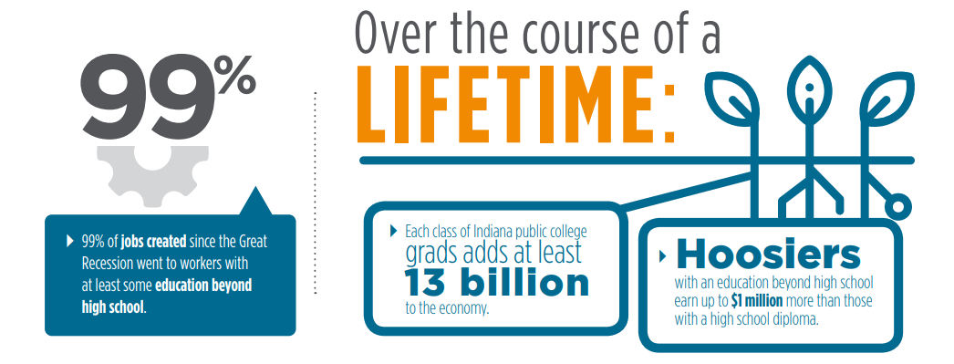
Why it Matters

Slide 5
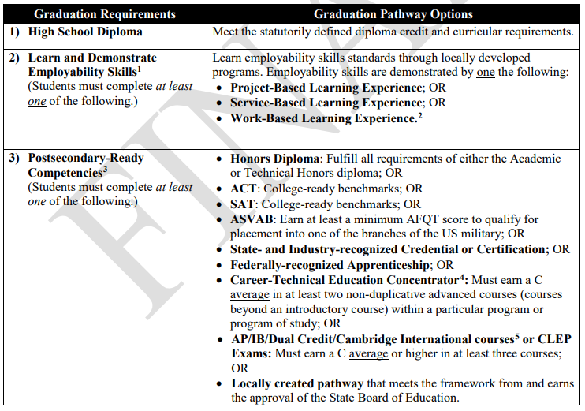
Graduation Pathways Alignment

Slide 6
Proposed Accountability Framework
1. Academic Proficiency
Measures whether students have met the "college- and career-ready" proficiency benchmark on Indiana’s statewide high school assessment.
2. High School Graduation
Measures whether students have completed all Indiana high school graduation requirements, including a high school diploma and Graduation Pathways.
3. College & Career Readiness
Measures whether students have satisfied the requirements of at least one of the postsecondary outcomes (Enrollment, Employment, Enlistment) listed below.
Enrollment | Employment | Enlistment
Percent of Students Who: Earn a General Education Certificate (STGEC) by high school graduation; OR Earn a short- or long-term workforce certificate by high school graduation; OR Enroll in postsecondary education without remediation upon high school graduation | Percent of Students Who: Earn an Industry-Recognized Certification by high school graduation; OR Earn a short- or long-term workforce certificate by high school graduation; OR Be employed through an apprenticeship (or comparable on-the-job training program) upon high school graduation | Percent of Students Who: Enlist and serve in military with qualifying ASVAB score upon high school graduation
BOLD TYPE to be reported in the graduation report due annually in the fall immediately following high school graduation year.

Slide 7
Data for Proposed Framework
1. Academic Proficiency
Measures whether students have met the "college- and career-ready" proficiency benchmark on Indiana’s statewide high school assessment.
2017-2018 ISTEP+ Grade 10
Passed both ELA & Math – 33.7%
Passed Math – 36.2%
Passed ELA – 59.0%
2017-2018 SAT and ACT
SAT
67% took the test
52% met both English/Math Benchmarks
ACT
32% took the test
73% met English Benchmark; 53% met Math Benchmark

Slide 8
Data for Proposed Framework
2. High School Graduation
Measures whether students have completed all Indiana High School Diploma requirements.
2017-2018 High School Graduation Rate
88.1%
Graduates by Diploma Type
Honors – 39.8%
Core 40 – 50.7%
General Diploma – 9.5%

Slide 9
Data for Proposed Framework
3. College & Career Readiness
Measures whether students have satisfied the requirements of at least one of the postsecondary outcomes (Enrollment, Employment, Enlistment) listed below.
Enrollment | Employment | Enlistment | Current Data
General Education Certificate (or STGEC) |  |  | 1,260 awarded in 2018-19
Short- & Long Term Workforce Certificate | Short- & Long-term Workforce Certificate |  | 1,811 awarded in 2018-19
 | Industry-recognized Certification |  | 6,673 awarded in 2017-18
Enroll in college w/o remediation |  |  | 88% of students who enrolled 2017
 | Employed through apprenticeship/comparable OTJ training program |  | N/A
 |  | Enlist and serve in military with qualifying ASVAB Score | N/A

Slide 10
Early College Credit and Credentials in High School
64% of students earn some type of early college credit in high school; 58% earn dual credit.
Of dual credit earners, 53% take technical courses.
42% of students who earn dual credit earn at least one semester worth of college-level credits.
58% earn less than one semester (1 to 11 credits)
30% earn at least one semester (12 to 23 credits)
12% earn two or more semesters (> 23 credits)
Between 2013 and 2016, the number of HS students earning an STGEC increased by 97%; associate degrees increased by 57%; and other certificates increased by 80%.

Slide 11
Framework Checklist
Does the proposed framework meet the goals set out for this group?
Aligned to Graduation Pathways
Outcomes Focused
Pathways for Every Student
Fairness
Postsecondary Preparation
Measureable Indicators

Slide 12
Considerations for Proposed Recommendations
Accountability Framework
Other Recommendations to Consider:
Study issues around the military enlistment pathway, including qualifying ASVAB score and ensuring enlistment that leads to service.
Study potential revisions to Indiana high school diploma requirements that align to graduation pathways and support student readiness and success.
Recommend the State Board of Education set weights to each of the three sections of the accountability framework with guardrails. (Example: At least % for outcomes and no more than % for proficiency.)

Slide 13
Discussion & Next Steps

Slide 14
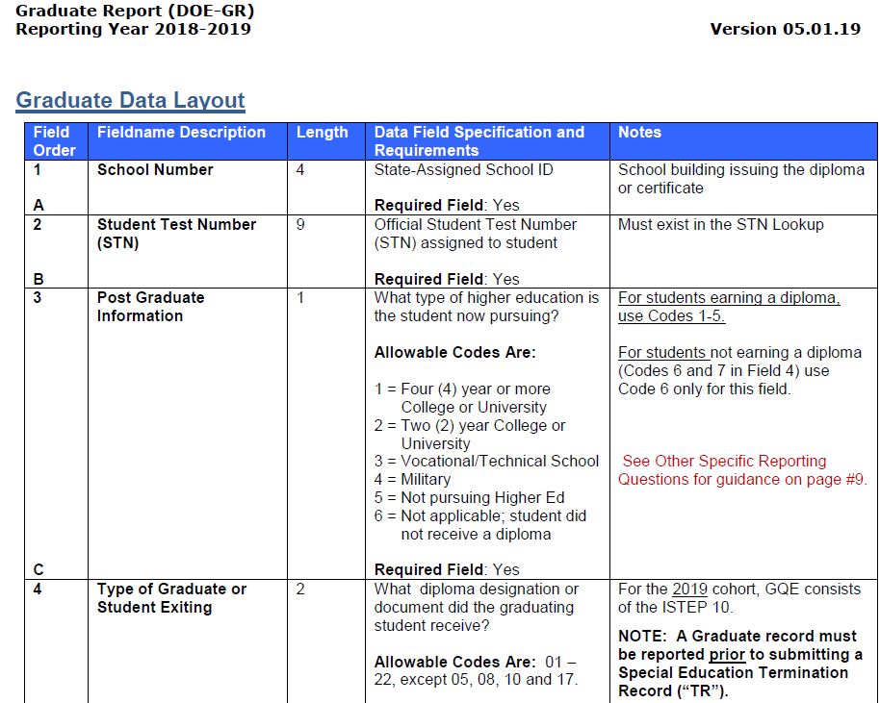
Annual Graduation Report

