Slide 1
State Board of Education Committee on Virtual Charter Schools
Prepared by
Dr. Robert A. Marra, Executive Director
Dr. Jamie Garwood, Academic Performance Coordinator
Marriette Siler, Executive Coordinator
August 1, 2018

Slide 2
OCS Engaged In The National/State Debate
Surrounding Quality Charter School Authorizing
2013 Indiana General Assembly Session
OCS collaborated with Indiana authorizers to help pass H.B. 1338 - Quality Authorizing Legislation
IC 20-24-2.2-1.5
Authorizer; adoption of standards
Sec. 1.5. All approved authorizers shall adopt standards of quality charter school authorizing, as defined by a nationally recognized organization with expertise in charter school authorizing.
As added by P.L.280-2013, SEC.12.

Slide 3
Core Performance Framework and Guidance
NACSA acknowledged the PMRC model authorizers, PMRC demonstration site authorizers, and Fund for Authorizing Excellence pilot sites for their contributions to this project.
PMRC Model Authorizers:
Central Michigan University’s The Governor John Engler Center for Charter Schools
Chicago Public Schools
Denver Public Schools
District of Columbia Public Charter School Board
Indianapolis Mayor’s Office
State University of New York Charter Schools Institute
Volunteers of America Minnesota
PMRC Demonstration Site Authorizers:
Atlanta Public Schools
Ball State University
Metropolitan Nashville Public Schools
New Jersey Department of Education
Fund for Authorizing Excellence Pilot Sites:
Arizona State Board for Charter Schools
Colorado Charter School Institute
Delaware Department of Education
Friends of Education
Nevada Public Charter School Authority
New Mexico Public Education Department

Slide 4
Ball State University
Virtual Charter School History
Indiana Connections Academy History
From 2010 to December 31, 2011 Indiana Connections Academy was approved and authorized by the Indiana Department of Education under a virtual pilot program.
On November 21, 2011, after Indiana charter law permitted virtual charter schools, Indiana Connections Academy submitted a charter proposal to Ball State University and has been authorized by Ball State University since December 9, 2011 to the present date.
Hoosier Academies Virtual Charter School
In 2008-09 Hoosier Academy-Indianapolis and Muncie opened as hybrid learning charter schools authorized by Ball State University.
From 2009-2011 Hoosier Indianapolis Virtual Charter School was approved and authorized by the Indiana Department of Education under a virtual pilot program.
In June 2011 when Indiana charter law permitted virtual charter schools, Hoosier Academies requested an amendment to add the virtual school to their charter agreements. This amendment was approved effective August 2011.

Slide 5
Ball State University
Virtual Charter School History (continued)
Hoosier Academies Virtual Charter School (continued)
In January 2013 the Hoosier Academies Boards requested restructuring of their schools which included closure of the Muncie campus. Based upon this restructuring, Hoosier Academy-Indianapolis was granted a 3-year charter extension.
Based upon the academic, financial and organizational performance of Hoosier Academy – Indianapolis, OCS made the decision to permit the Board to operate the hybrid and virtual schools under separate charter agreements and made the following renewal decision:
  Hoosier Academy – Indianapolis (the hybrid school) was granted a 5-year charter renewal
  Hoosier Academies Virtual Charter School (the fully virtual school) was granted a 2-year charter renewal
  Insight School of Indiana, a new virtual alternative charter school serving 7-12, was granted a 3-year charter.
  The combined enrollment for both fully virtual schools was capped at 4,000.
On September 26, 2017, the Board approved the decision not to pursue renewal of its charter agreement beyond the term ending June 30, 2018.

Slide 6
Applications for Virtual Schools
The University has not received any viable statements of interest from a virtual school since it authorized Indiana Connections Academy and Hoosier Academies Virtual Charter School following both schools’ pilot under the Indiana Department of Education.
Given our experience authorizing virtual schools, we would ask new applicants, in both the narrative application and interview, questions pertaining to unique issues related to virtual schooling, including, but not limited to:
  Onboarding
  Statewide Test Administration
  Student Engagement
  Technical Support for Students, Parents and Teachers

Slide 7
Ball State University Office of Charter Schools Authorizing Process

Slide 8
Academic Performance Framework and Review
OCS staff reviews data annually throughout the term of the charter contract. Data includes, but is not limited to:
Indiana A-F Accountability
Attendance rates, including absenteeism and suspension
Northwest Evaluation Assessment (NWEA)
ISTEP+ Proficiency and Growth
ISTEP+ Comparison (State, County, & Local District)
I-READ (3rd Grade Reading Assessment)
Subgroup proficiency and growth
SAT/ACT (High Schools)
Graduation rate (High Schools)
Post-Secondary Success
External AdvancED reviews are conducted mid-way through a charter term, and at the time of renewal.
Purpose of the mid-term review is to inform continuous improvement
Teams include diverse participants from traditional public schools, charter schools and private schools
Review teams are matched to schools based on experience and relevancy (e.g., grade levels, curricular focus, school design model)
Reviewers utilize AdvancED’s Performance Standards
During the charter renewal cycle, OCS staff reviews:
AdvancED’s External Review Team Report

Slide 9
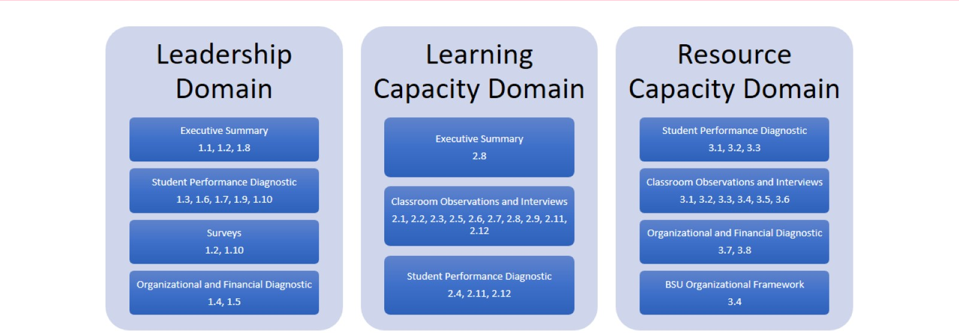
Renewal Application and Review
Alignment to AdvancED Standards

Slide 10
Unique Aspects of Evaluating the Academic Performance of Virtual Schools
The complexity of student population in a statewide virtual is the equivalent of multiple schools.
  Homeschool population
  Credit Deficient/Alternative Education population
  Geographic differences in resources, both family and community
Availability of data, and the ability to differentiate data by factors such as years of enrollment, mobility, credit deficiency
Conducting on-site classroom observations
Authorizing staff and/or external evaluators must have training on virtual learning
School Comparisons

Slide 11
Financial Performance Framework and Review
OCS staff reviews data on an ongoing basis throughout the term of the charter contract as well as during the renewal cycle. Data includes, but is not limited to:
Near Term Indicators
Current Ratio (Working Capital Ratio)
Cash to Current Liabilities
Unrestricted Days Cash
Enrollment Variance
Default
Sustainability Indicators
Total Margin
Debt to Asset Ratio
Cash Flow
Debt Service Coverage Ratio
The ongoing review also includes:
Annual Financial Audits by Donovan CPA or another SBOA approved independent auditor
OCS staff review of annual projected and final budgets
OCS staff review of quarterly financial statements
During the charter renewal cycle, OCS staff reviews:
Annual Financial Statements and Independent Audit Reports
Supplemental Audit Reports
OCS Financial Performance Financial Dashboard
Projected budget going forward

Slide 12
Organizational Performance Framework Review
OCS staff reviews data on an ongoing basis throughout the term of the charter contract as well as during the renewal cycle. Data includes, but is not limited to:
Education Program
Financial Management and Oversight
Governance and Reporting
Students’ and Employees’ Rights
School Environment
The ongoing review also includes:
Compliance with terms of charter agreement/Master Calendar of Reporting Requirements
During the charter renewal cycle, OCS staff reviews:
Review of Governance and Organizational Audit Report by Brian L. Carpenter PhD & Associates LLC

Slide 13
Organizational Performance Framework (continued)
During the charter renewal cycle, OCS contracts with Brian L. Carpenter PhD & Associates LLC to conduct governance and organizational audits which include a review of:
The current charter contract (executed copy)
The board’s current bylaws (executed copy)
Board minutes for the previous 24 months
The school’s certificate of insurance (and any documentation needed to demonstrate compliance with the coverage thresholds specified in the charter)
Any deficiency correspondence from your office to the school
All of the school’s financial policies (especially internal controls specified by the SBOA)
List of board members
List of board committees
Most recent completed financial audit
Most recent completed form 900
Form 941 filings for the current fiscal year
The EMO contract (where applicable)
Board president statement that the EMO contract was reviewed by the board’s attorney prior to renewal (as required by BSU policy)
Bank statements for the previous 12 months
Credit card statements for the previous 12 months
Board packet from its most recent meeting (which should include and income statement and a balance sheet)
Copies of expanded criminal background checks for directors and officers
Signed conflict of interest forms (should occur annually)
Indebtedness contracts (e.g., bank loans, line of credit, personal notes)

Slide 14
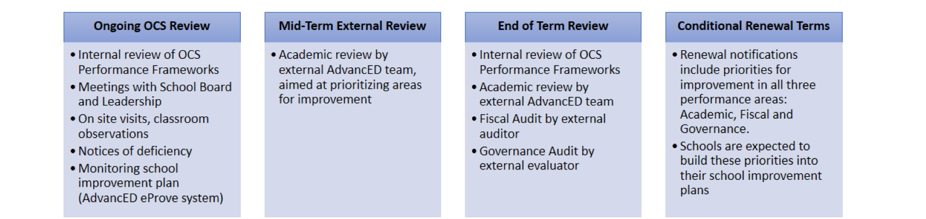
OCS Evaluation/Renewal Process
Sec. 2(a) under IC 20-31-5-2 provides that “A charter entered into under IC 20-24-4 may be used as a charter school’s three (3) year plan.”
OCS’s renewal procedure which is ongoing and continuous aligns with this three (3) year plan. The renewal application is designed to be a continuous improvement plan aligned to use AdvancED’s performance standards to meet the standards set out in the OCS Academic, Financial and Organizational Performance Frameworks

Slide 15
Reconsideration Procedures following a Non-Renewal Decision
School Board must submit a written request for reconsideration with 10 business days of receipt of Notice of Non-Renewal
A hearing will be scheduled no sooner no sooner than 10 business days no later than 20 business days following receipt of Request for Reconsideration
The University may schedule the hearing at any later date prior to termination date of the charter contract as necessary to accommodate the members of the Ball State University Charter Schools Hearing Panel or to allow proper preparation for the hearing
The University may, upon approving a request from the Organizer, schedule the hearing at any later date prior to termination date of the charter contract
The Ball State University Charter Schools Hearing Panel shall issue a written recommendation to the President within ten (10) business days of the hearing date.
The decision of the President is final.

Slide 16
Revocation Procedures
If the charter has been suspended, the request for hearing must be made within five (5) business days after the date of the deemed delivery of the notice of revocation was given. Otherwise, the request for hearing must be made within ten (10) business days after the date of the deemed delivery of the notice of revocation.
If the charter has not been suspended, the hearing will be scheduled no sooner than ten (10) business days after receipt of the hearing request. The University may, however, on its own initiative or upon approving a request from the Organizer, schedule the hearing at any later date prior to the revocation date stated in the notice, as necessary to accommodate the members of the Ball State University Charter Schools Hearing Panel or to allow proper preparation for the hearing.
If the charter has been suspended, the Ball State University Charter Schools Hearing Panel shall issue a written decision on the appeal within five (5) business days of the hearing date. Otherwise, it will render its decision within ten (10) business days. The Ball State University Charter Schools Hearing Panel may make one of the following two determinations: (1) Uphold the revocation of the Organizer’s charter or (2) Overturn the decision to revoke.
The Hearing Panel will submit their recommendation to the President of the University.
The decision of the President is final.

Slide 17
Charter Schools Non-Renewed, Closed or
No Longer Ball State’s Portfolio
School Name | Date Closed
Campagna Academy | 6/30/2012
Charter School of the Dunes | 6/30/2013
Hoosier Academy – Muncie | 6/30/2013
Imagine Schools on Broadway | 6/30/2013
Imagine Indiana Life Sciences Academy East | 6/30/2013
Imagine MASTer Academy | 6/30/2013
Kenneth A. Christmon STEMM Leadership Academy | 6/30/2013
LEAD College Preparatory Academy | 6/30/2013
Timothy L. Johnson Academy | 6/30/2013
West Gary Lighthouse | 6/30/2013
Imagine Indiana Life Sciences Academy West | 6/30/2014
Indiana Math and Science Academy – Indy | 6/30/2014
International School of Columbus | 10/25/2014
Career Academy of South Bend | 6/30/2015
Fall Creek Academy | 6/30/2015
Hammond Academy of Science and Technology | 6/30/2015
University Heights Preparatory Academy | 6/30/2015
Thea Bowman Leadership Academy | 6/30/2016
New Community School | 12/31/2016
Veritas Academy⁸ | 6/30/2107
Hoosier Academies Virtual Charter School | 6/30/2018
Xavier School of Excellence | 6/30/2018

Slide 18
Observations from Oversight of Virtual Charter Schools
What is the definition of online learning/virtual education:
  virtual distance learning;
  online technologies; or
  computer based instruction
  an interactive learning environment
  Virtual school vs. programs for online learning.
Accessibility to data as an authorizer is essential in conducting oversight
Virtual learning is not a match for every student and family.

Slide 19
Response to Observations from Oversight of Virtual Charter Schools
OCS monitors test participation as part of the evaluation of a school’s A-F grade. Our Organizational Framework has been revised to amplify student participation rate by evaluating the school policies, use of resources and practices to ensure that students are tested.
Ball State was awarded the Quality Counts: Building Quality Capacity Authorizer Innovation Grant, a portion of which will be used to fund a Virtual Charter School Case Study. In collaboration with faculty through the Research Design Studio (RDS), a resource in the Department of Educational Psychology and Teachers College at Ball State University, OCS and RDS will undertake a case study of Indiana Connections Academy. The case study will specifically explore what conditions and characteristics are required for a student, parent and teacher to be successful in a full time virtual learning environment. This virtual study will inform our own oversight of virtual schools, as well as statewide policy makers, and contribute to the broader knowledge base about virtual learning nationwide.

