Slide 1



STATE BOARD OF ACCOUNTS

Slide 2


PAUL D. JOYCE, CPA STATE EXAMINER
Indiana’s State Examiner and the agency head for the State Board of Accounts, Paul Joyce coordinates and manages the post-audits and examinations of over 4,000 state and local governmental entities in Indiana.

Slide 3

Indiana state board of accounts
Conservancy District Presentation
October 7, 2025

Slide 4
Topics
Overview of the SBOA
Resources available
Year-end Considerations
Q & A

Slide 5

SBOA – An Overview
What is the State Board of Accounts?
Created by Indiana Code 5-11-1
Audit the financial statements, records & accounts of all state and local governmental units
Prepares and file reports opining on the accuracy of the financial statements and noting any noncompliance with laws or guidelines.
Notes:
We are an independent audit agency for state and local units of government.
Read SLIDE
The documentation of our audit work comes in the form of a report of these audits, indicating our opinion on the financials statements of the unit and whether the laws of the State and the accounting requirements of the SBOA have been followed.
The primary responsibilities of the SBoA are to conduct examinations of the accounts of all
governmental entities to ensure compliance with the statutes of Indiana, and to prescribe and approve
forms to create a uniform system of accounting and financial reporting in Indiana for all units of government.
The SBoA has also been given additional statutory responsibilities in the areas of audits of federal
financial assistance, audits of nongovernmental entities, election recounts, and special studies created by the General Assembly.
The responsibilities and duties of the SBoA are set forth within the Indiana Code (IC 5-11-1 et.
seq.). Additionally, as a professional organization, we comply with attestations and auditing standards as declared by the American Institute of Certified Public Accountants (AICPA) and by the U.S. Government Accountability Office (GAO) when we so indicate in our reports.

Slide 6
SBOA – overview
Mission Statement:
“We are dedicated to providing the citizens of the State of Indiana with complete confidence in the integrity and financial accountability of state and local government.”

Slide 7
SBOA – An Overview
Organized by law in 1909 as “Department of Inspection and Supervision of Public Offices”
  Created in response to public concerns over theft and misuse of public funds.
  Originally comprised of the Governor, Comptroller, and the State Examiner with a field of 25 examiners.
In 1945, the rights, duties, and powers were transferred to the State Board of Accounts
  Composed of a Board including the State Examiner and two Deputy State Examiners
  Today the field and support staff contains over 200 individuals
Notes:
.

Slide 8
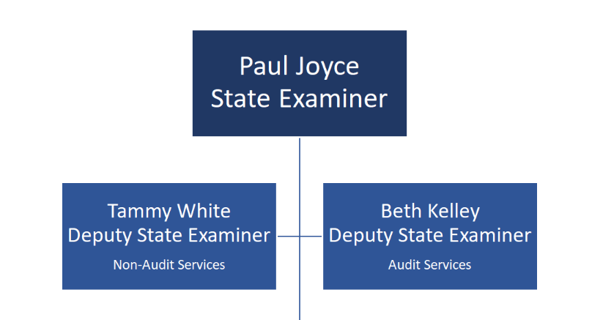
SBOA – An Overview
Indiana State Board of Accounts
  Three-member board consisting of a State Examiner and two Deputy State Examiners
Insert organizational chart?
Notes:
READ NOTES
The “Board” of the Board of Accounts consists of the State Examiner and two Deputy State Examiners.
The board members are appointed by the Governor with the appointments requiring acceptance by the Indiana General Assembly's Legislative Council.
The current State Examiner is Paul Joyce. The State Examiner participates on the State Board for Depositories and the Oversight Commission on Public Records by statute.
The Deputy State Examiners are Beth Kelley and Tammy White.
Board members are active members of the
Association of Government Accountants,
the National Association of State Auditors,
the Government Finance Officers Association,
the Public Integrity Coalition,
the Distressed Units Board,
and many other national and state organizations committed to the improvement of government accounting and auditing.

Slide 9

SBOA – An Overview
Audit Coordinators:
Supervise overall audit projects
Audit Managers
Manage audit projects
Audit staff
Team assigned to an engagement
  Lead auditor and assisting field examiners

Slide 10
SBOA – An Overview
Frequency of Audits
IC 5-11-1-25(b):
Audits conducted at times determined by SBOA using risk based criteria, which include:
  New fiscal officer
  Incorrect or non-filed reporting
  Rating agency requirement
  Any other factors determined by State Examiner
Not less than once every 4 years
Notes:
Many officials as “when am I getting audited?”
The state board of accounts shall conduct examinations of audited entities at the times determined by the state board of accounts, but not less than once every four (4) years, using risk-based examination criteria that are established by the state board of accounts and approved by the audit committee.
The risk-based examination criteria includes the following risk factors:
An audited entity has a newly elected or appointed fiscal officer.
An audited entity: (A) has not timely filed; or (B) has filed a materially incorrect or incomplete; annual financial report.
A ratings agency that rates debt maintained by an audited entity has determined an examination of the entity is required more frequently than once every four years
Any other factor determined by the state examiner and approved by the audit committee
Under some circumstances, an audit may be required annually. For example,
because of the receipt of federal financial assistance over $750,000;
due to continuing disclosure requirements; or
as a condition of a public bond issuance.
You need to notify SBOA within 60 days after the close of the year if you need an annual audit.

Slide 11

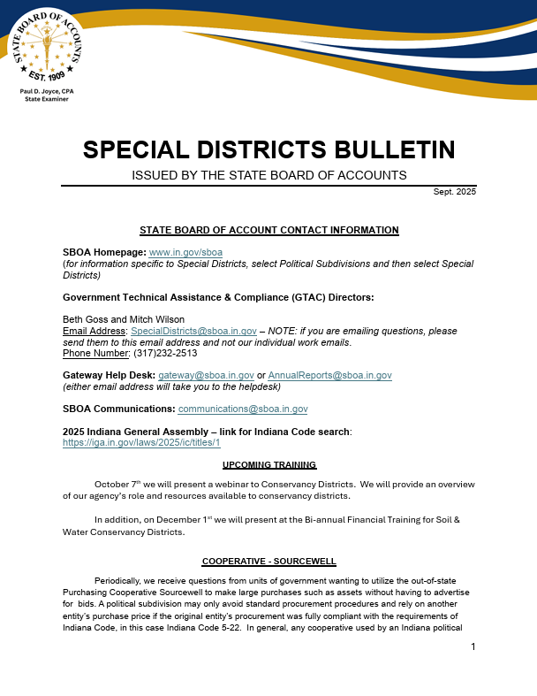
SBOA – Resources
Accounting & Uniform Compliance Guidelines Manual for Special Districts
Special Districts Bulletin
Notes:
Two publications – manual and bulletins.
We are required by law to prescribe or approve the accounting systems and necessary supplemental accounting forms for all local and state governmental units. The statutes require it be uniform for every public office and every public account
In an effort to do so, we prepare and publish accounting manuals relating to the various units of government. The one for Special Districts is the Accounting and Uniform Compliance Guidelines Manual for Special Districts
In addition, we issue Special District Bulletins every quarter. These bulletins contain additional information on various topics and they supplement the manuals.
The Manual, along with the Indiana Code, are what we are expecting during an audit. If we have to write a comment for noncompliance, the comment criteria will be referenced to either the manual or the Indiana Code

Slide 12
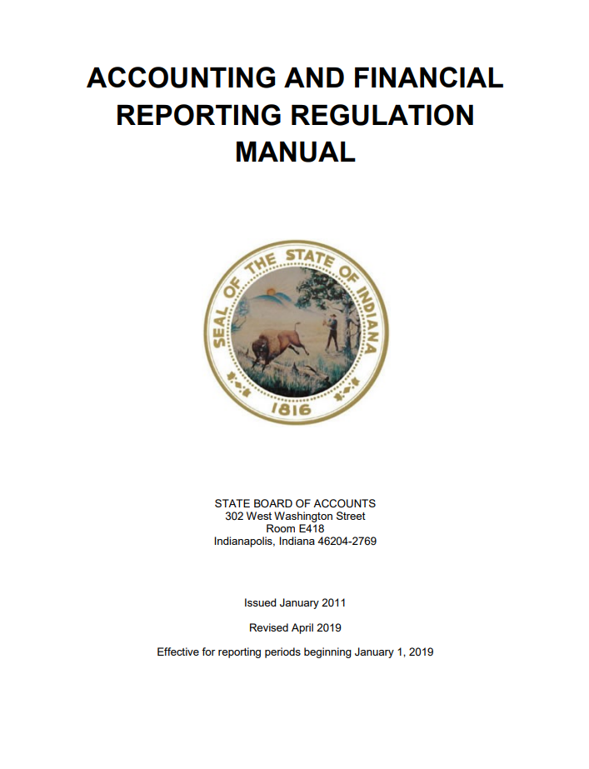

SBOA – Resources
Accounting & Financial Reporting Regulation Manual
Uniform Internal Control Standards
Notes:
We also have on our website the Accounting and Financial Reporting regulation manual and the Uniform Internal Control Standards manual.
Regulatory Manual – outlines how to report financial information for all local governmental units.
Purpose is to establish a consistent basis for accounting for local governments
A regulatory basis is defined as a basis of accounting that your special district uses to comply with the requirements of a regulatory agency – which is the SBOA in this case.
Internal Control Manual – provides a basis of understanding to assist public sector managers in maintaining a system of internal controls to promote government accountability and transparency. This requirement is noted in Indiana Code 5-11-1-27.

Slide 13
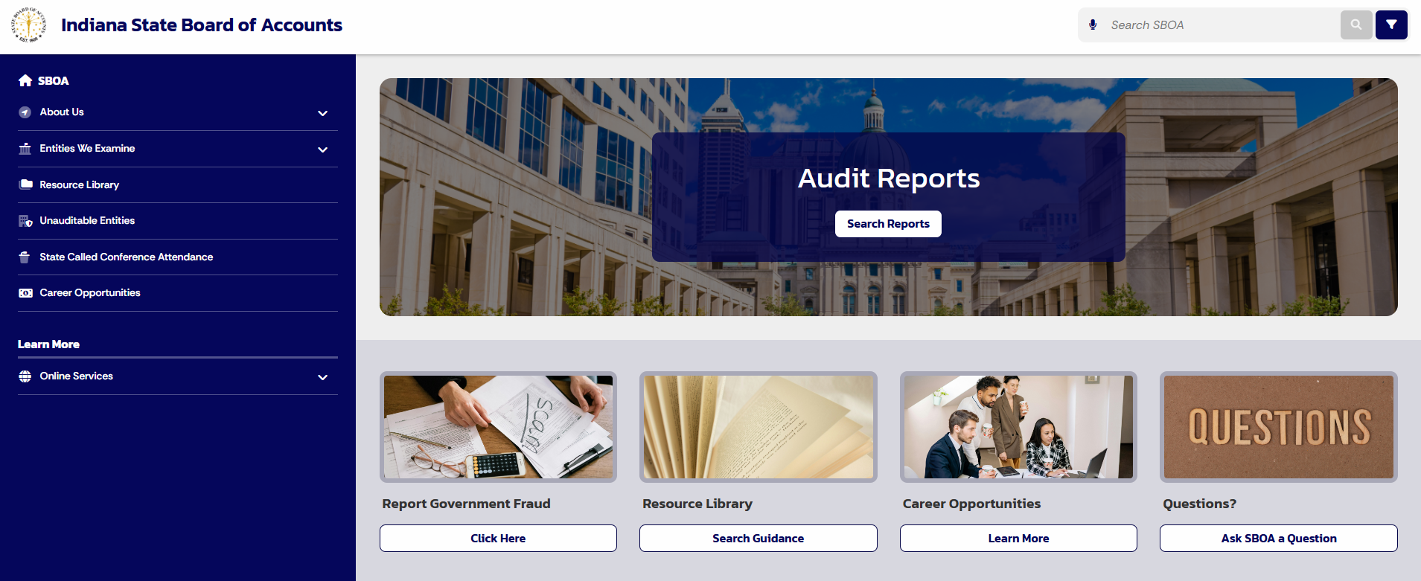
Sboa – resources www.in.gov/sboa
Notes:
Now let’s take a look at our website and show you how to locate some of the items I have just discussed. This is what the home page currently looks like. This site will provide you a lot of useful information and a great reference tool to answer some of the questions you might have.

Slide 14
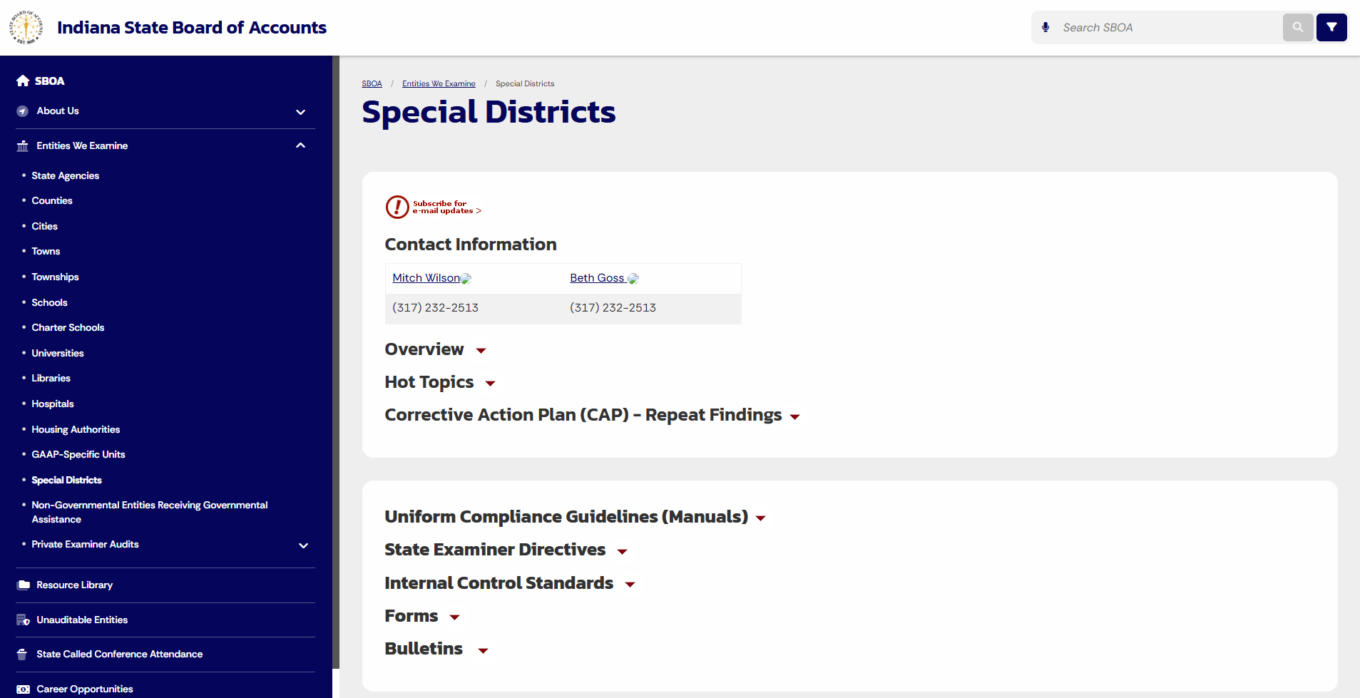
Sboa – resources www.in.gov/sboa
Notes:
On the left you will want to click on the drop-down arrow by “Entities We Examine” and select Special Districts. Once the page populates you will first see the contact information for Mitch and myself.
Again, this site provides links to a lot of useful information that can assist you daily. I highly recommend bookmarking or saving this site as a favorite. Here you will find uniform compliance guidelines manual, quarterly bulletins, and State Examiner Directives and much more.

Slide 15
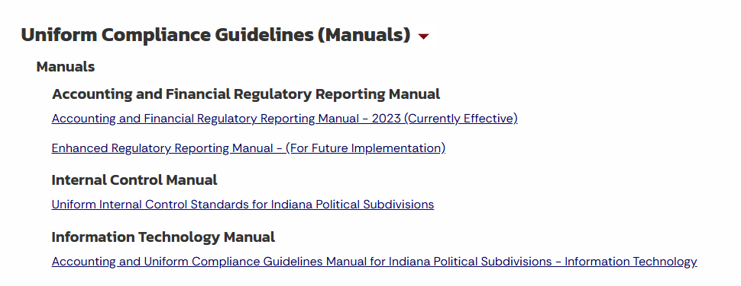
Sboa – resources www.in.gov/sboa
Notes:
Next, I will show you where the manuals are located on our website. Once you are the Special Districts landing page scroll down past the Corrective Action Plan, you will see another box with IC Standards and Uniform Compliance Guidelines.
If you click the drop-down arrow by Uniform Compliance Guidelines, you will see the section titled “Manuals”. Here we have provided links to the Regulatory Reporting Manual, Internal Control Manual, IT Manual, and (you can't see it on this slide) but the Uniform Compliance Guidelines Manual.

Slide 16
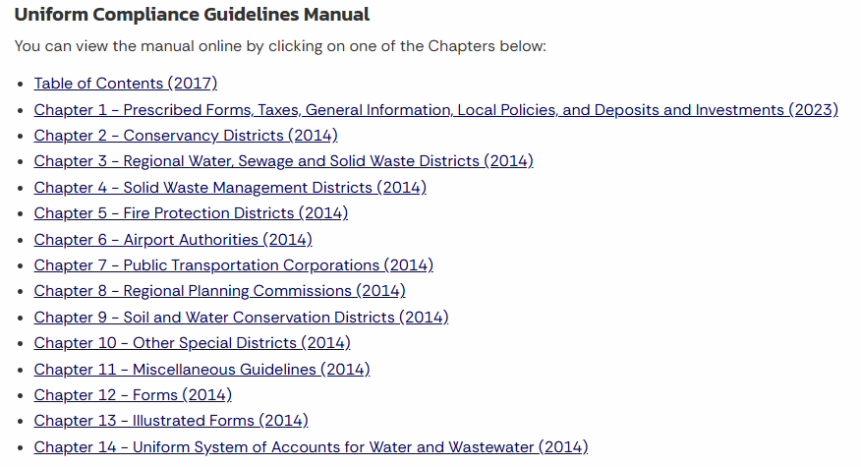
Sboa – resources www.in.gov/sboa
Notes:
This slide shows you the chapters for the Uniform Compliance Guidelines Manual.
So, the Manual is broken up by chapter and provides a wealth of information relating to your political subdivision. Please take the time to read through this manual, as a lot of times we will refer to it with your questions. These chapters are not extremely long and provide so much information!

Slide 17
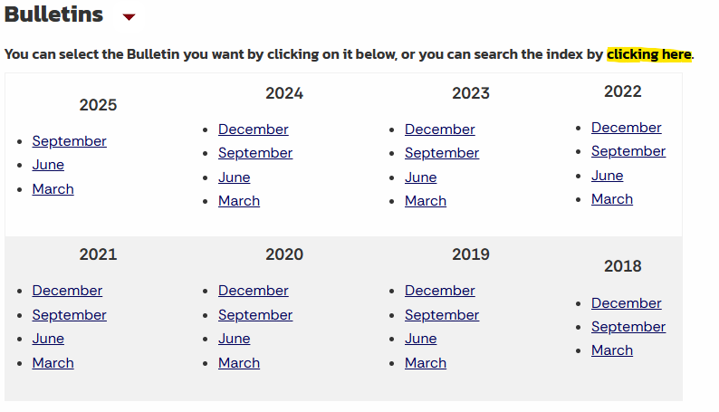
Sboa – resources www.in.gov/sboa
Notes:
Below the manuals we have a section for the quarterly bulletins. Here we have links to each quarterly bulletin as well as a link where you can search by topic in the index. The index will then guide you to which bulletin has the information you need.

Slide 18
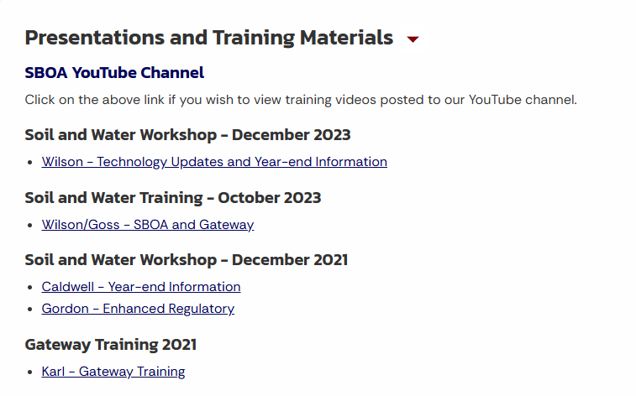
Sboa – resources www.in.gov/sboa
Notes:
Our site also has past presentations and training materials. So, if you miss a training or want to go back and refresh yourself on a training you can scroll down to the Presentations and Training Materials and click the drop-down arrow, and the presentations will appear newest to oldest.

Slide 19
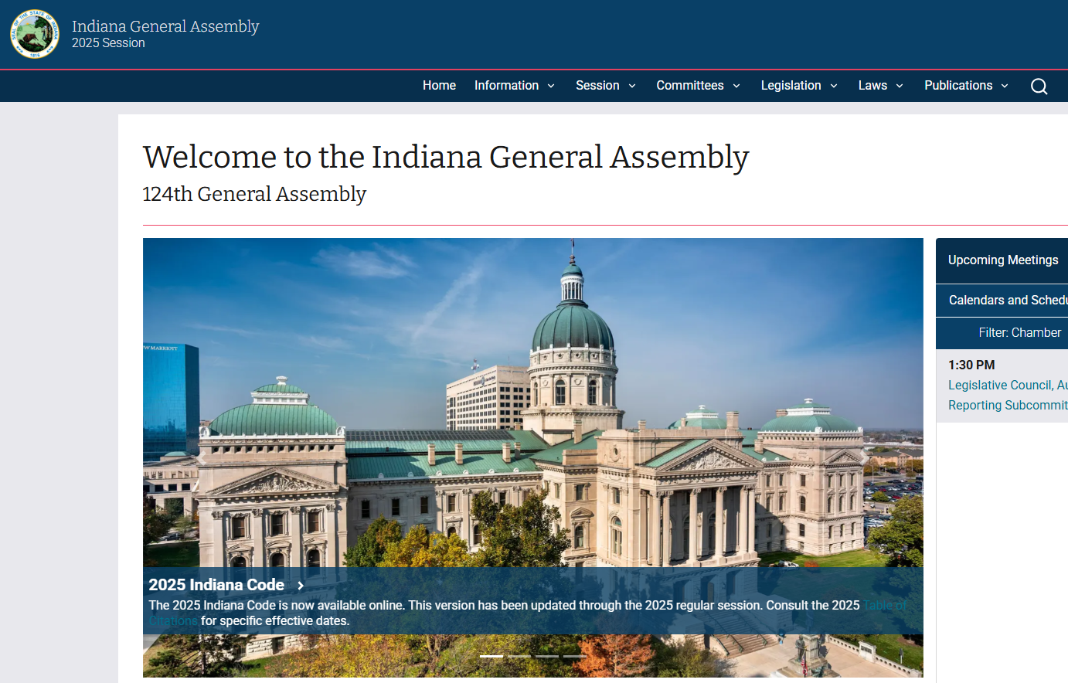
Indiana Code - iga.in.gov
Notes:
Next, I want to go over how to search the Indiana General Assembly website for any Indiana Codes you might be searching for. This slide shows what the home page currently looks like. To get to the search function for the code click on the drop-down arrow next to Laws and select Indiana Code.

Slide 20
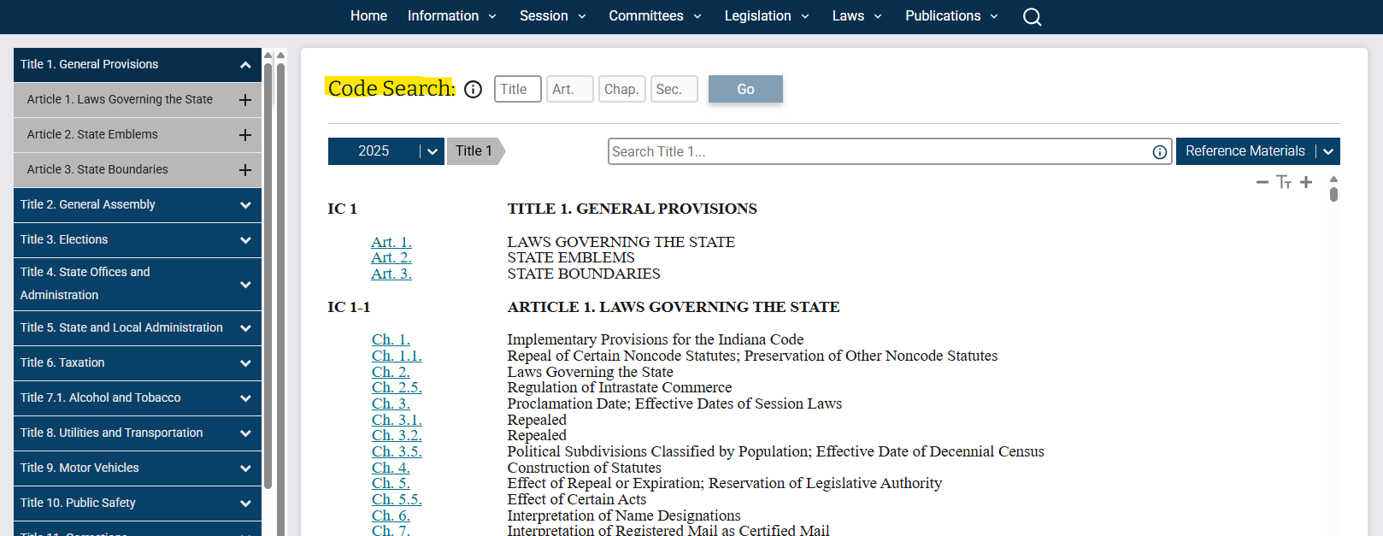
Indiana Code - iga.in.gov
Notes:
Once you do that this page will appear. You will want to enter the Indiana Code that you are searching for in the Code Search section.
Conservancy Districts are in Title 14, Article 33. So If you enter 14 in the Title box and 33 in the Art. Box the next page will populate

Slide 21
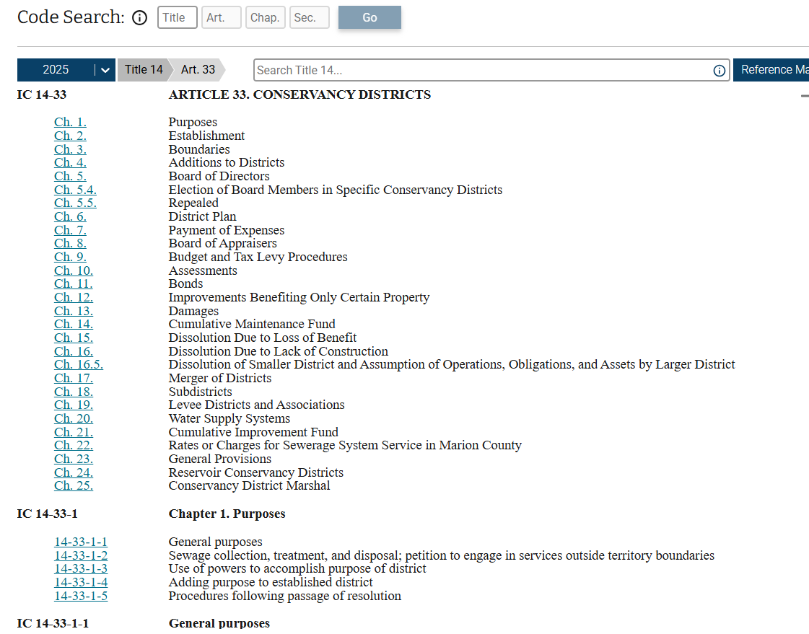
Indiana Code - iga.in.gov
Notes:
Now you can see all the chapters that are available and then w/in the chapters are the sections. You can click on any of the blue links and it will take you to that chapter or section w/in a chapter.
So, if we reference an IC in a bulletin or email and you want to view it in its entirety you can go to this website and enter the IC provided and click Go to view it.

Slide 22

YEAR - END
CONSIDERATIONS
Notes:
Hi everyone I`m Mitch Wilson and I`m the other half of our team here at the State Board of Accounts that works with our special districts.
So now that Beth has given you a little more information as to who we are and the resources we have available I want to go over some items for you to be aware of as we are getting close to the end of the year.

Slide 23
Gateway
Annual Financial Report (AFR)
Form 100-R
Monthly / Annual Uploads
Notes:
With the variety of unit types we work with, aside from internal controls, Gateway has to be one of the topics everyone loves to talk about.
So today I`m going to run through those wonderful Gateway submissions. This would entail the Annual Financial Report and the 100-R.
Then in conjunction with those are the required monthly and annual uploads.

Slide 24
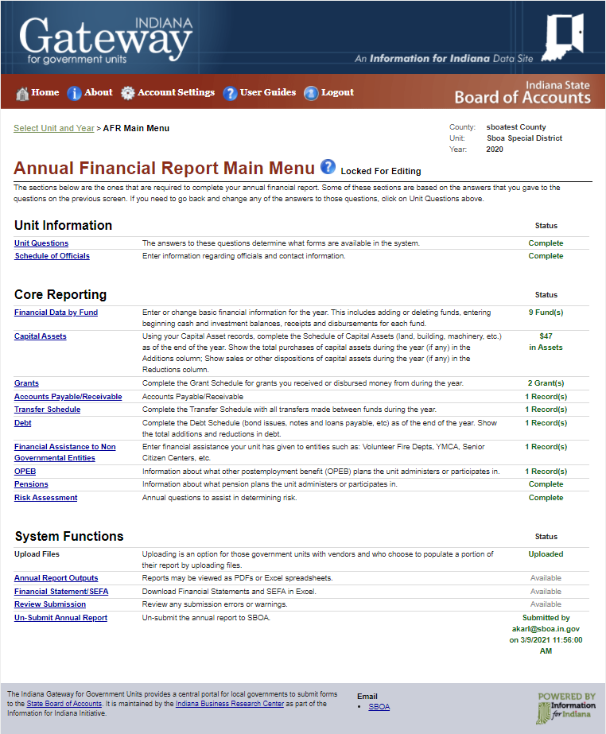
Annual Financial Report - Gateway
Required by IC 5-11-1-4
Due 60 days after end of year (3/1/26)
Notes:
The first of two annual uploads required by statute is the Annual Financial Report or the AFR
This is separate from any reporting you might do for your district
This one is required by statute in that IC 5-11-1-4 requires all audited entities to submit financial reports covering the full period of each year.
The AFR is required to be prepared and verified locally. Then it’s to be filed electronically with the State Examiner, again by using the Gateway online application.
Per statute, the report is due 60 days after the end of the year, which will be March first of next year.
If the report is filed late, that might create an audit issue during the next audit.
If the report is filed substantially late, we will be in contact with you later in March requesting the report and we can issue a subpoena in order to get the report completed and filed.
I will say the AFR is the more complex of the two required annual reports and if you have any questions while working through it don`t hesitate to email or call us.

Slide 25
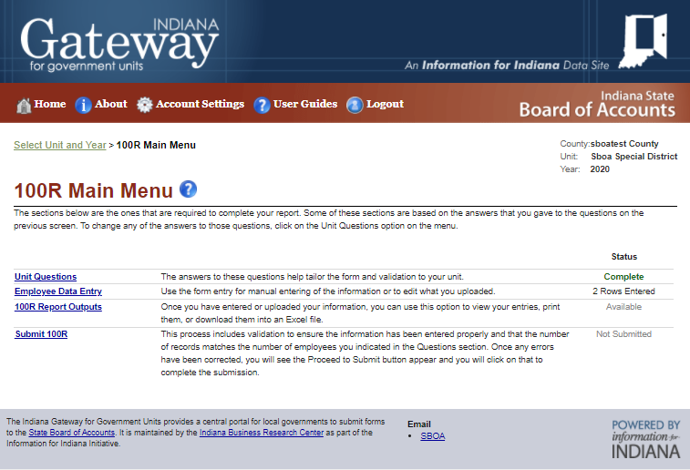
Form 100R - Gateway
Required by IC 5-11-13-1
Due during the month of January for the preceding year (by 1/31/26)
Notes:
The other annual statutorily required report is the Certified Report of Names, Addresses, Duties and Compensation of Public Employees – or what is commonly referred to by its form number – Form 100-R.
IC 5-11-13-1 requires audited entities to prepare and sign a certified report of each officer and employee of the audited entity.
The Form 100-R reports
The number of employees
How much they were paid during the reporting year
And some information on benefits
The report is again filed electronically through Gateway.

Slide 26


Form 100R - Gateway
Form 100-R must be submitted even if there are no employees to report.
Show “0” for Unit Question #1
Notes:
There are a couple things I want to note with this report.
Because this report is statutory – it is required for all Conservancy Districts – even if there are no employees to report.
The reason I bring this up is that we base our determination on what the IRS classifies as an employee to which that is as anyone that receives a W-2
Then question arises as to if this includes Board Members to which the IRS considers ALL elected officials, including Board Members, as employees and they should be issued a W2 if they are paid, regardless of the amount.
Like I mentioned earlier the 100R is less cumbersome than the AFR as there are only 5 questions here, but be sure to answer them all.
I know Beth threw a lot of resources at you earlier, but on our website on the left-hand side there is that entities we examine dropdown and if you click Special Districts within that dropdown it will take you to the Special Districts landing page that Beth mentioned . On this landing page near the bottom there is an entire section devoted to Gateway to which you can find a User Guide for both the AFR and 100R.
Within both of those User Guides there is a FAQ section that provides a lot of good information to the point Beth and I even use these sections quite often when questions come in regarding these reports.
Before we move onto the Gateway Uploads what questions do we have?

Slide 27

Monthly Uploads - Gateway
Notes:
Alright let’s shift gears a bit and continue with discussing those items that are required to be uploaded monthly in Gateway.
To begin with, State Examiner Directive 2018-1 requires those units subject to our audits to upload certain information each month.
The importance of these uploads is that by having the monthly and annual uploads this gives us the appropriate financial information that we can use to do pre-audit planning and testing.

Slide 28
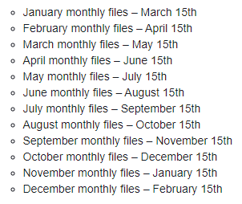
Monthly Uploads – When Are They Due
Notes:
So firstly, I know I`ve thrown around a couple different due dates with the AFR and 100R so let`s discuss the due dates for these monthly uploads first.
The monthly uploads must be uploaded no later than the 15th day of the second succeeding month which essentially entails 6 weeks after the end of the month. For example, January’s required uploads are due by March 15^{th.}
This schedule shown is from the Gateway Monthly and Annual Uploads User Guide so if it`s something you want to save or print out feel free to do so.

Slide 29
Monthly Uploads – Gateway
Bank Information
Reconcilement for each bank account you have
Includes copy of
Statement
  Optical images of checks
List of outstanding checks
Notes:
There are three items you are required to upload each month:
Bank Information
Approved Board Minutes
Funds Ledger
Let's look at the bank information component first though.
When I say bank information that entails your monthly bank reconcilement, your bank statements for that month, and your outstanding checks list pertaining to each bank
As you complete your bank reconcilements monthly you should already have each of these items.
What we require is just that you upload your reconcilement, copy of the bank statement, and a list of outstanding checks.
One item to note with the bank statement is that you will want to ensure that it includes optical images of cleared and cancelled checks. Traditionally this is at the end of the bank statement.
You may need to go online and download or print your statement and check images each month.
Then if anyone has multiple checking accounts, the information for each is required.
While we are on this topic, I do have to mention that I know bank reconcilements may be tedious at times, but they are not only required by statute. They are also necessary for good financial controls.

Slide 30
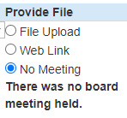
Monthly Uploads – Gateway
Meeting Minutes
Minutes from each Board meeting
If not signed/approved before due date, upload unsigned copy and replace with approved copy later
If meetings are not monthly, indicate so
Notes:
The next monthly upload is simply your approved board minutes for that month.
Minutes from each meeting need to be uploaded.
If the 6 week deadline that we talked about earlier comes up and you need to upload ‘draft’ or ‘unapproved’ minutes, you can do so. Just replace that file with the approved/signed copy when that is available.
One thing to note here is that if there’s a month when the board doesn’t meet then you just need to indicate “no meeting” for that particular month.

Slide 31
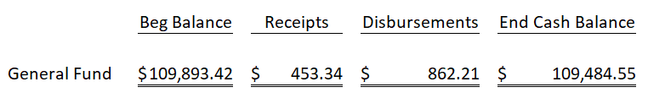
Monthly Uploads – Gateway
Funds Ledger
List of funds from your ledger/Quickbooks
Includes
Beginning of month fund cash & investment balance
Receipts in total for the month
Disbursements in total for the month
Ending fund balance
Notes:
Then the final monthly upload here might seem a bit odd on the surface for some of you that may only have one fund on your ledger.
However, we do require all units to submit a monthly “fund report” which shows all funds of a unit and their associated beginning monthly cash and investment balance, receipts for that fund in a month, disbursements for that fund, and the end of month cash balance.
For some of you this may simply look like the picture at the bottom here.

Slide 32
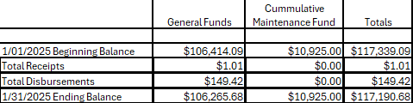
Monthly Uploads – Gateway
Notes:
Then here’s an example I found from a district that uploaded it into gateway
I think this may be a report that Quickbooks can run
But you can see it shows the beginning balance, total receipts, total disbursements, and the ending total cash in each fund
Such a file can simply be exported and uploaded
Or you it can be printed, scanned, and uploaded
Whatever method is easiest for you
That`s our last monthly upload so any questions about any of those three?

Slide 33

Annual Uploads – Gateway
Notes:
So really the monthly uploads are not too cumbersome as it`s just those three items.
There are a few more items that we require you to upload annually though.

Slide 34
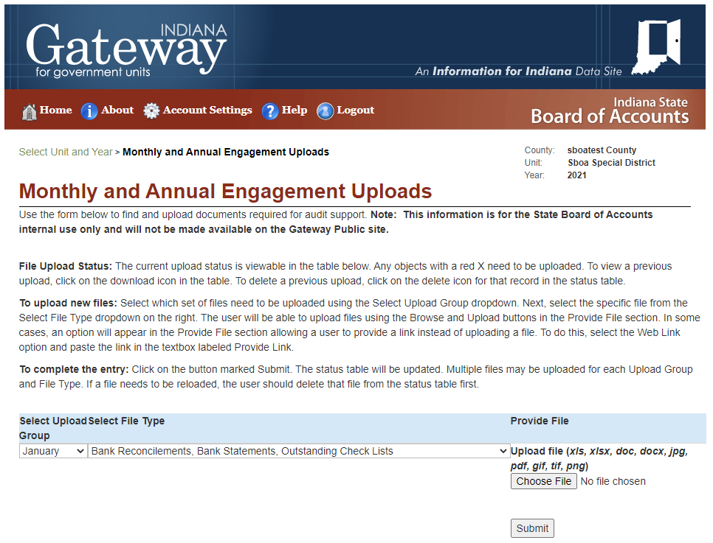
Annual Uploads – Gateway
Required to be uploaded by March 1, 2025
Same timeline as the SBOA AFR
Includes:
Year End Investment Statements
Detail of Receipt Activity
Detail of Disbursement Activity
Salary Ordinance
Vendor History Report
Payroll History Report
Funds Ledger
Accounts Payable / Receivable Report
Personnel Policy
Excel Data Capture
Notes:
Like the monthly uploads, State Examiner Directive 2018-1 requires certain documents and reports to be uploaded annually
These however, are similar to the AFR in that they are due by March 1st each year.
The list of items here include . . .
I know that`s quite a hefty list and there are a couple new things on there, but we are going to go through them individually here.

Slide 35
Annual Uploads – Gateway
Investment Statement
Similar to bank account statement - only for any investments you may have
Savings
CDs
Upload December 2024 statements for all investment accounts
Notes:
The first of these uploads are investment statements.
I will say most of you or maybe even all of you may not have these.
Investment statements would be anything you have related to an investment – like a savings account or CD.
It’s essentially just a checking account statement, but only for investments.
If you have anything like this, all you need to do is upload the December or year end statement.

Slide 36
Annual Uploads – Gateway
Detail of Receipt Activity
Does not apply to hand-posted records
Listing of all receipts issued and posted during the year
Most systems have a “history” function that should provide this information
May need to contact your software vendor for assistance
Include receipt numbers, dates, and amounts
Notes:
Next is a receipt activity
This does not apply to any units who have records that are posted by hand – meaning the unit does not have a computerized accounting system
If any of you have hand-posted records, you don’t need to do this.
For everyone else however
This is a listing of all receipts issued and posted during the year.
Most computerized accounting systems have a ‘history’ function that should be able to provide this information.
If you’re not sure, you may need to contact your software provider for assistance.
Any list would include the receipt number, date, amount, and possibly from whom the money was received

Slide 37
Annual Uploads – Gateway
Detail of Disbursement Activity
Does not apply to hand-posted records
Listing of all non-payroll disbursements posted during the year
Most systems have a “history” function that should provide this information
May need to contact your software vendor for assistance
Include check numbers, dates, amounts, and payee name
Notes:
Disbursement information is next
This also does not apply to any units who have records that are posted by hand.
So again, if any of you have hand-posted records, you don’t need to do this.
For everyone else though this is similar to the receipt activity, but only for disbursements where it’s a listing of all disbursements issued and posted during the year.
Again, most computerized accounting systems have a ‘history’ function that should be able to provide this information and if you have an issues you may need to contact your software provider.
For this activity a list would include the check number, check date, amount, and the name of the person or vendor to which the check was issued.

Slide 38
Annual Uploads – Gateway
Salary Ordinance
Shows the approved salary of district employees
For the year being reported - 2024
Notes:
Next is your Salary Ordinance or Salary schedule
Similar to when we discussed the 100R the salary schedule would include all employees of the district
This would entail how much was approved for each person
The reason for this is so we can audit that these persons were being paid the proper amount
And then it would be for salaries paid in 2024

Slide 39
Annual Uploads – Gateway
Vendor History Report
Does not apply to hand-posted records
Detailed listing of all vendors to whom checks were issued during the year
Ideally would show total by vendor
Most systems have a “history” function that should provide this information
May need to contact your software vendor for assistance
Notes:
Then the next report is the Vendor History Report
Like the previous reports – if you hand-post your ledger, this doesn’t apply to you
If you have a computerized accounting system, we need a detailed listing by vendor of checks issued for the year.
Also, ideally it would have a total by vendor.
For example, our field examiners could look at this report and see 8 checks were written to Mitch Wilson. That would seem out of character for a unit such as yours, so they could review these checks to ensure they were proper expenses of the district.
Then also like the other reports your system should have a ‘history’ function that should provide this information to which if you have any issues we`d advise reaching out to your software provider.

Slide 40
Annual Uploads – Gateway
Payroll History Report
Does not apply to hand-posted records
Applicable for employees not paid by County
Summary of all pay to employees
  Employee name
  Date
  Gross wages
  Check number
Report should not contain social security numbers
Excel file or searchable PDF is preferred
Notes:
The Payroll History Report is next which this is essentially a summary of all pays to employees.
It would include at a minimum the date, employee name, gross wages, and check number for all payroll checks issued for the year.
One thing to note here is that we ask that this report not contain social security numbers.
For auditing purposes an excel file is ideal or even a searchable PDF would be perfect.
Then for those with hand-posted records this would not apply.

Slide 41
Annual Uploads – Gateway
Funds Ledger
Summary for each fund that entails:
  Beginning Balance
  Receipts
  Disbursements
  End Balance
Excel file is preferred, but each system is unique
  May need to contact your software vendor for assistance
For hand-posted records you can upload a scan/photo
Notes:
Next is the Annual Funds Ledger
This is a report that shows the summary of the beginning balance, total receipts, total disbursements and ending balance of each fund for the year.
Then again, for auditing purposes an excel file is ideal, but we understand that each software system is unique. Again, this is one report where you may need to contact your software vendor if you have trouble finding this.
For those with hand-posted records you can simply upload a scan or photo of your manual records that would include this information.

Slide 42
Annual Uploads – Gateway
Accounts Payable / Receivable Report
List of accounts payable items
  By vendor and amount
  Totals amount presented on AFR
List of accounts receivable items
  By vendor and amount
  Totals amount presented on AFR
Notes:
The accounts payable and receivable report is more simple in nature and you may not have much to report here.
However, it is simply a listing of those accounts payable and receivable.
As a reminder, accounts payable items are items you have been billed for but have not paid yet and accounts receivable items are items you have billed and are awaiting payment on.
The totals of these reports should match up to those amounts you show on your AFR.

Slide 43
Annual Uploads – Gateway
Personnel Policy
Unique for each unit as to what it contains
Upload once beginning in 2023
Only upload in following years if policy is modified
Notes:
Another newer item we ask that you upload is your Personnel Policy
This one is very open ended as your personnel policy is probably unique for each unit.
However, we just ask that you upload that for audit purposes.
This is something that we began to require in 2023 so if you have already uploaded this there is no need to upload this each year unless it has been modified from the previous submission.

Slide 44
Annual Uploads – Gateway
Excel Data Capture
Detail of Receipts and Disbursements in one
Receipts / Disbursements:
  Receipt numbers / Check numbers
  Date received / Date disbursed
  Amount of receipt / Amount of disbursement
  Fund posted to
  Whom received from / Vendor or payee name
May need to reach out to software vendor for assistance
Takes the place of Detail of Receipts and Disbursements uploads
Notes:
Then finally the last item here is an Excel Data Capture.
This is essentially a detail of receipts and disbursements all in one.
As you can see the items required here are similar to those we talked about with your Detail of Receipts and Detail of Disbursement reports. This would entail . . .
With these requirements being similar to those reports, if you are able to upload this report you would not be required to upload the Detail of Receipts and Detail of Disbursements reports.
I know I have mentioned it a lot, but as this report is more complex in nature it may be something to discuss with your software vendor as to how to run this report.
So looking at all those annual uploads what questions do we have?

Slide 45
References
Gateway Information:
Annual Financial Report User Guide:
  https://gateway.ifionline.org/userguides/AFRguide
Form 100-R User Guide:
  https://gateway.ifionline.org/userguides/100Rguide
Monthly & Annual Upload User Guide:
  https://gateway.ifionline.org/userguides/engagementguide
Login:
  https://gateway.ifionline.org/login.aspx
Gateway Help Desk email address:
  gateway@sboa.in.gov
State Examiner Directive 2018-1 (Amended April 2025):
https://www.in.gov/sboa/library/state-examiner-directives/Amended-Directive-2018-1-4_23_2025-1.pdf
Notes:
I know we discussed a lot there so I wanted to leave you with some links to various reference materials.
I mentioned the Gateway User Guides earlier so here I have provided the links to those guides for the AFR, Form 100-R, and the uploads.
Next there is the link to the Gateway login
Then I have also provided the email address to our Gateway Helpdesk to which they can assist with everything from login questions to issues within the AFR/uploads such as maybe a box on the AFR isn’t accepting what you’re entering.
Then lastly is a link to the State Examiner Directive I mentioned a couple of times that discusses the requirements of the various uploads.

Slide 46
Contact Information
Mitch Wilson & Beth Goss
Government Technical Assistance & Compliance Directors
SpecialDistricts@sboa.in.gov
317-232-2513
Notes:
So that does conclude our presentation for today.
I have included our contact information here so if you ever have any questions don`t hesitate to send us an email or give us a call.
Also, as a reminder, all of our presentations are on our website under the presentations and training materials section of special districts landing page.
As promised though it does look like we do have some time for questions if there are any?
I`m sure there are questions after going over all of that today, but unfortunately it looks like I have went over my time a little bit here so if you do have any please send us an email and we can get those answered.
With that though I want to thank you all for your time today and I hope you have a great rest of your day!

