Slide 1


Slide 2

Indiana Medicaid
Substance Use Disorder (SUD) 1115 Waiver
Interim Evaluation Results
November 14, 2024

Slide 3
Background and Purpose of the 1115 Waiver
As part of the effort to combat the ongoing opioid crisis, the Centers for Medicare & Medicaid Services (CMS) created an opportunity under section 1115(a) of the Social Security Act for states to demonstrate and test flexibilities to improve the continuum of care for beneficiaries with Substance Use Disorder (SUD).
This demonstration opportunity aims to give state Medicaid programs flexibility to design demonstrations that improve access to high quality, clinically appropriate treatment for SUDs while incorporating metrics for demonstrating that outcomes for Medicaid beneficiaries are in fact improving under these demonstrations.
Indiana was one of the first states to obtain approval for its demonstration for the expansion of the delivery of SUD treatment services on Feb. 1, 2018.

Slide 4
Interim Evaluation
Indiana’s initial SUD demonstration ended December 31, 2020. The state subsequently was granted a new demonstration approval for the period of January 1, 2021 through December 31, 2025.
The State is in the process of applying for a renewal of this five-year waiver, along with the renewal of an accompanying Serious Mental Illness (SMI) 1115 waiver.
As required for the 1115 waiver renewal, Indiana engaged an independent evaluator to conduct an Interim Evaluation of the demonstration outcomes.
The population of the demonstration evaluation includes any Indiana Medicaid beneficiary with a diagnosis of SUD in the evaluation period.
The time period of this evaluation is January 1, 2021 through December 31, 2023.

Slide 5
Key Demonstration Activity
In support of the overall demonstration goal to reduce overdose deaths in Medicaid beneficiaries, Indiana undertook outcome-based action steps in a “whole of government” approach.
Action | Outcome
Allowed Opioid Treatment Providers (OTPs) to enroll as Medicaid providers beginning Aug. 2017 DHMA licensure of residential treatment providers and OMPP enrollment with Medicaid starting early 2018 | Increased access to community-based SUD treatment and reduced rate of ED utilization among beneficiaries with SUD
Offered state-sponsored American Society of Addiction Medicine (ASAM) training for providers | Increased use of medically-appropriate treatment for SUD
Created a standard SUD authorization form with guidance for use by all managed care entities (MCEs) | Increased approval of provider authorization requests
Contractual obligations added to MCE contracts regarding case management to SUD beneficiaries | Improved care coordination for beneficiaries needing or receiving SUD treatment

Slide 6
Notable Trends
A number of positive trends were observed in the Interim Evaluation during the demonstration:
Beneficiaries receiving an SUD service on a monthly basis grew 20%.
There was lower emergency department use after transitioning from higher level care (ASAM Levels 3 or 4).
The proportion of SUD providers in the state that accept Medicaid grew.
There was continual expansion in the offering of residential treatment services, both in licensed locations and licensed beds.
State-sponsored American Society of Addiction Medicine (ASAM) training proved helpful to new and existing Medicaid providers.

Slide 7
Summary of Findings

Slide 8
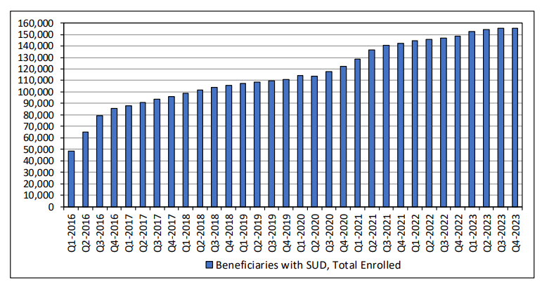
Medicaid Beneficiaries with SUD Diagnosis
The number of Indiana Medicaid beneficiaries with a SUD diagnosis has grown consistently during the eight-year period examined, from 48,860 in Q1 2016 to 155,251 as of Q4 2023. Medicaid enrollment during that time also grew significantly from 1.35M to 2.0M.

Slide 9
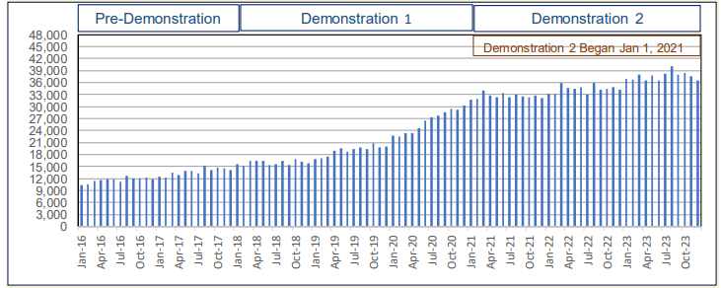
Beneficiaries Receiving Outpatient Treatment for SUD
The average number of beneficiaries with SUD using outpatient services in the demonstration period was 35,864 compared to 17,954 during the pre-demonstration period, an increase of 99.8%.

Slide 10
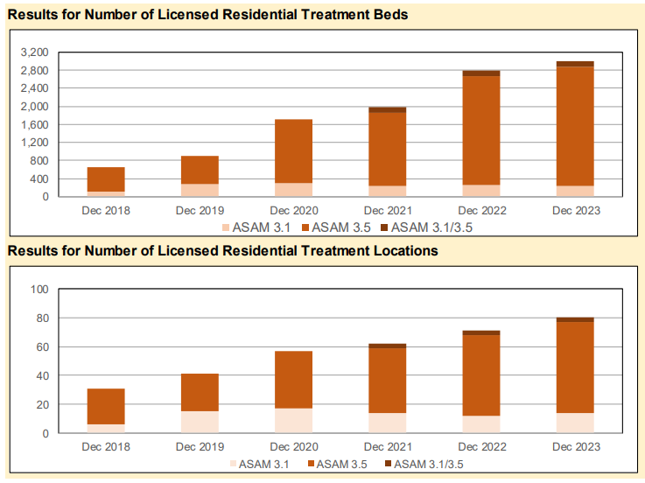
Number of Licensed Residential Treatment Beds
Both the number of beds and the number of locations licensed by the Division of Mental Health and Addiction (DMHA) increased during the demonstration period.
The number of locations increased from 31 in Dec. 2018 to 57 in Dec. 2020 and 80 in Dec. 2023. The number of licensed beds increased from 659 to 2,997 during this period.

Slide 11
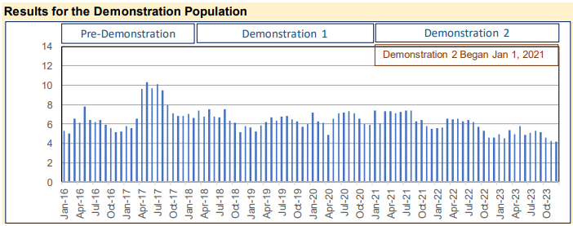
Emergency Department Visits for SUD
Average Emergency Department (ED) utilization for SUD in the demonstration period was 5.4 visits per 1,000 Medicaid beneficiaries compared to 6.4 visits per 1,000 during the pre-demonstration period, a decrease of 16%.

Slide 12
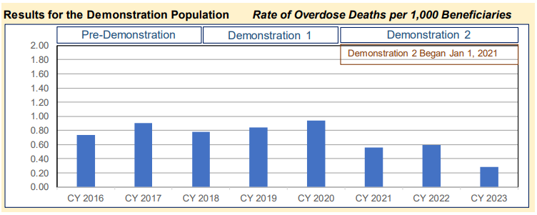
Rate of Overdose Deaths per 1,000 Beneficiaries
While the number and rate of overdose deaths among Indiana Medicaid beneficiaries increased during the initial demonstration period, since CY 2021, the rate and number of overdose deaths have declined. The rate was at its peak in CY 2020 at 0.94 beneficiaries per 1,000 and at its lowest rate at 0.29 beneficiaries per 1,000 in CY 2023.

Slide 13
Areas of Opportunity in Future Demonstration Activity
Continued Expansion of Provider Supply. Specific areas of focus include residential treatment services in northern counties of the state, intensive outpatient services, and supportive housing options.
Provider Support and Operations. Administrative simplification could include more streamlined authorization request forms, the development of a SUD-specific provider manual, additional provider trainings and conducting a root cause analysis regarding the lack of awareness and low uptake for early intervention services among providers.
Care Management Oversight. A need exists to continue strengthening oversight of the MCE’s delivery of case or care management to individuals with SUD who use higher levels of care.

Slide 14
Additional Medicaid Program Observations
Convening providers and MCEs on a regular basis to communicate what is happening “on the ground,” particularly at the introduction of new services or expansion of existing services is critical. In addition to providing a forum for implementation discussion, these meetings foster collaboration between stakeholders and offer the state the ability to share its vision for SUD service implementation to all stakeholders.
A balance is needed in communicating program changes to stakeholders, particularly new service coverage, policies, or operational requirements. Over-communication can cause as much confusion as under-communication, particularly if all policy and procedure considerations have been fully considered.
Indiana sponsored training from ASAM professionals to deliver training at no charge to providers and MCEs, and this investment is paying dividends. This is an important tool to help achieve a better understanding not only on best practices related to assessment, but also supporting service authorization requests and determining appropriate transitions of care for SUD beneficiaries.

Slide 15
Opportunities for Waiver Renewal Public Comment
Public Hearings:
  Friday, November 15, 2024
  11:00 a.m. – 12:00 p.m. EST
  Indiana State Government Center South, Conference Room 1 – Wabash Hall
  302 West Washington St. Indianapolis, IN 46204
  Wednesday, November 20, 2024
  10:00 a.m. – 12:00 p.m. EST
  Medicaid Advisory Committee
  Indiana State Library, Reference Room 211
  315 West Ohio St. Indianapolis, IN 46202
Via mail:
  Family and Social Services Administration
  Office of Medicaid Policy and Planning
  ATTN: Madison May Gruthusen
  402 W. Washington St., W374
  Indianapolis, IN 46204-7083
Via email:
  INMedicaidGA@fssa.IN.gov
  Please include “SUD/SMI 1115 Extension” in the subject line

