Slide 1
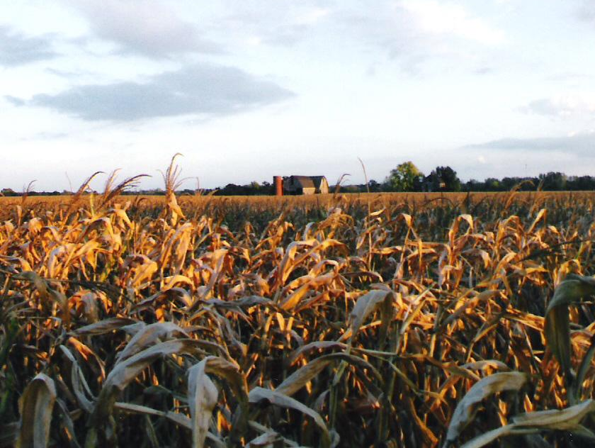



2025 Action Plan Public Hearing #1
State of Indiana
February 10, 2025
Presented by
Cheri Colter, Root Policy Research
Lucy McGehee, Root Policy Research

Slide 2
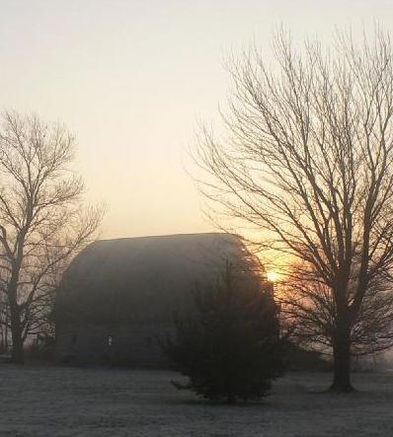
Agenda
Introductions
Overview of Consolidated Plan
Your input on 1) top needs and 2) funding priorities

Slide 3
Introductions
Who we are and how to reach us:
Root Policy Research, hello@rootpolicy.com (970) 880-1415. Send us public comments.
Pamela Guerrero, PGuerrero@ocra.IN.gov. Contact Pamela about CDBG.
Stephen Enz, IHCDA, SEnz@ihcda.IN.gov. Contact Stephen about HOME and HTF.
Kristin Garvey, KriGarvey@ihcda.IN.gov. Contact Kristin about ESG and HOPWA.

Slide 4
Introductions
To ensure that everyone in attendance has a chance to voice their opinion, thoughts, and comments:
We will call on all attendees to see if they have any comments after the presentation.
You may share comments verbally (keep to 2 minutes), in the chat, or through interactive exercises. Please participate in the way that works best for you,
If you have very detailed comments about programs, or more to say, please contact one of us by email. This will give everyone an equal chance to voice their comments.

Slide 5
2025 Consolidated Plan
Public Hearing #1
Purpose is to collect your input on top housing and community development needs!

Slide 6
Funds Covered
This Plan will be the start of a new 5-year Consolidated Plan, to be submitted May 15* pertains to specific HUD funding programs:
  Community Development Block Grant (CDBG)
  HOME Investment Partnerships Program (HOME)
  Emergency Solutions Grant Program (ESG)
  Housing Opportunities for Persons with AIDS (HOPWA)
  Housing Trust Fund (HTF)
*Submittal may be delayed by federal budget processes.

Slide 7
The 2024 funding will be the starting point for 2025 funding assumptions. 2025 funding amounts are not yet known and could be significantly different from 2024. OCRA and IHCDA will provide information on their planned activities once 2025 allocations are known.
2024 Funding Amounts
CDBG $30,000,000
HOME $14,000,000
ESG $4,000,000
HOPWA $2,000,000
Nat’l Housing Trust Fund $3,000,000
Total $53,000,000

Slide 8
Past (2020-2024) Consolidated Plan Goals
Do these goals still apply for 2025-2029?
Goal 1. Broaden housing choices in Indiana by facilitating the development of affordable rental and ownership housing and preserving existing affordable homes.
Goal 2. Reduce homelessness and increase housing stability for special needs populations.
Goal 3. Equip Indiana’s cities and towns with the infrastructure needed to stimulate and maintain thriving economies.
Goal 4. Address gaps in public infrastructure and services that arise as the needs of residents' change.
Goal 5. Build capacity of rural leadership.

Slide 9
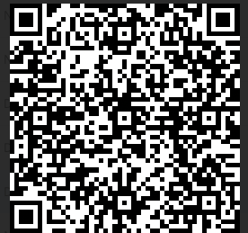

Please Participate in the Survey!
Take the survey at:
www.surveymonkey.com/r/IndianaHousingandCommunitySurvey2025
The survey will remain open until March 15, 2024
Share widely!

Slide 10
Your Input
In your area of the state, what are the top housing and community development needs?
What do you hope the plan will address?
How would you prioritize funding during the 5 year period?
Do you have questions about how to get involved, access the plan, or comment?

Slide 11
Contact us!
How to reach us:
Root Policy Research, hello@rootpolicy.com (970) 880-1415. Send us public comments.
Pamela Guerrero, PGuerrero@ocra.IN.gov. Contact Pamela about CDBG.
Stephen Enz, IHCDA, SEnz@ihcda.IN.gov. Contact Stephen about HOME and HTF.
Kristin Garvey, KriGarvey@ihcda.IN.gov. Contact Kristin about ESG and HOPWA.

