Slide 1

Questions? Email us at cdbg@ocra.in.gov
2025 Action Plan
Changes 2025 Quarter 4
Agency under the Office of Lieutenant Governor Micah Beckwith
Notes:
Hello there, my name is Armica Bash Gaspar, and I’m going to go over the recent changes that have been approved for the 2025 Action Plan for the Planning program and the Owner-Occupied Rehabilitation program.

Slide 2
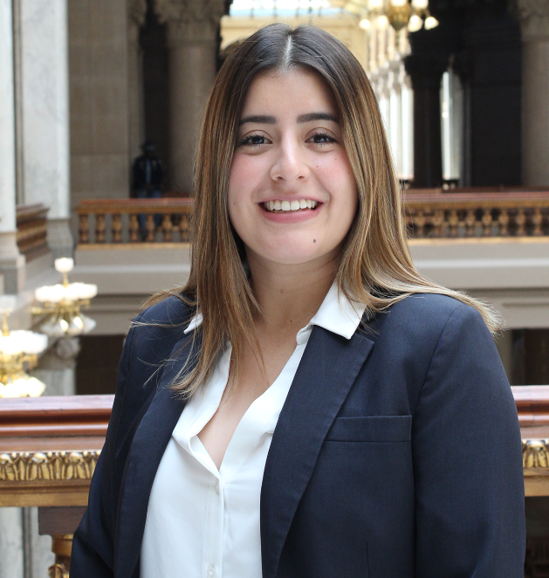
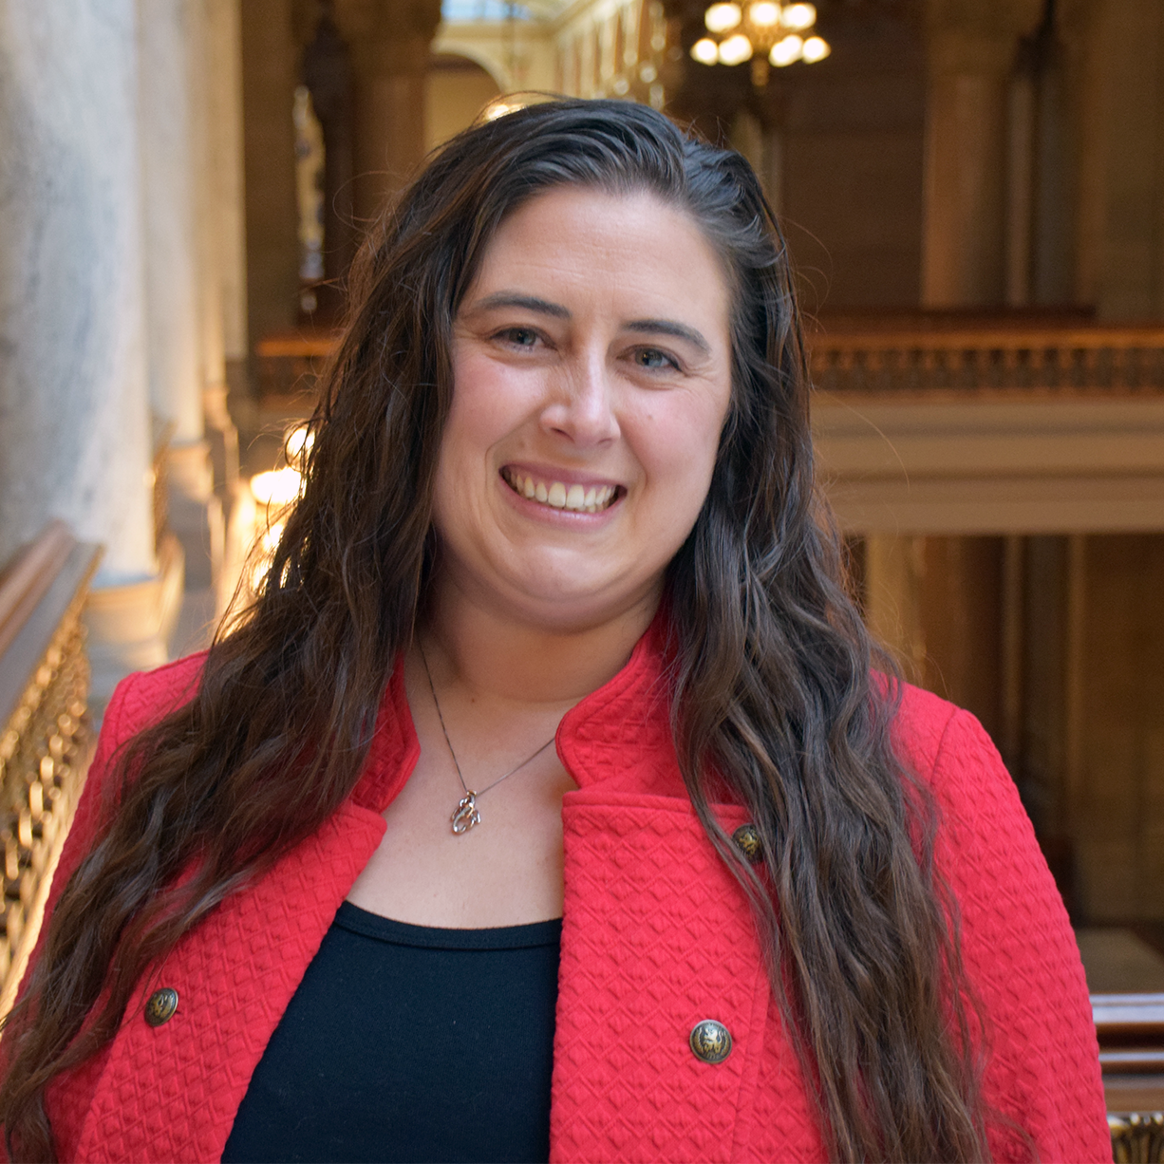
Pamela Guerrero
Senior CDBG Program and Policy Analyst
Tanaha Simon
CDBG Program Manager
Notes:
Tanaha

Slide 3
2025 Action Plan Goals
2025 Planning and Owner-Occupied Rehabilitation Timeline
Revised Application Requirements
Program Changes: Bonus Points
Resources
Q&A
Next Steps
Agenda
Notes:
Tanaha

Slide 4
Action Plan 2025 Goals
Goal 1 - Improve community water, wastewater, and stormwater
Goal 2 - Support community revitalization and historic preservation
Goal 4 – Create and maintain affordable houses for owner-occupants
Goal 3 - Provide planning grants to local governments
Goal 5 – Foster community resilience through grant programs
Notes:
Tanaha
Goal #4 – to support aging in place and accommodate disability requirements – OCRA/IHCDA

Slide 5
2025 Planning and Owner-Occupied Rehabilitation Quarter 4 Timeline
Oct 14
Q4 Application Opens
Oct 31
Pre-Approvals Due
Nov 14
Q4 Application Due
Dec 18
Q4 Grant Award Announcement
Notes:
Here are some key dates for 2025 to be aware of going into the next quarter or the Planning and Owner-Occupied Rehabilitation programs.

Slide 6

CDBG Programmatic Policies Changes

Slide 7

The following policies went into effect on September 1, 2025. Prior to their implementation, they were posted for a 30-day public comment period on the CDBG Policies Website.
CDBG Policy Notice 2025-002 Project Overdue Policy
CDBG Policy Notice 2025-003 Income Survey Policy
CDBG Policy Notice 2025-004 In-Kind Contribution Policy
CDBG Policy Notice 2025-005 Housing Projects Programmatic Policy
Now available on the CDBG Policies Website
Notes:
Pame

Slide 8
CDBG Policy Notice 2025-002 Project Overdue Policy
This policy revised the established OCRA's overdue policy for CDBG funded projects to ensure timely project completion.
Projects listed on the CDBG Project Timeliness Report are ineligible for funding unless the unresolved issue is addressed.
To avoid listing on the CDBG Project Timeliness Report:
  Submit closeout requests in GMS by the project’s assigned completion date (not the grant expiration date).
  Address unresolved findings within 30 days of notification.
  Submit all required reports (including sub-recipient and semi-annual) on time.
  Meet administrative deadlines (e.g., ER, ROF, Pre-ROF) or request extensions before the deadline. Late extension requests will not be accepted.
Notes:
Pame

Slide 9
CDBG Policy Notice 2025-002 Project Overdue Policy
Monthly Reporting Requirements
Projects on the CDBG Timeliness Report must submit monthly progress updates via GMS using the Status Report feature.
Reporting continues until the overdue status is resolved.
Projects become ineligible immediately upon overdue status—even if not yet listed publicly.
Submission Procedures & Communication
If progress is lacking, further corrective actions and findings may be issued.
Notifications sent to the Chief Elected Official and Grant Administrator detailing overdue status and required actions.
The Timeliness Report is publicly accessible and updated monthly on OCRA’s website.

Slide 10
CDBG Policy Notice 2025-003 Income Survey Policy
This policy updates the previous CDBG Policy Notice 2024-005 and It outlines new requirements for conducting income surveys, revises documentation standards, and sets a timeline for resubmission if the final LMI percentage is unsuccessful.
Income Survey Process Considerations
Communities must demonstrate a combined LMI percentage and margin of error (MOE) of at least 40% to be considered. The justification letter must meet the minimum standards in order to be considered for review.
MOE must not exceed 10%; if lower per ACS data, the lower value must be used.
Requesting an Income Survey Process
The request must be submitted via GMS and include a justification letter outlining the service area, current LMI %, MOE and a detailed map.
Denials reasoning is provided via GMS and email
Notes:
Pame

Slide 11
CDBG Policy Notice 2025-003 Income Survey Policy
Step 2 – Pre-Income Survey Data
The following documentation must be uploaded to GMS: the master population list, the randomized sample list, the Excel sheet calculator (CDBG Income Survey Toolkit), and the income limits used for the assessment
Step 3- Final Survey Submission
After the pre-income survey data is approved, the local government must complete the collection of survey data and submit the final survey results within 90 days of OCRA's approval. The survey collection period ends once the final LMI percentage is calculated.
The following documentation must be uploaded to GMS: the final surveys, Appendix D (income survey certifications signed by the Chief Elected Official and the grant administrator), and the list of households that were contacted, regardless of whether they responded or not

Slide 12
CDBG Policy Notice 2025-003 Income Survey Policy
Resubmission After a Failed Survey
If final LMI percentage is below 51%, resubmission may be allowed with stronger evidence.
Must include a new justification letter citing recent changes (e.g., population, economy).
Requires:
  Larger sample size
  95% confidence level
  Updated data supporting the need for a new survey
Resubmission allowed only after 180 days ) from the date the final income survey results are submitted in GMS.

Slide 13
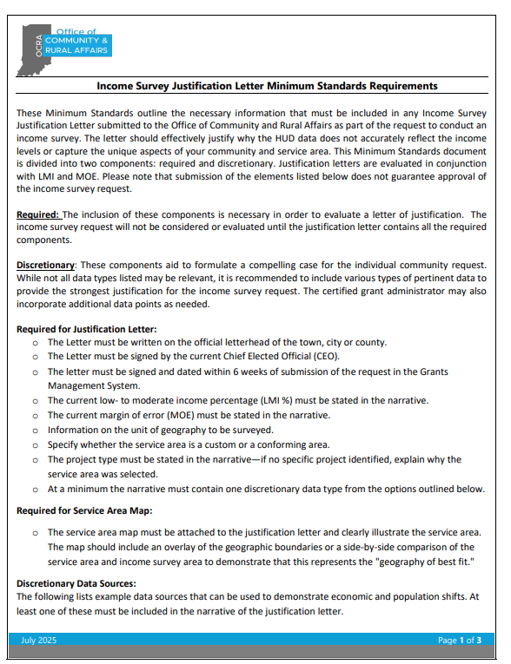
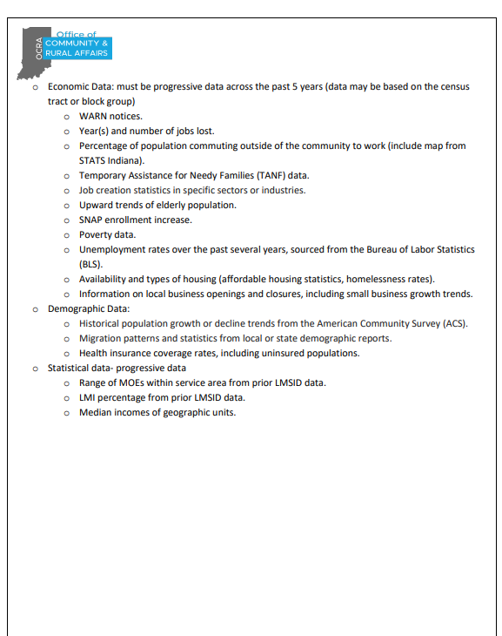
Income Survey Minimum Standards
Now available on the CDBG Resources Website : Income Survey Justification Letter Minimum Standards Requirements
Notes:
Pame

Slide 14
CDBG Policy Notice 2025-004 In-Kind Contribution Policy
This policy establishes procedures for eligible non-entitlement applications to include in-kind contribution as part of their required local match.
Defines acceptable in-kind options: Force Account Work, Volunteer Labor, and In-Kind Donations (items or administrative services).
Applies to all CDBG programs unless otherwise specified.
The Chief Elected Official (CEO) must formally request approval from OCRA to use in-kind contributions. In OCRA's required template and form.
Approval must be obtained from CDBG Program Manager before including in-kind contributions in the grant application budget.
Notes:
Pame

Slide 15
CDBG Policy Notice 2025-004 In-Kind Contribution Policy
In-Kind Contribution Limits
Total in-kind contributions (Force Account, Volunteer Labor, and Donations) are capped at:
5% of the grant amount, or
$25,000, whichever is lower.
OCRA approval is required before including these contributions in the budget.
The approval letter must be attached to the grant application.

Slide 16
CDBG Policy Notice 2025-004 In-Kind Contribution Policy
Types of In-Kind Contribution & Request Process
Force Account Work
Work performed by regular government employees at their standard pay rate.
Must comply with Indiana Code IC 36-1-12-3.
Request letter must include:
  Description of services
  Estimated hours and pay rates
  Proof of employment
  Tracking commitment
  Match amount calculation
If approved, grantees must document hours worked in the required format.

Slide 17
CDBG Policy Notice 2025-004 In-Kind Contribution Policy
Types of In-Kind Contribution & Request Process
2) Volunteer Labor
Unpaid professional or technical services by individuals not employed by the project’s political subdivision.
Valued at $15/hour, regardless of task.
Request letter must include:
  Type of work
  Estimated hours
  Tracking commitment
Must include a signed volunteer letter detailing:
  Work description
  Estimated value
  No compensation statement
Grantees must submit a pre-approved volunteer list before work begins.

Slide 18
CDBG Policy Notice 2025-004 In-Kind Contribution Policy
Types of In-Kind Contribution & Request Process
3) In-Kind Donations (Items or Administrative Services)
Donated goods or services valued at cost. (grant administration services are eligible services that can be donated)
Request letter must include:
  Description and cost of donated items/services
  Match amount calculation
  Donor commitment letter
For land donations:
  Must include fair market value appraisal and URA documentation.
  Donations from parties with financial or ownership interest in the project are ineligible.

Slide 19
CDBG Policy Notice 2025-005 Housing Projects Programmatic Policy
Overrun Fees
Local governments are authorized to use local funds to cover overrun fees incurred in connection with housing projects, provided that such local match funds originate from non-federal sources. The intent to use local funds as match and for overrun fees must be publicly disclosed by the local government at a public hearing prior to the submission of any application.
Professional Service Contracts
All professional service contracts related to the program must be executed directly with the local government. The Office of Community and Rural Affairs (OCRA) will not authorize or accept the use of subcontracts for professional services under this policy.
Environmental Review Costs: All environmental review costs associated with a housing project must be fully accounted for and included prior to the initiation of any rehabilitation activities. Costs related to radon and lead assessments or mitigation must be included within the $25,000 maximum cap established for housing projects. Any remaining funds within this cap may be allocated to rehabilitation activities.
Conflict of Interest
No publicly elected official shall benefit, either directly or indirectly, from participation in a local owner-occupied housing rehabilitation program while holding office. This provision is intended to prevent any perceived or actual conflict of interest.
Notes:
Conflict of interest relates to publicly elected officials and their immediate family

Slide 20
Changes to CDBG Programmatic Year 2025

Slide 21

Application Process-Intent to Apply
Planning and Owner Occupied Rehabilitation programs will now be occurring in three (3) rounds beginning in the 2026 calendar year. 2026 CDBG calendar will be released in the coming months.

Slide 22
General Selection Criteria
At the time of application submission, an applicant must not have more than three (3) open CDBG grants or pending awards (for cities and incorporated towns) or four (4) open CDBG grants or pending awards (for counties)
For applicants with an open Preserving, Stellar or any other capacity building program as stipulated by OCRA must have closed out the grant successfully before the deadline set by OCRA for receiving funding applications.

Slide 23

Application Process-Intent to Apply
Intent to apply must be submitted to the Community Liaison and cdbg@ocra.in.gov for both OOR and Planning Programs

Slide 24
Overdue Status
At the time of the application submission, the applicant must not have any overdue documents or outstanding semi-annual reports, closeout reports, State Board of Accounts audit findings, or unresolved monitoring issues from OCRA/IHCDA. The determination of what constitutes “overdue” is entirely at the discretion of the Indiana Office of Community and Rural Affairs.
Applicants must verify their overdue status in the CDBG Project Timeliness Report on the CDBG webpage, which is updated monthly.

Slide 25
Reminders: QBS Planning Procurement Policy
In accordance with OCRA’s QBS Planning Procurement Policy, procurement of professional services for the planning study must be completed before submitting the planning grant application.
All documentation related to this process must be included with the application.
Procurements will remain valid for 12 months from the completion date. After 12 months, the procurement will be considered expired and must be conducted again to reapply for CDBG funding. Please be advised that the procurement process can take up to 45 days.

Slide 26
Revised Instruction Format
The format of the application instructions have been updated to ensure that key dates and important information are clearly highlighted.
These revisions are intended to make the document more user-friendly and easier to navigate.

Slide 27
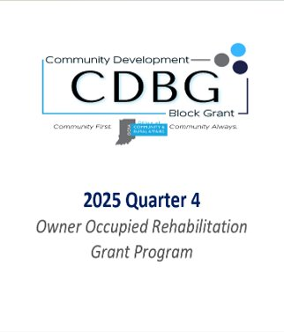
Revised Instruction Format

Slide 28
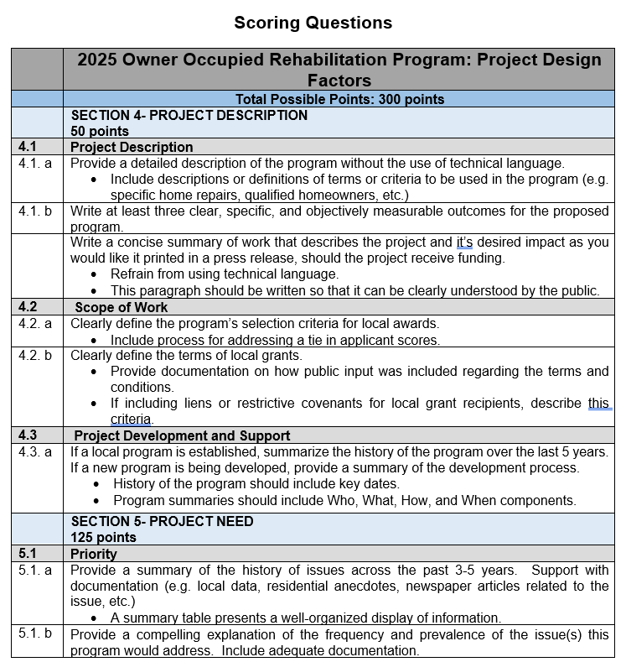
Revised Project Design Factors

Slide 29
Bonus Points-all programs
Applicants may be eligible to receive up to 40 points for the following criteria.
Community Resilience Index: Grant application will receive a maximum of 25 points for the submission of a community resilience vision plan, and their corresponding point awarded value from the Community Resilience Index as provided by Stats Indiana
Designated Disaster Areas: Communities designated as disaster areas with a Presidential Disaster within the last three years from round opening, which have been approved for individual assistance and public assistance categories A-G, are eligible to receive an additional 15 points if documentation is provided.

Slide 30
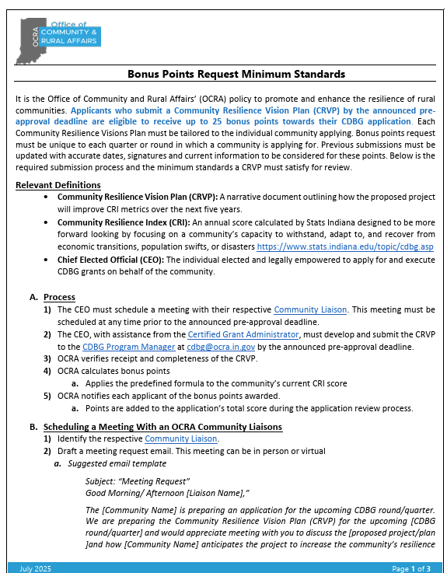
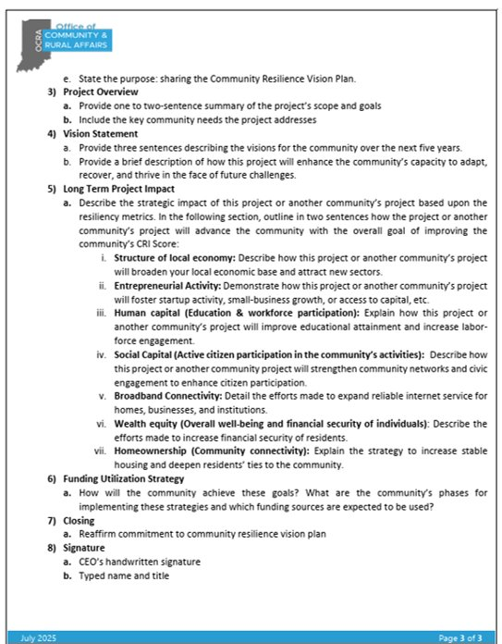
Bonus Points: Community Resilience Index
Now available on the CDBG Resources Website :Bonus Points Community Resilience Index Request Minimum Standards
Notes:
Armica
The bonus points for community resilience index has a document that outlines the minimum requirements. We encourage you to read this entire document so you can guide yourself through them. You can find this resource on the CDBG resources webpage on our website. The link is provided in this slide for your convenience.

Slide 31
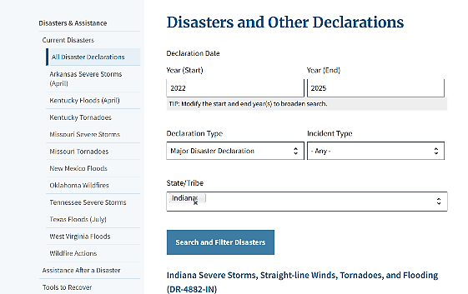
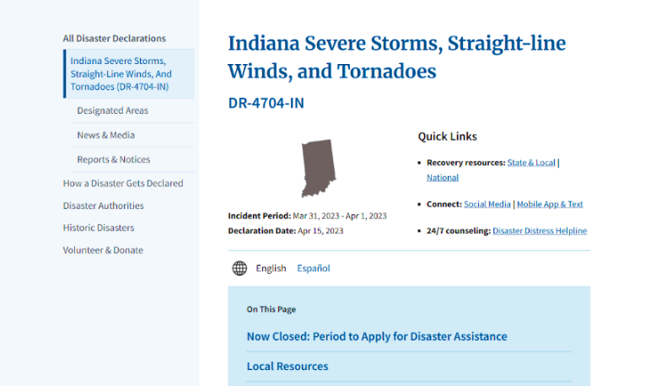
Bonus Points: Designated Disaster Areas
To be eligible for these points, applicants must provide documentation from FEMA
The following are the available resources to verify and provide the adequate documentation
  Step-by-Step Guide to Navigating the FEMA Declarations Portal
  Confirming Individual Assistance and Public Assistance Category Designations
Now available on the CDBG Resources Website : Bonus Points Designated Disaster Areas Step by Step Guide
Notes:
Armica
The bonus points for the designated disaster areas has resources on the webpage as well, along with a step-by-step guide. You must provide documentation from FEMA. We encourage you to utilize this guide to ensure you meet all the requirements to be eligible for these points.

Slide 32
Changes for Planning Program Year 2025

Slide 33
National Objective
Planning
Low-to Moderate-Income: Area Basis
100 points maximum awarded according to the percentage of low– and moderate-income individuals to be served by the project. The total points given are computed as follows:
NO= % Low/Mod Beneficiaries x 1
Prevention or Elimination of Slums or Blight
100 points maximum awarded based on the characteristics listed below.
Applicant has Slum/Blight Resolution for the project area that is no more than 10 years old. (50 pts.)
The project site is a brownfield (10pts)
The building or district is listed on or is eligible for listing on the Indiana or National Register of Historic Places (10 pts)
The building is on the Historic Landmarks Foundation of Indiana’s “10 Most Endangered List” (20 pts)
The building is historical building (10 pts).

Slide 34
Changes to Planning Program Year 2025:
Local match was reduced from 10% to 8%
Administrative fees were changed from 8% of total project cost to a set fee of $7,000 for any planning type.
A new planning type was added:
Single Utility Study $30,000
Two Utilities Study $60,000
Three Utilities Study $90,000
Notes:
The planning program supports communities’ housing development needs and facilitates the proactive resilience building through the planning program.
Instead of having the communities match 10% of the total program cost, we decided to lower that match to 8% so the communities would have a better chance to provide that lower match percentage.
On that same note, Administrative fees were 8% of the total project cost. Due to the feedback we heard from some of you, we decided to change the fee to a flat rate of $7,000 for any planning type.
When we went over the agenda for today, you heard about a new planning type that was added. It was a single utility study. You are now able to do a single utility study for the maximum amount of $30,000. The two-utility study and three utility study will remain at their max amounts of $60 and $90,000.

Slide 35
Planning Types Available
Plan | Maximum Grant Amount | Local Match Requirement
Master Utility Study | $90,000 | 8%
Two Utility Study | $60,000 | 8%
Single Utilities Study | $30,000 | 8%
Comprehensive* | $60,000 | 8%
Economic Development | $40,000 | 8%
Broadband | $70,000 | 8%
Public Facilities | $20,000 | 8%
Environmental Assessment | $20,000 | 8%
Historic Preservation | $20,000 | 8%
Downtown Revitalization* | $40,000 | 8%
COVID-19 Economic Recovery | $50,000 | 8%

Slide 36
Minimum Planning Requirements
All planning studies must fulfill the minimum planning requirements established by the Office of Community and Rural Affairs (OCRA).
To review the minimum planning requirements, please visit https://www.in.gov/ocra/cdbg/planning-grants/

Slide 37
Active Minimum Planning Requirements
MPR 2018-001 Broadband Readiness Plan
MPR 2018-002 Economic Development Plan
MPR 2018-003 Environmental Assessment Plan
MPR 2018-004 Historic Preservation Plans
MPR 2018-005 Feasibility Studies
MPR 2020-001 Comprehensive Plan
MPR 2020-002 COVID-19 Economic Recovery Plan
MPR 2020-003 Utility Study Plan
MPR 2023-001 Downtown Revitalization Plan

Slide 38
Program Specific Points
Total Possible Points: 50 points
Supplemental Input and Community Engagement – A maximum of 25 points will be awarded to communities that exceed the basic requirements of submitting letters of support, surveys, and holding two public hearings to document public engagement and input. These additional points recognize those that demonstrate meaningful public engagement and collaboration, indicating they took additional steps to solicit feedback from the community. This can involve activities such as community workshops, promotion, meetings with key stakeholders, citizens participation in committees and other methods to ensure broad participation towards the community’s application process.
Connection to Previous Planning Efforts and Implementation – A maximum of 25 will be awarded to communities that effectively demonstrates their engagement with previous planning initiatives. This includes providing documentation indicating how the current plan relates to a previous planning effort of the community applying or documenting the successful execution of a previous planning grant.

Slide 39
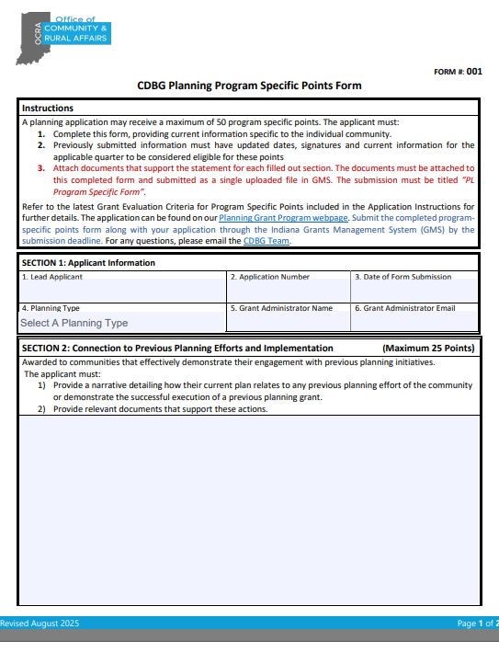
Program Specific Points Form
Applicants must use the Form PL-001 CDBG PlanningProgram Specific Points in order to receive points for this section
Notes:
Armica
The bonus points for the designated disaster areas has resources on the webpage as well, along with a step-by-step guide. You must provide documentation from FEMA. We encourage you to utilize this guide to ensure you meet all the requirements to be eligible for these points.

Slide 40
Changes for CDBG Owner-Occupied Rehabilitation Program Year 2025

Slide 41
National Objective
Owner Occupied Rehabilitation
Low-to Moderate-Income: Housing
100 points maximum. Documentation of the income verification form to be used is required to qualify for these points.
Properly update the form with Community related information including contact person and income levels.
Form OOR-002 Homeowner Application Packet

Slide 42
Program Specific Points
Total Possible Points: 50 points
Green Infrastructure (10 points): A maximum of 10 points for the inclusion of green infrastructure elements in the project.
Targeted Populations (25 points): A maximum of 25 points will be awarded to applicants whose program design parameters prioritize funding assistance to households that belong to at least one of the targeted population groups
New Administrator Experience (15 points): A maximum of 15 points will be awarded to applicants who are working with administering entities who can demonstrate prior experience in construction management, rehabilitation of built structures, and/or prior CDBG OOR experience through a different funding agency. Applicants must provide a written narrative explaining previous relevant experience and a third-party reference of experience in the above-mentioned fields to receive these points.
Applicants must use the Form OOR-001 CDBG Owner Occupied Program Specific Points to receive points for this section.

Slide 43
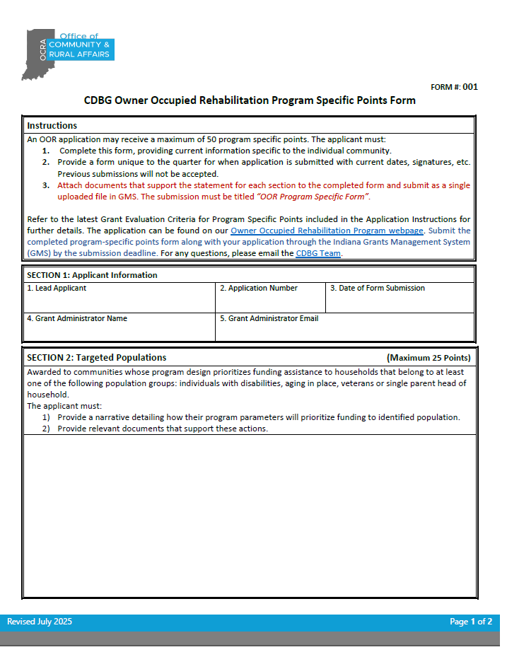
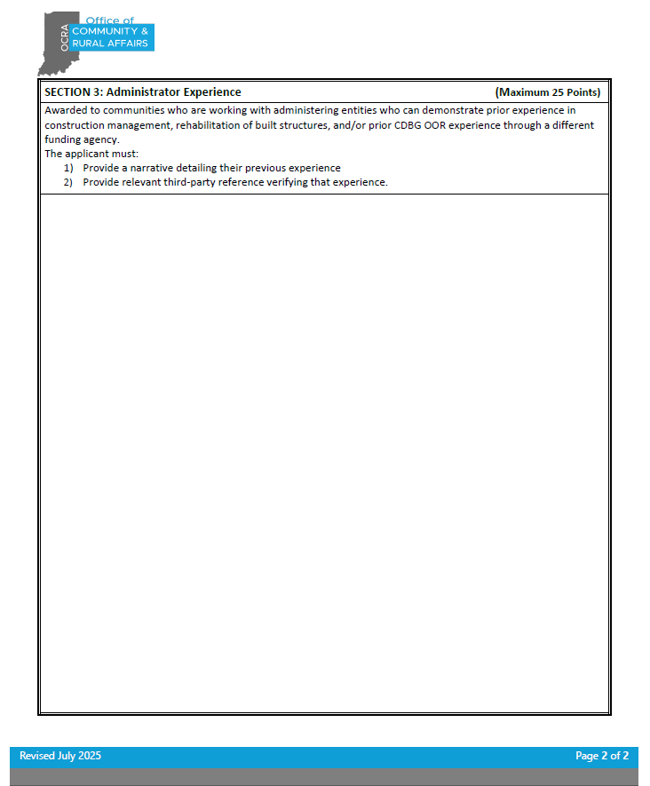
Program Specific Points
Notes:
Armica
The bonus points for the designated disaster areas has resources on the webpage as well, along with a step-by-step guide. You must provide documentation from FEMA. We encourage you to utilize this guide to ensure you meet all the requirements to be eligible for these points.

Slide 44
Questions and Answers
Will the website be updated to reflect these changes prior to 2025 Quarter 4 opening?
Yes! And so will the one pagers for each affected program.
Will the new program specific points form be required for all submitted program specific points?
Yes! Forms are available on the CDBG Resources webpage under "Program Specific Tools"
Yes, We will update GMS to the greatest extent possible.
Application as well as scoresheets are on the docket to be updated.
What are the dates for 2026 quarters?
Stay tuned!
Is GMS going to be updated?
Note that all programs are moving to rounds in 2026. The schedule for OOR/Planning in particular may be different than last year.
As soon as dates are confirmed, the OCRA website calendar will be updated.
Notes:
Tanaha

Slide 45

Next Steps
Watch the webinar reviewing quarter 4 updates
Read 2025 quarter 4 instructions once posted
Read New Policies & related materials on our website
  Bonus Points
  In Kind Policy
  Project Timeliness Report Policy
  Income Survey Policy
  Housing Projects Policy
Notes:
Tanaha-

Slide 46

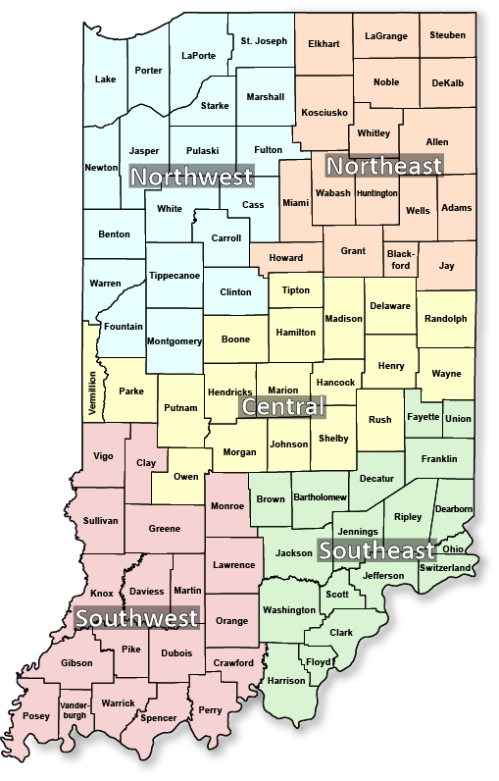
Stay connected!
Sign up for press releases and announcements at bit.ly/OCRA-signup
Find your regional Community Liaison’s contact information:
here
Notes:
If you haven’t signed up for email updates regarding some of the information you’ve learned today, please follow the link. If you need to get in touch with your community liaison, their link is available as well.

Slide 47

Questions?
Contact: cdbg@ocra.IN.gov
Follow us on social media @IndianaOCRA
Notes:
If you have any questions, you can email me at the CDBG email address. Thanks for listening and have a great rest of your day.

