Slide 1
E-rate Category 2
Danielle Smith, Account Mgr| danielle.smith@zayo.com
Joe Quigley, Account Mgr| joe.quigley@zayo.com

Slide 2
Introduction
ENA now Zayo Edu – With ISL since 2006
Account Manager Background and Coverage
Budget cuts and the search for savings
Category 2 traditionally underutilized
Helping our customers find savings and funding
Telecom spend – eliminate copper costs
Category 1 – hosted firewall to preserve Cat 2
Category 2 – managed and leased options

Slide 3

E-rate Categories – What’s the 1 and 2 thing?
Universal Service Administrative Co. (USAC)
Administers Universal Service Fund (USF)
E-rate is one pillar – RHC, Lifeline, High Cost
E-rate Category 1 – connectivity services, referred to as “Data Transmission” and “Internet Access”. Voice deprecated in 2016. Hot spots are no longer on the menu.
E-rate Category 2 – network infrastructure like switches, firewalls, cabling, wireless access points.

Slide 4
E-rate Funding Basis
Discount is based on the local school district % which is based on free and reduced lunch. Up to 90% in some districts.
Category 1 – fully funded*
No more library broadband grant
No more state matching funds for fiber build
Category 2 - budget based on building size
New 5 yr starts this year – 2026-2030
Was $4.50 sq ft, now it is $5.43
Funding floor is $30,175 (approx 5,600 sq ft)

Slide 5
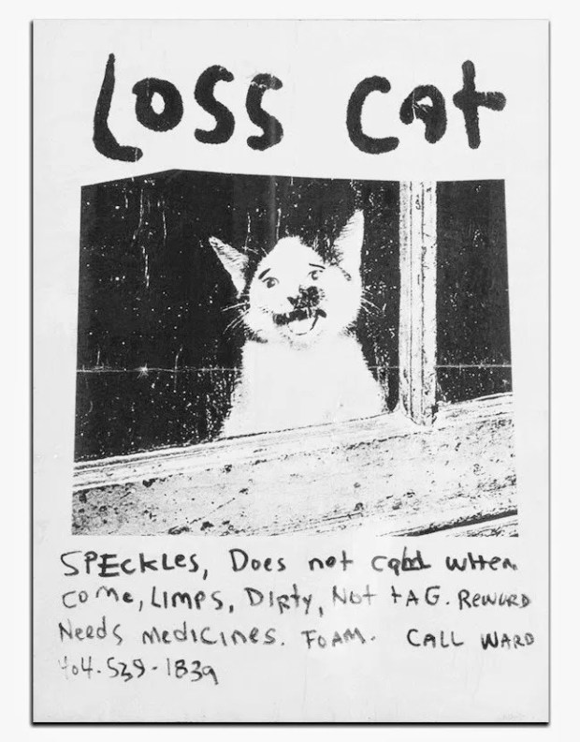
Find Your Cat 2 Budget on USAC Website
USAC.org >>> E-rate >>> Tools
Category 2 Budget Tool
Example search time!
Also found on your EPC account along with discount%

Slide 6
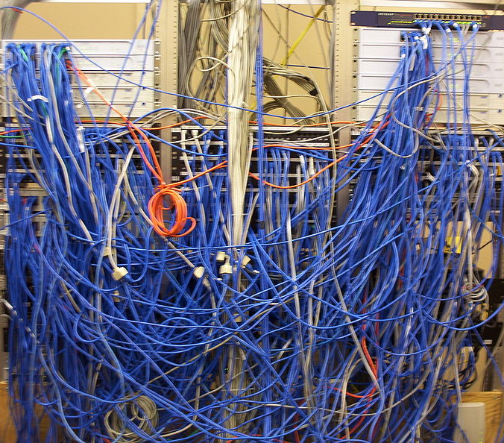
Category 2 – Product and Design Aspects
Not widely used – past experiences?
Redundancy bad - Resiliency good
Active traffic required – no spares
Eligible services list
IC, BMIC, and MIBS “flavors”
Ship us boxes, we got this – IC
Come help us get this implemented and we’ll take over – BMIC
I need you to cover the install and ongoing management – MIBS
Leased or Existing?
Firewall madness – basic firewall eligibility and limitations

Slide 7

Pre-filing Considerations
You get one bite at the apple every 5 years. Plan accordingly.
Your E-rate consultant is great at E-rate
Request vendor meetings in the summer
Vet the product, vet the vendor
Allow vendors to register deals
Explore budgetary possibilities
Help eliminate “gotchas”
Develop your RFP ask, before and after!
Great technology doesn’t overcome poor design

Slide 8

E-rate Cat 2 470 Filing Considerations
“Timing is everything” – or – “If you want it bad, you get it bad”
Provide ample time for competitors to produce their best bid response
Site visits should reset the timer – provide 28+ days past the date.
Engineering, Quoting, Finance, Bid response, Approval/Review
‘Tis the season…for vacations
Avoid skeleton crews!

Slide 9

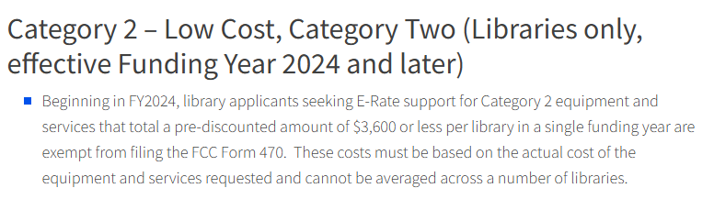
Competitive Bidding Exemption, or “Point of Diminishing Returns Diminished!”
No need for a 470 bid for smaller libraries to do big things or big libraries to do smaller things
“MIBS Leased” increases project cost potential – 25K sq ft
You will need to file an E-rate form 471
SPIN to win!

Slide 10

How is the funding received?
File a 471 – often handled by E-rate consultant
Libraries filing directly need EPC, Contract, FRN
Guidance available by Zayo for Zayo contracts
SPI or BEAR?
SPI – vendor requests funding from USAC, invoices library for non-eligible amount
BEAR – library pays vendor full amount and requests reimbursement from USAC

Slide 11
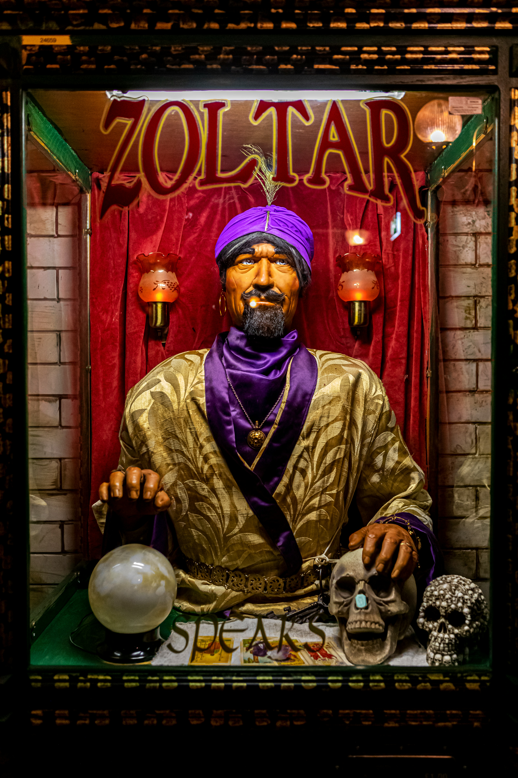
What does the future hold? Cybersecurity?
Current Cybersecurity Pilot through 2028
A little didn’t go a long way - $200M over 3 years
Expansion of the eligible services list?
Keep in mind if facing multi-year contract renewal
How to expand funding?
Redistribute USF funding base. In this timeline?

Slide 12
Example 1 – New Managed Network
Example 2 – Hardware Purchase - UPS
Budget assessment and equipment lifecycle
Vendor meeting
Provide details for quote
CAPEX or OPEX?
Quote review – bid or not to bid?
Bid route -
Budget assessment and equipment lifecycle
Vendor Quote request
Quote review – bid or not to bid?
Assess Comp Bid Threshold
No bid – award, get SPIN
Vendor only does BEAR

Slide 13
Q&A Thank you!

