Slide 1
Federal Government Websites for Kids
Kimberly Brown-Harden, Federal Document s Librarian, Indiana State Library

Slide 2
How can federal documents help me??
Federal documents are more than just dusty, old books in the library.
Federal documents are books, comic strips, posters, magazines, CD-ROMS, and newsletters.
Federal documents can help you buy a car, house; can help you get student loans; can help you find a job; can help you live a healthy lifestyle; help you save and spend money wisely, and many other ways to help you and your family.
Federal documents can help you learn about our country and how laws are made.
Want to know more???!!!

Slide 3
Federal Documents: then and now:
Federal Land Patent, 1824:
Federal documents can be found on laptops, Smartphones, etc.

Slide 4
Websites!

Slide 5
The federal government has websites for a variety of topics and issues:
Kids.gov:
http://kids.usa.gov/: This site has interesting facts, games, and resources for a variety of age groups. This is a one-stop shop for a lot of topics: math, science, money, music, etc. There’s also a section for teachers and parents to help teach government sources to students and children.

Slide 6
Kids.gov Arts:

Slide 7
Ben’s Guide
http://bensguide.gpo.gov/3-5/index.html. If you want to learn about government, how laws are made, how our President and Congress get elected, and facts about the United States-you can find that here. In addition to information, there are games and activities for different ages and skill levels!

Slide 8
Ben’s Guide Games:
Find the Map game
Interactive games

Slide 9
Government and Civics:
Kids in the House: http://kids.clerk.house.gov/. This site is provided by the Clerk of the U.S. House of Representatives. You can learn the history of the U.S. Government; notable, fun facts; and how laws are made in this country. The site has information for young learners, grade school, middle school, and high school-something for everybody!

Slide 10
Information for middle and high school learners:
Interactive tour of the House Chamber
Black Americans in Congress:

Slide 11
There’s More!
h.i.p. pocket change: http://www.usmint.gov/kids/collectorsClub/. Website teaches about money, how money is made, and the history of the U.S. Mint. You can also learn about coins from the U.S. and other countries. There are also games and cartoons to make learning about money less painful!

Slide 12
Cartoons about the U.S. Mint:

Slide 13
TreasuryDirect Kids:
http://www.treasurydirect.gov/kids/kids.htm
This site teaches about debt, bonds, history of the treasury, and games on how to save money.

Slide 14
Interactive History of the Savings Bond:

Slide 15
Health and Fitness!
Let’s Move: http://www.letsmove.gov/kids. This initiative was started by First Lady Michelle Obama to combat obesity and encourage healthy eating and physical activity. You can get recipes, and other healthy tips and resources such as planting a garden! You can also check out contests like the ‘Kids State Dinner’ and ‘Winning lunch recipes’ from young people all over the United States.

Slide 16
Let’s Move!

Slide 17
President’s Council on Fitness, Sports, and Nutrition:
http://www.fitness.gov/. Learn about healthy eating, exercise, physical activity guidelines, and other tips and resources to help live a healthy lifestyle. You can also get stories and inspiration by reading others’ stories about physical activity and how to fit it into your routines.

Slide 18
Be Active!

Slide 19
Health, Wellness, Safety:
Centers for Disease Control and Prevention: http://www.cdc.gov/healthyyouth/healthtopics/index.htm. Many people only think of the CDC when there’s a public health crisis such as bird flu, food recalls, etc. The CDC has a page dedicated to the concerns/issues of young adults, such as: STD’s/Pregnancy, young worker safety and health, and spotlights on special topics such as LGBT youth, etc.

Slide 20
CDC Page for Adolescents:

Slide 21
Education
United States Department of Education: http://www.ed.gov/. This website has information and resources for parents, families, teachers, and young adults. You can find out the current issues in education by reading their blog; learn about getting money for college; and learn about colleges to find out which one has the degree you want and how to apply.

Slide 22
College Resources:
College Navigator:
Money for college:

Slide 23
JOBS!
USAJobs: https://www.usajobs.gov/StudentsAndGrads. Looking for jobs? This is the place for you. You can search this site to look for government jobs by city and by college major. You can also look for a list of government agencies and volunteer opportunities to get valuable experience before getting into the workforce.

Slide 24
USA Jobs for recent graduates:

Slide 25
Career Information:
Bureau of Labor Statistics:
http://www.bls.gov/k12/index.htm. Are you thinking about what kind of job or career you want? Here’s a good place to start! You can click on any subject area and the Bureau of Labor Statistics has suggested occupations that may match your interest. There’s also information such as average salaries, educational requirements, skills required, etc.

Slide 26
Possible Careers???!!!

Slide 27
Product Safety and Consumer protection:
Federal Trade Commission: http://www.ftc.gov/bcp/edu/microsites/youarehere/. The Federal Trade Commission protects consumers from deceptive or unfair business practices. The FTC helps to keep customers informed and helps us to understand the competitive process. You can also learn how to spot scams, how to protect your privacy, and many other important issues and concerns to protect your money.

Slide 28
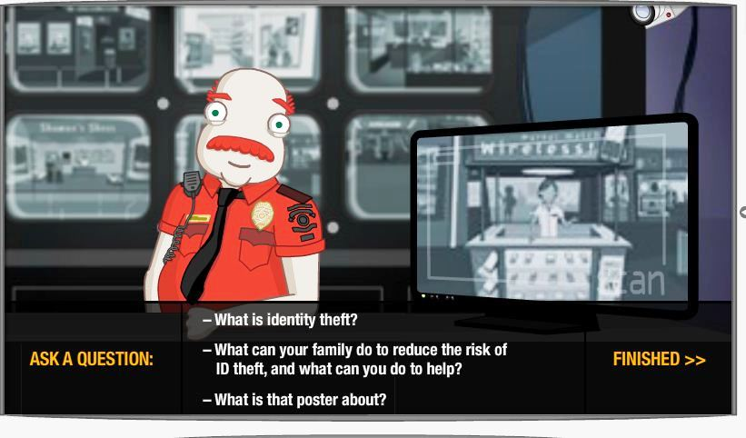
You Are Here!
Identity Theft:

Slide 29
Library of Congress:
http://www.americaslibrary.gov/index.html. America’s Library, the Library of Congress, provides a wide range of topics and information for people of all ages. You can learn about American history, famous Americans, the states, etc. There’s also a site, read.gov., which highlights books and stories for young readers.

Slide 30
America’s Library:
Games!
Fun Facts!
Dynamite Presidents:

Slide 31
Read.gov:

Slide 32
USDA for kids:
http://www.usda.gov/wps/portal/usda/usdahome?navid=FOR_KIDS. USDA kid’s site provides information for kids, parents, and teachers about agriculture. You can learn about science, nutrition, gardening, nature, weather, animal health, etc. There are games and other fun facts and resources for people of all ages.

Slide 33
USDA for Kids Page:

Slide 34
Animals!
Facts about cows:
Games!
Do cows really have four stomachs???!!

Slide 35
Learn about nature/environment:

Slide 36
Girls Only!
Girlshealth.gov. http://www.girlshealth.gov/. This website is dedicated to the issues and concerns for girls only! Find out information about health, beauty, nutrition, drugs, alcohol, relationships, and other matters of interest to young ladies. This site is maintained by the Office on Women’s Health in the Office of the Assistant Secretary for Health at the U.S. Department of Health and Human Services.

Slide 37
Health tips, advice, and free stuff!

Slide 38
Federal Bureau of Investigations (FBI)
http://www.fbi.gov/fun-games/kids/kids. The FBI’s kids site gives a history of the FBI, types of jobs at the FBI, safety tips, and games. This site is organized into two sections: K-5th grade and middle school-12th grade. There’s a lot of information and resources for every grade level.

Slide 39
Want to be a Special Agent???!!!

Slide 41
Thank You!

Slide 42
Template Provided By
www.animationfactory.com
500,000 Downloadable PowerPoint Templates, Animated Clip Art, Backgrounds and Videos

