Slide 1
State Library Introduction to the 2025 Budget Cycle
Ryan Burke
May 29, 2025

Slide 2
Disclaimer
This presentation and other Department of Local Government Finance materials are not a substitute for the law. The following is not legal advice, just an informative presentation. The Indiana Code always governs.

Slide 3
Agenda
New Legislation Webinar
Maximum Non-Binding Budgets (Ind. Code § 6-1.1-17-20.3)
Public Library Eligibility for Binding Review by Fiscal Body Resolution (Ind. Code § 6-1.1-17-20.4)
Additional Appropriations and Libraries
Abridged Budget Calendar
“Budgets 2.0” Sneak Peak
Department Resources

Slide 4
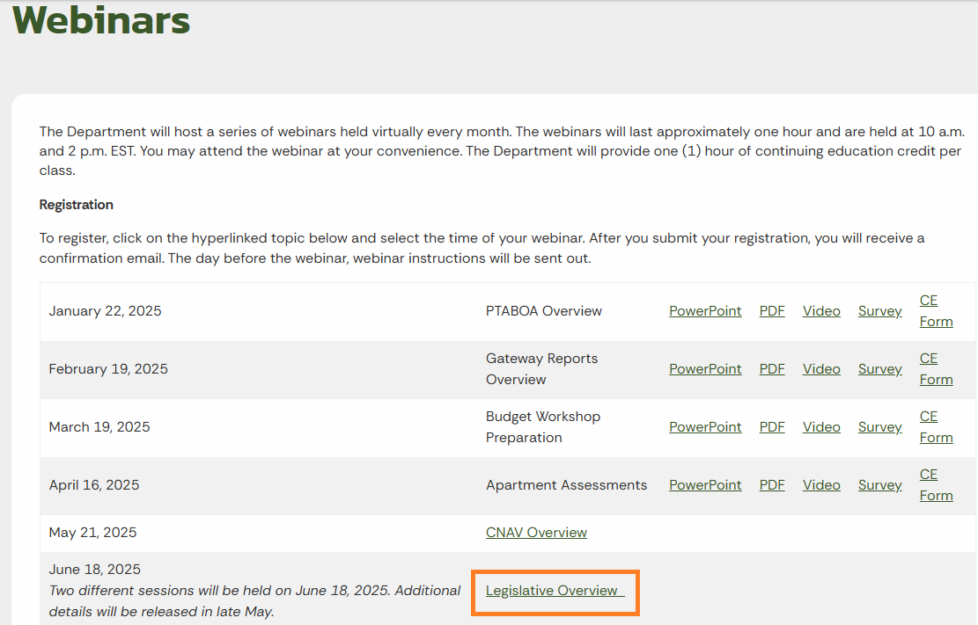
Legislative Overview Webinar
On June 18, the Department will be holding two legislative overview webinars.
Sign up for the two-part webinar at:
https://www.in.gov/dlgf/continuing-education/webinars/
Each session will be recorded.

Slide 5
Maximum Non-Binding Budgets for Libraries

Slide 6
Maximum Non-Binding Budgets for Libraries
Libraries are unique as it relates to determining the appropriate fiscal body that is responsible for adopting their annual budget.
Annually, libraries will determine whether the budget will be adopted by the library board or an appropriate county, city, or town fiscal body.
The determination will be based on the:
Current year Department certified budget.
Maximum Levy Growth Quotient (MLGQ)*
Ensuing year advertised budget.
*SEA 1 from the 2025 legislative session limits the MLGQ at no more than 4% for pay 2026.

Slide 7
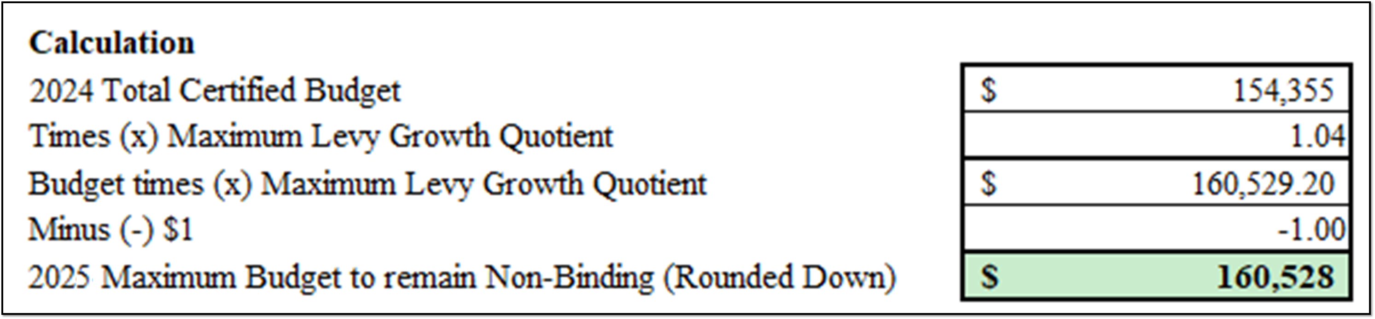
Maximum Non-Binding Budgets for Libraries
Pursuant to Ind. Code § 6-1.1-17-20.3, library boards may adopt budgets and levies for libraries that grow their budget by no more than the prior year budget multiplied by the MLGQ minus $1 (rounded down).
In the example below: for the ensuing year, the library board will have the authority to adopt any budget less than or equal to $160,528.
Any budget advertised for $160,529 or more, must be adopted by the appropriate county, city, or town fiscal body.

Slide 8
Maximum Non-Binding Budgets for Libraries
The Department notes that the library may advertise a budget of any amount, but if the library in this example advertises a budget that is greater than $160,528, then the library becomes subject to a binding budget adoption.
For binding libraries, the appropriate fiscal body of the city, town, or county (whichever applies) shall review and adopt each budget and tax levy for the public library.
The fiscal body may reduce or modify but not increase the proposed budget or tax levy.

Slide 9
Maximum Non-Binding Budgets for Libraries
After the budget adoption by the appropriate fiscal body, the budget will be reviewed and certified by the Department.
If the advertised budget does not exceed the prior year budget times the MLGQ, then the library board will be able to adopt their own budget.
For the following budget cycle, the budget control will default back to the library board.

Slide 10
Maximum Non-Binding Budgets for Libraries
The Department created a report specifically for libraries that will outline the maximum budget amount.
The Pay 2026 Library Report will be posted by July 15, 2025.
https://www.in.gov/dlgf/files/2025-reports/240712-2025-Library-Estimated-Maximum-Budgets-to-Remain-Non-Binding.xlsx
This excel spreadsheet will display the detailed calculation after you select your county and library.
Your Budget Field Representative (“BFR”) will have a copy of your report at your budget workshop.

Slide 11
Maximum Budgets for Libraries – FAQ #1
If I accidently advertise too high, can I just readvertise a lower amount so that I’m not binding?
Ind. Code § 6-1.1-17-20.3(d) outlines that binding units, including certain libraries, must submit their budget to their appropriate fiscal body no later than September 1*.
A library may correct their advertised budget to avoid a binding adoption if it is readvertised by September 1. On September 2, the Form 3 can be changed, but the change will not change the appropriate adopting body.
*If September 1 falls on a weekend or legal holiday, the deadline is extended until the next business day (September 2 for 2025 pay 2026 due to Labor Day).

Slide 12
Maximum Budgets for Libraries – FAQ #2
Does that mean that a library cannot update any of their budget forms after September 1?
A library may make updates to any of their budget forms throughout the process, but must be aware of the impact that the changes have on their advertised budget on the Form 3.
If the changes cause the library to advertise over their maximum budget, they will need to work with the appropriate fiscal body to have their budget adopted.
Libraries advertising a budget over their maximum non-binding amount will have read-only access after Sept 1.

Slide 13
Maximum Budgets for Libraries – FAQ #3
When calculating the maximum budget for the ensuing year, do I include my home rule or gift funds?
No, The maximum budget is calculated exclusively using the budgets for funds certified by the Department on the budget order.
This includes, but is not limited to the General, LIRF, Rainy Day, and/or any debt funds.

Slide 14
Maximum Budgets for Libraries – FAQ #4
Is the Department considering the advertised budget (Form 3), the adopted budget (Form 4), or the certified budget?
When calculating the maximum budget, the Department is using the certified budget amount found on the budget order.
The advertised and adopted amounts are not considered for this calculation.

Slide 15
Maximum Budgets for Libraries – FAQ #5
What impact do approved additional appropriations have on the “maximum budget calculation”?
The maximum budget calculation only considers the total budget amount listed on the Department budget order and the max levy growth quotient.
If a library had an approved additional appropriation during the budget year, it is not factored into the calculation.

Slide 16
Public Library Eligibility for Binding Review by Fiscal Body Resolution

Slide 17
Binding Review by Fiscal Body Resolution
Libraries are unique as it relates to determining the appropriate fiscal body that is responsible for adopting their annual budget.
In the prior section, we examined how the budgeted amount a library advertises may impact their authority to adopt their own budget.
In this section, we will examine how the fiscal body of a county, city, or town may require a library to become subject to binding review (Ind. Code § 6-1.1-17-20.4).

Slide 18
Binding Review by Fiscal Body Resolution
A library will be subject to a binding adoption if both conditions below are met:
Based on the Annual Financial Report (AFR), if the library’s cash balance of all funds derived from tax revenue is greater than one hundred fifty percent (150%) of the library’s certified budget for the ensuing year.
If the appropriate fiscal body for the library advertises a public hearing to make the library subject to binding adoption and adopts the resolution not later than July 1.

Slide 19
Binding Review by Fiscal Body Resolution
The fiscal body of the city, town, or county may not reduce a public library's proposed budget or levy in a budget year by more than ten percent (10%) of the public library's operating levy in the immediately preceding budget year.
The library will be subject to binding review until the December 31 cash balance of all funds of the public library derived from tax revenue, as reported on the AFR, no longer exceeds one hundred fifty percent (150%) of the library's certified budget.

Slide 20
Budget Calendar

Slide 21
Budget Calendar
The Department has posted its 2025 pay 2026 budget calendar. The calendar contains the statutory submission/due dates for some of the key deadlines for the budget certification process.
Units are encouraged to use the budget calendar as a starting point for creating a unit specific calendar.
https://www.in.gov/dlgf/files/2025-memos/250206-Bolser-Memo-2025-Budget-Calendar.pdf

Slide 22
Budget Calendar – June 1
Estimated launch date for the 2025 Pay 2026 Pre-Budget Worksheet in Gateway.
The Department will use the information on the Pre-Budget Worksheet to better prepare for budget workshops.
Units are able to and encouraged to provide any information that may be pertinent to the upcoming budget cycle.

Slide 23
Budget Calendar – June 30
Deadline for State Budget Agency (“SBA”) to provide the MLGQ to civil taxing units, school corporations, and the Department. (Ind. Code § 6-1.1-18.5-2(c))
Estimated launch date for the Budget Application in Gateway.

Slide 24
Budget Calendar – July 15
Department will provide each unit with an:
Estimate of the maximum amount of property taxes that may be levied in the ensuing budget year.
Estimate for non-property tax revenues for FIT, CVET, and Excise.
Estimate for circuit breaker loss for the ensuing year.
Department will provide each library with:
The “Library Estimated Maximum Budget Report” based on the MLGQ and the certified budget amount.

Slide 25
Budget Calendar – August 1
Last day for county auditor to certify net assessed values (“CNAV”) to the Department.
The Department will make assessed values (“AV”s) visible to every political subdivision via Gateway.
All units are encouraged to use Gateway’s public site to validate the AVs certified by the county auditor.
https://gateway.ifionline.org/report_builder
Notes:
Tax Cap deadline = (Ind. Code § 6-1.1-20.6-11.1)
Tax Cap = The report will be posted on the Department's website and the values will be loaded onto the Form 3 in the Gateway – Budget.

Slide 26
Budget Calendar – September 2
Last day for units with appointed boards, including certain libraries, to submit proposed 2026 budgets, tax rates, and tax levies to the appropriate fiscal body for binding adoption.
Pertains exclusively to units that are subject to binding review, libraries that prepare a budget in excess of the maximum allowable, and libraries whose fiscal body adopted a resolution no later than July 1.

Slide 27
Budget Calendar – Last Action Dates
October 14: Last day to post a notice to taxpayers (“Budget Form 3”) of proposed 2026 budgets, net tax levies, and a public hearing to Gateway.
October 24: Last possible day for taxing units to hold a public hearing on their 2026 budgets.
November 3: Deadline for all taxing units to adopt 2026 budgets, tax rates, and tax levies.

Slide 28
Budget Calendar – Budget Order Dates
December 31
Deadline for the Department to certify 2026 budgets, tax rates, and tax levies unless a taxing unit in a county is issuing debt after December 1 in the year preceding the budget year or intends to file a shortfall appeal.
January 15
Deadline for the Department to certify 2026 budgets, tax rates, and tax levies if a taxing unit in a county is issuing debt after December 1 in the year preceding the budget year or intends to file a shortfall appeal.

Slide 29
Resources

Slide 30
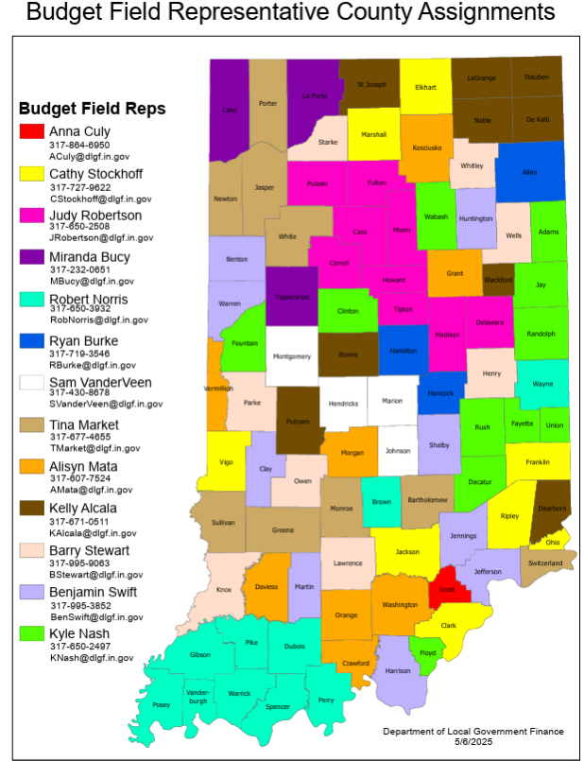
Budget Field Representatives
The FRs are the primary points of contact for local government officials.
While not able to provide legal or financial advice, they can:
Explain changes in procedures.
Identify resources available for local officials.
Help you to avoid common mistakes made during the budget cycle.
https://www.in.gov/dlgf/files/maps/Field-Rep-Map-Budget.pdf

Slide 31
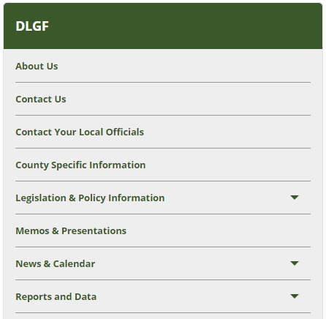
Memos and Presentations
The Department maintains a listing of the communications and legislative guidance from the last 5 years.
Notes:
Review the Budget Calendar each year for any changes

Slide 32
Memos and Presentations
The documentation represents the Department’s current position on topics from additional appropriations to binding library adoption procedures.
The library contains both presentation slides and recorded version of the presentations.
Presentations include:
Introduction to Budgeting
Introduction to Gateway
Circuit Breaker (Introduction, Budgeting, and Recon)
Introduction to the Form 4B
Notes:
Review the Budget Calendar each year for any changes

Slide 33
County Specific Information
In addition to the written guidance, the Department posts various calculations summarized by county.
This includes budget orders, maximum levies, estimated circuit breaker report, and the Library Maximum Budget Report.

Slide 34
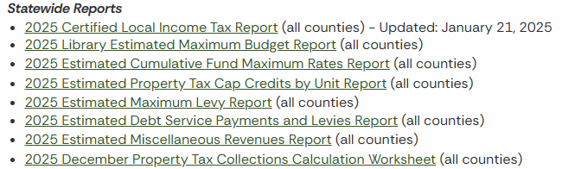
County Specific Information
The Department will issue the following reports on the County Specific Information page.
Not all reports will apply to all unit types.

Slide 35
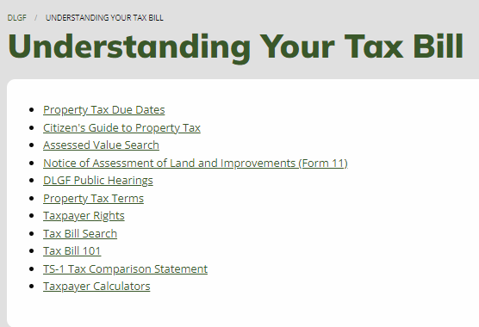
Additional Resources
The Department’s website contains information to assist taxpayers and local officials in understanding the larger tax property certification, billing, and collection cycle.
This includes maintaining a glossary of frequently used terms.

Slide 36
Budgets 2.0 is Coming Soon
This streamlined budget application is currently scheduled to launch in 2026 pay 2027.
Below are some of the notable planned features (subject to change)
The budgeting steps presented in a clear linear process.
It will ask a few questions before certain forms to tailor the data collection process to only those that apply to you.
Side by side comparisons of the previous year’s amounts will be available in the Form 1: Line-Item Budget Estimates and Form 2: Non-Property Tax Revenue Estimates.
Incorporation of Department estimates available if desired.

Slide 37
Budgets 2.0 is Coming Soon
This application will also have improved error prevention built in:
Libraries will answer if they are pursuing a non-binding review. The Form 1 won’t allow a budget to be entered that exceeds this, unless they change their answer to indicate they are pursuing a binding review.
The next couple of slides are added as an example of the current draft of the Form 1 and Form 2, but they are subject to change prior to the official launch.

Slide 38
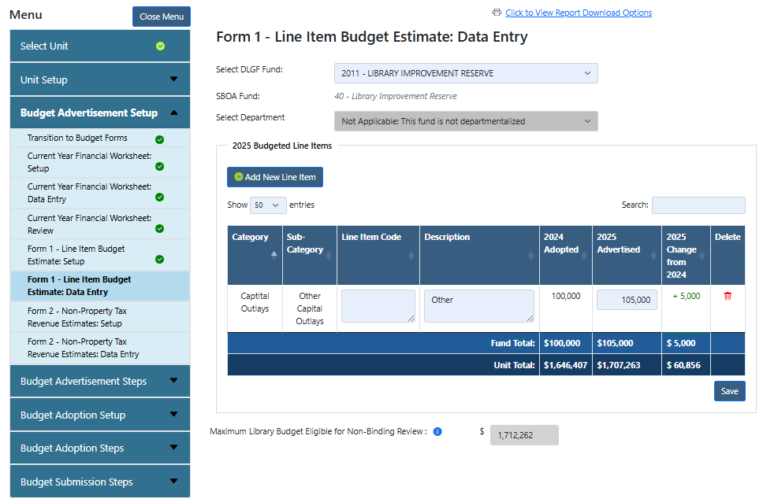
Budgets 2.0: Sneak Peak – Form 1 (Draft)

Slide 39
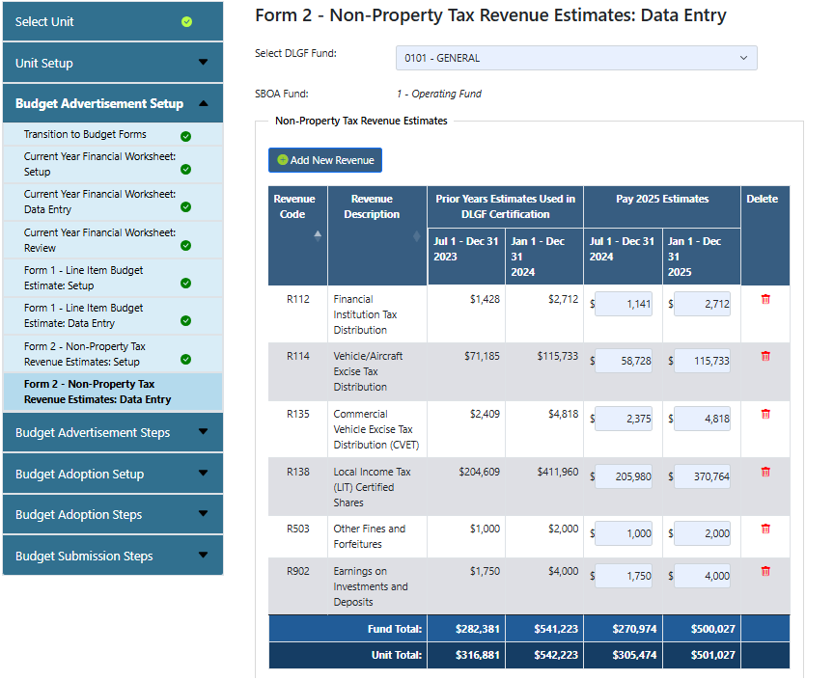
Budgets 2.0: Sneak Peak – Form 2 (Draft)

Slide 40
Contact the Department
Website: www.in.gov/dlgf
“Contact Us”: https://www.in.gov/dlgf/contact-us/
Budget Field Representative Map: https://www.in.gov/dlgf/files/Budget_Field_Reps.pdf
Gateway Support: Support@dlgf.in.gov
Telephone: (317) 232-3777

