Slide 1

Intersection Improvement Projects
U.S. 50 North Vernon Bypass
Jennings County High School
Wednesday, September 14, 2016

Slide 2
Welcome
Rickie Clark, INDOT Office of Public Involvement
Purpose of meeting
  Intersection improvement projects on U.S. 50 North Vernon Corridor
Meeting format
Visit our sign-in table
Informational handouts
Project display / Open House area

Slide 3
Welcome
Introduction of INDOT Project Team
  Project Management
  Design / Traffic
  Environmental Services
  Communications
  Capital Programs
  PARSONS
    Design Team
Recognition of elected & local public officials

Slide 4
Public Meeting
Sign-in at attendance table to be added to project mailing list
A copy of presentation and project documentation is available on-line via INDOT website
  Roundabout webpage http://www.in.gov/indot/3249.htm
  US 50 North Vernon webpage http://www.in.gov/indot/projects/2423.htm
  INDOT Seymour District page http://www.in.gov/indot/2706.htm
Public notice publishing:
  The North Vernon Sun & Plain Dealer
    Tuesday, September 6th
    Thursday, September 8th

Slide 5
Project Stakeholders
Indiana Department of Transportation
Indiana Division, Federal Highway Administration
Jennings County
City of North Vernon
Schools
Community residents & citizens
Commuters
Businesses
Emergency services
Farming industries
Trucking industries

Slide 6
Project Location
U.S. 50 & S.R. 750
  West side of North Vernon
U.S. 50 & S.R. 750
  East of North Vernon

Slide 7
Project Overview
Safety Project
Intersection Improvement
Purpose and Need:
  to improve overall traffic operation and safety through the intersection

Slide 8
How is a Roundabout Safer?
  U.S. DOT Federal Highway Administration Statistics
  Traditional intersections account for:
  45% of all crashes – FHWA
  33% of all traffic fatalities – FHWA
Compared to traditional intersections roundabouts:
  Reduce fatalities and injuries by 82% – FHWA
  Reduce total crashes by 44% – FHWA
  Require vehicles to travel at lower speeds
  For more information: http://safety.fhwa.dot.gov/intersection/innovative/roundabouts/

Slide 9
Benefits of a Roundabout
Enhances Safety
  Roundabouts reduce the number of potential accident points within an intersection
  75% fewer conflict points than four-way intersections
Slower vehicle speeds
  Reduces the severity of crashes
Efficient traffic flow
  Reduces need for turn lanes
  Improves traffic flow
Community benefits
  Reduces congestion
  Aesthetic landscaping
Notes:
Source: U.S. Department of Transportation Federal Highway Administration

Slide 10
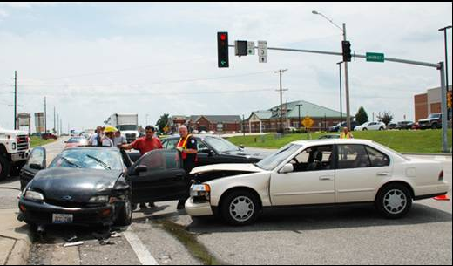
Roundabouts Enhance Safety
Collisions at traditional intersections are severe because:
  High speed
  Angle of impact

Slide 11
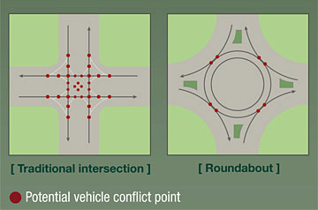
Roundabouts Enhance Safety
Conflict points are dramatically reduced because all vehicles travel in the same direction.

Slide 12
What is a Roundabout?
One-way circular intersection
Traffic flows counter-clockwise around a center island
Yield at entrance
No parking
No “activity” in center island

Slide 13
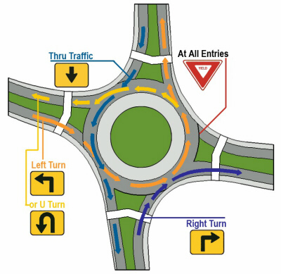
What is a Roundabout?

Slide 14
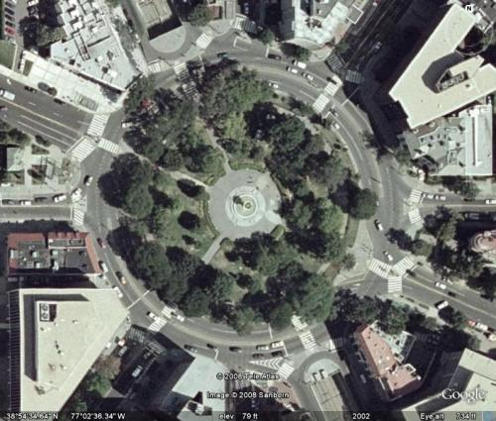
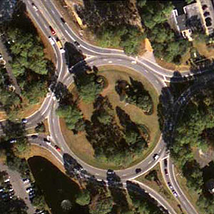
What is NOT a Roundabout?
Traffic circle
  Stop control or signalized
  D Circle, Washington, D.C.
  Monument Circle – Indianapolis
Rotary
  Common in New England states
  Entering traffic has right-of-way

Slide 15
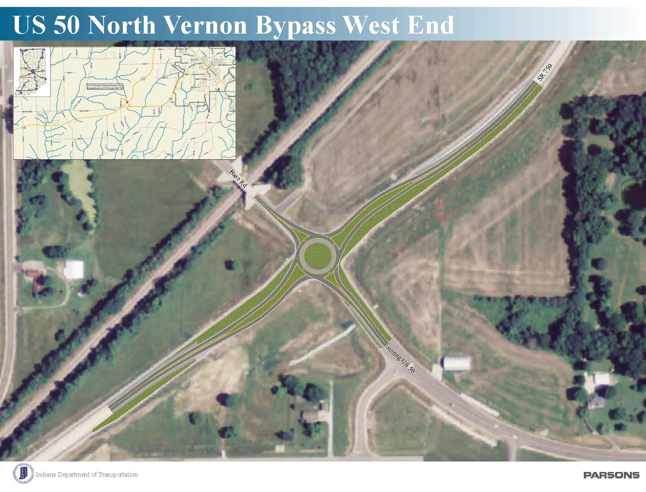
West Roundabout

Slide 16
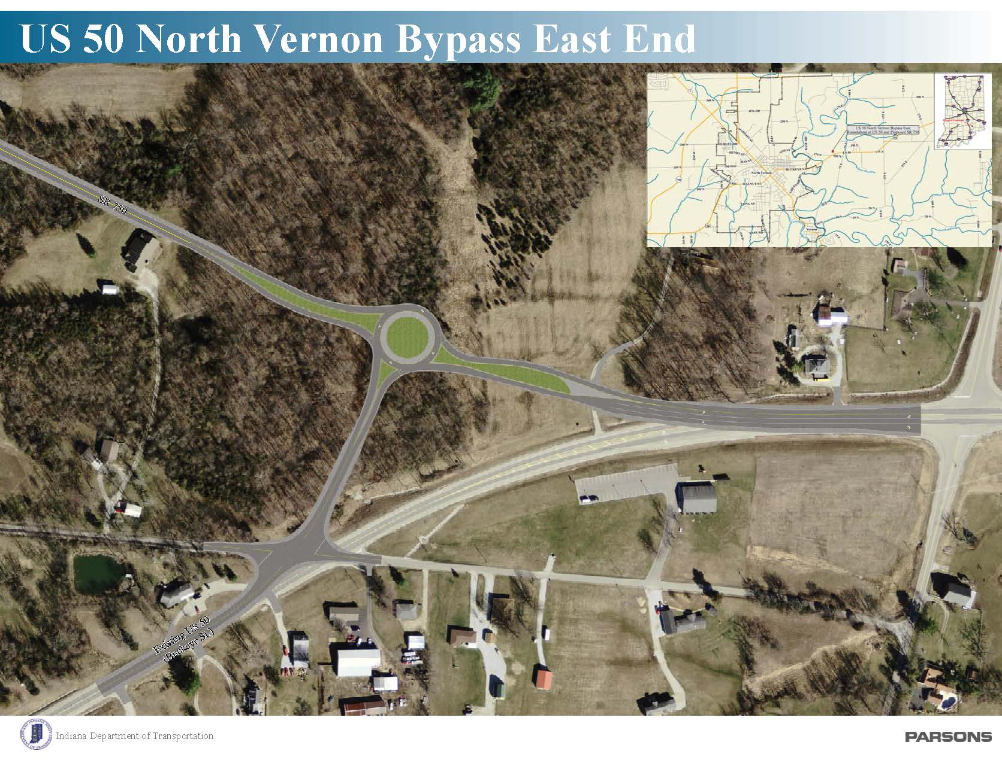
East Roundabout

Slide 17
Key Factors for these locations
Why a roundabout at these intersections?
  Roundabouts reduce number of contact accidents
  Keep motorist moving opposing to stopping and waiting at a signal (Goal of a Bypass roadway to increase mobility)
  Slows motorist down through the intersection to help reduce accidents and severity of accidents
Key Factors
  East Bypass under construction. Cost of roundabout about the same as signal
  West Bypass will reuse as much existing pavement to significantly reduce cost
  No additional right-of-way or utility relocation at either location
  Lighting will be included at both roundabouts to enhance safety

Slide 18
Roundabout Outreach & Education
Roundabout Simulation Video

Slide 19
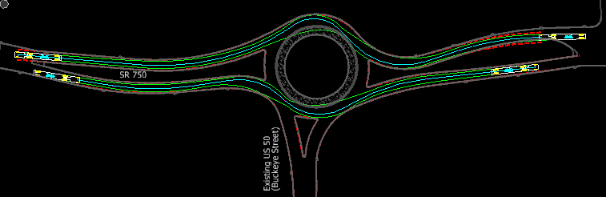

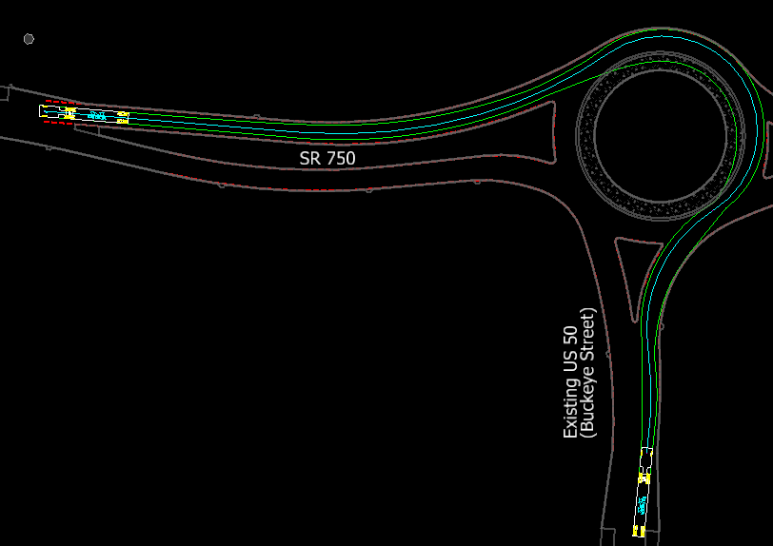
Truck Turning Movements
Accommodating large semi-truck
2” Corrugated truck apron to deter passenger cars while allow vehicles will trailers to make movements without shifting loads

Slide 20
Preliminary Maintenance of Traffic (MOT)
East Bypass:
  Currently under construction. MOT not required.
West Bypass:
  Early in the design stage, but plan to maintain traffic at all times.
  Build half the roundabout at a time to maintain traffic

Slide 21
Project Schedule
Public Meeting: 9/14/16
Public comments requested by COB 9/30/16
East roundabout: Fall 2016
West roundabout: Fall 2017

Slide 22
Feedback
INDOT would like to hear from you
  Talk with INDOT project team members
  Comment sheet in information packet
  E-mail or mail comments to INDOT
  Sign-in list to be added to project mailing list
  Visit INDOT Seymour District page at http://www.in.gov/indot/2706.htm and project webpage at http://www.in.gov/indot/2423.htm

Slide 23
Submit Public Comments
Submit public comments using the options described in first page of information packet:
  Public Comment Form
  Via e-mail
  Participating during public comment session via microphone
INDOT respectfully requests comments be submitted by Friday, Sept. 30, 2016.

Slide 24
Next Steps
Public and project stakeholder input
  Submit comments via options described on page 1 of information packet
INDOT review of public comments
  INDOT welcomes the opportunity to hear from community members
Communicate project updates
  Work through local media and social media outlets
  Update project website with timely information
Questions? Contact Public Involvement Team

Slide 25
Project Resource Locations
INDOT Seymour District Office
Customer Service Center
185 Agrico Lane
Seymour, IN 47274
1-877-305-7611
secommunications@indot.in.gov
INDOT Office of Public Involvement
IGCN Room N642
100 North Senate Avenue
Indianapolis, IN 46204
(317) 232-6601; rclark@indot.in.gov

Slide 26
Thank You
Please visit with INDOT project officials following the public comment session
Project Open House
  Project maps, displays, real estate acquisition table, INDOT project team, and informal Q & A
  INDOT Seymour District page http://www.in.gov/indot/2706.htm
  Project webpage http://www.in.gov/indot/2423.htm
  Roundabout Education web page http://www.in.gov/indot/3249.htm

Slide 27

Public Comment Session

