Slide 1

US 41 RIVER BRIDGES
Rehabilitation Projects
Evansville to Henderson
May 2016
6:00 p.m.
Please silence electronic devices.

Slide 2
Agenda
Welcome & Introductions
Presentations
  Adjourn
Back to the open house
Invited to the display area for
Q & A with the project team
Notes:
GOOD EVENING…… MY NAME IS MARY WRIGHT INDOT. I APPRECIATE EVERYONE TAKING THE TIME TO ATTEND THIS AFTERNOON
THE AGENDA IS SIMPLE - PRESENTATIONS – AND THEN ADJOURN BACK TO THE OPEN HOUSE
Kate Francis - Project Manager
Mike Matel – Bridge Project Manager – Butler Fairman & Seufert
Jason Tiller – Media Relations
KTC

Slide 3
Why are we here?
Information about the future 2017 rehabilitation projects on the
US 41 bridges
What to expect?
  Traffic Patterns
  Restrictions
  Timeframe
Future information updates

Slide 4
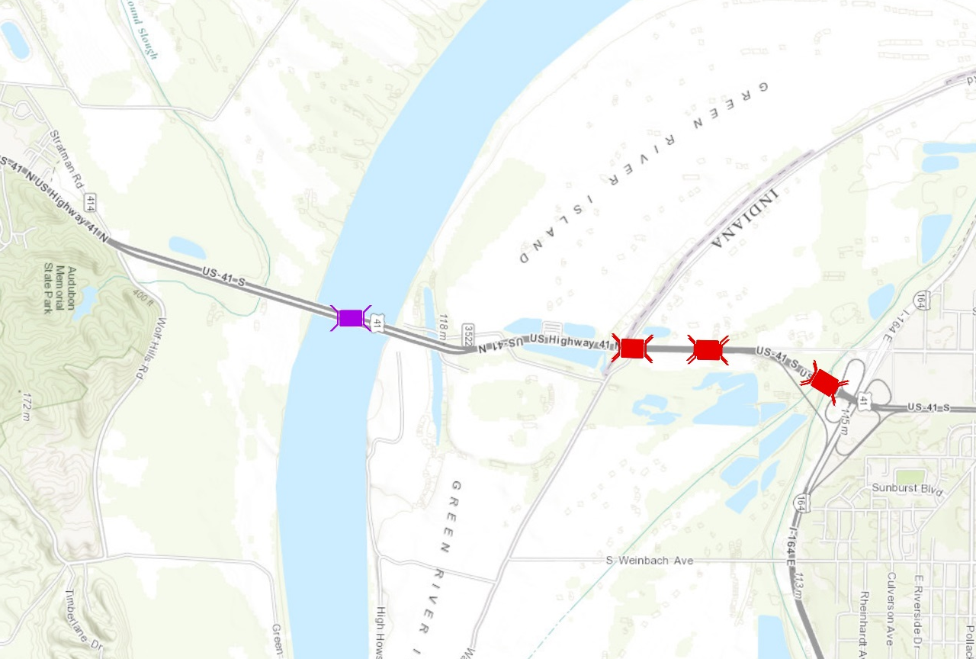
Project Area
  3.8 total miles in length
    .5 miles in KY
  7 bridges
  $25 Million
Notes:
Make sure INDIANA KENTUCKY line is very clearly illustrated

Slide 5
Extensive Planning
Safe and efficient project
  Coordination with other projects located in the greater Evansville area.
  Kentucky – Ohio River Bridges
  Numerous meetings with local, federal, and state agencies in Indiana and Kentucky
  Emergency services
  Local commerce
  Utilities
Notes:
Extensive over the last year
Shared costs all 8 bridges…but not the pavement
News in Aug 2015
Emergency Mgmt Sept 2015
PODI FHWA Spring 2015

Slide 6
Purpose and Need
Project Need
  Heavy vehicular use resulting in wearing down of bridge decks and roadway pavement
Purpose
  Address the ongoing deterioration of the bridge decks and cracking pavement
  Extend the lifespan of each bridge before major reconstruction is required.

Slide 7
Why All at Once?
Due to the type of work to be done.
  Deck replacements
  Pavement replacement
Keep two lanes open in each direction.
Lessen impacts to the traveling public.
Increase the service life of the bridges and pavement by 20 – 25 years.
Work zone safety
Notes:
Don’t talk about taking lanes yet

Slide 8
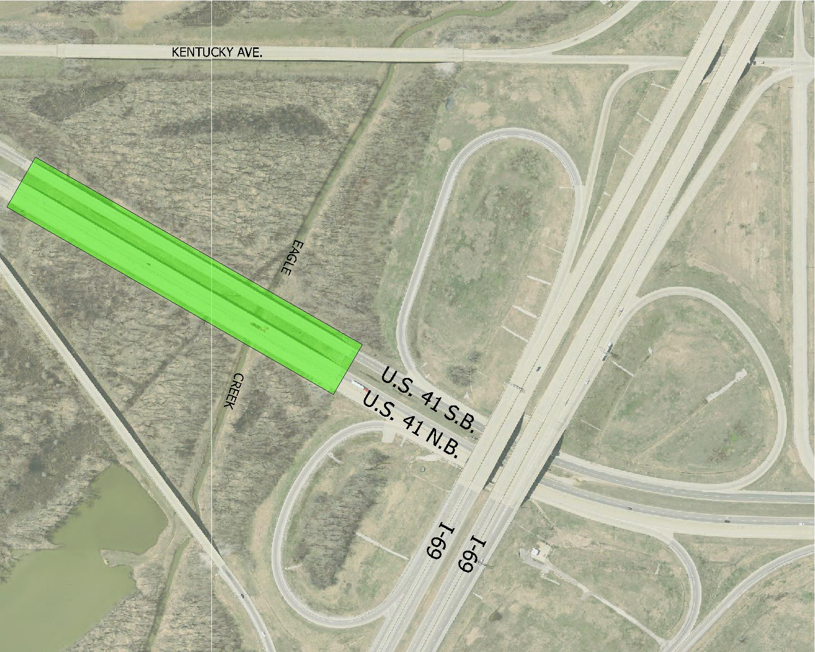
Locations
Eagle Creek Bridges located south of the US 41 and I-69 interchange
  Project starts at
  the I69 interchange
  Bridge decks being
  rehabilitated
  Kentucky Avenue
  closed only while
  constructing the
  southbound lanes
Notes:
Picture needs to reflect all of Kentucky Ave

Slide 9
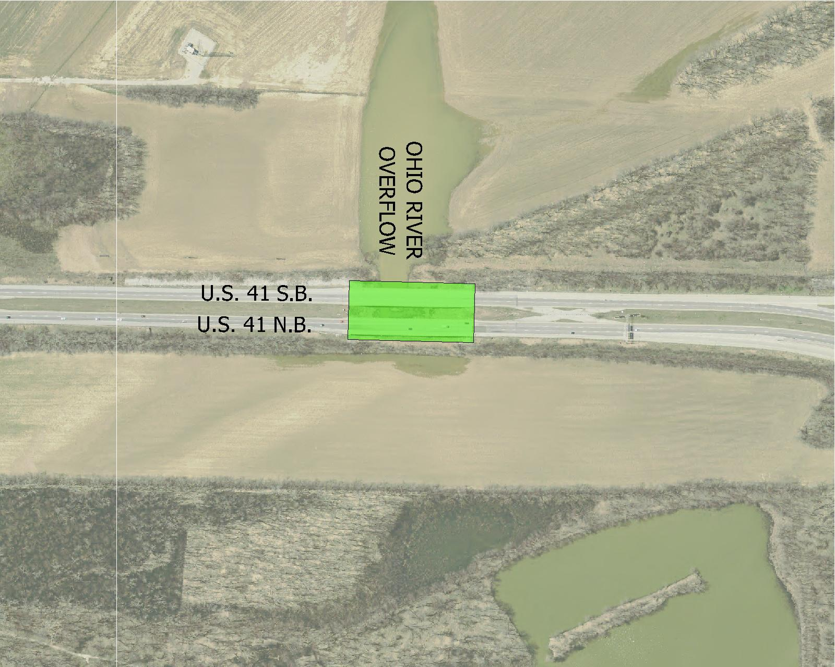
Locations
Ohio River Overflow
  Bridge decks being replaced
Notes:
Most drivers don’t even realize that there is a bridge here…

Slide 10
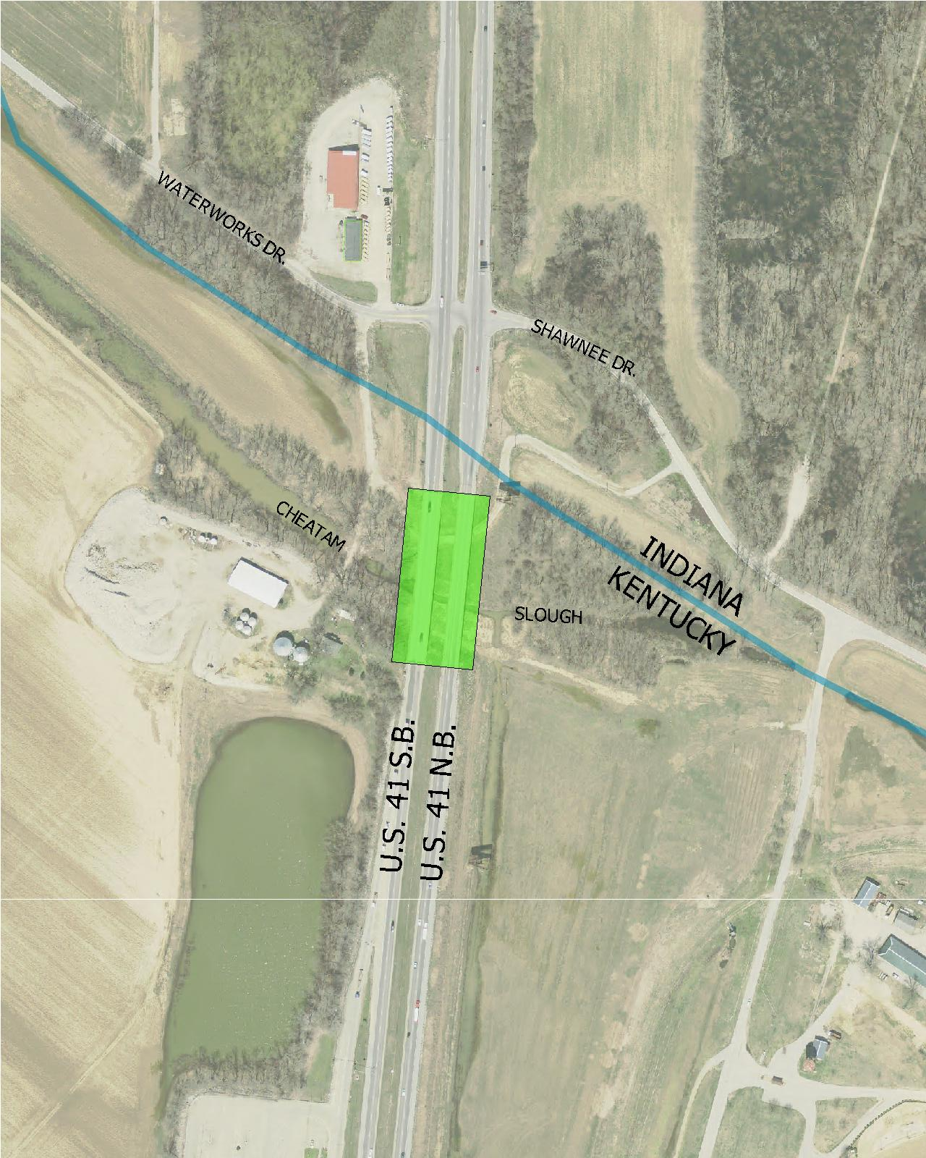
Locations
Cheatam Slough
  Bridge decks being
  replaced
  Temporary bridge for
  crossover
Turning Restrictions
  No left turns between
  Waterworks Road
  and Shawnee Drive, both north and southbound lanes
Notes:
Needs to reflect Waterworks Road

Slide 11
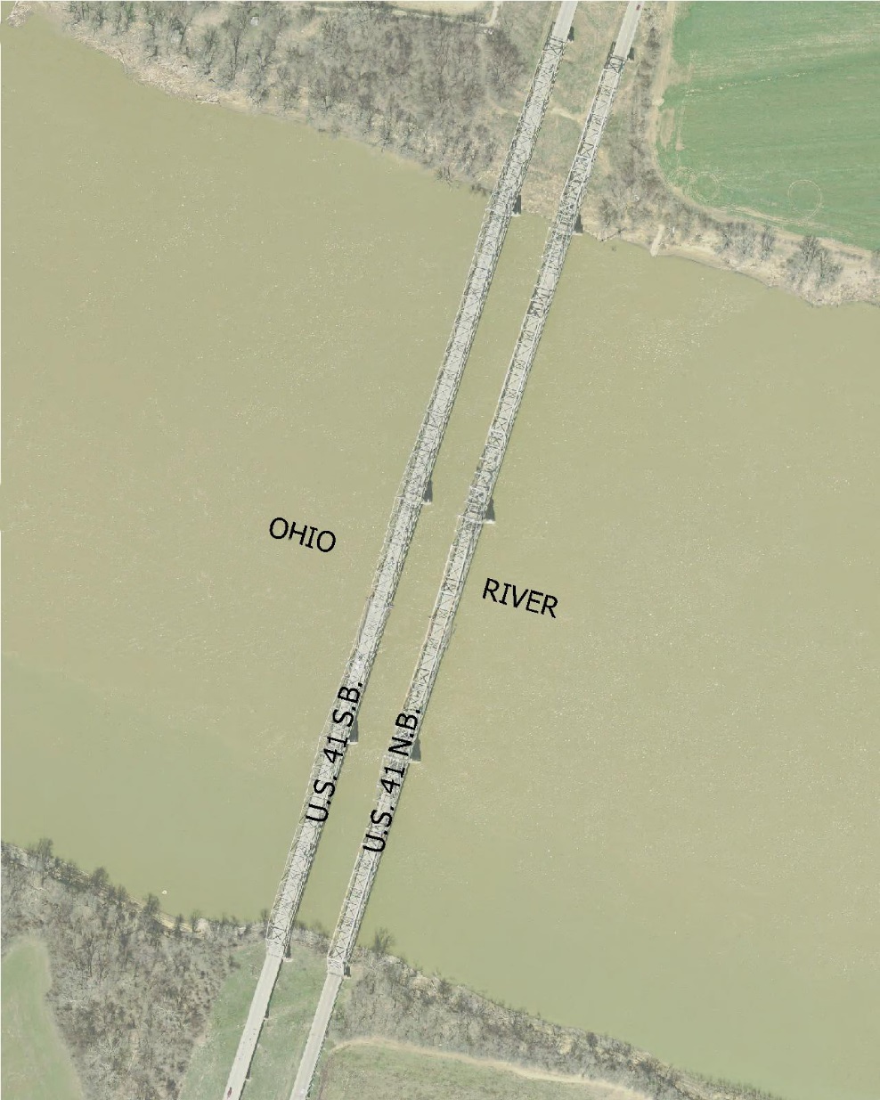
Locations
Kentucky
Ohio River Bridges
  Only southbound bridge
  Deck overlay
  90 to 120 days
  construction period for
  this location
Notes:
Absorbing KY bridge into IN project

Slide 12
Three Phases of Construction
Phase 1
  MOT
  Main Span SBL
Phase 2
  NB
Phase 3
  SB

Slide 13
Phase 1 Goals
Primary Goals
  Southbound Main Span over the Ohio River
  3,000 foot bridge deck overlay
Secondary Goals
  Utility relocation
  Shoulder widening and crossovers
  Temporary bridge at Cheatam Slough

Slide 14
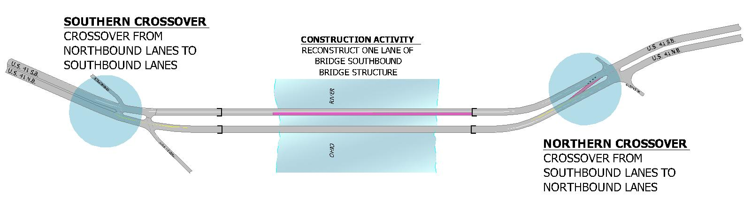
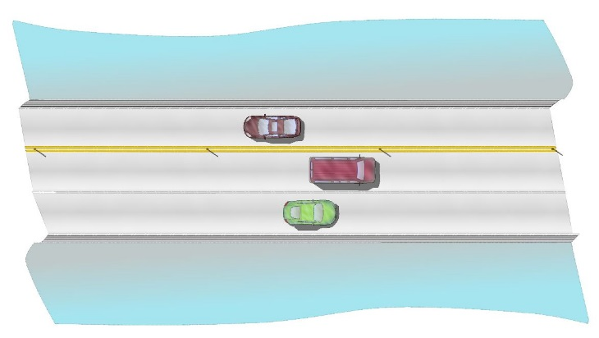
Phase 1 Multiple Activities
Kentucky Ohio River Bridge
  Joint repairs
  Bridge deck overlay

Slide 15
Utilities
Expect start in 2016
Minor relocations required
Intention to keep weigh station open during construction

Slide 16
Shoulder Widening and Crossovers
Shoulder Widening
  Entire length of the project in order to accommodate 4 lanes during Phase 2
  and Phase 3.
  Lane restrictions
  Night work
Crossovers located in roadway median
  Increase worker safety
  Increase speed of construction

Slide 17
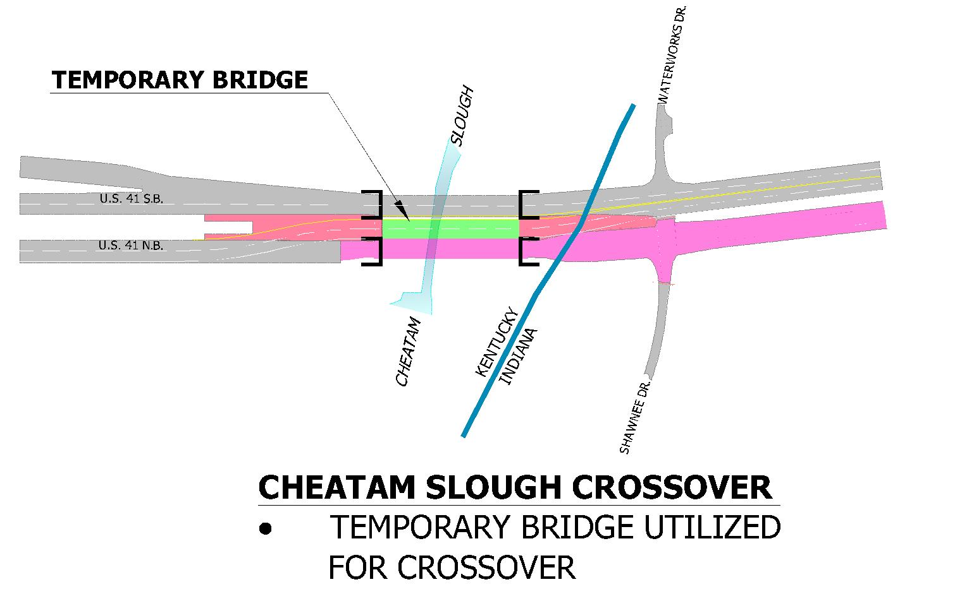
Temporary Bridge
Located at Cheatam Slough
  Facilitates a crossover

Slide 18
Phase 1
  Kentucky Ohio River Bridge
  deck overlay
    90 to 120 days construction period
  Maintenance of Traffic (MOT)
    3 lanes on northbound structure
    Truck traffic directed onto
    southbound bridge
      Past experience with tight lanes
      35 MPH speed limit

Slide 19
Phase 2
  Re-Open Main Span SBL
  Construct northbound bridges
  and roadway
  Maintenance of Traffic (MOT)
    All traffic to be shifted onto
    southbound lanes
    FLYOVER
Notes:
NOTE: This is a good time to explain how long the public can expect the project to last.
Do not talk in “Construction Seasons” – the public doesn’t know what that means.

Slide 20
Phase 3
  Construct southbound bridges
  and roadway
  Maintenance of Traffic (MOT)
    All traffic to be shifted onto
    northbound lanes
    FLYOVER
Notes:
NOTE: This is a good time to explain how long the public can expect the project to last.
Do not talk in “Construction Seasons” – the public doesn’t know what that means.

Slide 21

MOT – Detour Route
Wide loads and heavy haul
  Detour east to
  Maceo, Kentucky
  using US 231 bridge.

Slide 22
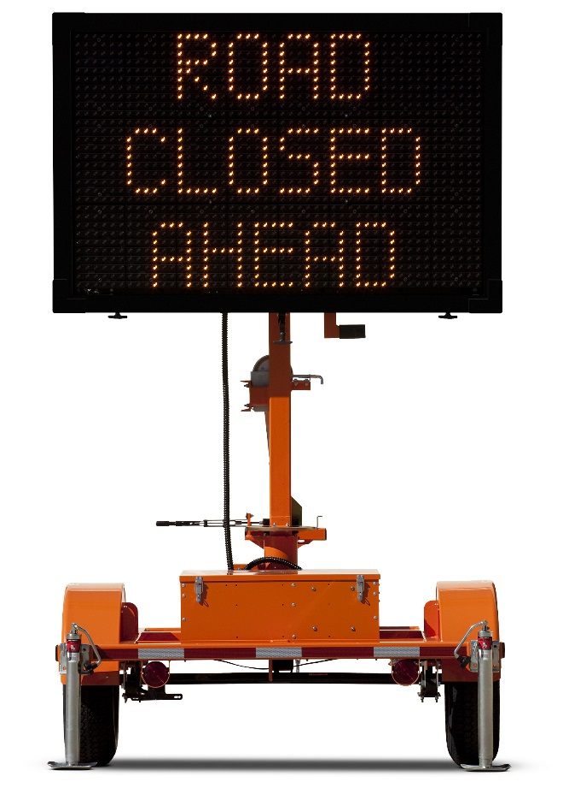
MOT – Public Awareness
Highway message boards
  Located on I-69, US 41, Lloyd Expressway and Kentucky State Routes
Website
Partner with local
news media with
updates
Lane Changes
Ahead

Slide 23
Public Safety
Reduced speed limit
Tow trucks on site and on call
  Rush Hour
  24/7
Monitored by law enforcement
  Additional patrols
Cameras
  Aid in emergency response

Slide 24

Community
River Run
  No conflict in 2017

Slide 25
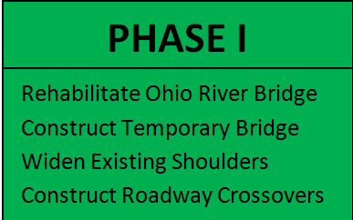
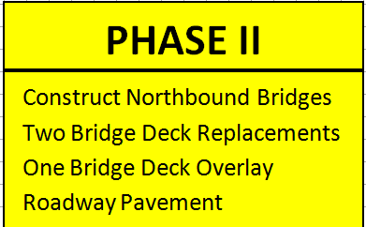
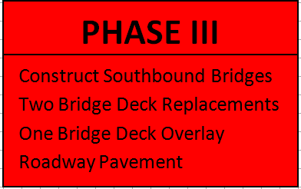
Tentative Construction Schedule
Spring and Summer 2017
Fall 2017 through
Fall 2018
Fall 2018 through
Summer 2019

Slide 26
Public Information
Remind to sign attendance sheet
There will be future updates
Web site
Contact information
  INDOT –Vincennes customer information

Slide 27
Thank You
Please visit with project officials
Informal questions and answers
View displays
Thank you for your attendance
this evening.
Notes:
THANK YOU FOR COMING TONIGHT. PLEASE STAY AFTER SO REPRESENTATIVES CAN ANSWER YOUR QUESTIONS AND CAN DISCUSS ANY OF YOUR CONCERNS….
THANK School
THANKS AGAIN AND HAVE A GOOD EVENING.

