Slide 1
U.S. 6 at S.R. 2 Intersection Improvement
Indiana Department of Transportation
Wednesday, Oct. 24, 2018
6 p.m.

Slide 2
Welcome
Purpose/explanation of public hearing
Public hearing format
Visit our sign-in table
Informational handouts
Participate during public comment session
Submit written public comments
Project display area

Slide 3
U.S. 6 at S.R. 2 Intersection Improvement
Introduction of INDOT Project Team
Project Management
Public Involvement
LaPorte District – INDOT Regional Office
Environmental Services
Troyer Group
Engineering, Design & Environmental Analysis Team
Recognition of elected & local public officials
Sign-in at attendance table to be added to project mailing list
Legal notice of public hearing published in Herald-Argus & NWI Times on 10/8, 10/9, 10/16 & 10/17
A notice of the public hearing was mailed to known property owners within the project area
Announcement of this hearing was posted to the INDOT website. A media release was also issued
A copy of presentation and project documentation are available for review on-line via the INDOT website

Slide 4
Project Stakeholders
Indiana Department of Transportation
Indiana Division Federal Highway Administration
LaPorte County
Elected & local officials
Residents & citizens
Commuters
Businesses
Emergency services
Schools
Churches
Community Organizations

Slide 5
Project Development
Project Selection
Early Coordination
Environmental phase begins
Purpose & Need
Develop alternatives
Preliminary design phase
Release environmental document for public review and comment
HOLD PUBLIC HEARING
Additional work to finalize environmental document and project design
Communicate Project Decision
Project Letting
Construction

Slide 6
Environmental Analysis Phase
National Environmental Policy Act (NEPA)
Requires INDOT to analyze and evaluate the impacts of a proposed project to the natural and socio-economic environments
NEPA is a decision-making process
Purpose and Need
Alternatives Screening
Preferred Alternative
Impacts are analyzed, evaluated and described in an environmental document
What are the impacts this project might have on the community?
How can impacts be avoided?
Can impacts be minimized?
Mitigation for impacts?

Slide 7
Environmental Analysis Phase
Notice of Entry for Survey – October 2015
Letters mailed to properties within general area
Describes early project proposal
Project personnel in area, access to properties
Gather data for environmental analysis
Section 106 of National Historic Preservation Act – June 2018
Take into account proposal’s impact to historic & archaeological properties
Public invited to participate
Public notice issued with 30-day comment period
NWI Times
LaPorte Herald-Argus
“No historic properties affected” finding issued
Draft environmental document released for public involvement – September 2018
Available for review via public repositories

Slide 8
Project Resources
INDOT LaPorte District Office
315 E. Boyd Boulevard, LaPorte, IN 46350
LaPorteDistrictCommunications@indot.in.gov
http://www.in.gov/indot/2705.htm
Planning, Project Development/Delivery, Construction, Maintenance for Northwest Indiana
Westville Public Library
153 W. Main Street, Westville, IN 46391
Phone: (219) 785-2015
INDOT Office of Public Involvement
100 North Senate Avenue, Room N642, Indianapolis, IN 46204
Phone: (317) 232-6601
rclark@indot.in.gov
Transportation Services Call Center
Provides citizen and business customers with a single point-of-contact to request transportation services, obtain information, or provide feedback through multiple channels of communications.
855-463-6848 • INDOT4U.com • INDOT@indot.in.gov

Slide 9
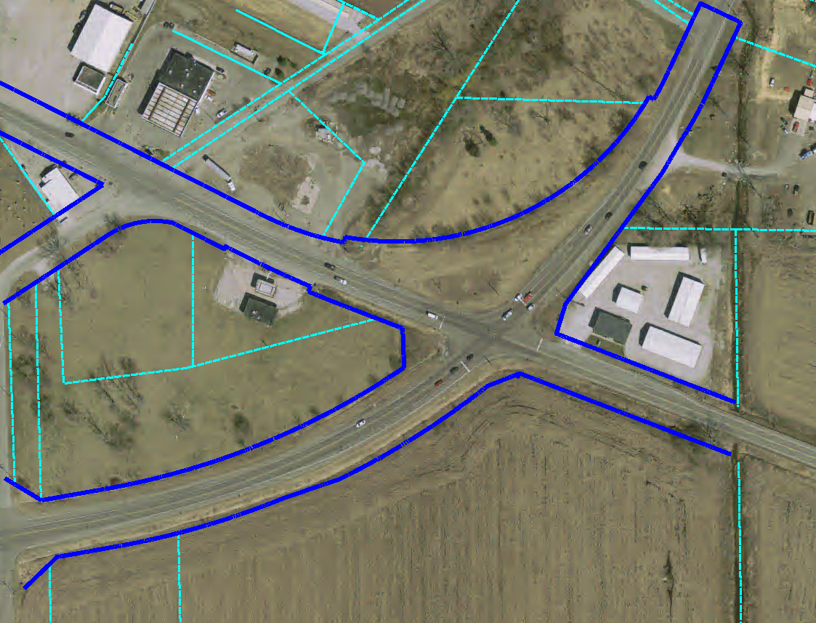
Existing Intersection
Existing Apparent R/W

Slide 10
U.S. 6 at S.R. 2 – Purpose and Need
Purpose
Enhance safety at the intersection of U.S. 6 and S.R. 2
Maintain or improve operational efficiency
Need
Number of traffic accidents at intersection
47 traffic accidents occurring between 2010 and 2017
Data obtained from Indiana Stare Police (ISP)
Accidents seem to occur due to driver confusion related to vehicle right-of-way
Operational efficiency
Current Intersection Level of Service is C (as measured on an A to F scale)
Intersection skew and geometry contribute to driver right-of-way confusion
Complete stops by heavy vehicles result in delayed acceleration through the intersection

Slide 11
Crash Data
Crash Data for U.S. 6 at SR 2 (2010-2017)
YEAR SEVERITY | ‘10 | ‘11 | ‘12 | ‘13 | ‘14 | ‘15 | ‘16 | ‘17 | Total
Crash with no Injury | 4 | 4 | 1 | 4 | 4 | 6 | 9 | 6 | 38
Non-Incapacitating Injury | - | 1 | 2 | - | 1 | - | - | 1 | 5
Incapacitating Injury | 1 | 1 | - | - | 1 | - | 1 | - | 4
Fatal | - | - | - | - | - | - | - | - | 0
Total | 5 | 6 | 3 | 7 | 6 | 6 | 10 | 7 | 47

Slide 12
Other Alternatives Considered
No Build
Baseline for comparison of build alternatives
Does not meet purpose & need, does not enhance safety at intersection, operational efficiency likely to decline with traffic growth
Signalized Intersection
Would require turns lanes to facilitate turning movements
Greater opportunity for higher speed accidents
Contributes towards sight distance challenges due to intersection skew
Does not adequately address the project purpose & need to enhance intersection safety
Preliminary cost estimates were higher than roundabout

Slide 13
Preferred Alternative – Roundabout Intersection
Meets purpose & need of project
Enhances safety by reducing the number of potential vehicle conflict points
Significantly reduces the severity of traffic accidents
Enhances operational efficiency at the intersection
LOS C to LOS B
Reduces average Intersection delay from 19.1 seconds to 10.4 seconds

Slide 14
Roundabout – INDOT Preferred Alternative
One-way circular intersection
Traffic flows counter-clockwise around a center island
Yield at entrance
No Parking
No “activity” in center island

Slide 15
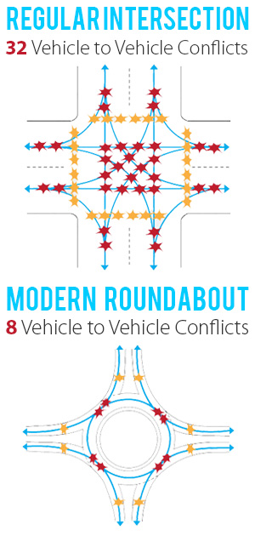
Benefits of Roundabouts
Conflict points are dramatically reduced because all vehicles travel in the same direction.
Enhances Safety
Roundabouts reduce the number of potential accident points within an intersection
75% fewer conflict points than four-way intersections
Slower vehicle speeds
Reduces the severity of crashes
Efficient traffic flow
Reduces need for turn lanes
Improves traffic flow
Community benefits
Reduces congestion
Aesthetic landscaping

Slide 16
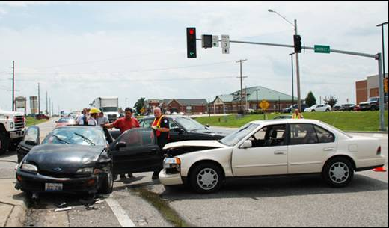
Roundabouts Enhance Safety
U.S. DOT Federal Highway Administration Statistics
Traditional intersections account for:
45% of all crashes - FHWA
33% of all traffic fatalities - FHWA
Compared to traditional intersections, roundabouts:
Reduce fatalities and injuries by 82% - FHWA
Reduce total crashes by 44% - FHWA
Require vehicles to travel at lower speeds
For more information: http://safety.fhwa.dot.gov/intersection/innovative/roundabouts/
Collisions at traditional intersections are severe because:
High Speed
Angle of Impact

Slide 17
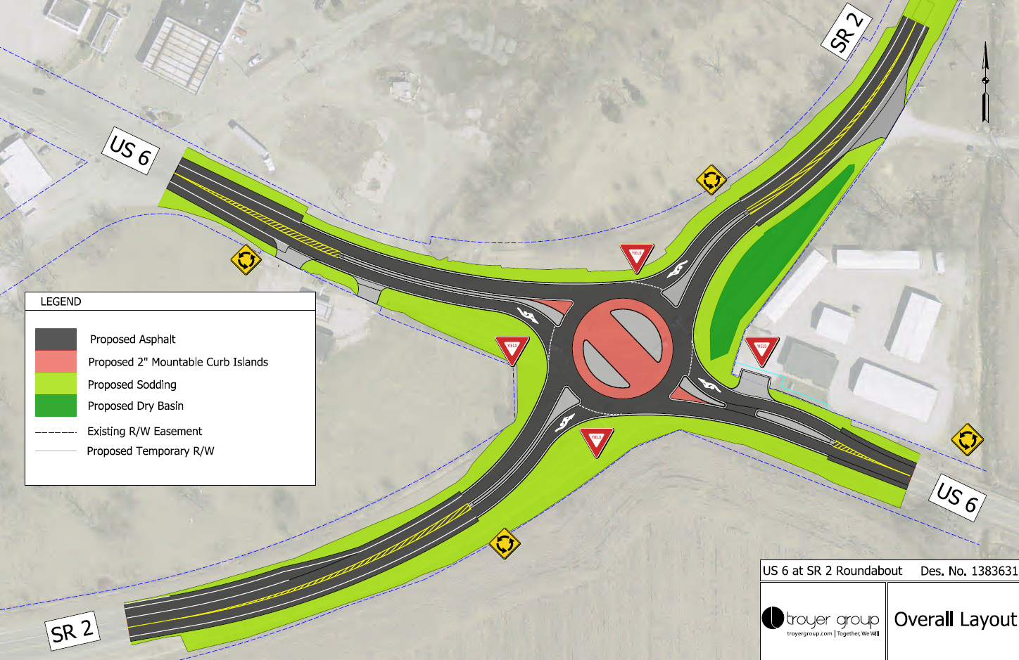
Roundabout Layout

Slide 18
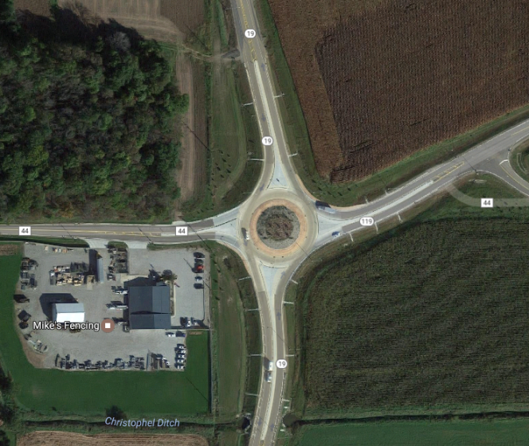
Approaching the Roundabout (example)
X
Images courtesy of Google Maps

Slide 19
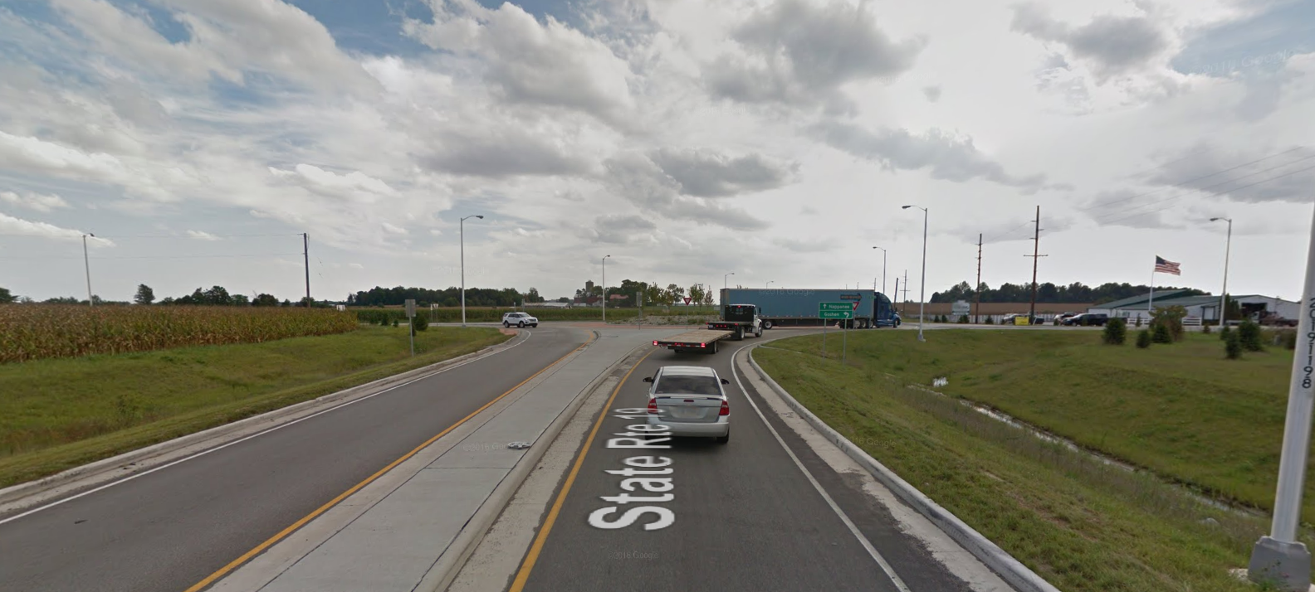
Approaching the Roundabout (example)
X
Images courtesy of Google Maps

Slide 20
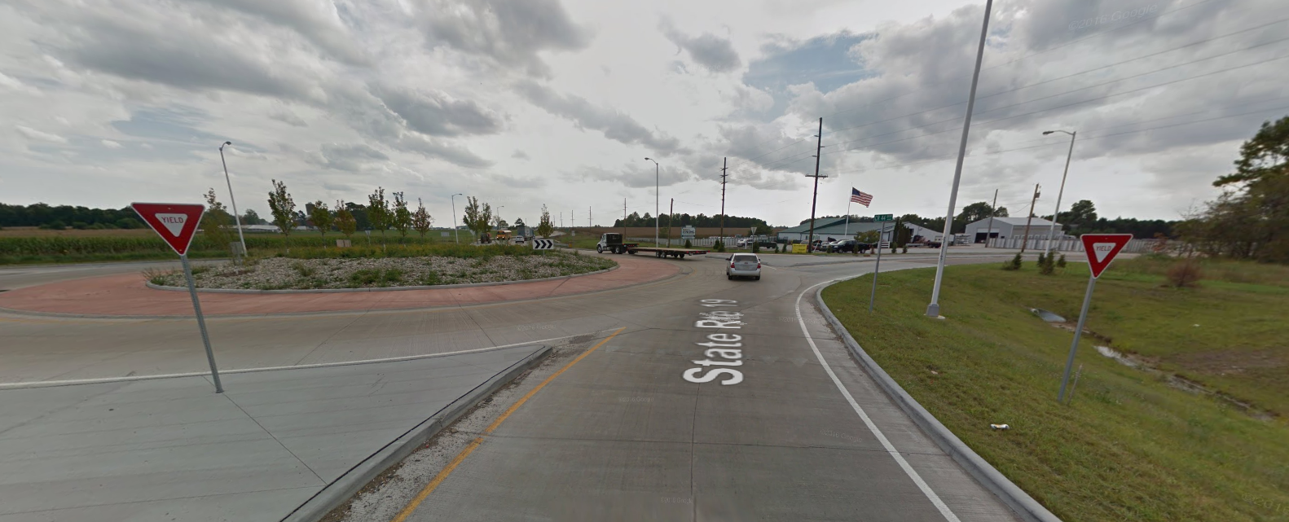
Approaching the Roundabout (example)
X
Images courtesy of Google Maps

Slide 21
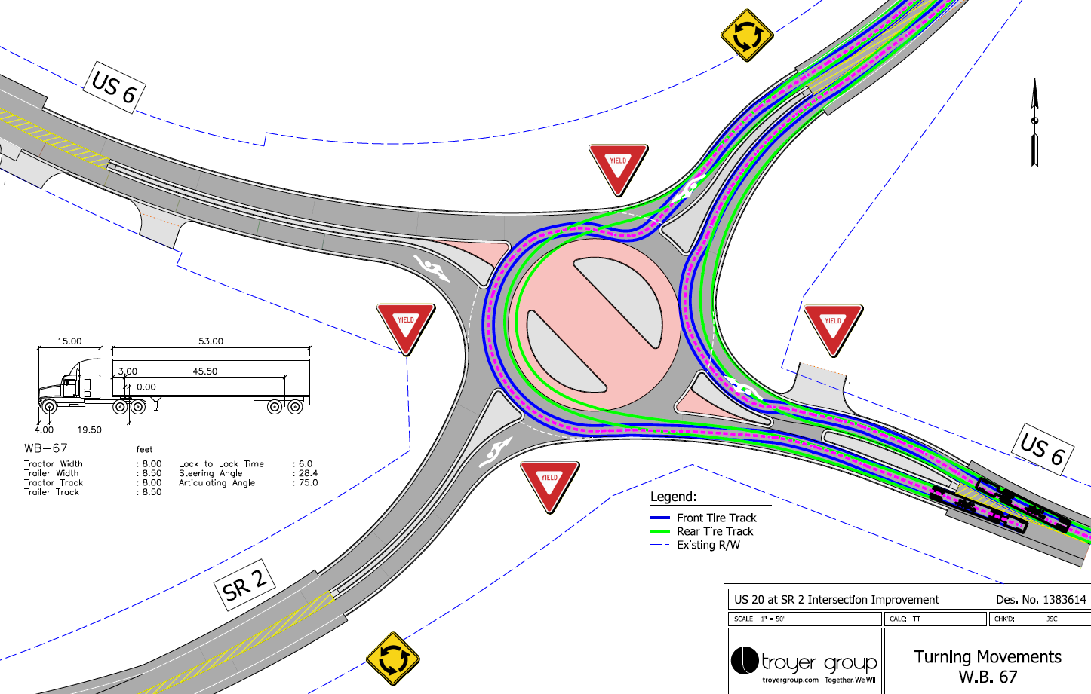
Turning Movement – Semi Truck

Slide 22
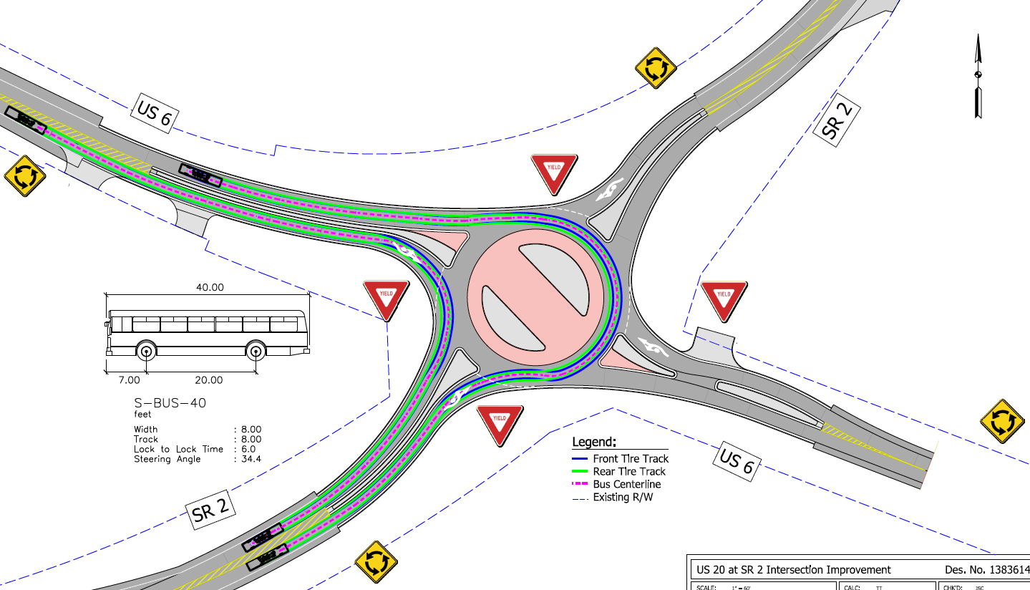
Turning Movement – Bus

Slide 23
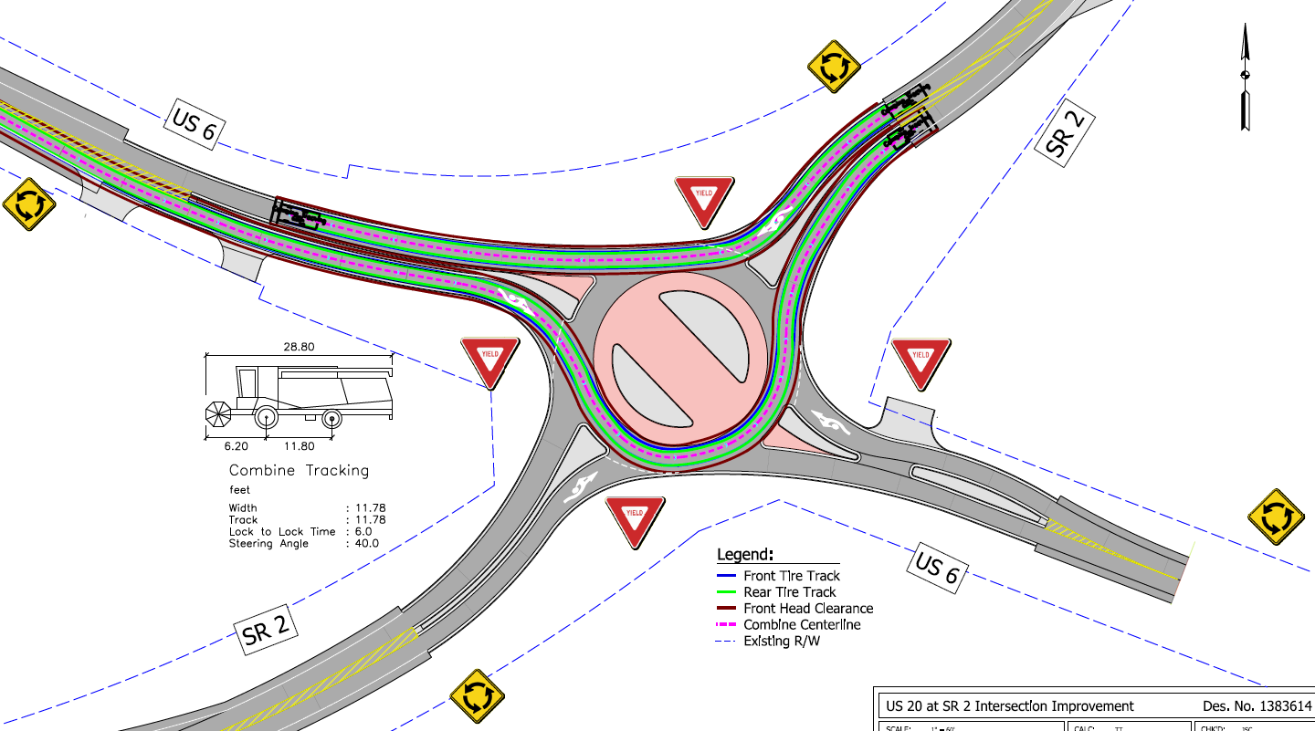
Turning Movement – Combine

Slide 24
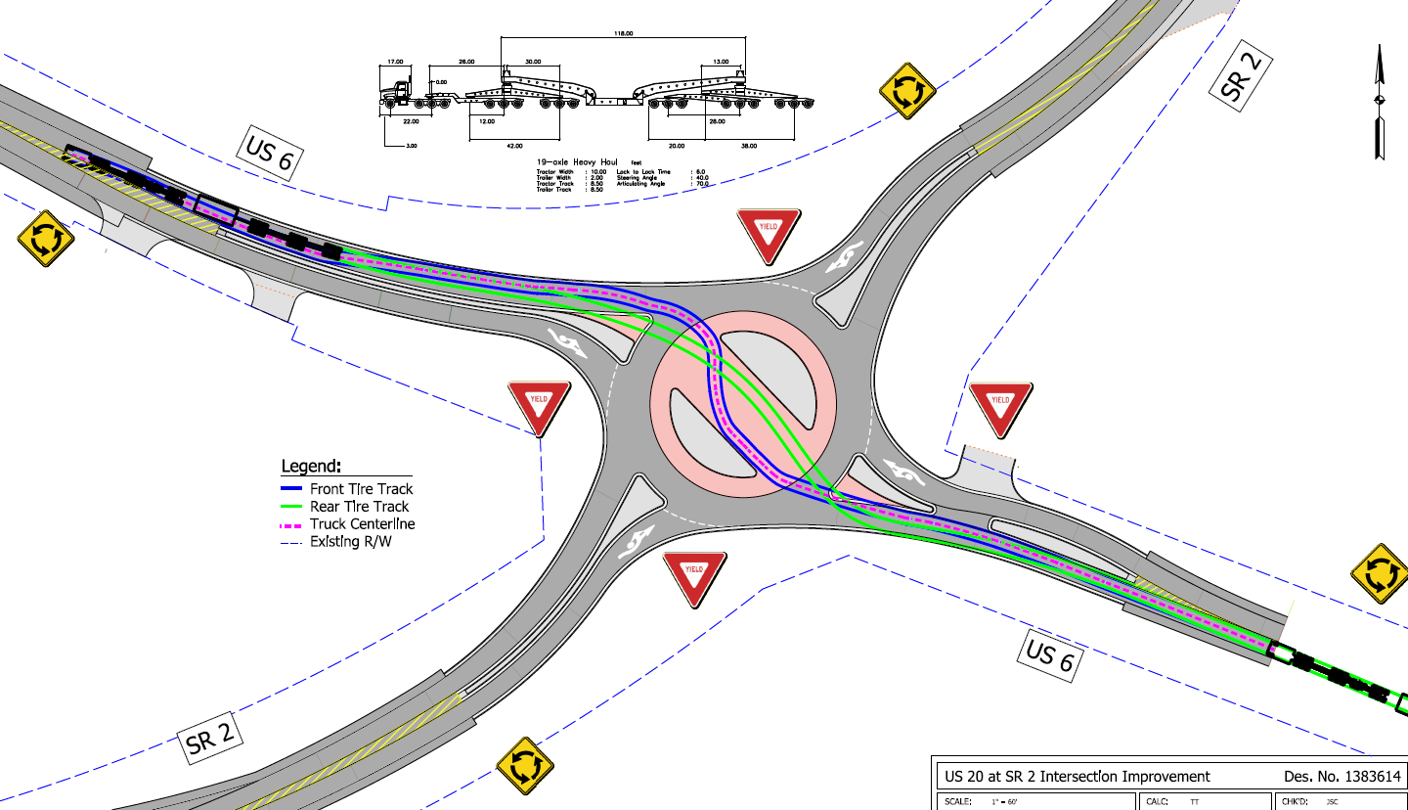
Turning Movement – Oversize/Overweight Vehicle

Slide 25
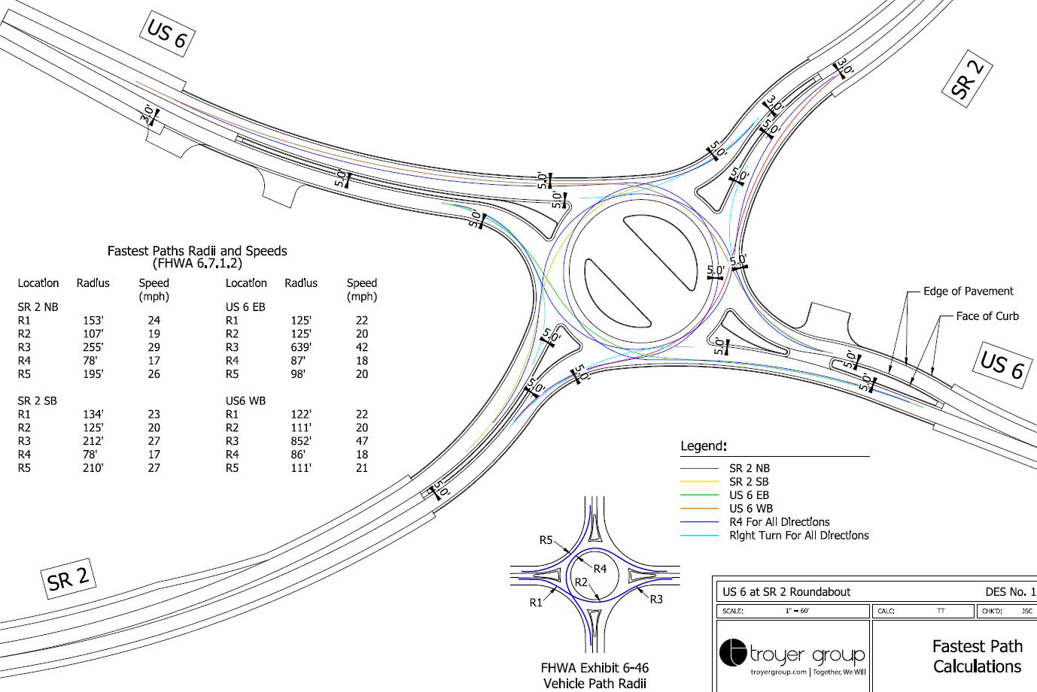
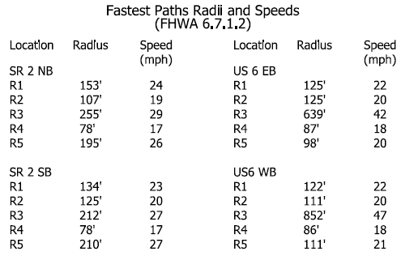
Fastest Path Checks

Slide 26
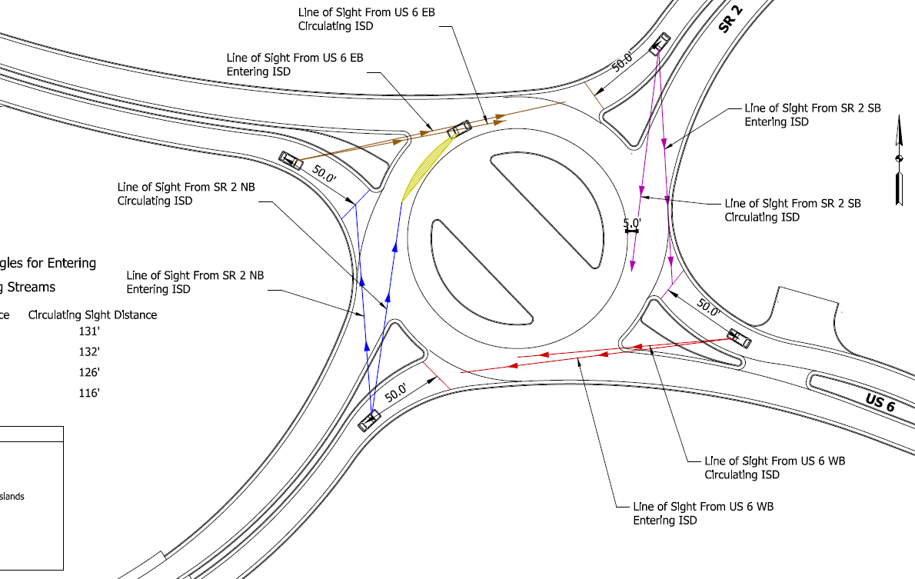
Sight Distance

Slide 27
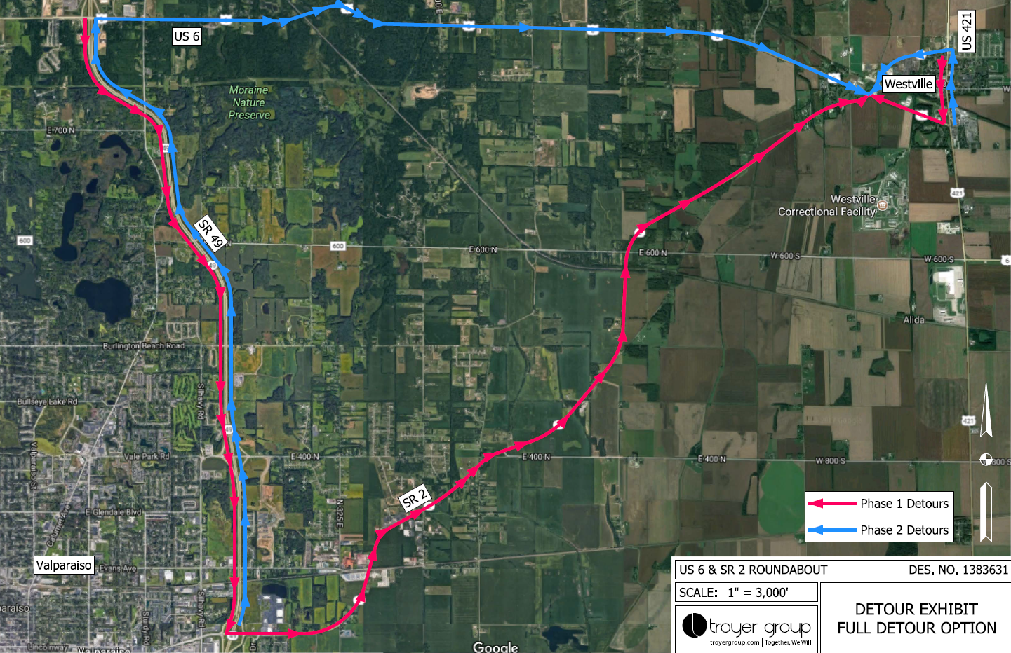
Maintenance of Traffic & Detour

Slide 28
Real Estate

Slide 29
Real Estate Acquisition Process
"Uniform Act of 1970"
All federal, state and local governments must comply
Requires an offer for just compensation
Acquisition Process
Appraisals
Review Appraisals
Negotiations
INDOT Real Estate Team to work with impacted property owners
Right-of-Way (ROW)
Permanent ROW
Land, once purchased by INDOT from legal land owner, becomes ROW owned by INDOT
Existing apparent ROW (6.5 acres) INDOT acquired land by Highway Grant some years ago, transactions in some cases not properly recorded, requires further action by INDOT
Temporary ROW
Land (0.04 acre) required during the construction of a project and is used for the purposes of construction-related activity
INDOT pays legal land owner a fee for land use during construction and/or as part of construction-related activities

Slide 30
Project Schedule
PUBLIC HEARING
Public comment period
Prepare Public Hearing Transcript
FALL 2018
Review public comments
Continue work on preliminary design and environmental document
FALL 2018
Finalize environmental document
Communicate Project Decision
FALL 2018
Complete design
2019
Construction
2020

Slide 31
Submit Public Comments
Submit public comments using the options described in first page of information packet:
Public Comment Form
Via e-mail
Participate during public comment session following formal presentation
INDOT respectfully requests that comments be submitted by Friday, Nov. 9, 2018
All comments submitted will become included in an official public hearings transcript and made part of the public record
Comments will be reviewed, evaluated and given full consideration during decision-making process

Slide 32
Next Steps
Public and project stakeholder input
Submit comments via options described on page 1 of information packet
INDOT review and evaluation
All comments given full consideration during decision-making process
Finalize/approve environmental document, complete project design
Communicate a decision
INDOT will notify project stakeholders of decision
Work through local media, social media outlets, paid legal notice
Make project documents accessible via repositories
Questions? Contact Public Involvement Team

Slide 33
Thank You
Please visit with the design team and INDOT project officials following the presentation and Q & A
Project Open House
Project maps, displays, INDOT project team and informal Q & A
INDOT LaPorte District page: http://www.in.gov/indot/2705.htm
LaPorteDistrictCommunications@indot.in.gov

Slide 34
Project Resources
INDOT LaPorte District Office
315 E. Boyd Boulevard, LaPorte, IN 46350
LaPorteDistrictCommunications@indot.in.gov
http://www.in.gov/indot/2705.htm
Planning, Project Development/Delivery, Construction, Maintenance for Northwest Indiana
Westville Public Library
153 W. Main Street, Westville, IN 46391
Phone: (219) 785-2015
INDOT Office of Public Involvement
100 North Senate Avenue, Room N642, Indianapolis, IN 46204
Phone: (317) 232-6601
rclark@indot.in.gov
Transportation Services Call Center
Provides citizen and business customers with a single point-of-contact to request transportation services, obtain information, or provide feedback through multiple channels of communications.
855-463-6848 • INDOT4U.com • INDOT@indot.in.gov

