Slide 1
Intersection Improvement U.S. 30 at C.R. 500 East in Whitley County
Indiana Department of Transportation
Tuesday, Oct. 8, 2019
6 p.m.

Slide 2
Welcome
Purpose/explanation of public hearing
Public hearing format
Visit our sign-in table
Informational handouts
Participate during public comment session
Submit written public comments
Project display area

Slide 3
U.S. 30 at C.R. 500 East Intersection Improvement
Introduction of INDOT Project Team
Fort Wayne District – INDOT Regional Office
Project Management
Communications
Environmental Services
Public Involvement Team
American Structurepoint
Engineering & Design
Recognition of elected and local public officials
Sign-in at attendance table to be added to project mailing list
Legal notice of public hearing was published in the Columbia City Post & Mail on 9/18, 9/25 & 10/2
A notice of the public hearing was sent to project stakeholders
Announcement of this hearing was posted to INDOT website; media release issued
A copy of presentation and project documentation are available for review online via Fort Wayne district webpage: https://www.in.gov/indot/2703.htm

Slide 4
Project Stakeholders
Indiana Department of Transportation
Indiana Division Federal Highway Administration
Whitley County
Elected and local officials
Residents and citizens
Commuters
Businesses
Emergency services
Schools
Churches
Community Organizations

Slide 5
Project Development
Project Selection
Early Coordination
Environmental phase begins
Purpose & Need
Develop alternatives
Preliminary design phase
Release environmental document for public review and comment
HOLD PUBLIC HEARING
Additional work to finalize environmental document and project design
Communicate Project Decision
Project Letting
Construction

Slide 6
Environmental Analysis Phase
National Environmental Policy Act (NEPA)
Requires INDOT to analyze and evaluate the impacts of a proposed project to the natural and socio-economic environments
NEPA is a decision-making process
Purpose and Need
Alternatives Screening
Preferred Alternative
Impacts are analyzed, evaluated and described in an environmental document
What are the impacts this project might have on the community?
How can impacts be avoided?
Can impacts be minimized?
Mitigation for impacts?
Draft environmental document released for public involvement – August 2019
Available for review at project resource locations

Slide 7
Examples of Items Evaluated during Analysis
Right-of-Way
Streams, Wetlands, and Other Waters
Floodplains
Endangered Species
Farmland
Cultural Resources (Historic/Archaeological)
Parks and Recreational Lands (Trails)
Air Quality
Noise
Impact to residential and commercial properties
Environmental Justice
Hazardous Materials
Permits
Mitigation

Slide 8
Project Resource Locations
INDOT Fort Wayne District Office
5333 Hatfield Road, Fort Wayne, Indiana 46808
Planning, Project Development/Delivery, Construction, Maintenance for Northeast Indiana
http://www.in.gov/indot/2703.htm
Peabody Public Library
1160 East S.R. 105, Columbia City, IN 46725
INDOT Office of Public Involvement
100 North Senate Avenue, Room N642, Indianapolis, IN 46204
Phone: (317) 232-6601
rclark@indot.in.gov
Transportation Services Call Center
Provides citizen and business customers with a single point-of-contact to request transportation services, obtain information, or provide feedback through multiple channels of communications.
855-463-6848 • INDOT4U.com • INDOT@indot.in.gov

Slide 9
Intersection Improvement – Purpose & Need
Need: Following traffic studies and crash data analysis, this intersection warrants improvement. Rate of severe injury accidents is three times higher than other intersection of the same type.
Purpose: Enhance safety for vehicular traffic at intersection
Reduce number and severity of vehicle collisions
Reduce / eliminate right angle collisions

Slide 10
Intersection Data
Year | Fatal | Injury | Property Damage | Total
2010 | 0 | 0 | 2 | 2
2011 | 0 | 1 | 4 | 5
2012 | 0 | 1 | 1 | 2
2013 | 0 | 0 | 1 | 1
2014 | 0 | 0 | 2 | 2
2015 | 0 | 0 | 0 | 0
2016 | 0 | 0 | 2 | 2
2017 | 0 | 1 | 1 | 2
2018 | 0 | 1 | 1 | 2
Totals | 0 | 4* | 14 | 18
50% of crashes are right angle crashes
Inadequate median width to store left turn vehicles
Identified as a high-crash location by frequency and severity
C.R. 500E: 850 vehicles per day
U.S. 30: 28,000 vehicles per day
* 3 Severe Injury Accidents

Slide 11
Alternatives Analysis
NOTE: Each alternative analyzed for 20 years after construction
No Build
Involves regular maintenance activities
Cost: $0
Does not enhance safety; does not meet purpose and need of project
Traffic Signal
Cost: $200,000 - $300,000
C.R. 500E does not meet signal warrants
Signals on high-speed roadways:
Are less efficient, causing vehicles traveling 60+ mph to slow down or stop
Are susceptible to red-light running
Can cause an increase in crashes where not warranted

Slide 12
Alternatives Analysis
Median U-Turn
Cost: $800,000-$1,200,000
Enhances safety by prohibiting county road through traffic from crossing U.S. 30 at the intersection
Meets purpose and need of project

Slide 13
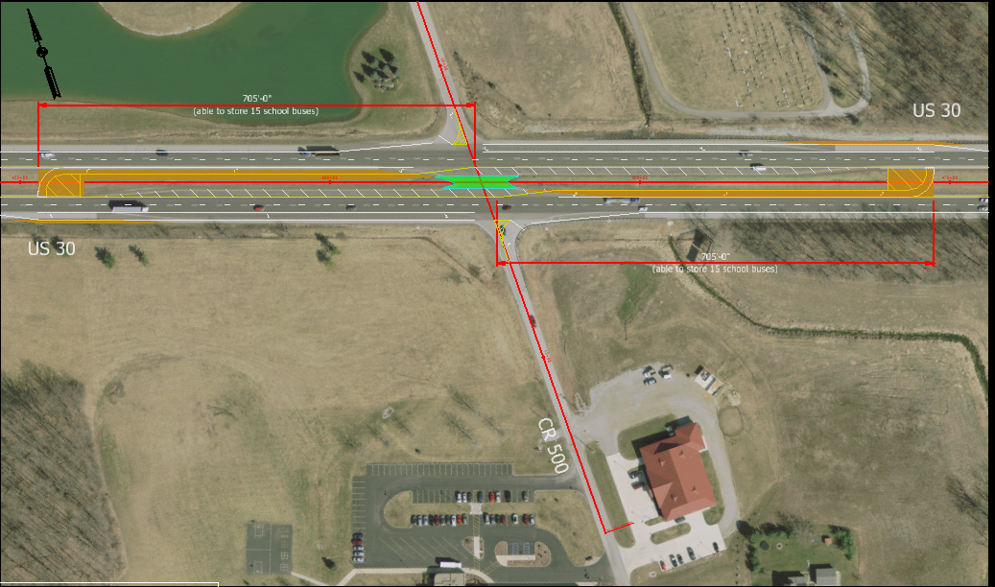
Preferred Alternative: Median U-Turn
Additional Pavement
Removed Pavement

Slide 14
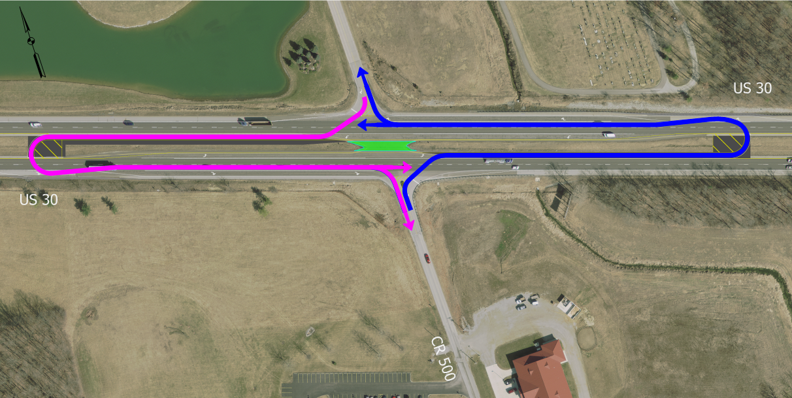
Median U-Turn Operations

Slide 15
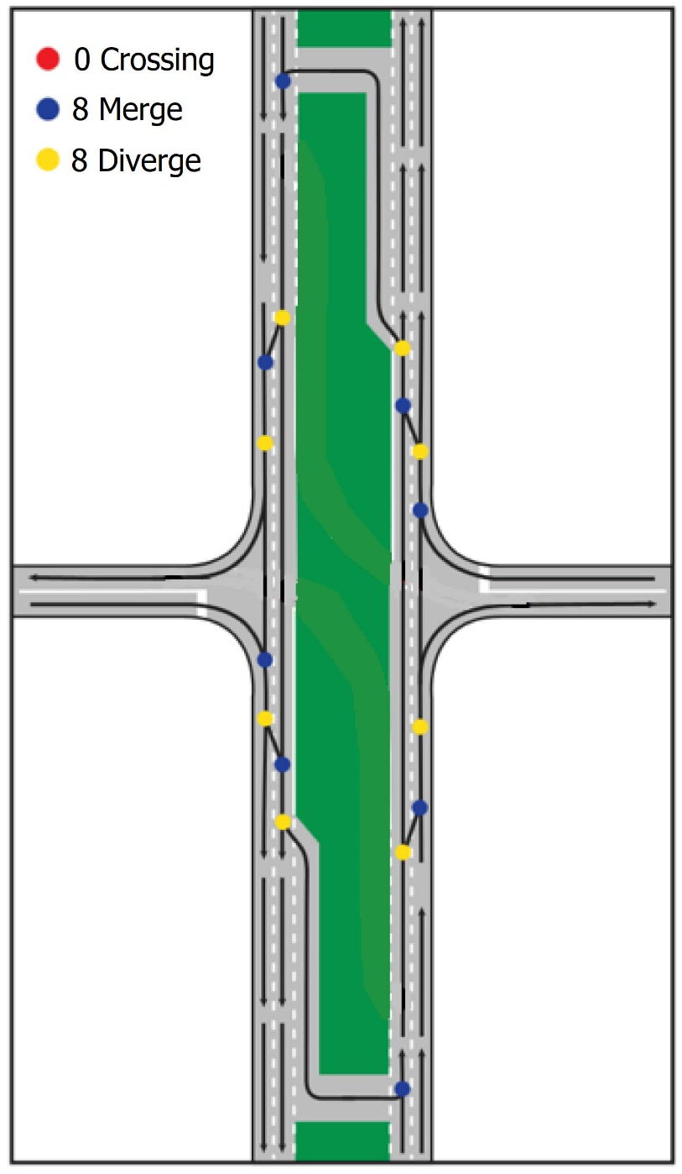
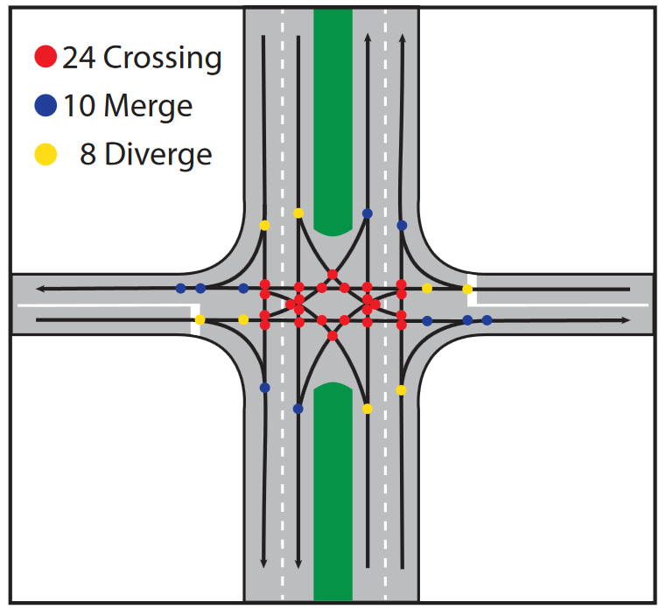
Median U-Turns Enhance Intersection Safety
Conflict points are dramatically reduced
Crossing points eliminated, reducing crash severity
Drivers only need to negotiate one direction at a time, simplifying the turning process
Conventional
Intersection
Median U-Turn
Intersection

Slide 16
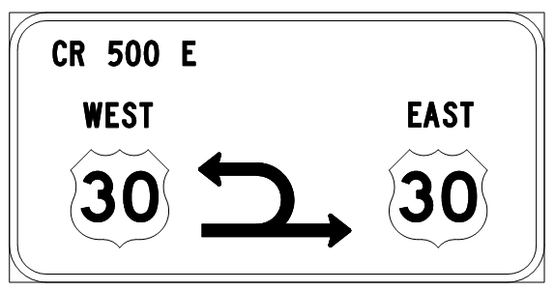
Design Features
Wider median shoulder (10’) to accommodate farm equipment
Diagrammatic signs on each approach
Delineators emphasize no through movement on C.R. 500E Road

Slide 17
Median U-Turn Safety Record in Indiana
U.S. 41 & State Road 114 (Newton County)
Four years before median U-turn opening – 22 crashes (9 injury/fatal)
Four years after median U-turn opening – 7 crashes (1 injury/fatal)
U.S. 231 & S.R. 62/68 (Spencer County)
Three years before median U-turn opening – 16 crashes (7 injury/fatal)
Three years after median U-turn opening – 5 crashes (3 injury/fatal)
U.S. 231 & S.R. 62/Washington (Spencer County)
Three years before median U-turn opening – 5 crashes (4 injury/fatal)
Three years after median U-turn opening – 2 crashes (0 injury/fatal)
U.S. 30 & S.R. 101 (Allen County)
Nine months before median U-turn opening – 5 crashes (2 injury/fatal)
Nine months after median U-turn opening – 2 crashes (0 injury/fatal)

Slide 18
Schedule and Maintenance of Traffic
Construction 2021
Construct in summer while school is out of session
Three- to six-month duration
Intersection lighting is being evaluated
Maintenance of Traffic
U.S. 30 to be constructed in phases
Phase 1 – Inside shoulder and median work
Phase 2 – Outside shoulder work
C.R. 500E to be constructed in phases
Work is minor in nature
To be completed using Flaggers
Possible short-term closure

Slide 19
Recap of Alternatives Considered
No Build
Does not include new construction but rather routine maintenance activity
Does not meet purpose and need
Signalized Intersection
Does not meet warrants for a traffic signal
Can cause an increase in crashes where not warranted
Median U-Turn Intersection
Enhances safety at intersection by eliminating or significantly reducing injury crashes
Cost-effective
Can be implemented in one construction season and be delivered next year

Slide 20
US 30 Median U-Turn

Slide 21
Social Media Comments

Slide 22
Submit Public Comments
Submit public comments using the options described in first page of information packet:
Public Comment Form
Via email at rclark@indot.in.gov
Participate during public comment session following formal presentation
INDOT respectfully requests comments be submitted by Friday, Oct. 25, 2019
All comments submitted are included in public hearings transcript and made part of the public record
Comments will be reviewed, evaluated and given full consideration during decision-making process

Slide 23
Project Resource Locations
INDOT Fort Wayne District Office
5333 Hatfield Road, Fort Wayne, Indiana 46808
Planning, Project Development/Delivery, Construction, Maintenance for Northeast Indiana
http://www.in.gov/indot/2703.htm
Peabody Public Library
1160 East S.R. 105, Columbia City, IN 46725
INDOT Office of Public Involvement
100 North Senate Avenue, Room N642, Indianapolis, IN 46204
Phone: (317) 232-6601
rclark@indot.in.gov
Transportation Services Call Center
Provides citizen and business customers with a single point-of-contact to request transportation services, obtain information, or provide feedback through multiple channels of communications.
855-463-6848 • INDOT4U.com • INDOT@indot.in.gov

Slide 24
Next Steps
Public and project stakeholder input
Submit comments via options described on page 1 of information packet
INDOT review and evaluation
All comments given full consideration during decision-making process
Finalize/approve environmental document, complete project design
Communicate a decision
INDOT will notify project stakeholders of decision
Work through local media, social media outlets, paid legal notice
Make project documents accessible via repositories
Questions? Contact Public Involvement Team
Project resource information online: https://www.in.gov/indot/2703.htm

Slide 25
Thank You
Please visit with the INDOT project team following the presentation and comment session
Project Open House
Project maps, displays, INDOT project team and informal Q & A
INDOT Fort Wayne District page: http://www.in.gov/indot/2703.htm

