Slide 1
S.R. 42 Pavement Replacement Town of Mooresville
Wednesday, June 12, 2019
6 p.m.

Slide 2
Welcome
Purpose of public meeting
Format
Visit our sign-in table
Informational handouts
Participate during public comment session
Submit written public comments
Project display area

Slide 3
S.R. 42 Pavement Replacement
INDOT Project Team
INDOT Crawfordsville District
Project Management
Public Involvement
Communications
Design/Engineering
Real Estate
Crawford Murphy & Tilly (CMT)
Design, Engineering, Environmental Analysis
Recognition of elected/local public officials
Sign-in at attendance table to be added to project mailing list
Public meeting notice mailed to known property owners within project area
Announcement of this meeting was posted to INDOT website.
A copy of presentation and project documentation are available for review on-line via INDOT website

Slide 4
Project Stakeholders
Indiana Department of Transportation
Federal Highway Administration
Town of Mooresville
Elected & local officials
Residents and citizens
Commuters
Businesses
Emergency services
Schools
Churches
Community organizations

Slide 5
Project Development
Project Selection
Early Coordination
Purpose & Need
Develop alternatives
Preliminary design phase
Environmental Analysis
Design
Engineering
Real Estate
Project Letting
Construction
Public Involvement:
Public Information Meeting 2018
Public Information Meeting 2019
Public Involvement

Slide 6
Project Resources
INDOT Crawfordsville District Office
41 West 300 North, Crawfordsville, IN 47933
Planning, Project Development/Delivery, Construction, Maintenance for West Central Indiana
On-line
https://www.in.gov/indot/2701.htm
INDOT Office of Public Involvement
100 North Senate Avenue, Room N642, Indianapolis, IN 46204
rclark@indot.in.gov
Transportation Services Call Center
Provides citizen and business customers with a single point-of-contact to request transportation services, obtain information, or provide feedback through multiple channels of communications.
855-463-6848 • INDOT4U.com • INDOT@indot.in.gov

Slide 7
Purpose and Need
Deteriorating Pavement Condition
Provide Pavement for a Long Service Life
Inadequate Storm Sewer Inlets
Reduce Ponding and Drainage Concerns
ADA Compliance
Provide ADA-Compliant Ramps
Intersection Safety Concerns
Enhance Intersections to Reduce Crashes

Slide 8
Project Location
From White Lick Creek Bridge to SR 67
Project Length = 1.0 Mile

Slide 9
Pavement Treatment
Green = Full Depth Asphalt Pavement Replacement
Blue = Asphalt Pavement Rehabilitation

Slide 10
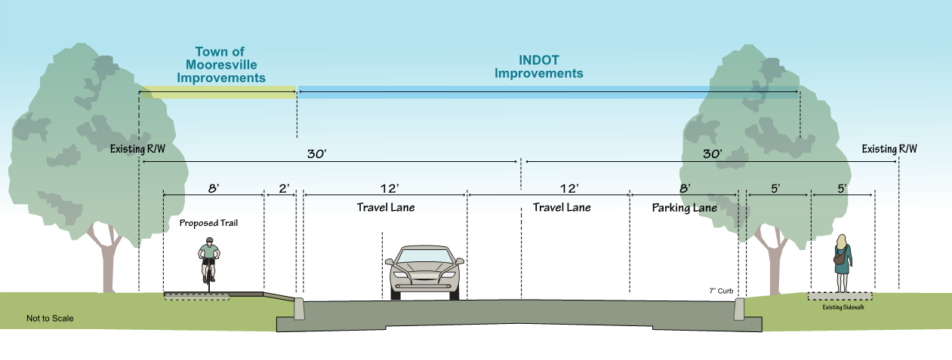
Typical Roadway Section

Slide 11
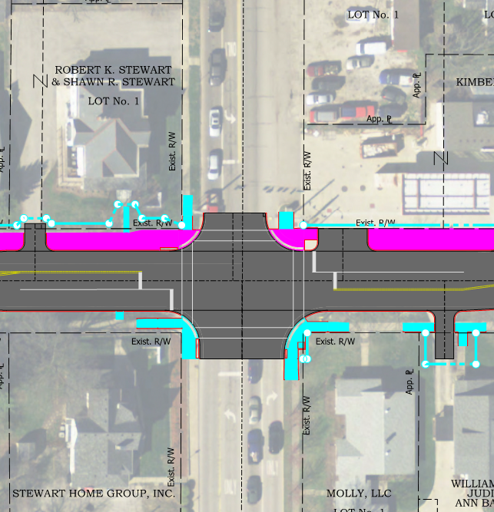
Intersection Treatments

Slide 12
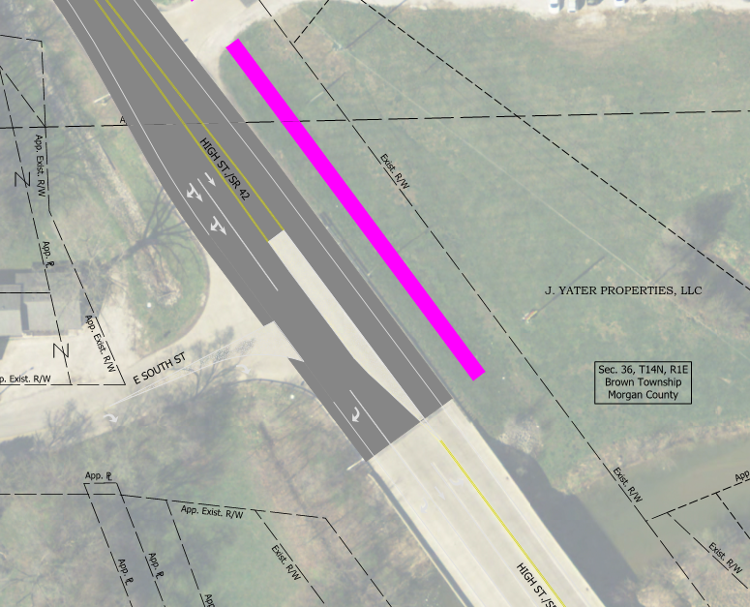
Intersection Treatments

Slide 13
Street Enhancements
New Curb Ramps
Northside Sidewalk to be Replaced by 8’ Wide Shared-Use Path
Street Lighting
Utility Upgrades

Slide 14
Construction Schedule
SR 42 Closed to Through Traffic
SR 42 Open to Local Traffic
Property Owners Always have Access

Slide 15
Construction Stage 1
Blue Line – Jefferson Street to Indiana Street
Spring 2021

Slide 16
Construction Stage 2
Red Line – White Lick Creek to Jefferson Street
Summer 2021

Slide 17
Construction Stage 3
Dashed Red Line – Railroad to SR 67
Summer 2021

Slide 18
Construction Stage 4
Green Line – Indiana Street to Railroad
Spring/Summer 2022

Slide 19
Real Estate

Slide 20
Real Estate Acquisition Process
Uniform Act of 1970
All federal, state and local governments must comply
Requires an offer for just compensation
Acquisition Process
Appraisals
Review Appraisals
Negotiations
INDOT Real Estate Team to work with impacted property owners
Right-of-way (ROW)
Permanent ROW
Permanent ROW is land, that once purchased by INDOT from the legal land owner, becomes ROW owned by INDOT
0.4 Acre
Temporary ROW
Temporary ROW is land required during the construction of a project and is used for the purposes of construction-related activity
INDOT pays legal land owner a fee for land use during construction
0.4 Acre

Slide 21
Project Schedule
Design / Engineering – Started Fall 2017
Real estate acquisition activities – To Begin July 2019
Appraising
Negotiations/buying
Utilities coordination
Construction – 2021 and 2022

Slide 22
Submit Public Comments
Submit public comments using the options described in the first page of the information packet:
Public comment form
Via email
Participate during public comment session following formal presentation
Comments will be reviewed by project team as project development activities continue
Respectfully request comments be submitted to INDOT by Friday, July 12, 2019
INDOT Customer Service 1-855-463-6848 (1-855-INDOT4U)
INDOT Office of Public Involvement rclark@indot.in.gov

Slide 23
Next Steps
Public and project stakeholder input
Submit comments via options described on page 1 of information packet
INDOT review and evaluation
Project to review comments
Continue project development activities
Preliminary design, engineering, real estate acquisition
Public Involvement Team
Additional public involvement activities to be determined as project development continues

Slide 24
Project Resource Locations
INDOT Crawfordsville District Office
41 West 300 North, Crawfordsville, Indiana 47933
Planning, Project Development/Delivery, Construction, Maintenance for West Central Indiana
District Webpage http://www.in.gov/indot/2701.htm
INDOT Customer Service
1-855-463-6848, INDOT@indot.in.gov
INDOT Office of Public Involvement
100 North Senate Avenue, Room N642, Indianapolis, IN 46204
Phone (317) 232-6601
rclark@indot.in.gov

Slide 25
Thank You
Please visit with INDOT project team following public comment session
Project Open House
Project maps, displays, INDOT project team and informal Q & A
INDOT Crawfordsville District page http://www.in.gov/indot/2701.htm

