Slide 1
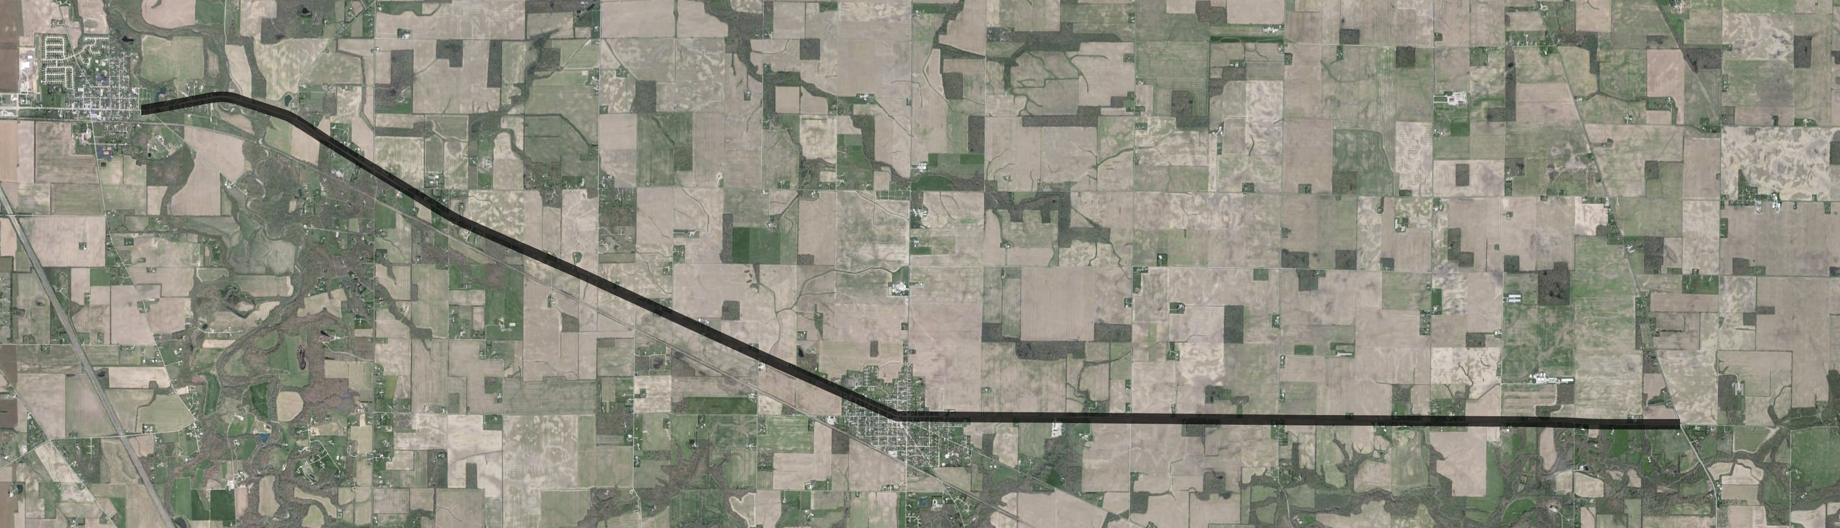
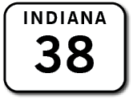
Section 2
Section 2 (east edge of Dayton Cemetery to 50 feet east of E. 350 S.)
Section 2 Part 1 - full depth reclamation of the travel lanes and construction of 2 foot paved and 1 foot aggregate shoulders
Section 2 Part 2 - mill and overlay the travel lanes and both shoulders
SECTION 2

Slide 2
Section 3
Section 3 (50 feet east of E. 350 S. to 200 feet west of West Street in Mulberry)
Full depth reclamation of the travel lanes
Construction of 2 foot paved and 1 foot aggregate shoulders
Some areas will include4 foot shoulders and the installation of guardrail
SECTION 3

Slide 3
Section 4
Section 4 (200 feet west of West Street to 750 feet east of Park Street in Mulberry)
Section 4 Part 1 is located in a residential area and Part 2 is located in a commercial area
Mill and overlay the travel lanes and both shoulders
SECTION 4

Slide 4
Section 5
Section 5 (750 feet east of Park Street in Mulberry to 800 feet east of N. 500 W.)
Full depth reclamation of the travel lanes
Construction of 2 foot paved and 1 foot aggregate shoulders
SECTION 5

Slide 5
Section 6
Section 6 (800 feet east of N. 500 W. to north Junction of SR 38/US 421)
Full depth reclamation of the travel lanes
Construction of 2 foot paved and 1 foot aggregate shoulders
Two sections there will include full depth reclamation of the travel lanes with 4 foot paved shoulders and guardrail will be installed
SECTION 6

Slide 6
Maintenance of Traffic (MOT)
The MOT for this project will require a full or partial closure allowing access for local traffic and utilizing an official detour route for all truck traffic.
The official detour route from west to east would utilize:
I-65 north to SR 26 to US 421/SR39 (approximately 21.1 miles)
I-65 south to SR 28 to US 421/SR 39 (approximately 24.3 miles).

Slide 7
Right-of-Way
This project will require approximately 50.83 acres of permanent right-of-way (ROW) from the following property types:
Residential – 18.10 acre
Commercial – 0.14 acre
Agricultural – 32.55 acre
Cemetery – 0.04 acre

Slide 8
Project Schedule
The anticipated schedule is…
Public Hearing – March 22, 2021
Environmental Document Completion – April 2021
Project Letting – Winter 2021
Construction to Begin – Spring 2022
Note – Construction completed by Fall 2023

Slide 9
Public Comment Reminders
Mail to Jason Rowley at Hanson Professional Services, Inc., 6510 Telecom Drive, Suite 210, Indianapolis, IN 46278
Email to jrowley@hanson-inc.com or SHeck@indot.in.gov
Please ensure that comments are postmarked no later than April 5, 2021
All comments will be reviewed, evaluated, and given due consideration during the decision making process

