Slide 1

Intersection Improvement Project
S.R. 9 at Broadway St. (Pendleton Ave.)
Des 2200064
Public Information Meeting
Presentation will begin at 5:30 p.m.

Slide 2
Topics We Will Cover
Purpose and Need
Environmental impacts review
Proposed solution
Ways to contact us
Project Team available for question and answers

Slide 3
Materials Available
Aerial illustration of proposed improvements
Existing conditions
Project fact sheet and comment form
Project team is available for question and answers

Slide 4
Project Team
INDOT Greenfield District
Maggie Elsbury, Project Manager
Jordan Yaney, Public Relations Director
Lochner Consulting Team
Adam Higgins, Design Manager
Jon Sherrick, Design Lead
Lisa Vale, Environmental Manager
Marie Jaffe, Public Involvement Specialist

Slide 5
National Environmental Policy Act (NEPA)
Environmental analysis and documentation is required for all federally-funded projects
Evaluates alternatives, including “no build”
Considers and addresses public comments
Incorporates socio-economic and ecological considerations in the decision-making process
What are the impacts?
How can they be avoided or mitigated?

Slide 6
National Environmental Policy Act (NEPA)
Environmental Impacts
No wetland or waterways on the project
No right-of-way property anticipated
No tree clearing
No historic concerns
Permanent traffic alteration anticipated

Slide 7
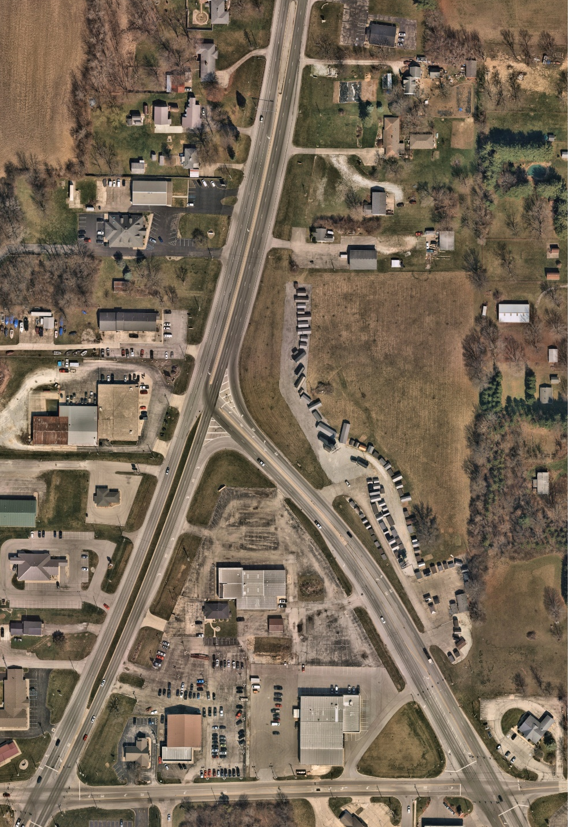
Existing Conditions
Broadway St.
S.R.9/Scatterfield Rd.
Hartman Rd.

Slide 8
Purpose and Need
This intersection improvement project is needed due to the high number of crashes, specifically right angle (T-bone) crashes. The purpose of this project is to improve safety while maintaining traffic mobility at the intersection.

Slide 9
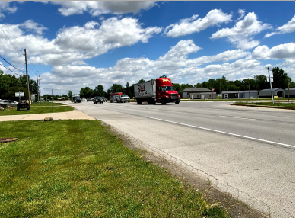
Purpose and Need
Current traffic movement causing backups
Reduce congestion at intersection
Addressing serious right angle T-bone collisions

Slide 10
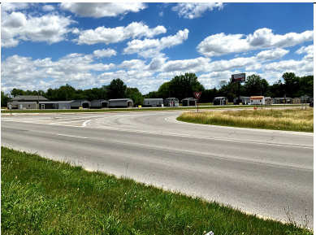
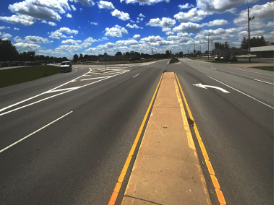
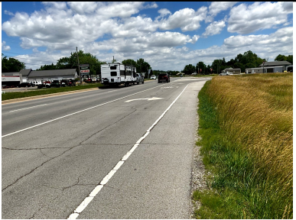
Existing Conditions
Facing east, west of the intersection looking at S.R. 9 east approach leg
Facing south looking at intersection
Facing north looking at Broadway NB right turn lane

Slide 11
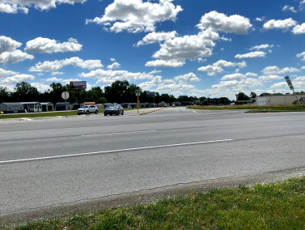
Existing Conditions
Facing east at the intersection
Facing northeast looking southbound traffic waiting in intersection to make left turn

Slide 12
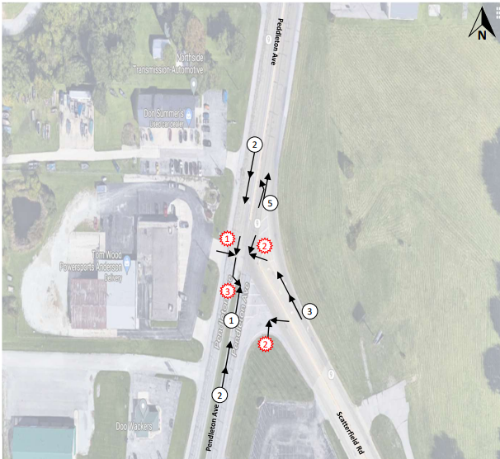

Collision History

Slide 13
Alternatives Analysis
Alternative 1- Modified Continuous Green T Intersection
Concrete median will separate the SB thru movement from the rest of the movements in the intersection.
The channelized right turn lane for WB movements will be removed.
Alternative 2- Roundabout
This alternative comes at a much higher cost to the Green T intersection.
Alternative 3- No Build
No build or do nothing was considered but was not chosen.

Slide 14
Proposed Solution
Traveling on S.R. 9 (Scatterfield Road)
Vehicles traveling north on S.R. 9 will have a dedicated right-hand turn lane onto Broadway Street headed north.
A signal will be installed at this intersection.
Traveling on Broadway Street
Vehicles traveling north on Broadway Street who want to turn right onto southbound S.R. 9 will have a dedicated
right turn lane.
There will also be two through lanes for traffic continuing north on Broadway Street. A traffic signal will be installed at this intersection to manage traffic.
Vehicles traveling south on Broadway Street who want to turn left onto southbound S.R. 9, will have a dedicated left turning lane with a traffic signal to assist with traffic movements.
Southbound traffic on Broadway Street will have two through lanes with a continuous green signal.

Slide 15
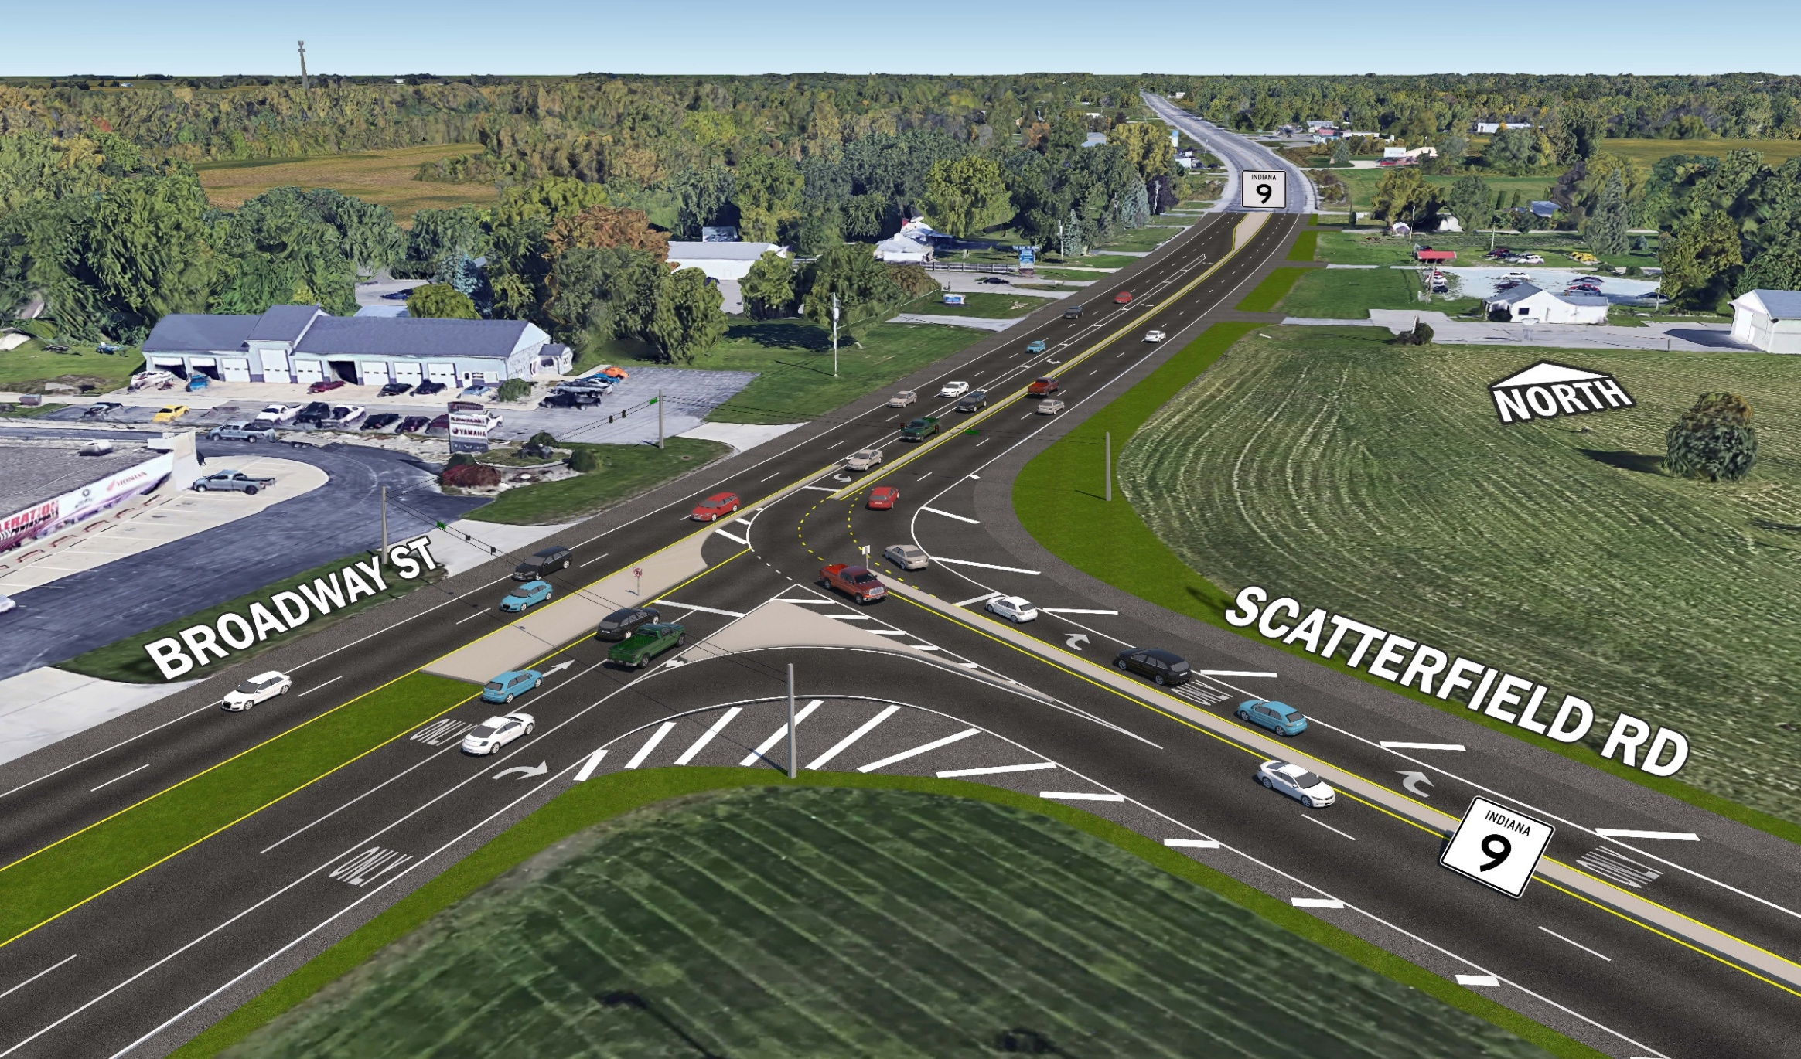
Proposed Solution

Slide 16
Maintaining Traffic During Construction
Maintain one-lane of traffic in all directions throughout the work zone with short-term closures, as needed
Coordination with adjacent property owners
Coordination with emergency responders and school district

Slide 17
Anticipated Timeline
Early 2026: Draft environmental document available for public review and comment
Spring 2026: Formal Public Hearing & finalize environmental document
Fall 2026: Finalize project design
Spring/Summer 2027: Start construction

Slide 18

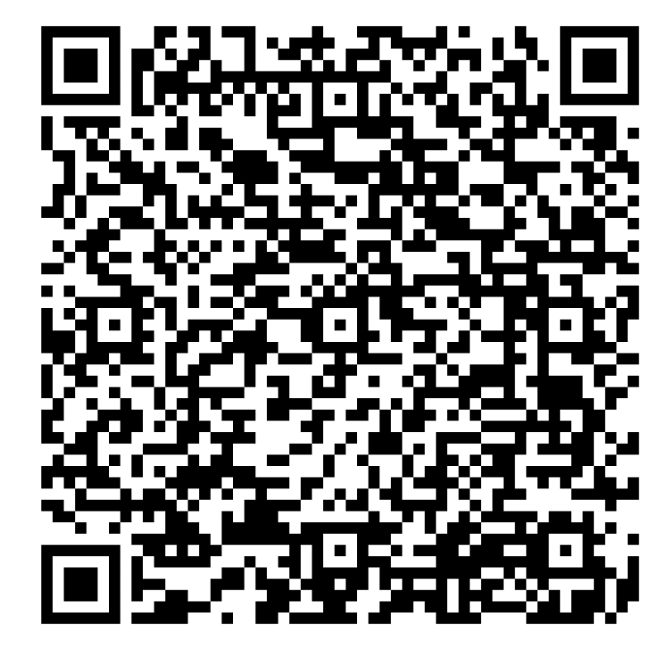
Posted After the Meeting
Presentation slides
Presentation recording
Aerial illustrations
Handouts

Slide 19
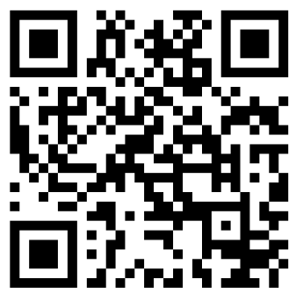

Ways to Provide Public Input
Paper and Online
Comment Form
Email Marie Jaffe
Lochner Communications
mjaffe@hwlochner.com
Scan to leave a comment

Slide 20

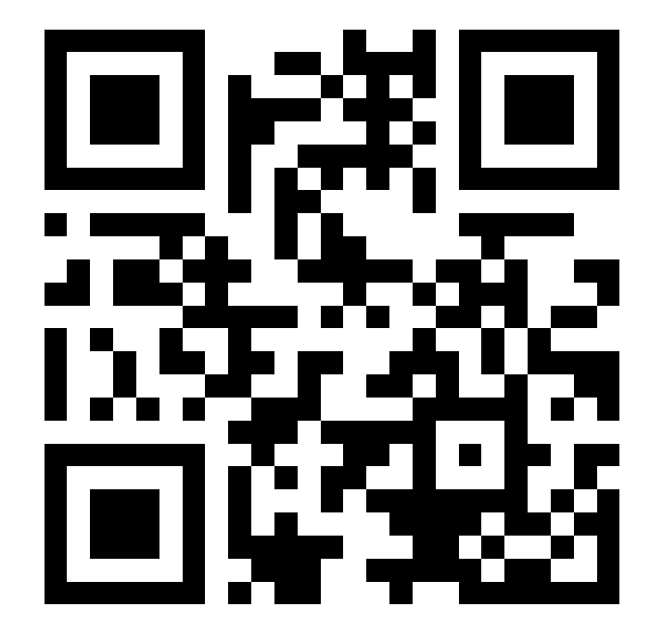

Stay Informed
@INDOTEast on Facebook & Twitter
Email & Text Alerts
511in.org

Slide 21
Next Steps
Aerial illustration of proposed improvements
Talk with project team members and ask questions
Provide comments using paper forms or digital

