Slide 1

Public Hearing for R-43059
US 6 at US 421 East Junction
Intersection Improvement
Near Town of Westville, LaPorte County
DES 1702989
Wednesday, February 15, 2023
5:00 pm CST Open House
6:00 pm CST Hearing Presentation
Westville Middle/Senior High School

Slide 2

Public Hearing for R-43059
Welcome
Purpose of Hearing
Hearing format
Visit Sign-In Table
Informational Handouts
How to Participate
Submitting written comments
Project display area

Slide 3
Public Hearing for R-43059
Introduction of INDOT project team
Project Management
Public Involvement
La Porte District- INDOT Regional Office
Environmental Services
Real Estate
GAI Consultants
Project Management
Design
Environmental Documentation
Permits
Recognition of Elected Officials
Sign-In at attendance table to
be added to a project mailing list.
A Public Hearing notice was mailed to known property owners in the project area.
An announcement of this hearing was posted to INDOT’s website.
A copy of the presentations and project documentation is available online via INDOT’s website.
Legal Notice publishing – Feb 2nd & 9th
Northwest Indiana Times
Laporte Herald Dispatch

Slide 4
Public Hearing for R-43059
Submit Public Comments
Submit public comments using the options described in the page of the information packet:
  Public Comment Form
  Via email (R.Webb@GAIConsultants.com or mgrylewcz@indot.in.gov)
  Participating during the public comment session via microphone
    Note that verbal comments will be recorded and transcribed for inclusion into the public hearing transcript.
INDOT respectfully requests comments be submitted by (Thursday, March 2, 2023).
All comments submitted will become part of the public record, and they will be entered into a transcript, reviewed, evaluated, and given full consideration during the decision-making process.

Slide 5
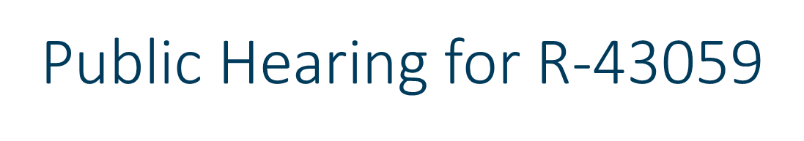

Project Resource Locations
Westville Public Library, 153 Main St. Westville, IN 46391
Transportation Services Call Center
  Provide citizens and business customers with a single point of contact to request transportation services, obtain information, or provide feedback through multiple channels of communication.
  855-463-6848  INDOT4U.com  INDOT@indot.in.gov
Project website on LaPorte District Page
https://www.in.gov/indot/about-indot/central-office/welcome-to-the-laporte-district/us-6-at-us-421-east-junction-intersection-improvement/

Slide 6
Public Hearing for R-43059
Project Stakeholders
Indiana Department of Transportation
Indiana Division of Federal Highway
La Porte County
Town of Westville
Elected and Local Officials
Residents and citizens
Commuters
Businesses
Emergency Services
Schools
Churches
Community organizations

Slide 7
Public Hearing for R-43059
Project Schedule
Public Hearing: February 15, 2023
Public Comments Requested by 5:00 pm CST, March 2, 2023
INDOT review and consideration of comments (Winter 2023)
  Finalize environmental document
  Complete Design
  Project decision
Real Estate acquisition phase has been completed
Utility relocation work in early 2023
Construction in 2024

Slide 8
Public Hearing for R-43059
Environmental Document
National Environmental Policy Act (NEPA)
Requires INDOT to analyze and evaluate the impacts of a proposed project to the natural and socio-economic environments
NEPA is a decision-making process
Purpose and Need
Alternatives Screening
Preferred Alternative
NEPA Environmental Documents are divided into categories based on impact level
Programmatic Categorical Exclusion (PCE) and CE Level 1 – Least impacts
CE Level 2-4 – Average level of impacts
Environmental Assessment/Impact Statement – Greatest level of impacts

Slide 9
Public Hearing for R-43059
Environmental Document (cont.)
Impacts are analyzed, evaluated and described in an environmental document
What are the impacts this project might have on the community?
How can impacts be avoided?
Can impacts be minimized?
Mitigation for impacts?
Environmental document released for public involvement
CE Level 1
December 2, 2022
Available for review via public repositories

Slide 10
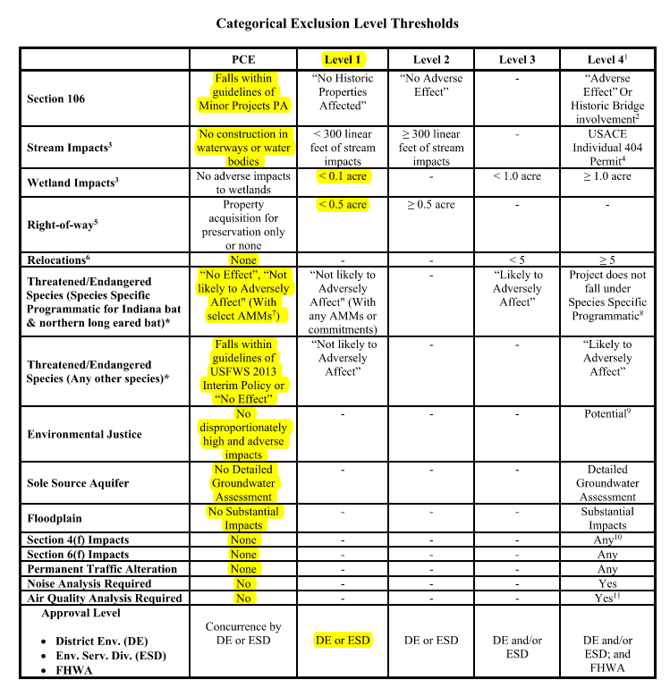
Public Hearing for R-43059
Environmental Document Levels

Slide 11
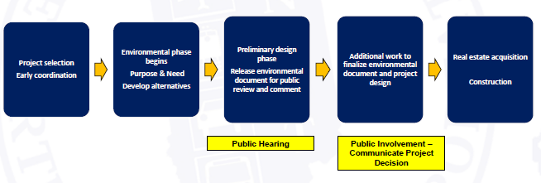
Public Hearing for R-43059
Project Development

Slide 12

Public Hearing for R-43059
Right of Way Acquisition Process
U.S. Department of Transportation
Federal Highway Administration
Publication No. FHWA – HEP-05-030
“Acquisition – Acquiring Real Property
for Federal and Federal-Aid Programs
and Projects”.
Describes the process to determine the fair market value of the land to be acquired. Written offers are presented. When possession changes hands, etc.

Slide 13
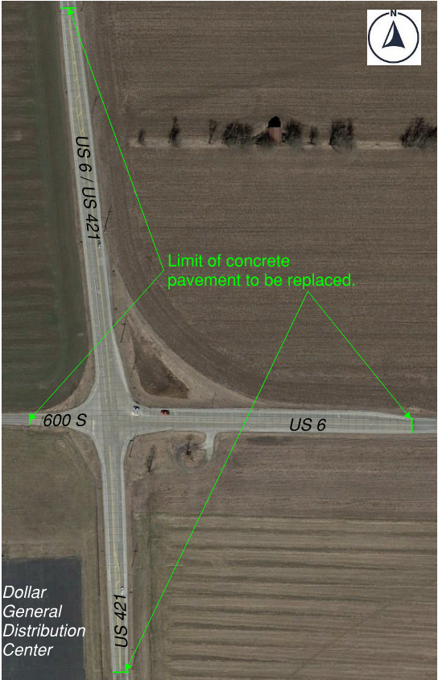
Public Hearing for R-43059
Existing Intersection

Slide 14
Public Hearing for R-43059
Alternatives for Intersection Improvement
No Build Alternative would not address the purpose and need of the project.
Four-Way Stop Control
  Crash history indicates west bound traffic does not stop for existing stop sign.
  Double signs, rumble stripes, overhead flasher have all failed to get drivers’ attention.
  All-Way stop control is recommended when all approaches have similar volumes.
Traffic Signal
  None of the nine signal warrants were satisfied at this location.
Roundabout – preferred alternative
  Crash frequency and severity would be reduced with lower approach speeds.
  Rear end crashes would be fewer with reduced Queue lengths from improve flow.
All Other Alternatives
  Remaining alternatives considered were either infeasible or imprudent.

Slide 15
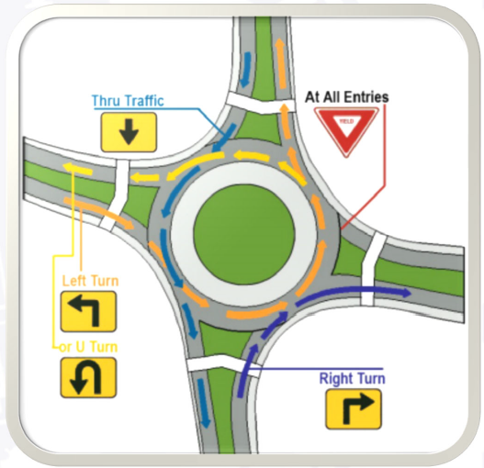
Public Hearing for R-43059
Roundabout – INDOT Preferred Alternative
One-way circular intersection
Traffic flows counter-clockwise around a center island
Yield at entrance to vehicles on the circulating roadway
No Parking
No “activity” in center island*
*Center island will be used for oversized vehicles

Slide 16
Public Hearing for R-43059
Roundabouts Enhance Safety
U.S. DOT Federal Highway Administration Statistics
Traditional intersections account for:
45% of all crashes
33% of all traffic fatalities
Compared to traditional intersections, roundabouts:
Reduce fatalities and injuries by 82%
Reduce total crashes by 44%
Require vehicles to travel at lower speeds
For more information:
http://safety.fhwa.dot.gov/intersection/innovative/roundabouts/
Collisions at traditional intersections are severe because of:
High speeds
Angle of impact

Slide 17
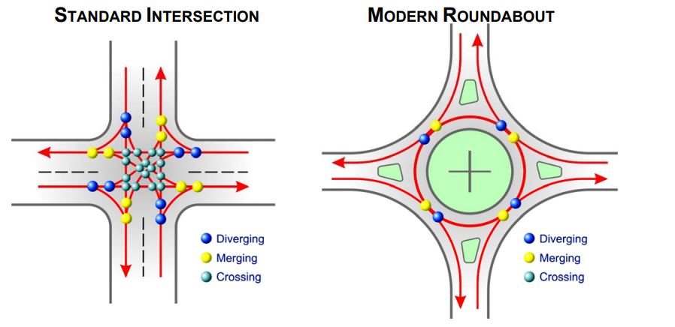
Public Hearing for R-43059
Roundabouts Enhance Safety
Conflict points are dramatically reduced because all vehicles travel in the same direction.
Enhances Safety
  Roundabouts reduce the number of potential collision points within an intersection.
  75% fewer conflict points than a four-way intersections.
Slower vehicle speeds
  Reduces the severity of crashes
Efficient traffic flow
  Reduces need for turn lanes
  Improves traffic flow
Community benefits
  Reduced congestion
  Aesthetically pleasing landscaping

Slide 18
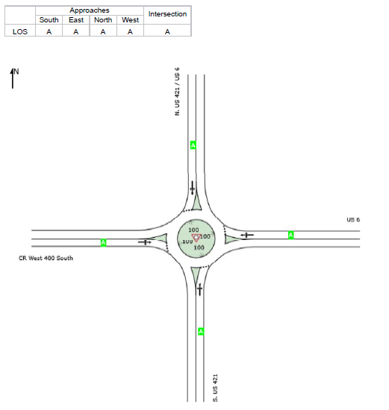
Public Hearing for R-43059
Roundabout Operation
All approaches will operate at a Level of Service A in the design year.
This is the highest level of operation based on the Highway Capacity Manual analysis for roundabouts.
It represents a less than 10 second per vehicle average delay when entering the intersection.
CR West 600 South

Slide 19
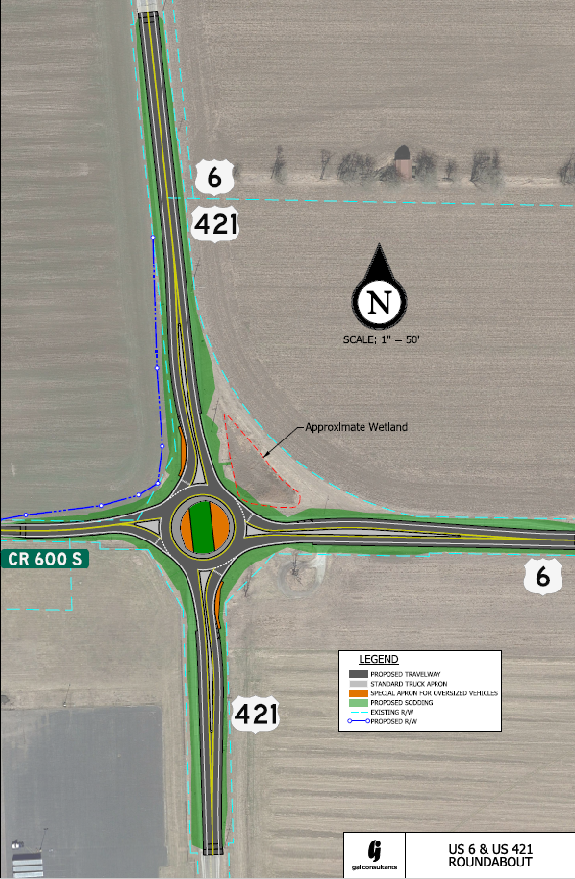
Public Hearing for R-43059
Proposed Roundabout Layout
0.053 acres Proposed R/W
Requires 0.053 acres of Right of Way
Reuses some lighting, new lights are added
Orange areas are oversized vehicle apron
Minor impact to wetland in NE corner
Cost Estimate is $2.5 million

Slide 20
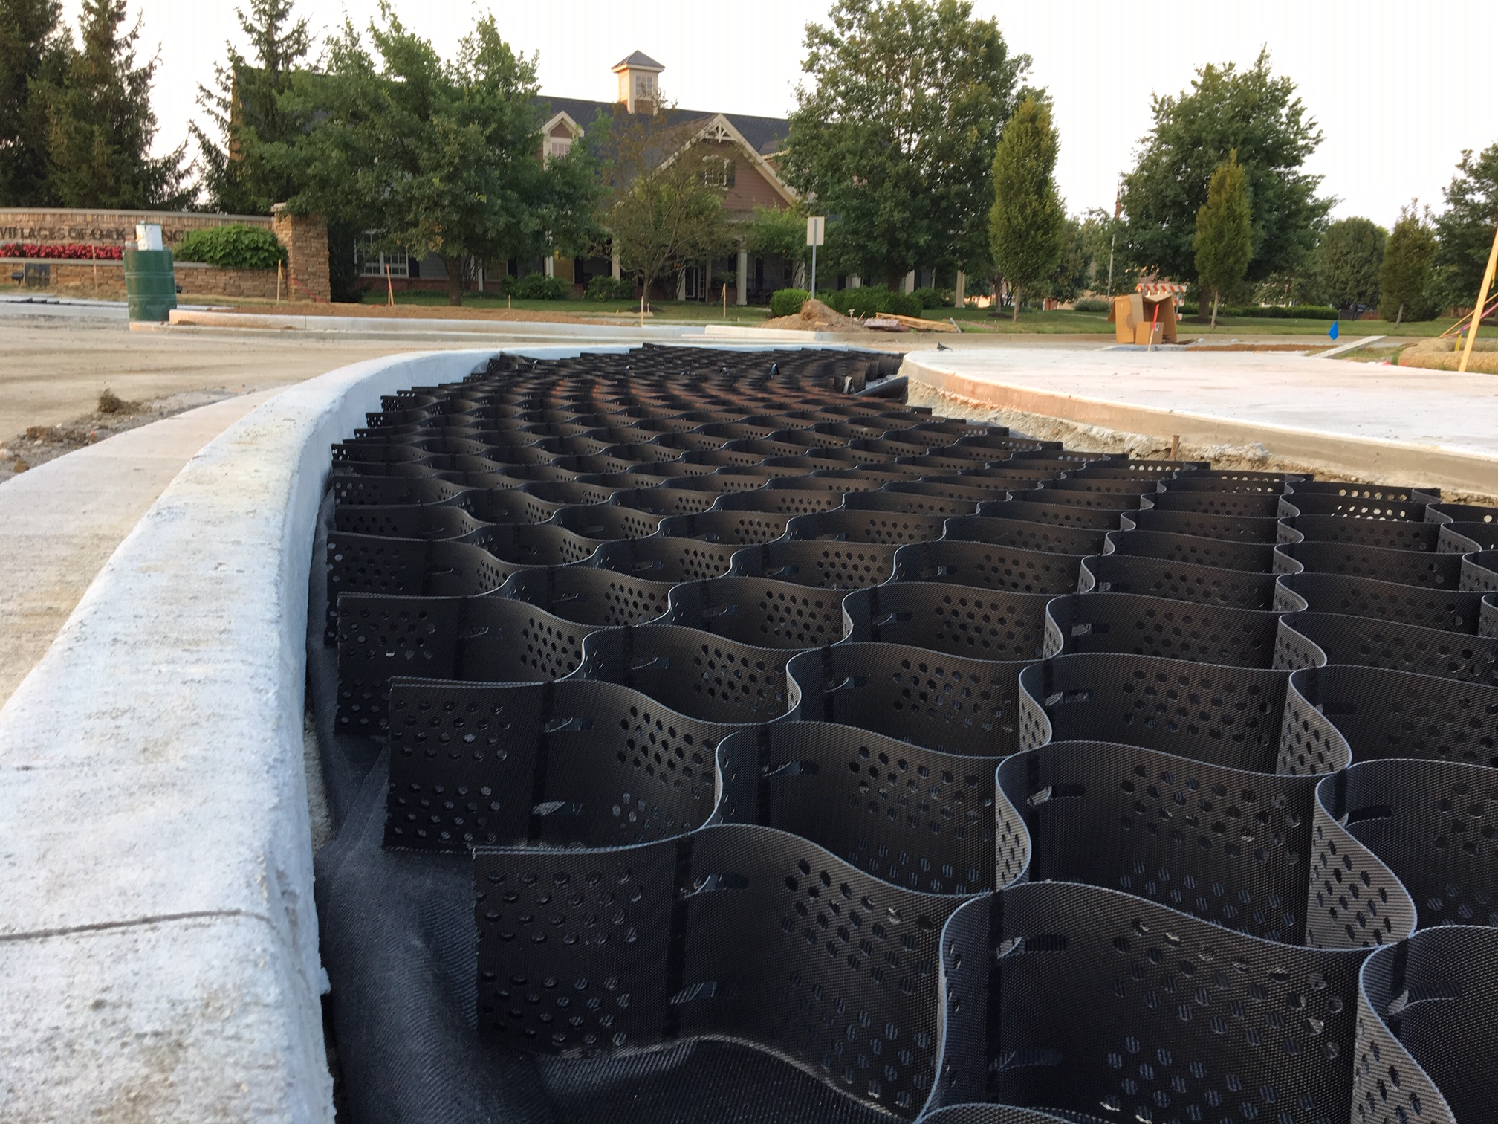
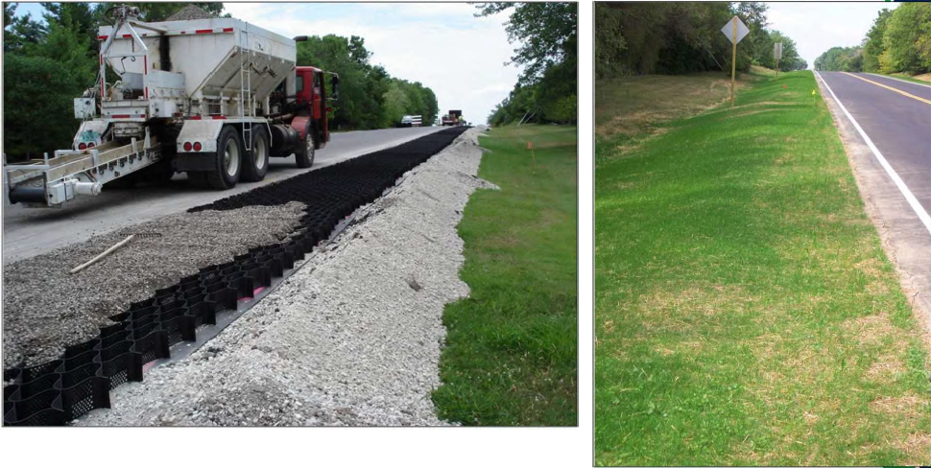

Public Hearing for R-43059
Central Island Appearance and Maintenance
Proposed to use Geocell reinforcement under turf for Oversized Vehicle Apron in island and outside curbline.
Would have grass that would be mowed.
Westfield, IN

Slide 21
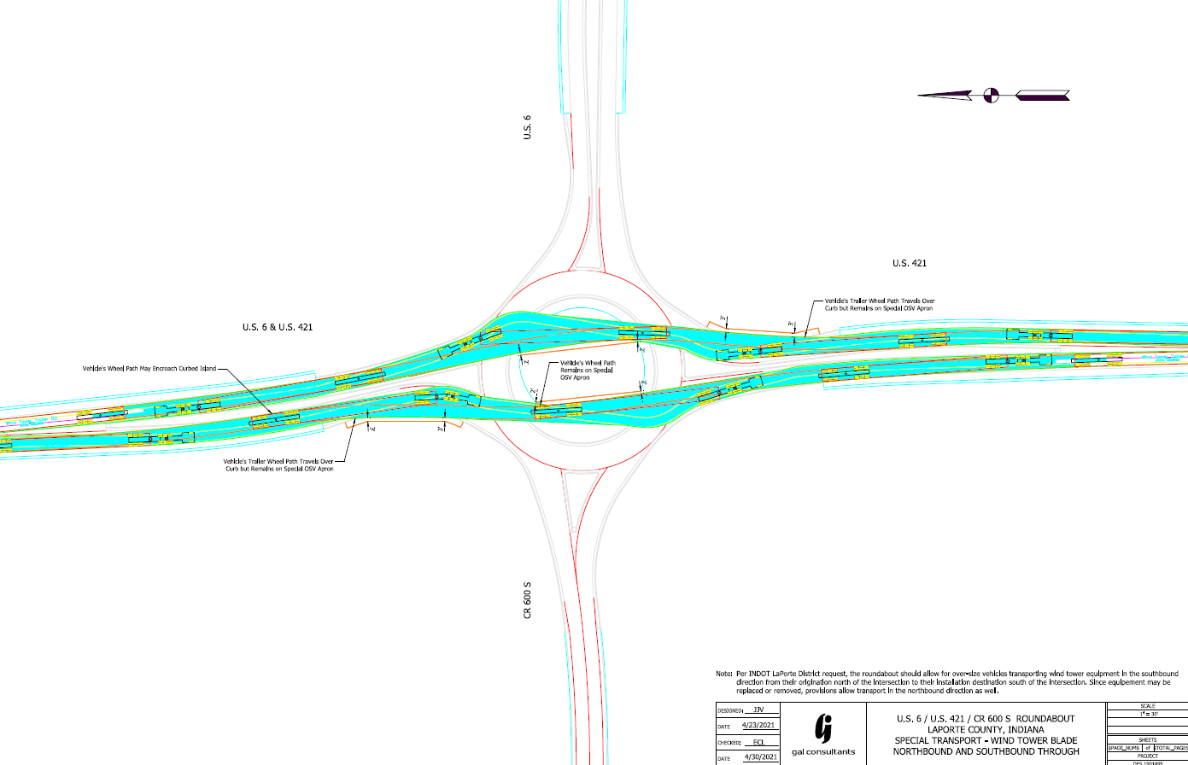
Public Hearing for R-43059
Turning Movement Diagram –
Wind blade transport truck

Slide 22
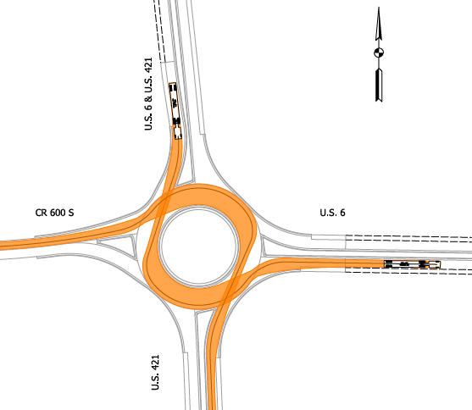
Public Hearing for R-43059
Design Vehicle Turning Movements
Indiana Design Vehicle WB-65 turning from:
Southbound to Eastbound
Northbound to Westbound

Slide 23
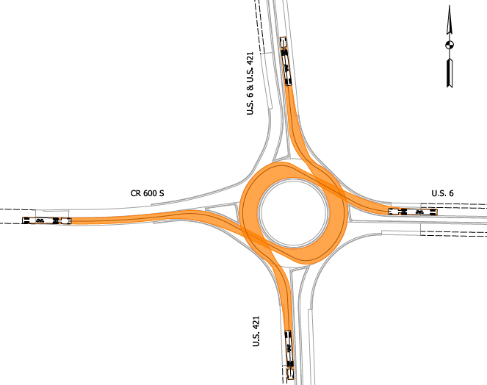
Public Hearing for R-43059
Design Vehicle Turning Movements
Indiana Design Vehicle WB-65 turning from:
Eastbound to Northbound
Westbound to Southbound

Slide 24
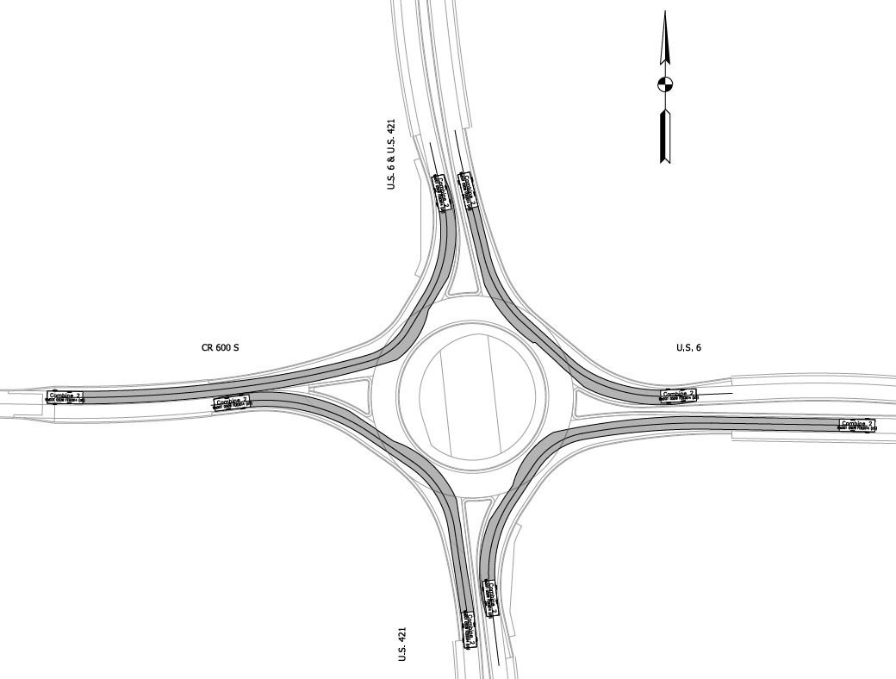
Public Hearing for R-43059
Turning Movement Diagram –
Combine Harvester

Slide 25
Public Hearing for R-43059
Full Closure vs Construction under Traffic
Phase Construction under traffic
  It will require temporary pavement, temporary markings and signs that add to the construction costs of the project.
  It takes more time to complete the project and fully open it to traffic. Estimate is that 180 days would be required to phase construct the intersection.
  Short term closures of CR 600 South and US 6 east leg would still be required and still require a posted detour.
  If the pavement is replaced with concrete, joints will be more frequent and partial width pavement joints require more maintenance.
Construction with Full Closure
  Requires all traffic to follow posted detours adding distance to trips
  Full closure is estimated to require 120 days with some additional days to fully open to traffic.
Either option will detour any wide loads during construction.

Slide 26
Public Hearing for R-43059
Maintenance of Traffic
Intersection of US 6 and US 421 will be closed to all traffic during the reconstruction of the intersection and pavement replacement.
Access to the Dollar General Distribution Center, Tazco Ready Mix Concrete Plant, residential and agricultural properties will be permitted. Temporary surface will be provided to maintain access to the properties.
Detours will be established for US 6 and US 421for traffic on those routes to be guided around the closure.

Slide 27
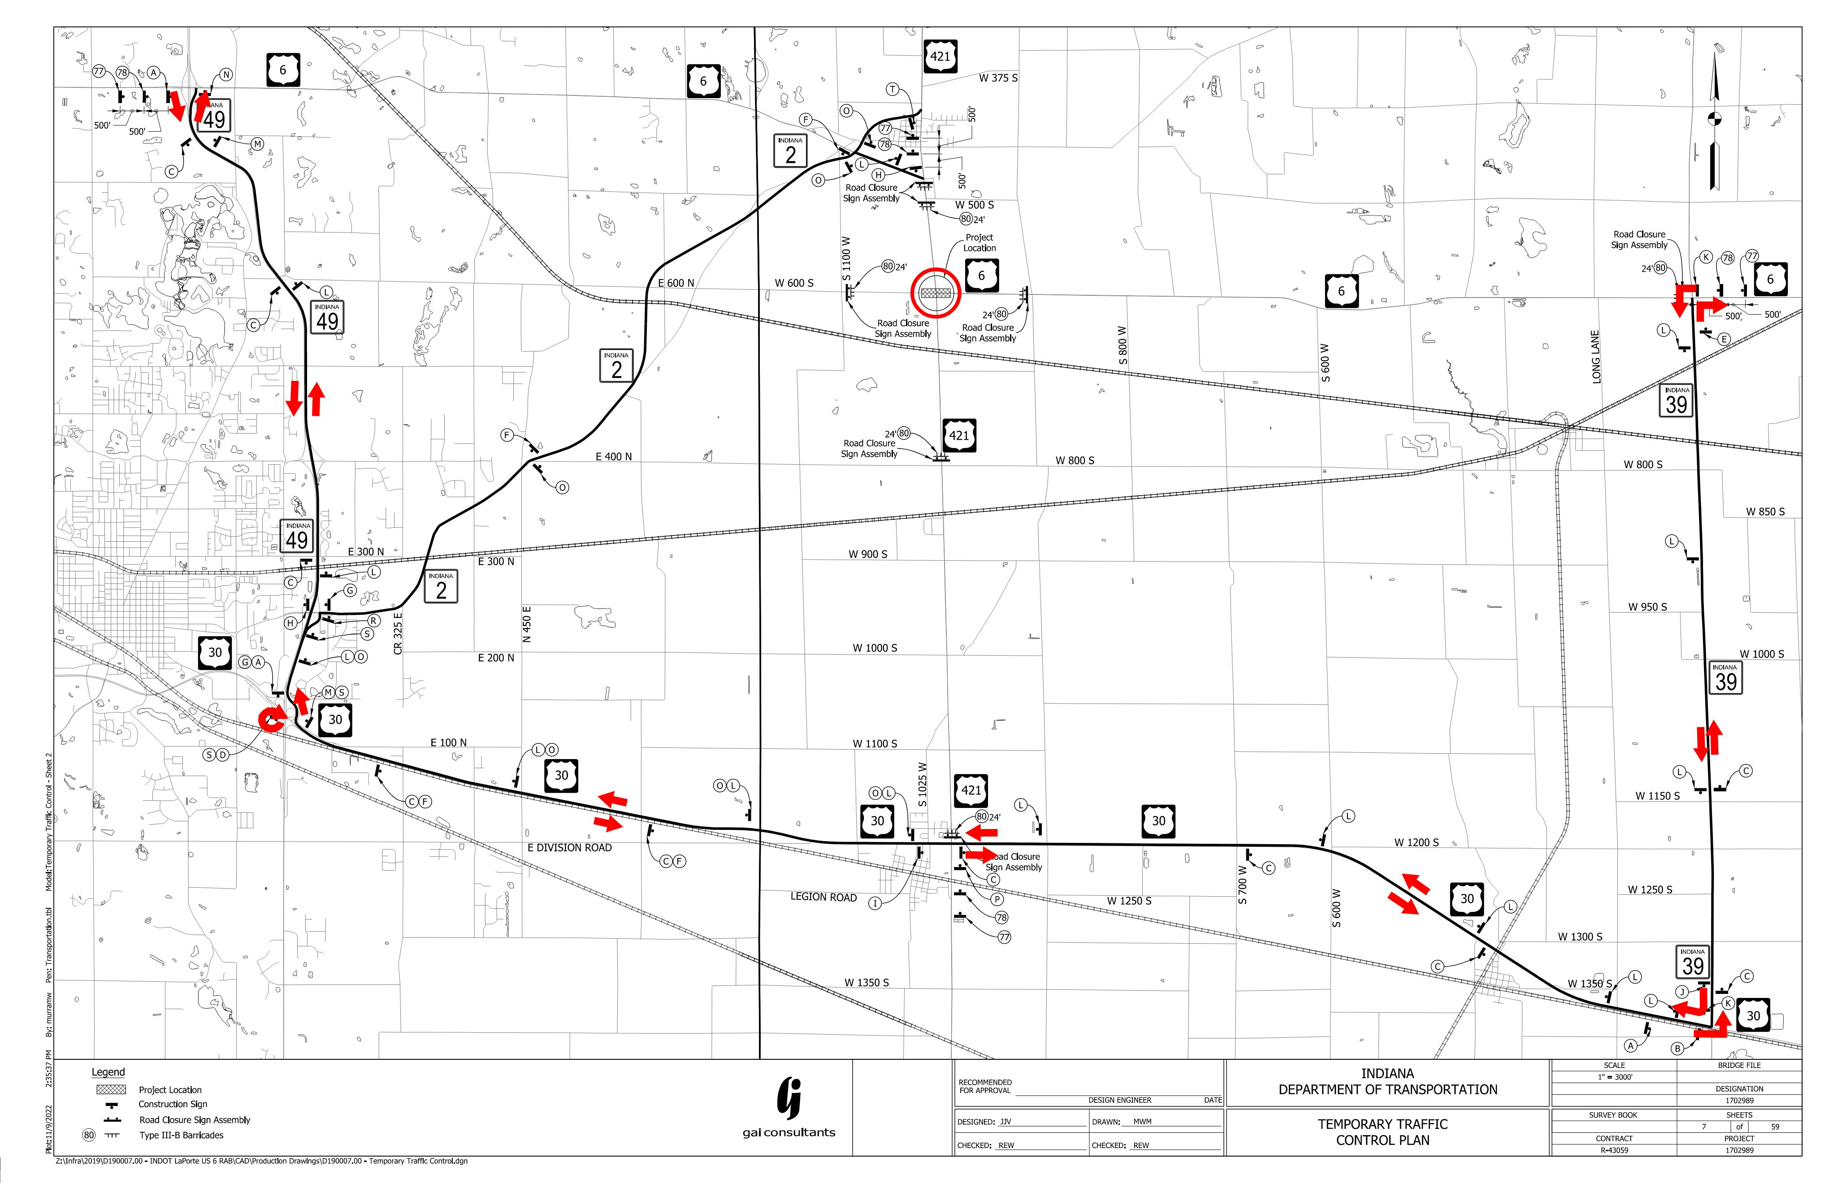
Public Hearing for R-43059
Maintenance of Traffic
Westbound US 6 Detour Route –
South on SR 39 to US 30
West on US 30 to SR 49
North on SR 49 to US 6
Eastbound US 6 would be reverse
Detour adds 13.4 miles
Detour adds approximately 15 minutes of travel time

Slide 28
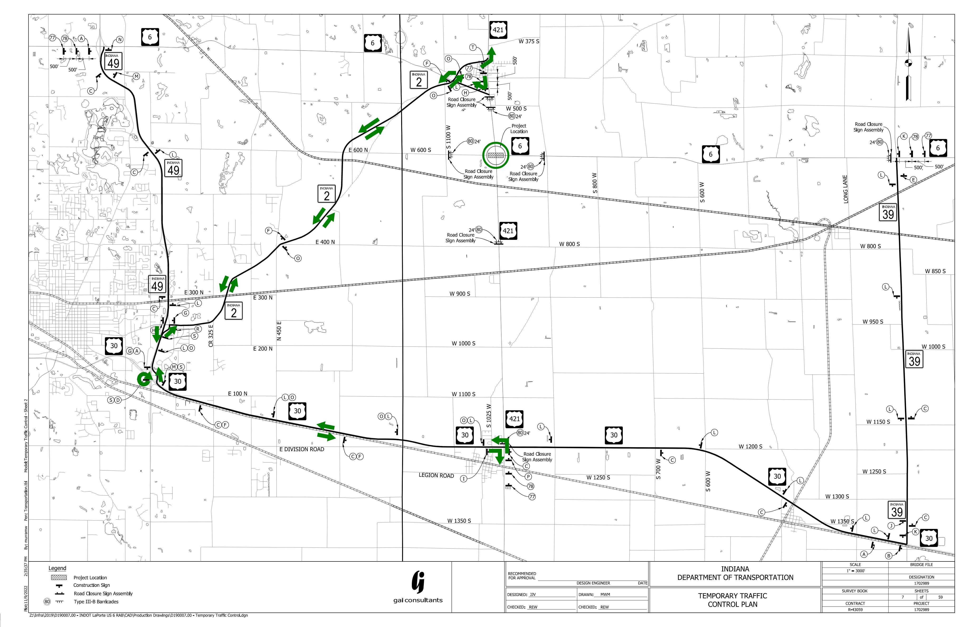
Public Hearing for R-43059
Maintenance of Traffic
Northbound US 421 Detour Route –
West on US 30 to SR 49
North on SR 49 to SR 2
Northeasterly on SR 2 to US 421
Detour route adds 10.4 miles
Detour route adds approximately 15 minutes of travel time

Slide 29
Public Hearing for R-43059
Submit Public Comments
Submit public comments using the options described in the page of the information packet:
  Public Comment Form
  Via email (R.Webb@GAIConsultants.com or mgrylewcz@indot.in.gov)
  Participating during the public comment session via microphone
    Note that verbal comments will be recorded and transcribed for inclusion into the public hearing transcript.
INDOT respectfully requests comments be submitted by (Thursday, March 2, 2023).
All comments submitted will become part of the public record, and they will be entered into a transcript, reviewed, evaluated, and given full consideration during the decision-making process.

