Slide 1
I-465 Concrete Pavement Restoration Project
The presentation will begin shortly.

Slide 2
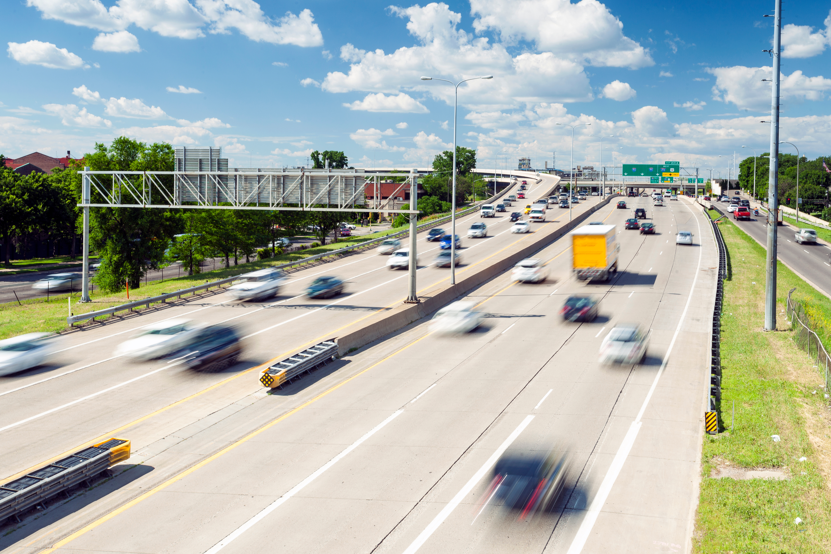
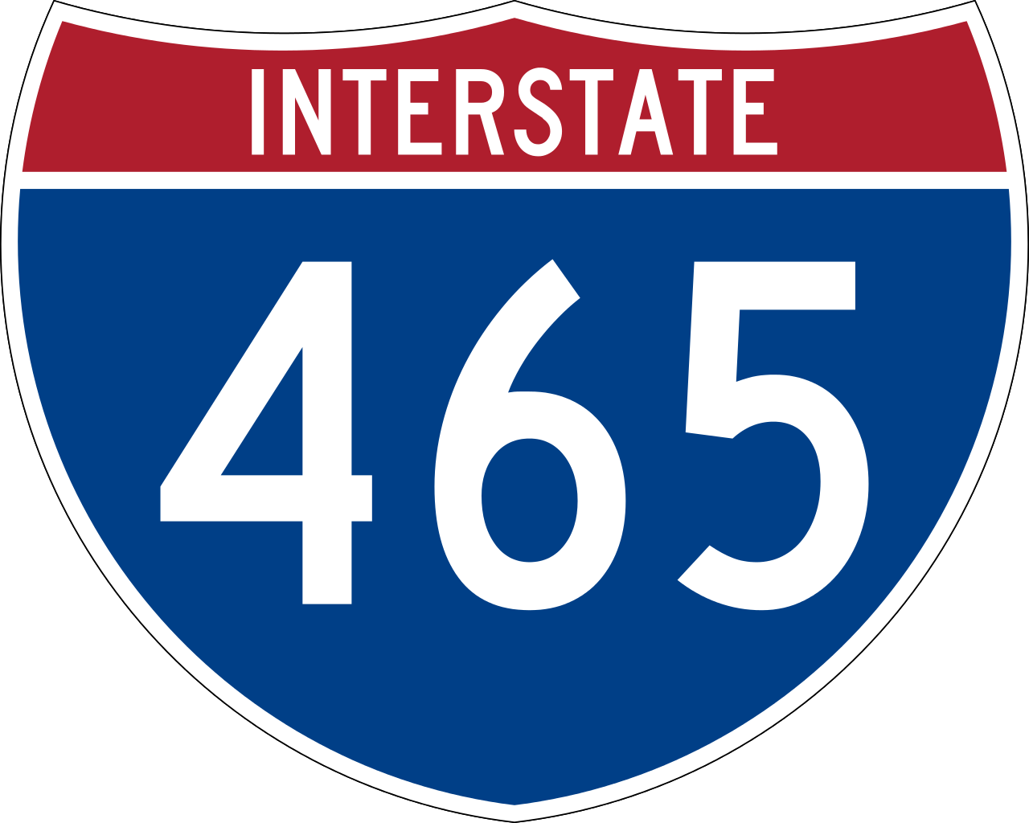
WELCOME!
PUBLIC INFORMATION MEETING APRIL 11, 2024
Notes:
Good evening. Thank you for joining our virtual public information meeting. My name is Cassidy Hunter; I am the communications manager for this project, and I will be leading our presentation tonight. Thank you for your time and attention as I discuss the planned concrete pavement restoration project on I-465 in Marion County.

Slide 3
AGENDA
Purpose & Need
Project Limits
Project Schedule
Maintenance of Traffic
Conclusion
Notes:
Before we dive in, I want to offer a quick overview of our agenda.
During tonight’s presentation, I will discuss why this project is needed and the purpose of the planned improvements. We will review the project limits and take a look at the project schedule. We will also spend some time talking about the maintenance of traffic during this construction project.
Finally, we will allow time for you to register your question or comment using the Q&A function on Teams. I’ll talk more about that later.

Slide 4
Purpose & Need
Extend pavement life on I-465 in Marion County
Mitigate costly repairs in the future
Prevent further deterioration
Notes:
I-465 in Indianapolis is a critical artery supporting local commuter traffic, trucking, national business, and tourist traffic. Within the project limits, which we will look at on the next slide, it serves as an urban interstate with a posted speed limit of 55 miles per hour and the number of lanes vary from 6 total travel lanes, or 3 in each direction to 10 total travel lanes or 5 in each direction. Depending on the location, I-465 carries between about 91,000 vehicles to about 192,000 vehicles each and every day.
[CLICK]
So, the purpose of this interstate corridor project is to extend the pavement life of I-465 in Marion County.
[CLICK]
By restoring the existing concrete pavement, INDOT can mitigate costly future repairs, and the ride can be improved for the traveling public.
[CLICK]
This project is critical for protecting against further pavement deterioration on I-465. The anticipated repair methods will include, but are not limited to, full depth Portland cement concrete pavement patching and joint repair.

Slide 5
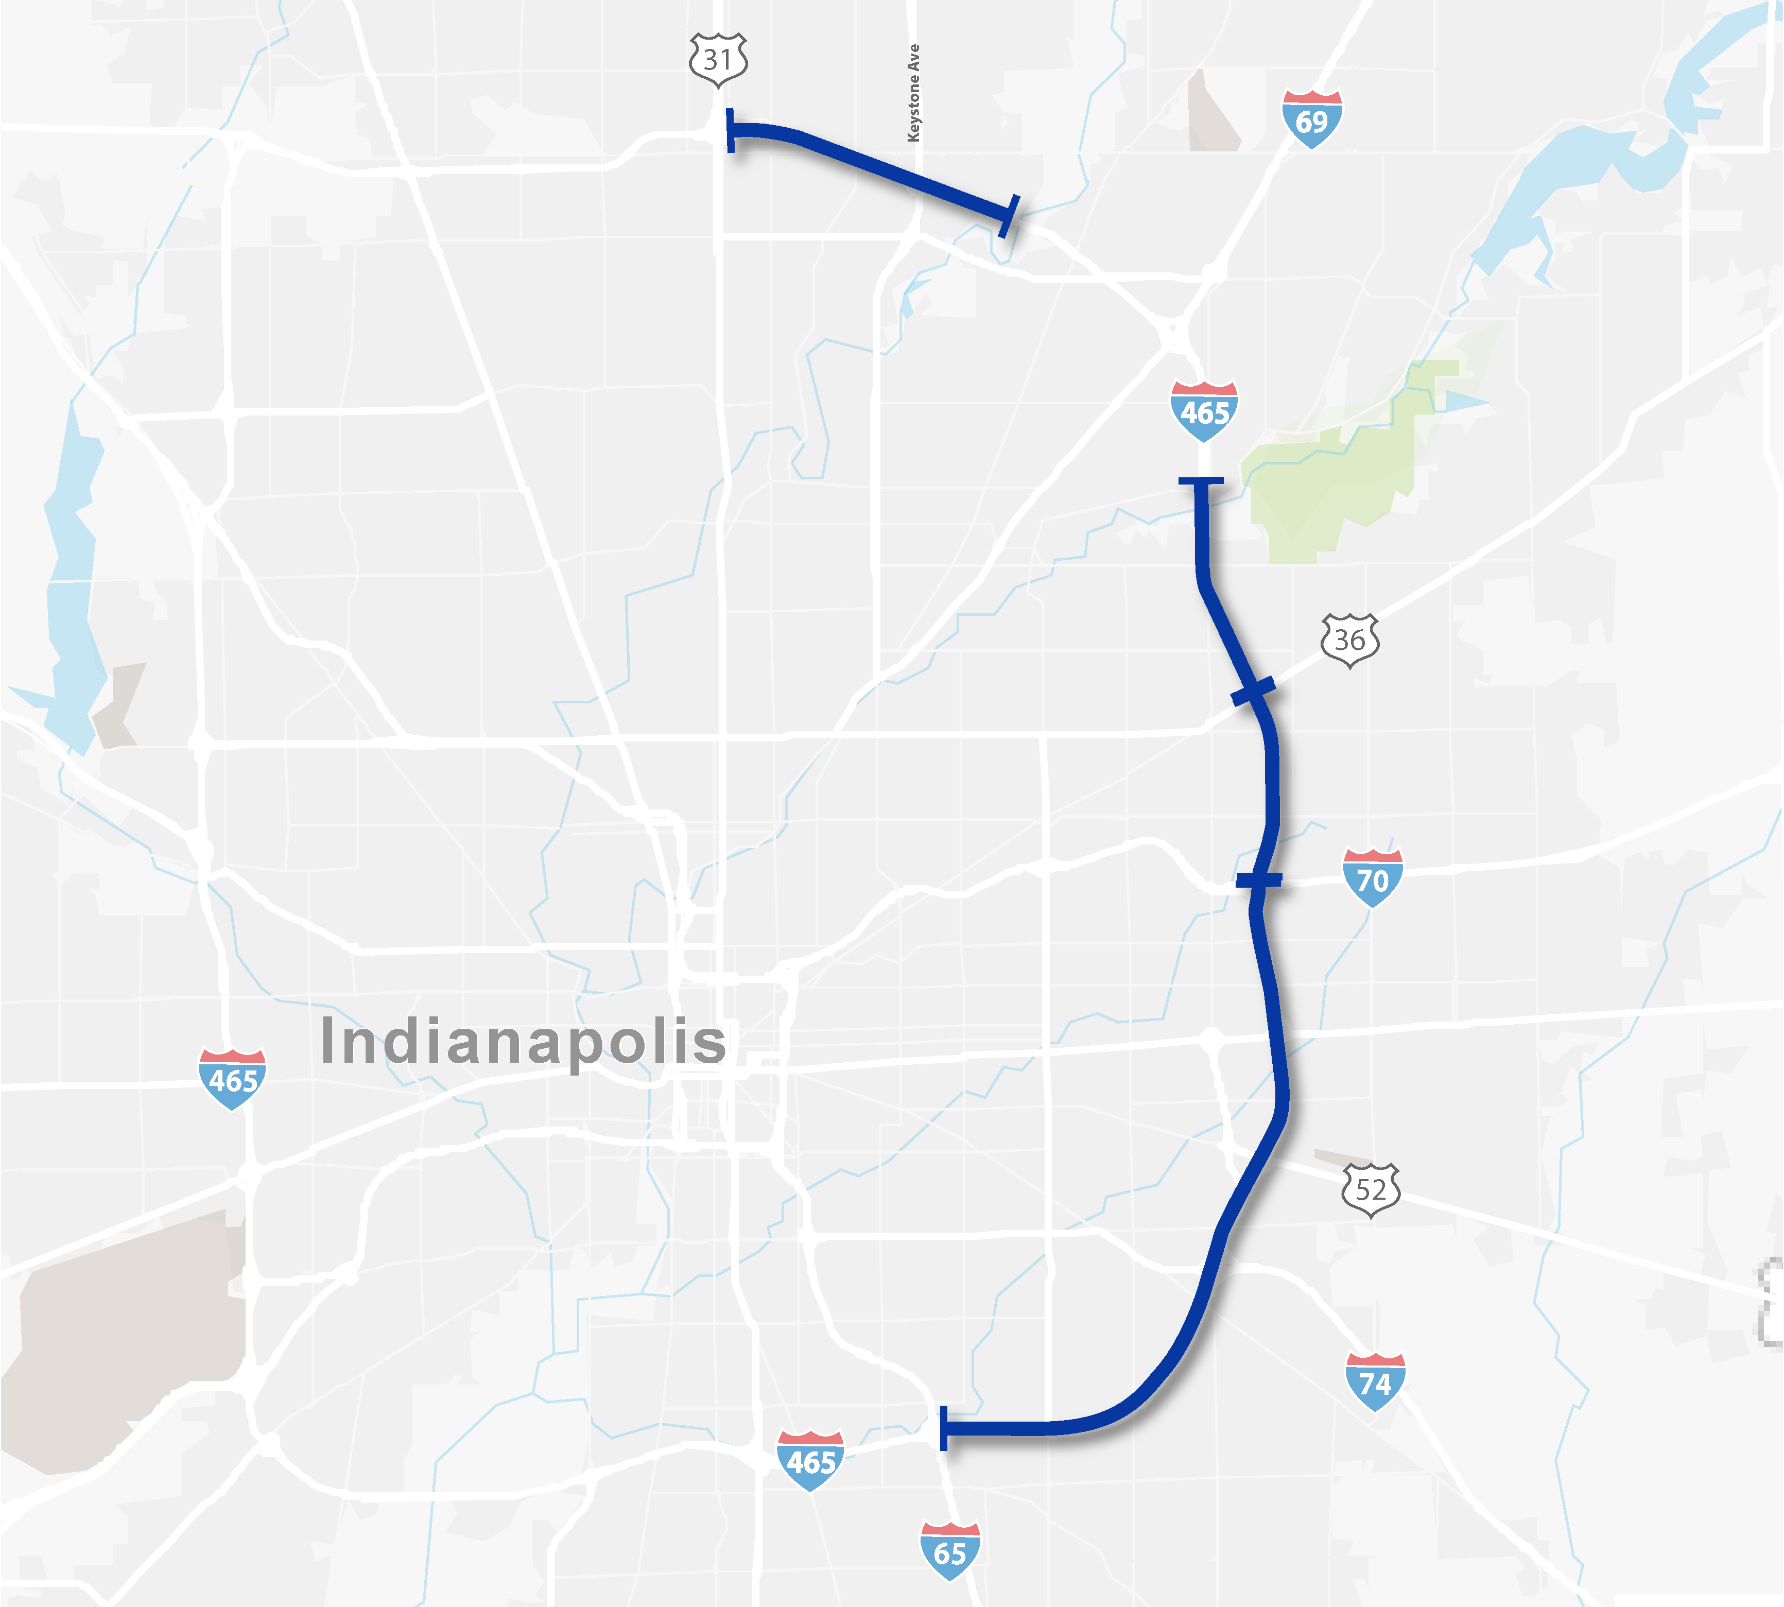
Project Limits
From I-465 and I-65 South juncture
To I-465 and US 31 North interchange
Excluding Clear Path 465 project limits
N
Notes:
The limits for the planned I-465 concrete pavement restoration project encompasses more than 17.5 miles of I-465, from the I-65 South juncture to the US 31 north interchange.
This excludes the Clear Path 465 project limits, which encompasses 4.5 miles of 1-465 from the White River to Fall Creek, and the I-465 and I-69 interchange and ramps; However, our project teams coordinate regularly on these adjacent projects and will continue to do so through the duration of both projects.

Slide 6
Project details
Full-depth patching, including 12 interchanges and 9 ramps
Preventative maintenance on 19 bridges
Partial-depth joint repair
Barrier wall protection
New pavement markings
Improvements to 55 drainage structures
Notes:
So, what does this project include? It includes concrete pavement repair to the mainline, shoulders, ramps, and interchanges on I-465 within the project limits.
[CLICK]
Nearly 22,000 square yards of full depth patching
[CLICK]
Bridge maintenance
[CLICK]
Almost 22,000 square feet of partial depth joint repair
[CLICK]
Barrier wall protection
[CLICK]
Approximately 1.1 million feet of new, permanent pavement markings
[CLICK]
Drainage improvements throughout the project limits
Now let’s take a look at the project schedule.

Slide 7
Notes:
Because of the critical need for this concrete pavement restoration project, pre-construction activities have already begun.
Phased construction is expected to begin soon. Work will continue through the 2024 construction season and is anticipated to be completed in its entirety in late 2025, as illustrated on this slide.
Of course, the construction schedule you see here are approximate and subject to change depending on a variety of factors, including inclement weather conditions and the status of adjacent projects.

Slide 8
Maintenance of Traffic
Safety:
For the traveling public
For contractors and others in the work zone
Constructability and Schedule:
Number of construction phases
Construction duration
Mobility:
Managing travel times
Access to/from the project area
Cost:
Total cost of construction
Future potential costs related to longevity
Meet expectations of the public
Notes:
The project team considered several factors when developing and analyzing the seven alternatives for maintaining traffic during project construction.
[CLICK]
The first was safety. INDOT’s top priority is always safety, both for the traveling public and for the contractors and others in the work zone. A safe work zone for the public is typically one that involves the free flow movement of traffic, clear sightlines, appropriate signage, and avoids lane drops and lane shifts. A safe work zone for contractors and other workers is one where they are protected and separated as far as possible from live traffic. The planned alternative includes extended shoulder widths and barrier wall protection to promote safety in the work zone.
[CLICK]
Next the project team looked at constructability and schedule, which considers the total number of construction phases and the operations and duration of each. This project will occur in phases to help promote efficiency in the construction schedule.
[CLICK]
We also looked at mobility, which includes managing travel times and maintaining access to and from the project area on I-465. One of the primary goals of the maintenance of traffic plan was to limit travel delays as much as possible during this essential concrete pavement restoration project.
[CLICK]
Of course, the total cost of construction and potential future costs related to the longevity of the improvements were considered when looking at alternatives.
[CLICK]
And finally, we considered how the maintenance of traffic plan would meet the expectations of the traveling public. This is a large, complex project that will likely impact each of you. However, this project is critical to the future usability and sustainability of I-465, which is a vital component to our transportation infrastructure.

Slide 9
17.5 miles of I-465
Phased construction
Nighttime and weekend patching
Directional closures
Ramp closures
N
Notes:
As mentioned, the limits for the planned I-465 concrete pavement restoration project encompasses more than 17.5 miles of I-465, from the I-65 South juncture to the US 31 north interchange. The phased construction will include nighttime and weekend patching work, ramp closures, and directional closures.

Slide 10
21-days directional closures from I-70 to I-65
I-465 SB/WB closure from May 29 – June 30
I-465 NB/EB closure between July 5 and August 4
Official detour route utilizes the I-65 and I-70 loop
Notes:
Directional closures on I-465 is an effective maintenance of traffic strategy that allows the Contractor to efficiently work on an entire direction of I-465 at one time.
By closing a direction, construction can be accelerated, and work can be completed with a significant time savings compared to construction adjacent to traffic. INDOT has successfully implemented this directional closure twice previously, most recently in the summer of last year to accommodate the I-69 Finish Line project.
For this project, each directional closure is anticipated to be in place for 21 days, beginning with southbound and westbound I-465. This closure is anticipated to place between May 29 and June 30, which will not conflict with the Memorial Day or Independence Day holidays.
The I-465 northbound and eastbound directional closure is anticipated to take place between July 5 and August 4. The official detour route for each directional closure will utilize the I-65 and I-70 loop. All other entrance ramps leading to the I-465 closure will be diverted to follow the I-65 and I-70 detour.

Slide 11
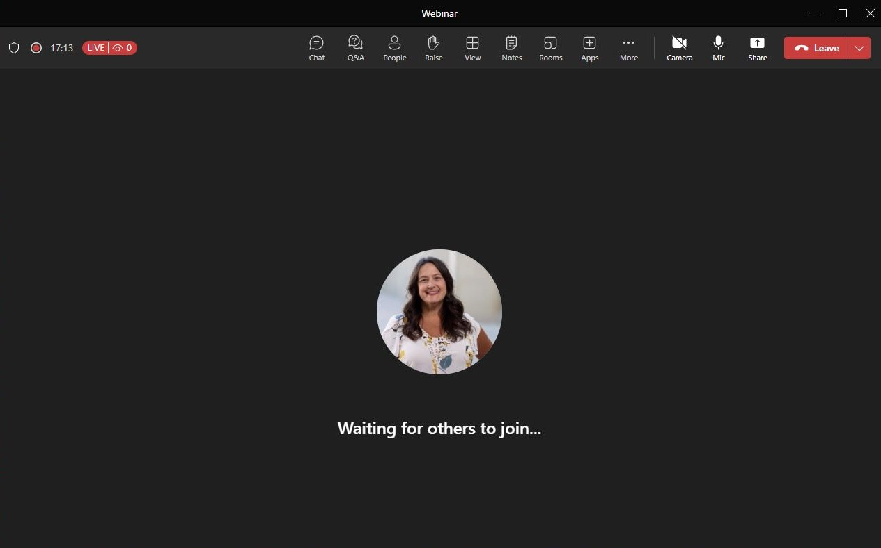
Notes:
That concludes this evening’s presentation. Thank you for your time and attention.
[CLICK]
If you would like to register a question or comment this evening, please use the Q&A function on your Teams app.
[CLICK]
If you would like a response, please include your email address, and a member of the project team will reach out to you.

Slide 12
THANK YOU FOR ATTENDING!
www.indot4u.com 855-INDOT4U 855-463-6848
Notes:
If you have questions or concerns following tonight’s meeting, please visit www.INDOT4U.com or call 855-INDOT4U. That’s 855-463-6848.
Finally, a recorded version of this public information meeting will be available at [???]
Thank you again for your time and attention.

