Slide 1

State Road 5 over Eel River
Bridge Rehabilitation
DES# 1006177
South Whitley Community Public Library
Thursday, February 5, 2015
5:30 p.m.
Please silence electronic devices.

Slide 2
Agenda
Welcome & Introductions
Formal Public Hearing
  Presentations
  Public Statements for the Record
  Adjourn Formal Hearing
Invited to the display area for
Q & A with the project team
Notes:
GOOD EVENING…… MY NAME IS MARY WRIGHT AND I AM THE HEARING EXAMINER FOR THE INDIANA DEPARTMENT OF TRANSPORTATION. I APPRECIATE EVERYONE TAKING THE TIME TO ATTEND THIS AFTERNOON AND I LOOK FORWARD TO HEARING YOUR COMMENTS, CONCERNS AND SUGGESTIONS REGARDING THIS PROPOSED PROJECT.
THE AGENDA IS SIMPLE - THE HEARING WILL CONSIST OF FORMAL PRESENTATIONS FOLLOWED BY A PUBLIC COMMENT SESSION……WHICH WE ASK YOU TO COME FORWARD TO MAKE PUBLIC COMMENTS OR STATEMENTS TO BE RECORDED FOR THE TRANSCRIPT OF THE OFFICIAL PUBLIC HEARING AND THEN WE WILL ADJOURN
Travis Kohl Project Manager – Crawfordsville Dist
Parsons – Design Engineer
Rich Connelly Parsons – Environmental
Debbie Calder– Media Relations

Slide 3
Why a Public Hearing?
Conducted as a requirement to the National Environmental Policy Act (NEPA).
  NEPA requires evaluation of potential
  impacts to surrounding natural, cultural,
  and social environments.
  Impacts are described in an
  environmental document.
  Requires opportunity for the public to be involved and comment in the decision-making process of said impacts.
Notes:
NEPA is a federal law enacted in 1970 that establishes a decision-making process that agencies must follow prior to design and construction of projects using federal money or requiring federal approval.

Slide 4
Environmental Document
Level 4 Categorical Exclusion
  Classification means the actions do not have a significant effect on the environment.
Released for Public Involvement on December 24, 2014
Published Legal Notice
  Post & Mail
  January 21 & 28, 2015
Document available for viewing
Notes:
THE ENVIRONMENTAL DOC FOR THIS PROJECT IS A LEVEL 4 –CLASSIFICATION MEANS THE ACTIONS DO NOT HAVE A SIGNIFICANT EFFECT ON THE ENVIRONMENT
RELEASED FOR PI AND PUBLISHED AND AVAILABLE FOR VIEWING AND COMMENT
Legal Notice Also sent to as many property owners as possible – unfortunately the mailing information is not always up to date.

Slide 5
How Can You Participate?
Verbally as a Public Statement
  Statements are recorded
Comment Form
  Submit via mail, fax, or drop box
Email
  mwright@indot.in.gov
Comment Period ends
  Friday, February 20, 2015
  Please feel free to use any and all methods.
Notes:
FIRST YOU MAY VERBALLY EXPRESS (Public Comment Session) YOUR CONCERNS HERE THIS EVENING BY SIGNING ON TO THE SPEAKERS LIST ON THE TABLE AS YOU ENTERED…. AS SOME OF YOU MAY ALREADY HAVE….IF YOU DID NOT SIGN UP YOU WILL STILL HAVE AN OPPORTUNITY TO COME UP AND SPEAK AFTER WE HAVE COMPLETED THE NAMES ON THE LIST. I WILL OPEN THE FLOOR FOR COMMENTS AT THAT TIME.
ALL SPEAKERS COMMENTS ARE RECORDED. IF YOU WOULD LIKE TO MAKE VERBAL COMMENTS BUT YOU ARE NOT INTERESTED IN SPEAKING IN FRONT OF SUCH A LARGE GROUP OF PEOPLE, PLEASE SEE ME AFTER THE PRESENTATION AND WE CAN RECORD YOUR COMMENTS OFF TO THE SIDE.
SECOND, WE HAVE PROVIDED FOR YOUR CONVENIENCE A COMMENT SHEET ON THE BACK PAGE OF YOUR INFORMATION PACKET SO THAT YOU MAY RECORD YOUR WRITTEN COMMENTS. YOU MAY FILL THIS OUT THIS EVENING AND HAND YOUR REMARKS TO ME OR
THE THIRD OPTION IS TO MAIL OR FAX YOUR COMMENTS TO US. NOT NECESSARILY ON THIS FORM.
THE ADDRESS FOR TRADITIONAL MAIL AND THE FAX NUMBER CAN BE FOUND ON THESE PAGES IN THE INFORMATION PACKET…
….AND THE LAST OPTION WOULD BE TO E-MAIL. MY ADDRESS IS ALSO ON THIS PAGE >>>>>>>>Please note that I will respond to all email with a quick reply telling you that I have received your comment.>>>>>>>>So as to assure you that it has been received.
REPRESENTATIVES WILL BE AVAILABLE AFTER THIS SESSION TO ANSWER QUESTIONS ONE ON ONE. HOWEVER PLEASE NOTE THAT GENERAL CONVERSATIONS ARE NOT PART OF THE OFFICIAL RECORD.
WE STRONGLY ADVISE FORMAL STATEMENTS FOR THE RECORD.

Slide 6
How Will Comments be Addressed?
All comments will be addressed in the Final Environmental Document as a result of:
  The public statements recorded at
  a public hearing.
  All written comments, concerns, and suggestions such as letters, faxes, and
  emails received during the comment period.
  Informal comments are always welcome, however, please note general conversations are not part of the official record.

Slide 7
Environmental Studies
Elements of environmental documents
Right-of-way
Hazardous Materials
Threatened & Endangered Species
Historic & Archaeological
Community Impacts
Floodplains
Land Use
Wetlands & Waterways
Noise
Air Quality
Public Involvement
Notes:
PRIOR STUDIES AND CONSIDERATIONS HAVE BEEN COMPLETED REGARDING THIS PROJECT. A LEVEL 4 CATEGORICAL EXCLUSION WAS released FOR PUBLIC INVOLVEMENT ON …….THIS IS THE ENVIRONMENTAL DOCUMENT PREPARED FOR THIS PROJECT. I HAVE A COPY HERE TONIGHT IF YOU WOULD LIKE TO TAKE A LOOK PLEASE SEE ME AFTER THE HEARING.
ENVIORNMENTAL DOCUMENT PREPARED AS PART OF THE NEPA PROCESS THIS DOCUMENT INCLUDES along with other areas
THE IMPACTS TO NATURAL AND HUMAN ENVIRONMENTS
SOCIAL AND ECONOMIC FACTORS
HISTORICAL PROPERTIES ====ONE REASON WE ARE HERE TONIGHT

Slide 8
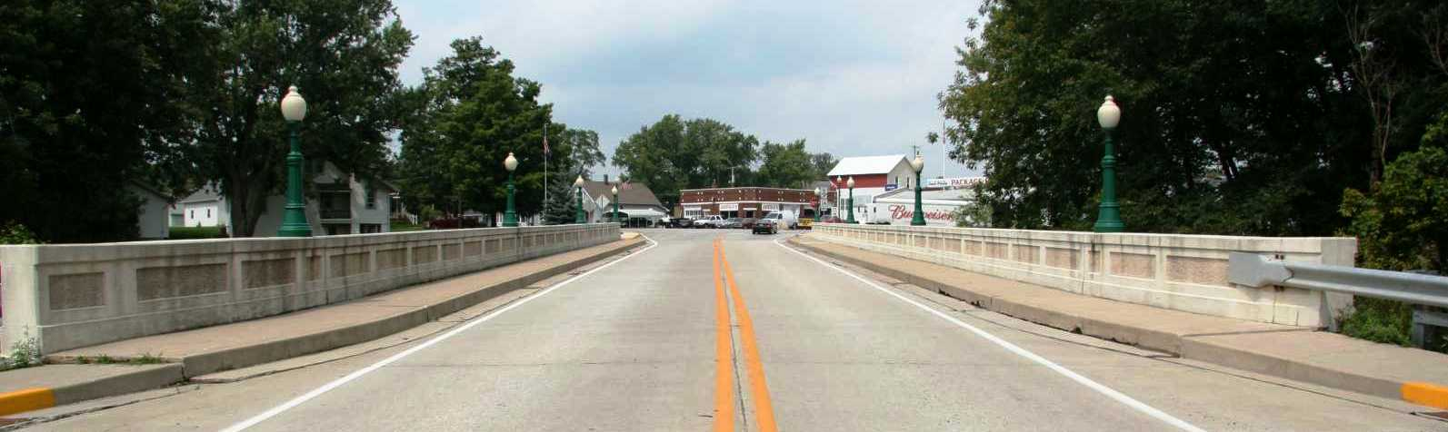
S.R. 5 over the Eel River
3 span, reinforced concrete, filled spandrel arch
Built in 1935 – Reconstructed 1990

Slide 9
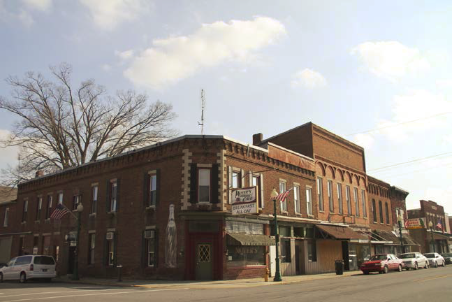
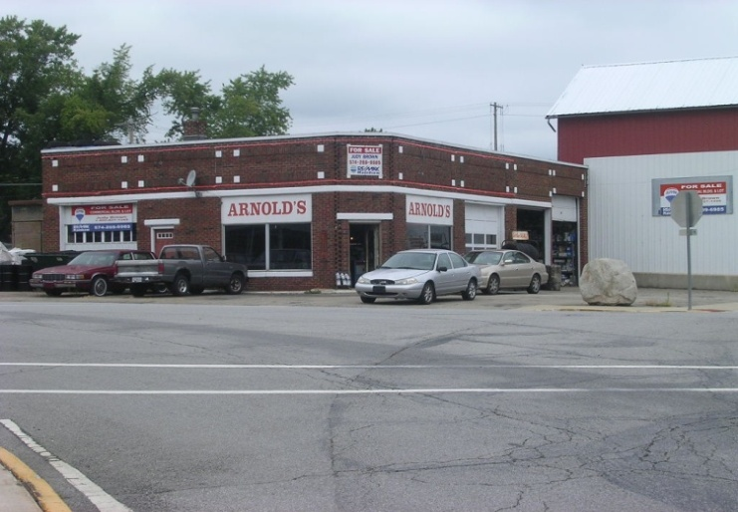
National Register Eligibility
The bridge is part of the South Whitley Historic District which is eligible for inclusion in the National Register of Historic Places (NR)

Slide 10
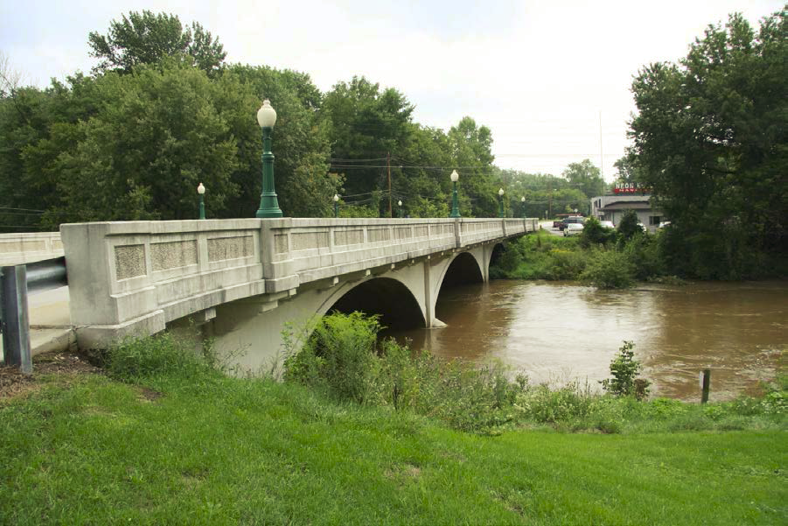
National Register Eligibility
The bridge is also individually determined eligible for the NR-listing

Slide 11
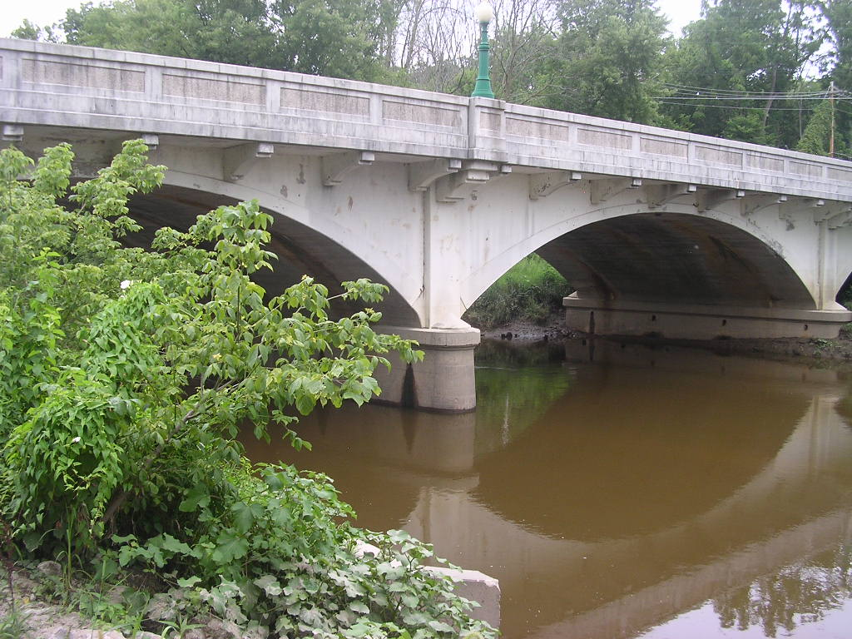
Historic Bridge Inventory
S.R. 5 Eel River Bridge is “Select”
  Select Bridges are:
    Excellent examples of a given type
    Most suitable for preservation

Slide 12
Select Bridges
FHWA will not consider demolition
to be a “prudent” alternative
Bridge must be preserved
FHWA will not participate in a project that results in demolition of a
“Select” bridge

Slide 13
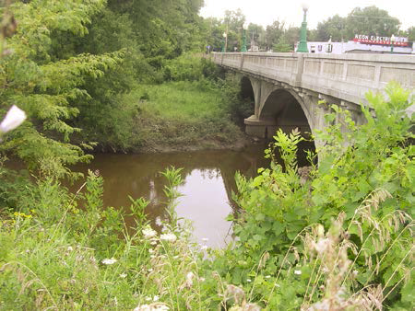
Select Bridges
Alternatives Analysis
  Preferred Alternative
    Rehabilitation for continued vehicular use

Slide 14
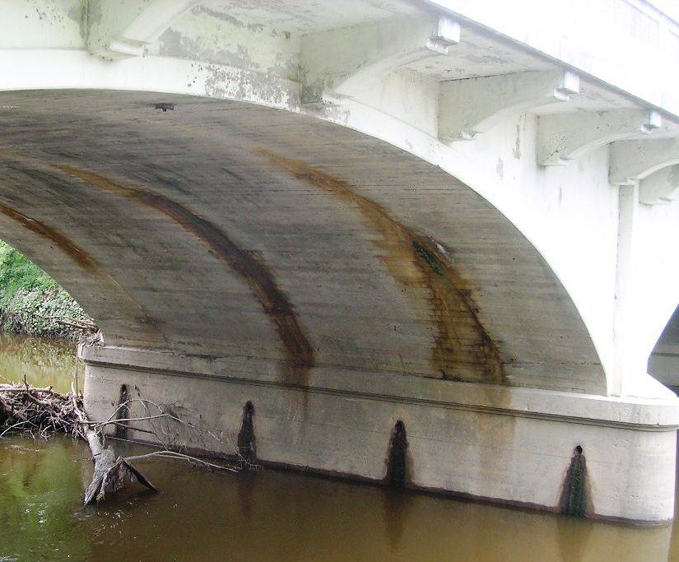
Rehabilitation Highlights
Repair, protect, and preserve integrity and qualities of “Select” bridge while a providing safe structure:
  Remove the existing pavement,
  railing, sidewalk, brackets, and
  top portion of spandrel walls.
  Reconstruct top portion of
  spandrel walls and brackets.

Slide 15
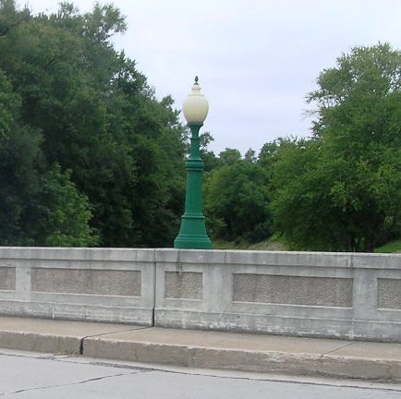
Continued Highlights
  Construct new slab in the pavement area with overhang in the sidewalk area.
  Replicate concrete bridges railing along each
  side of the structure.
  Reset existing ornamental street lights on
  top of the bridge rail.

Slide 16
Project Impacts
The project will rehabilitate the bridge according to the Secretary of the Interior’s Standards for Rehabilitation.
The project will not adversely impact the S.R. 5 Bridge or the South Whitley Historic District.
Overall “No Adverse Effect” finding for the project.

Slide 17
Final Steps?
Seek consulting party input
  No objections to project to date
  State Historic Preservation Officer agrees
  with proposed project
Identify preferred alternative
  Rehabilitation/repair
Hold Public Hearing
  February 2015
Environmental Document Approval
  After public hearing comment period

Slide 18
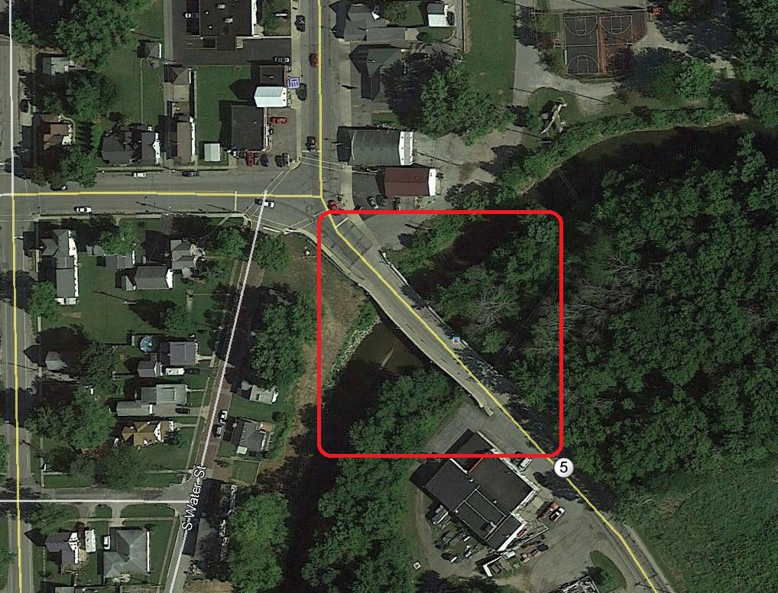
Proposed Project Area

Slide 19
Purpose and Need
Project Need
  Deteriorating condition of the pavement, curbs, sidewalks and brackets.
Project Purpose
  Maintain the pavement, driving surface,
  and sidewalk.
  Extend the useful life of bridge.
  Avoid complete replacement.

Slide 20
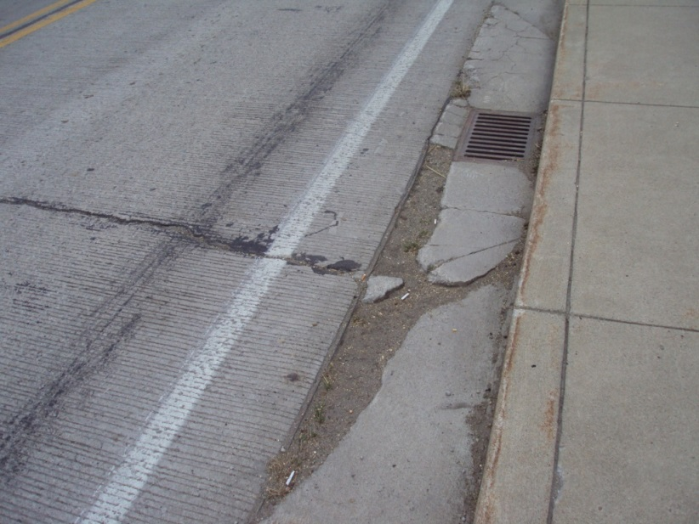
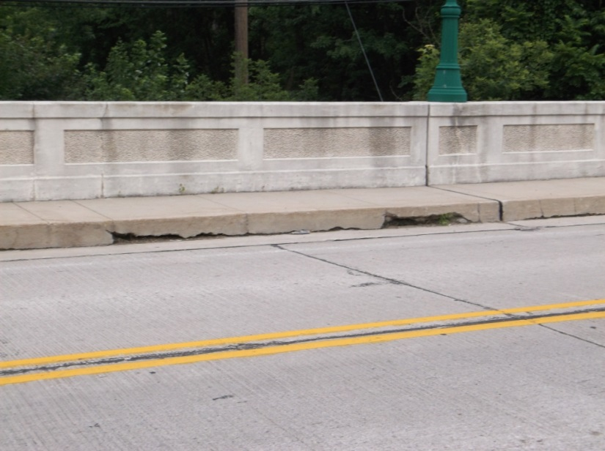
Deficiency of Existing Bridge
Existing Pavement
  Transverse cracks in pavement
  Spalling at gutters
Existing Curbs
  Spalling in curbs
Notes:
Show them what the can’t see!
Be mindful of using the term “structure” - Although design standards identify a difference between a structure and a bridge the public does not necessarily make that distinction . The public’s frame of mind is that a structure means a building.

Slide 21
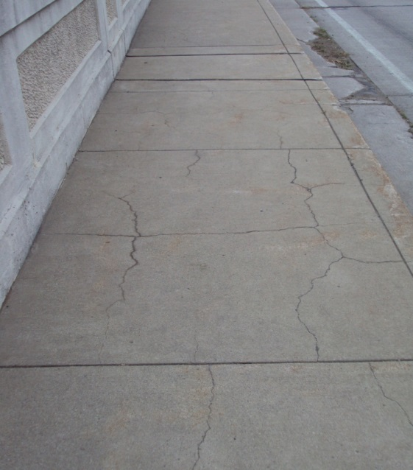
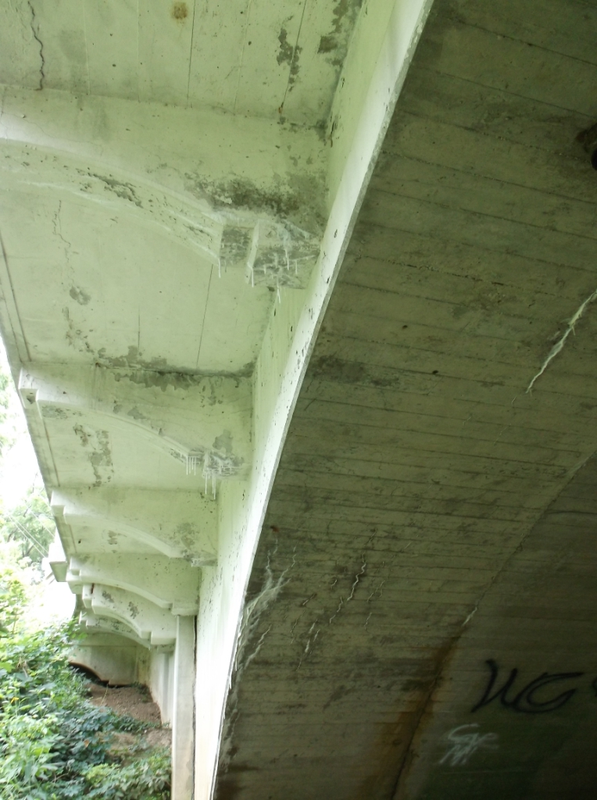
Deficiency of Existing Bridge
Existing Sidewalk
  Random cracking
Concrete Brackets
  Cracks and leaching
Notes:
Show them what the can’t see!
Be mindful of using the term “structure” - Although design standards identify a difference between a structure and a bridge the public does not necessarily make that distinction . The public’s frame of mind is that a structure means a building.

Slide 22
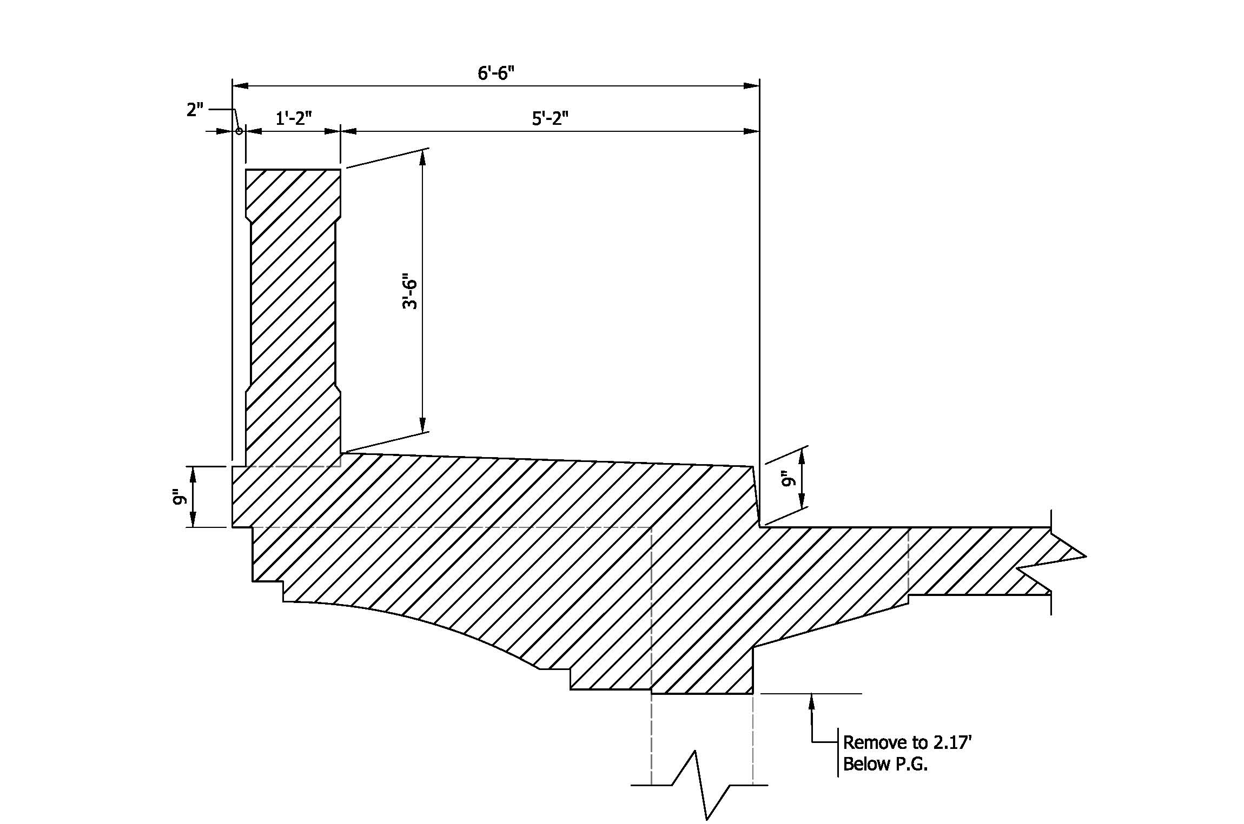
Proposed Improvements
Remove existing pavement, gutter,
rail, sidewalk and brackets.

Slide 23
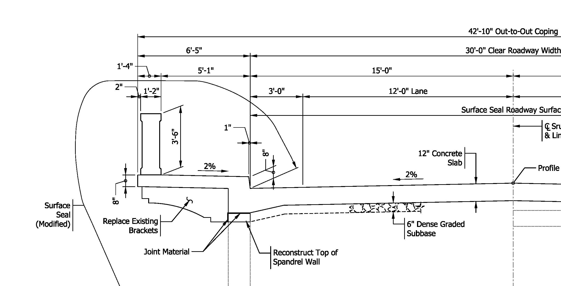
Proposed Improvements
Construct new deck, rail, sidewalk
and brackets.

Slide 24
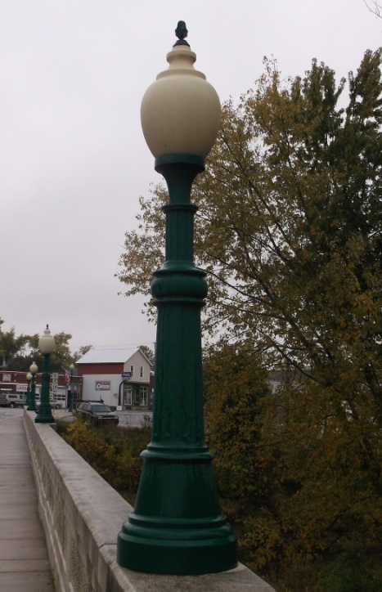
Proposed Improvements
Re-set existing bridge street lighting.

Slide 25
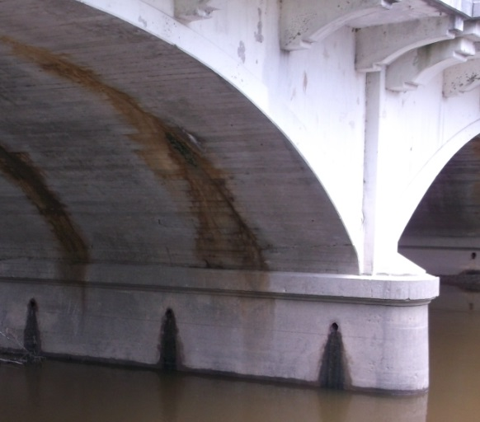
Proposed Improvements
Patch spalling at arch ring.

Slide 26
Proposed Improvements
Reconstruct sidewalk at corners and provide curb ramps.
Replace pavement at ends of structure.
Resurface beyond full depth pavement to transition to the existing surface.
Install new guardrail.

Slide 27
Maintenance of Traffic (MOT)
  Bridge will be closed to vehicular traffic during construction.
  Detour Route will use S.R. 114, S.R. 13
  & S.R. 14.
  Pedestrian traffic will be maintained
  by constructing one-half of the bridge
  at a time.
Notes:
NOTE: This is a good time to explain how long the public can expect the project to last.
Do not talk in “Construction Seasons” – the public doesn’t know what that means.

Slide 28
Maintenance of Traffic (MOT)
  Construction letting is expected October 2015
  Maximum closure time is 140 days.
  Construction completion date is anticipated July 2016.
Notes:
NOTE: This is a good time to explain how long the public can expect the project to last.
Do not talk in “Construction Seasons” – the public doesn’t know what that means.

Slide 29
Public Comment Session
Speakers sign-in sheet
Open to the floor for additional public comment.
Please come forward to the
podium so that we may accurately record your statements.
Please be courteous and mindful
of appropriate language.
Notes:
TURN ON RECORDER
THIS COMMENT SESSION IS THE OPPORTUNITY FOR THE COMMUNITY TO MAKE STATEMENTS FOR THE PUBLIC RECORD. WE KNOW YOU MAY HAVE QUESTIONS THAT YOU WOULD LIKE TO DISCUSS BUT WE ASK YOU TO HOLD ON TO THESE UNTIL AFTER THE HEARING IS ADJOURNED WHEN YOU CAN CONVERSE ONE ON ONE WITH THE REPRESENTATIVES.
DURING THE COMMENT SESSION IT IS IMPORTANT THAT WE RECORD YOUR STATEMENTS AS ACCURATELY AS WE CAN FOR THE RECORD SO WE ASK THAT YOU PLEASE COME FORWARD TO THE PODIUM AND MICROPHONE.
AT THIS TIME WE WILL MOVE FORWARD TO THE SPEAKER LIST. IF YOU DID NOT SIGN UP TO SPEAK YOU STILL MAY DO SO AFTER WE HAVE COMPELTED THE NAMES ON THE LIST. I WILL OPEN COMMENTS TO THE FLOOR.
AT THIS TIME I WOULD LIKE TO OPEN THE PODIUM TO THE FLOOR. IS THERE ANYONE WHO WOULD LIKE TO COME FORWARD TO SPEAK???
PLEASE STATE YOUR NAME

Slide 30
Public Comments
Statements recorded at public hearing.
Written Statements
  Mary Wright, INDOT Public Hearings, IGCN 642
  100 North Senate Avenue
  Indianapolis, IN 46204
  mwright@indot.in.gov
Respectfully request comments to be postmarked by February 20, 2015
All comments will be reviewed and evaluated
and given full consideration before final
design decisions.
Notes:
Example

Slide 31
Project Schedule
Public Hearing – February 2015
Completion of the Environmental Document 2015
Completion of the Design Phase
Construction period anticipated
in 2016
Notes:
EVERY STATEMENT RECORDED AND WRITTEN THAT INDOT RECEIVES WILL BE EVALUATED AND ANSWERED IN THE FINAL DESIGN SUMMARY.
IF YOU RECEIVED THE NOTICE ABOUT THIS HEARING AND YOUR ADDRESS HAS NOT CHANGED,
OR YOU HAVE SIGNED IN THIS EVENING WITH A LEGIBLE NAME AND A COMPELTE ADDRESS. YOU WILL RECEIVE A LEGAL NOTICE OF INTENT.
ALL OF THE COMMENTS MADE HERE TONIGHT AS WELL AS ALL RECEIVED IN THE NEXT TWO WEEKS WILL BECOME A PART OF THE OFFICIAL PUBLIC RECORD.
IF YOU DECIDE YOU NEED ADDITIONAL COPIES OF THE INFORMATION PACKET OR ADDITIONAL INFORMATION TO MAKE YOUR COMMENTS, PLEASE FEEL FREE TO CONTACT MY OFFICE. AGAIN THE NUMBERS CAN BE FOUND IN THE INFO PACKET.
IF ANYONE NEEDS EXTRA PACKETS….THEY ARE STILL PLENTY ON THE TABLE IN THE BACK…..FEEL FREE TO TAKE SOME.
REMIND TO SIGN IN

Slide 32
Thank You
Please visit with project officials following the public comment session.
Informal questions and answers
View displays and preliminary plans
Real Estate Process
Thank you for your attendance
this evening.
This public hearing is adjourned.
Notes:
THANK YOU FOR COMING OUT TO THE PUBLIC HEARING TONIGHT. PLEASE STAY AFTER SO REPRESENTATIVES CAN ANSWER YOUR QUESTIONS AND CAN DISCUSS ANY OF YOUR CONCERNS….
THANK LOCATION
THANKS AGAIN AND HAVE A GOOD EVENING.
THIS SESSION IS ADJOURNED.

