Slide 1

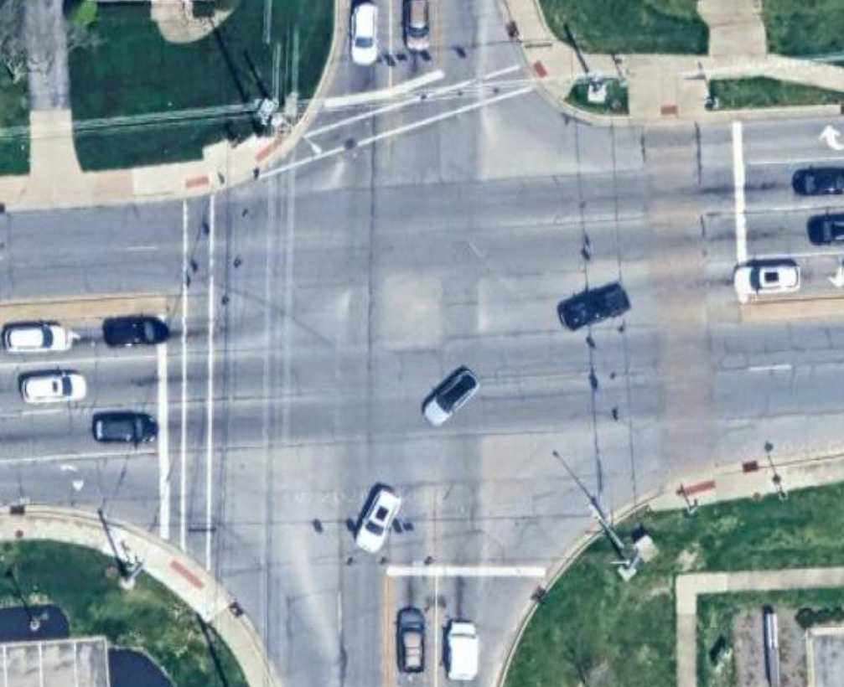
COLLISION DIAGRAM
Road 1 Name & Road 2 Name
Study Period: ___________________ Location: _______________________
District: _________ County: ____________ City/Town: ______________________
Analyst: ___________ Date: ____________ Ref. Project:______________________
YYYY to YYYY
LAT/LONG
District
County Name
City Name
Your Name
MM/DD/YYYY
####
N
Road 2 Name
Road 1 Name
Road 1 Name
Road 2 Name
* Diagram not to scale
Aerial imagery from Google Maps
__Additional Comments__
Start comments here
ICF | --
ICC | --
______________Object Symbols______________
__Collision Symbols__
_Fixed Object Codes_
Moving Vehicle
A
Animal
Rear End
B – Bridge or Overpass
C – Building
E – Culvert or ditch
F – Curb
G – Guardrail or Barrier
H – Embankment
J – Fence
K – Traffic Pole
L – Utility Pole
M – Sign
N – Tree / Shrub
P – Construction Barrier
Q – Crash Attenuator
R – Other
S – Unknown
Turning Vehicle
D
Debris in Roadway
Signalized Intersection
Head On
Backing Vehicle
#
Fixed Object
(see table for #)
STOP
Stop Sign
Sideswipe - Same
Sliding Vehicle
Sideswipe - Opposite
Parked Vehicle
#
Incapacitating/Fatal
Right Angle
Pedestrian
#
Non-Incapacitating
Right Turn
Bicycle
#
PDO (If > 1)
Left Turn

