Slide 1
INDOT Pavement Design Requests
10/27/2025

Slide 2
Presentation Overview
When is a Pavement Design Needed?
Pavement Design Process
Responsibilities
Timeframe
Data Matrix
Standard Pavement Sections
Pavement Design Request Forms
Geotechnical Request Form
Resources

Slide 3
When is a Pavement Design Needed?
Use Pavement Design Process Flowchart
  IDM Figure 601-5A or IDM Figure 601-5B
Review the Project’s Work Type, Scope, and anticipated MOT.
Projects that require a pavement design:
  All roadway paving projects
  Any non-roadway project with paving items*
  Any project anticipated to use shoulders for MOT**
Projects that do not require a pavement design:
  A project with no pavement pay items.
  *A non-roadway project with paving items that meets Figure 601-5C criteria.
  **A project anticipated to use shoulders for MOT that meets Figure 601-5C criteria.

Slide 4
When is a Pavement Design Request Needed?
All projects that require a pavement design will need a pavement design request, except:
  A consultant designed project that include the pavement design task in their scope of services.
  A non-roadway project that meets Figure 601-5C criteria.
  A project anticipated to use shoulders for MOT that meets Figure 601-5C criteria.

Slide 5
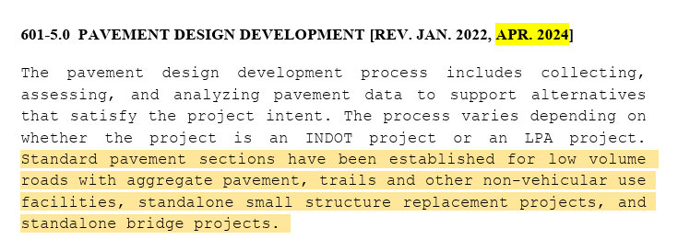
Pavement Design Process
INDOT Design Manual Chapter 601

Slide 6
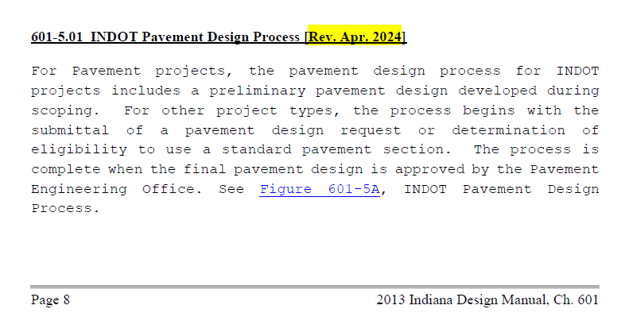
Pavement Design Process
INDOT Design Manual Chapter 601
  IDM Figure 601-5A or IDM Figure 601-5B

Slide 7
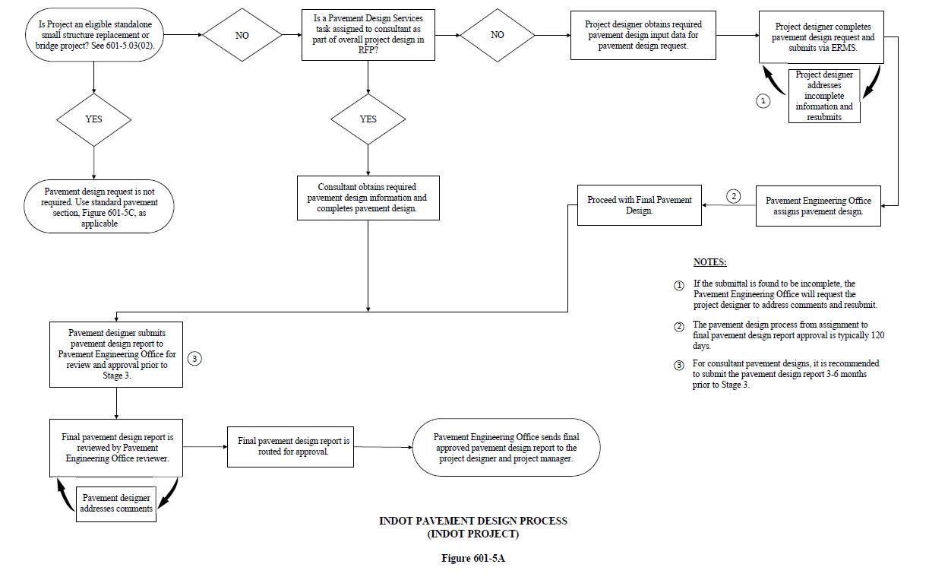
Pavement Design Process
IDM Figure 601-5A

Slide 8
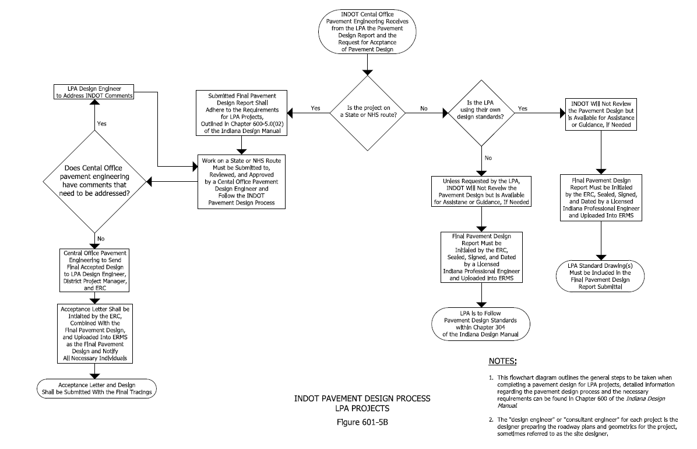
Pavement Design Process – LPA Projects
IDM Figure 601-5B

Slide 9
Responsibilities
Responsibilities, Project Manager:
  Knowledge of project work type and scope.
  Understanding if project will require a pavement design request.
  Determine if pavement design is included in the design consultant’s scope of services or will need to be performed in-house or assigned to pavement design on-call consultant.
  Determine if geotechnical report, including pavement parameters, is included in design consultant’s scope of services or will need to be performed in-house or assigned to geotechnical on-call consultant.
  Understanding of the request form and documentation needed.
  Ensure the project designer submits the pavement design request in a timely manner, to keep project on schedule.
  Ensure any supporting information needed to complete pavement design is collected in a timely manner, to keep project on schedule.
    Pavement Core Report
    FWD
    Traffic Forecast

Slide 10
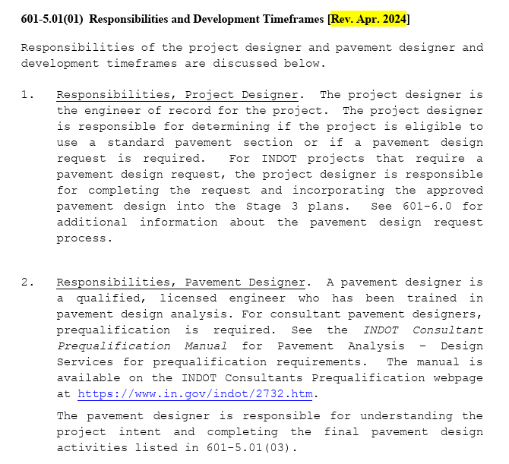
Responsibilities

Slide 11
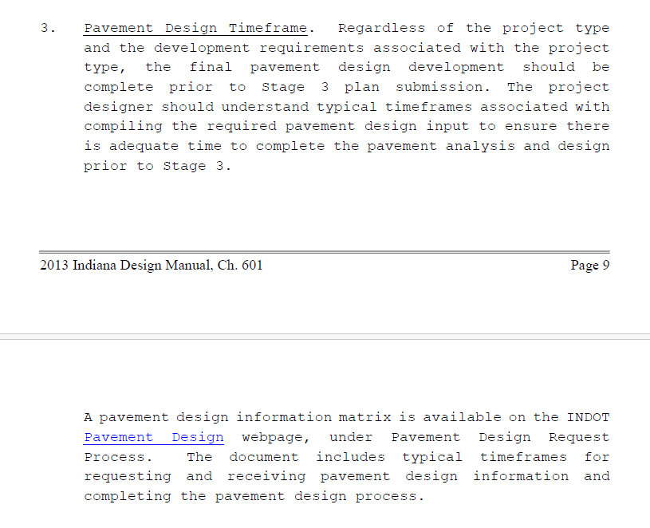
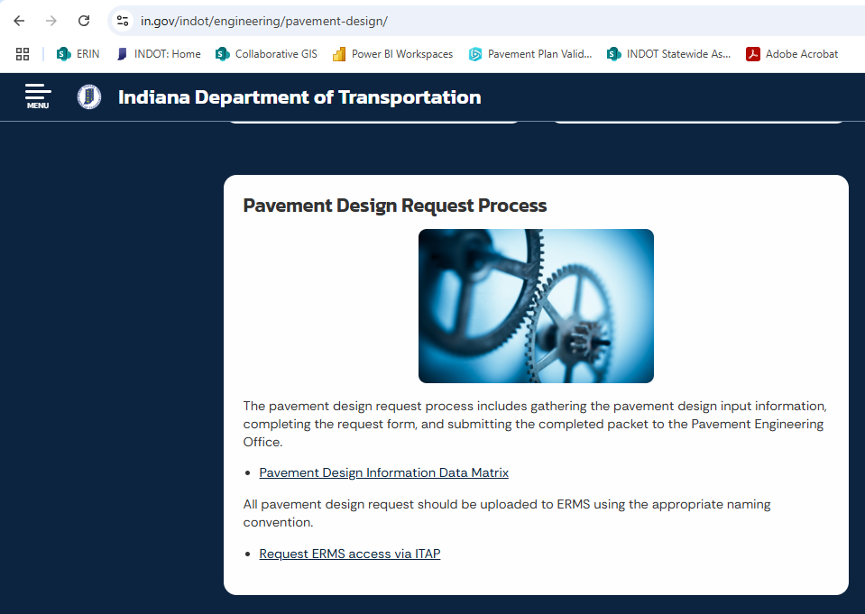
Pavement Design Timeframe

Slide 12
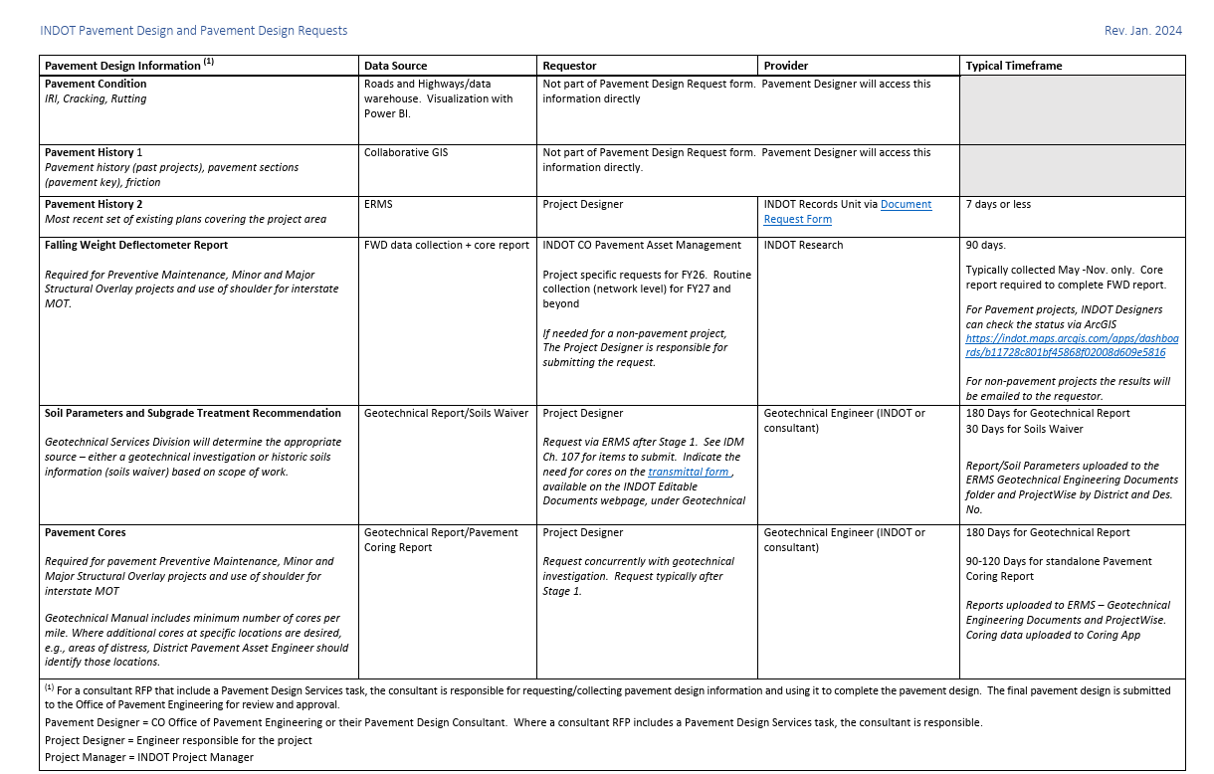
Pavement Design Information Data Matrix

Slide 13
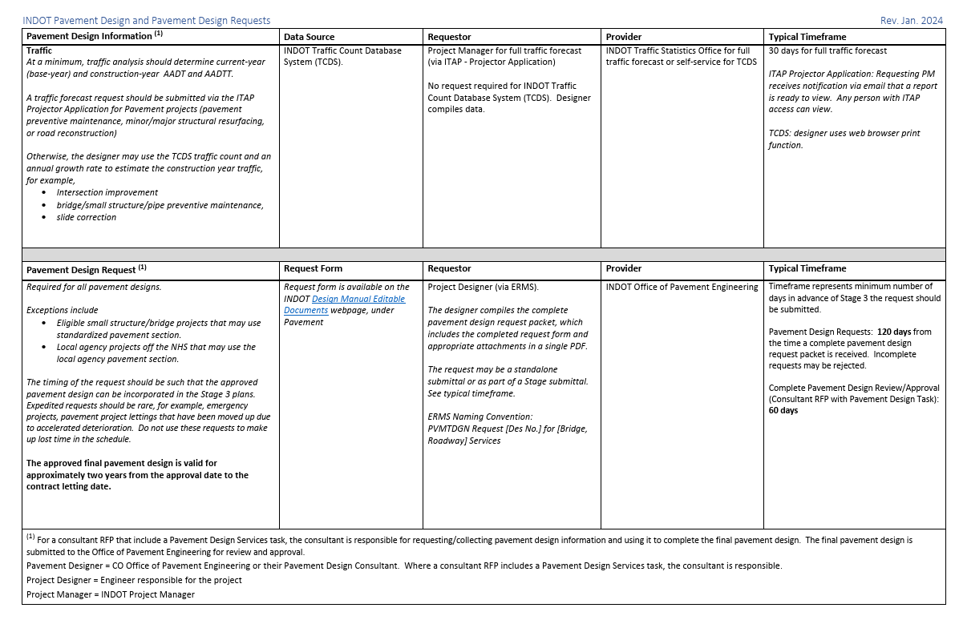
Pavement Design Information Data Matrix

Slide 14
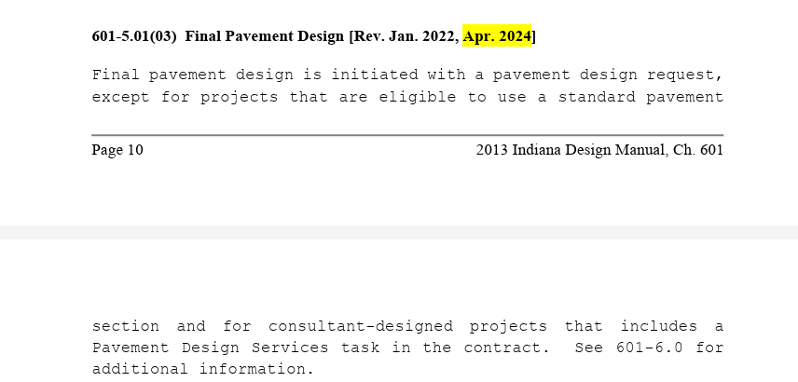
Final Pavement Design

Slide 15
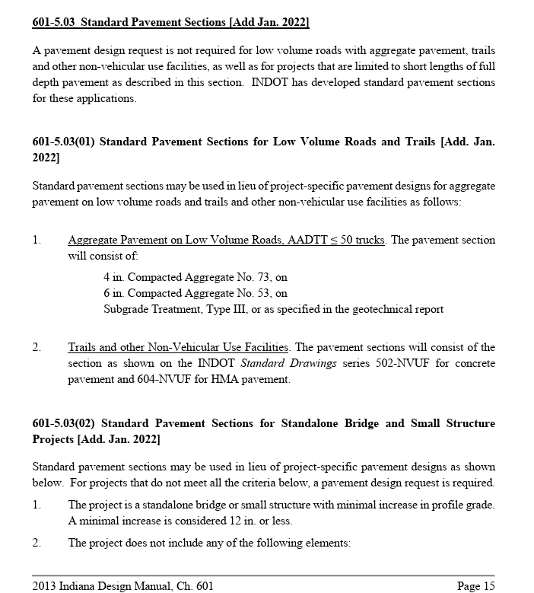
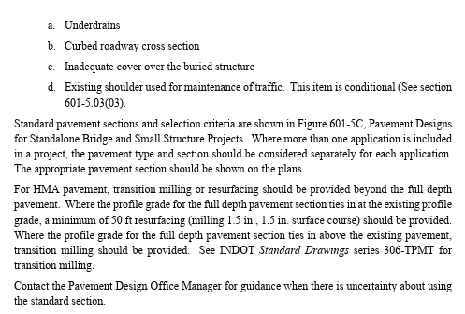
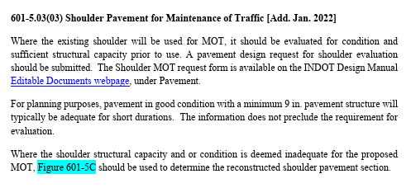
Standard Pavement Sections

Slide 16
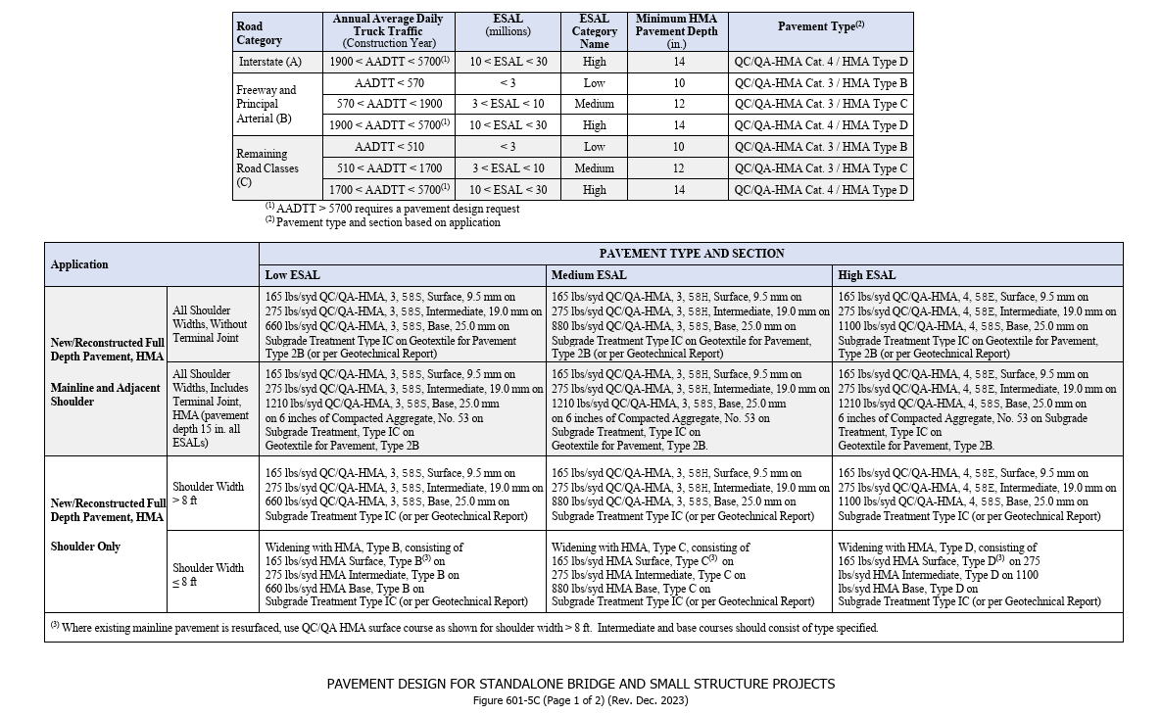
Standard Pavement Designs

Slide 17
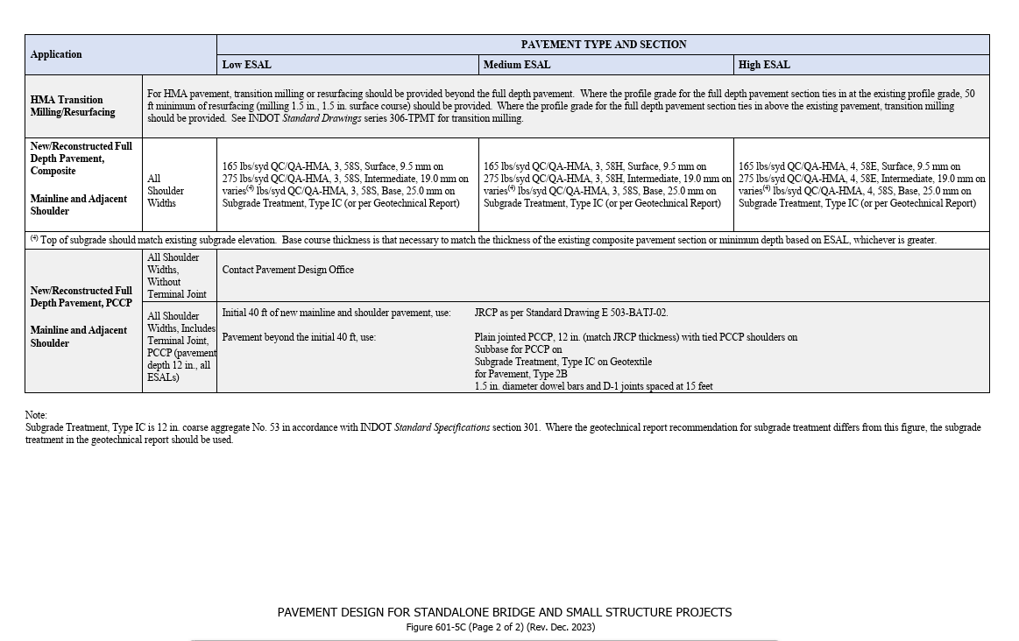
Standard Pavement Designs

Slide 18
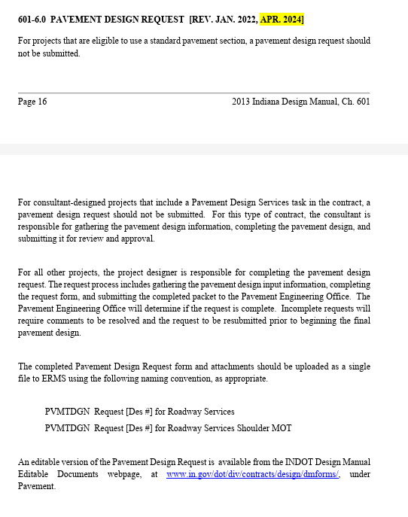
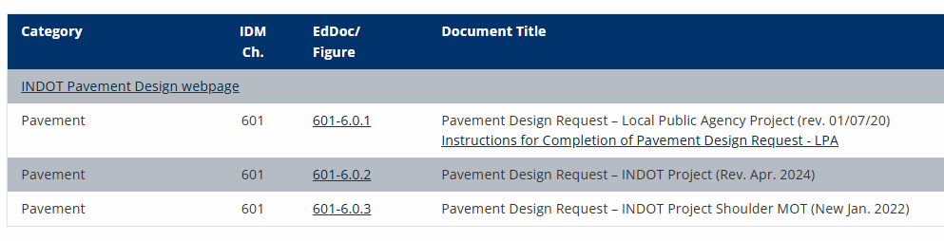
Pavement Design Request
https://www.in.gov/dot/div/contracts/design/dmforms/

Slide 19
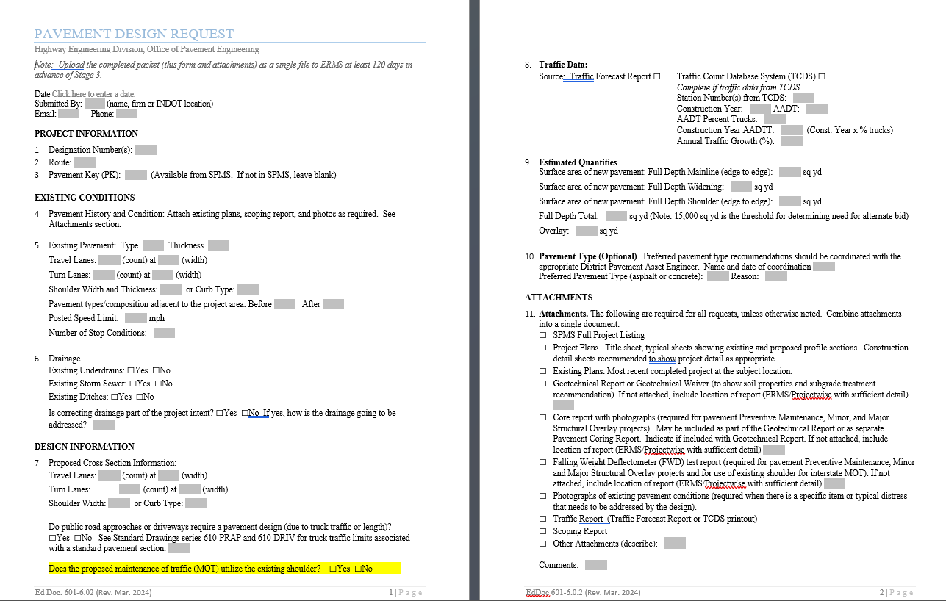
Pavement Design Request – INDOT Project

Slide 20
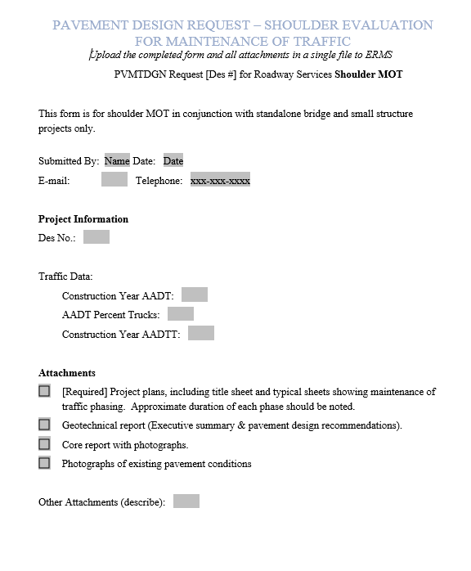
Pavement Design Request – Shoulders for MOT

Slide 21
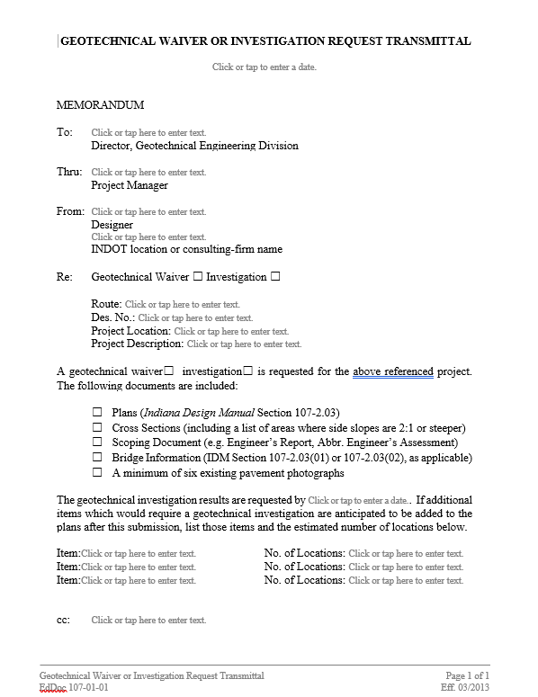
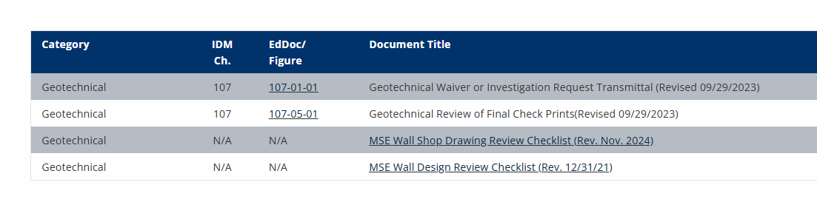
Geotechnical Request
https://www.in.gov/dot/div/contracts/design/dmforms/
  Doc 107-01-01

Slide 22
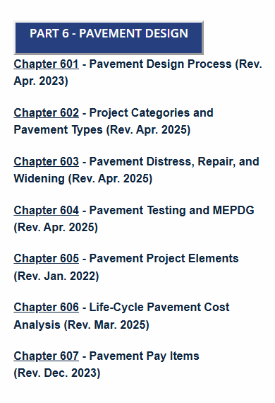
Resources
Indiana Design Manual
  IDM Chapter 601 – Pavement Design Process
  https://www.in.gov/dot/div/contracts/design/IDM.htm
INDOT Pavement Design webpage
  https://www.in.gov/indot/engineering/pavement-design/

Slide 23
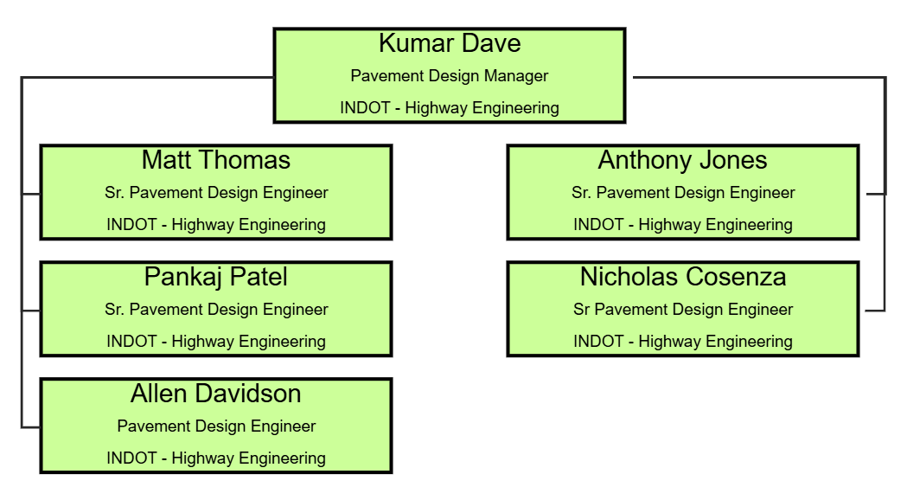
Resources
INDOT Central Office Pavement Design

