Slide 1
Bidder’s List (Subcontractor Quotes)
Steve Duncan
INDOT Director of Contract Administration
October 2025
Rev 5

Slide 2
Index
49 CFR 26.11(c)
INDOT Implementation
Court Injunction
Bidder’s List Form
Form Instructions
Submission Requirements
December 2024 reporting and prior letting review
Frequently Asked Questions

Slide 3
49 CFR 26.11(c)
https://www.ecfr.gov/current/title-49/subtitle-A/part-26/subpart-A/section-26.11
§ 26.11 What records do recipients keep and report?
(a) You must submit a report on DBE participation to the concerned Operating Administration containing all the information described in the Uniform Report to this part. This report must be submitted at the intervals required by, and in the format acceptable to, the concerned Operating Administration.
(b) You must continue to provide data about your DBE program to the Department as directed by DOT Operating Administrations.
(c) You must obtain bidders list information as described in paragraph (c)(2) of this section and enter it into a system designated by the Department.
(1) The purpose of this bidders list information is to compile as accurate data as possible about the universe of DBE and non-DBE contractors and subcontractors who seek to work on your federally assisted contracts for use in helping you set your overall goals, and to provide the Department with data for evaluating the extent to which the objectives of § 26.1 are being achieved.
(2) You must obtain the following bidders list information about all DBE and non-DBEs who bid as prime contractors and subcontractors on each of your federally assisted contracts:
(i) Firm name;
(ii) Firm address including ZIP code;
(iii) Firm's status as a DBE or non-DBE;
(iv) Race and gender information for the firm's majority owner;
(v) NAICS code applicable to each scope of work the firm sought to perform in its bid;
(vi) Age of the firm; and
(vii) The annual gross receipts of the firm. You may obtain this information by asking each firm to indicate into what gross receipts bracket they fit (e.g., less than $1 million; $1-3 million; $3-6 million; $6-10 million; etc.) rather than requesting an exact figure from the firm.

Slide 4
January 2025 INDOT Letting Announcement
In accordance with changes to USDOT rules (49 CFR 26), INDOT is now required to collect certain information for all prime contractors and for any subcontractors who’ve submitted a quote to a prime prior to letting. Required information includes the firm name and address, DBE or non-DBE classification, NAICS codes for work being sought to perform, race and gender of the firm’s majority owner, and age and size of firm. INDOT is required to report this information to the USDOT in December each year.
INDOT will provide a reporting form via email to prior bidders and will post the form on the INDOT Letting webpage. This reporting form is required to be submitted for a bid to be considered responsive. One complete form per contract shall be submitted no later than 24 h after the time specified in the Notice To Contractors for receipt of bids. This is a requirement of all bidders, not just the low bidder, to maintain eligibility to continue bidder status with INDOT.
INDOT will reject any bid that does not comply
Could affect bidder eligibility

Slide 5
Federal Court Injunction
There is a federal court in Kentucky that is requiring Indiana to submit these bidder’s lists monthly to FHWA starting in December 2024
(Note: FHWA rescinded this requirement in 2025, falling back to annual submissions occurring in December of each year.)

Slide 6
Form availability – week of January 6th
This form will be loaded to our letting web page
Updated form loaded in October 2025)
This training power point file will also be posted to our web page
These documents will be e-mailed to all of our letting subscribers
Virtual training sessions will be scheduled – invitation through email subscribers list

Slide 7
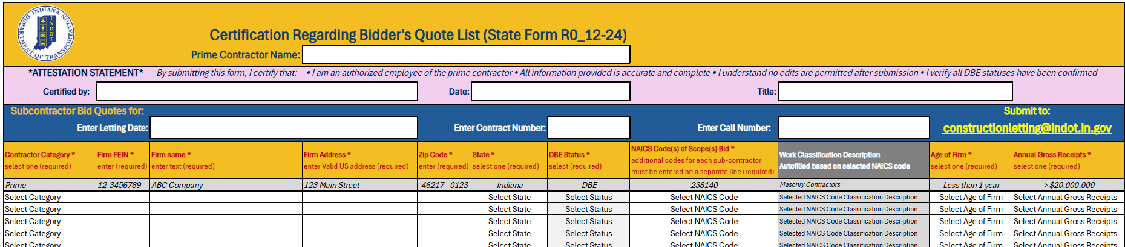
Subcontractors Bid Quote Form
Copy of the form

Slide 8
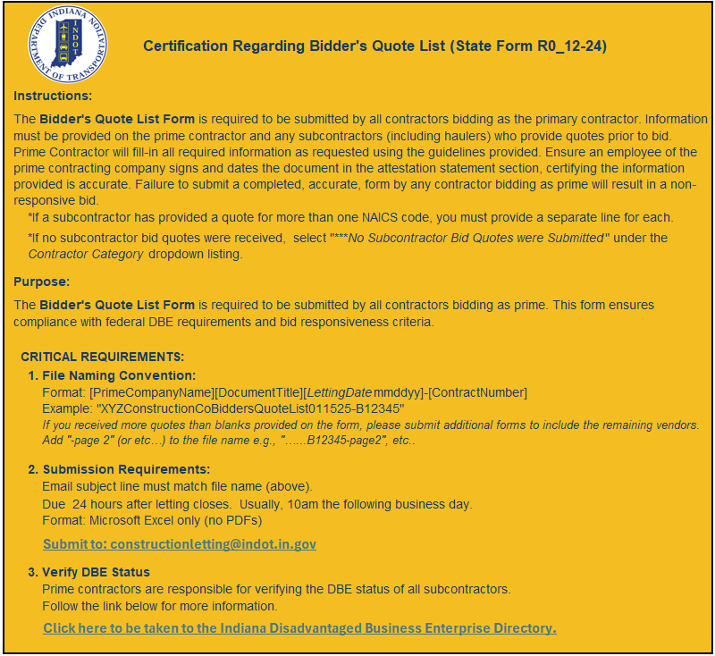
Form Instructions
To be updated!

Slide 9
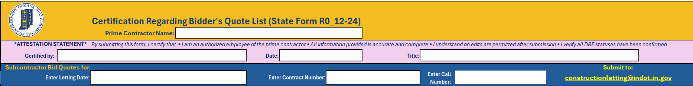
Form Instructions - Header
Each of these white boxes are open text entry by you – the prime contractor.
Attestation Statement: By submitting this form, I certify that: * I am an authorized employee of the prime contractor * All information provided is accurate and complete * I understand no edits are permitted after submission * I verify all DBE statuses have been confirmed

Slide 10
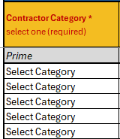
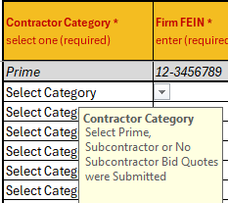
Form Instructions –“Relationship to Prime”
Select relationship via the drop-down box
The prime contractor should be listed first, with all the sub-contractors, including haulers, listed after.
In the instance that a prime contractor would be completing all work, then select “No Subcontractor Bid Quotes were Submitted”
The prime will still need to enter their own information

Slide 11
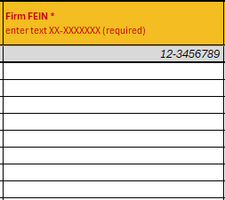
Form Instructions – “Firm FEIN”
Enter the firms Federal Identification Number here in open text.

Slide 12
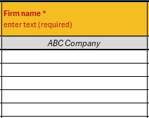
Form Instructions –“Firm name”
Enter firm name – open text
This is the name of the firm used to do the bidding with. Do not use “doing business as” names.

Slide 13
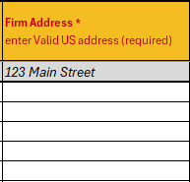
Form Instructions – “Firm Address”
Enter the firm’s address – open text

Slide 14
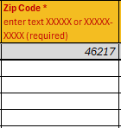
Form Instructions – “Zip Code”
Enter Zip code – open text

Slide 15
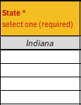
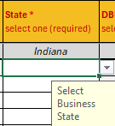
Form Instructions – “State”
Select state via the drop-down box

Slide 16
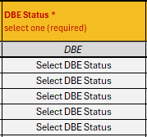
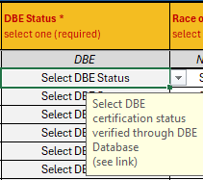
Form Instructions – “DBE Status”
Select DBE status via a drop-down box
Choose DBE or non-DBE

Slide 17
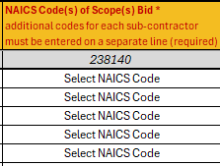
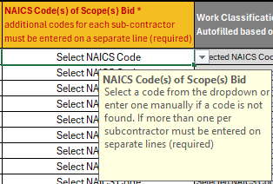
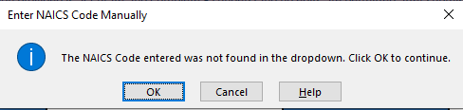
Form Instructions –“NAICS Code(s) of Scope(s) Bid”
Select the NAICS code via the drop-down box
If a NAICS code is not available in the drop-down list, you can enter a code in this field.
You will get this message when entering manually – click OK to move on

Slide 18
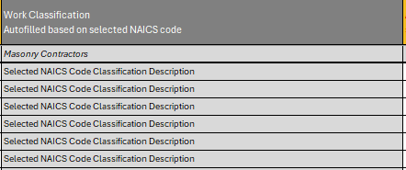
Form Instructions – “Work Classification”
This field is auto-filled from choice of NAICS code in previous column

Slide 19
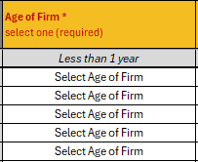
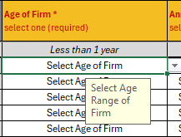
Form Instructions – “Age of Firm”
Select age of firm via the drop-down box
The choices are a range of years:
Less than 1 year
1 - 3 years
4 - 7 years
8 - 10 years
More than 10 years

Slide 20
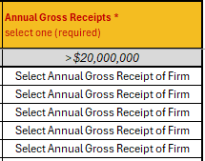
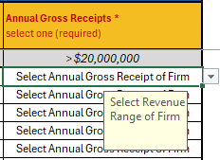
Form Instructions – “Annual Gross Receipts”
Select annual gross receipts via the drop-down box
Choices are:
Less than $1,000,000
$1 - $3,000,000
$3 - $6,000,000
$6 - $10,000,000
$10 - $20,000,000
Greater than $20,000,000

Slide 21
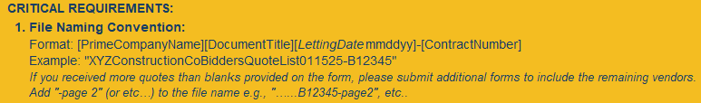
Completing and Submitting form
Once information is entered there is a file naming convention that we need to successfully process your submission.
This is the same instruction currently used for Performance Bond and Drug Policy documents
Another Example of file naming:
DuncanConstructionBiddersList011525-R68321B
Adding another page: DuncanConstructionBiddersList011525-R68321B-page2

Slide 22
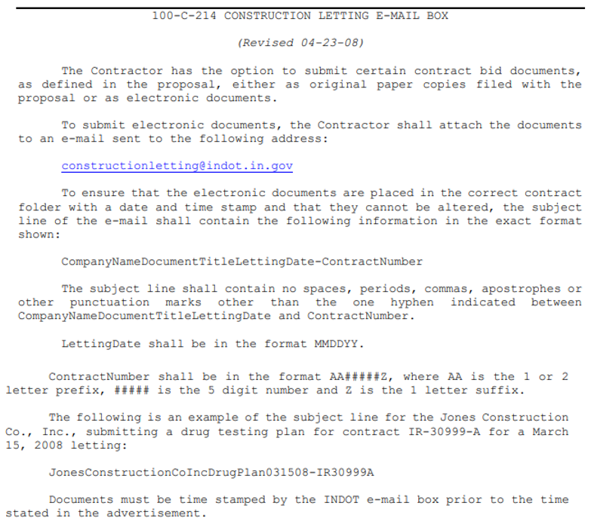
Recurring Special Provision 100-C-214
Only one document per email message. The message line indicates the contract number for the documents enclosed. Documents for other contracts will be disregarded.

Slide 23

Submission Requirements
The federal government requires this information to be submitted by bidders at the time of letting.
A grace period of 24 hours has been allowed for now.
Deadline for submission is 10:00 am the following business day.
Failure to submit will result in your bid being rejected.

Slide 24

Thank You!

