Slide 2
Letting Registration Changes
Session 2
1-12-2026

Slide 3

We will not be taking verbal questions during this meeting. But please, if you have a question, post it in the meeting chat. We will post answers on our web page and via email message

Slide 4
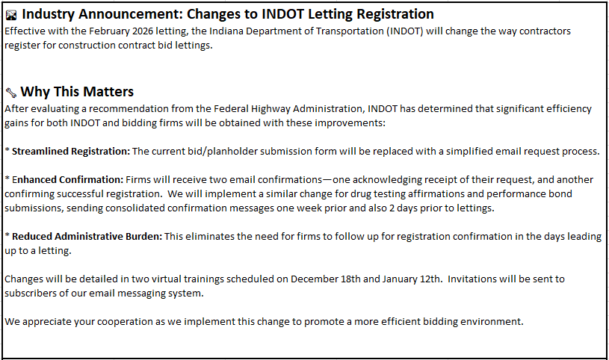
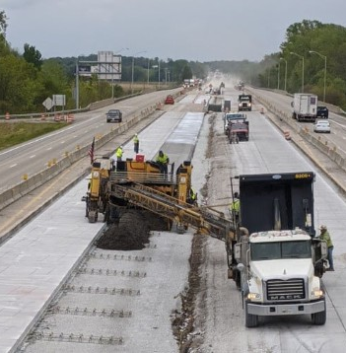

Slide 5
Improvements
Streamlined Registration
Enhanced Confirmation
Reduced Administrative Burden

Slide 6
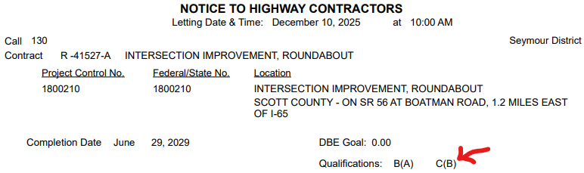
Streamlined Registration
Bidders & Planholders Registration Form is eliminated
You no longer need to enter 10 lines of information and manage a form
Email your request to register to INDOTBIDDERS@INDOT.IN.GOV
Email text is simple; just include the contracts you wish to bid and your FEIN #
Prequalification codes can be found on the Notice to Highway Contractors
Plan holder designation is no longer needed – all plans have been available to the public for over 9 years.

Slide 7
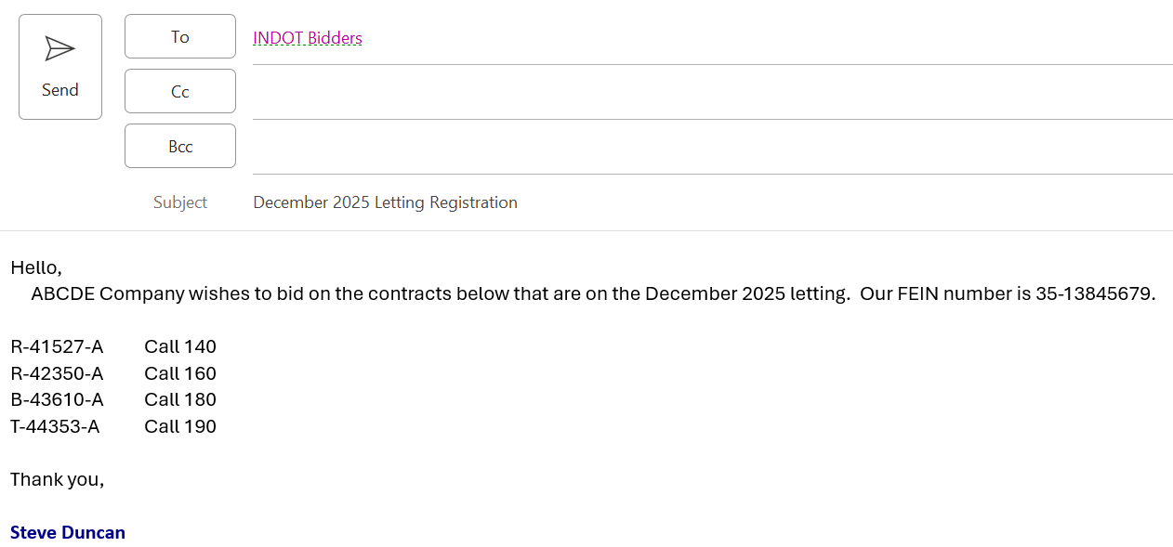
Registration Email Example

Slide 8
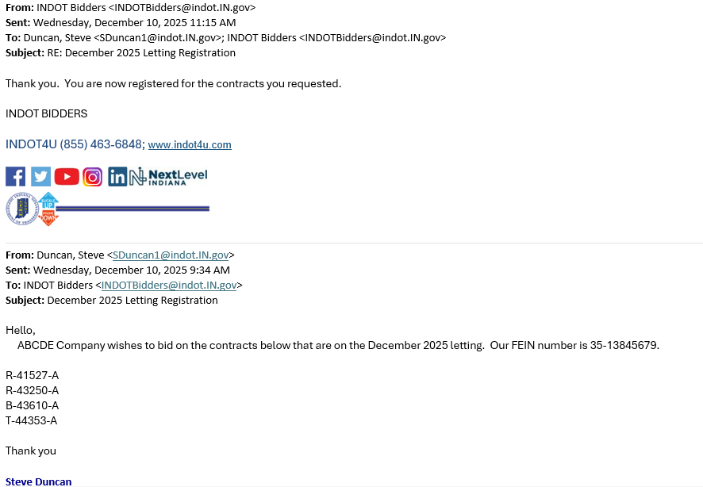
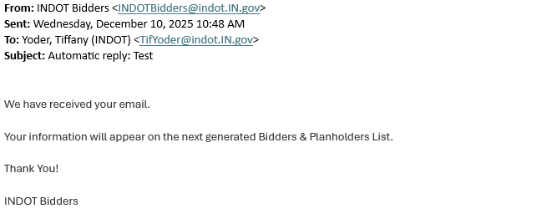


Enhanced Confirmation
You will receive an immediate email acknowledging receipt of your request
You will receive another email confirming that you are registered

Slide 9
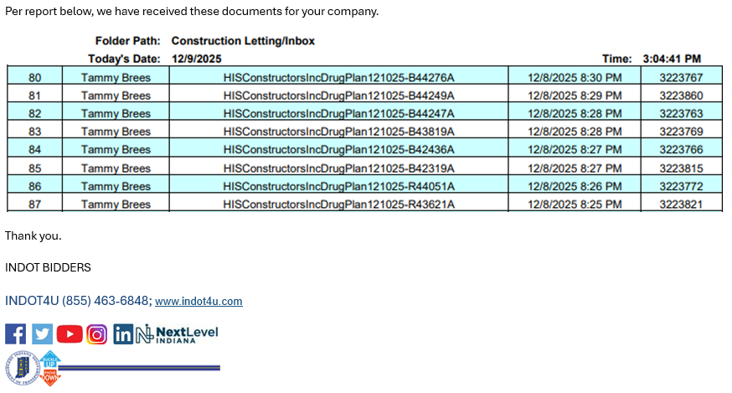
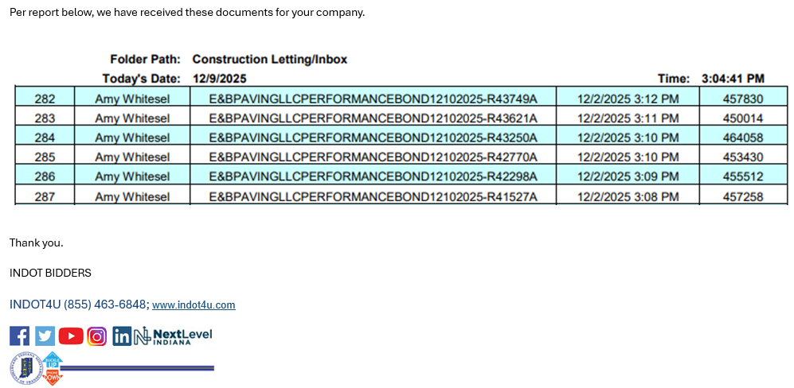
Reduced Administrative Burden
Many contractors contact us regularly asking the contracts team to confirm that they are indeed registered, or that INDOT has received their performance bond and/or drug plan documents.
You no longer need to do this – your confirmation email messages are more direct and timelier. You don’t need to go search for reports or postings and or worry if we don’t post as quickly as you would need.
* These messages will be sent the week prior to the letting and on Monday the week of the letting

Slide 10
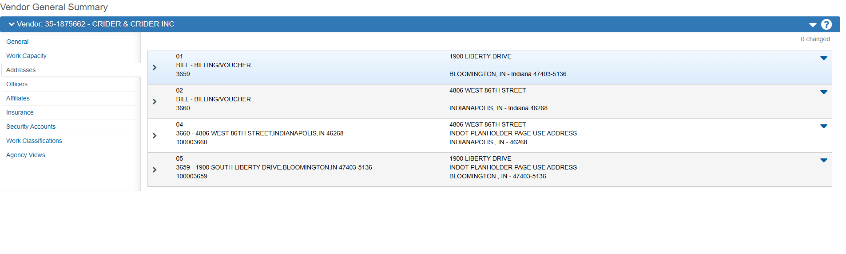
AWP registration page – address issue?
The drug plan and performance bond confirmation messages will be sent to the email addressed attached to their main company address: “01” in our system.

Slide 11


Bid Express
Small Business Network ®
The Bid Express Small Business Network® allows prime contractors and subcontractors to exchange sub-quotes and communicate projects within the Bid Express website.
Post an unlimited number of sub-quote requests
Set up email notifications for sub-quotes posts and responses
Easily locate pre-qualified and certified small and disadvantaged businesses
View all outstanding sub-quote requests at a glance
Access to the Bid Express Small Business Network® is included for all Basic Service subscribers.

Slide 12
Timeline
Training Session 2:
January 12th
2:00pm
Notice-to-Contractors for the February Letting is released on January 14th
New registration process begins on January 14th

Slide 13
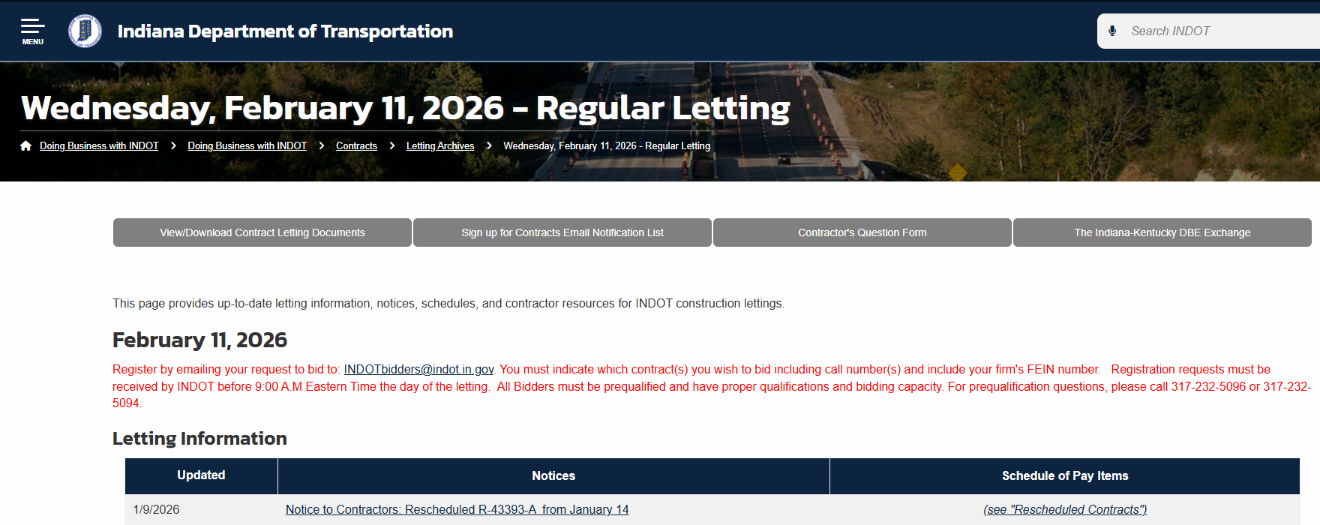

Slide 14
Questions Answers Comments
1.) Can the training presentation be shared?
1.) Yes – it is now posted on our web page
1.)https://www.in.gov/indot/doing-business-with-indot/home/contracts/
2.) How do we check our vendor email addresses?
2.) We will send out a test message week of 12-29
3.) How do subcontractors upload quotes on BidX?
3.) I’m inquiring with BidX and will respond
3.) working on a training session with Bidx
4.) Does this apply to Executive Order 25-64?
4.) No
5.) As for joint ventures, it’s assumed the extra forms will still be needed?
5.) JV requirement have not been affected and process remains the same
5.) CM 32-34, Contractual Obligations, Revision Acknowledgements

Slide 15
Questions Answers Comments
6.) Performance Bonds still need to be submitted?
6.) Yes – Still submit as you currently do
6.) We are now sending reports showing what has been sent
7.) The current registration allows us to add an email utilized during that letting we need to know what will be utilized for future lettings
7.) Whomever sends the registration request to us, we will reply directly to that email address
7.) Performance Bonds and Drug Plans will be sent to the contractors main account address
8.) When we register, do we include the email address where quotes from Subs should be sent?
8.) Quotes from subs are not part of this registration process

Slide 16
Questions Answers Comments
9.) In the test email regarding the Main Contact email. We did not receive the email. Probably sent to some one no longer withe the company. Where can I go to change the "MAIN" email address?
9.) You will change with our Prequalification Department: Korin: 317-232-5095
klight@indot.in.gov
9.) If you send to: INDOTBIDDERS@INDOT.IN.GOV we can take care of for you
10.) How do we change the official email address
10.) You can change with our Prequalification Department: Korin: 317-232-5095
klight@indot.in.gov
11.) Is it possible to have 2 official email address at the main?
11.) Only one address

Slide 17
Questions Answers Comments
12.) If our company has multiple office locations, can each office send in their request to the email, or does it need to be one email covering all offices for said company?
12.) Requests to register can be sent from multiple users – we will respond directly to their message
12.) Only the Performance Bond and Drug Plan documents report will be sent to the main or official company email
13.) If we were already registered for a Contract that was postponed to February Letting, do we need to register again?
13.) No need to re-register. Your registration moved with the bid request
14.) How can we check to see who our Main contact email is for our company? We did not receive a test email on 12-29?
14.) Please send a request to verify to: INDOTBIDDERS@INDOT.IN.GOV

Slide 18
Questions Answers Comments
15.) What should we do if we do not receive the test email tomorrow (Jan 12th)?
15.) Please send a request to verify to: INDOTBIDDERS@INDOT.IN.GOV

