Slide 1
Local Road and Bridge Matching Grant Funds – Access and Complete the CCMG Application Process
Kathy Eaton-McKalip
Director of LPA/MPO & Grant Administration
Indiana Department of Transportation

Slide 2
Online Application – Introduction
The purpose of this presentation is to help locals navigate the CCMG on-line application with step-by-step instructions, examples, and screenshots. Please use this tool in lieu of the Local Road and Bridge CCMG Guidance Document for Local Public Agencies posted on our Local Public Agency Program CCMG Program website under CCMG Resources.
Reference all CCMG Application sections of the Local Road and Bridge CCMG Guidance Document for Local Public Agencies to help you complete an application.
For questions regarding the CCMG Application contact your District Local Program Director. Reference CCMG Guidance Document, Section Resource – Who is my District Local Program Director? for their contact information.

Slide 3
Online Application – Introduction
Applications MUST be completed by the local and no one else.
CCMG applications take time to complete, do not wait until the last moment to start.
INDOT does our best to review those applications submitted early for fatal flaws.
When INDOT reviews your application and sends it back to you, review the comments, make the necessary changes, and resubmit the application ASAP.
If the application is not resubmitted, it will not be eligible.

Slide 4
Online Application – Introduction
ACCESS INDIANA
An Access Indiana account is now required for all external users to access ITAP and all applications within ITAP.
INDOT TECHNICAL APPLICATION PATHWAY (ITAP)
To access INDOTs CCMG application locals must have an INDOT Technical Application Pathway (ITAP) business account and a registered user linked to their local agency to apply for Community Crossings funds.
Once you have an Access Indiana account, go to https://itap.indot.in.gov to login to ITAP. The link will navigate you to the Access Indiana login page. Once you enter an email address and password, you will be taken to the ITAP Dashboard upon a successful sign in.
If you have questions or are unsure if your agency is enrolled, contact Michael Cales at mcales@indot.in.gov for ITAP support.
For questions regarding the Access Indiana and ITAP Registration Enrollment reference the Local Road and Bridge CCMG Guidance Document for Local Public Agencies, section CCMG Application – Access Indiana and ITAP Registration Enrollment.

Slide 5
Online Application – Introduction
Required documentation to submit a CCMG Application
Signed Financial Commitment Letter.
Detailed Cost Estimate for each mapped road segment.
Approved Asset Management Plan Letter.
Structure Inventory and Appraisal Report (SIA) is required for Bridge projects only. Reference CCMG Guidance Document section
For questions regarding Required Documentation reference the Local Road and Bridge CCMG Guidance Document for Local Public Agencies, section CCMG Application – Required Documentation.

Slide 6
Important – Project Closeout
INDOT reviews all previously awarded CCMG projects to ensure that projects older than two-years-old have been closed out.
If any Local Unit of Government does not meet the requirements of project close out prior to the close out deadline, they will be deemed ineligible for the current call and all future calls until all outstanding projects over two-years-old are closed out.
For details regarding project closeout, reference the Local Road and Bridge CCMG Guidance Document for Local Public Agencies, section Close-Out Documents – Required CCMG Project Close Out Documentation.

Slide 7
Online Application - Login
To login to ITAP go to https://itap.indot.in.gov/.
The On the ITAP page, select ‘Others’.
Enter you ‘User Name’ and ‘Password’.
Click ‘Login’.

Slide 8
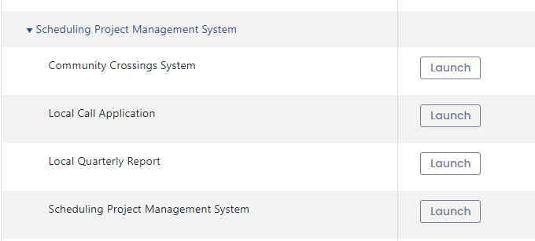
Online Application – Login
Click ‘Scheduling Project Management System’.
Click ‘Community Crossings System’
Click ‘Launch’.

Slide 9
Online Application – Login
The Call Lists will appear.
This is a list of all the past calls applications.
Click ‘Call Applications’ action button for the ‘Active’ CC Call Status.

Slide 10
Online Application – Begin Application
The Call Application List will appear.
This is a list of all your current application(s).
Click ‘Add New’ to start a new application.

Slide 11
Online Application – Begin Application
Read this disclaimer and click ‘Continue’ to start the application process.

Slide 12
Online Application – Begin Application
Within the application, you can easily maneuver from section to section by clicking the tabs located on the right side of the application.

Slide 13
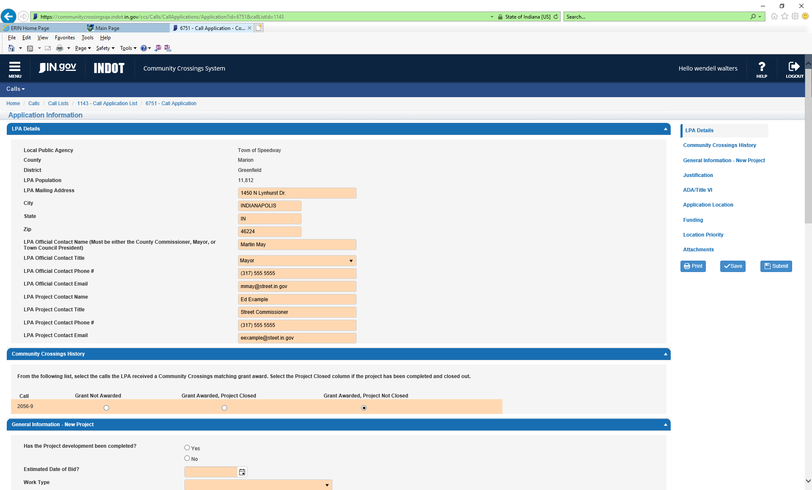
Online Application – LPA Details
Complete all required field with your LPA contact details.
The District Program Director will use the LPA Official Contact and LPA Project Contact listed as the official contacts for the project.

Slide 14
Online Application – Community Crossings History
Complete the CCMG funding history for your local by choosing:
Grant Not Awarded = local did not apply for that call, or
Grant Awarded, Project Closed = local did apply for that call and local has closed out the project, or
Grant Awarded, Project Not Closed = local did apply for that call and local has not closed out the project.

Slide 15
Online Application – General Information – New Project
Has the project development been completed? CCMG funds are for CN only.
Estimated Date of Bid? Project should be ready for bid once notified of award.
Work Type? Choose the type of work being completed.
Funding Type? Choose if project will be bid or force account work.
Detailed Project Scope? List the desired scope of the project in detail.

Slide 16
Online Application – Justification
Give a detailed justification for the project. Including the purpose and need, any deficiencies, connections, benefits, and economic growth. INDOT wants to know why this project is needed, and why it will benefit your local public agency.

Slide 17
Online Application – ADA / Title VI
Complete all required fields with your LPA’s ADA and Title VI coordinator’s.
Reference the Local Road and Bridge CCMG Guidance Document for Local Public Agencies, section CCMG Application - ADA & Title VI Certification.

Slide 18
Important - Mapping
Do not type in the fields ‘Route Name’, ‘From’, or ‘To’. The ‘From’, or ‘To’ fields will automatically fill in once you have clicked on ‘Show/Select Route on Map’ and mapped your location.
To correct this mapping error, delete the road segment and start over by first clicking the ‘Show/Select Route on Map’.
To help you get the best results when mapping your projects, zoom in as much as possible on the ‘Start’ and ‘End’ points to ensure that the points line up exactly where you want them. This will ensure the project length is correct and ‘to’ and ‘from’ points match your map.

Slide 19
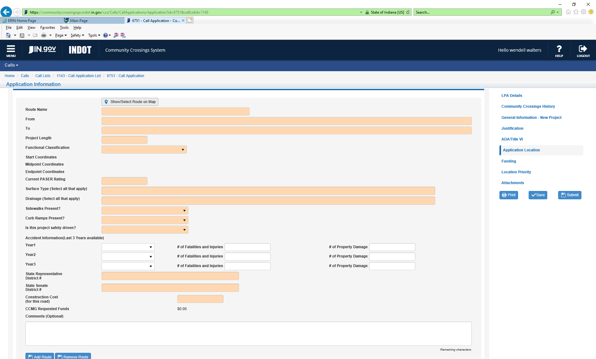
Online Application – Application Location
To enter the location(s) to the application, first click the action button ‘Show/Select Route on Map’ to map a road.

Slide 20
Online Application – Application Location
When mapping a road, ensure it is the correct road name and the project length is accurately represented.
The road name that is used must be the same as what is in the Certified Road Mileage and Inventory
Example: Road name is listed as E County Road 400 N on the map, correct road name is Vale Park Rd.
There should be no confusion on the road you are applying for.

Slide 21
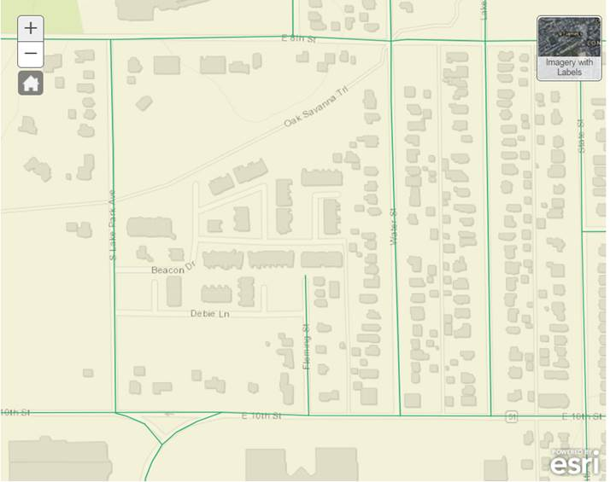
Example – Mapping Issues
The base map that appears when the applications maps are opened is a purchased product. It is only used for orientation. INDOT does not have editing rights to this base map.
In the example below Beacon Dr and Debie Ln are shown on the base map but are not roads within the locals Certified Road Mileage. Notice there is no GREEN line on those roads, so those roads cannot be selected by the local to apply for that road segment.

Slide 22
Important – Certified Road Inventory
If a road should be in your road inventory, the local must get the road segment added to their Certified Road Inventory before INDOT is able to award funds for the road.
To find out how to update your Certified Road Inventory, reference Local Road and Bridge CCMG Guidance Document for Local Public Agencies, section CCMG Application – Certified Road Inventory.

Slide 23
Online Application – Application Location
When mapping your road, use the mouse and click on a GREEN line to select the road segment you want to apply for. Once it is selected / clicked it will be identified as a BLUE line.
BLUE line signifies the road segment within your Certified Route Inventory you are applying for.
GREEN lines represent all the roads in your Certified Route Inventory and are roads that can be applied for and awarded CCMG funding.

Slide 24
Online Application – Application Location
When a GREEN line is selected, a box will pop up with the Route ID and Route (road name).
The Route ID is a 17-digit number.
The first 3 digits are the owner code
If 1st number is 3, it is a county road,
If 1st number is 5, it is a city/town road
The next 2 numbers are the county id number.
The next 4 digits are the specific local agency identifier.

Slide 25
Online Application – Application Location
Route (road name) shown is secondary information and can be revised if the name is incorrect.
Contact INDOT to revise the Route (road name).
The Route (road name) mapped on the application is the Route (road name) that will be reflected on your contract. The Route (road name) on the application and on the detailed itemized cost estimate must match.
Once you choose the route you are applying for, click ‘Yes’.

Slide 26
Example – Mapping Issues
Vale Park Rd (in the certified road mile and inventory) is shown on the base map as ‘E. County Rd 400 N’. If the name in the box is wrong, contact INDOT to get it corrected.
Notice the AQUA highlight goes beyond limits of picture, therefore once you say ‘Yes’, this is the correct road, you will have to zoom out to find the ‘From’, or ‘To’ points.

Slide 27
Online Application – Application Location
Once you click ‘Yes’, the start and end points appear Green and Red.
If no adjustment to the ‘From’, or ‘To’ are needed, close the map.
Start and End Points (to and from).

Slide 28
Example – Mapping Issues
If an adjustment is needed to the ‘From’, or ‘To’ point(s), click, and grab a GREEN or RED point and drag it along the highlighted line to a new location for that point. The ‘From’, or ‘To’ points cannot be drug off the highlighted line.
For this example, the entire Vale Park Rd is 1 segment in the inventory and was all highlighted BLUE when you selected the road, but you want to decrease the project length.
The start point (Green) was dragged along the road to a new start point for the project length.

Slide 29
Online Application – Application Location
Once you have selected the road, the information below will automatically populate into the application. DO NOT modify any of this information.

Slide 30
Online Application – Application Location
Complete the remaining required fields by using the drop-down menus.
If the project is safety driven, the accident data is required.

Slide 31
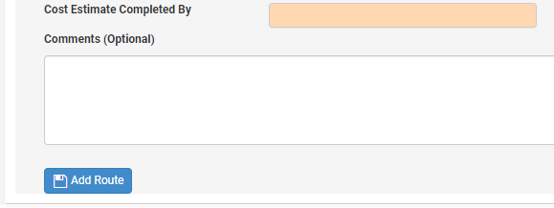
Online Application – Application Location
To add another road segment to the application, click Add Route.
If you have questions regarding your application or mapping issues, contact Cassandra Hudson at chudson1@indot.in.gov for support.

Slide 32
Online Application – Funding
Your application automatically calculates the ‘Total Construction Cost’ of all the roads ($80,000.00 for this example) and calculates the ‘Total CCMG Requested Funds’ for you ($40,000.00 for this example).
Notes:
Going to ask for a program update on how it calculates

Slide 33
Online Application – Location Priority
If you have more than one location, you can prioritize the ‘Route Name’ by using the ‘up’ and ‘down’ arrows on the left of the Route Name. If you do not prioritize the routes, the routes will be automatically prioritized in the order you entered the route.

Slide 34
Online Application – Attachments
To add your attachments, click the button to add attachments.
Ensure you attach all the required documents.
Remember there will be a Detailed Estimate uploaded for each road (Route Name).
Reference the Local Road and Bridge CCMG Guidance Document for Local Public Agencies, section CCMG Application – Required Documentation and section CCMG Application - Document Naming Conventions for Local to Upload Documents.

Slide 35
Online Application – Attachments
Click ‘Select Files’.
Ensure the Document Name is descriptive, (i.e., Road Name Estimate, AMP, Financial Commitment Letter).
Choose from your files all required attachments.

Slide 36
Online Application – Attachments
Choose the ‘Document Type’ from the drop-down menu.
Click ‘Upload Files’.
Click ‘Close’.

Slide 37
Online Application – Attachments
Required upload documentation - Naming Conventions
Financial Commitment – Reference Application # in File Name
Detailed Cost Estimate – Identify Road Segment in File Name (To and From should be included if have same segment with different locations)
Asset Management Approval Letter from LTAP – Place Approval Date in File Name
Structure Inventory and Appraisal Report – Place Bridge Number in File Name

Slide 38
Online Application – Signature and Submittal
To electronically sign and submit the application, click the ‘I Accept’ and then click ‘Submit’.

Slide 39
Online Application – Signature and Submittal
If there are any Validation Errors due to incomplete information, you will receive a notification like this when you hit the submit button.
Return to the application, fix any Validation Errors, and resubmit.

Slide 40
Online Application – Submittal
Once the application is submitted, you can verify submittal by returning to your Call Application List. The ‘Application Status’ will read ‘Submitted’.

Slide 41
Online Application – Submittal
Note: Locals can ‘pull back’ a submitted application by going back into the application and clicking on the icon. After the local has completed their revisions, they must follow the submittal steps on the previous slide to re-submit the application. Verify re-submittal was successful by returning to your Call Application List. The ‘Application Status’ will read ‘Submitted’.

Slide 42
Online Application – Application Priority
Click ‘Edit Application Priority’.
Once you have the priority set click ‘Done Editing’.

Slide 43
Application - Fatal Flaws
Financial Commitment Letter – is missing or is missing funding content or proper signature.
Detailed Cost Estimates – is missing or does not include detailed itemized pay items per road segment.
Asset Management Plan – is missing or is expired.
Structure Inventory and Appraisal Report (SIA) - is missing, for Bridge projects only.
Mapping a Road or Bridge – is missing accurate road name and ‘to’ and ‘from’. Update local road inventory.
Project Closeout Documentation - local has not submitted past awarded Project Closeout documentation for all projects older than two-years by the deadline.

