Slide 1

DocuSign
Kathy Eaton-McKalip
Division Director – LPA/MPO Grants
INDOT

Slide 2
DocuSign
INDOT uses DocuSign for electronic signatures on INDOT LPA Contracts and Local Roads and Bridges Matching Grant Agreements.
INDOT LPA Contract
The local agency’s Employee in Responsible Charge (ERC) must submit a list of individuals authorized to sign INDOT contracts, along with the ordinance that grants this authority.
Local Roads and Bridges Matching Grant Agreement
On the CCMG application, locals must enter individuals authorized to sign INDOT contracts and upload the ordinance that grants this authority.

Slide 3
DocuSign ‒ Legal Binding Authority
Definition of Legal Binding Authority:
A person with legal authority to bind the agency, demonstrated by one of the following:
Mayor (authority established under state law).
Ordinance granting signature authority.
Resolution assigning signature authority.
Meeting minutes delegating authority.
Multiple signatures from a quorum of Commissioners, Board of Works, or Town Council.

Slide 4
DocuSign ‒ Legal Binding Authority
INDOT requires only one legal signature per contract.
Cities with a mayor do not need an ordinance; mayors have the authority under state law to sign contracts.
All other local governments must provide an ordinance identifying who has authority to sign contracts.

Slide 5
DocuSign ‒ Legal Binding Authority
Before routing a contract for signature, INDOT must have:
Signer Name: = Full legal name.
Signer Email: = Direct email for the signer.
Signer Cell Phone Number: = Used for DocuSign identity verification via text (preferred method).
Alternative Means of Signature Verification: = If no cell phone is available, DocuSign will send an email containing the authorization code.

Slide 6
DocuSign ‒ Legal Binding Authority
Below is an example of the form required to list signing authority for
an INDOT LPA Contract.
List only the legal signers who are available to sign.
All listed signers must complete their signatures in DocuSign.
DocuSign routes the contract in the exact order signers are listed.
Signers cannot be skipped; DocuSign will not advance to the next signer until the previous signer has signed.
If a listed signer becomes unavailable, notify your District Program Director so they can be removed.
Removing a signer during routing will restart the signature process for all signers.
LPA Name: | Town in Indiana
1 – Signer Name: 1 – Signer Email: 1 – Signer Cell Phone Number: | Dan Doe ddoe@email.com 317-555-1234
2 – Signer Name: 2 – Signer Email: 2 – Signer Cell Phone Number: | Jane Doe jdoe@email.com 317-555-9999
3 – Signer Name: 3 – Signer Email: 3 – Signer Cell Phone Number:
4 – Signer Name: 4 – Signer Email: 4 – Signer Cell Phone Number:

Slide 7
DocuSign ‒ Routing for Signatures
INDOT will email a draft copy of the contract to the ERC or designated contact when a contract is initially routed.
The draft is for review only and is not for signing; may be used for any public meeting and votes.
The ERC should inform legal signers when the contract has been routed via DocuSign.
The draft copy may be used for meetings and internal review prior to official signing.

Slide 8
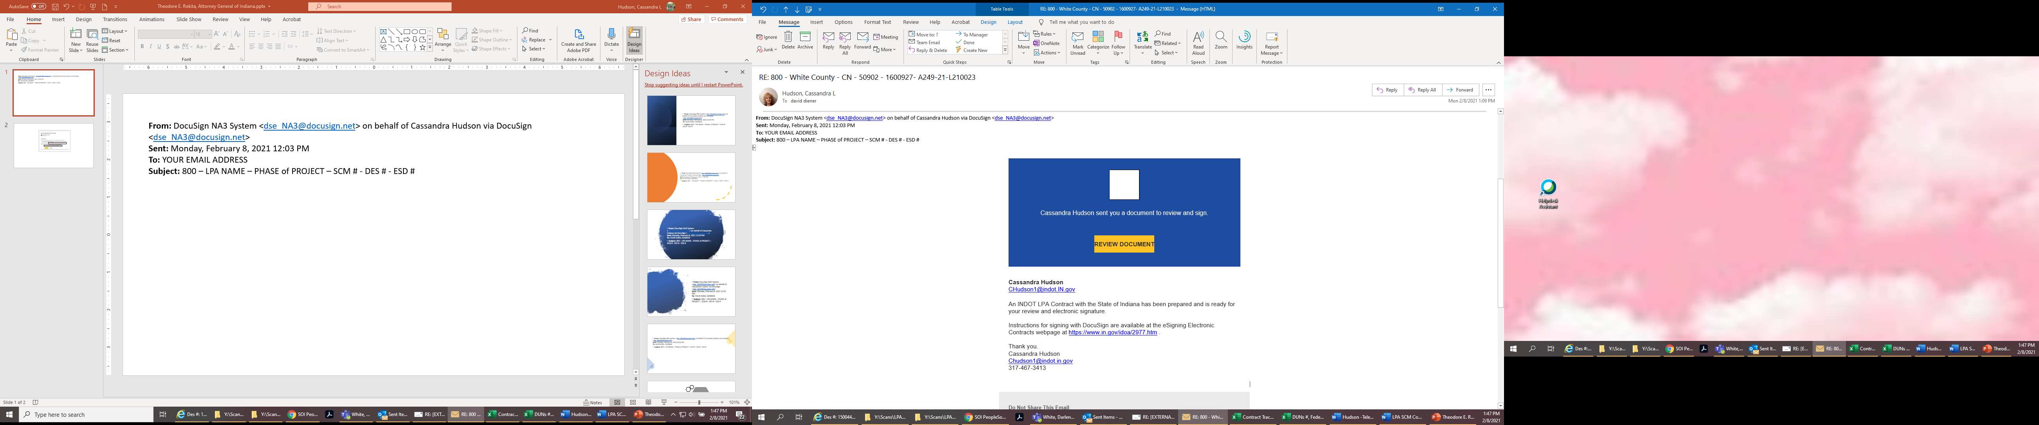
DocuSign ‒ DocuSign Emails
Legal signers will receive an email from dse_NA3@docusign.net (may appear in Spam/Junk).
Subject line includes the project information (agency name, phase, SCM#, DES#, EDS#).
Signers click REVIEW DOCUMENT to begin.

Slide 9
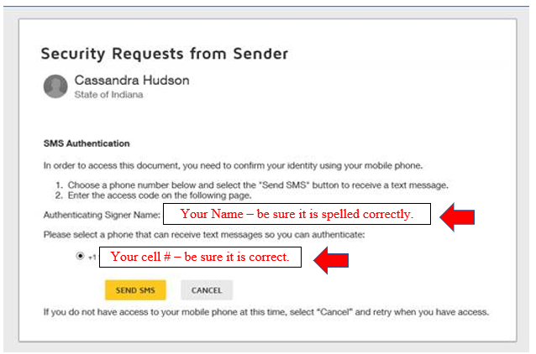
DocuSign ‒ DocuSign Emails
To verify identity, signers must request an authorization code. Click SEND SMS to request the texted authorization code.
Authorization codes expire after 48 hours.
A new code can be requested at any time by reopening the original email and clicking SEND SMS again.

Slide 10
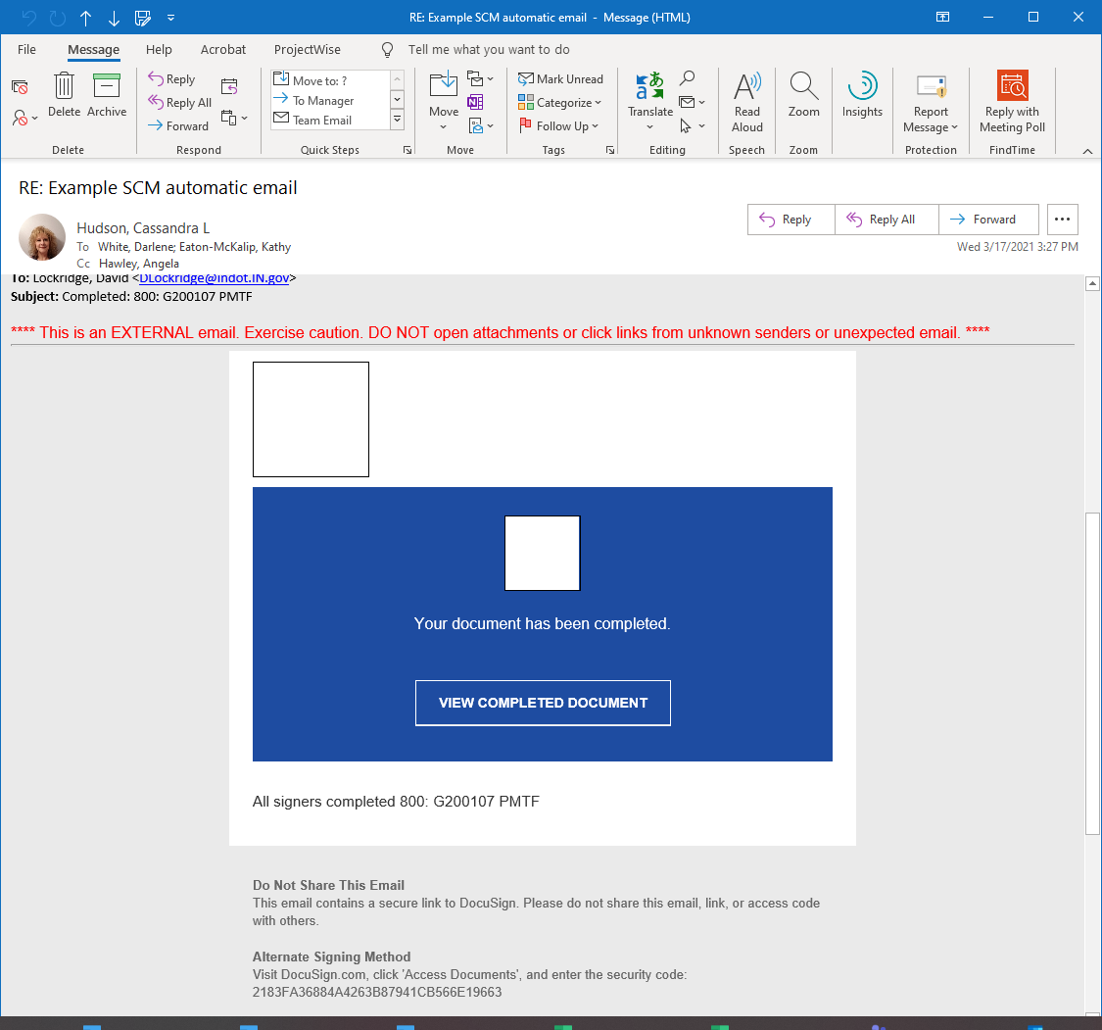
DocuSign ‒ DocuSign Emails
After all local legal signers and INDOT’s Grant Administrator sign, DocuSign will send an automatic “Your document has been completed” email.
This e-mail is automatically generated by DocuSign and DOES NOT indicate that the contract is fully executed.

Slide 11
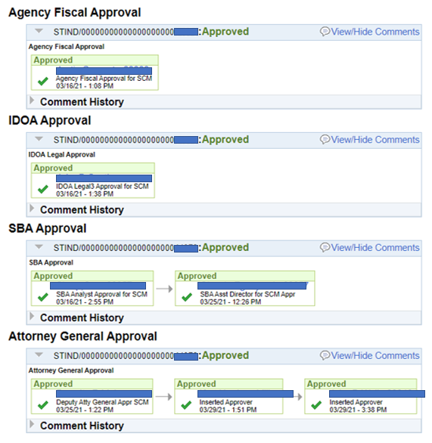
DocuSign ‒ DocuSign Emails
Additional state-level signatures are required (IDOA, SBA, and AG for amendments).
Once all required signatures are obtained, the District Program Director will forward the fully executed contract to the ERC or designated contact.

Slide 12
DocuSign ‒ Lifecycle of the Contract
Local provides signer information and ordinance.
INDOT drafts the contract and routes via DocuSign.
Local receives a draft for internal review.
Legal signers complete DocuSign signatures.
INDOT receives the signed contract.
INDOT runs DWD/DOR clearances.
If clearance issues exceed 30 days, the contract must be re‑signed by all parties.
Contract is routed to external agencies (IDOA, SBA, AG if amendment).
Fully executed contract is sent to the local for records.

Slide 13
DocuSign ‒ Helpful Links
Local Public Agency Program https://www.in.gov/indot/doing-business-with-indot/local-public-agency-programs/
How to Electronically Sign a Contract Training Materials https://www.in.gov/indot/doing-business-with-indot/local-public-agency-programs/
DocuSign Process for Signing a State Contract https://www.in.gov/idoa/wbt/DocuSign_IdentityAuth/index.html
DocuSign Process to Decline to Sign a State Contract https://www.in.gov/idoa/wbt/DocuSign_DeclineSigning/index.html
Instructions for signing with DocuSign - eSigning Electronic Contracts https://www.in.gov/idoa/procurement/supplier-resource-center/esigning-electronic-contracts/

Slide 14
LPA Program Contacts
We are here to help you. A complete list of Local Program Directors is listed on our website under ‘Contact Us’: https://www.in.gov/indot/doing-business-with-indot/local-public-agency-programs/.
For questions regarding the Federal Program, please contact Michael Cales at mcales@indot.in.gov.
For questions regarding the CCMG Program, please contact Cassandra Hudson at chudson1@indot.in.gov.

