Slide 1



Housing Affordability, Availability & Need: Using Available Data to Advocate for Affordable Housing
IHCDA
Stephen Enz - Real Estate Policy and Data Manager
David Boltz – HMIS Data Analyst
Center for the Homeless
Lani Vivirito - Chief Policy and Resource Officer
August 27th, 2025
Notes:
Welcome to Housing Affordability, Availability & Need: Using Available Data to Advocate for Affordable Housing.
I am David Boltz, one of the HMIS Data Analysts at IHCDA.
I am joined today by Stephen Enz, the Real Estate Policy and Data Manager at IHCDA and Lani Vivirito, the Chief Policy and Resource Officer at Center for the Homeless.

Slide 2
David Boltz (IHCDA)
Data Analyst - Homeless Management Information System
Notes:
Today, I will be covering a few data sources that you can use to advocate for affordable housing in your community.

Slide 3
Where data Portal Information comes from?
HMIS
Homeless Management Information System
DV ClientTrack
Domestic Violence comparable system
HUD Federal Reports Archive
HIC, PIT, LSA, SPM
Notes:
The information from the HMIS Data portal comes from the HIC, PIT, LSA, and SPM.
These are the four main reports that we send to HUD from our HMIS each year.

Slide 4
Where to find information?
National Low-Income Housing Coalition
Housing needs by state
Indiana Census Data
County level demographic information
United for ALICE
Housing authority voucher data
Housing costs compared to median area wages
Office of Public & Indian Housing
HMIS Data Portal – HIC, PIT, LSA, SPM
HIC – Housing inventory Count
PIT – Point in Time Count
LSA - Longitudinal Systems Analysis
SPM - System Performance Measures
Notes:
On the left, we have a breakdown of the acronyms I mentioned on the previous slide.
On the right here are some non HMIS resources that help provide context to the HMIS data.

Slide 5
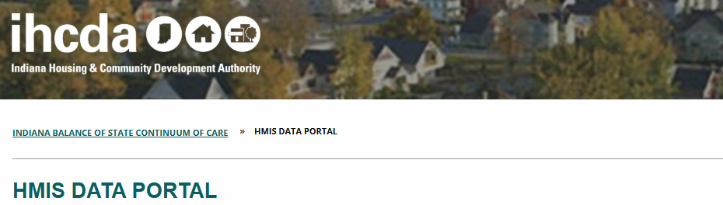
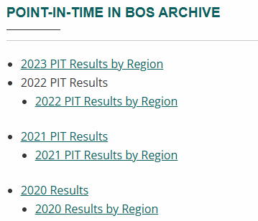
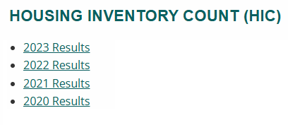
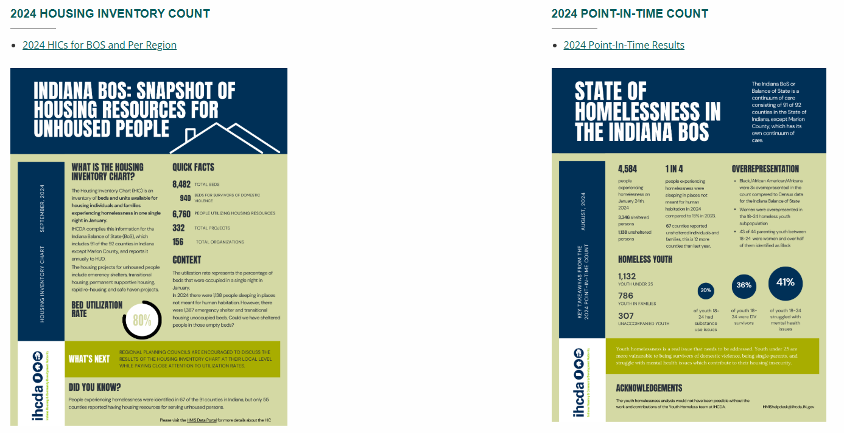
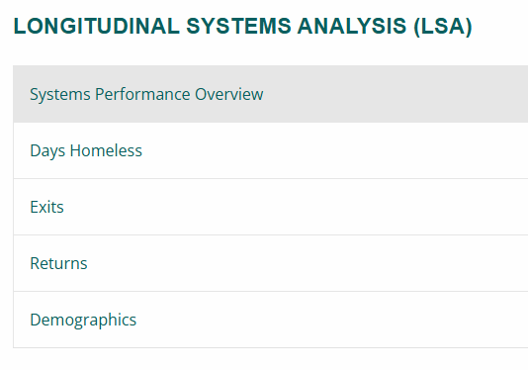
HMIS Data Portal
Source: HMIS Data Portal
Website
Notes:
The HMIS data portal is a great place to find information from HMIS for previous years of reporting.
Our team plans to add HIC and PIT information form this years counts to the website next week.
We will share these slides after the conference with links to each of these resources.

Slide 6
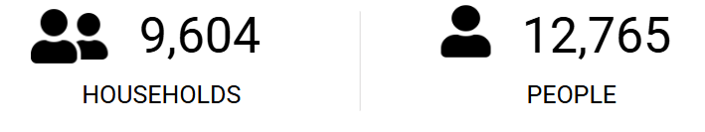
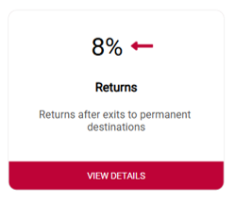
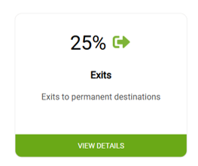
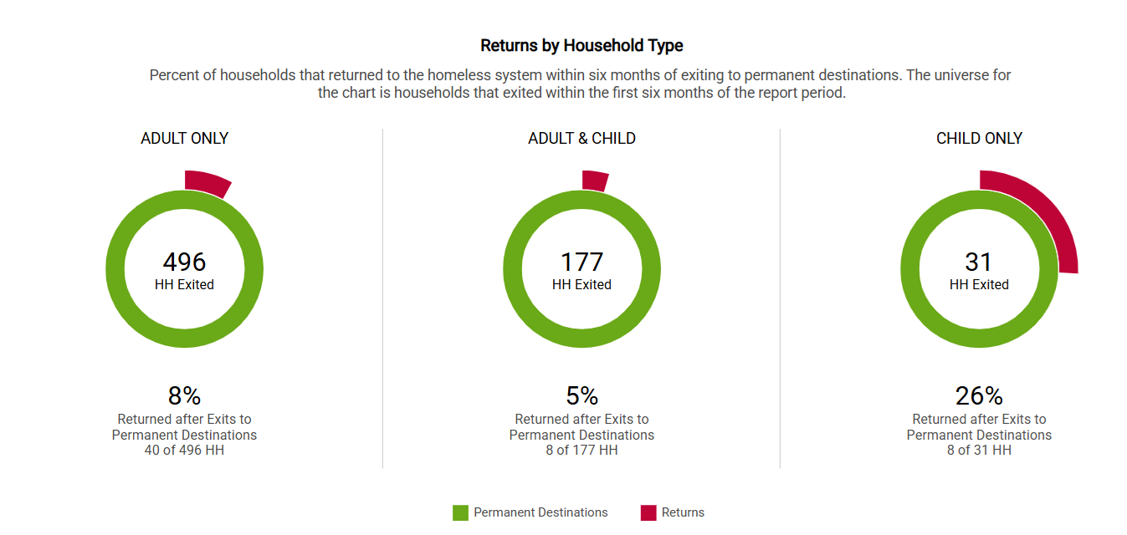
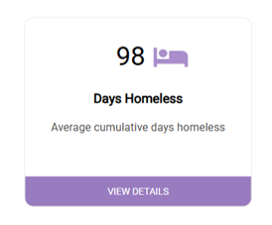
System Performance Overview
Source: HMIS Data Portal
Website
Notes:
The HMIS data portal has updated screenshots of recent LSA data.
I will go over the next few slides briefly to show you some of the types of data available from the LSA.

Slide 7
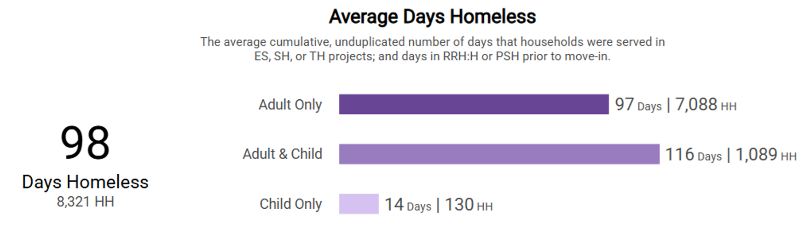
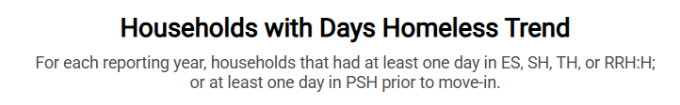
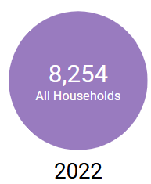
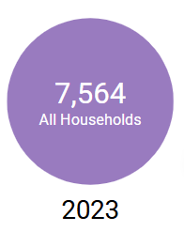
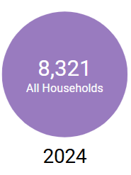
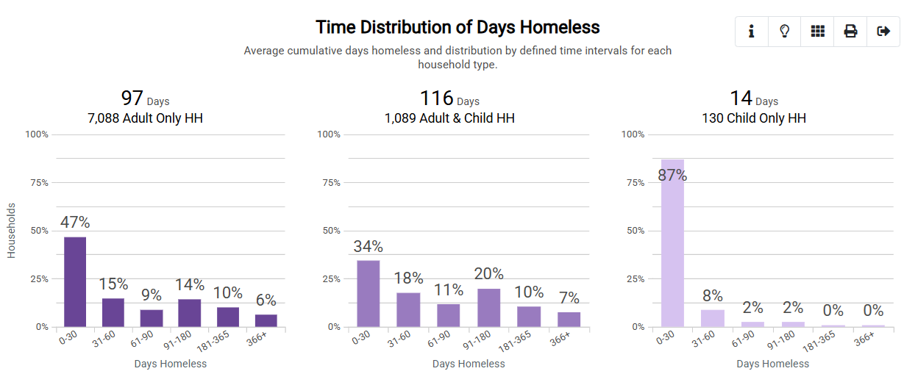
Days Homeless
Source: HMIS Data Portal
Website
Notes:
Here you can see the average days homeless, number of households served, and some demographic information.

Slide 8
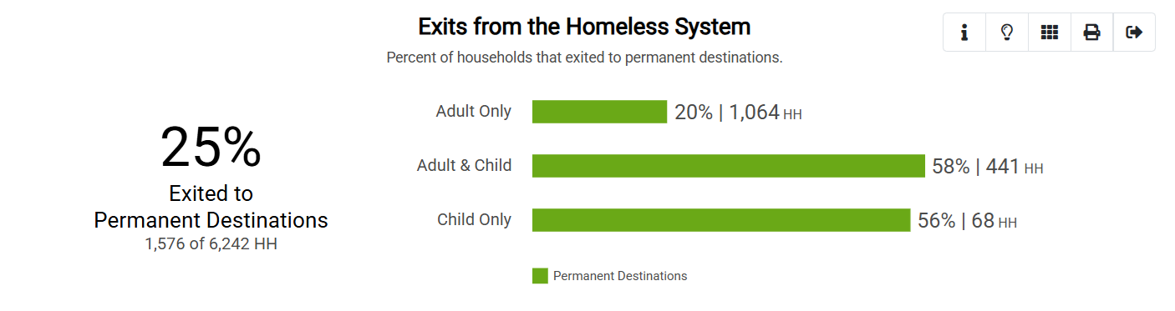
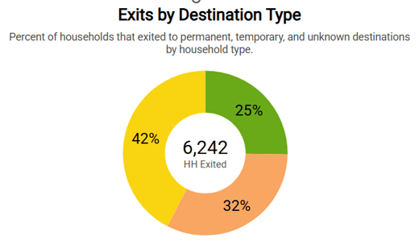
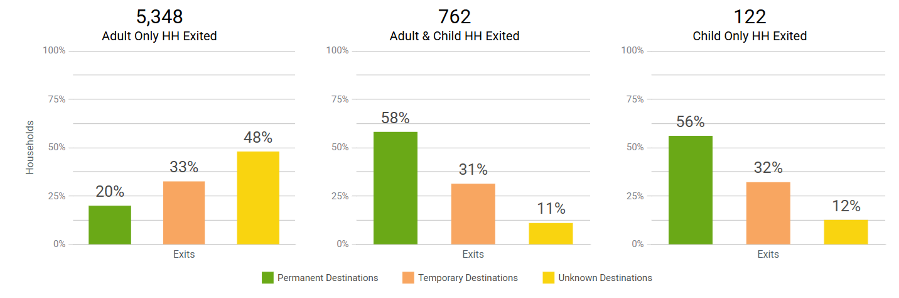
Exits
Source: HMIS Data Portal
Website
Notes:
Exits from the Homeless system by destination type and housing composition.

Slide 9
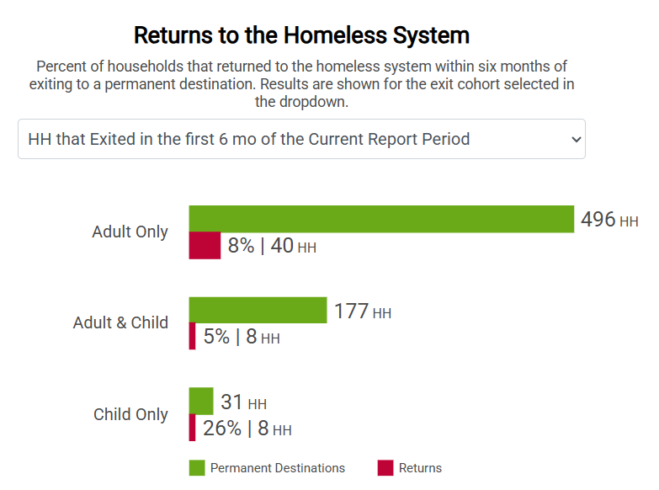
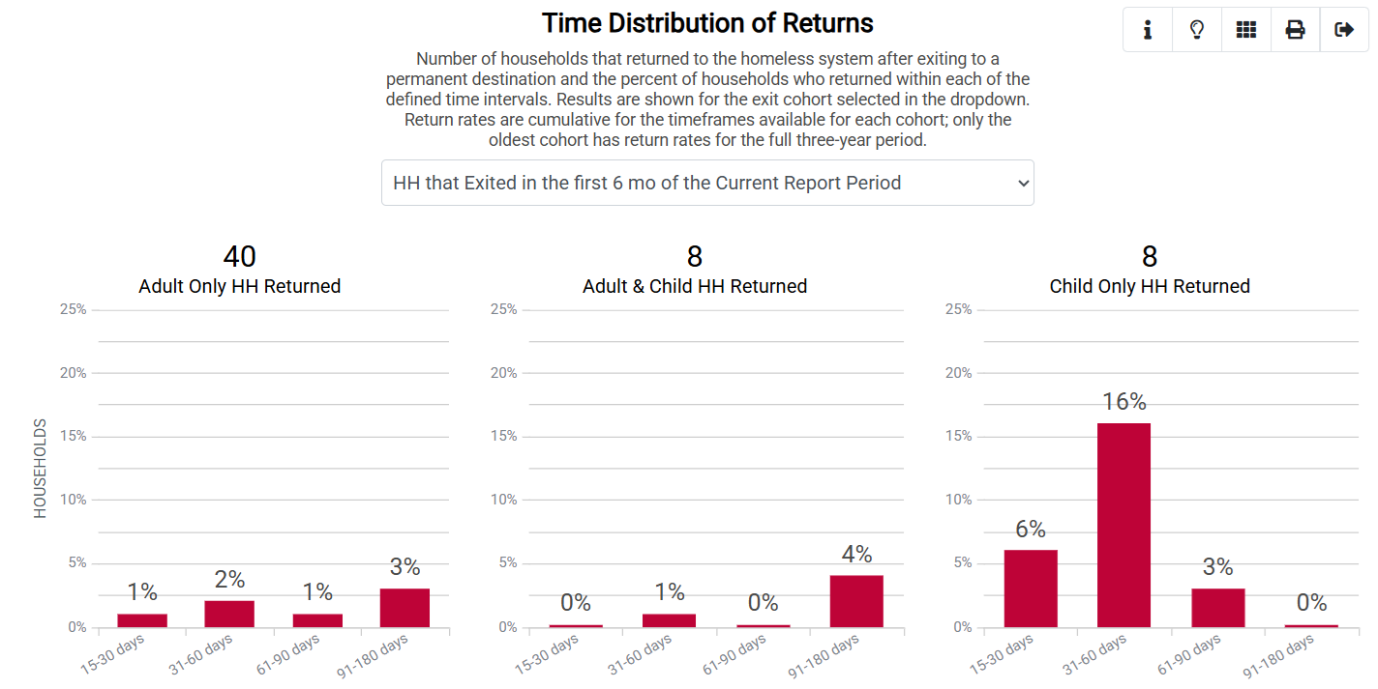
Returns
Source: HMIS Data Portal
Website
Notes:
Returns to homelessness by household type.

Slide 10
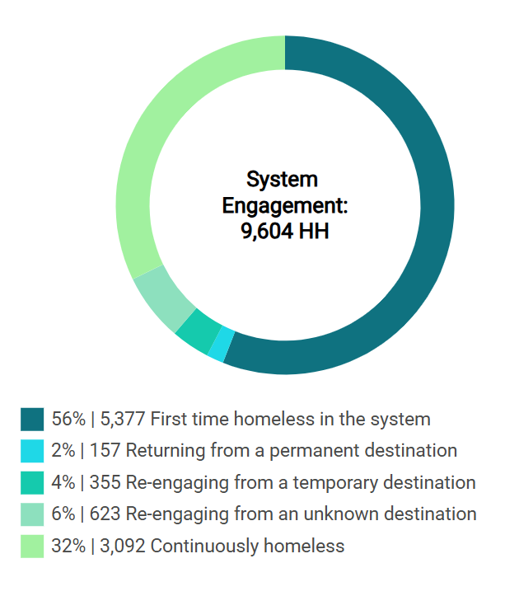
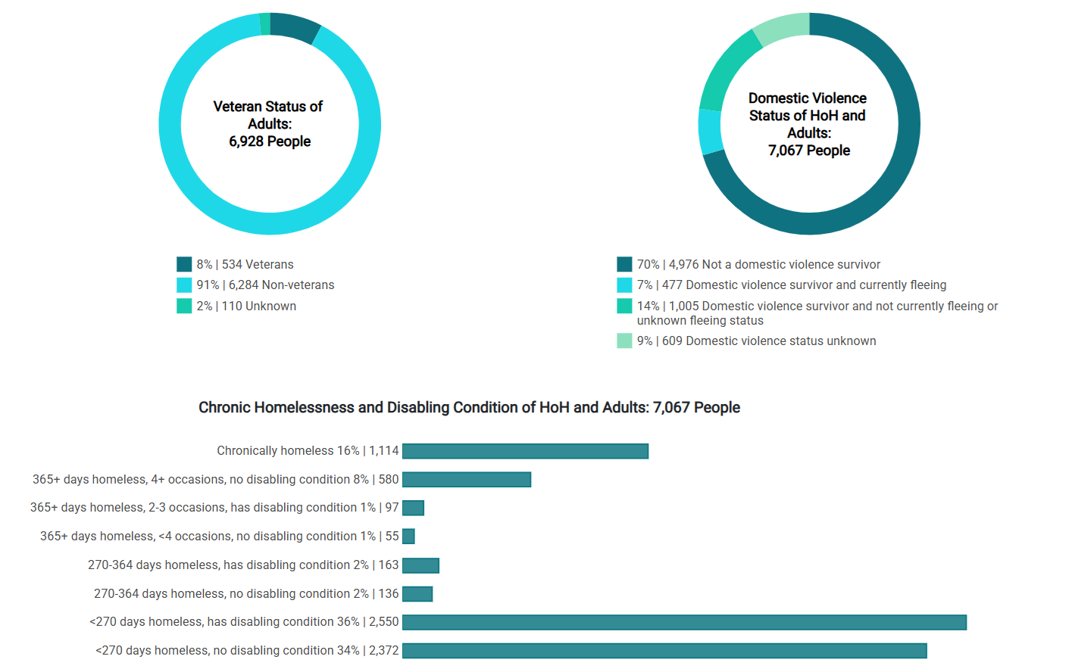
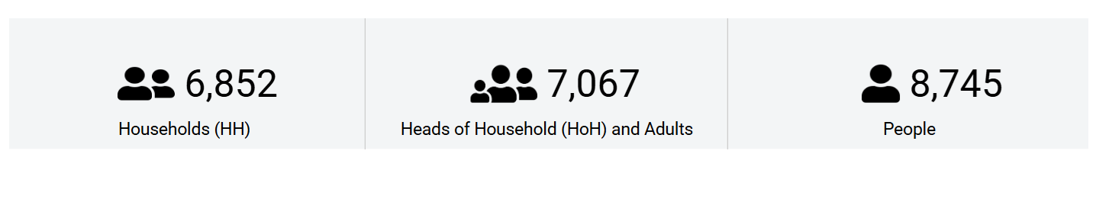
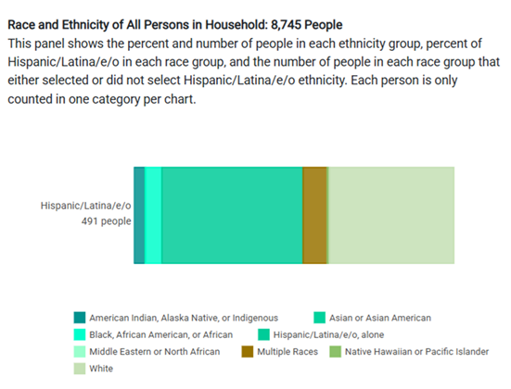
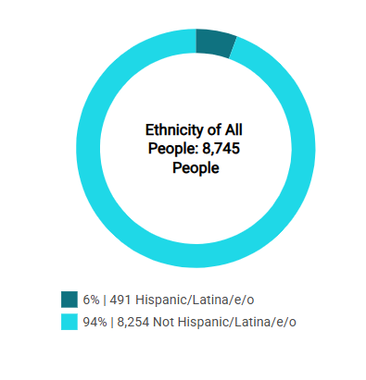
Demographics
Source: HMIS Data Portal
Website
Notes:
Finally, we have a demographic breakdown which includes homeless veteran status, DV history, ethnicity, and total people served.

Slide 11
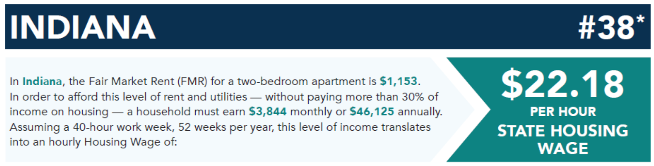
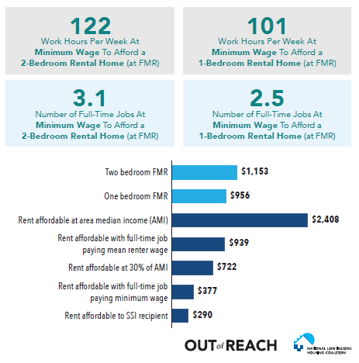


Source: Prosperity Indiana
Out of Reach Report
Notes:
David
A little bit later Stephen will share some housing trends for the state.
Here is another resource that shows housing availability as well as a chart with the number of hours required at minimum wage to afford common housing types.
For reference, to a afford a two-bedroom apartment, a household must earn $22.18 per hour, without paying more than 30% of their income on housing.
To learn more about this study, feel free to review the full “out of reach” report from the National Low Income Housing Coalition.

Slide 12
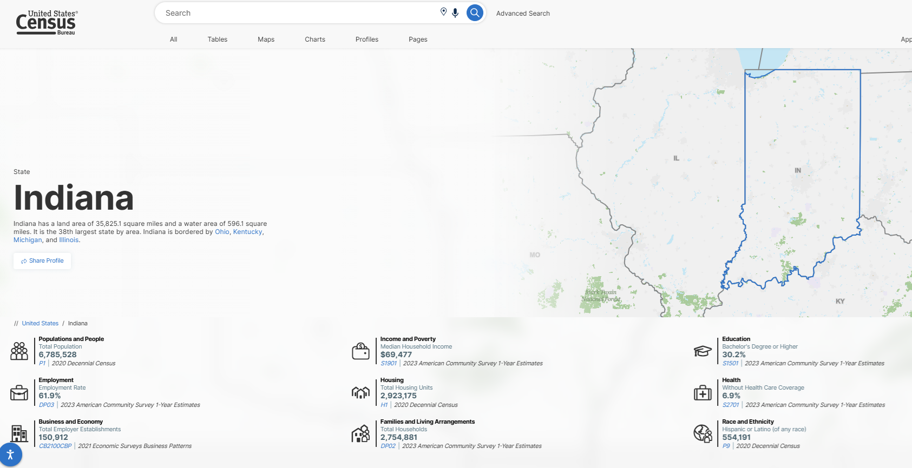
Indiana Census Data
Source: Indiana Census Data
Website
Notes:
Indiana census data is another great resource to compare homeless data to the wider populations of Indiana.
This includes some county and school district level data.
https://www.census.gov/programs-surveys/saipe.html

Slide 13
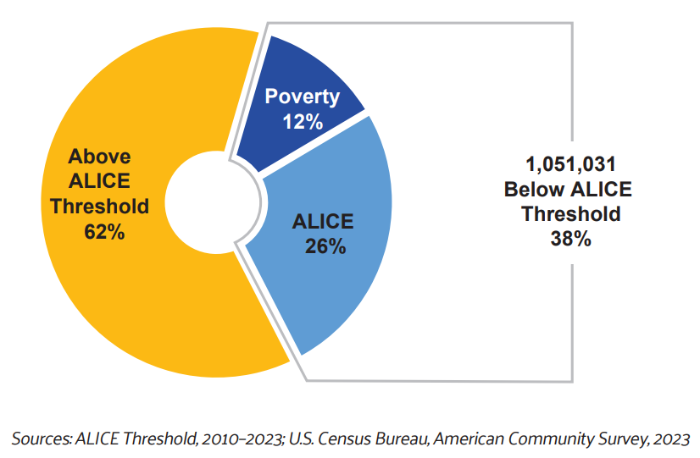

Indiana ALICE Report
Notes:
David
The information from this slide comes from an ALICE report conducted by area United Ways.
ALICE stands for: Asset Limited, Income-Constrained, Employed
In this example, we see a minimum survival budget with common expenses compare to different household types.
The second chart shows the number of HH in Indiana living below this threshold.
----------------------------------------
https://www.statsamerica.org/sip/Workforce.aspx?page=ow&ct=S18
https://www.statsamerica.org/sip/rank_list.aspx?rank_label=miacs_b&item_in=2023&ct=S18

Slide 14
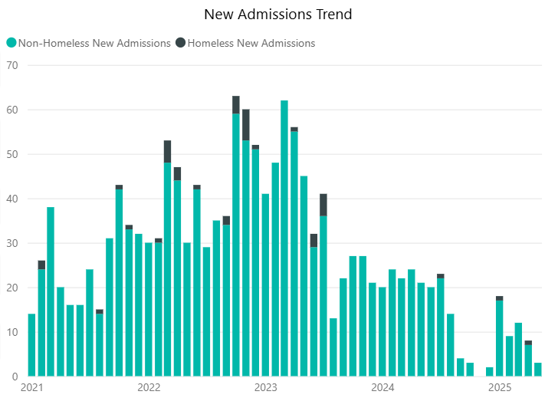
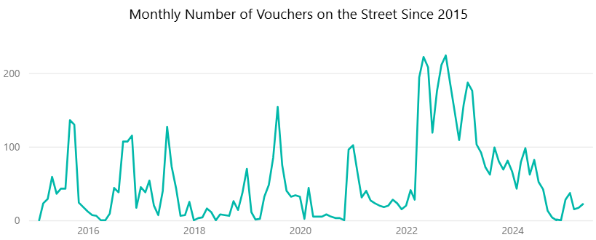
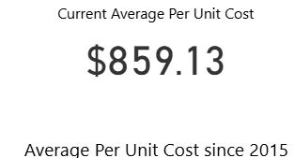
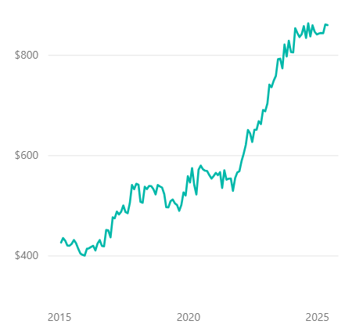
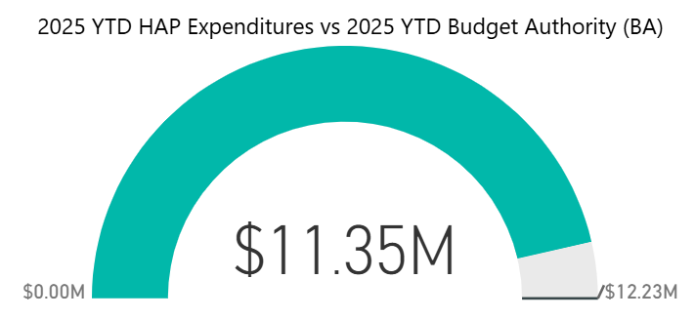

Housing Level Data: South Bend, St. Joseph & Mishawaka
Source: Office of Public & Indian Housing
Website
Notes:
This slide begins our region level analysis for BOS COC R2a.
This information comes from the Office of Public & Indian Housing. Here we see voucher data for the housing authorities in South Bend, St. Joseph & Mishawaka.
A key takeaway to see here is the increase in the average per unit cost over the last 10 years. Even with these increases the number of available vouchers has remained stagnant.

Slide 15
Data Snapshot for 2a
575 (Sheltered and Unsheltered)
Point in Time Count (1/29/25)
First Time Homeless*
(1/30/24 – 1/29/25)
*Clients who did not have ES, SH, TH, or PH enrollments in the prior 24 months.
Notes:
Here we have a data snapshot for R2a from the PIT and SPM
For this region, individuals were primarily counted in shelter locations.
A common misconception is that our homeless populations are primarily the same people form year to year.
From the SPM’s we see that 71% of people were first time homeless from (1/30/24 to 1/29/25).
This means that an individual or household has no prior enrolments, in our most common project types, for the prior 24 months, at the time of intake.
----------------------------------------------------------------------------------
First time homeless in in line with the BOS for this time period. (71% compared to 79% for the BOS)
Region 2a HIC Numbers:
ES- Orgs: 5 Current Year-round Beds: 452
TH- Orgs: 5 Current Year-round Beds: 180
RRH- Orgs: 4 Current Year-round beds: 75
PSH- Orgs: 4 Current Year-round Beds: 391
Persons served in RRH and PSH on 1/29/25: 430
Persons served in RRH: 75. Persons served in PSH: 355. 10 unique orgs in 2a

Slide 16
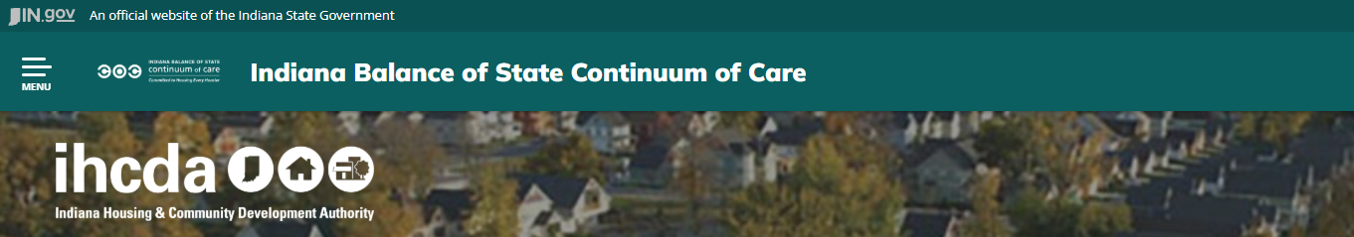
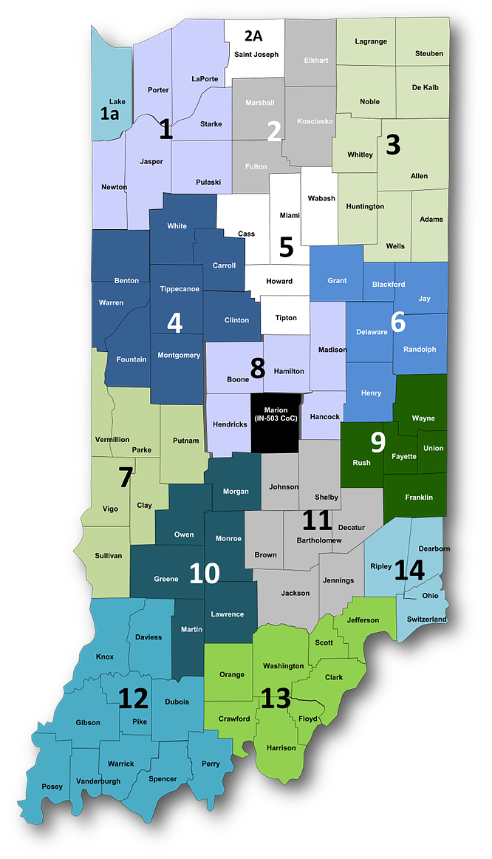
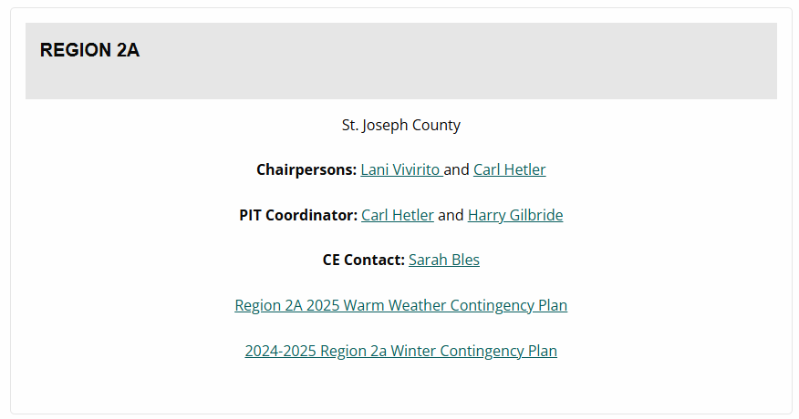
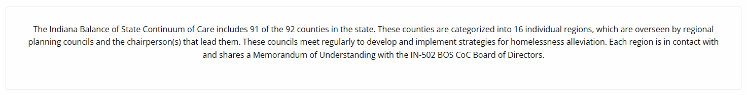
Regional contact Page
Regional Data Leads
Contact Information Coming Soon
Source: Regional Structure Page
Website
Notes:
For more information about your county, please reach out to the regional contacts on the IN BOS COC website.
We are working to establish regional data leads who will be able to run reports in HMIS with current data.
Later, Lani will share more about the types of information that these contacts will be able to provide.
Next, Stephen will share another data source that you can use to advocate for affordable housing.

Slide 17
Stephen Enz (IHCDA)
Director of Real Estate Data and Policy
Notes:
Thank you, David, one of our recent initiatives was setting up the Indiana Housing Dashboard.

Slide 18
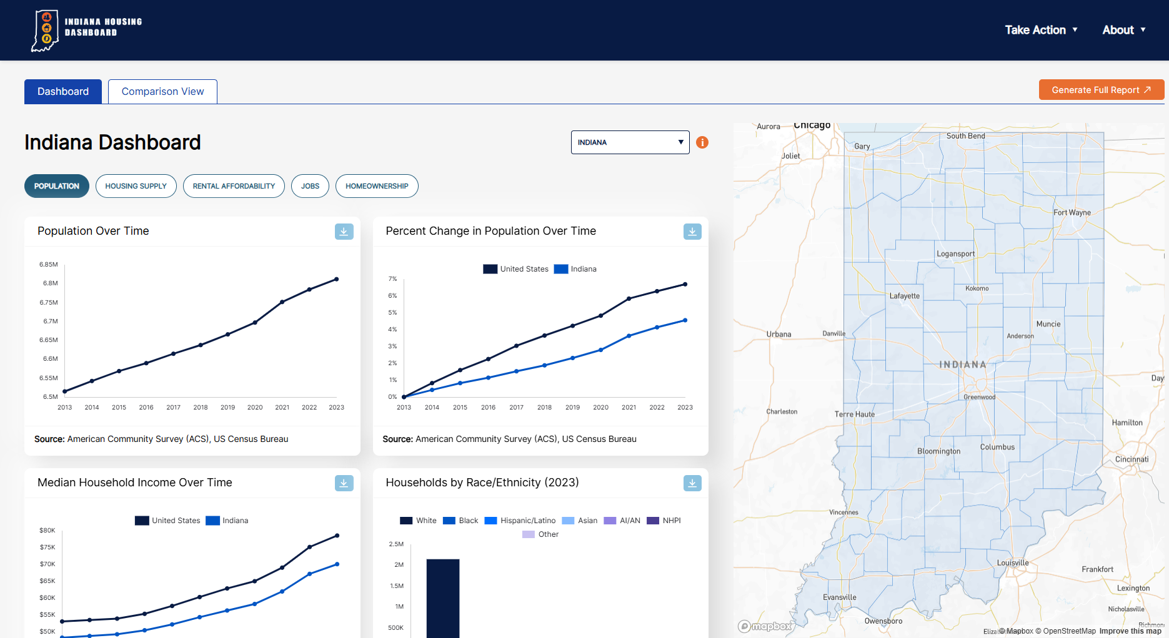
Indiana housing Dashboard
Source: Indiana Housing Dashboard
Website
Notes:
Today, I will be walking us through a brief demonstration of the data you can view through this portal.
Demonstration
------------------------------------------------------
Next, Lani will share more information about the regional data lead position.

Slide 19
Lani Vivirito (CFH)
Chief Policy and Resource Officer
Notes:
Hello, I am Lani Vivirito from Center for the Homeless.
I am their Chief Policy and Resource Officer. I am also one of the Chairs for the R2a BOS COC.

Slide 20
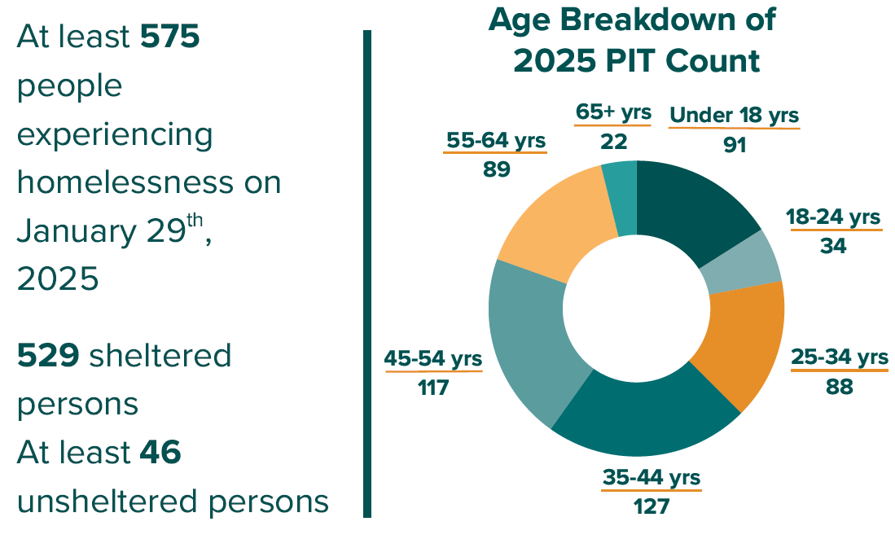
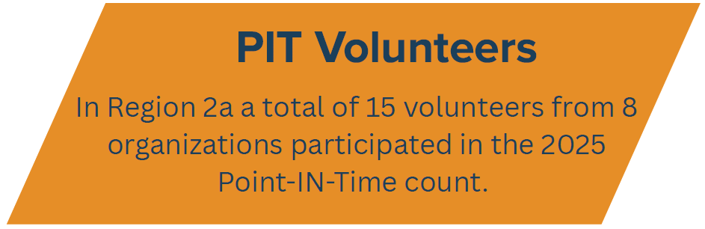

State of Homelessness: Region 2a (St. Joseph County)
Notes:
Soon, we will be releasing one-page reports for each of the regions.
Here is an example of some of the data that will be shared.
PIT Volunteers
Age Breakdowns
Number of people counted
Sheltered and Unsheltered

Slide 21
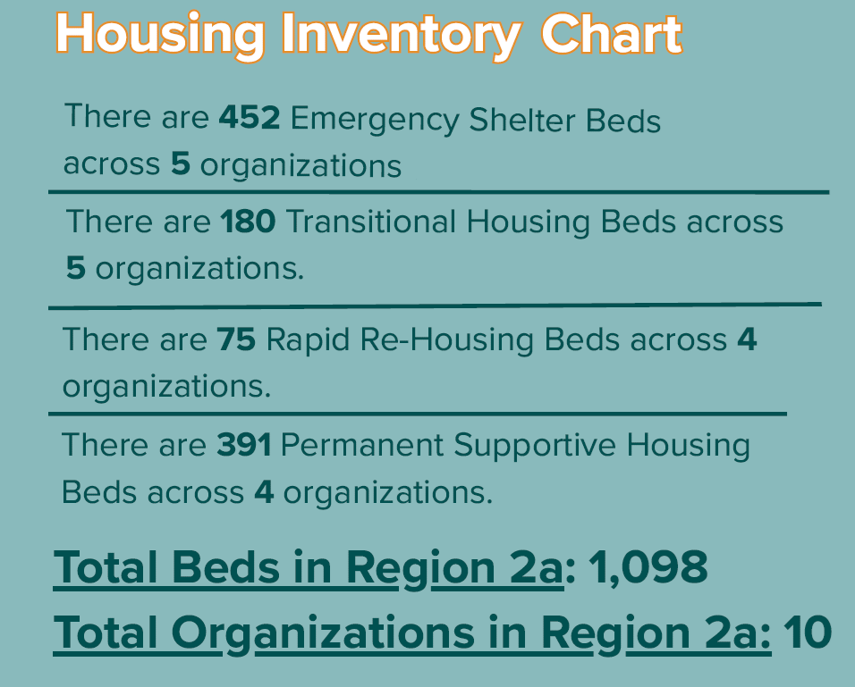
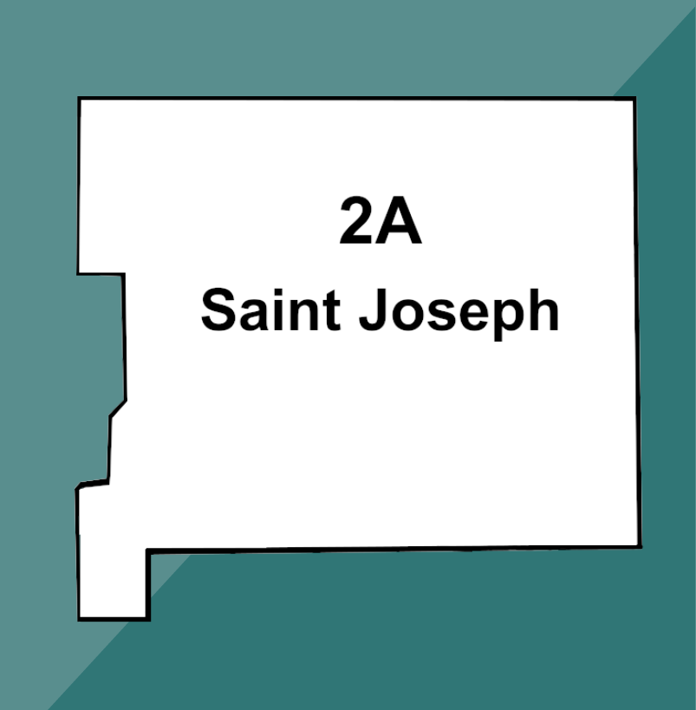
State of Homelessness: Region 2a (St. Joseph County)
Notes:
Housing Inventory Chart
Number of participating organizations
Total and per project bed counts

Slide 22
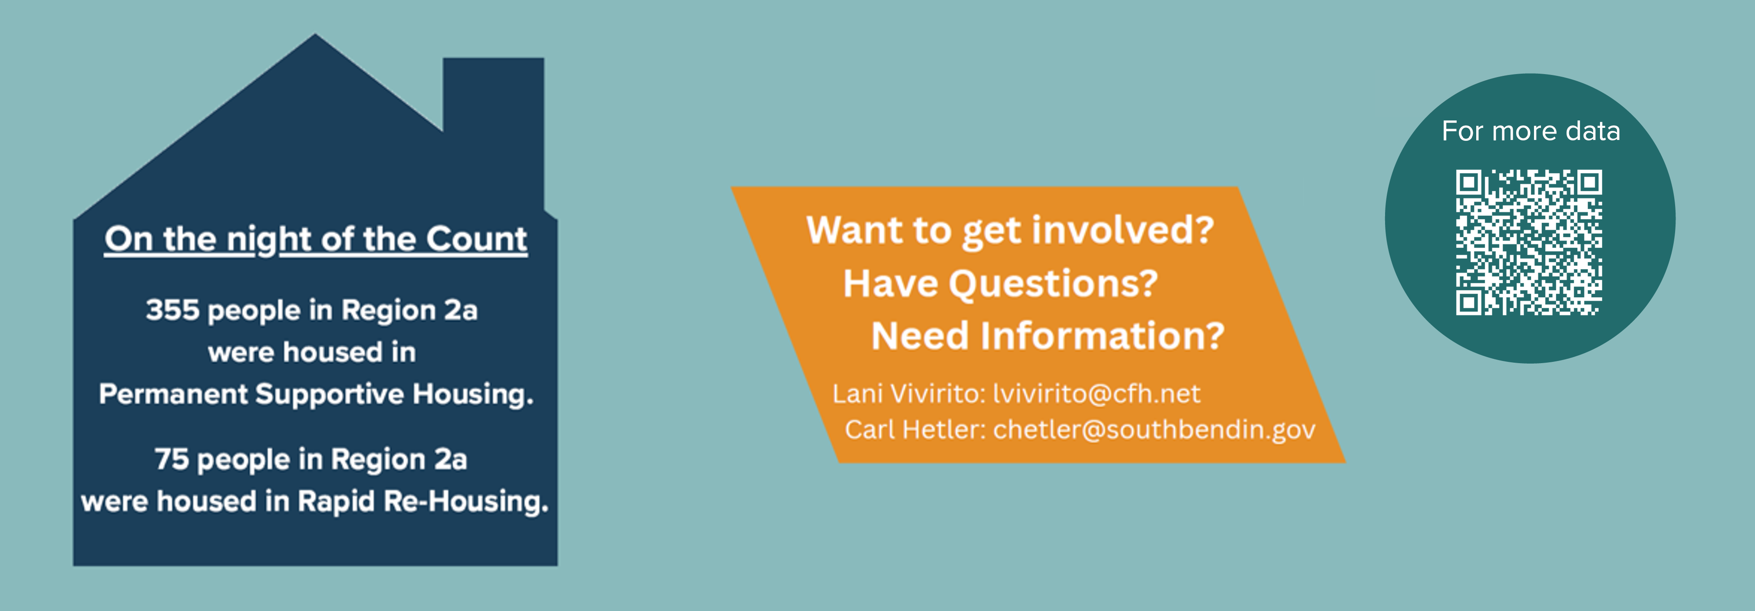
State of Homelessness: Region 2a (St. Joseph County)
Notes:
Ways to get involved
A link to additional data – HMIS Data Portal

Slide 23
Resource Links
HMIS Data Portal
Indiana Housing Dashboard
Office of Public &
Indian Housing
National Low-Income
Housing Coalition
Indiana Census Data
United for ALICE
Notes:
Here are links to some of the resources presented today.
IHCDA
- HMIS Data Portal
- Indiana Housing Dashboard
Additional Resources
Indiana Census Data
Office of Public & Indian Housing
National Low-Income Housing Coalition
United for ALICE

Slide 24
Thank you for joining us today!
Notes:
Thank you so much for participating in today’s presentation.
Questions (Time Permitting)
-----------------------------------------------------------------
We hope you have a wonderful rest of your day!

