Slide 1
LIHWAP Water Vendor Training PY2023 September 15, 2022 Thomas Hartnett-Russell Community Programs Manager

Slide 2
Purpose of this Training
The purpose of today’s training is to prepare vendors for the PY 2023 LIWAP season by reviewing common issues and discussing ways to collaborate and improve for the upcoming season.
Please note this is not a Vendor Portal Training – Roeing will be responsible for that training and update.

Slide 3
Today we Will Cover
Overview of Water Program, Vendor Guide, and MOA
Common Areas of Issue
Transmittal Process
Vendor Monitoring
Contact Protocols
Next Steps

Slide 4
WATER PROGRAM OVERVIEW
The Low-Income Household Water Assistance Program (LIHWAP) is a new program funded in part by the American Rescue Plan Act of 2021.
LIHWAP is a temporary emergency program designed to help low-income households and families who have fallen behind on their water and wastewater bills.
LIHWAP will provide income-eligible households with a one-time benefit to assist with current or past-due charges for water and/or wastewater services. Starting in PY2023, a household no longer needs to be disconnected or in arrears on these charges in order to qualify for a benefit.
This funding is available to be used through September 30, 2023 and the program will be finished when the funds run out, unless additional legislation is passed to continue the program.

Slide 5
WATER ASSISTANCE
Temporary program
Can assist income-eligible households with current and past-due charges
Cannot PURPOSEFULLY create a significant positive balance, but can assist with current charges as of date of application.
Can pay deposits
There is no “in crisis” distinction or required mitigating measures

Slide 6
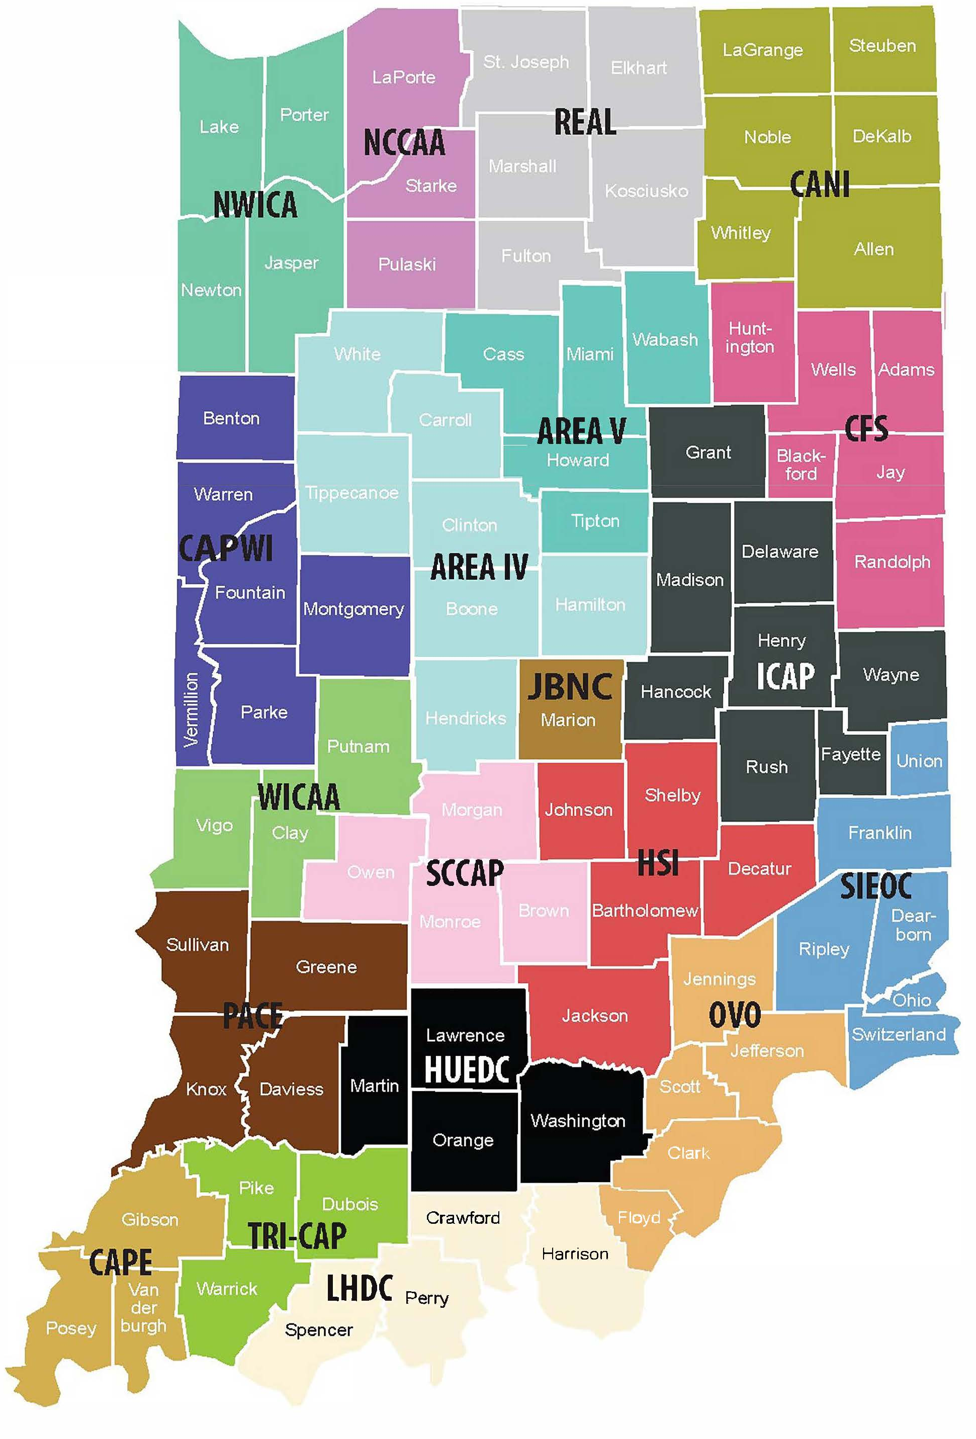
APPLYING FOR THE WATER ASSISTANCE PROGRAM
Indiana residents who qualify for the Energy Assistance Program (EAP) may be considered for LIHWAP funding as well.
When completing the EAP application, applicants must check a box to apply for water assistance and submit their most recent bill.
EAP accepts applications each year from October 1st until mid-May.
Service Territory Map for EAP and LIWAP
Notes:
Indiana residents who qualify for energy assistance (EAP), you may be considered for LIHWAP funding as well. When completing the EAP application, check a box to apply for water assistance and submit your most recent bill.. You can apply for an energy assistance benefit for Program Year 2022 from October 1, 2021 until May 16, 2022. https://www.in.gov/ihcda/homeowners-and-renters/low-income-home-energy-assistance-program-liheap/

Slide 7
Client Eligibility
LIHWAP benefits are available to households with a combined annual income at or below 60% of State Median income. In order to be eligible for LIHWAP benefits under this program, an applicant must maintain residency and active utility service within the state of Indiana.
Documents Collected:
Photo ID for head of household (person completing and submitting application on behalf of the household).
Proof of US Citizenship or residency (Social Security card, Real ID, or other documents)
Proof of Indiana Residency (utility bill, applicant’s Driver’s license, or other documents)
Proof of Income for entire household
Landlord Affidavit or Lease for applicants with utilities included in rent only
Utility bills or account statements
Other documents as needed based on specific household characteristics

Slide 8
Benefit Determination: The basics
Covers arrearages, deposits, reconnection fees, and current charges
Cannot PURPOSEFULLY create positive significant forward balances
Based on bill at time of application
Crisis/arrearage benefit is based on exact amount on bill (minus any unallowable charges)
An allowance is provided to help cover current charges
All documentation the same as EAP
Application
Photo ID for applicant
Proof of Indiana residency
SSN verification for all household members
Income documentation for all adult household members
Water/wastewater bill
Other documentation as required according to the circumstances

Slide 9
Benefit Level
Based on bill at time of application
Both for arrearage and current bill
No minimum
Maximum of $2,500 (without a waiver)
Are there any questions about the program?

Slide 10
Vendor moa
Must be signed for client to receive benefit
All benefits on behalf of clients are paid directly to Vendors
Vendors must apply payments to the specific individual’s account for water/wastewater
Currently 212 Participating Vendors
Includes consumer protections

Slide 11
ALLOWABLE CHARGES
Water
Wastewater
Stormwater
Fire Hydrant Flush Fees
Fire Protection
Hydrant Charge
Disconnect/Reconnect Fees
Taxes
Deposits
Costs associated with properties switching from septic tanks to local sewer system
Cannot cover installment of the new lines or removal of old septic tank
Can cover everything that happens after they are hooked up with the sewer company
Sanitary Service
Only if the vendor defines it as wastewater/dirty water

Slide 12
UNALLOWABLE CHARGES
Trash
Sanitation
Solid Waste
Extra Bin
Street Maintenance
Clean Air Fee
Insurance
Repairs
Infrastructure
Well Water
Septic
Benefits may not be assessed to settle an old debt on an inactive account unless settling this debt will lead to restoration of the account or establishment of new service for the customer.
*We suggest to our LSPs that they check vendor website to clarify charges – but if they cannot figure them out from the website they may reach out to your organization

Slide 13
Consumer PROTECTIONS
Application of Funds to the Household. The Vendor will apply funds provided by the Water Program to the household on behalf of which the funds were provided. The Vendor will then charge the eligible household, in the normal billing process, any difference between the actual amount due and the amount of the payment made by IHCDA.
Reconciliation. The Vendor will provide written reconciliation and confirmation to IHCDA upon request that benefits have been credited appropriately to households and their services have been restored on a timely basis or disconnection status has been removed if applicable.
No Adverse Treatment. No household receiving assistance under this grant will be treated adversely because of such assistance under applicable provisions of state, territorial or tribal law or public regulatory requirements.
Restoration of Service. The vendor must restore any disconnected services for an approved applicant within three (3) calendar days of receipt of payment from IHCDA on behalf of said applicant.

Slide 14
Agreement #3: Cooperation
By signing the MOA, the vendor agrees to cooperate with IHCDA and LSPs with regards to sharing information about LIHWAP applicant accounts, including water consumption and cost, payments, disconnection prevention and restoration of service, arrearage amounts, account status, and other data related to LIHWAP.
This includes but is not limited to providing billing statements for applicant households, regardless of the billing name of record.
IHCDA has obtained consent from all applicants to collect this data. If the account is in the name of a non household member, the applicant has certified that they have obtained consent from the account holder.
Collection of this data is federally mandated.

Slide 15
Agreement #4: Vendor Responsibility for other location(s)
Only the parent company needs to complete an MOA and ACH form if the deposit and W-9 information for other locations match the parent.
All subsidiary locations must be listed on MOA Attachment B if they handle their own transmittals.
In order to streamline the management of vendors, we are seeking to reduce the number of distinct MOAs and ACH Authorizations where possible.
In cases where payment goes to the same bank account, the locations should be grouped under the same parent organization for MOA purposes.
If a specific person at a satellite/subsidiary office needs to be contacted for pledges or transmittals, that is an issue to be addressed with the Local Service Providers (LSPs) and does not impact the MOA.

Slide 16
Agreement #12: Acceptance of Payment
In accordance with state code, all payments must be made by electronic funds transfer (EFT).
In order to be paid by check, the vendor must meet both of these conditions:
The vendor does not have and is unable to establish a savings or checking account capable of receiving such payments with a financial institution within the business’s geographic area without payment of a service fee.
The vendor is able to provide a written statement from its financial institution confirming the inability to establish such an account without paying a fee.
Claim approval and payment notifications will be sent via e-mail from reset@ihcda.in.gov.

Slide 17
Agreements #16: Refunds and Overpayments
Refunds and overpayments are to be issued on separate checks.
Refunds must be accompanied by:
name of LSP
client’s name
client’s account number
and transmittal number
Overpayments must be accompanied by:
overpayment remittance sheet
the original transmittal number
IHCDA has created a register sheet to accompany all refund/overpayment checks to assist our fiscal department in properly handling these payments.

Slide 18
Agreement #20: Record Keeping
The vendor agrees to maintain an adequate accounting system to allow verification and auditing of the amount of service delivered to eligible households.
This includes documentation that LIHWAP funds were not applied to unallowable costs and that refunds and overpayments were remitted to IHCDA rather than to the customer.
Records must be maintained for a period of three years following the close of a program year (e.g., PY2023 records must be maintained until September 30, 2026).

Slide 19
MOA Requirements
Any questions on what we have just covered?
Are there other areas where you have experienced issues in regards to the MOA?
If the issue is super specific and may only apply to you we may table the conversation in training and work with you offline to resolve.

Slide 20
Transmittal Process

Slide 21
Transmittal Process
Transmittals will serve as the official record of the benefit for which a client has been approved.
If there is a discrepancy between a pledge received via LSP contact and the amount on the transmittal, the transmittal amount will be considered correct.
Transmittals are not valid for payment until they have been signed by both a representative of the LSP and a representative from the vendor. Any changes made to the transmittal need to be made prior to execution.
All LSPs have been instructed to ensure that transmittals are generated and sent on at least a biweekly basis, with weekly transmittals strongly encouraged.

Slide 22
Transmittal Process
It is the vendor’s responsibility to fully review the transmittal before signing it.
This review should include:
ensuring that the client is a customer of the utility;
that the name, service address, and account number are correct;
and that the account is currently active and is not scheduled for disconnection or closure at the customer’s request.
If there are any errors or any accounts that need to be removed, it is the vendor’s responsibility to mark these changes directly onto the transmittal report and adjust the total amount if necessary before signing and returning the transmittal report to the LSP.
Notes:
Failure to review the transmittal and provide corrections is a violation of Agreement 9 in the MOA.

Slide 23
Transmittal Process
Utility vendors should make every effort to return signed and/or corrected transmittals to the LSP within 7 days. If this will be delayed, we strongly recommend keeping an open line of communication with the LSP to inform them of the delay and when they may anticipate receiving the transmittal.
Once an LSP has received a signed application back from the vendor, the LSP has 7 days to submit the transmittal to IHCDA for payment.
Upon submission to IHCDA, payment should be generated within 30 days.
Water utility providers are encouraged to note the benefit to the customer’s account upon receipt of transmittal from the LSP.

Slide 24
Transmittal Process
If an LSP discovers an error has been made in benefit or eligibility determination, the LSP may award the client additional funds or submit a negative transmittal accompanied by an overpayment remittance.
The LSP may award additional funds at any time. Overpayment remittances must be submitted within 60 days of initial approval.
If an overpayment remittance is received more than 60 days following initial approval, you may inform the LSP that the window to request overpayment remittance has lapsed. In this case, it becomes the LSP’s responsibility to repay the benefit out of unrestricted funds. You may choose to accept the overpayment remittance at your discretion even after the 60-day window has elapsed.

Slide 25
Transmittal Process
An overpayment occurs because:
An applicant was accidentally awarded more funds than they were actually eligible for under the program rules
or
they were approved for benefits when they were in fact not eligible.
Therefore, any delinquency caused by the removal of an overpayment from the customer’s account becomes the customer’s responsibility to pay.
When a vendor receives a negative transmittal, they are to follow the same procedure as above.
After returning the signed negative transmittal to the LSP, the vendor will also sign the overpayment remittance.
The signed overpayment remittance is to be sent with a check to IHCDA and the returned payment register sheet to be reinvested in the program.

Slide 26
Transmittal Process
In order to keep payments on time and not negatively impact customers/clients, we are asking all vendors to return signed transmittals to LSPs within one week of receipt.
Vendors must maintain records of all transmittal reports.
Claim notification e-mails will note which transmittals have been approved for payment and the total of each transmittal. Please use these e-mails in conjunction with the transmittal reports for the purposes of correctly distributing funds and reconciling claims.
Please remember that no LIHWAP funds are ever to be released back to the customer. All unused funds are to be sent back to IHCDA within 60 days of account closing along with the refund register sheet.

Slide 27
Transmittal Process
Discussion and questions
What questions do you have?
What issues have you experienced that you need additional support or guidance on?

Slide 28
Vendor Monitoring and Best Practices

Slide 29
What is Vendor Monitoring?
The purpose of vendor monitoring is to ensure compliance with the LIHWAP program by the utility vendor. It is also an opportunity to improve processes and lets us know where areas of confusion or additional assistance are needed
Vendor monitoring is a federally-mandated component of the LIHWAP Statute as indicated on the MOA.
All vendors that participate in the State of Indiana’s LIHWAP are subject to vendor monitoring.
Monitoring will be conducted as a desktop review.
IHCDA is in the process of hiring an additional staff person to assist with Vendor communications and monitoring

Slide 30
Vendor Monitoring Process
Vendors will be sent a 30-day letter notifying them of when the session is to begin.
Vendors will be required to submit requested documentation prior to the start of the monitoring session.
All vendors being monitored will receive an Assessment Completion Report within 30 days of IHCDA completing the desktop review.
Vendors will be required to complete a Water Utility Supplier Survey.

Slide 31
Vendor monitoring documents
Vendors will be required to complete a Water Utility Supplier Survey.
A sampling of approved accounts found on a LIHWAP transmittal from the program year will be randomly chosen for review.
All vendors are to comply with any request for additional information or documentation as a part of vendor monitoring as stated in the MOA.

Slide 32
Vendor Best practices
All vendors should create written processes to promote consistency and program integrity. In turn those processes can be submitted at time of monitoring to show the utility’s processes and program compliance.
All vendors should perform internal quality assurance audits on LIHWAP customer accounts.
All vendors should create a system to ensure that unallowable expenses are not being paid using LIHWAP funds.
All vendors should create a three (3) year record retention and destruction policy for all LIHWAP documentation including electronic documentation.
All vendors should strive to meet all reporting deadlines. This allows IHCDA to fulfill Federal Reporting requirements and make effective program changes.

Slide 33
Vendor best practice
Vendors should develop outreach strategies. Outreach is an important aspect of the Low Income Home Water Assistance Program. It helps fill in the gaps in services, so low-income households maintain access to residential water service.
IHCDA is working with our Marketing Team on additional outreach material for this Program Year.
https://www.in.gov/ihcda/program-partners/energy-assistance-program-eap/liheap-and-lihwap-resources/ - this link will house the new material once it is developed
Please ensure you are providing clients with accurate information – we have often seen links to the wrong websites.
Correct link for sharing to connect portal: http://eap.ihcda.in.gov

Slide 34
Who Should I Contact?

Slide 35
Contact protocols
To help reduce confusion and streamline communication, you should ensure you are always communicating with the appropriate entity.
In most cases, the LSP will be your primary point of contact.
In some cases, IHCDA may be your primary point of contact.
IHCDA is not the primary point of contact for clients/EAP recipients.
No vendor or vendor representative should ever provide any IHCDA contact information directly to any customers, whether they are LIHWAP recipients or not.
The next slide has additional information on common communications/ questions

Slide 36
Who to Contact
LSP
Questions about a specific client/household
IHCDA
Questions about payment that you are unable to answer after review of your transmittals and claim approval e-mails
Assistance for Clients
Questions about a benefit
Questions about submission of transmittal
Confirming application status
Notification of suspected customer meter tampering or unauthorized use when the customer is an LIHWAP client or applicant
Questions about MOA terms
Problems getting information from LSPs
Follow-up on a refund or
Suspicion of fraud/misconduct at LSP level
All referrals to LIHWAP from the vendors should be made to the appropriate LSP or 2-1-1.
2-1-1 or http://in211.communityos.org
Customers may be referred to http://eap.ihcda.in.gov for more detailed information or to apply online.

Slide 37
LIHWAP/EAP Service area

Slide 38
Contact protocols
To contact IHCDA, please use Water@ihcda.in.gov.
This is a shared mailbox that the entire department can access.
It ensures that your message can be read and addressed regardless of absences.
You can cc Thom on the emails as well- THartnettRussell@ihcda.IN.gov
Fiscal department is separate from LIHWAP and does not have access to this mailbox.
What questions do you have?

Slide 39
Next Steps
This program year’s calendar is:
EAP ASSISTANCE SEASON
October 1, 2022 | Opening day of Federal PY2023.
October 3, 2022 | Online application opens to the public. LSPs may distribute mail-in applications to households who do not qualify as at-risk.
November 1, 2022 | Statewide start of the Energy Assistance Program: In-person appointments may begin. Transmittals may be sent to utility vendors. Applicant Notification letters may be sent to clients.
May 15, 2023 | End of EAP application period at 5:00pm Eastern time.
May 30, 2023 | All incomplete EAP applications must be fully processed.
June 10, 2023 | Last day to submit transmittals.
June 24, 2023 | All vendors must be fully reconciled.

Slide 40
Next steps
Thank you for attending this training and the hard work you complete to help make LIHWAP successful.
If you have questions or concerns, please reach out to water@ihcda.in.gov
IHCDA will be updating our Vendor Guide and the marketing material in preparation for the 2023 program year
We are still working with Roeing to get a Vendor Portal Training scheduled.
They are working through some enhancements for the 2023 year and once those are completed then they will be able to proceed with training

