Slide 1
IHCDA HOME Homebuyer Program Application Underwriting Criteria Session 2
Samantha Spergel
Director of Real Estate Strategic Initiatives and Engagement
Indiana Housing & Community Development Authority

Slide 2
IHCDA’s Mission and Vision
Our Mission
To provide housing opportunities, promote self-sufficiency, and strengthen communities.
Our Vision
An Indiana with a sustainable quality of life for all Hoosiers in the community of their choice.

Slide 3
Agenda
What are the subsidies?
Resale and Recapture – Abridged
Development Uses
Buyer Purchasing Power
Development Sources
Breaking Down the Commitment Proforma

Slide 4
What are the HOME Homebuyer Subsidies?

Slide 5
Three Subsidies
Developer Subsidy
Buyer Subsidy
Interim Construction Financing

Slide 6
Developer Subsidy
Developer subsidy is the difference between Total Development Cost and Market Value
This is called the “Appraisal Gap”
HOME can be used as a grant from IHCDA to the Developer to cover the difference when TDC > Market Value; no expectation from IHCDA of repayment (washed away)
Cost over value may be driven by:
Failed/Distressed market
Inefficient scale of development
Cost of to ensure federal compliance

Slide 7
Buyer Subsidy
Called the “Affordability Gap”
HOME provided to the buyer as a forgivable loan, including down payment or closing costs
While eligible, want to generally avoid a reduction in sales price below market value

Slide 8
Interim Construction Financing
0% Loan from IHCDA to Developer to cover capital cost gaps for homebuyer projects
Used when the developer does not have enough sources to cover the project
Required under regulations to be repaid to IHCDA – this is not a permanent contribution to the housing, unlike Developer Subsidy
EXCEPTION: CHDOs! More on this later!

Slide 9
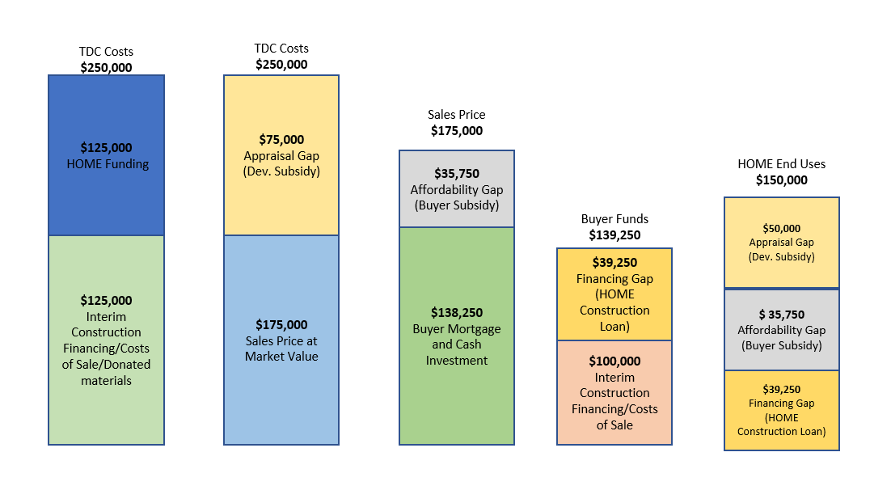
What does this mean?

Slide 10
Recapture and Resale – Abridged Version

Slide 11
Period of Affordability
Period of Affordability (POA) is the required length of time the Lien and Restrictive Covenant (LRCA) is on the property.
Type of lien, and length of time of the LRCA is based on if there is a Buyer Subsidy needed for the homebuyer.
Different from HOME Rental in which POA is based on construction type.

Slide 12
Period of Affordability
Subsidy of under $15,000 – Five years
Subsidy of $15,000-$40,000 – Ten Years
Subsidy of $40k or higher – 15 Years

Slide 13
Recapture
“Sell to anyone, for any price but pay back the subsidy”
To use recapture, there must be direct assistance to the buyer – i.e. “Buyer Subsidy”
POA is then based on Buyer Subsidy only
Generally POA length is between 5-15 years
More on Recapture requirements in Sessions 4 and 5!

Slide 14
Resale
Used when there is no Buyer Subsidy – only Developer Subsidy and/or Interim Construction Financing
POA based on TOTAL HOME award for unit
POA length may be longer than just POA under Recapture
Amount under LRCA will be higher
More on Resale requirements in Sessions 4 and 5!

Slide 15
Breaking Down the Pro-Forma

Slide 16
Pro-Forma
Two Pro-Forma worksheets:
Commitment – due with Application
Closing – due at least 3 weeks prior to closing
Three Main sections:
Development Uses
Buyer Purchasing Power
Development Sources
Pro-forma must be completed by unit
No such thing as a generic proforma

Slide 17
Development Costs and Budget

Slide 18
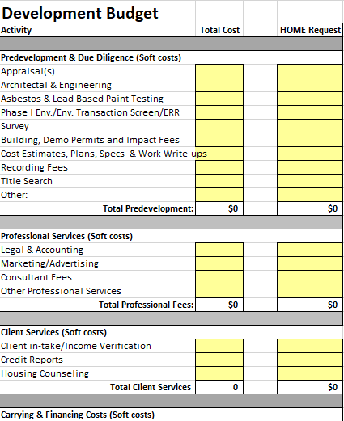
Sources or Uses first?
Development Costs come first
Be realistic and be complete
Construction cost estimates must be included in application and reflected in Development Budget
Include costs to develop AND sell units

Slide 19
Types of Uses
Budget should include total costs for:
Pre-development and Due Diligence
Appraisals
Architectural and Engineering Fees
Recording Fees
If rehab – cost of Lead Inspection/Asbestos testing
Professional Services
Legal & Accounting
Client Services
Housing Counseling
Income Verification
Carrying & Financing costs
Title Insurance for construction loans
Builder’s Risk/Liability insurance

Slide 20
Types of Uses
Budget should include total costs for:
Acquisition
Land and Building
Closing Costs at Acquisition
NOTE: Remember that land value is based either on Purchase Agreement, “As-Is” Appraisal or Comparative Market Analysis (subject to IHCDA approval).
Hard Construction Costs
Residential Structures
Free-standing accessory structures – NOTE: not HOME eligible
Appliances
Contractor Contingency
5-7.5% must be budgeted for new construction projects
7.5-10% must be budgeted for rehabilitation
Developer Fee – cannot exceed 15%
Final fee usually paid out of closing proceeds.
Seller’s Closing Costs – Not HOME Eligible

Slide 21
Other Uses Considerations
On-site infrastructure is eligible as a site improvement
Underground utilities
Connection to public lines
Off-site infrastructure is NOT HOME-Eligible
Extending public services to site, like sewer
Units must meet HOME Property Standards
Rehab:
Useful life (5 years) – this is MINIMUM. If in doubt, replace it!
Lead Based Paint if pre-1978
Reasonable Accommodations
Energy Efficiency
Remember commitments of Universal Design, Green Building and Design Features

Slide 22
Cost Standards
2 CFR 200 Cost Principles apply; costs must be:
Reasonable, necessary, allocable and documentable
Must document all uses
Every project is unique – build your cost estimates from scratch
Do not overlook, ignore or understate costs
Budget conservatively
Don’t use lowest end of cost ranges

Slide 23
Buyer Analysis

Slide 24
Preliminary Buyer
Commitment – Based on unknown, “lowest achievable” buyer profiles
Closing – Based on known buyer, individual analysis, reconciles to the closing statement
Some may have buyers lined up but circumstances can change.
Commitment section will estimate the amount of proposed buyer subsidy
Must underwrite each unit and each buyer separately!

Slide 25
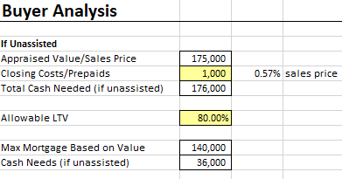
Determining Cash Needs
Projected appraised value or Sales Price entered at top of pro-forma
Add in the estimated closing costs or any pre-paid funds
Allowable LTV: IHCDA recommends an LTV no higher an 95%; LTV can be no lower than 80%.
Enter as percentage
This will calculate the maximum projected mortgage based on the value, and the cash needed (DPA/closing cost assistance/buyer cash) for the projected closing.

Slide 26
Principle, PMI and Mortgage
Estimated interest rate
HFH will have 0%
Mortgage Insurance Premium Rate: Enter projected PMI
Will not apply to HFH
Want to see if we can limit this
Enter projected Mortgage term – minimum is 20; cannot exceed 30-year term.
Pro-forma will calculate projected mortgage payment

Slide 27
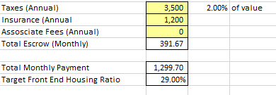
Understanding the Front-End Ratio
Front-End Ratio indicates what portion of an individual's income is allocated to mortgage payments
For these buyers, will also include taxes, insurance, utilities
Does NOT include other non-housing debt.
IHCDA uses 29% Front-End Ratio
We can accept waivers to this with your application.

Slide 28
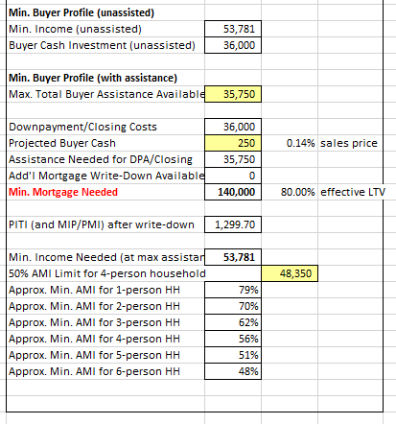
Buyer Profile
You will identify the 50% AMI limit 4-person household for your county.
See RED Notice 23-26
This does not limit you to that AMI, but shows you the suggested buyers’ AMI limits to ensure affordability for that buyer.
Buyer must put in minimum of $250 toward purchase – okay to go higher.
Max Total Buyer Assistance is amount needed after projected buyer cash. This is projected Buyer subsidy for unit.
Pro-forma will identify PITI.

Slide 29
Buyer Profile
Buyer Subsidy:
In 2023 policy, will allow buyer subsidy of up to $60k for households at or below 50% AMI
50-80% AMI cannot exceed $50,000
LTV may not be lower than 80%
Higher Buyer Subsidy will mean longer POA – homebuyer education is critical
HFH – Right of First Refusal not allowed during POA
This is a tool to look at who should be in your buyer’s pool.

Slide 30
Development Sources

Slide 31
Circling back on the subsidies
Remember the three subsidies:
Development Subsidy
Homebuyer Subsidy
Interim Financing
Each of these will be calculated under the “Development Sources” section of the pro-forma

Slide 32
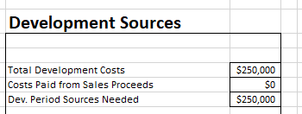
Total Development Costs
Pro-Forma will pull TDC from Development Budget
This example presumes no developer fee.

Slide 33
Development Subsidy Sources
Pro-Forma will pull Gross Developer Subsidy.
Other grants to be applied to the Developer subsidy include all those that are donated to the site. This can include:
Donations/discounts (including volunteer labor)
Waived Fees
Philanthropic Support
Public Funding
Cash donations could count as equity and not be counted as part of Developer Subsidy

Slide 34
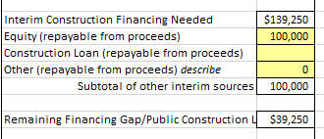
Interim Development Financing
Interim Construction Financing is TDC – (Development Subsidy + Buyer Subsidy + Costs paid from Sales proceeds)
Think of this financing as proceeds that must be paid back.
Habitat mortgage could be recorded as equity.
Revolving cash donations that would go back to NFP can be noted as a loan.

Slide 35
“How much HOME do I need? Putting it all together

Slide 36
Total HOME Investment Needed
Development Subsidy of $50,000
Washed by IHCDA
Buyer Subsidy of $35,750
Subject to Recapture and will have LRCA for 10 years
Interim Financing of $39,250
Repayable to IHCDA within 30 days of closing to IHCDA unless CHDO
Total HOME award of $125,000

Slide 37
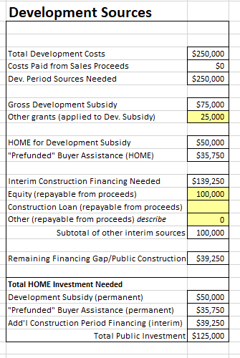
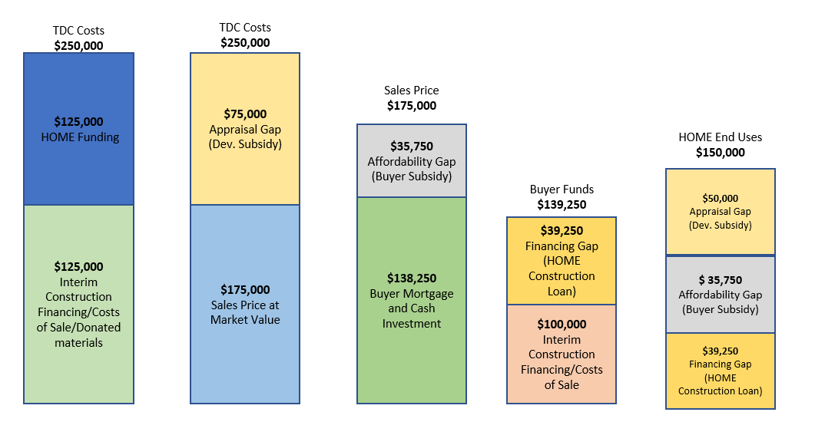
Remember me?

Slide 38
HOME Request
$125,000 would go under “HOME request” column under Development Budget
Will assist IHCDA staff with setting up contract if project is approved by board
Budget will go into contract and IHCDA Online

Slide 39
HOME Request
Remember sources = uses
Please note that HOME request is projection of actual costs and buyers.
Closing Pro-forma will reassess proposed sales and final development numbers.
Keep documentation of change of development costs, and other sources

Slide 40
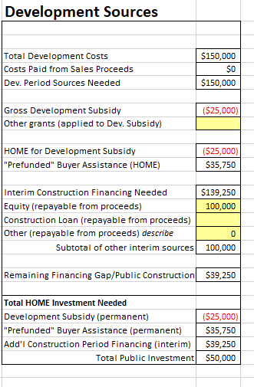
Sales Price > TDC
If sales price exceeds TDC, the unit is not eligible for developer subsidy.
Pro-Forma will show negative Appraisal Gap
Application is still eligible for Interim Construction Financing + Buyer Subsidy
NOTE: Buyer Subsidy alone is not eligible

Slide 41
Upcoming Training –
Monday, August 28th
9:30am

Slide 42
Managing a HOME Homebuyer Project
Cross-Sectional Regulations
Section 3
Davis Bacon
IHCDA Contract Process
Inspection Policy
Retainage Policy
Extension Requests
HOME timelines and deadlines
Expenditure deadline
De-obligation
9-month timeline

Slide 43
Any Questions?
Samantha Spergel, Director of Real Estate Strategic Initiatives and Engagement
sspergel@ihcda.in.gov

