Slide 1
2026 Neighborhood Assistance Program (NAP) Application Webinar
Presenters: Samantha Spergel
Chief Community Programs and Services Officer
Antonio Rodriquez
IDA/NAP Analyst
nap@ihcda.in.gov

Slide 2
2026 Neighborhood Assistance Program
Application is now open!
The submission deadline is Friday, May 1, 2026, 5PM EST.
https://ihcda.jotform.com/nap550/2026-27-nap-application

Slide 3
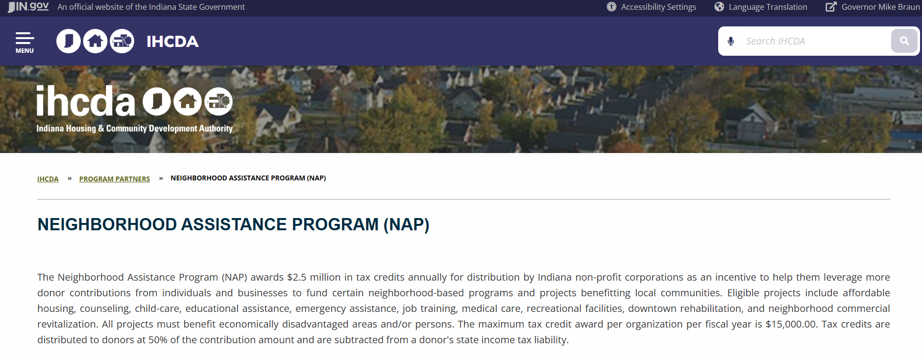
NAP Resources
Please visit IHCDA’s NAP webpage to review the NAP Manual, signup for updates, and see success stories! Email nap@ihcda.in.gov with questions!

Slide 4
Webinar Agenda
Neighborhood Assistance Program Outline
NAP Program Overview
Eligible Organizations
What Can NAP Be Used For?
Application Program Eligibility
Areas and Services – Economically Disadvantage / Ex-Offenders
How Do NAP Credits Work?
Contributions Policy
Donors and Donations
Program Timeline
Award Process
Resources
Additional resources can be found on the NAP partner website: https://www.in.gov/ihcda/program-partners/neighborhood-assistance-program-nap/

Slide 5
What is the NAP Program?

Slide 6
Neighborhood Assistance Program
Established by Indiana Code 6-3.1-9 and administered by the Indiana Housing and Community Development Authority (IHCDA), the Neighborhood Assistance Program (NAP) provides $2.5 million in Indiana State tax credits annually to non-profit organizations for distribution to donors as a fundraising tool to support neighborhood projects.
NAP credits are worth 50% of the value of a donation/contribution. This means that a $100 NAP tax credit equates to $200 in donations for the organization.

Slide 7
Eligible organizations
Must be designated a 501(c)3 by the IRS:
Must be registered as an active, domestic non-profit corporation with that State of Indiana in good standing with the Indiana Secretary of State
If a previous awardee of NAP, have met the benchmark reporting requirements from the previous funding cycle and met the closeout reporting deadline

Slide 8
What can Nap be used for?
NAP program areas include but are not limited to:
Education
Medical Care
Economic Development
Emergency Assistance
Job Training
Allowable uses of NAP will depend on the Service Category
Services Provided in an Economically Disadvantaged Area
Services for Individuals who live in an Economically Disadvantaged Area
Services for Economically Disadvantaged Households
Services for Ex-Offenders
Neighborhood Assistance

Slide 9
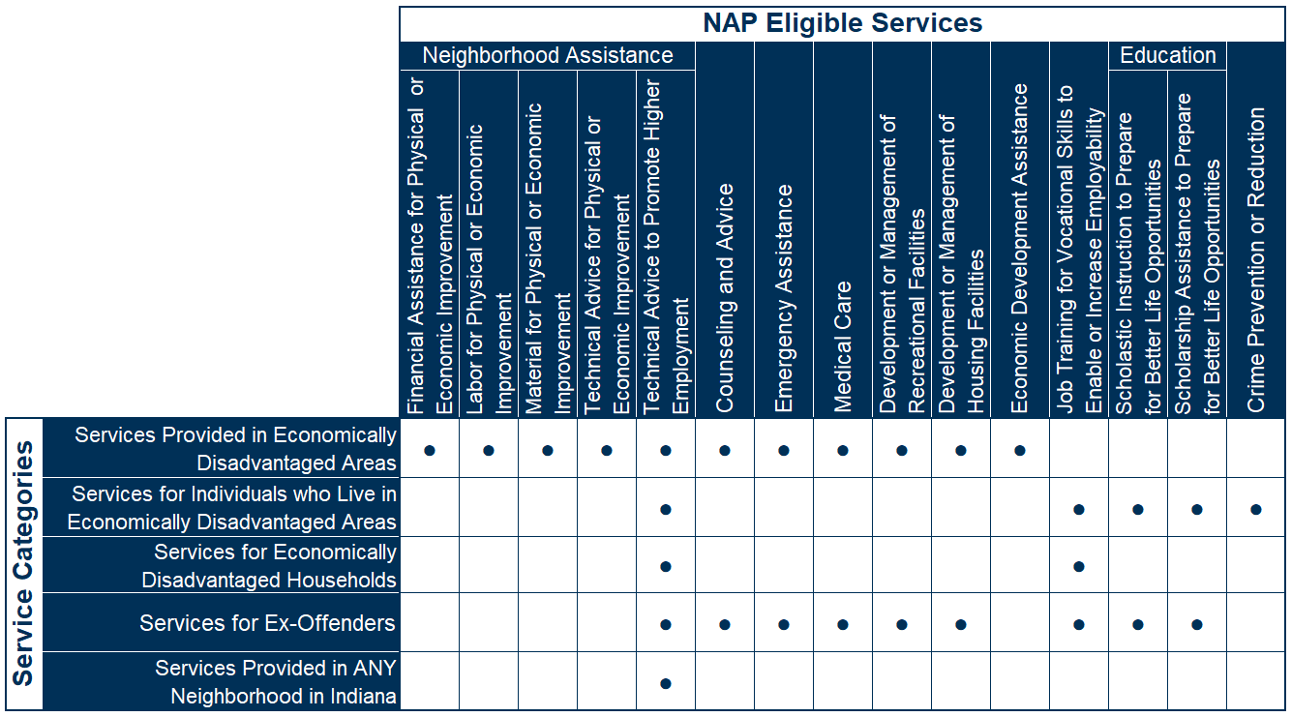
NAP Application PROGRAM eligibility
NAP Eligible Services by Category

Slide 10
Economically disadvantaged areas
All NAP eligible services in this category must be PHYSICALLY provided in a designated economically disadvantaged area to qualify for funding using NAP donations (Opportunity Zones, Qualified Census Tracts, Urban Enterprise Zones):
Counseling and advice
Emergency assistance
Medical care
Development and/or management of recreational facilities
Development and/or management of housing facilities
Economic development assistance
Neighborhood assistance to aid in the physical or economic improvement of all or part of a qualifying area: Financial Assistance, Labor, Material, or Technical Advice

Slide 11
Services for those who live in an EDA:
NAP eligible services in this category DO NOT need to be PHYSICALLY provided in economically disadvantaged areas; however, all individuals served using NAP donations must RESIDE in designated economically disadvantaged areas (Opportunity Zones, Qualified Census Tracts, Urban Enterprise Zones):
Job training providing vocational skills to enable individuals to become employable or seek a higher grade of employment
Crime prevention or reduction activities
Education to prepare for better life opportunities: Scholastic Instruction or Scholarship Assistance

Slide 12
Other Service categories
Services for economically disadvantaged households
NAP eligible services in this category are not location based; however, all individuals served must be members of economically disadvantaged households (income less than 200% FPL/80% AMI).
Job training providing vocational skills to enable individuals to become employable or seek a higher grade of employment *
Services provided in ANY neighborhood in Indiana
NAP eligible services in this category are not location, income, or population based.
Technical Advice to promote higher employment

Slide 13
Services for ex-offenders
NAP eligible services in this category do not need to be location or income based; however, all individuals served using NAP donations must be ex-offenders or justice involved individuals who have completed their criminal sentences or are serving a term of probation or parole.
Counseling and advice
Emergency assistance
Medical care
Development and/or management of recreational facilities
Development and/or management of housing facilities
Job training providing vocational skills to enable individuals to become employable or seek a higher grade of employment
Education to prepare for better life opportunities: Scholastic Instruction or Scholarship Assistance

Slide 14
How does the NAP Program work?

Slide 15
How do nap credits work?
NAP credits are distributed to donors in exchange for contributions to the NFP.
NAP credits are worth 50% of the value of a donation/contribution. This means that a $100 NAP tax credit equates to $200 in donations for the organization.
Credits are reported on donors’ Indiana tax returns and applied to their state tax liability.

Slide 16
CONTRIBUTION POLICY
Agencies can begin accepting contributions starting July 1
Credits for donations can only be claimed in the calendar year that the donation was made in. This means that for 2026-2027 NAP credits:
If a donation is made in the 2026 calendar year (July 1 through December 31, 2026 – the first half of the program year), the donor will claim the credit on their 2026 Indiana State taxes.
If the donation is made during the 2027 calendar year (January 1 through April 1, 2027 – the second half of the program year), the donor will claim the credit on their 2027 Indiana State taxes.

Slide 17
CONTRIBUTION LIMITS
Multiple donations are allowed, to one or many organizations.
If multiple donations are made to one agency and all donations are credit- eligible, then the donor should receive a contribution form for each donation.
A single donor may only claim up to $25,000 in total credits (for $50,000 in donations) each calendar year, even if they donated to multiple organizations. Anything beyond that will not be honored.
Each donation must a minimum of $100 ($50 in NAP credits), UNLESS an agency has less than $50 in credits remaining. In this case, the donation must be for the remaining credit amount.

Slide 18
ELIGIBLE DONORS
Organizations or Corporations:
Organizations and corporations are welcome to make NAP tax credit eligible contributions.
Additional steps or information may be required when reporting these contributions, based on whether the organization or its shareholders claim the credits.
Families or Couples:
See manual for how to treat donations and credits if a couple files jointly or separately.
Donor Advised Funds:
See manual for how to treat donations from donor advised funds.

Slide 19
ELIGIBLE DONATIONS
Eligible Contributions:
Cash
Check
Credit Card
Stock (after it has been liquidated)
401k and IRA distributions
Contributions designated through United Way (minus United Way’s cut)
In-kind donations - exclusively building materials to be used in the NAP-
funded program
Property donations - must be used for or pertain to the current NAP activity.
Ineligible Contributions:
Services (sweat equity), supplies, and equipment are not eligible in-kind
donations
Donations from charitable organizations and foundations
Membership dues or fees

Slide 20
2026-2027 PROGRAM TIMELINE
Application Open | March 27, 2026
Application Training | April 9, 2026
Application Closes | May 1, 2026, 5pm EST
Awards Announced (approximate) | June 15, 2026
Agreements Issued (approximate) | June 29, 2026
Agreements Returned/Program Year Begins/First Day to Sell Credits | July 3, 2026
60% Benchmark (60% due to be sold) | December 31, 2026
60% Benchmark/First Half Donor Report Due | Mid-January 2027
100% Benchmark (100% due to be sold) | April 1, 2017
100% Benchmark/Second Half Donor Report Due | Mid-April 2027
Close-Out Report Due | September 30, 2027

Slide 21
Application Process

Slide 22
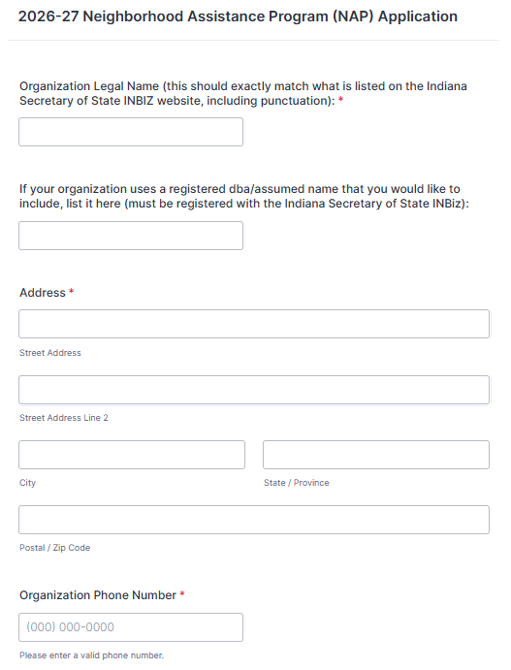
APPLICATION Information:
Organization Information:
Organization Legal Name and Possible DBA assumed named Registered with the Secretary of the State INBiz

Slide 23
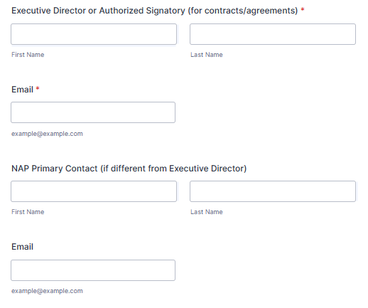
APPLICATION Information:
Authorized Signatory: An individual empowered by a business entity to sign contracts, financial documents, and agreements on its behalf, ensuring contract validity, risk management, and governance.

Slide 24
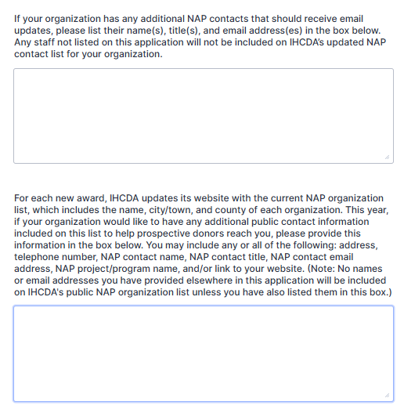
APPLICATION Information:
Additional NAP Contacts:
Additional public contact information:

Slide 25
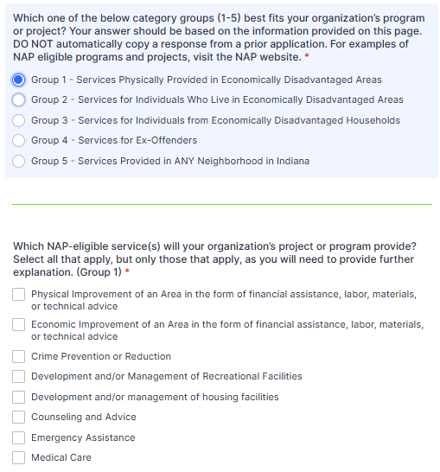
APPLICATION Information:
Organization’s program or project Category: Group 1: Services Physically Provided in Economically Disadvantaged Area

Slide 26
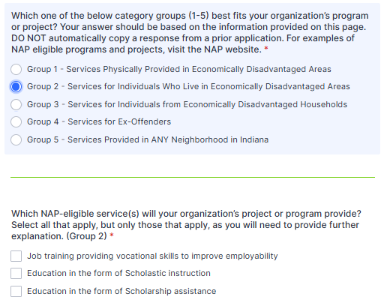
APPLICATION Information:
Organization’s program or project Category: Group 2: Services for Individuals who live in an Economically Disadvantaged area

Slide 27
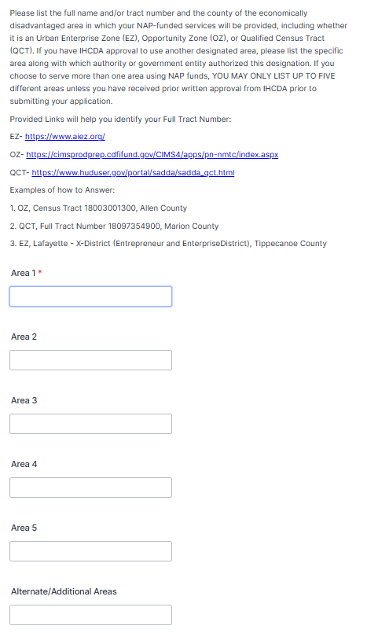
APPLICATION Information:
EZ, OCT, or OZ?
For Groups 1 and 2: Please list the full name and/or tract number and the county of the economically disadvantaged area in which your NAP-funded services will be provided, including whether it is an Urban Enterprise Zone (EZ), Qualified Census Tract (QCT), OR Opportunity Zone (OZ),
EZ: https://www.aiez.org/
QCT: https://www.huduser.gov/portal/sadda/sadda_qct.html OZ: Internal Revenue Bulletin: 2018-28 | Internal Revenue Service Qualified Opportunity Zones in Indiana - OpportunityZones.com

Slide 28
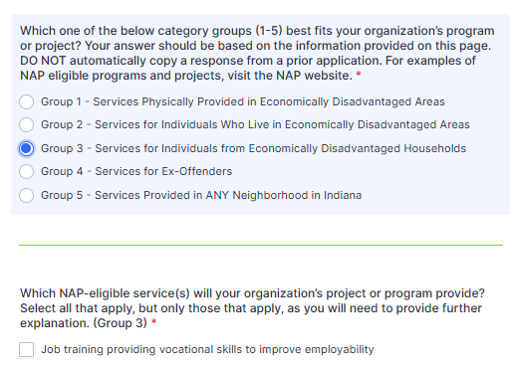
APPLICATION Information:
Organization’s program or project Category: Group 3: Services for Individuals from Economically Disadvantaged Households

Slide 29
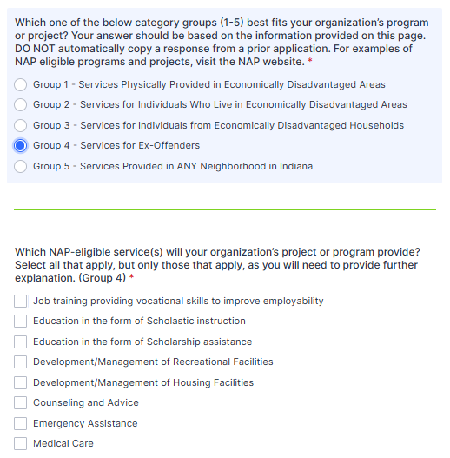
APPLICATION Information:
Organization’s program or project Category: Group 4: Services for Ex-Offenders

Slide 30
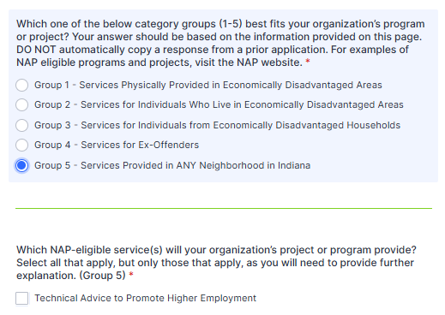
APPLICATION Information:
Organization’s program or project Category: Group 5: Services Provided in ANY Neighborhood in Indiana

Slide 31
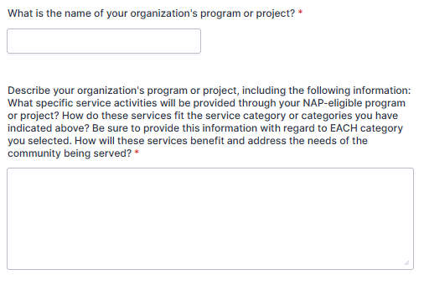
APPLICATION Information:
Organization’s program or project:
Provided a description of the program or project

Slide 32
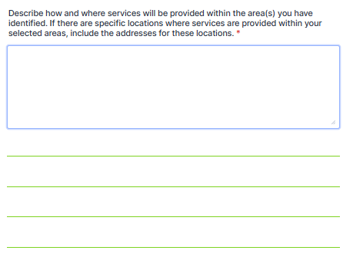
APPLICATION Information:
How and where will services be provided?

Slide 33
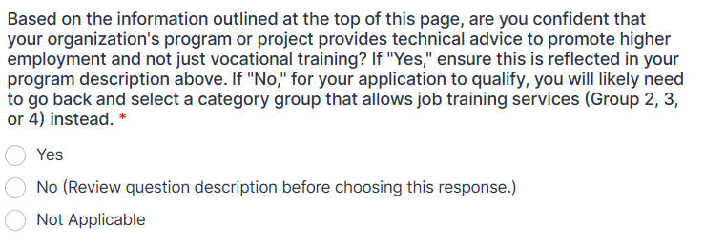
APPLICATION Information:
Does your program provide technical guidance and support aimed at enhanced employment, beyond vocational training?

Slide 34
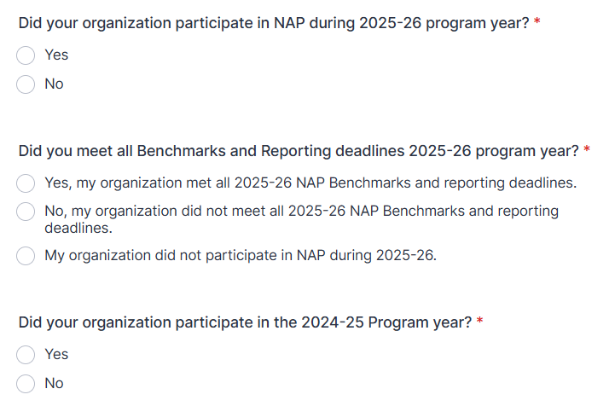
APPLICATION Information:
NAP Program Participation and Compliance: PY2024-26

Slide 35
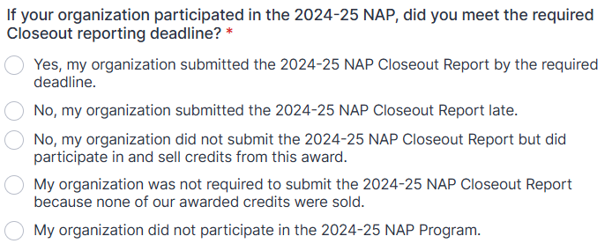
APPLICATION Information:
NAP Closeout Compliance: PY2024-26

Slide 36
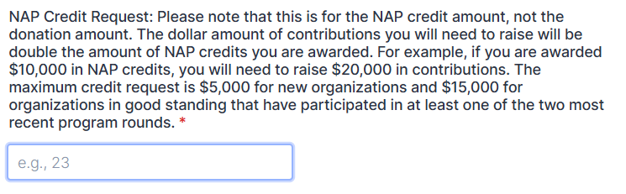
APPLICATION Information:
NAP Credit Request

Slide 37
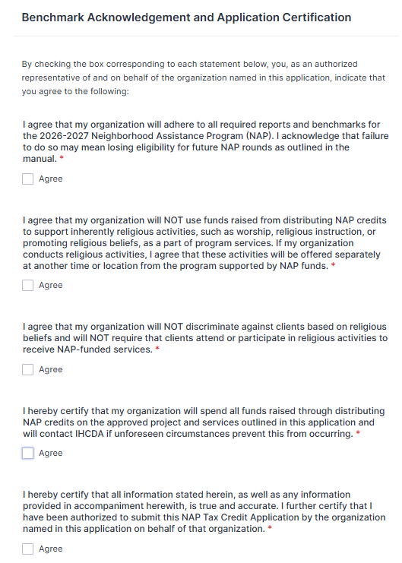
APPLICATION Information:
Benchmark Acknowledgement and Application Certification
By checking the box’s, the authorized representative confirms agreement to all statements on behalf of the organization.

Slide 38
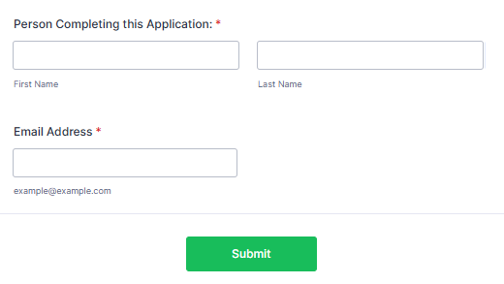
APPLICATION Information:
Application Submission

Slide 39
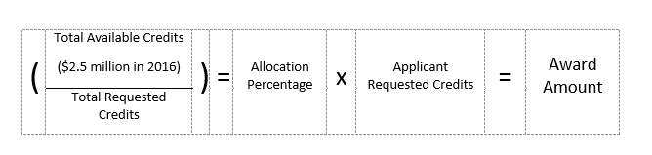
AWARD PROCESS
NAP is non-competitive. All qualifying applicants receive an award based on a percentage of the total requested credits vs. available credits.
The formula below is used to determine the value of an applicant’s NAP award. Elements such as the total available credits and the requested credit amount by approved applicants are taken into account.
This means that the amount of credits you receive is based on the total amount that has been requested, rather than IHCDA’s discretion.

Slide 40
Questions?

Slide 41
Thank you for participating in this webinar.
If you have any unanswered questions, please email the NAP inbox at Nap@ihcda.in.gov

