Slide 1
Ohio River Bridges Project
Kendra W. York
Public Finance Director of the State of Indiana
Indiana Finance Authority

Slide 2
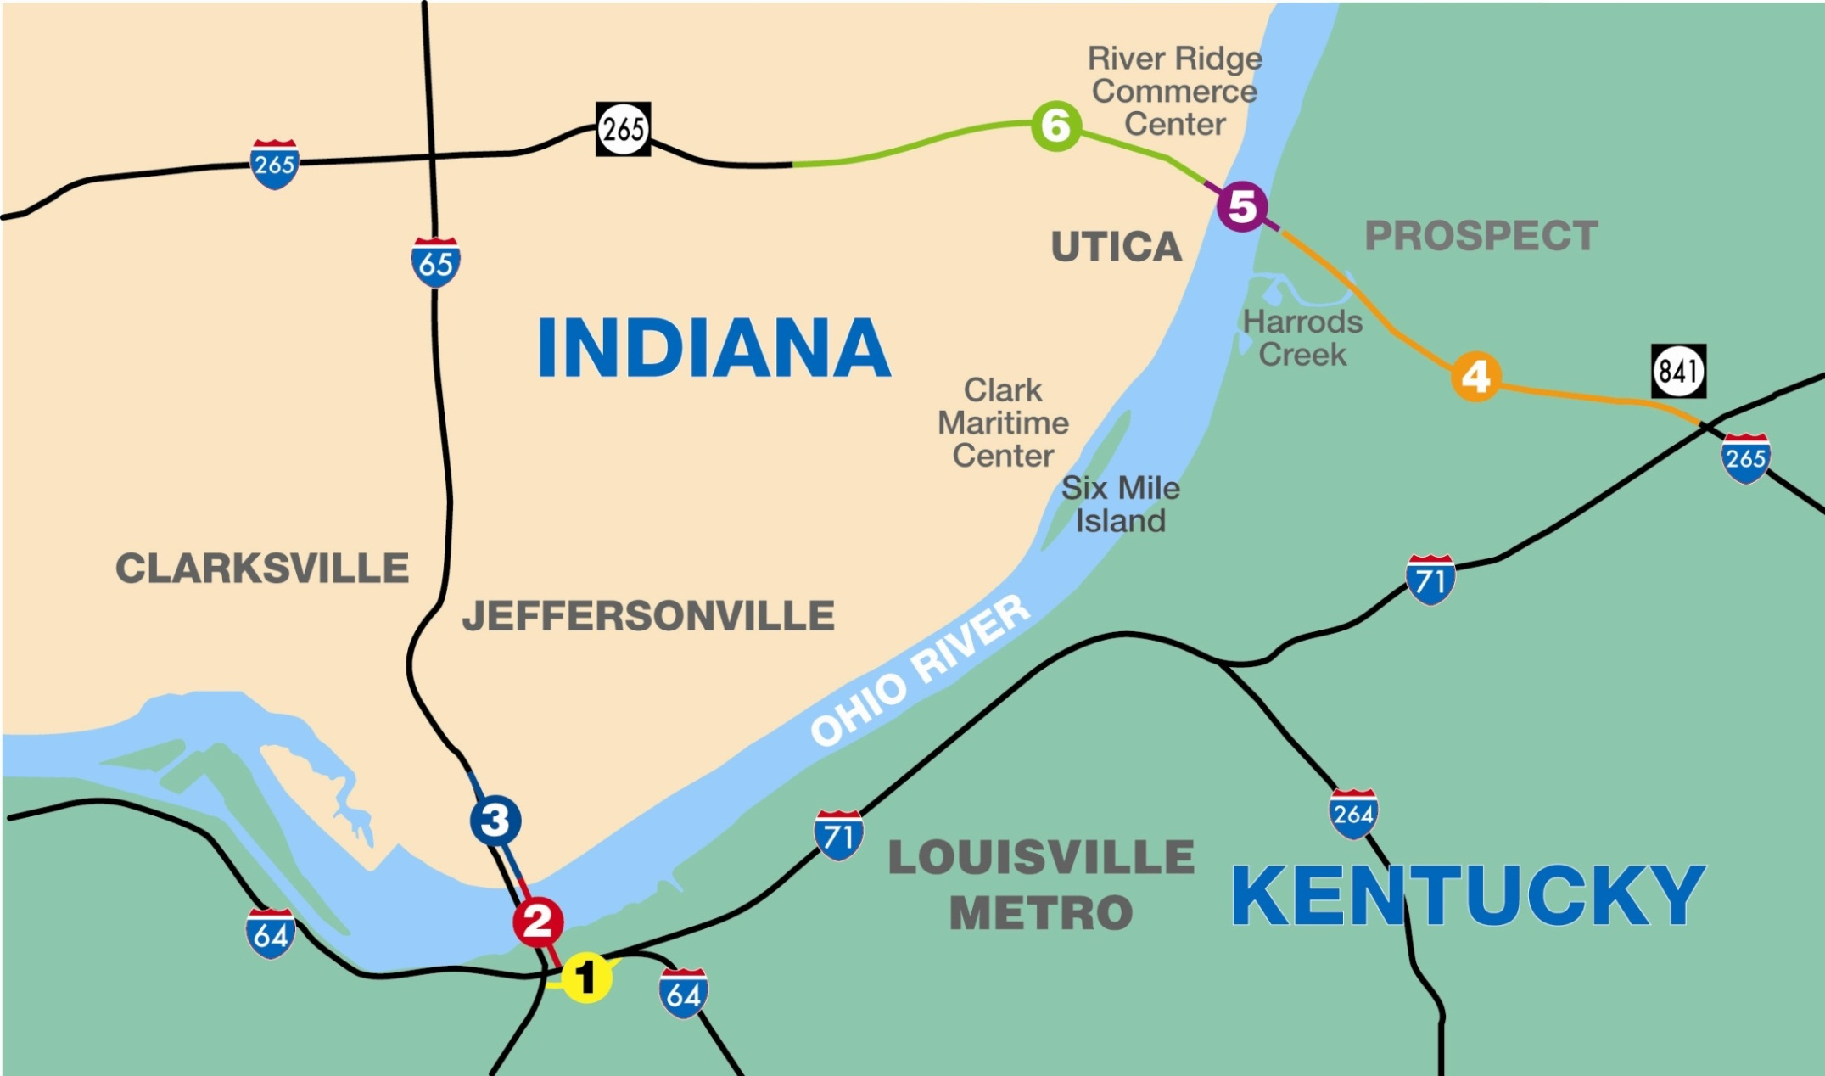
The Bridges Project

Slide 3
Memorandum of Understanding Between the States
Executed by Gov. Daniels and Gov. Beshear on March 5, 2012:
One project, Two procurements
Indiana to lead on East End (AP)
Availability Payment (AP)
Kentucky to lead on Downtown (DB)
Design Build (DB)

Slide 4
Selection of Availability Payment Model
Significant market appetite for risk sharing
Availability payment is fixed subject to indexation, creating budgetary certainty for public authority
Innovative design process is facilitated by competitive RFP process
Developer requires lower return due to guaranteed payment stream (subject to deductions)
Encourages developer to keep facility open and perform to standards
Developer has ability to access most efficient financing structure (bank vs. bond)

Slide 5
East End Crossing Procurement
Availability Payment structure, assuming positive Value for Money
Concessionaire responsible for delivering Sections 4, 5 and 6
Section 4 to be maintained by Kentucky
Section 5 and Section 6 to be maintained by Concessionaire
A separately procured toll operator to be responsible for all tolling operations

Slide 6
East End Procurement Schedule
Memorandum of Understanding March 5
RFQ Issued March 9
Shortlist Announced April 23
Final Economic Impact Study April 26
Draft RFP Issued May 2
Final RFP Issued July 22
Committed Bids Received Oct 26

Slide 7
Evaluation Process
Technical Proposal and Financial Proposal evaluations conducted separately by separate teams
Evaluators are all IFA/INDOT personnel supported by staff and consultants
No communication occurred between technical and financial teams until both teams had fully completed their evaluations
Final step of combining technical and financial scores resulted in a total score out of a maximum of 100 points available

Slide 8
Financial Score
Represents 75 of the total 100 proposal points available
72.5 of the 75 points determined by the proposer’s MAP score according to formula:
Remaining 2.5 points awarded based on feasibility of financial proposal as determined by the evaluation committee
Total Financial Score = MAP Score + Feasibility Score
Lowest Value of Base MAP
MAP Score =
X 72.5 Points
Proposer’s Value of Base MAP

Slide 9
Technical Score
Represents 25 of the total 100 proposal points available
Comprised of the sum of the Technical Proposal Score (up to 22.5 points) and Schedule Score (up to 2.5 points)
Technical Proposal Score determined by 3 major elements:
Preliminary Project Management Plan (40%)
Preliminary Design-Build Plan (30%)
Preliminary Operations and Maintenance Plan (30%)
Schedule Score determined by formula:
Difference (in calendar days) between (i) Proposer’s scheduled date to achieve Substantial Completion and (ii) the Base MAP Date
Schedule Score =
X 2.5 Points
Difference (in calendar days) between (i) the earliest scheduled date to achieve Substantial Completion shown in any conforming Proposal, and (ii) the Base MAP Date

Slide 10
Best Value Determination
Final step merges financial and non-financial considerations into a final score out of a maximum of 100 points available
Combination of scores determined by formula:
Total Proposal Score (out of 100) = Financial Score (up to 75 points) + Technical Score (out of 25 points)

Slide 11
Preliminary Preferred Proposer
WVB East End Partners
Equity Partners: Walsh Investors, VINCI Concessions, and Bilfinger Berger PI
Financial Highlights
Construction Cost: $763m*
MAP: $32.9m
Proposal Key Dates
Commercial Close | 12/24/2012
Financial Close | 3/25/2013
Substantial Completion | 10/31/2016*
Construction Years | 3.6 years
*Construction cost lower than the $987m included in the July 2012 Initial Financial Plan
*Completion date earlier than the June 30, 2017 completion date included in the July 2012 Initial Financial Plan

