Slide 1


Indiana Brownfields Program:
Brownfields 101
Environmental Stewardship. Economic Development.
Mitchell Smith, Communications Lead & Project Manager
mismith@ifa.in.gov 317-234-8833
Notes:
This is the Brownfields 101 presentation, created by Mitchell Smith the Communications Lead & Project Manager for the Brownfields Program.

Slide 2


What you should learn
What is the general functionality of the Brownfields Program?
How is a brownfield defined?
What is a comfort letter and who can receive them?
What is a BFPP and what are the requirements and responsibilities?
Notes:
After this presentation concludes, you should know: the basic functionality and how the Indiana Brownfields Program operates, how a brownfield is defined, what a comfort letter is and who is eligible to receive a comfort letter, and not only what a BFPP is, but also the requirements and responsibilities of a BFPP.

Slide 3
What is a Brownfield?
A parcel of real estate that is abandoned or inactive; or may not be operated at its appropriate use;
And on which expansion, redevelopment, or reuse is complicated;
Because of the presence or potential presence of a hazardous substance, a contaminant, petroleum, or a petroleum product that poses a risk to human health and the environment.
Notes:
So what is a brownfield? A brownfield is not only a parcel of real estate that could be abandoned or inactive, but also where redevelopment or reuse is complicated by the presence or POTENTIAL presence of a hazardous substance, contaminant, or petroleum product. It’s important to remember that contamination does not need to be present for a parcel or site to be considered a brownfield.

Slide 4
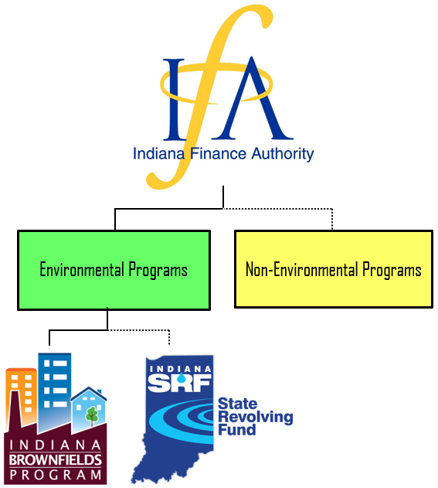
Technical and Financial Assistance
What: Provides free governmental assistance; allows for voluntary participation – not enforcement;
Who: Typically works with communities or prospective purchasers; in partnership with U.S. EPA & IDEM
Why: Offers closure & liability clarification documents
How: different processes for different incentives (grants, loans, POSI, etc.); with a qualified pool of consultants
Notes:
Assistance the Brownfields Program provides includes: free governmental assistance to address environmental issues that impede redevelopment; typically with communities or prospective purchasers; voluntary participation – WE ARE NOT ENFORCEMENT. The image on the right shows the make up of the Indiana Finance Authority (IFA), with the Brownfields Program and State Revolving Fund (SRF) as the environmental programs within IFA. We work with EPA, mainly Region 5 contacts, and IDEM, with different processes for different incentives and funding sources. We just updated our qualified pool of consultants in the Spring of 2023. Of course, we use the R2 for site evaluations and we offer closure and liability clarification documents.

Slide 5
Technical and Financial Assistance
Voluntary - not regulatory
No fees
Non-responsible parties
Property transfers and/or financial assistance for assessment/remediation
Use existing laws, regulations, and/or policies
Assistance
  Financial
    “Grants”
    Loans
  Legal
    Comfort Letters
  Technical
    Closure Letters
    Comment Letters
  Educational
Coordination
  U.S. EPA
  Other IDEM Programs
    Voluntary Remediation Program
    State Cleanup
    LUST
    RCRA
Notes:
So what do we do? We are voluntary, again we are not enforcement. We have no fees or penalties. We typically work with non-responsible parties and we will get into situations where we do a little later. We typically provide technical assistance to applicants during, or prior to, a property transfer as well as providing financial assistance through various funding sources for assessment and remediation. Again, we use existing regulations and policies as well as the R2 for guidance. We have financial, legal, technical, and GIS staff and we coordinate with essentially all other IDEM Programs. Comfort and closure letter review and evaluation make up the bulk of our work.

Slide 6

Obstacles to
Brownfield Redevelopment?
Real or suspected environmental contamination
Assessment/Cleanup costs
Liability concerns
Viability of re-use plans for the site
Lack of resources – knowledge,
money, partners
Unknowns – risks, ownership, access
Notes:
There are typically obstacles to redevelopment of brownfields, which include: real or suspected environmental contamination, again it can be the presence or potential presence of contamination; assessment and cleanup costs - not everyone has a deep enough pocket to deal with environmental concerns; liability concerns for anyone involved; socio-economic issues such as opposition to another industrial facility to be the reuse of a certain Site; and viability of reuse plans which could include that same industrial facility, perhaps that is the only viable reuse of that Site. And finally, there could be a lack of money and knowledge along with unknowns including risks. One of the largest hurdles to overcome is the lack of knowledge related to all aspects to brownfield redevelopment.

Slide 7
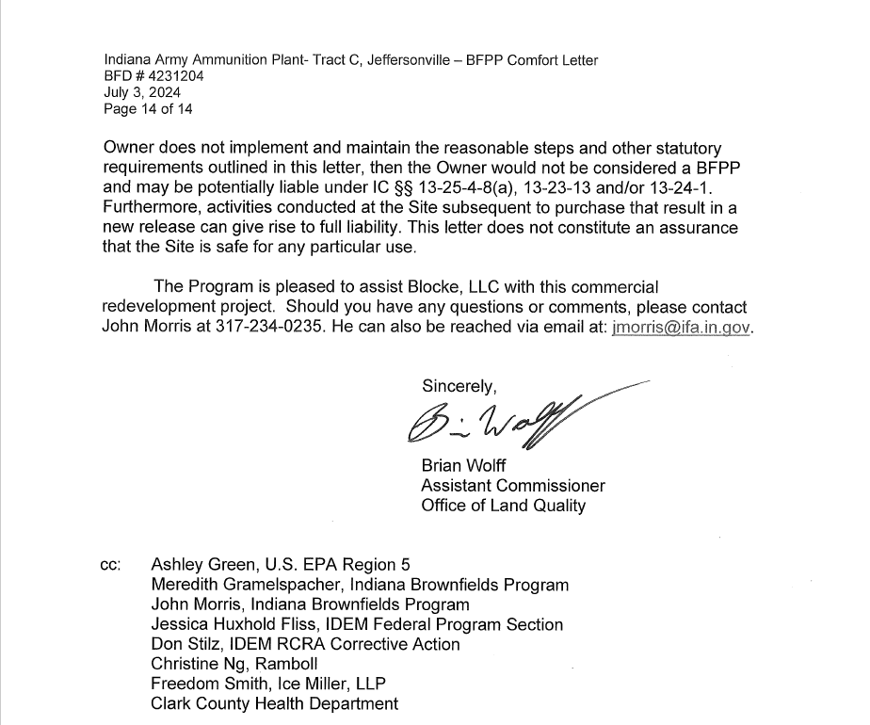
Comfort Letter
Process & Timeline
Timeline is generally minimum 120 days*
*Length of the time varies based on:
    the number of other requests already in the queue
    the volume of data/reports associated with the subject site that require review
    Review process includes peer review, general counsel review, technical review, and signature review
    Complexity of the Site/project and redevelopment plans
    BFPP liability defense is self-implementing
Notes:
Comfort Letters are not issued to Responsible Parties. The bulk of our Program workload is document review for Comfort Letter requests. Each Letter drafted by the Program goes through peer, legal, and technical review before being reviewed and signed by IDEM. The Program utilizes IDEM Science Services to review and comment on data or work plans as needed. Letters typically take a minimum of 120 days from the time we receive all pertinent information – not just the application. The length of time varies based on other requests, volume of reports and data, and complexity of the Site. Some sites could be within other or multiple IDEM programs. The BFPP liability defense is self-implementing; meaning someone does not need a Comfort Letter before closing to be eligible for the liability defense.

Slide 8
Bona Fide Prospective Purchaser (BFPP)
    A BFPP is a bona fide prospective purchaser or owner of a site that satisfies “all appropriate inquiry” (AAI)
    AAI is a rule under CERCLA (Comprehensive Environmental Response, Compensation, and Liability Act of 1980)
    Remember! The BFPP liability defense is self implementing!
Notes:
A BFPP is a prospective purchaser or owner of a site that satisfies “all appropriate inquiry” by completing a Phase I ESA prior to purchasing (or leasing) a site at which all disposal of hazardous substances or petroleum products occurred prior to purchase (or lease). AAI is a rule under CERCLA that prescribes the due diligence necessary for a buyer to undertake so it knows what it is getting into when buying a property with contamination.

Slide 9
BFPP Comfort Letter
Bona Fide Prospective Purchaser (BFPP) Defense
  Meet AAI requirements – Phase I ESA (ASTM1527-21)
  Self Implementing by statute – letter not needed but helpful
  No RECs or Historical RECs and/or no contamination
    Program can’t issue Comfort Letter because no enforcement risk
    Comment Letter
  Reasonable Steps (due care)
    Technical opinion (mitigation to exposures)
  Phase II Investigation
    Identified RECs should be investigated but are not required to be
    IBP comments on recommended reasonable steps/continuing obligations
Notes:
Again this process is self-implementing and the letter can be issued after purchase. As long as a BFPP satisfies AAI, then a comfort letter is not needed prior to purchasing a property. If there are no recognized environmental conditions (recs) and/or no contamination then the Program cannot issue a Comfort Letter. Without environmental liability, there can be no clarification given, so in the event there are no recs or contamination, a Comment Letter would be issued instead. Within the letter, reasonable steps will be provided which include technical opinions for mitigating exposures. It is important to note that a BFPP is not responsible for cleanup of a site, it is their responsibility to mitigate exposures to any occupants. These reasonable steps can be ‘beefed’ up with input from Science Services. Some brownfield sites could be within other IDEM programs, with oversight for a different reason, such as cleanup efforts. That other IDEM program will work with the responsible party. Typically, all comfort letters will include the summary of a Phase two which should investigate all recs identified in a Phase one ESA but they aren’t required. If a rec isn’t investigated, a reasonable step will be included stating the need to investigate that rec.

Slide 10
Comfort Letter - BFPP
Phase I ESA
RECs vs CRECs vs HRECs
  Recognized Environmental Condition (REC)
  Controlled REC
  Historical REC
  Definitions listed in ASTM 1527-21
    Consultants have misused/confused the terms
    Program staff will correct the term(s) in the Comfort Letter
    Program staff may identify and list site conditions it perceives as RECs not identified by the Phase I ESA
Notes:
The Phase one ESA is an important component of the AAI, where environmental conditions on the Site are identified. No samples are collected during a Phase one, only site reconnaissance and document review to identify recognized environmental conditions. There are three types: recs, C-recs, and H-recs. A rec is defined as the presence or likely presence of any hazardous substances or petroleum products in, on, or at a property due to a release or under conditions that pose a material threat of a future release. A controlled rec is a result of a past release that has been addressed to the satisfaction of IDEM (or other applicable regulatory agency), with contamination allowed to remain in place along with land use restrictions. An h-rec is a past release that has been addressed to the satisfaction of IDEM meeting unrestricted use.

Slide 11
Comfort Letter - BFPP
Phase II ESA
Phase II Environmental Site Assessment (ESA)
  Investigate RECs identified in the Phase I ESA
    Exposure Risks
      Soil - direct contact residential, commercial/industrial, excavation worker scenarios
      Groundwater
      Soil gas – vapor outside building or beneath slab
      Indoor air – vapor in the building
    More information (data and reuse plans), better letter
Notes:
A Phase two ESA is meant to investigate any recs identified in the Phase one ESA. This could include the advancement of soil borings or soil gas ports, the installation of groundwater monitoring wells, or the collection of indoor air samples in efforts to determine exposure risks. The more data that is collected, the more comprehensive of a review and better determinations can be given by the Program. In the event that a determination cannot be made, the Program will ask for more data to be collected prior to issuing a letter or within the letter.

Slide 12
Environmental Restrictive Covenant (ERC)
Form of institutional control used in risk-based closure
Land Use Restrictions
  Drafted by the Program; issued with letter
  Recorded/Attached to property deed through an ERC
  Detail property conditions
    Contaminants – levels and locations
    Affected media – soil, groundwater, surface water, soil gas, and/or indoor air
Notes:
If site conditions warrant land use restrictions, along with the comfort letter Program staff will draft an environmental restrictive covenant (ERC). The ERC will proscribe actions or prohibitions deemed necessary for safe intended property use whether it be residential, commercial, or industrial. Modifications can be made as property conditions change or more information is gathered.

Slide 13
Petroleum Brownfields
Financial Options for Communities
  Petroleum Orphan Site Initiative (POSI)
    Addressing petroleum contamination on brownfield sites resulting from leaking underground storage tanks that cannot be addressed by the responsible party due to an inability-to-pay, bankruptcy, or other factors (orphan sites)
    The following sites are eligible for POSI funding:
    Sites with no viable responsible party
    Sites that are effectively abandoned due to tax delinquency
    Sites with a responsible party solely based on current ownership (e.g., inheritance)
Notes:
Transitioning away from the comfort letter and environmental liability side of the Program, we also have petroleum brownfields. We have a funding source called the Petroleum Orphan Site Initiative (POSI) which we use for sites that either have an inability to pay, cannot be addressed by a responsible party, referred to us by IDEM enforcement, or other factors including inheritance or tax delinquency.

Slide 14
Petroleum Orphan Site Initiative (POSI)
POSI Process
  Site Access obtained & request for proposal (RFP) issued for each Site
  RFP includes:
    Activities at sites with no available info include:
      Phase I, geophysical, UST removal, Phase II, and final monitoring
    Average project duration is 2 years
    Site remains in process until NFA is issued
  Project Manager involvement/oversight include:
    Site visits for UST/soil removal
    Approve change orders (if needed)
    Approve invoices
    Draft Environmental Restrictive Covenants (ERCs)
    Work cooperatively with consultants/technical staff to close out sites
Notes:
After a site access agreement is obtained we will send a request for proposal out to our qualified pool of consultants with a bid deadline date included. Once bids are received, they are reviewed and a consultant will be selected for each individual site. Field work could include a Phase one, phase two, underground storage tank removal, remediation, and groundwater monitoring. The Brownfield project manager will oversee all field work and review all reports submitted for each site. When it is determined that a site could be closed (with a No Further Action Letter) we will ask for concurrence from IDEM science services. Because we are not enforcement, all determinations made in regard to closure or exposure risks within a letter will be stated as if it was made by IDEM, not the Program.

Slide 15
Question #1
A gasoline station is adjacent to a vacant parcel. The vacant parcel was never historically used as a gasoline station or had any other related petroleum use. True or False: the vacant parcel could be considered a brownfield.
Answer: True. The mere potential of contamination to migrate onto the vacant parcel would result in a brownfield.
Notes:
A gasoline station is adjacent to a vacant parcel. The vacant parcel was never historically used as a gasoline station or had any other related petroleum use. True or False: the vacant parcel could be considered a brownfield.
The answer is true. The mere potential of contamination to migrate onto the vacant parcel would result in a brownfield.

Slide 16
Question #2
Mr. Smith needed a larger office building for his business and was interested in purchasing a property with a history of environmental contamination with various investigations. He purchased the property on December 22, 2023 and planned to have a grand re-opening in March 2024. Mr. Smith contracted a consulting firm, and completed a Phase I ESA which satisfies AAI, dated November 30, 2023. Can Mr. Smith get a Comfort Letter if he requests one on January 23, 2024?
No, the Comfort Letter request is after the date of purchase.
No, the Brownfields Program was not provided an AAI compliant Phase I ESA until after the property was purchased.
Yes, the Phase I ESA was AAI compliant and completed prior to purchase and the BFPP exemption was designed to be self-implementing.
Yes, because the Comfort Letter request was made before the new office building was occupied.
Notes:
Mr. Smith needed a larger office building for his business and was interested in purchasing a property with a history of environmental contamination with various investigations. He purchased the property on December 22, 2023 and planned to have a grand re-opening in March 2024. Mr. Smith contracted a consulting firm, and completed a Phase I ESA which satisfies AAI, dated November 30, 2023. Can Mr. Smith get a Comfort Letter if he requests one on January 23, 2024?
The answer is C. If the Phase one ESA was AAI compliant and completed prior to purchase, then the Program can issue Mr. Smith a Comfort Letter even if that request date is after the purchase date. A and B are incorrect, because a Comfort Letter can be issued after a purchase date and as long as an AAI compliant Phase one ESA is conducted prior to purchasing the property, the Program does not have to review it prior to purchase. D is incorrect because occupying the building is not part of AAI.

