Slide 1
Indiana Palliative Care & Quality of Life Advisory Council
Stakeholder Meeting
April 30, 2019

Slide 2
Indiana Palliative Care and Quality of Life Advisory Council
Quality of Life and Palliative Care Advisory Council
Legislation in 2016
American Cancer Society Cancer Action Network
IC 16-19-17
12 members (appointed)
Open meetings, bimonthly

Slide 3
COUNCIL MEMBERS
Susan Hickman, PhD (Chair) – IU School of Nursing
Mika Hill, RN, BSN – Heart to Heart Hospice
Chris Brinneman, MSW – Parkview Hospital
J. Derek Imars, PharmD, MBA – St. Vincent
Steve Ivy, PhD – IU Health (retired)
Katherine Crawford – American Cancer Society
Tom Ledyard, MD – Community Health System
Lynn Robbin, MSN, RN, ANP-BC – Franciscan Health Michigan City
Gerald Walthall, MD – Franciscan Health (retired)
Stacey Sharp, MBA – Community Health System
Amy Haskamp, MSN, RN, PCNS-BC – Riley Children’s Hospital
Bryan Hannon – American Cancer Society Cancer Action Network
Staff Support
Megan Agnew (ISDH)
Natasha Young (ISDH)
Heather Sager (ISDH)
Grace Miller (ACSCANS)

Slide 4
Purpose
To educate and advocate for quality palliative care;
To collect, analyze on, and develop state initiatives concerning the establishment, maintenance, operation, and evaluation of palliative care in Indiana;
To make policy recommendations to improve palliative care and the quality of life of individuals with serious illness;
To prepare a report not later than January 1 of each year.

Slide 5
Year 1 Activities
Reviewed work of other state councils
Discussed current challenges
Identified three focus areas
Advance care planning
Access to palliative care
Pain medication and management

Slide 6
Year 2 Activities
Establishing Advisory Workgroups
Access to Palliative Care
Hospital-based palliative care; defining the practice; health system role in education (awareness, who is eligible); ensuring Medicaid patient access; inpatient hospice as pall care provider
Advance care planning
Training requirements; registry; existing advance directives;
Nursing home quality initiatives (done!)

Slide 7
Year 2 Activities (cont)
Pain medication and management ideas
Palliative care carve-out; access to meds in rural areas; mandatory education; hospice pain medication disposal; model policy for standard of care with accountability measures included

Slide 8
Website Development for Public

Slide 9
Palliative Care Team Statewide Survey
Developed survey
Called every hospital
Identified contacts
Emailed surveys to 36 contacts
Received responses about 16 hospital-based palliative care teams

Slide 10
Sample Profile

Slide 11
YEAR 3 ACTIVITIES
Council Stakeholder Workgroups
Three groups; leadership from Council members
Members from community stakeholders, broadly conceptualized
Two working meetings
Review issues identified by Council
Conducted SWOT analysis
Council reviewed SWOT and made final recommendations

Slide 12
Workgroup Members*
Stakeholder members representing:
Indiana State Department of Health
Indiana Rural Health Association
Indiana Pharmacy Alliance
Indiana Medicare/Medicaid
Division of Aging
Indiana Minority Health Coalition
Indianapolis Coalition for Patient Safety
Indiana Catholic Conference
Center for Hospice Care (South Bend)
Indiana Hospital Association
Indiana Health Care Association
Indiana LeadingAge
Indiana Area Agency on Aging
Indiana Hospice and Palliative Care Organization
Indiana Association for Home and Hospice Care
Indiana Department of Homeland Security
Indiana State Board of Nursing
Medical Licensing Board of Indiana
American Cancer Society
*Please let us know if you participated and your organization is missing from this list!

Slide 13
Recommendations Explored by the Access to palliative care Workgroup
1. Define the practice of palliative care for state regulation.
2. Identify best practice policies for hospitals and palliative care programs.
3. Create requirements for health systems to inform patients about the availability of palliative care services and/or the development of systems to identify patients who would benefit from palliative care.
4. Ensure Medicaid eligible adults on Healthy Indiana Plan (HIP) have access to palliative care or hospice care in an extended care facility (ECF) or skilled nursing facility (SNF).
5. Explore the possibility of permitting hospices to offer palliative care to non-terminal patients or inpatient hospices to offer non-terminal inpatient palliative care.

Slide 14
Final council Recommendation for Access to palliative care
Define the practice of palliative care for state regulation.

Slide 15
Recommendations Explored by the advance care planning Workgroup
1. Revise the Indiana living will/advance directives.
2. Support development of a registry for advance directives and POST forms.
3. Encourage additional nursing home data requirements: Data collection of advance care planning, advance directives and POST.
4. Support advance care planning education and training for healthcare professionals.

Slide 16
Value based purchasing training
New training for nursing facility staff through Division of Aging as part of Value Based Purchasing Formula added in 2018..
Nursing facilities with a trained staff member received 5 points toward the 100 Value Based Purchasing point total.

Slide 17
final council Recommendations for advance care planning
Revise the Indiana living will/advance directives.

Slide 18
INDIANA ADVANCE DIRECTIVE PROGRESS
2019 House Bill 1516 (Rep. Kirchhofer with Rep. Hatfield)
Goal = One Indiana Advance Directive
Consolidate 3 statues
Create uniform signatory requirements and revocation procedures; flexible formalities
Eliminate mandatory use of “official” form
Clarify standards for legal representatives
Bill was not introduced; exploring in summer session

Slide 19
Recommendations explored by the Pain Medication and Management workgroup
1. Adjust the current seven-day limit on opioid prescriptions to better serve palliative care patients (clarifying qualifications for those dispensing medication).
2. Explore mandatory pain management education for prescribers.
3. Provide sufficient and streamlined methods of pain medication disposal to those who are on the front lines of palliative care.
4. Draft a model policy for a standard of care that includes accountability measures.

Slide 20
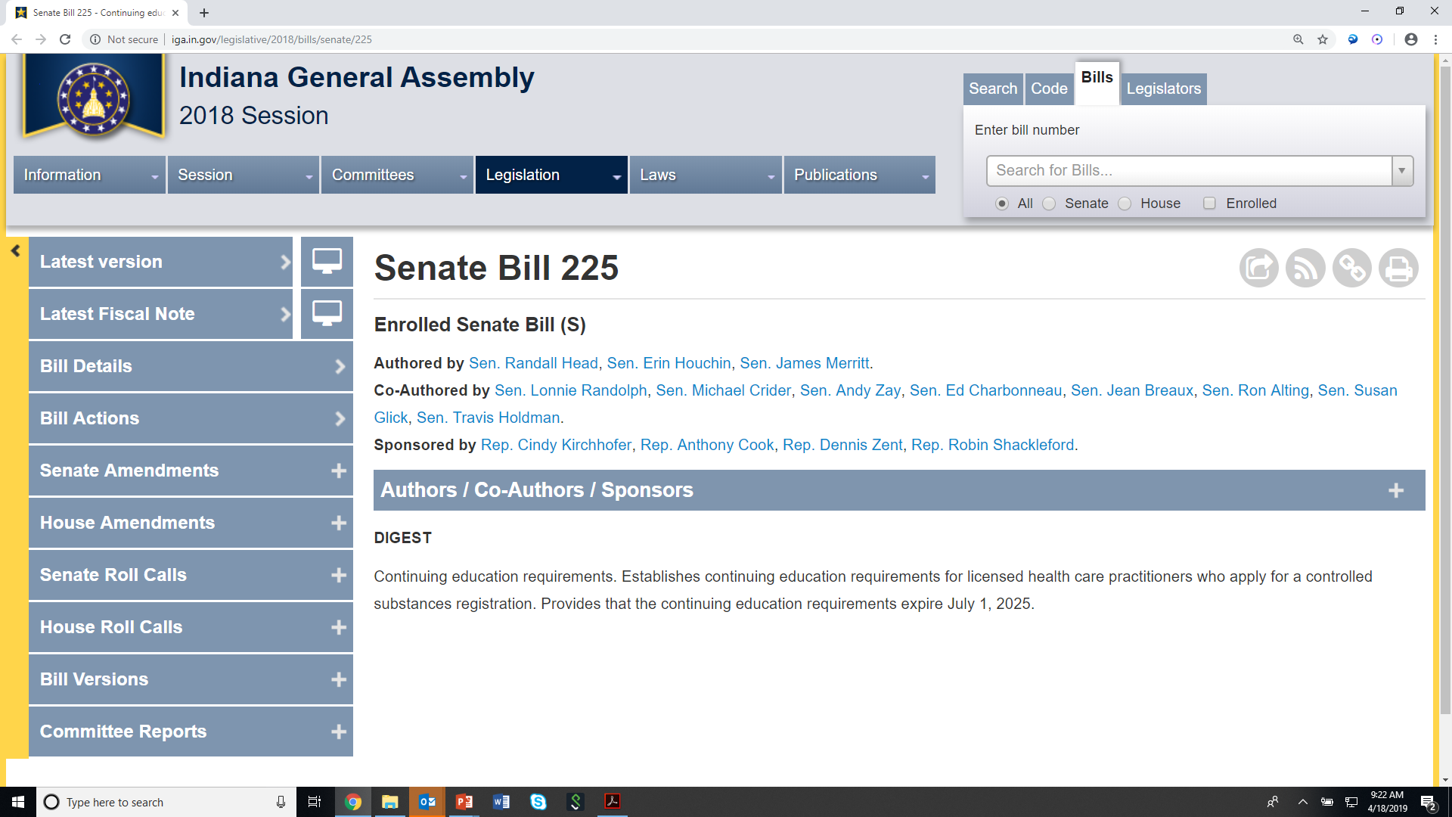
INDIANA EDUCATION BILL

Slide 21
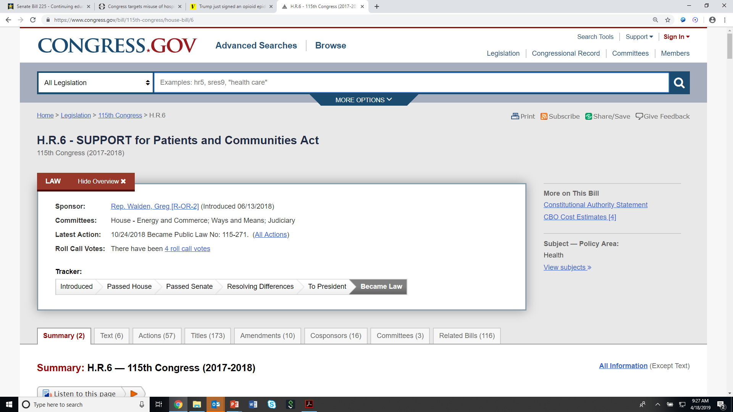
Federal Legislation Addressing Opioid Disposal by Hospice

Slide 22
Final Council recommendations for Pain Medication and Management
Adjust the current seven-day limit on opioid prescriptions to better serve palliative care patients (clarifying qualifications for those dispensing medication).
Provide sufficient and streamlined methods of pain medication disposal to those who are on the front lines of palliative care.

Slide 23
FINAL COUNCIL RECOMMENDATIONS - SUMMARY

Slide 24
DIRECTIONS FOR THE FUTURE

