Slide 1
Department of Veterans Affairs
Vocational Rehabilitation and Employment

Slide 2
Department of Veterans Affairs
Vocational Rehabilitation and Employment
Today’s session will cover:
The mission and intent of VA Vocational Rehabilitation & Employment (VR&E)
Criteria by which Veterans and Service Members are determined eligible for and entitled to VR&E services
Application and evaluation process for VR&E
Services offered through VR&E
Advantages/benefits of VR&E

Slide 3
Department of Veterans Affairs
Vocational Rehabilitation and Employment
What is Vocational Rehabilitation & Employment (VR&E)?
Pathway to suitable employment and career stability or increased independence in daily living for eligible Veterans and Service Members with service-connected disabilities.
VR&E Program Intent
Provide services to assist Veterans and Service Members with service-connected disabilities to succeed:
  In transition … through services to support transition back to civilian life
  At work … through services resulting in suitable employment
  On campus … through services to support them during education and training
  At home … and in their communities … through services to maximize independence in daily living

Slide 4
VR&E Benefits and GI Bill
Is VR&E Program the same as the GI Bill?
No. GI Bill is an educational benefits program.
  The purpose of the VR&E Program is to help Veterans with service-connected disabilities and barriers to employment to become suitably employed.
  Four of the Five VR&E categories of services are geared specifically toward employment with personalized employment services offered (e.g., work readiness preparation, resume development, job-seeking skills, job accommodations, placement assistance, post-employment follow-up, etc.).
  The “E” in VR&E stands for the program’s mission to assist Veterans and Service Members with obtaining suitable Employment.

Slide 5
VR&E Benefits and GI Bill
--VR&E services include Assisting the Veteran with:
  Career Choice – Help the Veteran understand the best career options for them based on their interest and capabilities. The Veteran will receive a comprehensive evaluation to determine abilities, skills, and interests for employment.
  Benefits Coaching – guidance on the effective use of VA benefits and/or other resources to achieve educational and career goals.
  Personalized Support – Academic or adjustment counseling and personalized support to remove any barriers to employment success. The Veteran will receive Vocational counseling and rehabilitation planning for employment services as well as supportive rehabilitation services including case management, counseling, and medical referrals.

Slide 6
VR&E Eligibility Criteria
Veterans:
Honorable or other than dishonorable discharge
A VA service-connected disability rating of 10% or more; or memorandum rating of 20%
Apply for VR&E benefits
Active Duty Servicemembers:
Expect to receive an honorable discharge
Obtain a VA memorandum rating of 20% or more
Obtain a Proposed Disability Evaluation Service (DES) rating
Service Members awaiting discharge due to a medical condition resulting from a serious injury or illness that occurred in the line of duty may be automatically entitled to VR&E benefits.
Apply for VR&E benefits

Slide 7
VR&E Basic Benefit Information
A maximum of 48 months of entitlement
May be used within 12 years from the date of initial VA disability rating notification. The 12-year period begins on the latter of these dates:
  Date of separation from active military duty, or
  Date when the Veteran was first notified of a service-connected disability rating
Exception for Veterans with a Serious Employment Handicap (those Veterans who have very severe, significant difficulties and limitations with regard to preparing for, obtaining and maintaining employment).

Slide 8
VR&E Application & Evaluation Process
Veteran or Service Member submits application for benefits.
Applicant is scheduled for an appointment to come in for orientation and meet with a Vocational Rehabilitation Counselor (VRC).
VRC determines whether applicant is entitled to services. The following criteria must be met for the applicant to qualify for VR&E services:
  Finding that the applicant has barriers to employability
  The barriers are due substantially to his/her service-connected disability conditions
  The applicant must not have overcome the barriers by being suitably and stably employed or by having training/education/skills needed to qualify for suitable employment.
If entitled to services, the Veteran or Service Member works with VRC to identify services needed.

Slide 9
VR&E Services: 5 Tracks to Employment
Re-employment
Designed for individuals separating from active duty, National Guard, or Reserves and are returning to their previous employment.
  Consultation with employers, job accommodations, re-employment rights advice, case management
Rapid Access to Employment
Designed for individuals expressing interest in seeking employment soon after separation or have the necessary skills to be competitively employed in an appropriate occupation.
  Resume development, job search assistance, placement services, post-employment follow-up
Employment through Long-Term Services
Designed for individuals requiring specialized training and/or education to obtain suitable employment; nearly all Veterans that a Certifying Official will see are in this track.
  Internships/apprenticeships, On-the-Job Training, college/vocational/technical training; coverage of tuition, fees, books, supplies; monthly subsistence allowance; case management

Slide 10
VR&E Services: 5 Tracks to Employment
Independent Living Services
Designed for individuals who may not be currently ready for employment or currently able to pursue a vocational goal.
  Acquiring assistive technology, independent living skills training, community-based support services, gaining increased access within the home and community
Self-Employment
Designed for individuals who have the desire and skills to run a business and need a flexible or accommodating work environment because of their disabilities.
  Help developing a business plan, analysis of business concept, training in small business operations/marketing/finances, and guidance in obtaining resources to implement the business plan

Slide 11
Benefits of VR&E Services
Support a wide variety of training programs (college, OJT, self-employment)
Payment of all tuition costs, books, required supplies plus a monthly stipend
Monthly stipend can be paid at the Post 9/11 GI Bill rate
Work one-on-one with a Vocational Rehabilitation Counselor to facilitate successful completion of planned services
Work one-on-one with an Employment Coordinator for assistance with job placement
Use of Tax Incentives only available through VR&E
Eligible to expanded medical care at VA medical facilities
Educational and vocational counseling for transitioning Service Members, recently discharged Veterans, and students receiving VA educational benefits.
  Educational and career counseling also provided to Veterans’ dependents who qualify for Dependents’ Educational Assistance (Chapter 35).

Slide 12
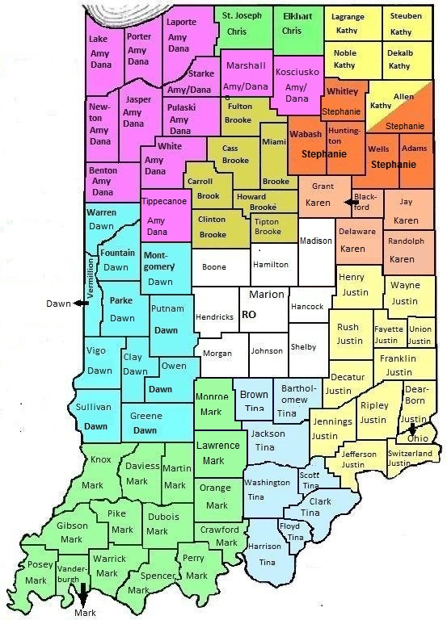

VR&E in Indiana
Where Are We Located Eight locations throughout Indiana: South Bend, Crown Point, Ft. Wayne, Kokomo, Columbus, Scottsburg, Evansville and the VA Regional Office in Indianapolis.

Slide 13
Department of Veterans Affairs
Vocational Rehabilitation and Employment
Apply for Benefits
www.ebenefits.va.gov
For further information on VA VR&E or other VA Benefits
http://www.benefits.va.gov/vocrehab/
1-800-827-1000
Website for self-paced CareerScope Testing:
www.benefits.va.gov/gibill

