Slide 1
Safety Planning
Emily Dellinger, LCSW
Suicide Prevention Coordinator
Indianapolis VA Medical Center

Slide 2

Before We Begin:
Suicide can be an intense topic for some people.
  If you need to take a break, or step out, please do so.
Immediate Resources:
  988 Suicide and Crisis Lifeline
  Veterans and Service members: Dial 988 then Press 1 to connect with the Veterans Crisis Line.
    Text: 828255
    Chat: VeteransCrisisLine.net/Chat

Slide 3
Facts About Veteran Suicide

Slide 4
Suicide is a National Public Health Problem
Suicide is a national issue, with rising rates of suicide in the general population.
For every death by suicide, approximately 135 individuals are impacted.
Notes:
Suicide is a national issue, with rising rates of suicide in the general population. In addition, suicide rates are higher, and are rising faster, among Veterans than among non-Veteran adults.
Societal factors, such as economic disparities, race/ethnicity/LGBT disparities, homelessness, social connection and isolation, and health and well-being, play additional roles in suicide.
Coronavirus Disease 2019 (COVID-19) pandemic has also placed additional strain on our Nation and on individuals and communities
Our nation grieves with each suicide, necessarily prompting the collective tireless pursuit of evidence-based clinical interventions and community prevention strategies, critical to the implementation of VA’s National Strategy for Preventing Veteran Suicide.
Cerel, J., Brown, MM., Maple, M., Singleton, M., van de Venne, J, Moore, M., & Flaherty, C., How many people are exposed to suicide? Not six. Suicide and Life-Threatening Behavior, (2018) https://doi.org/10.1111/sltb.12450
Turecki, G., Brent, D.A. (2016) Suicide and suicidal behavior. Lancet. 387:12271,227–39.
Zalsman G., Hawton, K., Wasserman, D., van Heeringen, K., Arensman, E., Sarchiapone, M., … Zohar, J. (2016) Suicide prevention strategies revisited: 10-year systematic review. Lancet. 3:646–59.
Department of Veterans Affairs (2018). National Strategy for Preventing Veteran Suicide. Washington, DC. Available at https://www.mentalhealth.va.gov/suicide_prevention/docs/Office-of-Mental-Health-and-Suicide-Prevention-National-Strategy-for-Preventing-Veterans-Suicide.pdf.

Slide 5
Suicide is a Complex Issue with No Single Cause
Suicide is often the result of a complex interaction of risk and protective factors at the individual, community, and societal levels.
Risk factors are characteristics that are associated with an increased likelihood of suicidal behaviors. Protective factors can help offset risk factors.
To prevent Veteran suicide, we must maximize protective factors while minimizing risk factors at all levels, throughout communities nationwide.

Slide 6
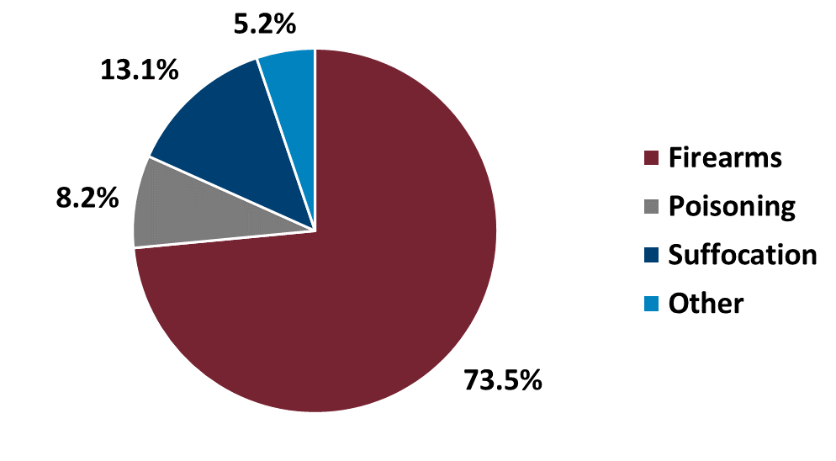
U.S. Veterans and Suicide Methods (2022)
Veterans
Non-Veteran U.S. Adults
UˌSˌ Department of Veterans Affairs, Office of Suicide Preventionˌ 2024 National Veteran Suicide Prevention Annual Reportˌ 2024ˌ
Notes:
Lethal means are methods used to attempt suicide. Examples include poisoning, suffocation, and firearm use. Firearms accounted for 73.5% of Veteran Suicide in 2022

Slide 7
Suicide is preventable.
Notes:
Suicide is preventable, and preventive treatment works. Every day, people across the nation reach out for support and are able to live healthy, productive lives.

Slide 8
Safety Plan
Brief clinical intervention that results in a prioritized written list of warning signs, coping strategies, and resources to use during a suicidal crisis

Slide 9
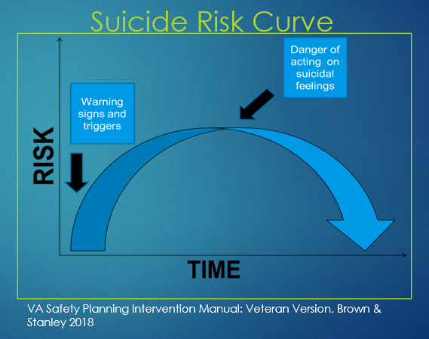
Why is Safety Planning Useful?
Feelings of intense distress and suicidality fluctuate over time.
Individuals who have struggled with suicidal intent are at high risk to have a similar future crisis.

Slide 10
Why is Safety Planning Useful?
A safety plan is designed to break the cycle early, providing patients with a tool to avoid entering the suicidal state
Once aware that such temporary periods of distress may reoccur, the client can proactively plan effective strategies for such periods-maintaining safety, reducing distress, and speeding recovery

Slide 11
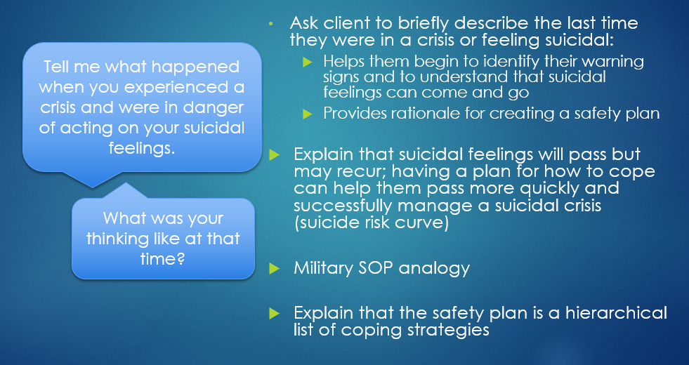
Introducing the Safety Planning Intervention

Slide 12
Introducing the Safety Planning Intervention
Triggers, Risk Factors, and Warning Signs
  Signs that I am in crisis and that my safety plan should be used
Internal Coping Strategies
  Things I can do on my own, without contacting another person, to distract myself/keep myself safe
Social Contacts Who May Distract From the Crisis
  People I can contact to take my mind off my problems/help me feel better
  Public places, groups, or social events that distract me/help me feel better
Family Members or Friends Who May Offer Help
  People I can tell that I am in crisis and need support
Professionals and Agencies to Contact For Help
  Mental health professionals, services, and crisis lines I can contact for help
Making the Environment Safe
  Ways I can make my environment safer and protect myself from lethal means

Slide 13
Introducing the Safety Planning Intervention
Work collaboratively with the client to:
understand the reasons for using each step, one at a time and in order
brainstorm ideas, by asking the client for suggestions or offering choices, to identify specific warning signs, coping strategies, or resources
ask for feedback to improve feasibility and remove barriers for each response
Inform the client that it is not necessary to follow this list of strategies before reaching out for help.

Slide 14
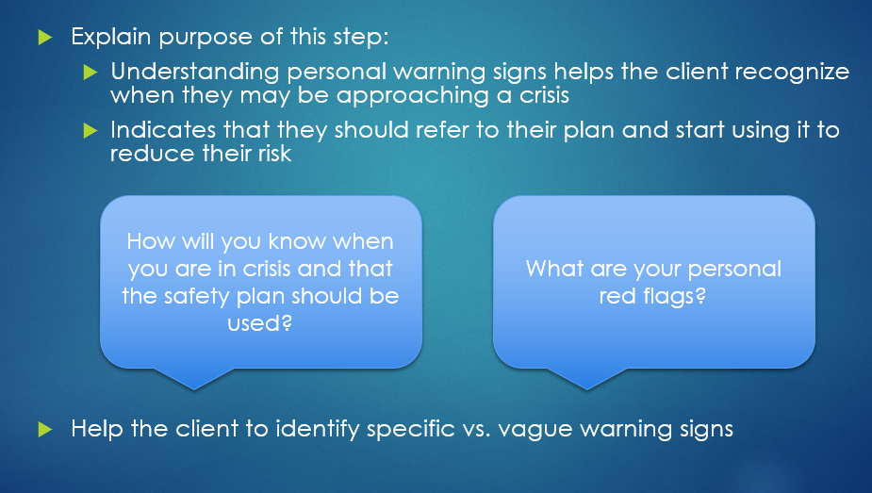
Step 1: Triggers, Risk Factors, and Warning Signs

Slide 15
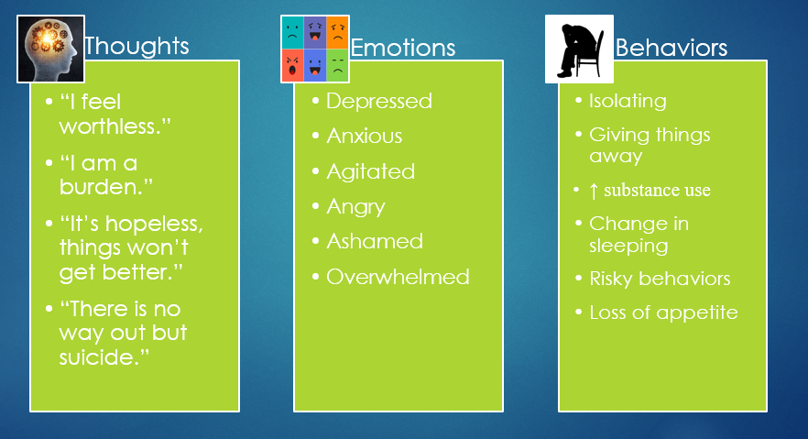
Step 1: Triggers, Risk Factors, and Warning Signs

Slide 16
Step 1: Triggers, Risk Factors, and Warning Signs
Sample client responses:
1. When I feel put down at work
2. When I feel overwhelmed, especially by finances
3. When I start feeling like a burden to my family
Reviewing this Step:
After warning signs have been identified, remind the client that the presence of warning signs are an indication that the safety plan should be put into action.
Explain that the plan should ordinarily be used in a stepwise fashion unless the client needs emergency rescue.

Slide 17
Step 2: Internal Coping Strategies
Introducing this Step:
Explain to the client that the purpose of internal coping strategies is to distract them from their suicidal thoughts, which can help lower risk.
Ask client to identify specific behavioral activities that can serve as strong distractors to suicidal thinking
These should be activities the client can engage on their own, without contacting another person.
Engaging in problem solving or responding to specific thoughts is often challenging to do during a crisis. The best strategies here are simple, easy to use, and absorbing.

Slide 18
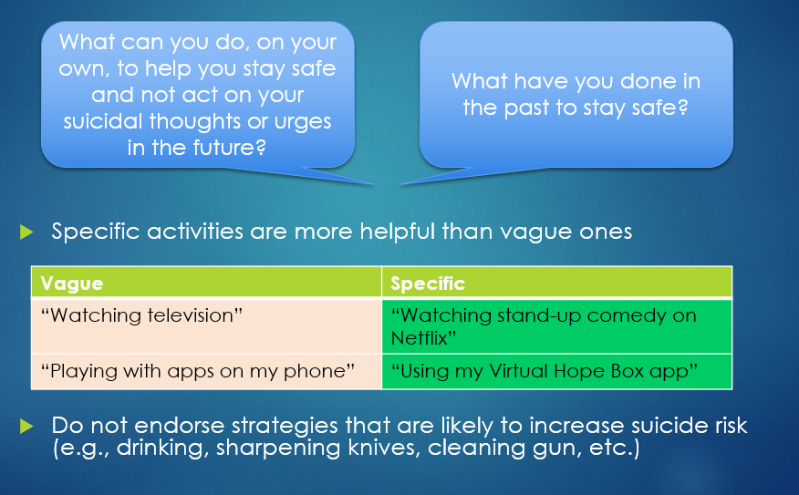
Step 2: Internal Coping Strategies

Slide 19
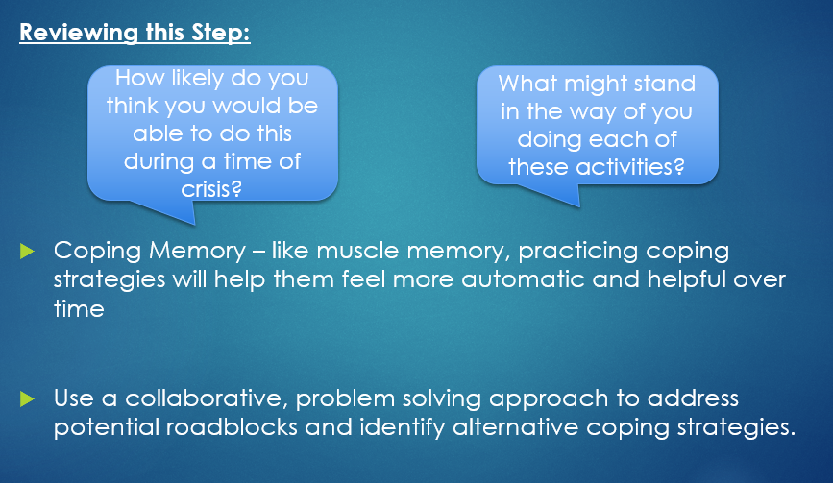
Step 2: Internal Coping Strategies

Slide 20
Step 3: Social Contacts Who May Distract From the Crisis
Introducing this Step:
People and social settings can be good distractors.
In this step, the client identifies people who they would not necessarily inform that they were in crisis, but with whom they feel better or with whom they can focus less on painful feelings.
Clinicians and formal health/mental health providers should not be included in this step.
Remind the client to use Step 3 if Step 2 does not resolve the crisis or lower risk.

Slide 21
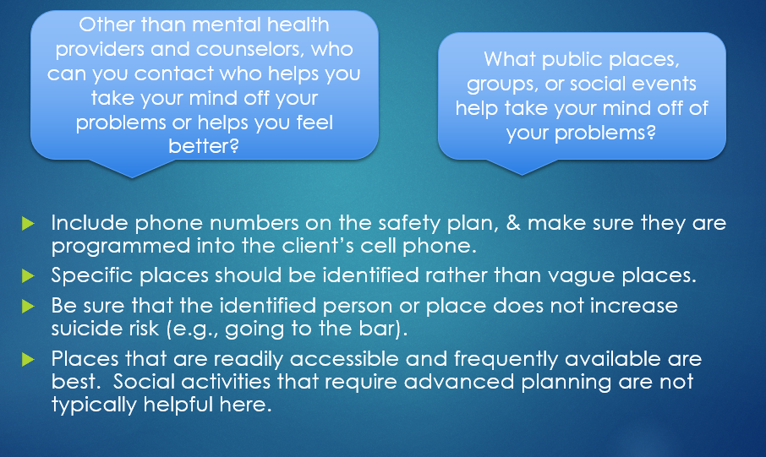
Step 3: Social Contacts Who May Distract From the Crisis

Slide 22
Step 3: Social Contacts Who May Distract From the Crisis
Sample client responses:
People I can contact:
1. John Doe Phone: 555-555-55555
2. Jane Smith Phone: 444-444-4444
3. Tom Jones Phone: 777-777-7777
Places I can go:
Bill’s Café
Jones’s Beach
Sunnydale Library
Sunnydale YMCA
Vet Center

Slide 23
Step 3: Social Contacts Who May Distract From the Crisis
Reviewing this Step:
Assess likelihood that client will contact others or visit places listed during a crisis
  Should not just be people/places that ‘sound good’ to the clinician; instead, should be people/places the client is actually likely to engage with as distractions in a time of crisis
  Do not list places that the client has never visited and has no real intention of visiting

Slide 24
Step 4: Family Members or Friends Who May Offer Help
Introducing this Step:
Sometimes distraction is not enough, and the client needs to disclose crisis to people who can help
In this step, the client tells a family member or friend that he/she is in crisis and needs support.
  May be some overlap between people listed on Step 3 and Step 4
Remind the client to use Step 4 if Step 3 does not resolve the crisis or lower risk.

Slide 25
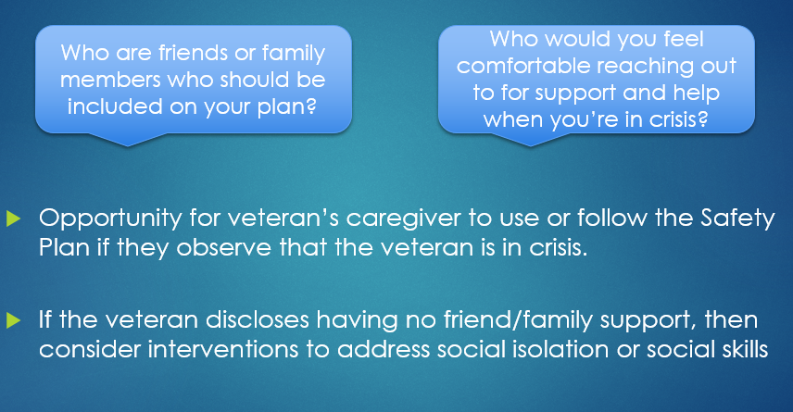
Step 4: Family Members or Friends Who May Offer Help

Slide 26
Step 4: Family Members or Friends Who May Offer Help
Sample client responses:
People I can contact:
1. Mom Phone: 555-555-55555
2. Sister Phone: 444-444-4444
3. Tom Jones Phone: 777-777-7777

Slide 27
Step 5: Professionals and Agencies to Contact for Help
Introducing this Step:
Sometimes the client may need support from a mental health professional or agency to help resolve their crisis.
In this step, client reaches out to a mental health professional, crisis line, or emergency service for help.
Remind the client to use Step 5 if Step 4 does not resolve the crisis or lower risk.

Slide 28
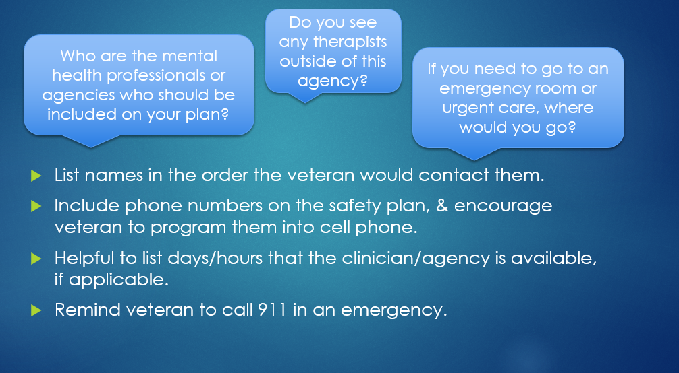
Step 5: Professionals and Agencies to Contact for Help

Slide 29
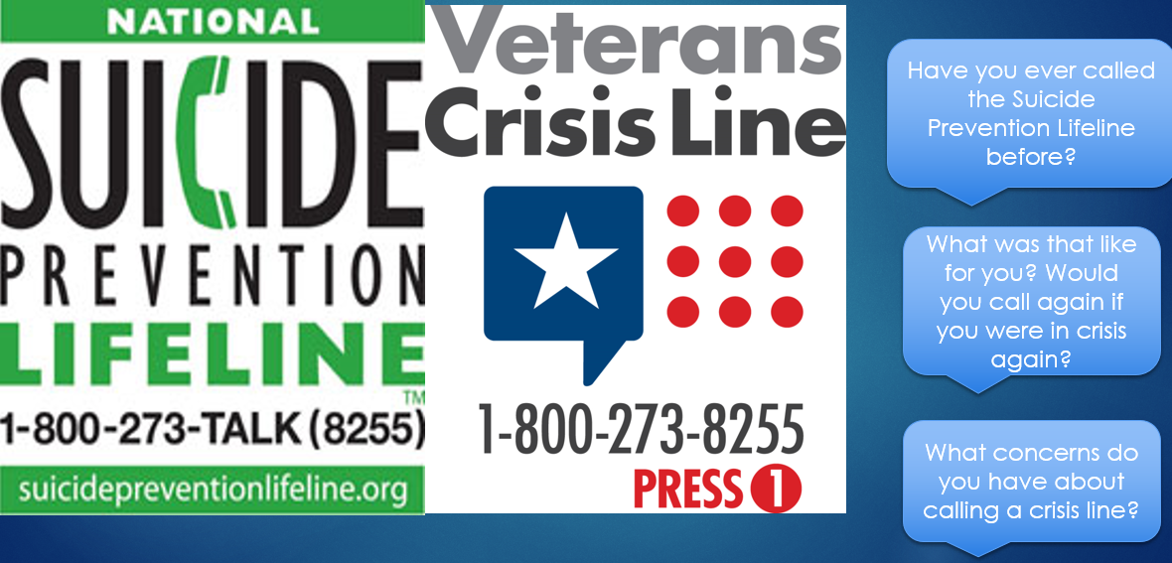
Step 5: Professionals and Agencies to Contact for Help

Slide 30
Step 5: Professionals and Agencies to Contact for Help
Sample client Responses:
Name: Dr. Doe (Therapist) Phone: 222-222-2222
Name: Dr. Smith (Psychiatrist) Phone: 111-111-1111
Veterans Crisis Line: 988 (press “1” at the greeting)
Text to 838255
Online chat at veteranscrisisline.net/chat
Sunnyvale Urgent Care, 2222 Peace Avenue, open 8am-7pm
ER at First Community Hospital, 1111 Hospital Road, 555-555-5555
Reviewing this Step:
Identify potential obstacles and problem-solve
Role play with client may be helpful

Slide 31
Step 6: Making the Environment Safe
Introducing this Step:
Having ready access to lethal means places the client at greater risk for suicide and does not allow the client enough time to use the steps in the safety plan.
Reducing or slowing access to means is a highly effective strategy to prevent suicide.

Slide 32
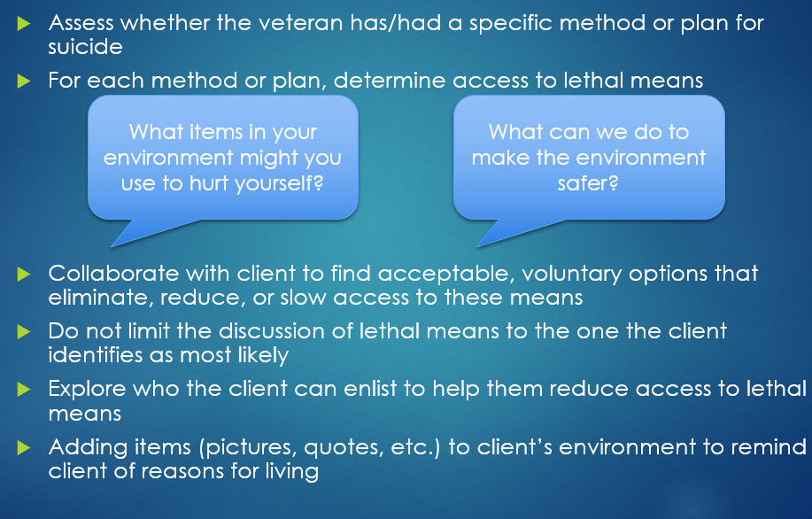
Step 6: Making the Environment Safe

Slide 33
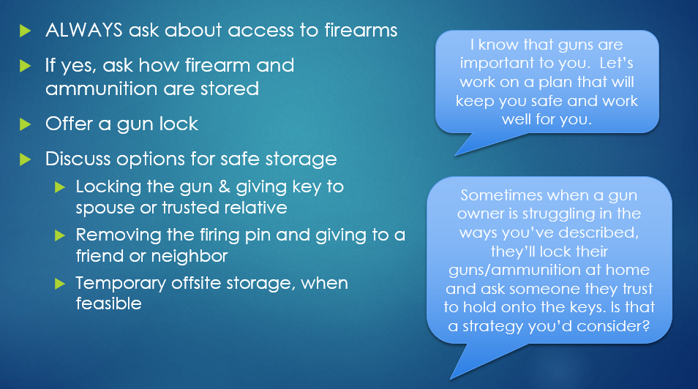
Step 6: Making the Environment Safe-Firearms

Slide 34
Firearms – What should you recommend?
Goal is to find something that is achievable…
  For the Veteran
  Within the context of the interaction

Slide 35
Safe Storage within the home
US GAO Report 17-665
Ad Council and Dept of Public Health, Seattle & King County, WA

Slide 36
Step 6: Making the Environment Safe - Opioids
Ask about access to opioids
Discuss options for safe disposal of unneeded opioid medications, including med drop boxes
Offer education on overdose identification and reversal
Offer naloxone/referral for naloxone prescription

Slide 37
Step 6: Making the Environment Safe
Sample client Responses:
Ways to make my environment safer:
I will bring my old meds to the pharmacy to get rid of them, consider getting a lock box for my meds, and use a gun lock on my gun.
People who will help me protect myself from having access to dangerous items:
Name: Sue (Wife) Phone: 888-888-8888
Planned follow-up date with therapist:
August 20th, 2022

Slide 38
Step 6: Making the Environment Safe
Reviewing this Step:
Set a date to check in with the client that the agreed-upon steps for reducing access have been put in place.
Explore ambivalence or doubt about limiting access to lethal means
Set a date to follow up with the client to confirm that the agreed-upon steps have been implemented
For additional training on Lethal Means Safety Counseling:
Lethal Means Safety & Suicide Prevention on VISN 19 MIRECC website

Slide 39
How to initiate this conversation…
There is no formula
Find your own language
Don’t be intimidated
Practice makes it easier
Use scripts if helpful
If it’s going poorly, ask for help (VCL)

Slide 40
Added benefits to safe firearm storage to discuss
Safe firearm storage is protective from unintentional firearm injury, unintentional firearm death, and firearm suicide death for other household members
Theft prevention
Safe firearm storage is considered a key element of responsible firearm ownership by many firearm advocacy organizations
Keeps Family and Friends safe
Anglemyeret al. Ann Intern Med. 21 Jan 2014
Monuteauxet al. JAMA Peds. 2019 Jul 1;173(7):657-662

Slide 41
Challenges you may face during discussion
Firearm use/ownership is an important aspect of identity for many Veterans
Concerns about personal and/or household protection, including within the context of history of personal trauma
Federal and/or State laws may require background checks for firearm transfers
Can be challenging to coordinate off-site storage with socially isolated Veterans or those with limited means

Slide 42
Following up
Always warranted
Definitely, if given permission from last conversation
Absolutely, if something has changed
  Suicide risk
  Firearm practices/ownership

Slide 43
Follow-up language examples
“Last time you mentioned it would be okay if we talked about some things to keep you safe while you’re going through this, is it okay if we touch base briefly on that again?”
“Last time you said it was alright to discuss the guns in your house, and I’m hoping it’s okay if we can do that again?”
“Last time you mentioned you might talk with your brother, Jim, about holding onto your handgun until things are smoothed out a bit for you. Did you get a chance to do that?”
  One step further, ask if you can call brother Jim together to verify the plan

Slide 44
Conclusion and Reminders
Safety plan is not a static/one-time intervention
Should be reviewed and revised, especially after a crisis, or after the client has had a chance to use the plan
Review the Safety Plan periodically with the client when circumstances or needs change. Ask:
Do you remember the last Safety Plan you developed?
Have you actually used the Safety Plan?
If so, was the Safety Plan helpful for preventing you from acting on your suicidal thoughts and urges? If not, why not?
How can the Safety Plan be revised so that it can be more helpful to you?

Slide 45
Resources
Notes:
Customize the Resources section based on your audience

Slide 46
Crisis Intervention & Mental Health Access – Quick Reference
Richard L. Roudebush (Indianapolis) VA Medical Center
1481 West 10th Street, Indianapolis, IN 46202
(317) 554-0000
wwwˌindianapolisˌvaˌgov
Veterans Crisis Line – Connects Veterans in crisis (or family and friends) with qualified, caring Department of Veterans Affairs responders through free confidential support 24/7/365, via phone, chat, or text. Anyone who calls may remain anonymous; however, if the Veteran caller chooses to disclose his or her identifying information and agrees to a referral to connect with the VA Medical Center closest to their home address, the Veterans Crisis Line will contact and send a referral to the Suicide Prevention Coordinator (SPC). After the immediate crisis has been addressed, the SPC will follow up by making an outreach call to the Veteran, ensuring that the Veteran in-need has barrier-free access to mental health services and assisting with accessing resources either within the local VA or in the community.
Phone Option: 1-800-273-8255 (press 1)
Chat Option: wwwˌveteranscrisislineˌnet
Text Option: 838255

Slide 47
Indiana Vet Centers – For those Veterans who may not be eligible for mental health services through the VA, the Vet Center provides a broad range of counseling, outreach, and referral services to combat Veterans and their families. Vet Centers also guide Veterans and their families through many of the major adjustments in lifestyle that often occur after a Veteran returns from combat.
  Indianapolis – (317) 988-1600 or (877) 927-8387
  Gary Area – (219) 736-5633 or (877) 927-8387
  Evansville – (812) 473-5993 or (877) 927-8387
  Fort Wayne – (260) 460-1456 or (877) 927-8387
  South Bend – (574) 231-8480 or (877) 927-8387

Slide 48
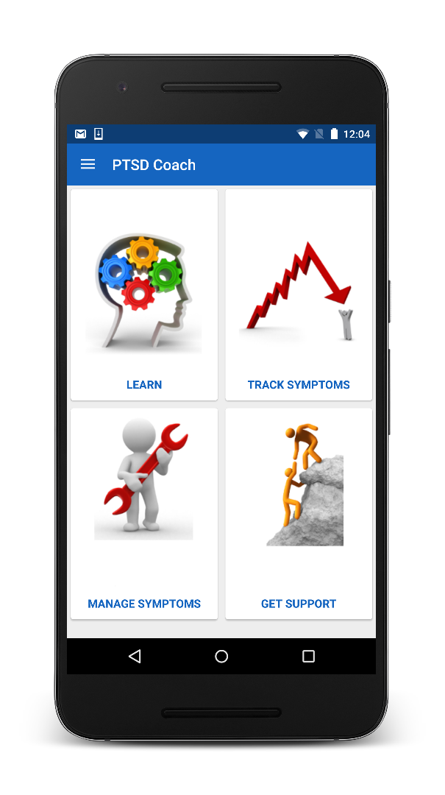

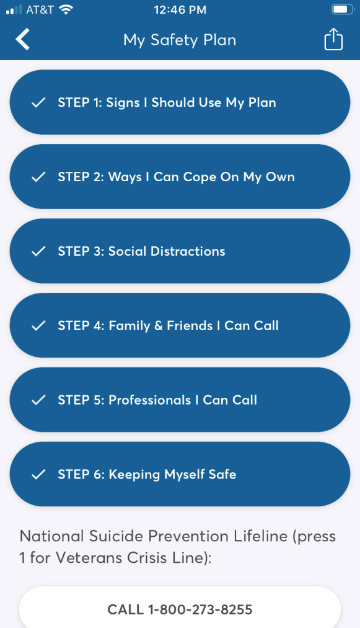
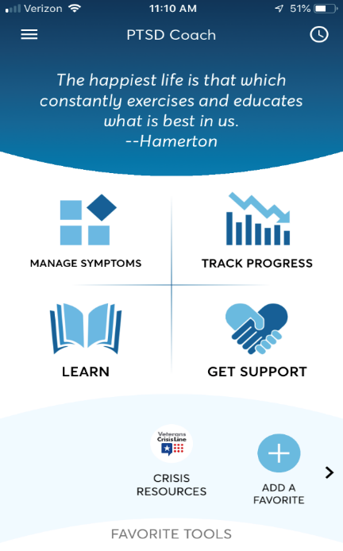
Safety Plan now in PTSD Coach!
To access the Safety Plan:
  Download* and open PTSD Coach
  Tap the lateral menu
  Tap Safety Plan
National Center for PTSD website:
https://wwwˌptsdˌvaˌgov/appvid/mobile/ptsdcoach_appˌasp
Notes:
The safety plan walks users through the creation of a detailed suicide safety plan. Users can create a safety plan on their own, with a provider, or with other supportive contacts.
The digital SP mirrors the paper plan currently being used. All of the steps, prompts, and resources on the paper plan are included in the digital version. The digital version even includes additional psychoeducational materials, which we’ll show you later.
Some may continue to have their plan on paper, and some may prefer to have it only on their phone. Some may want both! Hopefully by allowing them to access their plan in their preferred form, they may be more likely to keep it with them.

Slide 49
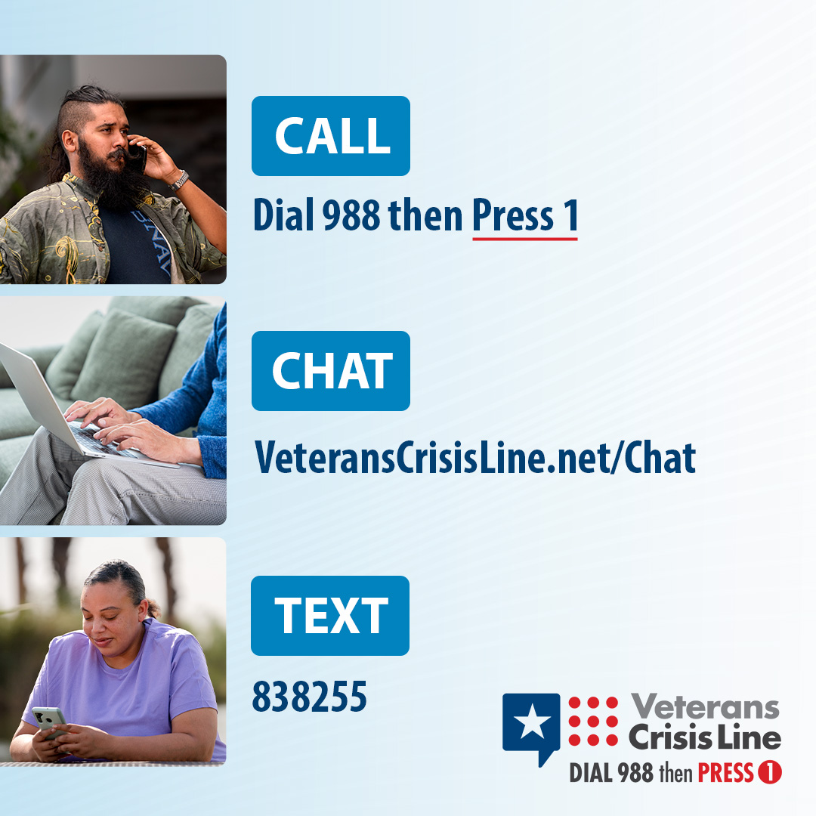
Free, Confidential Support 24/7/365
Veterans
Service members
Family members
Friends
Notes:
Script suggestion
Veterans Crisis Line: The Veterans Crisis Line connects Veterans in crisis and their families and friends with qualified, caring VA responders through a confidential toll-free hotline, online chat, or text. Veterans and their loved ones can call 988 and Press 1, chat online, or send a text message to 838255 to receive confidential crisis intervention and support 24 hours a day, 7 days a week, 365 days a year. More information is available at https://www.veteranscrisisline.net/.

