Slide 1

Indianapolis Regional Office
Briefing for
Indiana County Veteran Service Officers
May 30, 2024

Slide 2

Workload Updates – Comp & Pen
Rating Claims
National inventory 945,783
149.0 Average Days to Complete FYTD
Non-Rating Claims
National inventory 359,957
83.5 Average Days to Complete FYTD
Pension Claims
National inventory 82,368
134 Average Days to Complete FYTD
Notes:
Data date: 5/23/2024

Slide 3
Workload Updates – Appeals
Legacy Appeals
Approximately 41,639 pending
Appeals Modernization Act Cases
Appeal Type | Number Pending | ADP | Completions | ADC
BVA | 1,794 | 46.5 | 12,714 | 20.1
Higher-Level Review | 67,893 | 57.3 | 123,676 | 107.2
Supplemental Review | 181,527 | 87.3 | 350,049 | 137.6

Slide 4

Pact Act Claims
PACT Act
1,655,593 claims received since August 10, 2022
394,534 claims still pending
1,327,220 claims rated since August 10, 2022
(as of May 23, 2024)

Slide 5
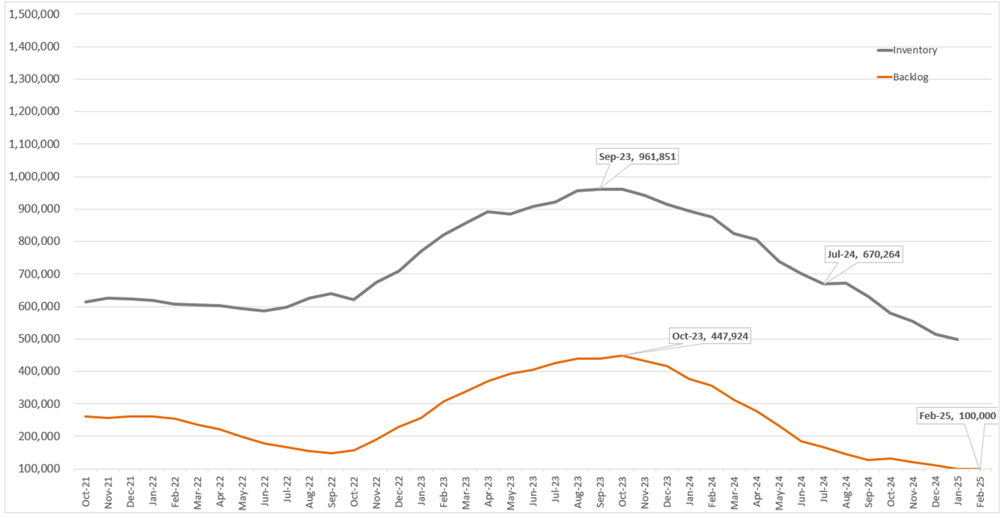
PACT Act Changes

Slide 6

Workload Updates – Fiduciary
Fiduciary
Provides oversight of the most vulnerable beneficiaries who are unable to manage their VA benefits due to injury, disease or age
Regional mission for 14 northeastern states including Indiana
              1,601 Beneficiaries and 1,290 Fiduciaries in Indiana

Slide 7

VR&E
Veteran Readiness & Employment (Ch 31)
Prepares disabled Veterans for employment or independent living
Tailored to each Veteran
About 1,764 Veterans in program
Independent Living

Slide 8

Questions

