Slide 1
APPEALS BRIEFING
Fiscal Year 2021
Aaron Filsinger
VSCM
Indianapolis
December 2020

Slide 2
What is AMA?
AMA is The Veterans Appeals Improvement and Modernization Act of 2017
Signed into law August 23, 2017; fully implemented February 19, 2019
One of the most significant statutory changes to effect VA and Veterans in decades
New process is simple, timely, and fair to Veterans which offers a greater choice in resolving disagreements in VA decisions

Slide 3
Why Change?
Veterans deserve an earlier resolution
Greater choice of options and easier to understand
Creates a new claims and appeals process that is simple, timely, transparent and fair, and enables earlier resolution of decisions
VBA’s goal for decisions under the Higher-Level Review & Supplemental Claim lanes is 125 days on average

Slide 4
Who Does This Impact?
All VA Administrations (VBA, VHA, VCA)
All VBA claimants (Veterans, survivors, and other beneficiaries)
All VA Business Lines (Compensation, Pension & Fiduciary, Loan Guaranty, VR&E, Insurance, and Education)
All VBA claims and appeals personnel

Slide 5
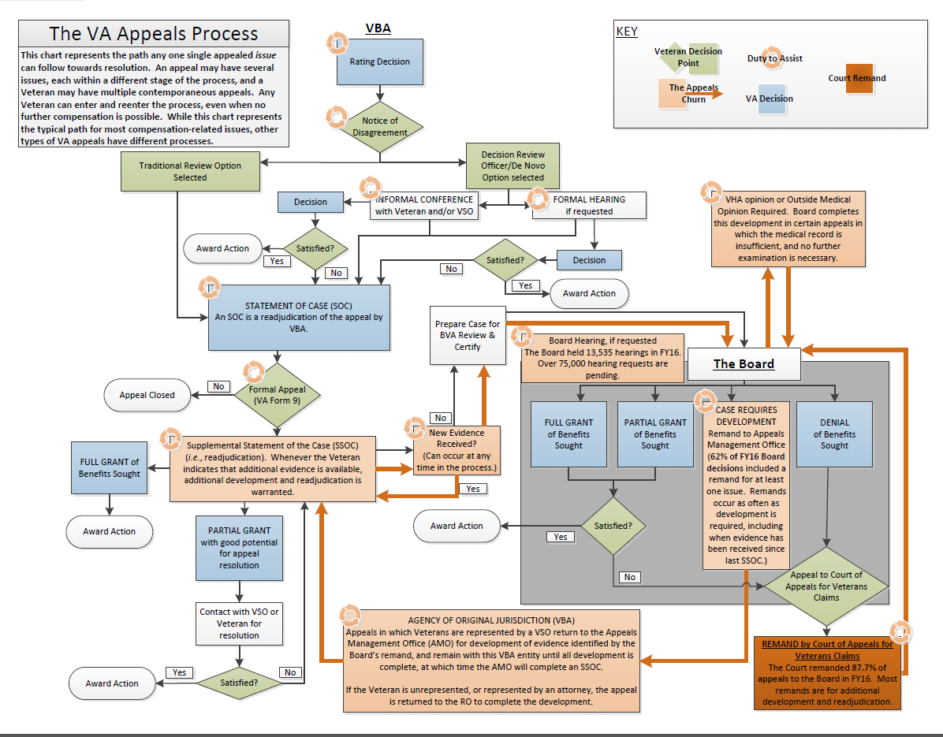
Appeals-Legacy System

Slide 6
Pending Legacy Appeals
Claimants with a pending legacy appeal may “opt-in” to the new modernized review system
Test Programs (concluded)
--- Rapid Appeals Modernization Program (RAMP)
--- Board Early Applicability of Appeals Modernization (BEAAM)
Opt-in from a SOC/SSOC
---Available after the effective date of the new law
---Must be filed within 60 days of receipt of SOC/SSOC, or within the one-year appeal period
!
The claimant may not return to the legacy process once opt-in has been chosen
for that issue
Notes:
Note: These other services are not provided by a VSC; however, depending on size of station multiple service lines might be present within a Regional Office.

Slide 7
AMA offers three options:
Three-option framework to choose from when dissatisfied with VA’s decision
Supplemental Claim
Higher-Level Review
Board Appeal
New evidence
Same evidence
Submits NOD
Conducted at Regional Office
Conducted at Decision Review Operations Center (DROC)
Conducted at the Board of Veterans’ Appeals

Slide 8
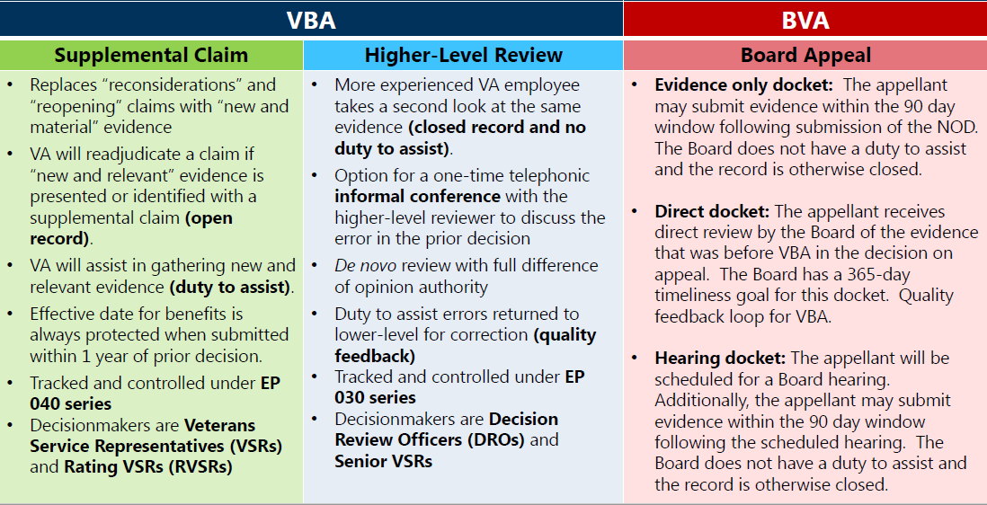
Three Review Options

Slide 9
How to Opt-In
Claimants must file an opt-in request within 60 days of receipt of the SOC/SSOC, or within the one-year appeal period if still within that timeframe. (see 38 CFR 3.2400(c)(2))
Claimants will use the new enterprise-wide VA forms to “opt-in” a legacy appeal into the modernized system.
  VA Form 20-0995, Decision Review Request: Supplemental Claim
  VA Form 20-0996, Decision Review Request: Higher-Level Review
  VA Form 10182, Decision Review Request: Board Appeal (Notice of Disagreement)

Slide 10
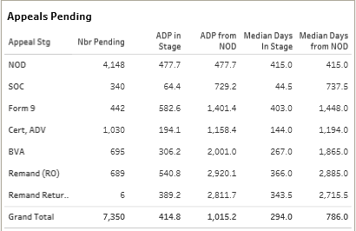
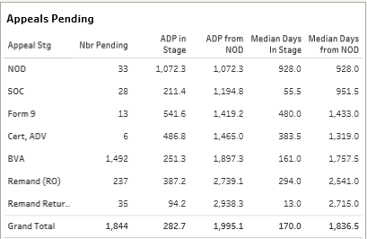
Impact to Indiana Veterans
Pending as of December 1, 2018
Pending as of
December 1, 2020

Slide 11

Impact of COVID-19
Exams
ACE/Mental Tele-health
Utilize PPE for in-person visits
Hearings
Virtual
Same result; Never leave home
Public Contact
Visits by appointment
Utilize PPE
Send in evidence

Slide 12
Fiscal Year 2021 Focus
Remand Inventory by end of March 2021
17,000
Current Remand Inventory
35,743
Completion of Legacy Appeals

Slide 13
Questions

