Slide 1
Veteran Eligibility and Enrollment

Slide 2
Objectives
In this section, the participants will describe criteria for Veteran eligibility for healthcare services in the VHA system and steps for enrollment. Participants will also describe priority groups and characteristics of service.

Slide 3
How Veterans Apply for Benefits
VA encourages Veterans to submit information electronically via the eBenefits site
Veterans can also use the eBenefits site to access a full list of resources and services related to VA benefits
https://www.ebenefits.va.gov/ebenefits/homepage
Veterans can also apply for VA benefits in person

Slide 4
Veteran Healthcare
The services provided are a BENEFIT
This is not health insurance
This benefit complies with the Healthcare Reform Act
Health benefits are different for each Veteran

Slide 5
Registration vs. Enrollment
Registration
Required
Occurs at the VA Medical Center
Patients may be registered even if they are not eligible for enrollment (example: Non-eligible patients treated for humanitarian reasons)
Enrollment
Patients may decline enrollment
VistA submission is processed by the national the Health Eligibility Center (HEC)
Veterans may decline or cancel enrollment at any time with written communication to the HEC
Only the HEC can process the request and override the enrollment status
Eligibility updates are completed through the HEC

Slide 6
Eligibility Definitions
Ineligible
No qualifying period of service
Notification is performed by the VA Medical Center
Rejected
Income exceeds national threshold
No income information was provided
Notification is performed by the HEC

Slide 7
Eligibility Definitions (cont.)
Compensable
Veteran receives monetary benefits related to a service-related illness, disease or injury
Non-compensable
Veteran is not in receipt of monetary benefits related to a military service-connected disability
Means Test
National income limit irrespective of where the Veteran resides
Geographic Means Test Threshold (GMT)
Factors in the Cost of Living for a specific location

Slide 8
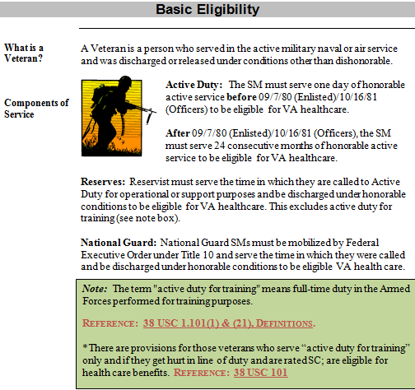
Eligibility Criteria
Notes:
After 09/7/80- must serve 24 consecutive months of honorable active service to be eligible for VA Health care, or completed full term of service.
National Guard/Reserves- must be called to service under executive order Title 10.

Slide 9
Basic Eligibility (cont.)
Criteria for VA benefits eligibility by Service member type are listed below.
Enlisted:
Prior to 9/7/80 = 1 Day of Honorable Active Service
After 9/7/80 = 24 Consecutive Months Active Service
Officer:
Prior to 10/16/81= 1 Day of Honorable Active Service
After 10/16/81= 24 Consecutive Months Active Service
Reservists & National Guard:
Must serve the full time called to Active Duty under Executive Order, Title 10

Slide 10
Characteristic of Service
Qualifying Characteristics of Service:
Honorable
Under Honorable Conditions
General
Non-Qualifying Characteristics of Service:
Dishonorable
Bad Conduct
Other than Honorable

Slide 11
Ineligible Patients
MSAs must pay attention to the eligibility of patients they are scheduling
Care will never be refused
Patients must be advised when they are ineligible. Verify your local process with your supervisor for how to handle ineligible patients who wish to proceed with treatment. This typically consists of the Veteran signing a formal Statement of Understanding.
Notes:
In this example, patients who call in or walk in prior to their future CID will request either a specific date or a next available date.
When the scheduler pulls up a patient in Appointment Management, the information screen will list the future patient’s appointments along with an action or disposition box. Within this box, there are several abbreviations for the scheduler to review information about the patient. For example: PD will show the patient’s demographics, MA is used to make the patient’s appointment, etc…

Slide 12
Combat Veterans
Combat Veterans who were discharged or released from active service on or after January 28, 2003, are eligible for enhanced enrollment for VA health care for 5 years from the date of discharge or release. Enhanced benefits for these Combat Veterans include:
Cost-free (no copay) health care, hospital care, medical services and nursing home care for any illness potentially related to combat service as decided by the treating provider for that encounter without needing to disclose income
Priority Group 6 unless eligible for a higher Priority Group
Enrollment for 5 years begins on the date of discharge
Full access to VA’s Medical Benefits Package
See the Combat Veteran Eligibility fact sheet for additional details

Slide 13
Combat Veterans (cont.)

Slide 14
Knowledge Check
A Veteran that served in Desert Storm wants to be seen for a knee problem.
Is the Veteran eligible for care?
If so, what care is the Veteran eligible for?
Where would you look in VistA to see the eligibility of this Veteran?
Notes:
The Veteran is eligible for VA care as a Combat Veteran.
The Veteran is eligible for:
Cost free health care, hospital care, medical services and nursing home care for any illness.
No Co-Payments / Not required to disclosed their income
Priority Group 6 unless eligible for a higher PG
Enrollment for 5 years begins on the date of discharge
Full access to VA’s Medical Benefits Package
Under the scheduling menu option, after you have pulled up the patient, look in the “enrollment priority group” field in VistA

Slide 15
Priority Groups
Priority Group 1:
Rated Service Connected (SC) disability 50% or more
Unemployable due to VA SC disability
Medal of Honor (MOH)
Priority Group 2:
Rated SC Disability 30% - 40%
Priority Group 3:
Former POWs (No Pharmacy Co-Pay)
Purple Heart
Discharged due to a disability that was incurred or aggravated in the line of duty
10% - 20% SC Disabilities
Individuals disabled by treatment or vocational rehabilitation

Slide 16
Priority Groups (cont.)
Priority Group 4:
Receiving aid and attendance or housebound benefits
Determined by VA to be Catastrophically Disabled
Priority Group 5:
NSC and 0% Non-compensable SC Veterans with income and net worth below established VA Means Thresholds
Veterans in receipt of VA pension benefits (Retirees)
Veterans eligible for Medicaid benefits
Priority Group 6:
Combat Veterans
Veterans exposed to Ionizing Radiation
Veterans exposed to Agent Orange
Project 112/SHAD
Persian Gulf Veterans (SW Asia)

Slide 17
Priority Groups (cont.)
Priority Group 7:
Veterans with income and/or net worth above the VA national income threshold and below the geographic threshold who agree to pay copays
Priority Group 8:
Veterans who agree to pay specified copays with income and/or net worth above the VA threshold and geographic threshold (income more than 10% above NTL threshold)
Priority Group 8 (A & C):
Non-compensable 0% SC and NSC Veterans enrolled as of January 16, 2003 and who have remained enrolled since that date and/or placed in this sub-priority group due to change in eligibility status

Slide 18
Priority Groups (cont.)
Priority Group 8 (B & D):
Non-compensable 0% SC and NSC veterans enrolled on or after June 15, 2009 and whose income exceeds the VA threshold and geographic threshold by 10% or less as a result of expanded enrollment relaxation
Priority Group 8 (E):
Non-compensable 0% SC Veterans applying for enrollment after January 16, 2003 (can be treated for SC disabilities only)
Priority Group 8 (G):
NSC Veterans applying for enrollment after January 16, 2003
If treated the Veteran will have to sign a Statement of Understanding and will be charged at the Humanitarian Rate

Slide 19
Priority Groups (cont.)
Notes:
Enrollment Priority: GROUP 5 – According to means test information (income) is below the threshold.
If everything else checks out, this person will be in priority group 5 where he
will pay for medication only.
Category: IN PROCESS – Patient is not actually enrolled yet. The information has been put in at the local level
(OVAMC) but not completed in Health Eligibility Center (HEC), Atlanta GA. When we submit the
Information in VistA, VistA communicates with HEC, who verifies information provided. HEC
actually enrolls the veteran. Once HEC has completed the verification process (usually within 24-48 hours) it will change to ENROLLED if eligible or NOT ENROLLED if found not eligible.
End Date: - 09/04/2009 – The date of last means test. Since this is noting 2009, the veteran needs to do a means
test to update his information. If he does that, it will generate action at HEC and may
change from IN PROCESS to either ENROLLED or NOT ENROLLED.

Slide 20
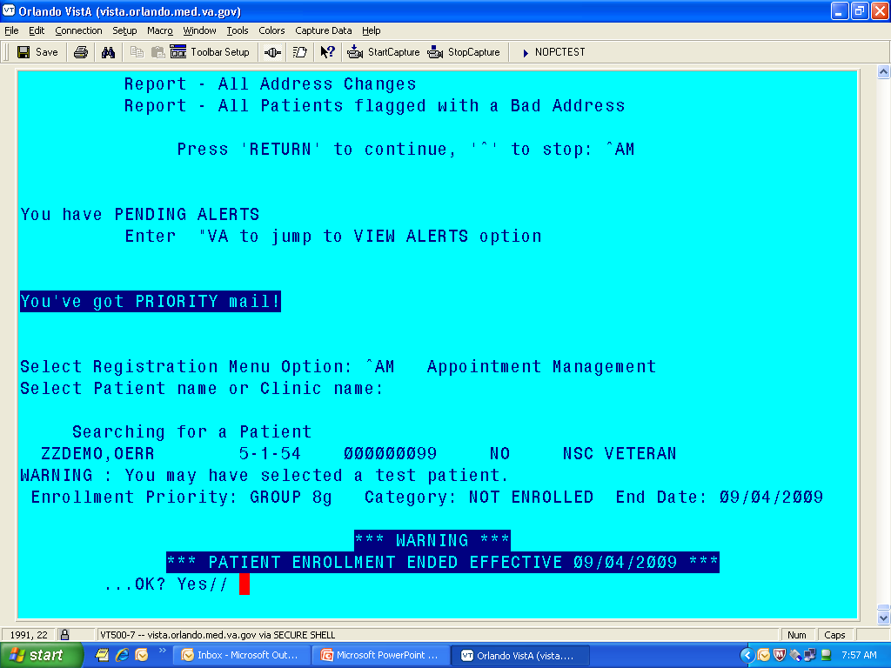
Non-Veteran/8G Ineligible Record

Slide 21
Medical Benefits Package
The medical benefits package includes:
Preventive Care Services
Inpatient and Outpatient Diagnostics and Treatment
Prescription Services
Benefits subject to certain eligibility restrictions include:
Eyeglasses and Hearing Aids
Ambulance Service
Non-VA Care
Prosthetics, Durable Medical Equipment and Rehabilitative Devices
Dental
Certain Counseling Services
VA Foreign Medical Program

Slide 22
Medical Benefits Package Exclusions
The following health care services are not included in the VA Medical Benefits Package:
Abortions and abortion counseling
Cosmetic surgery, except where determined by VA to be medically necessary
Gender alteration
Health club or spa membership
In-vitro fertilization
Drugs, biological, and medical devices not approved by the Food and Drug Administration, unless part of formal clinical trial under an approved research program or when prescribed under a compassionate use exemption
Inpatient hospital or outpatient care for a Veteran who is either a patient or inmate in an institution of another government agency, if that agency has a legal obligation to provide the care or services

Slide 23
Co-payments
A co-payment (aka co-pay) is a fixed amount to be collected from Veterans for covered VA health care goods and services, such as medications and outpatient visits. The eligibility office will relay co-pay requirements to Veterans upon establishing care in the system.
Many Veterans qualify for cost-free health care services and are not subject to co-pays. Common criteria for cost-free health care services include:
Purple Heart recipient
Former Prisoner of War (POW) Status
50% or more Compensable VA service-connected disabilities
Veterans deemed catastrophically disabled by a VA provider
Veterans with income below the income threshold
Other qualifying factors, including treatment related to their military service experience
An annual financial assessment should be completed by the Veteran to determine if (s)he qualifies for cost-free services.

Slide 24
Outpatient Services Co-pays
Primary Care Services – Those services provided by a primary care clinician. Primary Care Co-pay = $15
Specialty Care Services – In general, services delivered in a specialty outpatient clinic provided by specialty clinicians who are highly-specialized, narrowly-focused health care professionals. Specialty Care Co-pay = $50
There is no co-pay requirement for preventive services, such as screenings or immunizations
Veterans will only be subject to the highest applicable co-pay per day
Example: A Veteran sees her Primary Care Provider in the morning and sees a Dermatologist in the afternoon. She will be charged $50 for the co-pay for Specialty Care, but not the $15 for Primary Care.

Slide 25
Pharmacy Services
VA Formulary List
A comprehensive medication list that is always in stock in all VAs
VA Non-formulary Medications
Medications that are not normally in stock
Primary care providers can special order
Notes:
All non-formulary medications will be listed by their generic name not by brand names

Slide 26
Medication Co-pays
Veterans in Priority Group 1 receive free medication
Veterans in Priority Groups 2-8:
Are required to pay for each 30-day or less supply of medication for treatment of nonservice-connected condition (unless otherwise exempt)
Are subject to the following copayments:
Have a $700 medication copayment cap
For the most current co-pay and medication tier information visit the Health Benefits website at https://www.va.gov/healthbenefits/cost/copay_rates.asp
Outpatient Medication Tier | 1-30 Day Supply | 31-60 Day Supply | 61-90 Day Supply
Tier 1 (Preferred Generics) | $5 Copay | $8 Copay | $11 Copay
Tier 2 (Non-Preferred Generics and some OTCs) | $10 Copay | $16 Copay | $22 Copay
Tier 3 (Brand Name) | $15 Copay | $24 Copay | $33 Copay

Slide 27
Dental Eligibility
Veterans may be eligible for dental benefits if they are:
Service Connected at 100% and the Veteran is determined VA Unemployable
Service Connected for a dental condition
A former Prisoner of War (POW)
Within 180 days of discharge, if indicated on DD214
Homeless
Enrolled in Vocational Rehabilitation

Slide 28
Financial or Medical Hardship
Veterans may be eligible for VA assistance due to:
Financial distress
Struggling to pay VA copays
Loss of job or experienced a significant decrease in household income
Veteran’s current year income is substantially reduced from the prior year
Loss of employment, sudden decrease in income or increases in out-of-pocket Veteran or family health care expenses, factor into VA’s hardship determination
Notes:
Veterans who have not applied for VA enrollment because they thought their income was too high may want to reconsider applying if their projected current year’s income is lower.
VA’s Medical Care Hardship program helps Veterans qualify for VA enrollment for health care services if they had a recent change in their income, even if they were previously denied enrollment based on their household income.

Slide 29
MEANS Test
The Financial Assessment is used to:
Determine a Veteran’s ability to pay for medical care
Establish eligibility for beneficiary travel
Ensure that Veterans are assigned to the appropriate priority group

Slide 30
Knowledge Check
A Vietnam war Veteran states (s)he is not service connected, but (s)he does not make enough money to afford healthcare. What should (s)he do?
Notes:
The Veteran should complete a Means Test to see if his income is below the national threshold. He may fall into Priority Group 5, making him eligible due to income.

Slide 31
What about TRICARE and CHAMPVA?
Veterans may be dual-eligible for care under a combination of TRICARE and Veteran benefits
If a Veteran’s insurance information lists TRICARE, ensure you validate whether the patient is using TRICARE or VA benefits for the visit
CHAMPVA program status varies by facility. Be sure to know the status of your local CHAMPVA program.

Slide 32
Covered VA Services
Primary Care Services
Inpatient Care Services
Ancillary Services
Specialty Care Services
Mental Health Care
Veteran's Crisis Line
Homeless Services
Woman’s Services
Transplant Services
Reproductive Services
Adoption Services

Slide 33
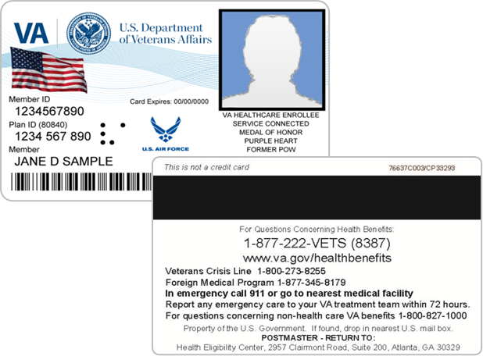
Veterans Health Identification Card (VHIC)
The VHIC is only for identification of those who are eligible/registered for health care and is used when Veterans check into appointments
The card is not an insurance card and does not authorize or pay for care at non-VA facilities

Slide 34
Fugitive Felon Program
If you become aware that a Veteran is a fugitive felon:
Do not inform the Veteran of the FFP status
Notify your Supervisor, VA Police or send the Veteran to the Enrollment Department
VA is prohibited from providing or continuing to provide health care and other services
VHA will take appropriate steps to transition care from the VHA to alternative outside care
Persons identified as a Fugitive Felon must contact the Originating Agency that issued the warrant, not the VA Police
For more information visit http://www.va.gov/healthbenefits/assets/documents/publications/FS164-9.pdf

Slide 35
Fugitive Felon Flag

Slide 36
Sensitive Record

Slide 37
Questions

