Slide 1


QUALITY COUNTS II
Application Guide
Tip: have two screens to view this presentation and follow the instructions at the same time!
Click here to begin!

Slide 2

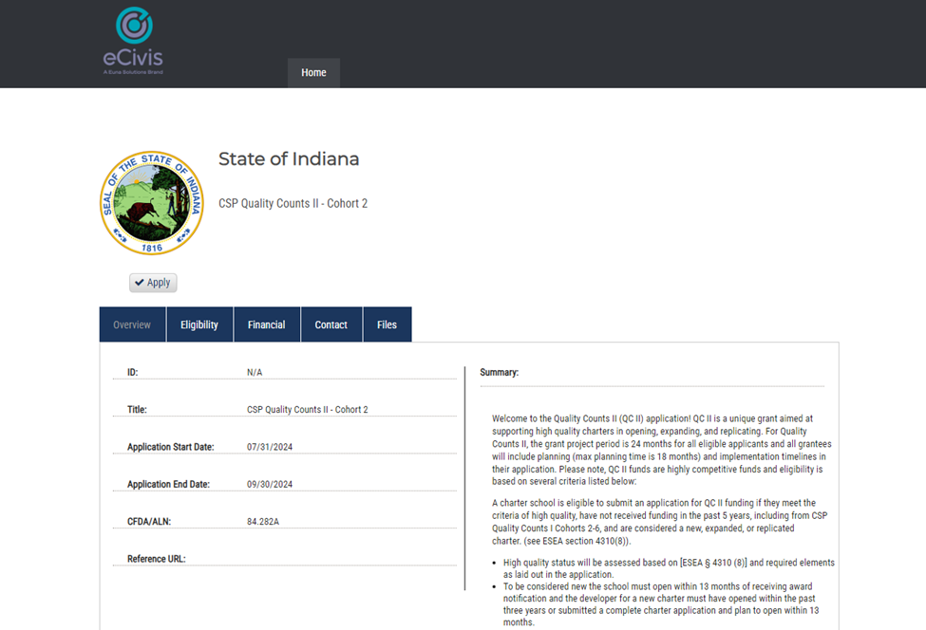

1
This page should now be open
Click the “Files” tab

Slide 3
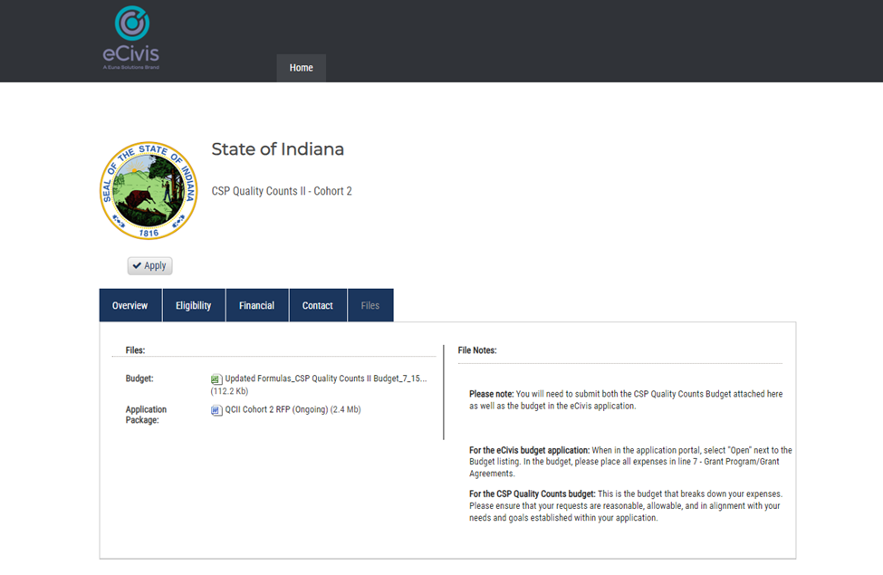
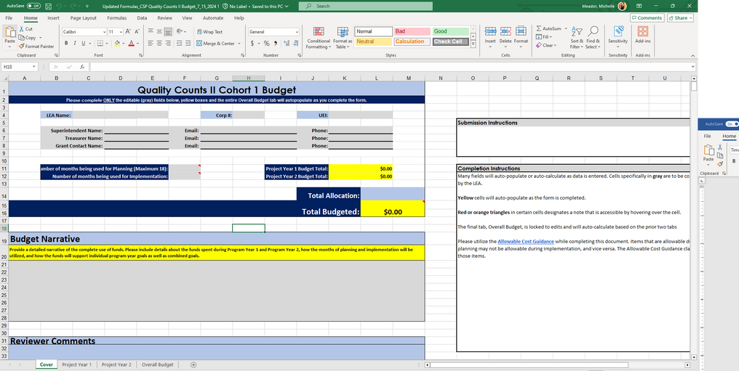
2
Click the Excel file to download the Detailed Budget
(not present on example) Also click the Quality Counts II Assurances and Authorizer Letter of Support documents to download
Click the “Apply” button
2
1
This is the budget that just downloaded. Complete and save this in Excel. Later in the presentation you’ll see where to upload it. The assurances document will need a non-electronic signature and also to be uploaded later.

Slide 4
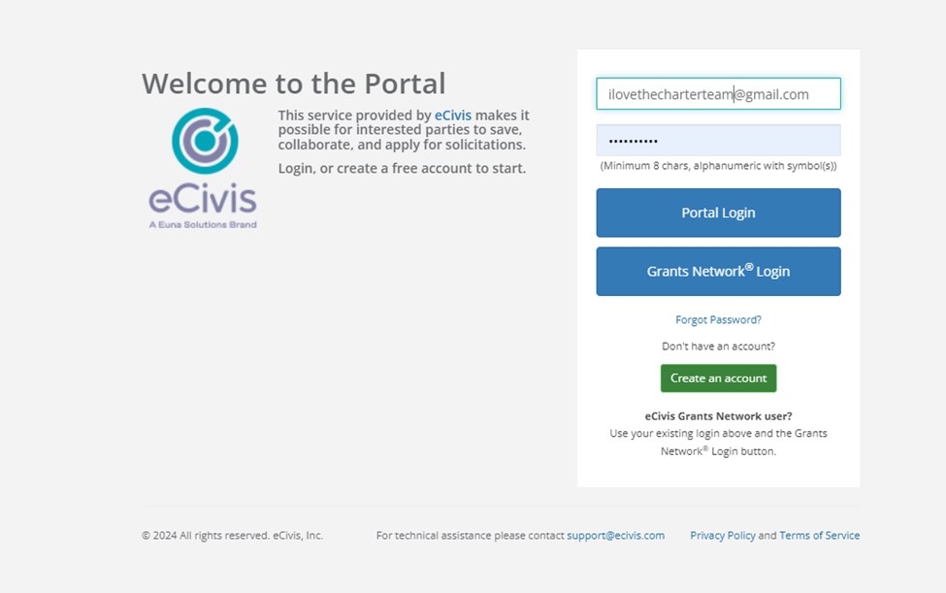
3
Welcome to the eCivis Portal Log in!
You will need to create an account. Once you do, you will use the “Portal Login” button

Slide 5
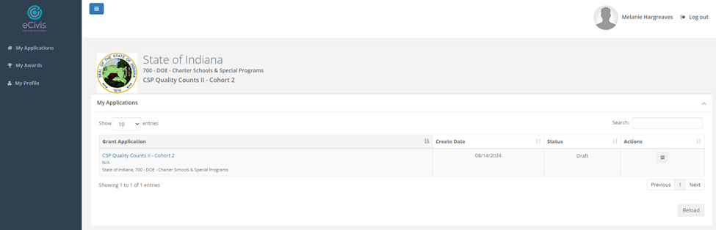
4
You’re in! Click the “CSP Quality Counts II - Cohort 4” button

Slide 6
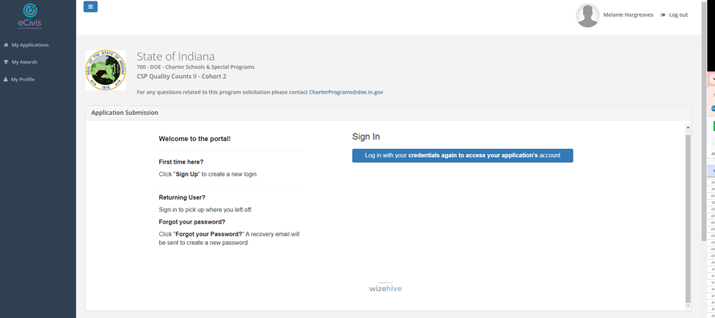
5
Your screen should now look like this
Before you begin the application, scroll on the outer scroll bar down to “Application Budget”

Slide 7
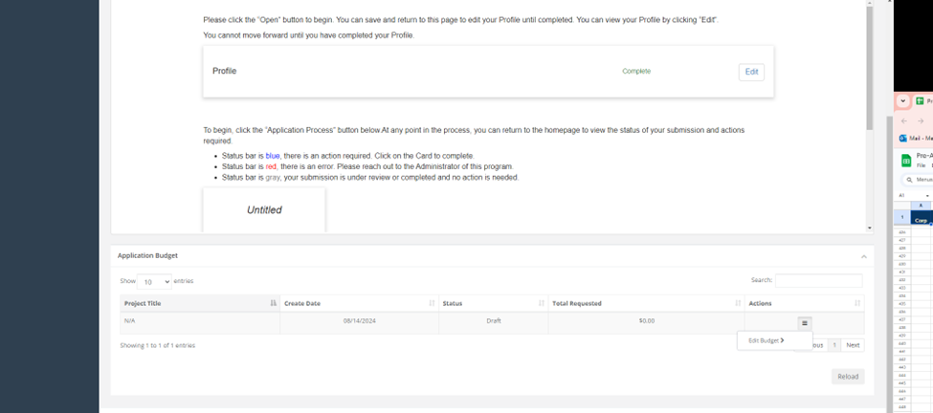
6
Once under the “Application Budget” section, click the 3 lines on the right, then click “Edit Budget”

Slide 8
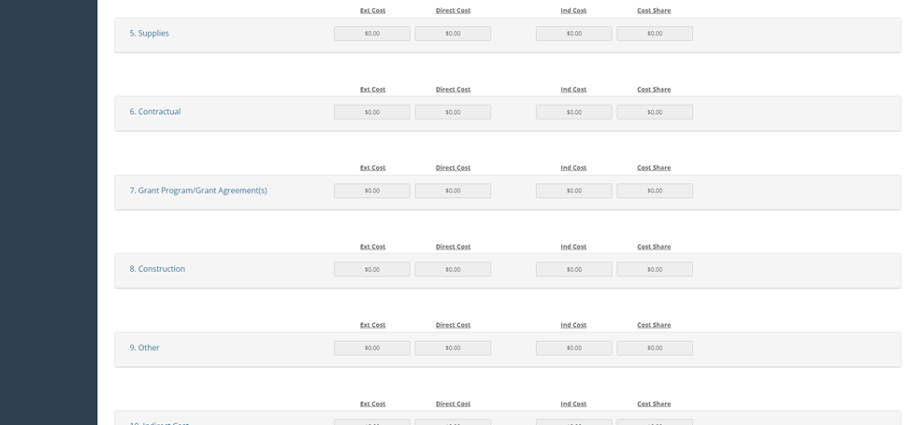
7
Allow the page to load, then scroll down to line item 7
Click the text “7. Grant Program/Grant Agreements(s)”

Slide 9
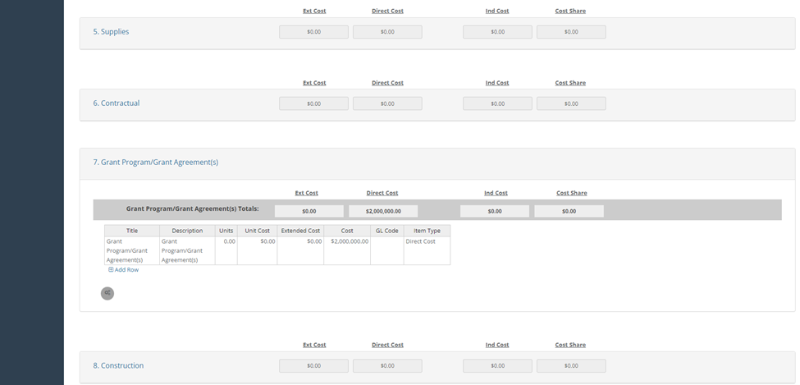
8
Enter the amount you’re requesting from the grant in the “cost” box
You may request up to $2,000,000.00 (note: amount requested is not a review criterion, it will not affect your application positively or negatively)
Because you completed this part, once awarded you will be able to use your eCivis portal to check your grant spend-down
Scroll to the bottom of the page

Slide 10
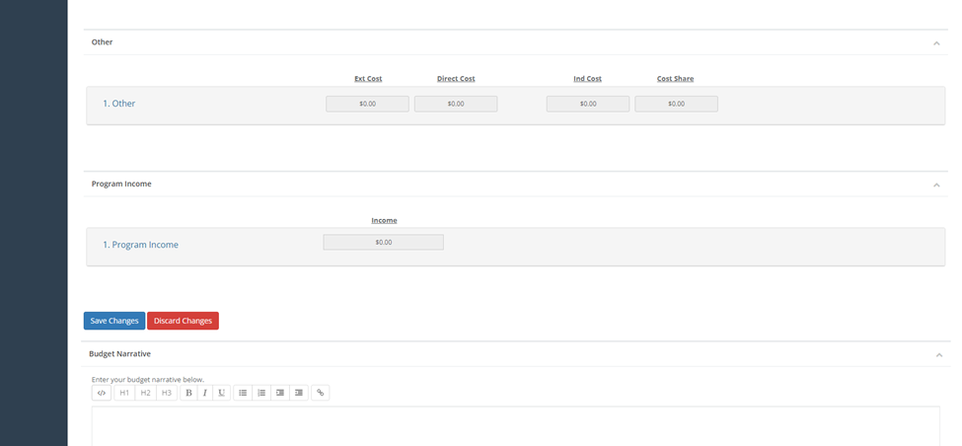
9
Click “Save Changes”
Scroll to the top of the page

Slide 11
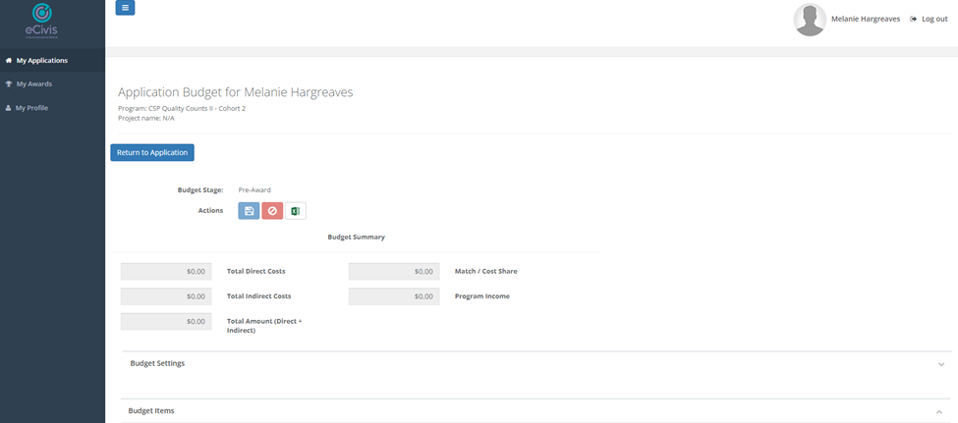
10
Click “Return to Application”
Allow page to load

Slide 12
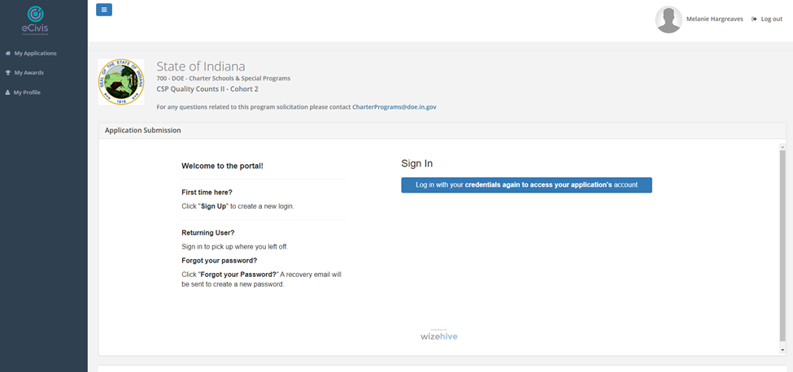
11
Log in again

Slide 13
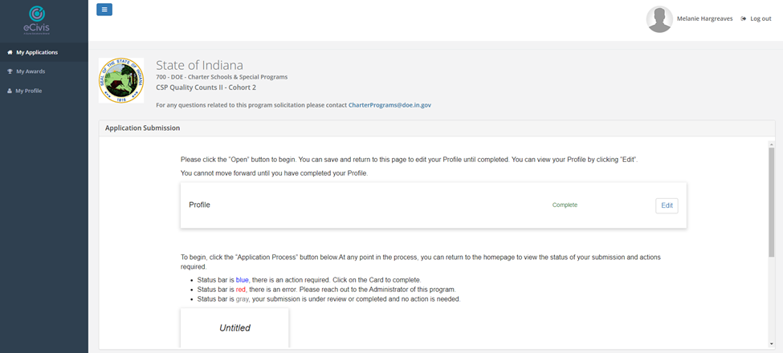
12
Complete your Profile and save the changes, then return to this page

Slide 14
13
Back at this page, Click the “Untitled” square to open the application

Slide 15
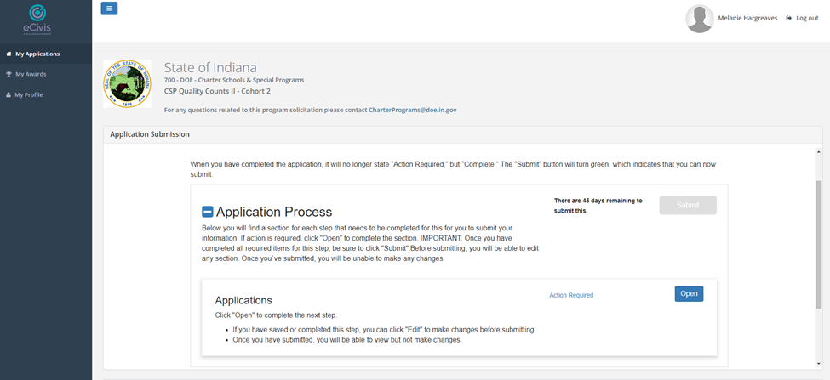
14
Click the blue “Open” box

Slide 16
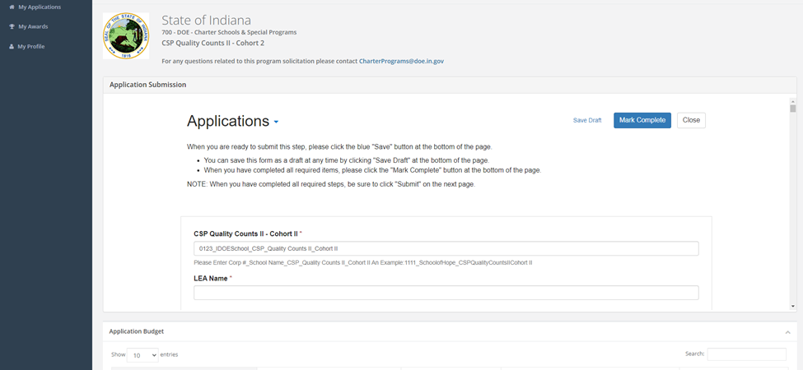
15
Complete the application
Please follow naming conventions and contact ALittrell@doe.in.gov with any questions
Use the “Save Draft” button to save your work and resume later

Slide 17
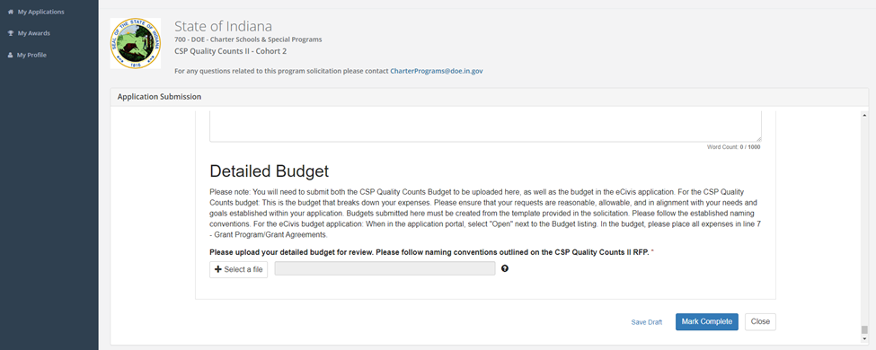
16
At the bottom of the page, upload the completed Excel file Detailed Budget you downloaded at the beginning of the presentation
Once all portions are complete and the budget is uploaded, click “Mark Complete” then “Close”

Slide 18
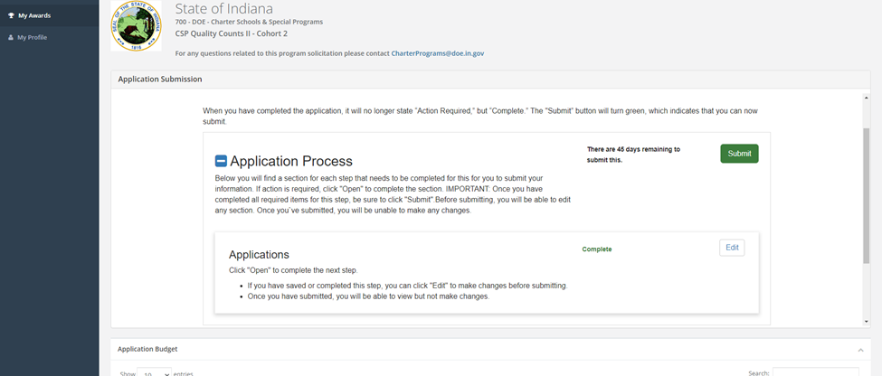
17
Back in the application home page, the “Submit” button is now green
Click to submit your finished application! You can check the status of your application in your eCivis portal

Slide 19
THANK YOU
Contact ALittrell@doe.in.gov with questions

