Slide 1
Paid Lunch Equity (PLE)
2025-2026
RCCIs do not need to complete the Paid Lunch Equity Tools, as all students are free. Exception: RCCIs with day treatment centers (students are not residents)
What is Paid Lunch Equity?
When and how do I calculate my Paid Lunch Equity Requirement?
Can we apply for an exemption from the PLE requirement?

Slide 2
Paid Lunch Equity (PLE)
Healthy, Hunger-Free Kids Act of 2010
  Increase prices charged for “paid” lunches, or
  Provide other non-Federal sources to the nonprofit school food service account
  Calculation of the Paid Lunch Equity
    SY 16-17 $2.78
    SY 17-18 $2.86
    SY 18-19 $2.92
    SY 19-20 $3.00
    SY20-21 $3.09
    SY 21-22 $3.18
    SY 22-23 $3.31
    SY23-24 $3.56
    SY24-25 $3.85
    SY25-26 $4.01
Notes:
As part of the Healthy, Hunger-Free Kids Act of 2010, school food authorities (SFAs) participating in the National School Lunch Program are required to ensure sufficient funds are provided to the nonprofit school food service account for lunches served to students not eligible for free or reduced price meals. Schools have the choice of raising their paid meal prices or making up the difference using other non-Federal funds:
any State or local per-lunch reimbursement specifically provided for ANY PAID MEALS (lunches and breakfasts)
funds provided specifically for PAID MEALS by organizations
any proportion attributable to PAID MEALS from direct payments made from school district funds to support lunch service

Slide 3
Paid Lunch Equity (PLE)
SFAs Qualifying for the SY 2025-2026 PLE Exemption
For SY 2025-2026 SFAs with a positive or zero balance in the nonprofit school food service account as of June 30, 2024, SFA’s are exempt from PLE pricing requirements found at 7 CFR 210.14(e).
  An attestation needs to be completed verifying that SFA’s nonprofit food service account was positive or zero balance as of June 30, 2024. Once the attestation statement is submitted, you should receive an email receipt verifying submission. Please keep this receipt and verification of your balance of your school food service account as of June 30, 2024, to be considered approved.
While not required, exempt SFAs may still use the PLE tool to complete the steps necessary to determine their target SY 2025-2026 paid lunch price, consistent with Program regulation at 7 CFR 210.14(e), and adjust their paid lunch prices accordingly,. Please note, the SY 2025-2026 PLE tool and instructions can be found at: Paid Lunch Equity (PLE)
The weighted average price for 2025-2026 should be at or above $4.01
If you have any questions, please email: SCNFinance@doe.in.gov (Please put your sponsor number, and “PLE Tool” in the subject line).
Common Questions & Answers can be found at: Paid Lunch Equity (PLE)

Slide 4
Paid Lunch Equity (PLE)
SFAs Not Qualifying for the SY 2025-2026 PLE Exemption
  SFAs that had a negative balance in the nonprofit school food service account as of June 30, 2024, must follow PLE requirement according to 7 CFR 210.14(e) when establishing their paid lunch prices for SY 2025-2026. SFAs may use the PLE tool found at: Paid Lunch Equity (PLE) to determine their paid lunch prices.

Slide 5
Paid Lunch Equity (PLE)
SFAs Not Qualifying for the SY 2025-2026 PLE Exemption
  In the PLE tool, SFAs may use the price they last charged students as the basis for the SY 2025-2026 paid lunch equity price calculation, even if those prices were charged during a year the SFA was not required to comply with PLE requirements.
  If an SFA did not charge for meals during SY 2024-2025, such as an SFA that operated the Community Eligiblity Provision, Provision 2 or 3, or a State funded non-pricing option and is returning to standard counting and claiming in SY 2025-2026, it may use the most recent paid lunch price date as the basis for its SY 2025-2026 paid lunch calculation. If an SFA is unable to find documentation of the last paid meal price charged to students, then it must follow FNS guidance for new schools found in Guidance on Paid Lunch Equity and Revenue from Nonprogram Foods | Food and Nutrition Service (usda.gov).
  Consistent with 7 CFR 210.14(e)(4)(i), SFAs are not required to raise their paid lunch price by more than 10 cents for SY 2025-2026 from the last year they charged for paid lunches. SFAs can still choose to raise the price by more than 10 cents.

Slide 6
Paid Lunch Equity (PLE)
PLE Tool Excel Tabs:
Tab 1: Guidance
Tab 2: Instructions (Enter sponsor number and name in cell A3)
Tab 3: SY 25-26 Requirement Calculator
Tab 4: SY 25-26 Price Raise Calculator
Tab 5: SY 25-26 Non-Federal Calculator
Tab 6: SY 25-26 Split Calculator
Tab 7: SY 2025-26 REPORT
Tab 8: SY 10-11 Price Calculator
You will start with the Instructions tab by entering your sponsor number and school name in cell A2
Notes:
SFAs will start on the Instruction tab entering your sponsor number that can be found in the upper right hand corner in CNPweb
SFAs will continue to the “Unrounded Requirement Finder” tab.

Slide 7
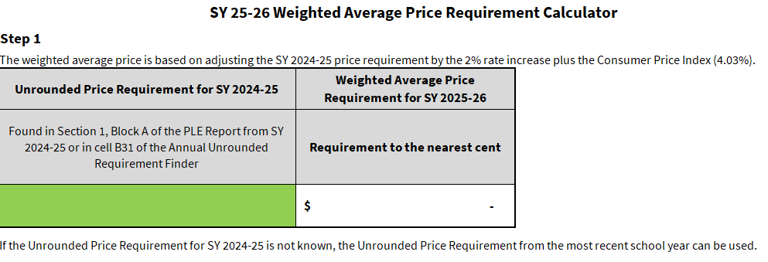
Unrounded Requirement Finder Step 1
Tab 2: Unrounded Requirement Finder
If a PLE Tool was not completed for 2024-2025, you may want to enter your October 2023 Monthly # of Paid Lunches, and Paid Lunch Price on the SY 24-25 Price Calculator tab
Price requirement (unrounded) from SY 2024-2025 PLE Tool
Notes:
Enter the unrounded required price from the prior year’s PLE Tool. Notice it says UNROUNDED. Do not use the rounded down number and also do not use your current weighted average price. You can find this number by opening the prior year’s PLE Tool and looking on the Unrounded Requirement Finder tab. It will be in the white box to the left of the peach box.
If you do not know the unrounded price requirement, then you will need to complete: “Complete if you do NOT know your SY 2024-2025 Unrounded Price Requirement” which can be found on the same tab
Choose the next tab options based on how you want to meet the requirement
SFAs may use the prices they last charged students as the bases for their SY 2025-2026 paid lunch price calculation, even if those were charged during a year the SFA was not required to comply with PLE requirements (SFAs will want to enter their monthly # of Paid Lunches, and Paid Lunch Price for October 2024 on tab SY 25-26 Price Calculator).

Slide 8
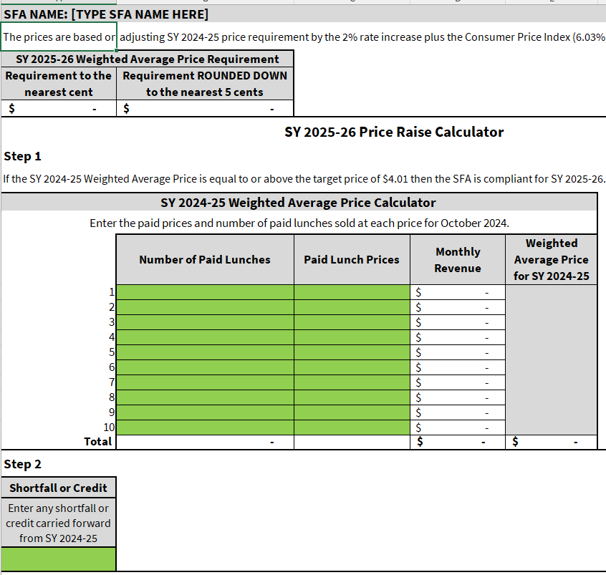
Weighted Average Price Calculator (Step 2)
Current Weighted Average Price
Notes:
In the next section you will enter the number of PAID meals from October of the year prior, and the price charged for those paid meals. This is only the amount a full paid student meals and does not include free, reduced or adult meals. If you have tiered pricing at a school (high schools often times have two or more different prices for different meals) you will want to split that school into two or more lines…the number of meals at one price point and the number of meals at the other price point(s) on other lines. This calculates your current weighted average price for your school district.
Below that is the Total Price Increase followed by the Required Price with the minimum 10-cent average increase in lunch price (The SFA has an option of a price increase above the 10 cents).

Slide 9
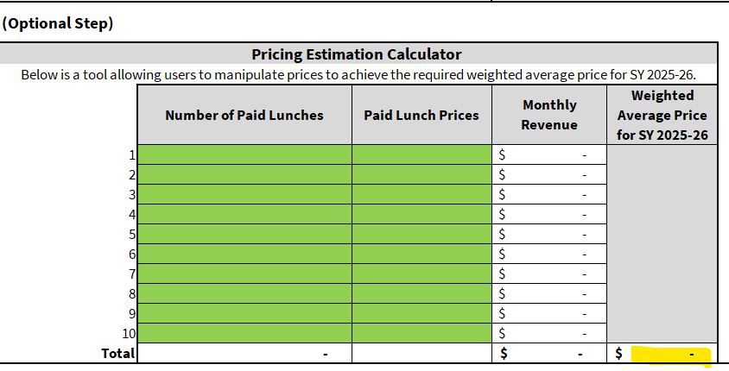
Step 3
New Weighted Average Price
Notes:
This step is optional and allows users to try different prices to achieve the required new weighted average price. You will use the same meal counts as you used above in the weighted average price calculator then change your prices until your new weighted average price meets the minimum requirement. SFA can increase the lunch amount above the .10 cents if necessary.
You can also raise the price at one school higher than at the other school to meet the requirements (5 cents at one school and 15 cent at another so the average is at least 10 cents). You do not have to raise the prices the same amount for each school, but the weighted average price needs to equal at least the minimum requirement.

Slide 10
PLE Exemptions
A PLE Exemption, if approved by the State Agency, allows a school meeting pre-determined criteria, an exemption from the PLE Pricing requirements. This means the school will not have to raise paid lunch prices for that year. The school will need to complete an attestation statement that can be found at: Paid Lunch Equity (PLE)
Congress determines whether to allow exemptions each year and the State Agency has the authority to approve or deny the requests based on multiple factors.

Slide 11
PLE Exemptions SY 2025-2026
For SY 2025-2026 SFAs with a positive or zero balance in the nonprofit school food service account as of June 30, 2024, SFA’s are exempt from PLE pricing requirements found at 7 CFR 210.14(e).
  An attestation needs to be completed verifying that SFA’s nonprofit food service account was positive or zero balance as of June 30, 2024. Once the attestation statement is submitted, you should receive an email receipt verifying submission. Please keep this receipt and verification of your balance of your school food service account as of June 30, 2024, to be considered approved.
SFAs that had a negative balance in the nonprofit school food service account as of June 30, 2024, must follow PLE requirement according to 7 CFR 210.14(e) when establishing their paid lunch prices for SY 2025-2026. SFAs may use the PLE tool found at: Paid Lunch Equity (PLE) to determine their paid lunch prices. Please email your PLE Tool: SCNFinance@doe.in.gov (Please include PLE Tool and your sponsor number in the subject line)

Slide 12
State Agency Contact
  For questions about Financial Management of the Food Service Account, contact:
    Joe Olivadoti Andrea Hollin
    JOlivadoti1@doe.in.gov AHollin@doe.in.gov
    (317) 234-4378 (317) 232-0410
    Common questions and answer can be found at: Paid Lunch Equity (PLE) Or
    Email: SCNfiance@doe.in.gov
    (Please be sure to include your sponsor number and PLE Tool in the subject line)

