Slide 1
Annual SFSP Staff Training
Spring 2022
Created as a Resource for Sponsors to Train Staff in
Program Requirements

Slide 2
ATTENTION SFSP SPONSOR! IDOE Disclaimer
Please note that this training tool is not an all-encompassing resource that covers every single aspect of SFSP operations in detail. Instead, this tool should be viewed as a sample staff training document.
Keep this in mind when training your staff and volunteers while making sure all aspects critical to your specific sponsorship are addressed to help ensure compliance and success at each site.

Slide 3
Training includes three separate sessions:
1. Site Staff
2. Site Supervisors
3. Site Monitors*
Different sessions are divided by the color of slides.
When the color changes, you can dismiss some of the attendees based on their job duties and training needs.
*Monitors should stay for the entire training. Site Supervisors should stay for the first 2 sessions.

Slide 4
Preliminaries
Please make sure to sign in on the training sign in page.
If you have any questions, do not hesitate to ask!
All SFSP employees are required to be trained in program requirements each year.

Slide 5
SFSP- What is it?
SFSP = Summer Food Service Program
The SFSP is funded by the USDA (United States Department of Agriculture)
All rules and regulations are federal (national) requirements
The SFSP is locally administered by the Indiana Department of Education

Slide 6
SFSP Purpose
SFSP IS…
A program to provide nutritional meals to underprivileged children during times when school is not in session
SFSP is NOT…
A program to feed adults
Designed to provide children with all food that they need in a day
A program for children to take food home to eat at a later time
Attention! Waivers that allowed off-site meal consumption during the pandemic have expired

Slide 7
USDA
Funds the program.
Creates the rules for the program.
Oversees the IDOE administration of program.
IDOE
Approves sponsoring organizations as well as new sites.
Trains sponsors on program regulations.
Monitors sponsors for compliance.
Conducts SFSP Administrative Reviews according to USDA requirements.
Our Local Sponsoring Agency
Provides nutritious meals to children that meet meal pattern requirements.
Ensures daily compliance with all USDA regulations.
Spends federal tax dollars only on providing nutritious meals to children.
Feeds children at approved meal service sites during approved meal times.
Self-monitors to ensure continued compliance at each site.

Slide 8
Site Selection
Sites are located in approved meal service areas.
Sites may not be moved to a new location without prior approval from the IN Department of Education.
Site locations should be chosen with accessibility in mind and located where children can gather easily.

Slide 9
Site Rules
Meals are only available to children 18 and younger. If older, the child must be enrolled as a student in a K-12 school.
Persons with disabilities who are over the age of 18 must be enrolled in the local K-12 school to receive meals. (For reference, students with mental disabilities often graduate around the age of 21 or 22.)
Pregnant women over the age of 18 do not qualify for a free meal.
Small children who are not eating solid foods (younger than 6 months) or who are too young to eat the food provided should not be served a meal.

Slide 10
Program Adult vs. Non-Program Adult
Program Adult- An employee or volunteer who has a job duty specific to SFSP.
For example, a monitor watching to ensure children stay on site, kitchen staff, meal counters, custodians assigned with program related duties.
Non-Program Adult- A person over the age of 18 who does not have a specific job duty within the SFSP. This can include employees or volunteers who do not work with the meal service operation.
For example, parents who bring their kids to the site, daycare staff who bring children to your site, YMCA counselors who do not help with SFSP in any way, custodians who do not work in the cafeteria.

Slide 11
Program Adult vs. Non-Program Adult Meals
SFSP Sponsors may (but are not required to) provide program adults one meal free of charge. This is considered an allowable expense. These meals are marked on the daily meal count form but not claimed for reimbursement!
Non-Program adult meals must be either purchased or donations are made to the program from an outside source.
It is recommended that all adult meals be eaten on site to avoid confusion among children about what foods may be taken off site.
Some sites solicit donations from community partners in order to serve non-program adults free of charge. Each sponsor must set a non-program adult meal price and ensure that the meals are counted and the money for the meals is deposited into the SFSP account.

Slide 12
Site Rules
Meals must be served within the approved meal service time.
Times may be changed throughout the summer, but prior approval must be given by the IDOE before serving meals at the new time.
It is best to keep meal service time consistent throughout the summer to ensure regular attendance.
Changes to the meal service time may take several days to approve.
All meals served outside of the approved meal service time are ineligible for reimbursement.
If a household continually shows up after meal service has concluded, provide a written reminder of the meal service time.

Slide 13
Site Rules
If a site is located outside bad weather may result in the cancellation of meal service.
An inclement weather plan should be determined prior to the start of the program season and entered in the site information application in CNPweb.
Discuss your alternate meal service plan in case of bad weather with your SFSP director.
Make sure all staff are trained to follow the inclement weather plan.

Slide 14
Share Table
Will you use a share table? (Click image below)

Slide 15
Share Table Reminders
If the site opts to operate a share table, items on the share table may only be consumed by children and youth age 18 and younger.
A Share Table is a designated area where unopened, individually wrapped food items may be placed for participants who are still hungry. Share tables must meet all requirements as established by the local health department.
If a child eats all of their meal and the site allows, they may select one of the allowable items (fruit or vegetable or grain) from the share table to take home.

Slide 16
Share Table Reminders
Only pre-packaged items may go on the share table
For example: cheese sticks, goldfish cracker packages, milk cartons, juice boxes, apples, oranges, banana, packages of baby carrots, uncrustable sandwiches
Items that have been opened or contaminated must be thrown away
Items should be kept at food safe temperatures
If you accept milk, it is best to have a cooler or a bowl with ice to keep the milk at a food safe temperature
Share table items may be kept and put out the following day as long as they have been held a food safe temperatures
Make sure that any perishable items (milk) are checked for expiration if kept more than one day

Slide 17
Meal Pattern
Menus are planned to meet the minimum meal pattern requirements.
Each Breakfast meal must include:
1 serving bread/grain
½ cup of fruit or vegetable
8 oz of milk
Each Snack Must include 2 of the following: (pick any combination)
1 oz meat or meat alternate
1 serving of bread or grain
¾ cup of fruit or vegetable (6 oz juice)
8 oz of milk
Each Lunch Meal must include:
2 oz of meat or meat alternate
1 serving of bread or grain
¾ cup total fruit and/or vegetable in 2 different varieties
For example: ¼ cup carrots and ½ cup of peaches
8 oz of milk
Sites must not change the planned menu without approval from the SFSP director!

Slide 18
Meal Pattern
All children must take all of the planned menu items unless the site is approved to use Offer versus Serve
Milk is a required component of breakfast and lunch/supper and no substitution of water or juice is allowable.
Fruit and vegetable are grouped into one component. You may serve 2 fruit options or 2 vegetable options or one of each at lunch.
Not all food substitutions are equal!! Before making substitutions to the planned menu, please contact the SFSP director for approval.
If any food donations are received on site, ensure that this is documented, including who donated and in what quantity.

Slide 19
Congregate Meals
All meals must be consumed on site this summer!
No off-site meal consumption is allowed.
Parents or caregivers may not pick up meals for their children.

Slide 20
Meals to be eaten on site!
As site staff, you must enforce that meals are eaten on site only.
Meals must be consumed in the presence of site staff.
If meal service ends at 12:30 and site staff leave at 12:32, they should collect all trash prior to leaving the site. Children should not have complete meals at the time site staff leave to ensure on-site meal consumption.
Meals must be consumed in the designated meal service area.
If a household continually leaves the site with food in hand after being explained the site rules, site staff may decline to serve the child.

Slide 21
Children must be present to receive a meal
Meals can only be served to children present at the meal site.
Adults can purchase meals at the set adult meal price.
There are no exceptions to this requirement!!
Click Here when Finished

Slide 22
Local Program Procedures
Let’s take a moment to discuss our specific procedures and processes:
Integrity Plan
Daily Documentation
Food Safety Procedures
Food Packaging

Slide 23
Meal Counting
For meals meeting the meal pattern, each meal served will be documented on the daily meal count form.
This form is to be completed as the children go through the line at the point where the child receives their complete meal.
The form cannot be completed before the meal or after the meal is served, it must be filled out during the meal service.
One person must stand at the end of the meal service line to document the meal each child receives.
To avoid miscounting, the person assigned to document the meal count should not also be plating the food.

Slide 24
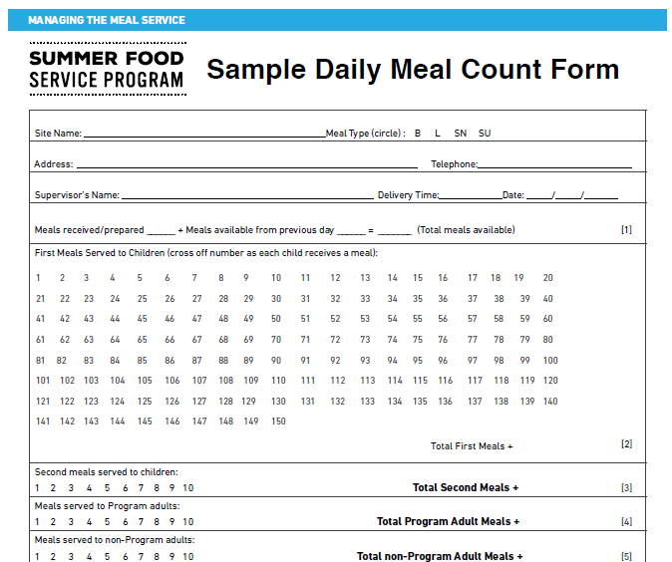
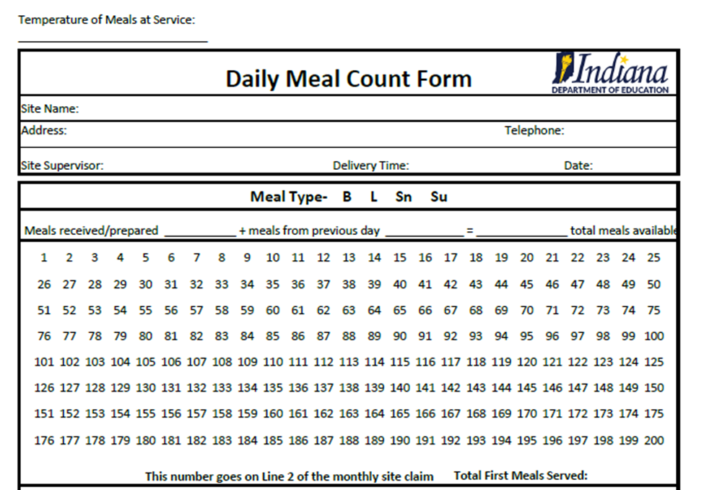
Let’s Review Meal Counting Form
Each site is required to use the USDA daily meal count form or one of the IDOE pre-approved daily count forms (see SFSP webpage for approved alternates). Pay attention to all the sections of this form!

Slide 25
Meal Count Form
This should be the address of the site, not the sponsor! This is the address listed in CNPweb!
Phone number for the site, not sponsor.
Site name is important!! This and the address can be pre-filled for ease of use.
Meal Type is required for claiming!
The site supervisor for the day must be listed. This person must be trained in Site Supervisor Responsibilities! A trained site supervisor must always be present!
The number of meals available must be completed on a daily basis. If you claim more meals than the number here, the extra meals will be disallowed by IDOE.
Delivery time and date are important to ensure food safety!!

Slide 26
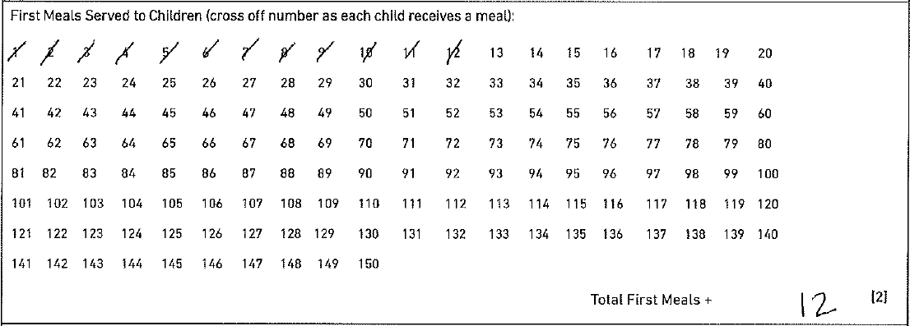
Meal Count Form
Only first meals served to children are counted here. Meals must be counted individually. No lines through all the numbers, no circle of the final number- each meal must be counted individually!
The total number of meals served must be included and match the number of individual meal count marks!

Slide 27
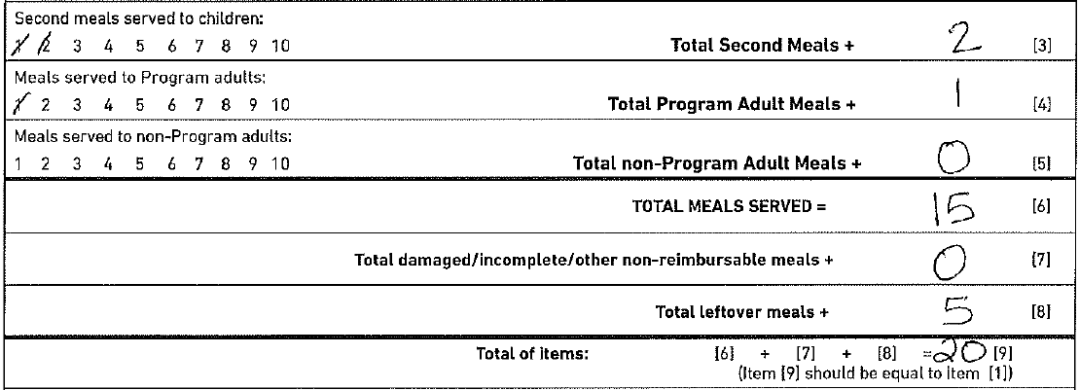
Meal Count Form
Individual meal counting is still required. And these must be complete meals, not only one component or leftovers.
Totals matching the meal counts must be listed.
Total all meals served and left over meals and add to get the number of meals available for the day.
This total should be the number of meals you listed as available for the day!!!

Slide 28
Meal Count Form
Count meals here if: you served all available meals prior to the end of the meal service time and there are additional children requesting a meal. Count the total number of kids up to the end of the approved meal service time.
Signature and Date are REQUIRED. The form should be signed by the person counting meals on the day of meal service. The person counting meals should not sign to site supervisor’s name in this line, they should sign their name on the line. The sponsor may require the site supervisor to also sign off of the meal count form if they desire.

Slide 29
Meal Count Form
Meals will be disallowed by the IDOE if meal count records are not complete, including:
Meals are not counted individually: one line through many numbers or one mark on the final meal count
Missing required information such as total number of meals available or missing signature
More meals were claimed than the number of meals available
Exact meal counts repeat daily with no variation

Slide 30
Meal Counting Questions?
This is a very important aspect of our program, so please make sure you understand all the requirements and ask questions!

Slide 31
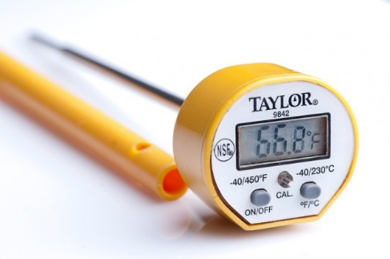
Food Safety
It is extremely important that food is kept at food safe temperatures during the hot summer months.
Sites may utilize Time or Temperature Control
Whether using time or temperature to control bacteria growth, documentation must be kept to ensure proof of food safe practices.
In the event of a food borne illness outbreak, the health department will ask to see all documentation that proper food safety controls were put into place for Summer Food Service Program operation

Slide 32
Food Safety
Time as a control:
When using time control, food may be taken out of temperature holding (hot or cold) for up to 4 hours prior to service. Once the 4 hour time limit has been reached, all food items must be discarded.
When using this method, sites must document what time food was taken out of temperature control and what time the items were discarded.
Keep in mind if opting to utilize this method, that children are more likely to eat food items kept at their ideal temperature. (Kids don’t like warm milk!!)

Slide 33
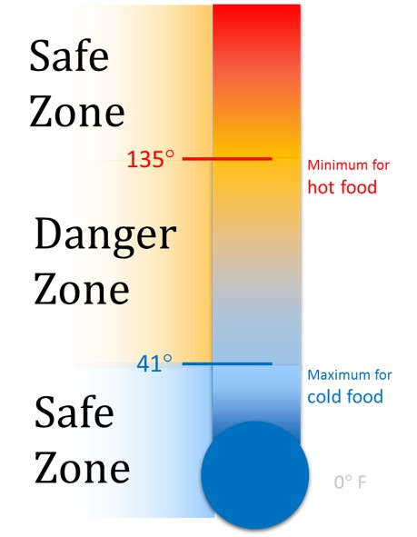
Food Safety
Temperature as a control:
When utilizing temperature as a control, sites must document that food is maintained at proper temperature for the item being served
Cold items: below 41 degrees
Hot items: 135 degrees or above
Proper equipment must be in place-- steam tables or chafing dishes for hot items and coolers and ice packs or cold tables for cold items
Sites must document the receiving temperature as well as hot or cold holding temperatures for all items being served
A temperature log is required and thermometers must be used at the site level to document proper holding temperatures.

Slide 34
Food Safety
Hairnets and gloves must be worn by servers serving open food items
for example: serving green beans out of a pan
If all meal items are packaged and placed into bags in the central kitchen and site staff only hand out a bag and milk carton, the requirement may not be applicable.
Be mindful of your surroundings- if the wind is blowing grass or leaves into your meal service area, shield food items from the debris so it does not contaminate your food items

Slide 35
Daily Site Reminders
Meal service area should be inspected daily, free from debris and safe for children
Greet children with a smile and “how are you today?”
All meals served must contain all of the required food items
Count meals individually as children go through the line
Clean up the meal service area and throw away all trash
Ensure children have enough time to finish eating before you leave the site. When you leave, all meals should be eaten and trash thrown away.
If in doubt, ask your site supervisor!

Slide 36
Questions?
Any questions about meal service or general program compliance?

Slide 37
Civil Rights
Civil Rights seeks to ensure that all program participants are treated fairly and that benefits are equally accessible to all children
Discrimination occurs when a person or groups of people are treated unequally.
Discrimination may be intentional or unintentional
The protected classes in child nutrition programs:
Race, Color, National Origin, Age, Sex, and Disability
You may not treat someone differently if they are a member of one of the protected classes

Slide 38
Civil Rights
Civil Rights Laws require:
Equal treatment for everyone
Equal access to all programs and activities
Elimination of barriers that prevent or deter people from receiving benefits
Dignity and respect for all
Ensure that discrimination, prejudice and stereotyping do not exist
Knowledge of both rights and responsibilities

Slide 39
Civil Rights
Who is responsible for Civil Rights compliance?
Is civil Rights training required annually for all staff and program volunteers?
YES!

Slide 40
Civil Rights
Non-discrimination statements must be included on all materials sent to households in reference to any child nutrition program.
Contact your SFSP director for the correct statement to be included on your materials.
Before sending out any flyers or informational papers, ensure that the non-discrimination statement is attached!
Camp Sponsors: The statement should be included on any application you send to households!

Slide 41
Civil Rights
Do you have a need to communicate in a language other than English?
If so, please ensure that all program materials are provided in all languages necessary to fully communicate with your participating families.
The IDOE has flyers with the site rules available in both English and Spanish.

Slide 42
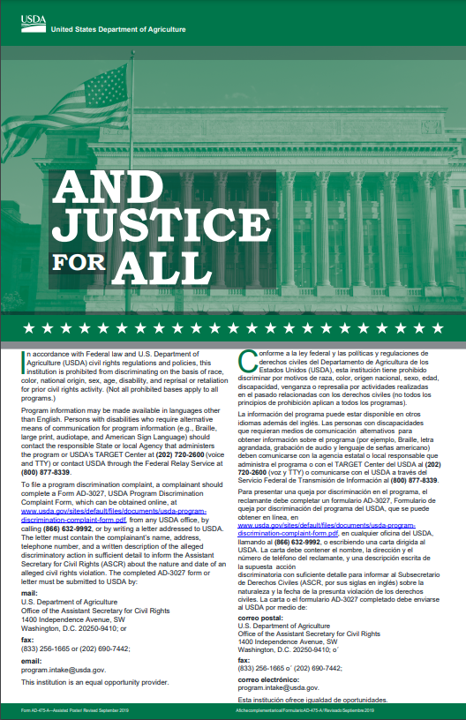
Civil Rights
The “And Justice for All” poster must be visible to program participants at every meal service site!
You must utilize the full 11x17 inch size
If you need additional posters for each site,
please contact your SFSP director

Slide 43
Civil Rights
A part of the Civil Rights compliance requirement is completing the Racial/Ethnic Data form
It must be collected annually by sponsor staff for each site

Slide 44
Civil Rights Complaints
It is a basic right for individuals to file a civil rights complaint at any time.
Complaints may be given verbally or written
Complaints may be given anonymously
Complaints may be filed at any time up to 6 months after the incident has occurred
Complaints must be logged correctly and reported to either the USDA office of Civil Rights or to the Indiana Department of Education

Slide 45
Civil Rights
Information to be collected when receiving a civil rights complaint:
Who: Contact Information of Complainant
What: Description of Incident(s)
When: Date of the Incident
Where: Location(s) of Occurrence
Who Else: Possible Witnesses
Then, contact your SFSP director!

Slide 46
Civil Rights
Everyone has a responsibility to ensure all people are treated equally and with good manners
Civil Rights complaints are to be taken seriously
All complaints must be reported to the USDA
It is not up to you to determine whether the complaint is valid- you simply report the complaint as it is stated to you

Slide 47
Civil Rights
Meal Substitutions
Meal substitutions must be made for students with an allergy or disability
A substitution that can be made within the meal pattern does not require a note by a medical authority
For example: A child states that they are lactose intolerant and you have soy milk available. No doctor’s note is required, but you may request one at the local level to make sure you provide the most appropriate substitution
Substitutions made with a doctor’s note may follow what the documentation says and substitutions are allowable outside of the meal pattern
For example: the allergy note states the child is allergic to milk and soy, so juice should be substituted at lunch. As long as the note is signed by someone with prescriptive authority, you may make the meal pattern change. Keep the doctor’s note available for review by State Agency reviewers. This documentation may be kept in the sponsor’s central office.

Slide 48
Site Supervisor Training
All site staff who will not be site supervisors or monitors may be dismissed at this time.

Slide 49
Site Supervisor
What is your role?
To ensure that compliance is met daily for each meal that you supervise.
Serve meals to all children who come to your site.
Provide excellent customer service to the families that you serve.
A trained site supervisor must be present during meal service (observing actual meal service the entire meal period) each day

Slide 50
Site Supervisor
Responsibilities
Ensure each meal served is reimbursable
Maintain meal count documentation
Maintain meal pattern compliance documentation
Maintain delivery receipts as needed
Communicate with Sponsor about meal delivery changes
Ensure food safety
Ensure civil rights compliance
Inform your SFSP director of the need for a change in meal service time or meal type
Submit all appropriate to the central office each week
Keep your site safe

Slide 51
Ensuring Reimbursable Meals
Each child must be offered the minimum required items according to the meal pattern
Each meal claimed must contain the minimum required meal components/items according to your service method
Each meal claimed must be eaten on site
Children should be served before adults
Only meals served to children may be claimed for reimbursement, all other meals must be counted in the correct section of the daily meal count form

Slide 52
Maintain Meal Count Documentation
Ensure meals are counted at the point of service
Ensure there is one person designated to count meals on each meal service line
Ensure the person counting meals is trained in how to complete the daily meal count form
Look over all meal count sheets to ensure completeness and accuracy

Slide 53
Maintain Meal Pattern Compliance Documentation
Keep recipes and CN labels for items served
Each site must track what is offered in a meal.
Detailed Menu
and/or
Production Records
Any substitutions made must be documented
Discuss with your SFSP Director how menu documentation should be maintained.

Slide 54
Detailed Menu Example
Lists all items offered and the serving size for each.

Slide 55
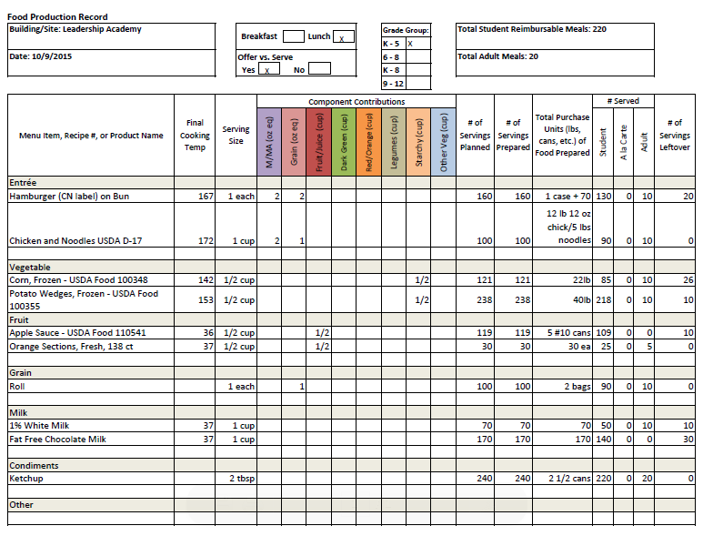
Production Record Example

Slide 56
Maintain Delivery Receipts
If serving vended meals, the vendor should provide some sort of documentation of how many meals have been delivered.
Meal delivery slips may be maintained at the sponsor level, however, a daily sign off or delivery confirmation slip of how many meals were delivered at each site should be standard practice at the site level.
If receiving raw foods, maintain delivery receipts and invoices
Check to ensure food is delivered at proper temperature and in good condition

Slide 57
Communicate Meal Delivery Changes
Sponsors insert how meal delivery changes should be handled:
whom do they contact?
Is there a phone number or email?
Is there a cut-off time?
Do they need to notify more than one person?

Slide 58
Ensure Food Safety
Make sure that all employees are following food safe practices
If you have a food safety plan, make sure that Standard Operating Procedures are followed
Ensure food is stored at proper temperatures
Ensure food temperatures are taken during preparation and service and recorded in the correct temperature logs
OR if using time as a control, documenting the time items have been out of temperature control to be thrown away

Slide 59
Ensure Civil Rights Compliance
Maintain an operation that allows equal access for all children
Treat all families that you come into contact the same while expecting customer service excellence from other site staff
Make sure the “And Justice for All” poster is posted during meal service each day

Slide 60
Inform the SFSP Director of Changes
All meals must be served within the approved meal service time
Confirm with your SFSP Director what meal service time is approved for your site
No changes can be made without prior approval by the IDOE
Any need to change meal service time will take a few days to be approved, so changes will not be immediately available
Field trips for enrolled groups must be put into the online system and approved by the IDOE
Emergency situations (i.e. the breakdown of a delivery truck) should be communicated to the IDOE immediately

Slide 61
Submit all Required Documentation
Submit all required paperwork:
Daily Meal Count Forms
Proof of meal pattern compliance
Meal Count Consolidation Forms
Meal Delivery Receipts (for vended meals)
Food invoices and delivery receipts
Milk delivery receipts
Sponsors, you can adjust this list based on the document you require

Slide 62
Safety First!
If you ever feel unsafe or threatened at your job, call the police
If you fear the children are unsafe or being threatened, call the police
In the event that a parent or other adult becomes upset, do what the parent is asking first and explain the requirements/rules after the fact
Do not antagonize an adult in order to strictly follow the rules
If someone at the site is continually a bother, call your SFSP monitor or director to come speak with the person
Most parents may not know the rules and just need a gentle reminder of the policies that you must follow

Slide 63
First Week Reminders
Communicate all of the rules to each family and child who eats at your sites
Ensure proper meal counting procedures from staff
Ensure meals are served in the correct meal service time
Follow the planned menu or plan a menu to meet meal pattern requirements
Expect excellent food safety and customer service from other site staff
Create a fun meal atmosphere

Slide 64
Communicating with Customers
Communicate the rules to all participants and family members
Determine with your SFSP Director how rule violations will be handled on a daily basis
Recommendations for dealing with parents eating child’s meal:
Slip a note to the parent explaining the rules
As the family is leaving, pull the parents aside and explain the rules
Post the rules in a visible location in the meal service area
Make a broad announcement to remind parents in attendance that they are not permitted to consume any portion of a child’s meal
Partner with a community organization to offer meals free of charge to non-program adults

Slide 65
Engaging Kids
Talk with kids- ask them how their day is going
Encourage children to try items that might be new or unfamiliar to them.
Discuss food items that might be local and where they were grown/produced
Allow children enough time to finish their meal without being rushed
Sit with kids while they are eating (if you have time)
Be mindful of how you talk about the food you are serving

Slide 66
Site Supervisor Handbook
Each Site Supervisor should be given the Site Supervisor Guide or a link to a digital copy.
The Site Supervisor Guide is a helpful resource
The link to both English and Spanish versions of the Guide can be found here:
https://www.fns.usda.gov/sfsp/handbooks

Slide 67
Site Supervisor Questions?

Slide 68
Sponsor Monitor Training
All sponsor monitors must be trained annually.
It will be helpful for each Monitor to have a Sponsor Monitor’s Guide available during this training for reference.
https://www.fns.usda.gov/sfsp/handbooks

Slide 69
Role of the Monitor
The role of the sponsor’s monitor is to ensure total compliance of all SFSP regulations through sponsor self-monitoring visits.
The sponsor monitor must be independent of the day-to-day operations of the sites they are to monitor.
The sponsor monitor must be knowledgeable of all SFSP program requirements and regulations and be able to objectively monitor sites, answer questions about program requirements and provide technical assistance to site staff.

Slide 70
Monitor Job Responsibilities
Be the link between the SFSP director and the site staff including Site Supervisors
Monitor all assigned sites within the required time frame
Pre-Operational Visits
First Week Visit
4 week Site Reviews
Conduct training as necessary for site staff
Ensuring proper meal counting practices and reconciling meal counts with the site supervisor
Complete the Racial/Ethnic Data Form
Conducting follow-up visits as needed

Slide 71
Assisting Site Staff
Have a thorough understanding of meal pattern requirements in case site staff need to make changes to the planned menu or need assistance in planning menus.
Understand meal counting requirements thoroughly enough to provide corrective training as necessary.
Have an understanding of good food safety practices to be able to make suggestions when issues are noted.
Be able to provide Civil Rights training to site staff who may have missed training or who are newly hired.
Know when meals should not be claimed for reimbursement.

Slide 72
Monitoring Observations
Visit vs. Review
The first week observation is called a “visit.” The visit ensures that meal service operations are running smoothly and that any obvious errors are corrected immediately.
The 4 week observation is called a “review.” During the Site Review, the monitor will ensure that ALL areas of SFSP compliance is met. The Monitor must remain on site the entire length of service for the Site Review.

Slide 73
Monitor Reminder
Monitors need to ensure that all service errors are noted on the review documentation and that corrective action or training has been conducted to ensure future compliance.
Errors noted on the sponsor’s monitoring forms are not included on any State Agency administrative review. When the State Agency reviewer sees that sites were monitored objectively with errors noted, it shows the State Agency representative that errors are taken seriously and corrected as needed.
When monitoring reports completed by the sponsor’s monitor state that there were no errors, but State Agency Staff monitor and there are numerous errors, it shows a lack of objective observation and corrective action.

Slide 74
Pre-Operational Visit
Pre-operational visits are conducted for new sites and those that experienced operational problems the previous year before a site operates the summer program.
The visit should be conducted on site to ensure accurate information is obtained through observation.
These visits are required to determine that the sites have the facilities to provide meal service for the anticipated number of children in attendance and the capability to conduct the proposed meal service.
The Pre-Operational Visit form is to be completed prior to the site’s operation.
Sponsors, please review the Pre-Operational Visit Form with staff to ensure understanding of how to complete the visit.

Slide 75
First Week Visit
First Week Visit is required for all sites, except for returning successful sites (thanks to the waiver in PY 2022 only).
This review is meant to be a brief look at the food service operation for meal service compliance.
There is some flexibility that you do not have to observe the entire length of meal service with this visit. Best practice would be to stay the entire length of meal service to see all areas of compliance.
Please review the First Week Visit Form with Monitors to ensure understanding of form completion.

Slide 76
First Week Visit
Critical items to double check for correctness:
Site address
Site supervisor name
Site Type (open or closed)
Operating Dates
Meal types served & Field trips
Meal times
Ensure sites are operating according to the site type. If the site is to be open, site staff cannot limit children coming into the facility for a meal.
For example, if the program is a summer daycamp that is listed as open site, children must be able to walk in from off the street and be served a meal during the listed open serving time.

Slide 77
First Week Visit
Check to make sure the “And Justice for All” poster is visible and the correct size
Ensure proper food safety practices
Ensure proper meal counting procedures
Ensure meals meet the meal pattern requirements for the type of meal served
Ensure the site rules are enforced
Are children staying on site to eat their meals? Are adults aware they cannot eat off a child’s plate? Are Site Rules utilized or posted? Are share table items available only to children?

Slide 78
Site Review
The Site Review is to be conducted within the first four weeks of site operation.
The review looks at all areas of SFSP compliance, not just meal service.
Please review the Site Review form to ensure understanding of completion.
Note this is a multi-page document!!

Slide 79
Site Review
Complete the Site Review form completely.
Stay for the entire length of meal service for the meal observed.
Record all errors in compliance.
Describe corrective action to be implemented.
Conduct a follow-up review as needed.

Slide 80
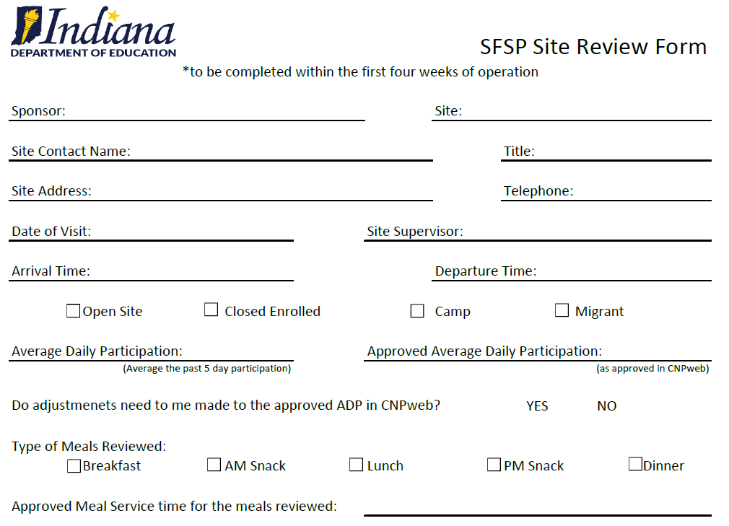
Completion of the Site Review Form- pg 1
Complete all of the requested information.
You must remain on site for the entire meal service period.
You do not have to observe more than one meal type. You are only required to observe one of the meal types offered at the site, but can observe more as needed.
Average Daily Participation can be figured by looking at the past 5 days of meal service participation and averaging the daily participation.

Slide 81
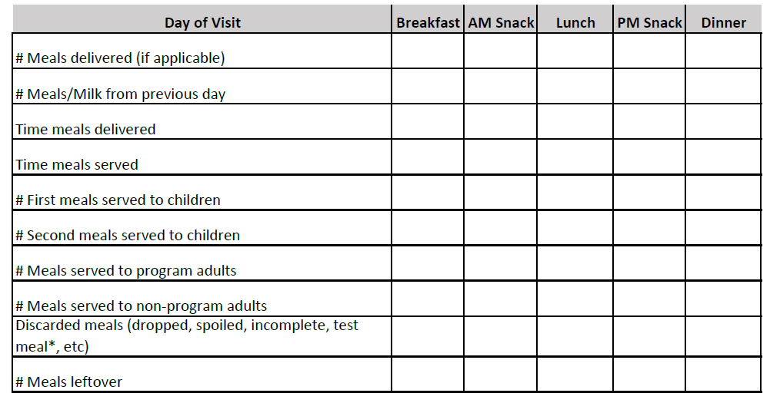
Completion of the Site Review Form- pg 1
You will complete each of the boxes based on the meal type that you are observing.

Slide 82
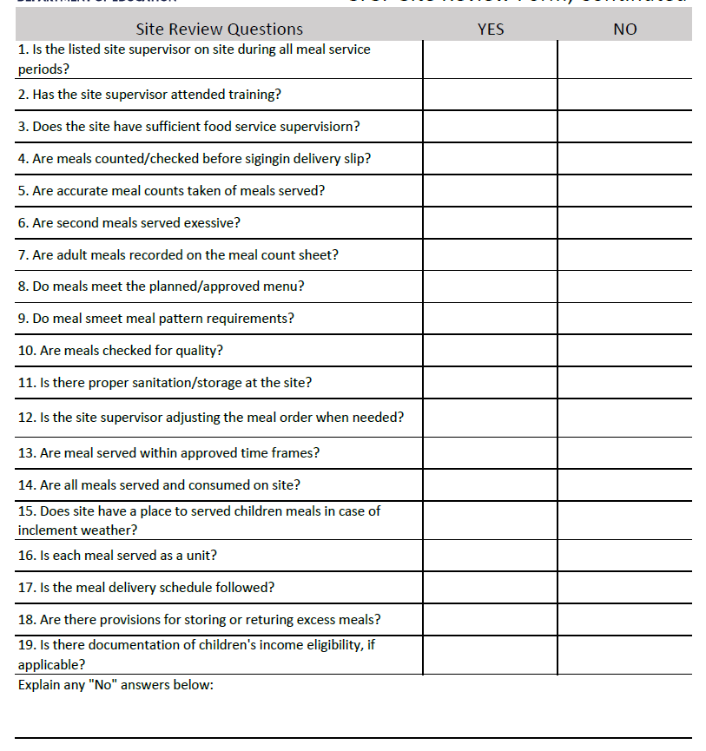
Completion of the Site Review Form- pg 2
Answer the next questions honestly.
Any discrepancies or non-compliance should be recorded on page 3 with corrective action described.
Any questions where the answer may be “not applicable” please write “n/a”.
Explain any “no” answers as that will describe any errors in compliance.

Slide 83
Completion of the Site Review Form
Please note that there is only one short question about food safety. However, it is important that you ensure proper food safety practices are followed and report when they are not.
Proper food safety practices include:
Taking temperatures or checking the time prior to serving meals
Ensuring that either the time or the temperature is reported on the proper log
Wearing hair coverings and gloves when needed
Keeping coolers and milk cases closed when not serving meals
If preparing meals at the site, are dishes clean and sanitized properly?
Are cooler or hot holding unit temperatures taken?
If serving outside, is the food service area free from debris?

Slide 84
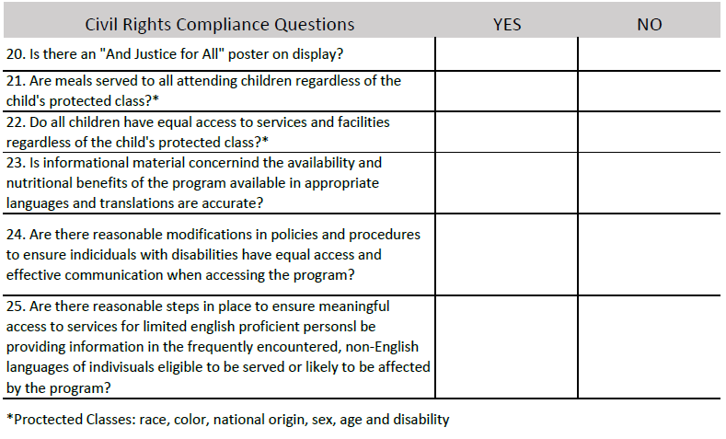
Completion of the Site Review Form- pg 3
Page 3 is all about Civil Rights!
Answer all questions honestly and make adjustments to procedures as needed.

Slide 85
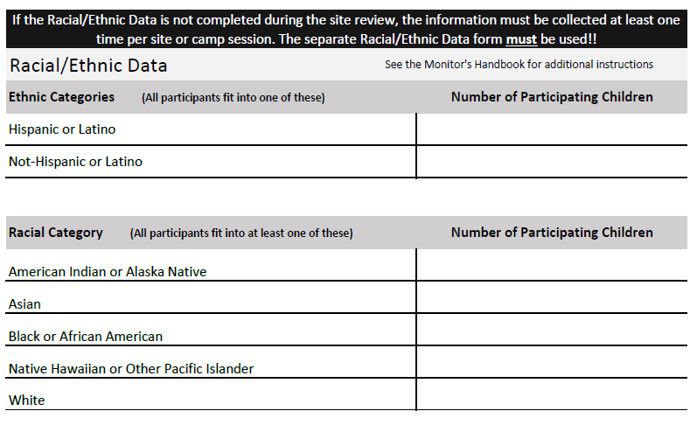
Completion of the Site Review Form- pg 3
Racial/Ethnic Data can be collected as part of the Site Review.
Racial/Ethnic Data must be collected at least one time throughout the summer.
If you have a rotating population of children, Racial/Ethnic Data must be collected each time the population

Slide 86
Completion of the Site Review Form- pg 3
From the Sponsor Monitor’s Guide:
The sponsor should complete this form for each site under its jurisdiction each year. Sponsors of residential camps must collect this information for each camp session. For all other sites, the sponsor must count the participating children at least once during the site’s operation.
The sponsor must retain racial and ethnic data, as well as documentation for the data for 3 years and must safeguard this information to prevent its use for discriminatory purposes. Access to Program records containing racial and ethnic data should be limited to authorized personnel.

Slide 87
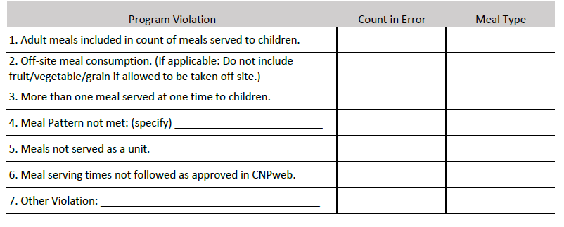
Completion of the Site Review Form
Under Program Violations, you can record the number of meals that should not be claimed due to non-compliance.
Any meals knowingly served that do not follow SFSP regulations should not be claimed for reimbursement.
For example, the monitor arrives before the approved meal service time and 10 children have already been fed. These meals should not be claimed for reimbursement.

Slide 88
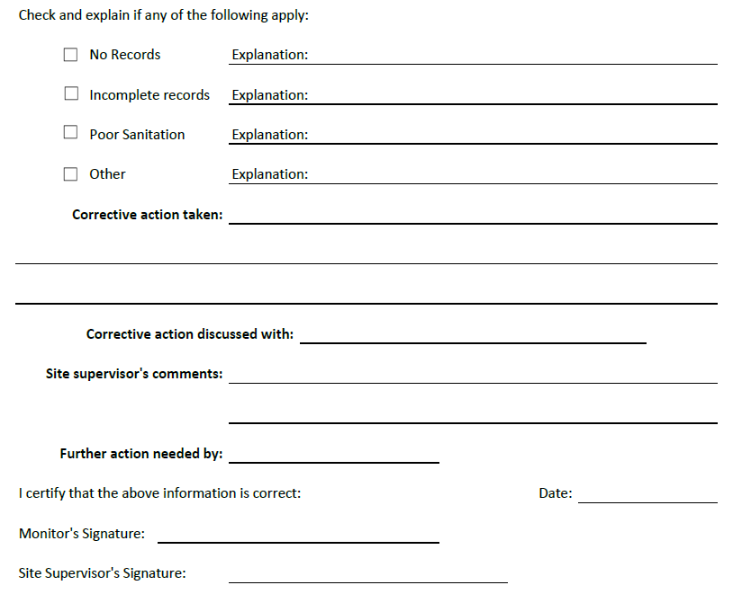
Completion of the Site Review Form- pg 4
In the next section you can record additional errors and explain what was observed.
Then, you will list any corrective action that was discussed and the plan for correction.
Make sure to sign the review form and have the site supervisor sign the form also.

Slide 89
Completion of the Site Review Form
If you need additional space to list corrective action or issues noted, you can use additional paper to further explain.
List all areas of non-compliance and create a corrective action plan (CAP)
Conduct a follow-up review for all sites with areas of non-compliance.

Slide 90
Follow-up Review
Complete the Site Review form again.
Ensure all areas of non-compliance have been corrected and meal service is running smoothly.
Note on the review form how issues found in the last review have been corrected or that further corrective action is needed.

Slide 91
Record Keeping
Sponsors- insert here the record keeping procedures you would like your monitors to follow–
Where do they turn in review forms?
To whom do they report issues?
How are follow-up reviews and corrective action planned? Etc.

Slide 92
Planning Your Reviews
It is important to map out your site visits well in advance to ensure enough time to complete the reviews.
Helpful Hint: Put together a calendar (either paper or electronic) where you list all site reviews and timeframes you need to complete during the summer.
First, list the operating dates of all the sites you need to visit and highlight all the new sites and sites with operational issues last year.
Helpful Hint: There is a report that your SFSP Director can run from CNPweb that lists all sites under your sponsorship with operating information included! The monitor can use this to double check site operations for accuracy.

Slide 93
Planning Your Reviews
Then, place all the first week visits that you will need to conduct on the calendar. This will help you to see if you have enough time to conduct all that you need.
Next, list all of the Site Reviews (one for each site!) that you need to complete within the first 4 weeks of each site operation.
Don’t forget when planning your visits and reviews that you can plan multiple in one day- visit breakfast at one site, then lunch at another. Just don’t forget to add in travel time!
Then, plan pop-in site visits for sites throughout the program operation. Keeping tabs on how sites are doing throughout the entire program operation will ensure continued compliance.

Slide 94
Any lingering questions about our meal service
plans this summer? Let’s discuss it now!

