Slide 1
LEPC ROSTER REPORT
Indiana Emergency Response Commission
2025

Slide 2
LEPC Roster Reports
Why Do LEPCs Need A Roster
Helpful Reminders
How To Enter the Report Into Hazconnect
Roster Update Requests Explained

Slide 3
Why do the LEPCs need a Roster Report
LEPCs must comply with Indiana Codes, 4-2-7-3, 13-25-1-6, 13-25-2-5, 13-25- 2-10.6(b), 13-25-2-10.7 and 13-25-2-14 to receive funding. To meet funding and IERC requirements, the following documents/information must be submitted annually through the LEPC online reporting system (Hazconnect) at
https://tier2.dhs.in.gov/Account/Login.aspx

Slide 4
HELPFUL REMINDERS:
The Roster Report is due in Hazconnect by, April 30 of each year.
The LEPC must review and vote to approve the Roster for the current year before uploading into Hazconnect. The roster should reflect current member status and information.
The Roster must include at least 12 members (listed as primary), one in each career category. The 12 categories are; broadcast/print media, community groups, emergency management, emergency medical services, environment, fire department, health, hospitals, industry, law enforcement, local/state government and transportation.
A person listed as primary can have as many people listed as proxies as they deem necessary but only one of those will count for voting purposes and quorum in a meeting.

Slide 5
HELPFUL REMINDERS Cont.:
Meeting Quorum - to meet quorum the LEPC must have 50% plus one of its Primary members or their Proxy attend the meeting for it to meet quorum and to be valid for decision making and voting purposes.
The best way to organize a roster is to have 12 Primary members (one for each career field), with the rest being listed as a proxy. This will ensure that at any meeting only seven members (or their proxy) will be needed to conduct business and meet quorum. This can help to ensure a successful outcome and reduce the need to have more meetings.
The process for appointing and removing members from the LEPC Roster has changed. This process will be included in this presentation.

Slide 6
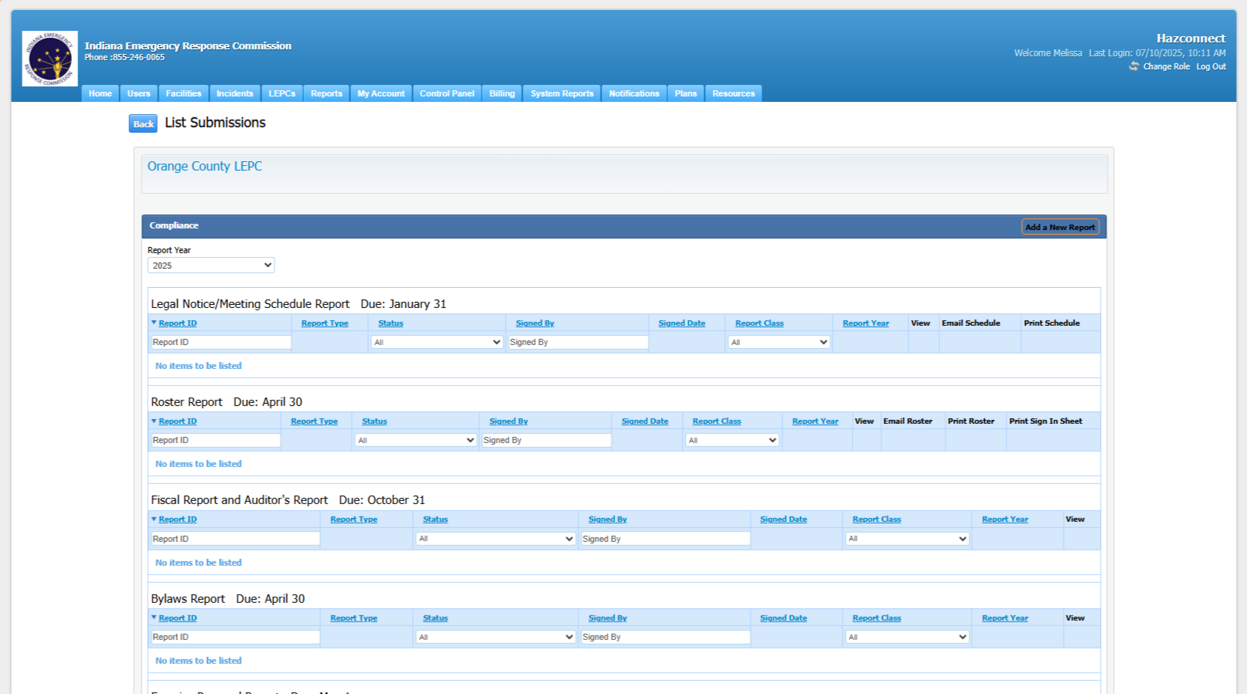
How to enter the Roster Report into Hazconnect:
Go to the counties LEPC reports page:

Slide 7
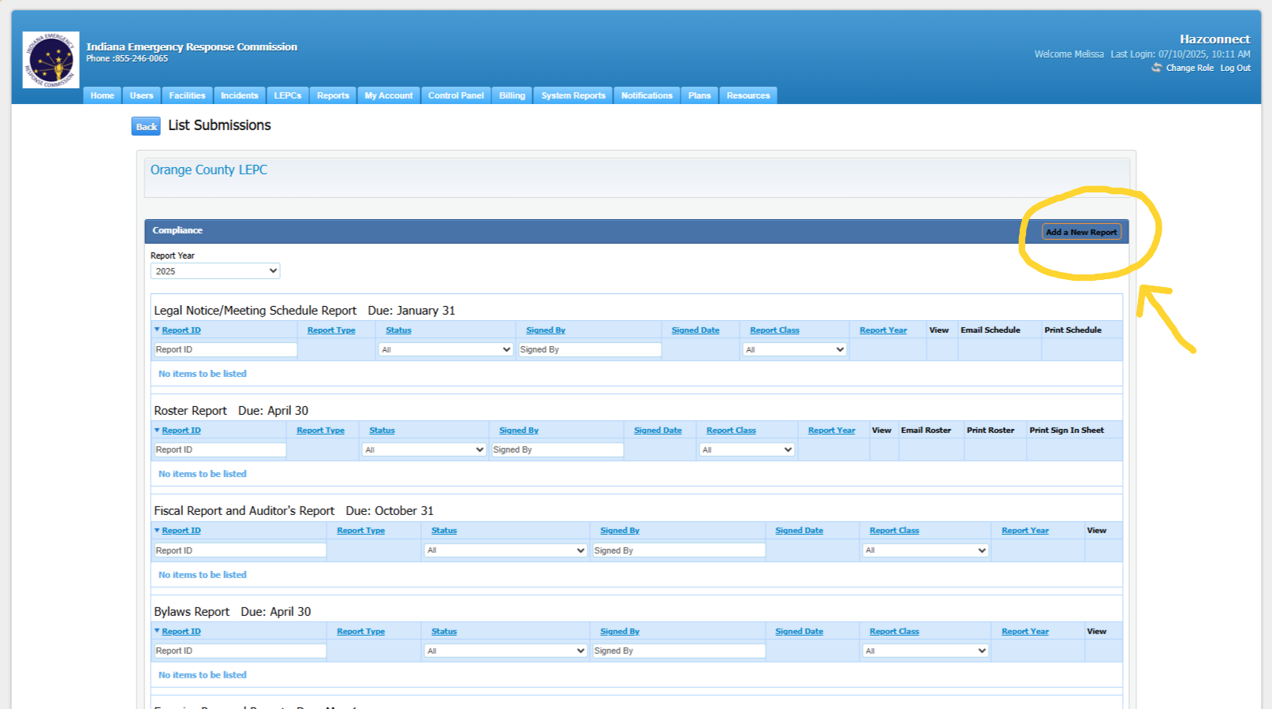
Entering the Roster Report into Hazconnect, Cont.:
2. Choose add a new report (at the top right of the page.)

Slide 8
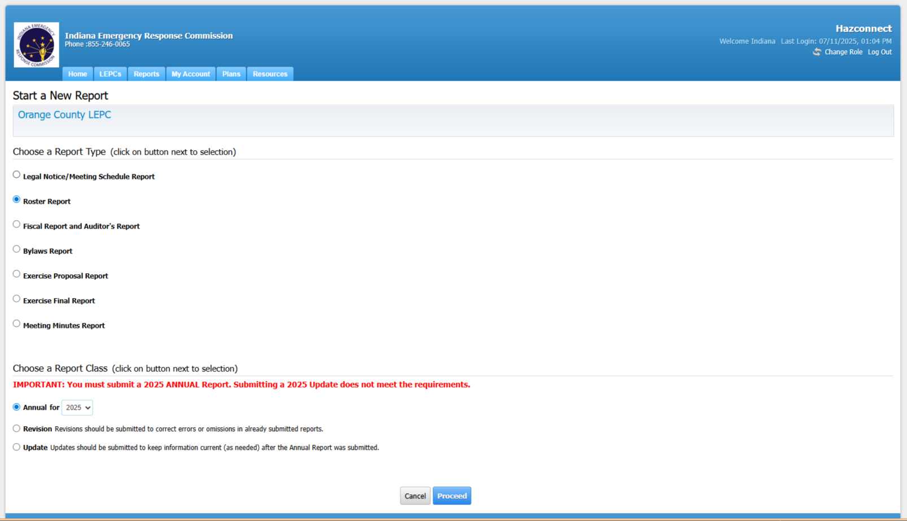
Entering the Roster Report into Hazconnect, Cont.:
3. Next choose roster report and then at the bottom choose annual for (current year.), then the proceed button.

Slide 9
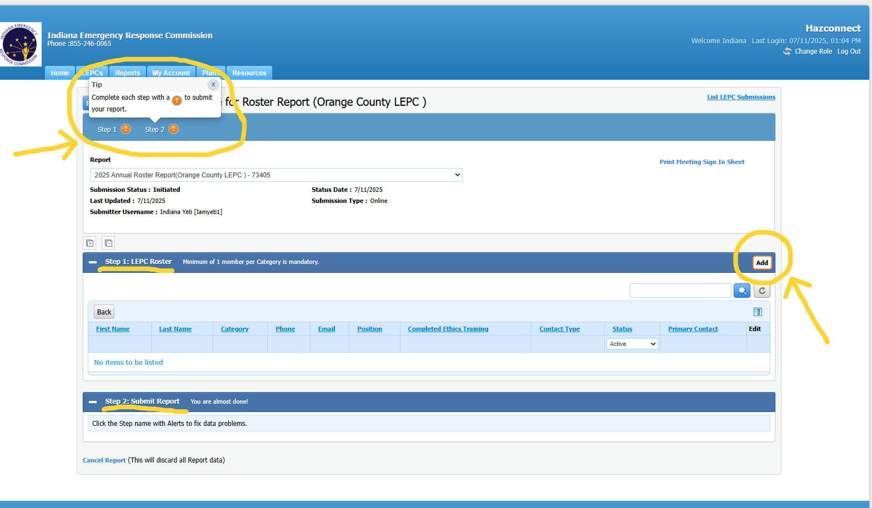
Entering the Roster Report into Hazconnect, Cont.:
4. At the top it shows that there are two steps that need to be completed. Go to Step one: LEPC Roster and to the right of that you will see the add button. Choose the add button to begin the report.

Slide 10
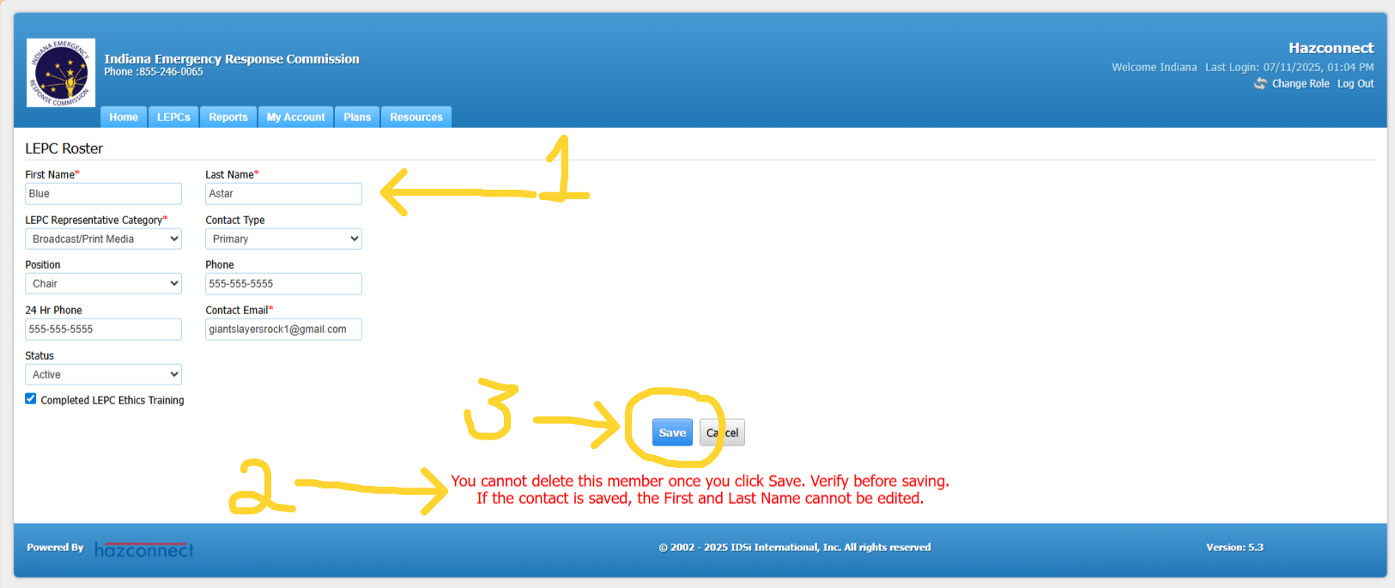
Entering the Roster Report into Hazconnect, Cont.:
5. (1) The boxes marked with a red asterisk must be completed. It’s best if you can complete all the information. (2) Once a member is added their information will remain in the system. If they become in-active, they will just be marked as in-active. (3) Choose save when finished.

Slide 11
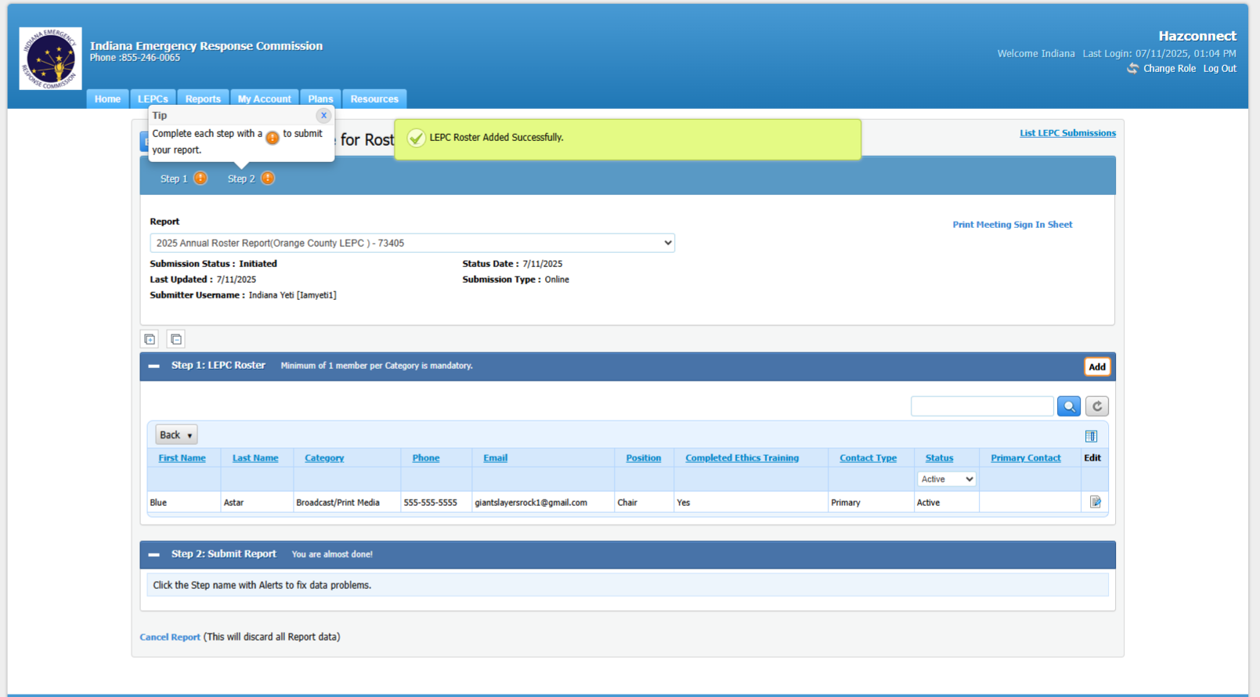
Entering the Roster Report into Hazconnect, Cont.:
6. A green box will appear at the top of the screen when you have successfully added a member to the roster.

Slide 12
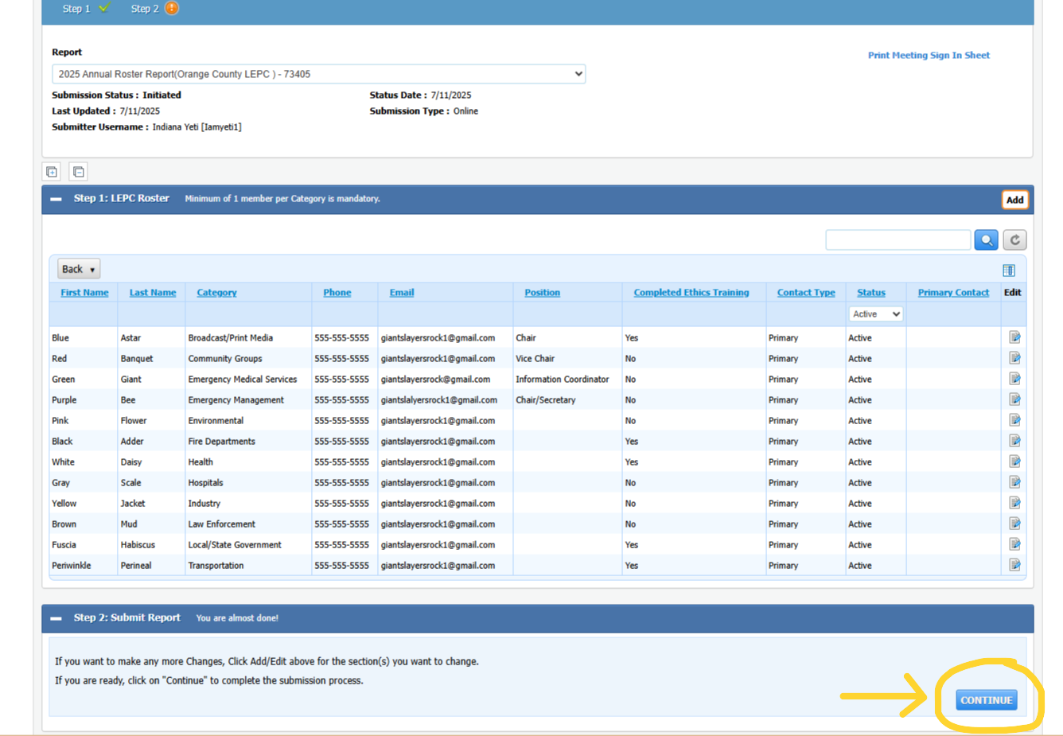
Entering the Roster Report into Hazconnect, Cont.:
7. After you have entered 12 members (one Primary in each career category), the report will let you proceed and a CONTINUE button will appear in the bottom right corner of the page. (If you don’t have at least 12 Primary, one in each job category the report won’t let you advance to the next step.)

Slide 13
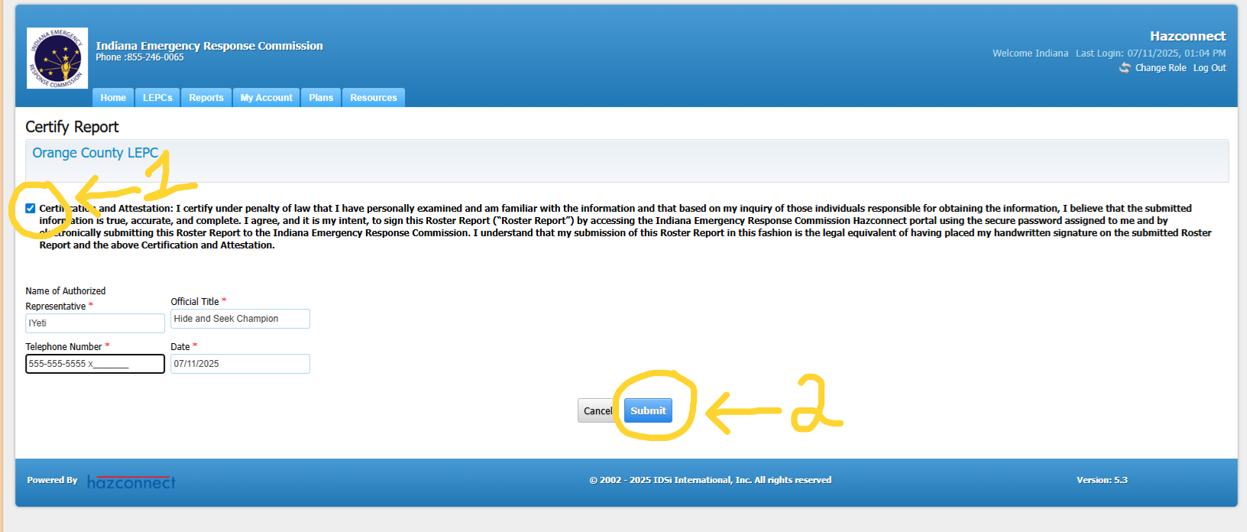
Entering the Legal Notice Report, Cont.:
8. When certifying the report step (1) check the certify box and fill in the information with the asterisks. Step (2) choose the submit button.

Slide 14
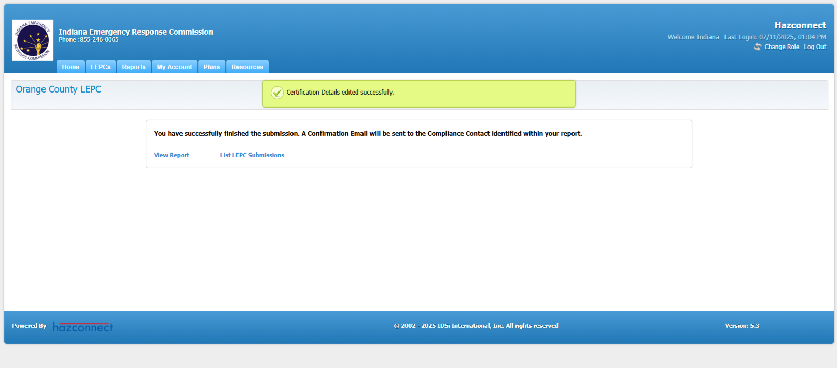
Entering the Legal Notice Report, Cont.:
9. After you have submitted the report, you will see confirmation in a green box saying that it was certified successfully. You have completed the report.

Slide 15
Roster Appointments and Removal Requests Explained:
There is a new procedure for changes to the LEPC rosters. The new procedure requires the LEPC to request appointments and/or removals of members to each LEPC.
To request changes the LEPC must fill out either an appointment request letter or a removal request letter for any member coming or going to or from the LEPC.
The Letter templates can be found here: DHS: Local Emergency Planning Committees
The LEPC will then conduct business as usual, (appointing new members, removing members and conducting votes in a valid meeting as usual.)
You can find lists of Instructions at DHS: Local Emergency Planning Committees and https://www.in.gov/dhs/boards-and-commissions/lepc-information/#Resources
After the IERC votes on the roster requests, each LEPC will receive final letters of appointments and removals for the members from the IERC.

Slide 16





FEEDBACK IS WELCOMED
If you have any feedback or questions, contact the IERC inbox or your LEPC Program Manager:
ierc@dhs.in.gov and IndianaLEPC@dhs.in.gov

