Slide 1
LEPC Meeting Minutes Report
Indiana Emergency Response Commission
2025

Slide 2
LEPC Meeting Minutes Report
Why do LEPC’s need Meeting Minutes Reports
Helpful Reminders
How To Enter the Report Into Hazconnect
The Last Meeting Minutes Report of the Year Explained

Slide 3
Why do the LEPCs need Meeting Minutes reports?
LEPCs must comply with Indiana Codes, 4-2-7-3, 13-25-1-6, 13-25-2-5, 13-25- 2-10.6(b), 13-25-2-10.7 and 13-25-2-14 to receive funding. To meet funding and IERC requirements, the following documents/information must be submitted annually through the LEPC online reporting system (Hazconnect) at
https://tier2.dhs.in.gov/Account/Login.aspx

Slide 4
Helpful Reminders:
LEPC’s must have a minimum of 4 valid meetings a year. Two must take place in the first half of the year and two in the second half of the year.
For a meeting to be considered valid it must meet quorum, votes must be taken for any financial decisions, votes must be taken for any decisions that will affect the LEPC, its members or to conduct any type of business. (Robert’s Rules of Order are used as a guideline for conduct of meetings. Information can be found here: DHS: Local Emergency Planning Committees)

Slide 5
Helpful Reminders Cont.:
To meet quorum 50% + 1 of the LEPC Primary members (or their proxy) must be present at the meeting. (To find more information on quorum please see the LEPC Rosters, located here: DHS: Local Emergency Planning Committees)
The meeting minutes reports must be initiated in Hazconnect within 60 days after a meeting takes place. (It must be completed after the next valid meeting takes place.)
The report must include a sign-in sheet and corresponding meeting minutes signed by the Chairperson. (Corresponding means that the meeting date, sign-in sheet, and meeting minutes should all be for the exact same date and in the same report.)

Slide 6
Helpful Reminders Cont.:
Your LEPC should always review and vote to approve the meeting minutes from the previous meeting, before the Chairperson signs it and before it’s uploaded into Hazconnect.
The correct order is to conduct a meeting, initiate the meeting minutes report in Hazconnect and upload the sign-in sheet (but do not submit, yet), create the meeting minutes, at the next LEPC meeting have the LEPC review and vote to approve the meeting minutes, then the Chairperson signs the approved meeting minutes, last upload the corresponding meeting minutes to the Initiated meeting and then submit the meeting minutes report in Hazconnect.

Slide 7
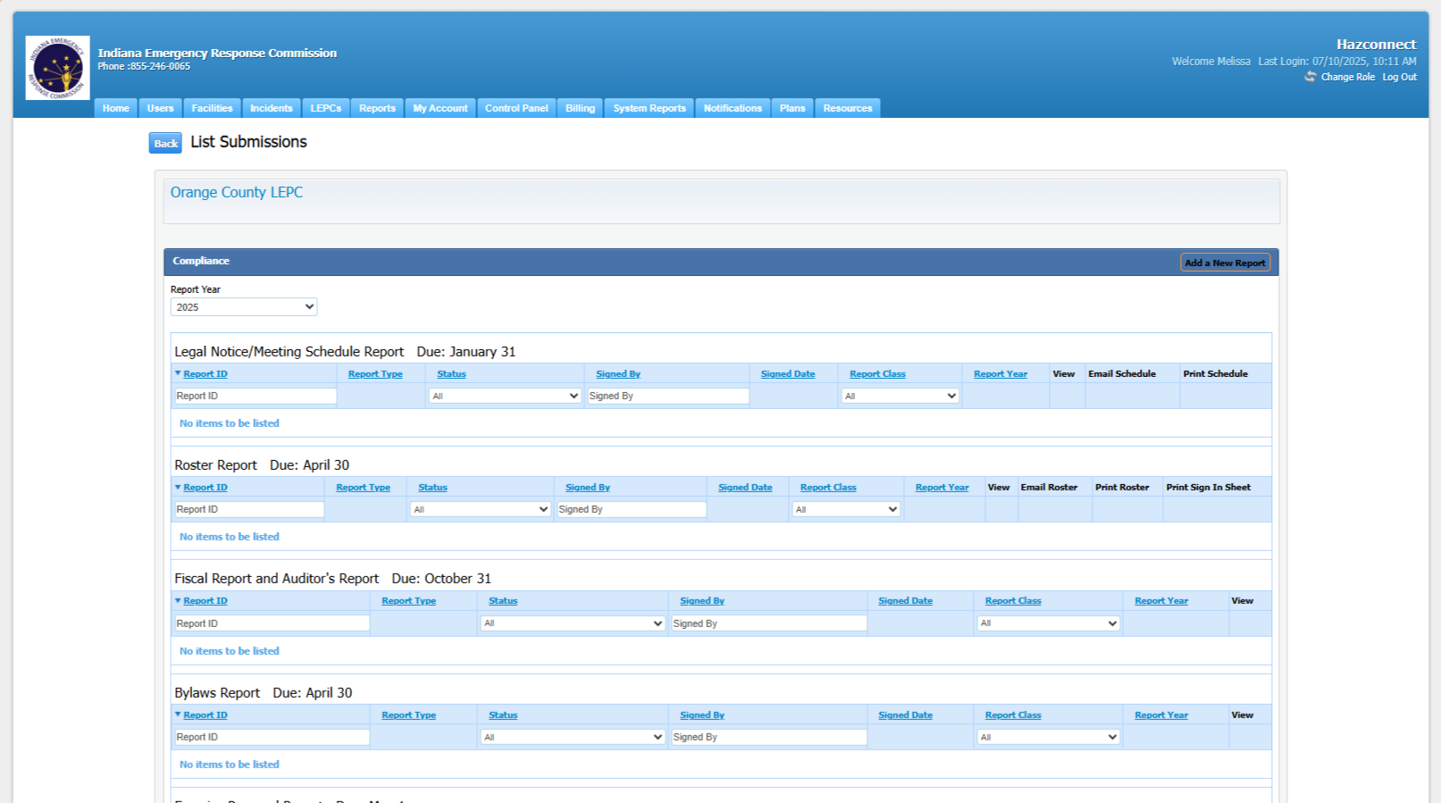
How to Enter the Meeting Minutes Report Into Hazconnect:
Go to the counties LEPC Reports page:

Slide 8
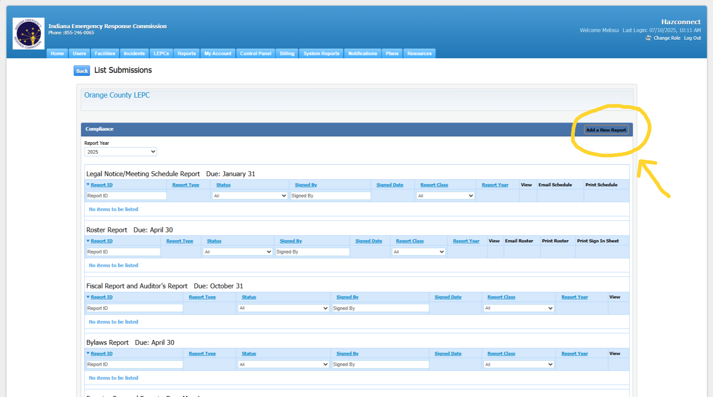
Entering the Meeting Minutes Report, Cont.:
2. Choose Add a New Report (at the top right of the page.)

Slide 9
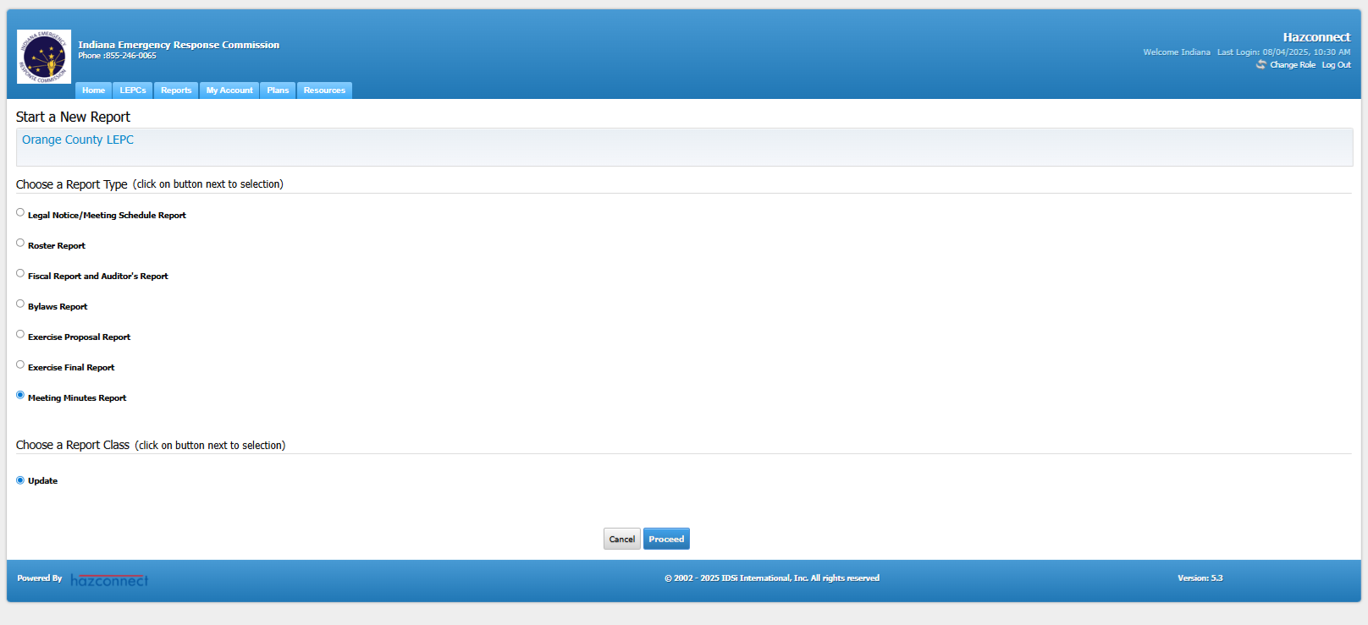
Entering the Meeting Minutes Report, Cont.:
3. Next Choose Meeting Minutes Report and then at the bottom choose Update, then the Proceed button.

Slide 10
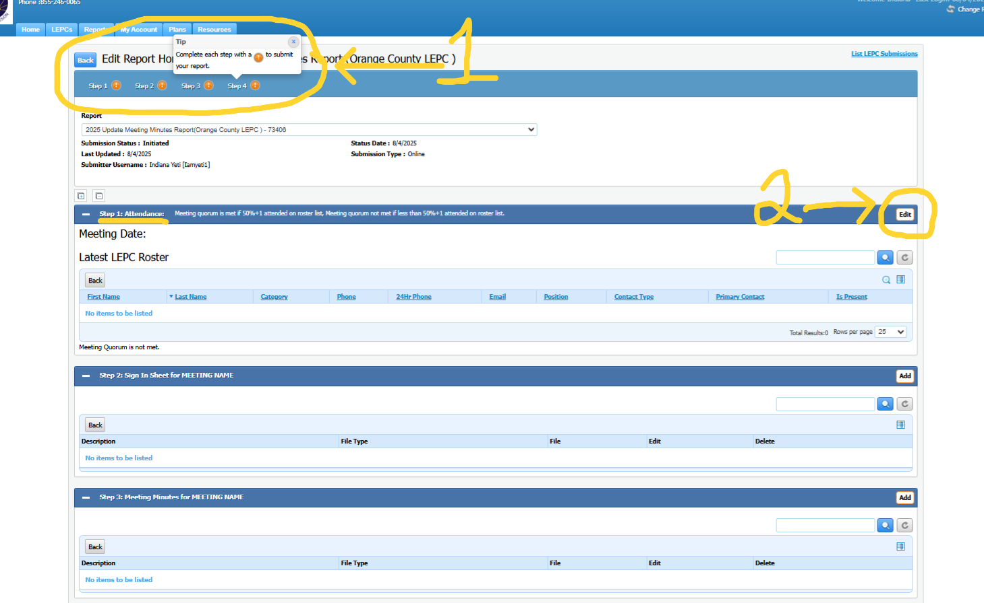
Entering the Meeting Minutes Report, Cont.:
4. At the top of this screen you will see 4 Steps (1), these 4 steps must be completed before the report can be submitted. To start go to Step 1: Attendance and choose the Add button on the right (2).

Slide 11
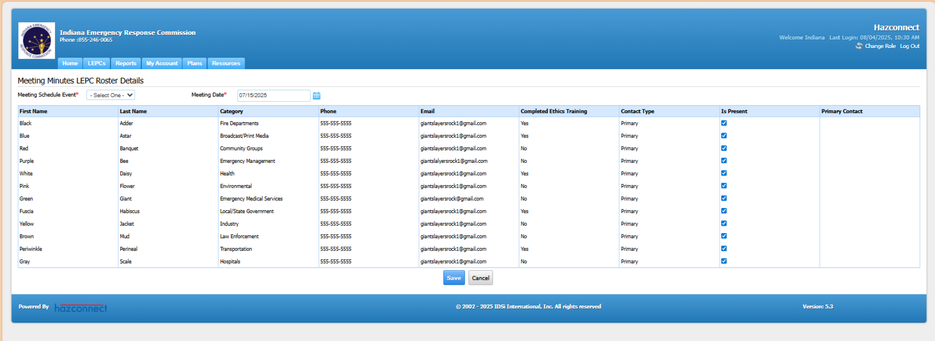
Entering the Meeting Minutes Report, Cont.:
This screen lists all the Primary and Proxies that are listed as Active on the LEPC Roster. There are 3 required steps that must completed on this screen.

Slide 12
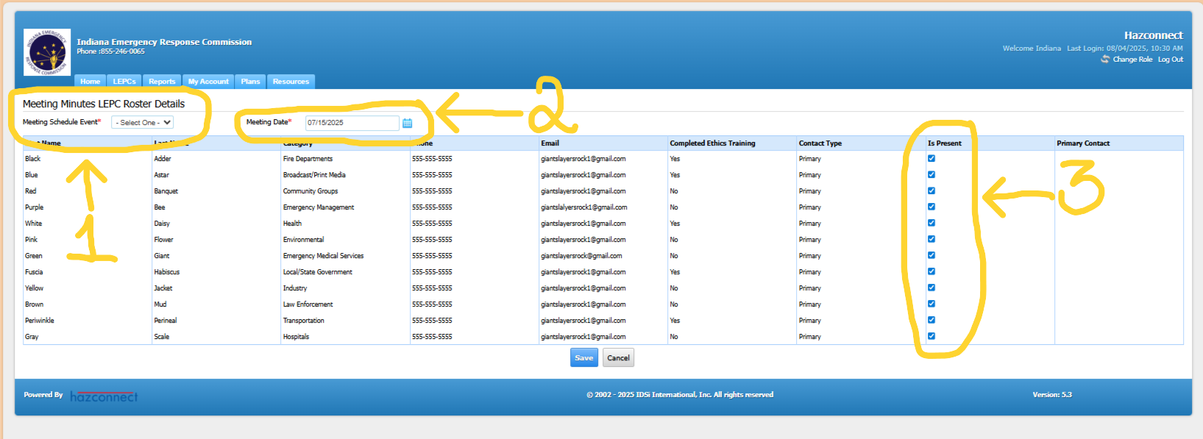
Entering the Meeting Minutes Report, Cont.:
5. First choose from the drop-down box beside the Meeting Schedule Event * (choose LEPC Meeting) (1). Next choose the Meeting Date* (2). On the right of each name is a column with check boxes that says, Is Present, check the box for each person that was present at the meeting (both Primary and Proxy) (3). Choose Save to submit.

Slide 13
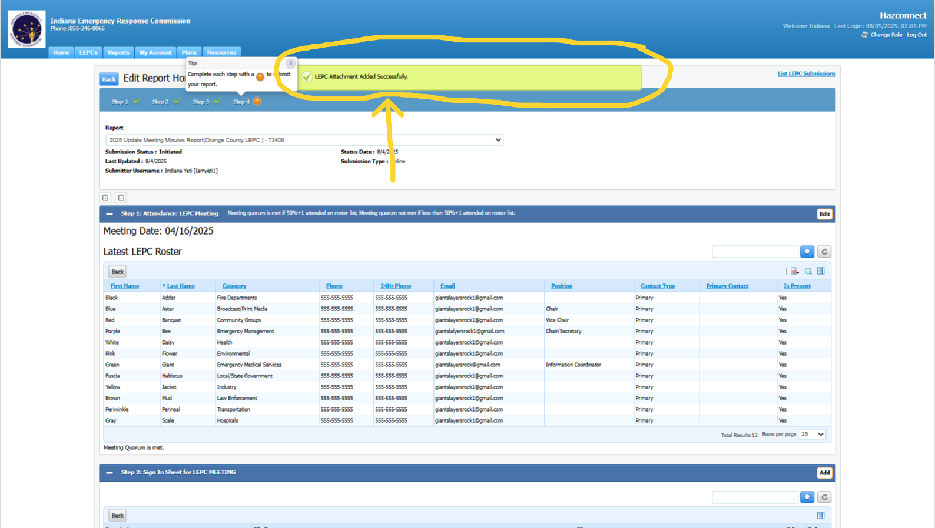
Entering the Meeting Minutes Report, Cont.:
When this portion of the report is completed successfully you will see a green rectangle at the top of the screen that says it was completed successfully.

Slide 14
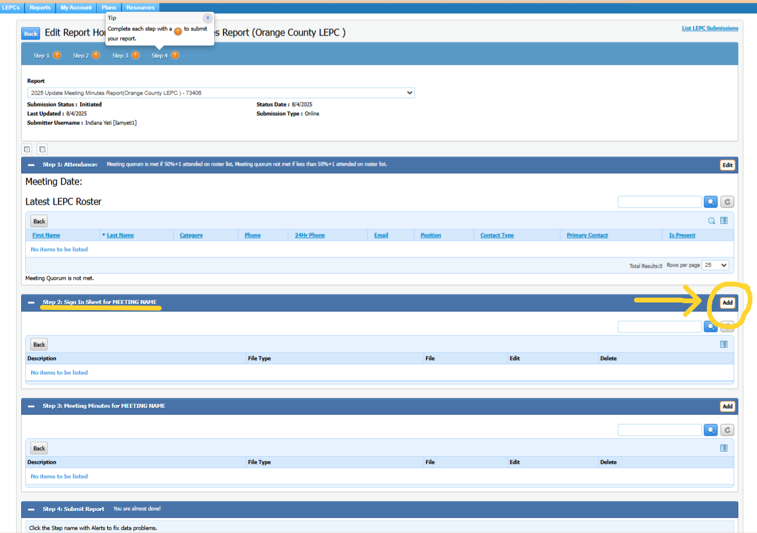
Entering the Meeting Minutes Report, Cont.:
6. To begin Step 2: Sign In Sheet for Meeting Name choose the Add button to the right.

Slide 15
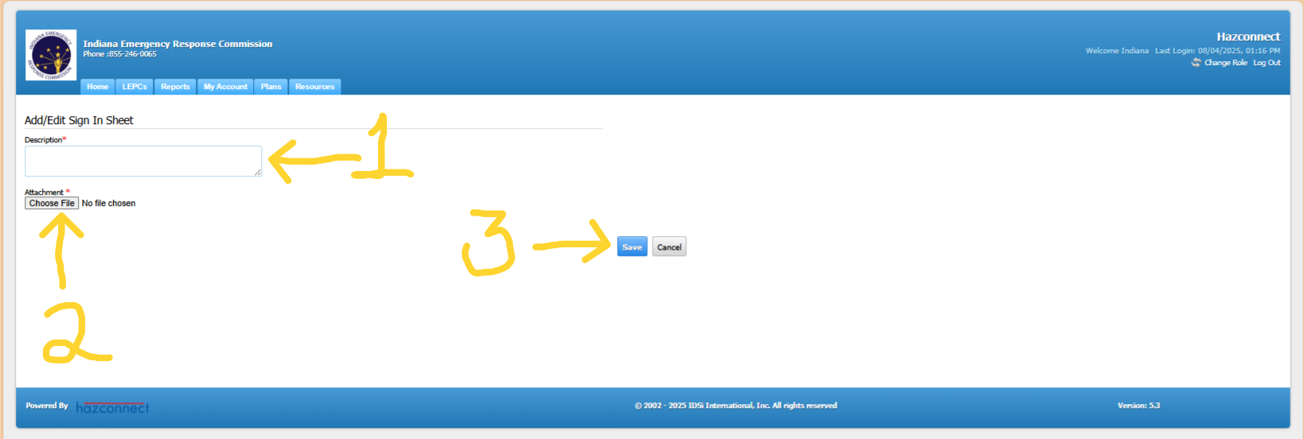
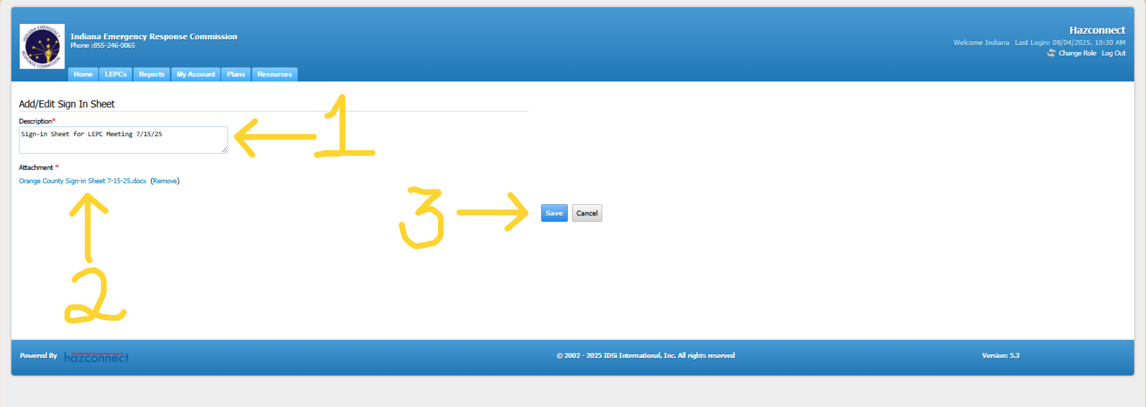
Entering the Meeting Minutes Report, Cont.:
7. In the Description Box type in the title of the document (1). Next use the Choose File option to upload a document from your computer (2). Then choose the Save button (3). The document will be uploaded to the Meeting Minutes report.

Slide 16
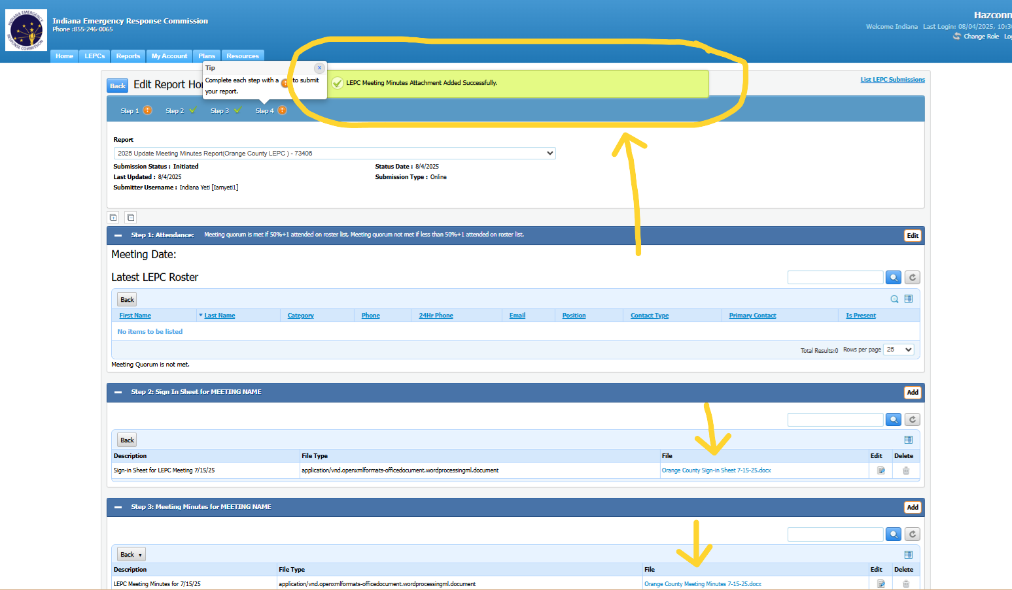
Entering the Meeting Minutes Report, Cont.:
When this portion of the report is completed successfully there will be a green rectangle at the top of the screen that says it was completed successfully. The title of the documents that have been uploaded into each step will be visible.

Slide 17
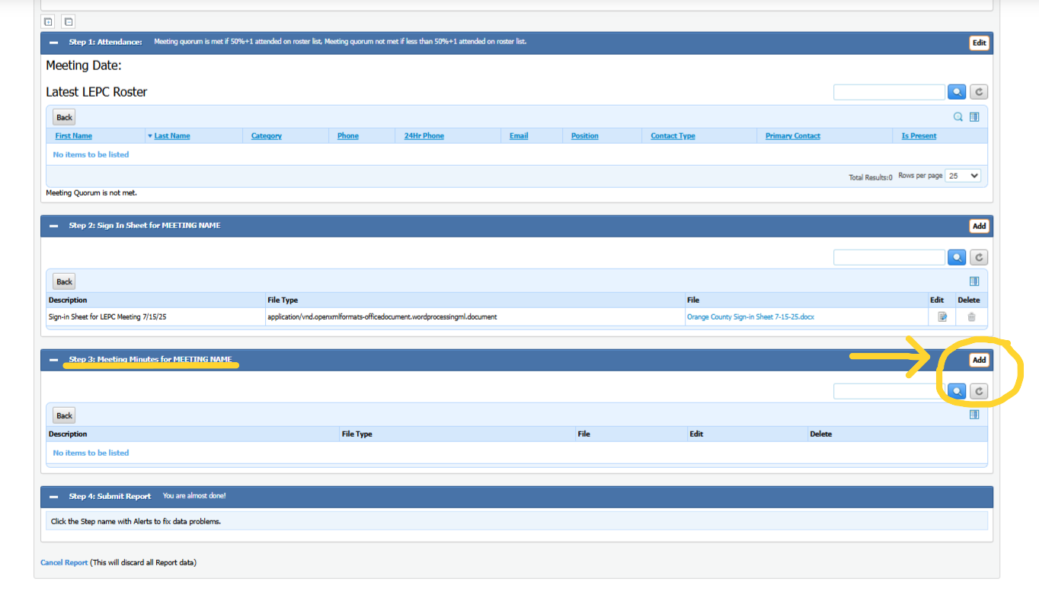
Entering the Meeting Minutes Report, Cont.:
8. To begin Step 3: The Meeting Minutes for Meeting Name choose the Add button to the right.

Slide 18
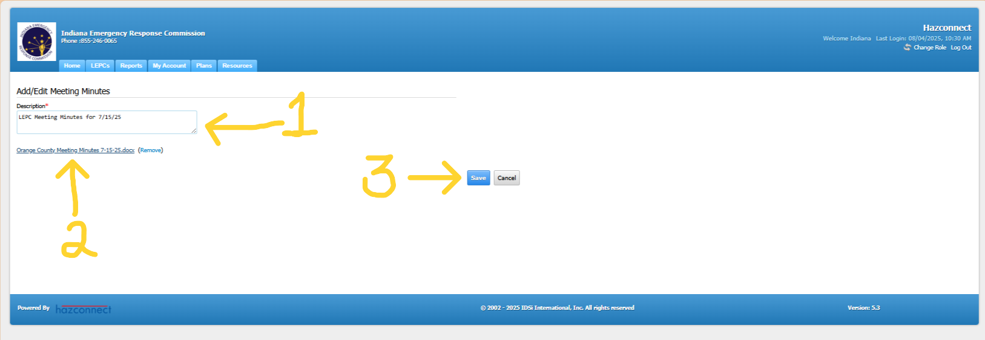
Entering the Meeting Minutes Report, Cont.:
9. In the Description Box type in the title of the document (1). Next use the Choose File option to upload a document from your computer (2). Then choose the Save button (3). The document will be uploaded to the Meeting Minutes report.

Slide 19
Entering the Meeting Minutes Report, Cont.:
When this portion of the report is completed successfully there will be a green rectangle at the top of the screen that says it was completed successfully. The title of the documents that have been uploaded into each step will be visible.

Slide 20
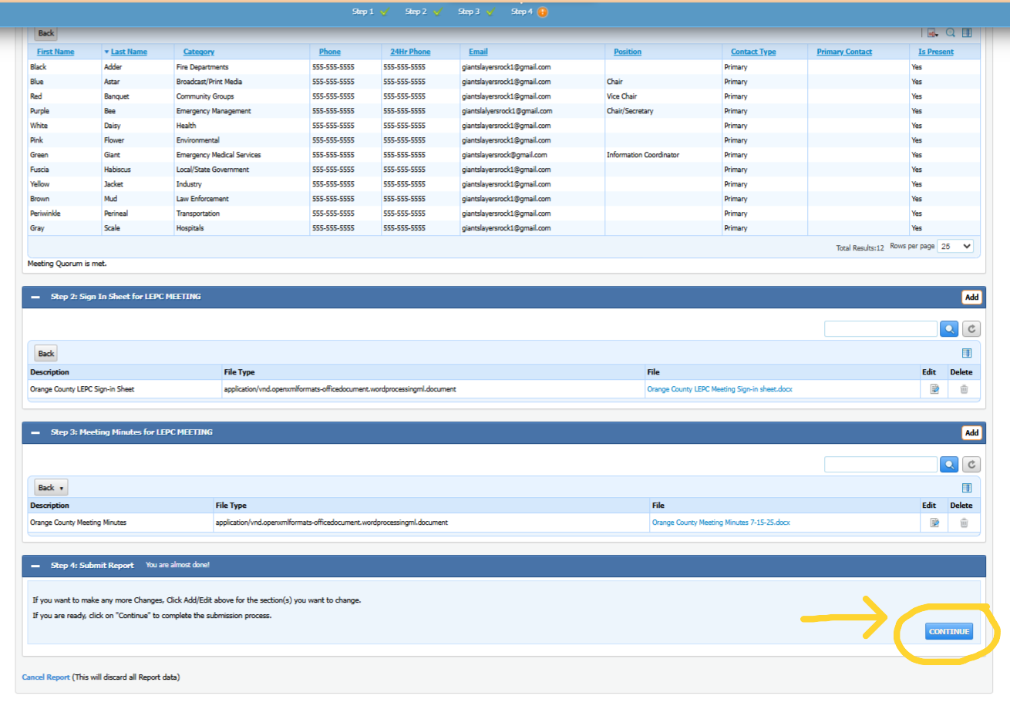
Entering the Meeting Minutes Report, Cont.:
10. After Steps 1, 2, 3 are completed, Step 4 will open at the bottom of the page, and it will say: Continue. Choose Continue to submit the report.

Slide 21
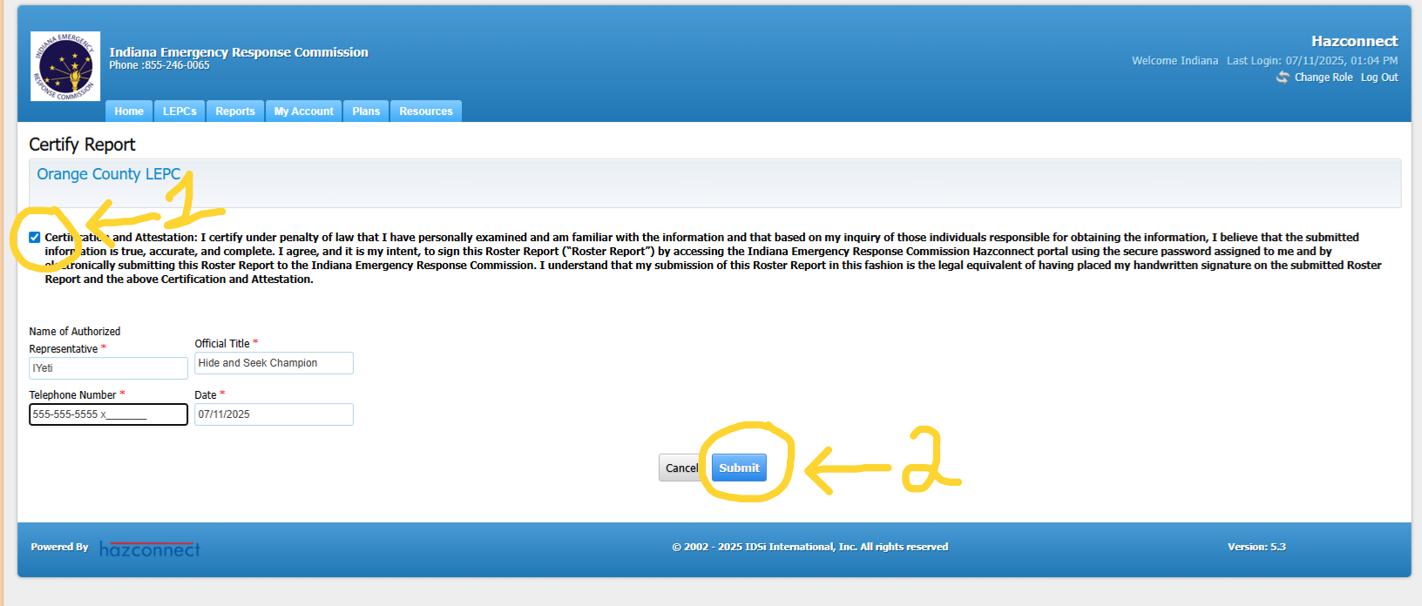
Entering the Meeting Minutes Report, Cont.:
8. When certifying the report Step (1) check the Certify box and fill in the information with the asterisks. Step (2) choose the Submit button.

Slide 22
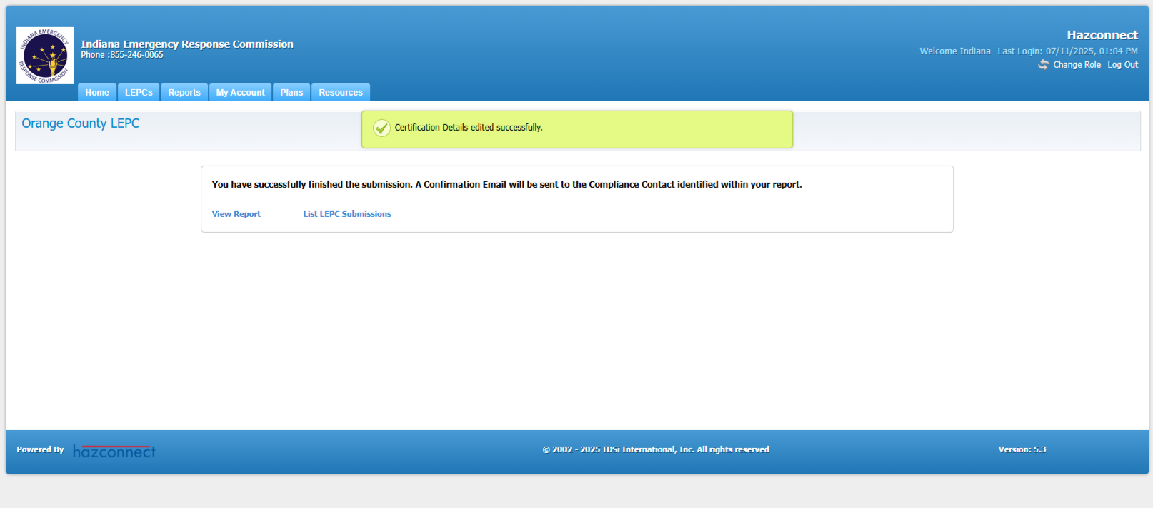
Entering the Meeting Minutes Report, Cont.:
9. After the report has been submitted, a green box at the top of the screen saying that it was certified successfully will be visible. The report has been completed.

Slide 23
The Last Meeting Minutes Report of the year Explained:
Please Initiate the last meeting minutes report of the year, before Dec. 31. (This way Hazconnect will show that you did have the meeting. You will be able to upload the meeting materials if the report has been Initiated. Hazconnect won’t allow you to initiate a report in the new year for the previous year.)
When you create the last meeting minutes report of the year, you should do it the same as ALL other meeting minutes reports and leave it in initiated status only (Do Not submit the report, just because it is at the end of the year.)
It is the same process as all the other meeting minutes reports. After you have your first meeting of the new year and the LEPC reviews and votes to approve the report, and after your Chairperson has signed the meeting minutes, then you will upload it in Hazconnect and submit as you would any other meeting minutes report.
Remember that all the meeting materials should correspond with the meeting minutes report that is being submitted to Hazconnect.

Slide 24





Feedback Is Welcomed
If you have any feedback or questions, contact the IERC inbox or your LEPC Program Manager:
ierc@dhs.in.gov or
IndianaLEPC@dhs.in.gov

