Slide 1
LEPC Legal Notice Report
Indiana Emergency Response Commission
2025

Slide 2
LEPC Legal Notice Report
Why do LEPC’s need a published Legal Notice
Helpful Reminders
Template For the Legal Notice
How To Enter the Report Into Hazconnect

Slide 3
Why do the LEPCs need Meeting Minutes reports?
LEPCs must comply with Indiana Codes, 4-2-7-3, 13-25-1-6, 13-25-2-5, 13-25- 2-10.6(b), 13-25-2-10.7 and 13-25-2-14 to receive funding. To meet funding and IERC requirements, the following documents/information must be submitted annually through the LEPC online reporting system (Hazconnect) at
https://tier2.dhs.in.gov/Account/Login.aspx

Slide 4
Helpful Reminders:
The Legal Notice Report is due by Jan. 31 of each year. (It is important because these dates are added to the IDHS website on the LEPC Lookup page each year.)
The LEPC should vote on the new years meeting dates. (The best time to do this vote is during the last meeting of the year. But don’t enter it into Hazconnect until after Jan. 1 of the new year. It must be entered in the current year.)
You must upload a photocopy of the ad and receipt.
If the ad is printed as a courtesy of the paper, you still need a photocopy of the ad and a statement from your chairperson saying that it was printed as a courtesy.

Slide 5
Helpful Reminders Cont.:
The LEPC must have 4 valid meetings per year. Two meetings must take place in the first half of the year and two meetings must take place in the second half of the year.
The legal notice must be published in a local newspaper that serves your area. You may also put it online, but you will still need the notice to be published.
Legal notices need to be published 48 hours prior to a meeting taking place.
The legal notice must be completed before the system will allow any meeting minutes reports to be entered into Hazconnect.
All meetings follow open-door policy and are open to the public.

Slide 6
A Legal Notice Should Include:
All meeting dates for the year, time and location where the meeting is being held.
Contact information for the LEPC.
An address and times where the LEPC Plan is located and can be viewed.
A template for a printed ad is on the next slide and can be used as it is, but doesn’t have to be, it’s at the discretion of the LEPC.

Slide 7
Legal Notice Template (Public Notice)
The ______________ County Local Emergency Planning Committee (LEPC) will hold its meetings for the year_______ at ___________ p.m. at ________________________ on the following dates:__________________ , _________________, ______________ and _____________ and at such other times as shall be duly authorized by act of the Committee or its Chairman. All interested parties are encouraged to attend. The______________ County Emergency Plan for Hazardous Materials Incidents may be reviewed during regular business hours at the office of ______________________, _________________, IN. All information filed by covered SARA Title III facilities in ___________ County may be reviewed during regular business hours at the offices of the ______________________, ______________, IN. Copies of documents may be obtained at these offices, and the Committee may charge a fee for copying. For further information on these matters, please contact ______________, Chairman, at (XXX) XXX-XXXX.

Slide 8
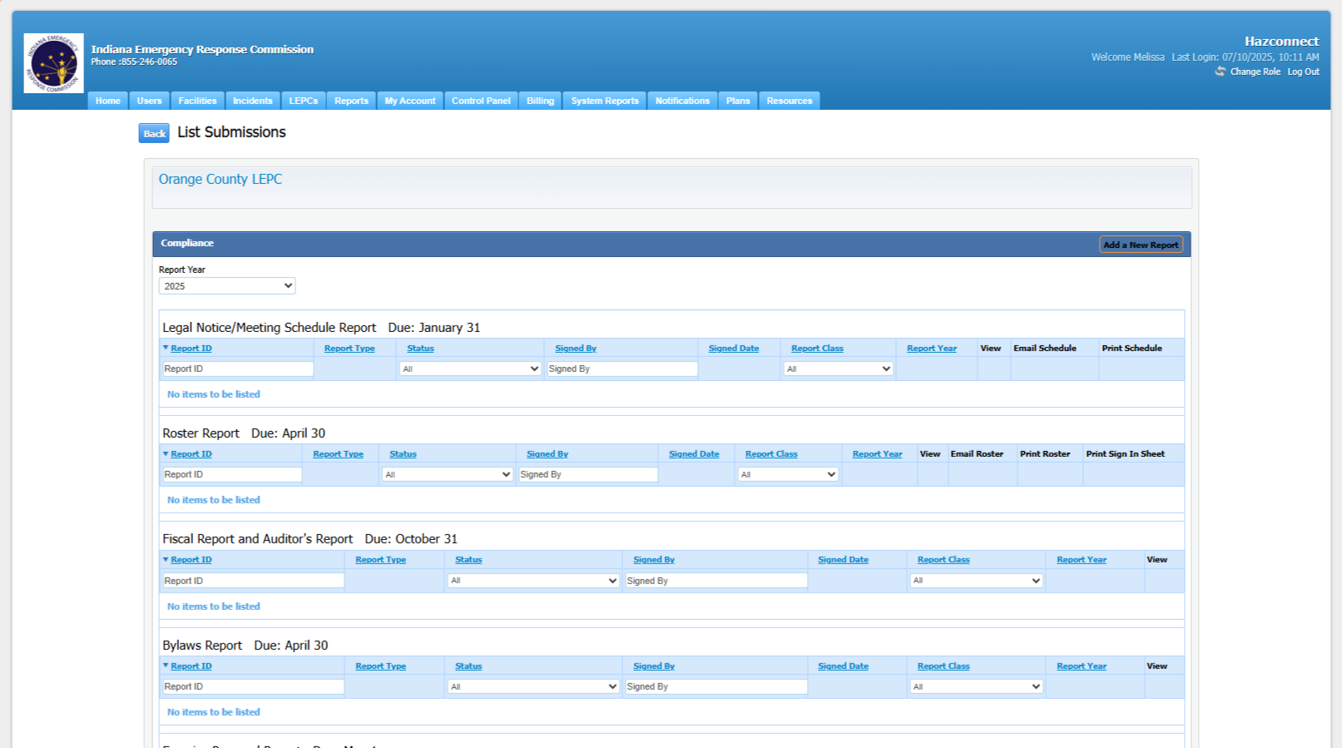
How to enter the Legal Notice Report into Hazconnect:
Go to the counties LEPC Reports page:

Slide 9
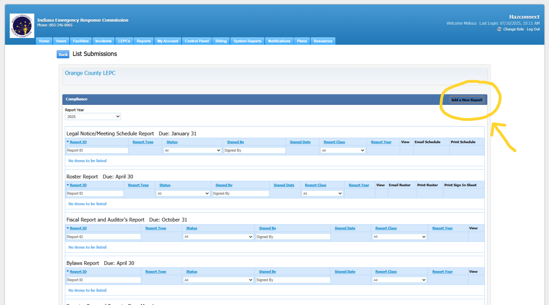
Entering the Legal Notice Report, Cont.:
2. Choose Add a New Report (at the top right of the page.)

Slide 10
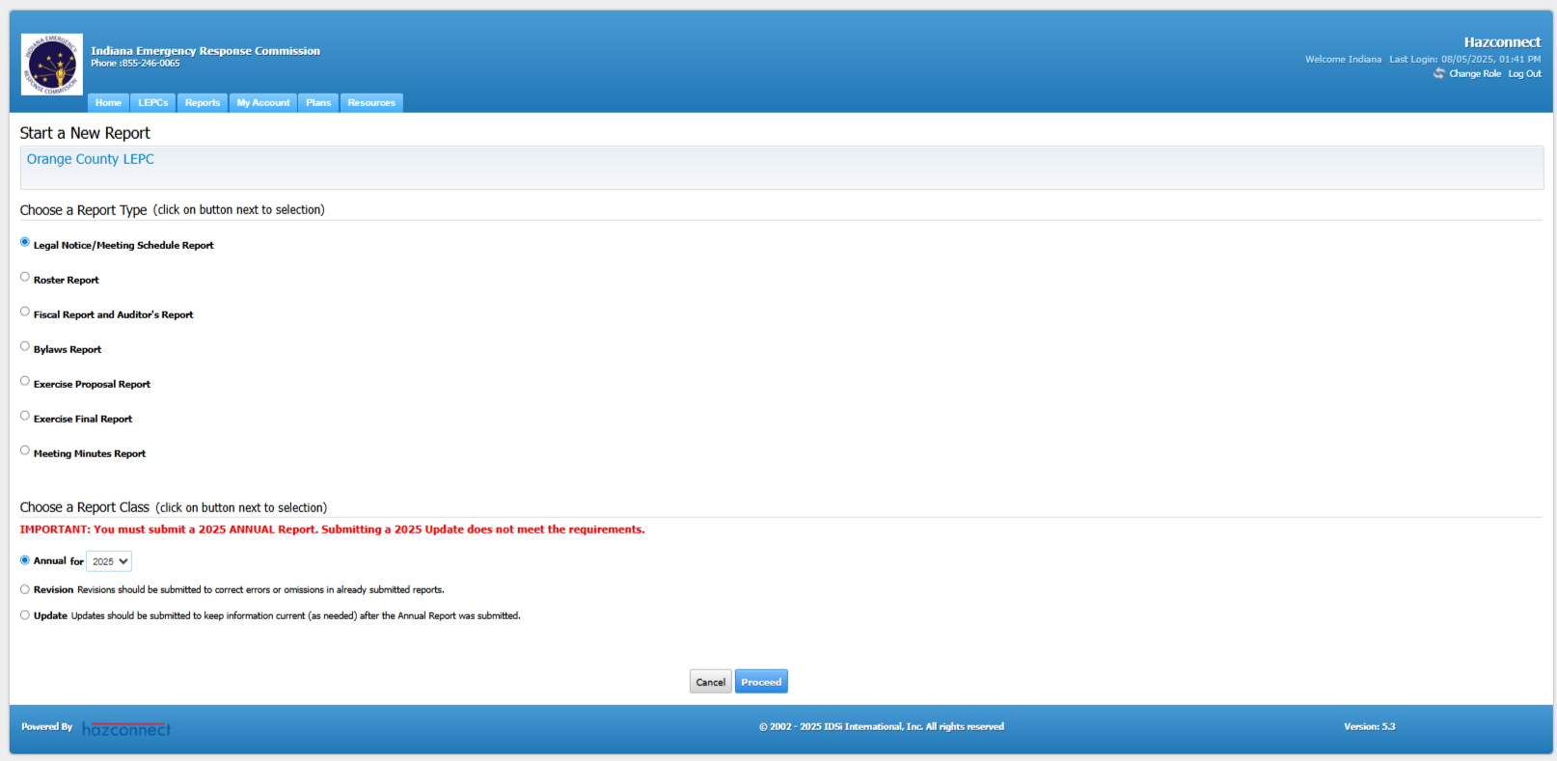
Entering the Legal Notice Report, Cont.:
3. Next Choose Legal Notice Report and then at the bottom choose Annual with the current year, then the Proceed button.

Slide 11
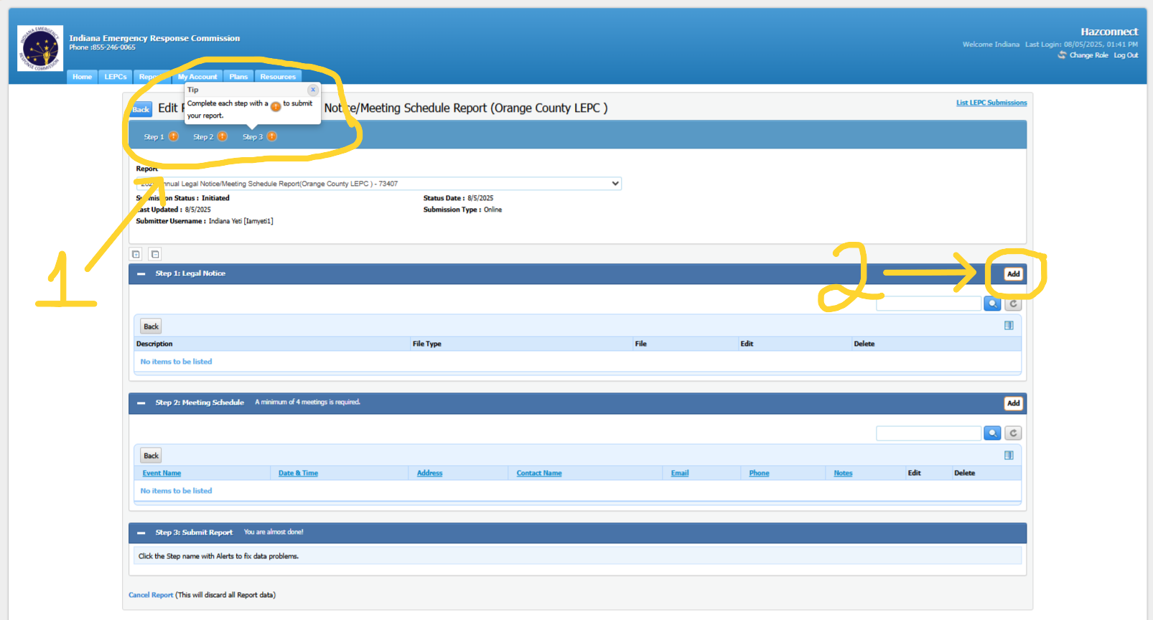
Entering the Legal Notice Report, Cont.:
4. At the top of this screen you will see 3 Steps (1), you must complete these 3 steps before you can submit the report. To start go to Step 1: Legal Notice and choose the Add button on the right (2).

Slide 12
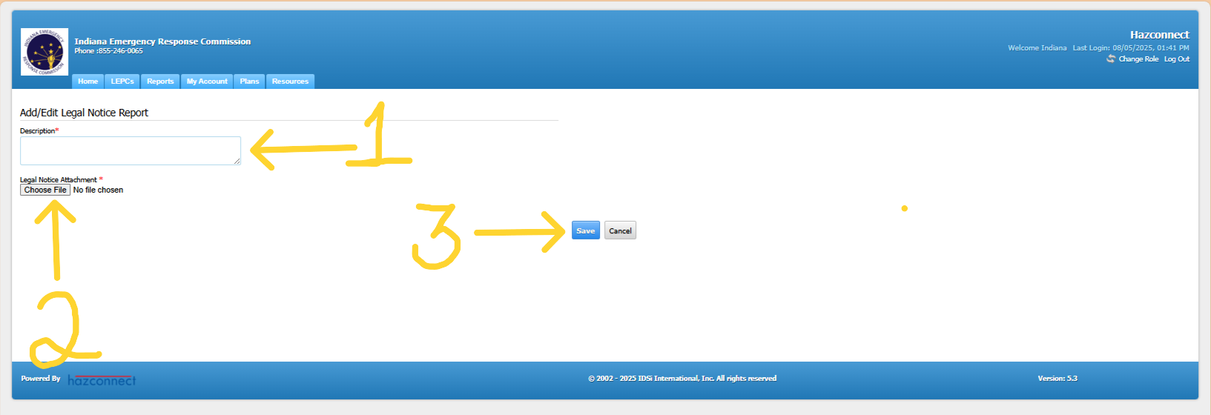
Entering the Legal Notice Report, Cont.:
Here you will upload the photocopy of the ad and receipt (or statement if the ad is printed as a courtesy by the newspaper). You can upload this as one document or you can repeat these steps to upload two or more separate documents.

Slide 13
Entering the Legal Notice Report, Cont.:
5. In the text box type in the title of the document that is being uploaded (1). Use the Choose File option to upload a document from your computer (2). Choose the Save button to submit the upload (3).

Slide 14
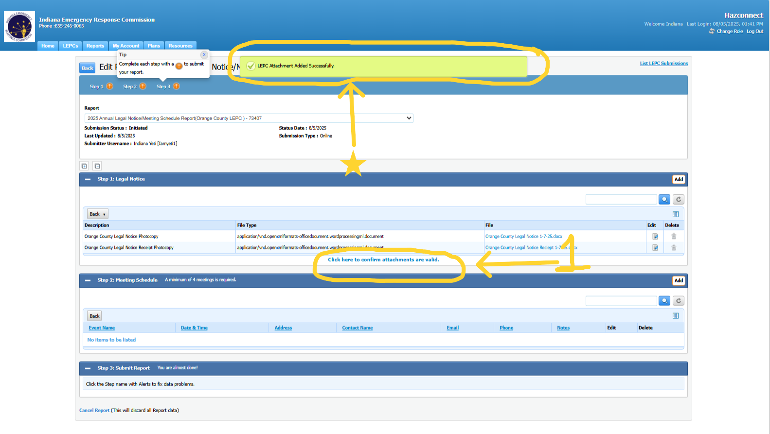
Entering the Legal Report, Cont.:
6. When this portion of the report is completed successfully you will see a green rectangle at the top of the screen * that says it was completed successfully.
You will also see a blue highlighted sentence below the uploads that says: Click here to confirm attachments are valid (1). Choose this option after you have uploaded all documents.

Slide 15
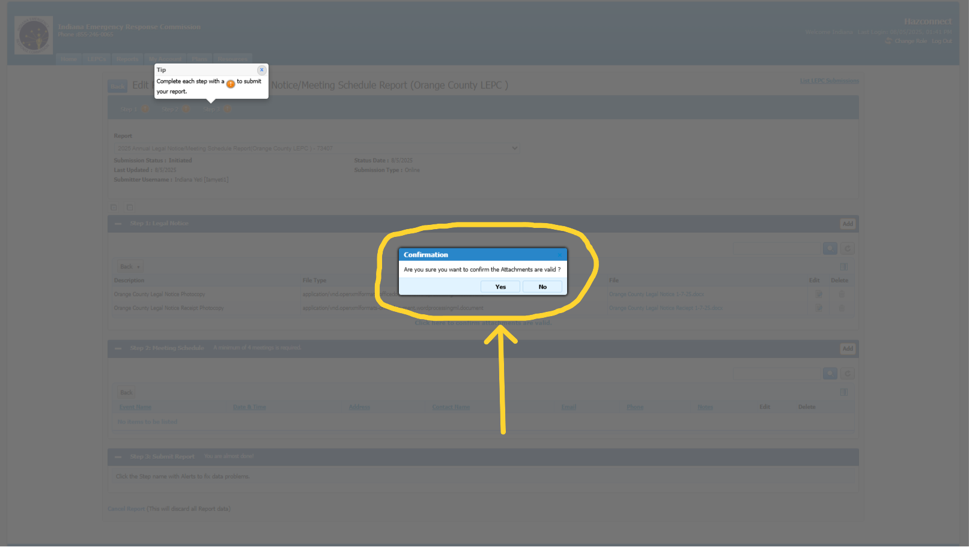
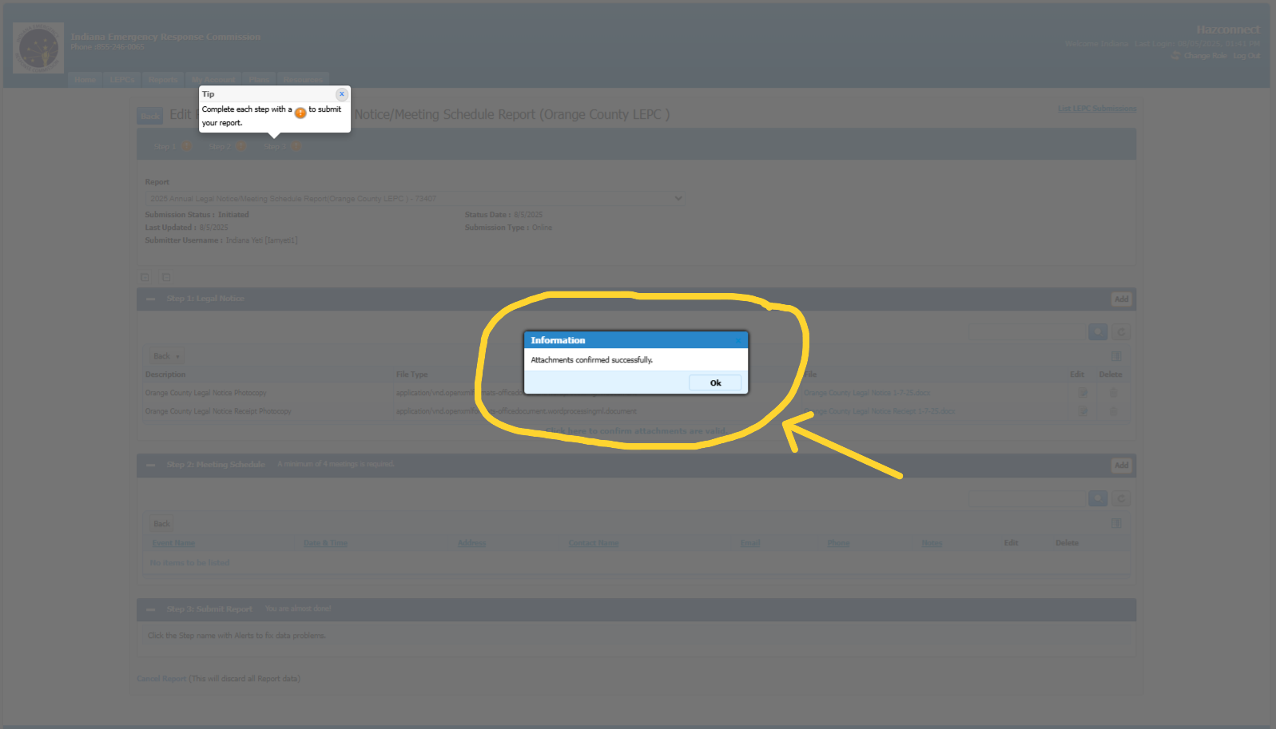
Entering the Legal Report, Cont.:
After you choose Click here to confirm attachments are valid, the system will ask you to verify. Choose Yes to confirm and then Ok.

Slide 16
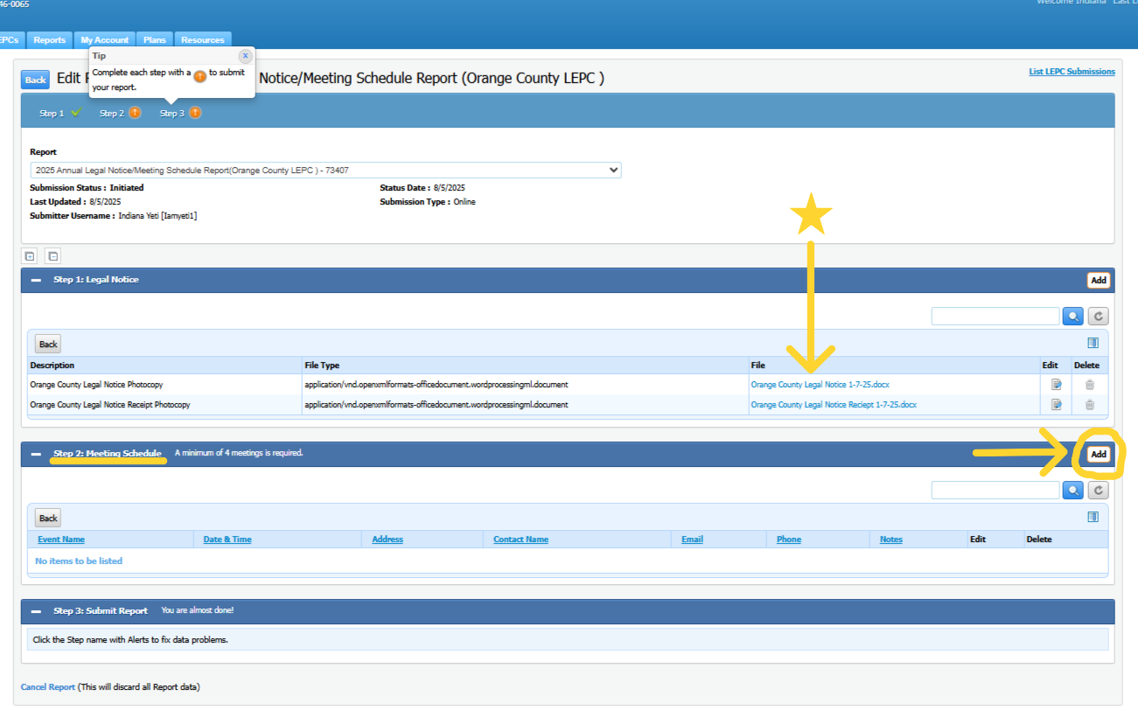
Entering the Legal Notice Report, Cont.:
7. Next you will see the uploads in Step 1 *, below that you will see Step 2: Meeting Schedule choose the Add button to the right.

Slide 17
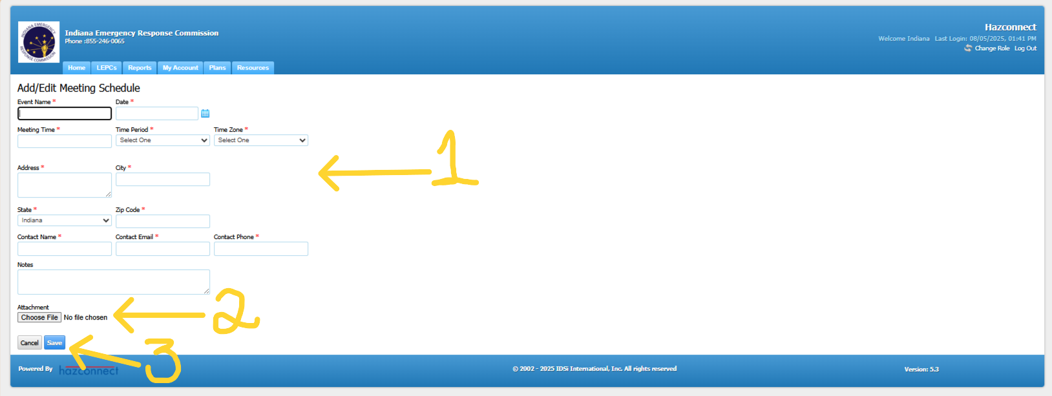
Entering the Legal Notice Report, Cont.:
8. Here you will add the meeting details. You must add at least 4 meetings. You can also choose to enter an exercise date or exercise planning dates, but it’s not required. You must fill in anything that has a red asterisks next to it (1). You can also choose to upload a file with any meeting date, but it’s not required (2). Choose Save when finished (3).

Slide 18
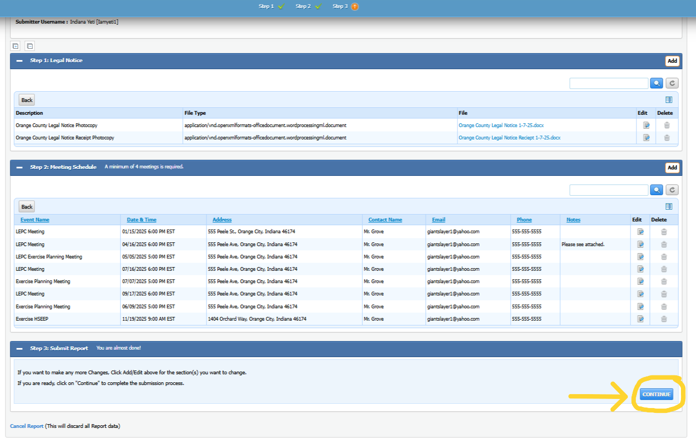
Entering the Legal Notice Report, Cont.:
9. After your meeting dates are uploaded successfully your screen will look like the one shown here. Step 3 will open, and you will see a Continue button on the bottom right of the screen. Choose this to submit the entire report.

Slide 19
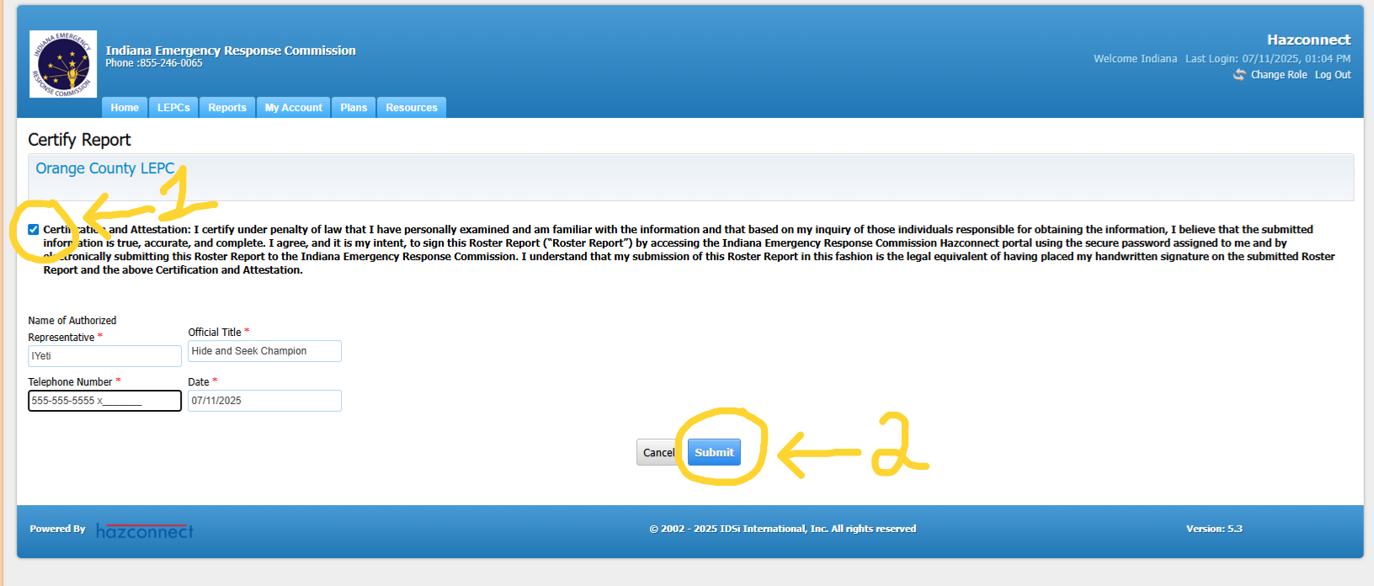
Entering the Legal Notice Report, Cont.:
10. When certifying the report Step (1) check the Certify box and fill in the information with the red asterisks. Step (2) choose the Submit button.

Slide 20
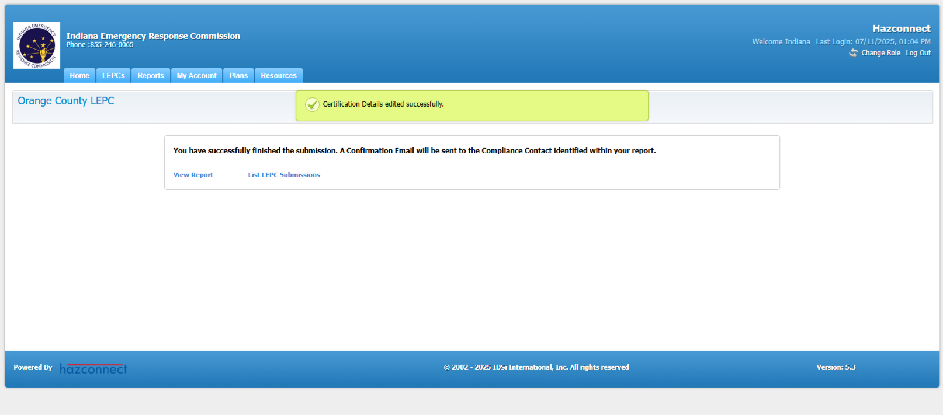
Entering the Legal Notice Report, Cont.:
After you have submitted the report, you will see confirmation in a green box saying that it was certified successfully. You have completed the report.

Slide 21





Feedback Is Welcomed
If you have any feedback or questions, contact the IERC inbox or your LEPC Program Manager:
ierc@dhs.in.gov or
IndianaLEPC@dhs.in.gov

