Slide 1
LEPC EXERCISE PROPOSAL
Indiana Emergency Response Commission
2025

Slide 2
LEPC Exercise Proposal Report
Why do LEPC’s need an Exercise Proposal Report
Helpful Reminders
How To Enter the Report Into Hazconnect

Slide 3
Why do the LEPCs need an Exercise Proposal report?
LEPCs must comply with Indiana Codes, 4-2-7-3, 13-25-1-6, 13-25-2-5, 13-25- 2-10.6(b), 13-25-2-10.7 and 13-25-2-14 to receive funding. To meet funding and IERC requirements, the following documents/information must be submitted annually through the LEPC online reporting system (Hazconnect) at
https://tier2.dhs.in.gov/Account/Login.aspx

Slide 4
Helpful Reminders:
Due May 1st of each year.
When making the report items needed are; a brief paragraph of the Exercise Scenario, the date, time and address of the Exercise, the chemical/s, CAS# and the supporting agencies that will participate in the Exercise and include whether the Exercise will be HSEEP or Non-HSEEP.
Decide before making the report if the Exercise will be HSEEP or Non-HSEEP (if the LEPC wants to apply for the HMEP Grant, the Exercise will need to be HSEEP.)

Slide 5
Helpful Reminders Cont.:
There is an HSEEP check box (only check it if the Exercise will be HSEEP), that choice must match what is entered into the Final Exercise Report, or the Exercise Proposal will have to be re-done, because the two reports are linked.
An HSEEP Exercise requires different types of paperwork and meetings, than a Non-HSEEP Exercise. (Know before making the Exercise Plans what will be needed to qualify for HSEEP approval.)
More information about Exercises can be found on the IDHS Exercise Section webpage: DHS: Exercise Section

Slide 6
Helpful Reminders Cont.:
The Exercise needs to include an Extremely Hazardous Substance (EHS) that is found on the EPA’s Consolidated List-of-Lists (even if it’s Non-HSEEP). It must have a CAS# and you must include the quantity that will be used for the exercise scenario.
The Exercise can include more than one chemical but must include at least one EHS.
It doesn’t have to be an EHS that is in your county's facilities, as your county most likely has EHS being transported through it on a regular basis via, semi-trucks, trains, boats, etc., that is different than what is being used/stored in your county's facilities.
Keep the Exercise realistic, but it’s ok to broaden and challenge the knowledge of those participating in the Exercise.

Slide 7
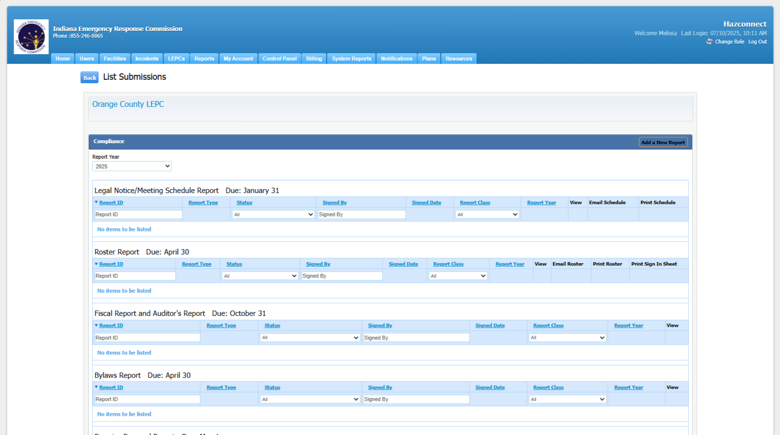
How to enter the Exercise Proposal Report into Hazconnect:
Go to the counties LEPC Reports page:

Slide 8
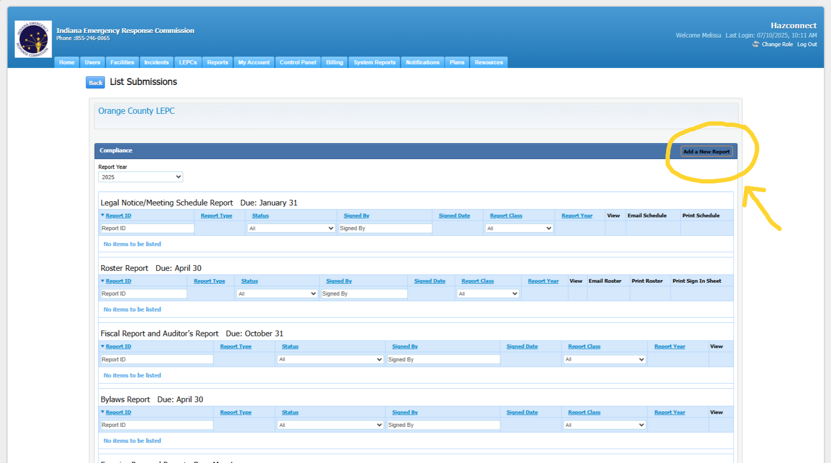
Entering the Exercise Proposal Report, Cont.:
2. Choose Add a New Report (at the top right of the page.)

Slide 9
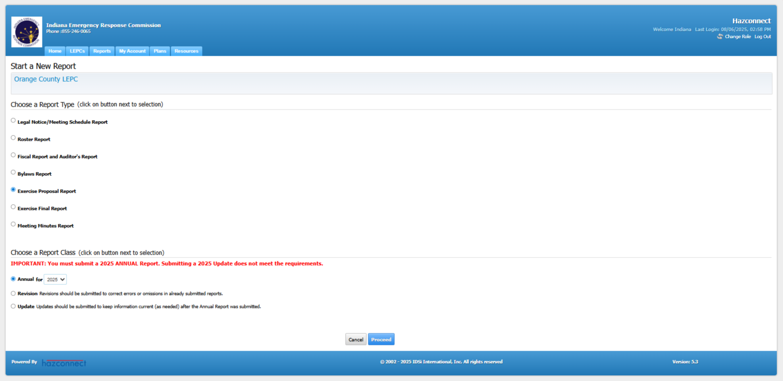
Entering the Exercise Proposal Report, Cont.:
3. Next Choose Exercise Proposal Report and then at the bottom choose Annual for (current year), then the Proceed button.

Slide 10
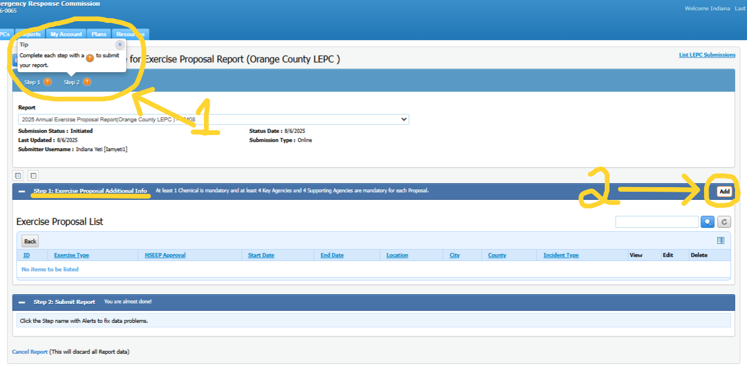
Entering the Exercise Proposal Report, Cont.:
4. At the top of this screen you will see 2 Steps (1), these 2 steps must be completed before the report can be submitted. To start go to Step 1: Exercise Proposal Additional Info and choose the Add button on the right (2).

Slide 11
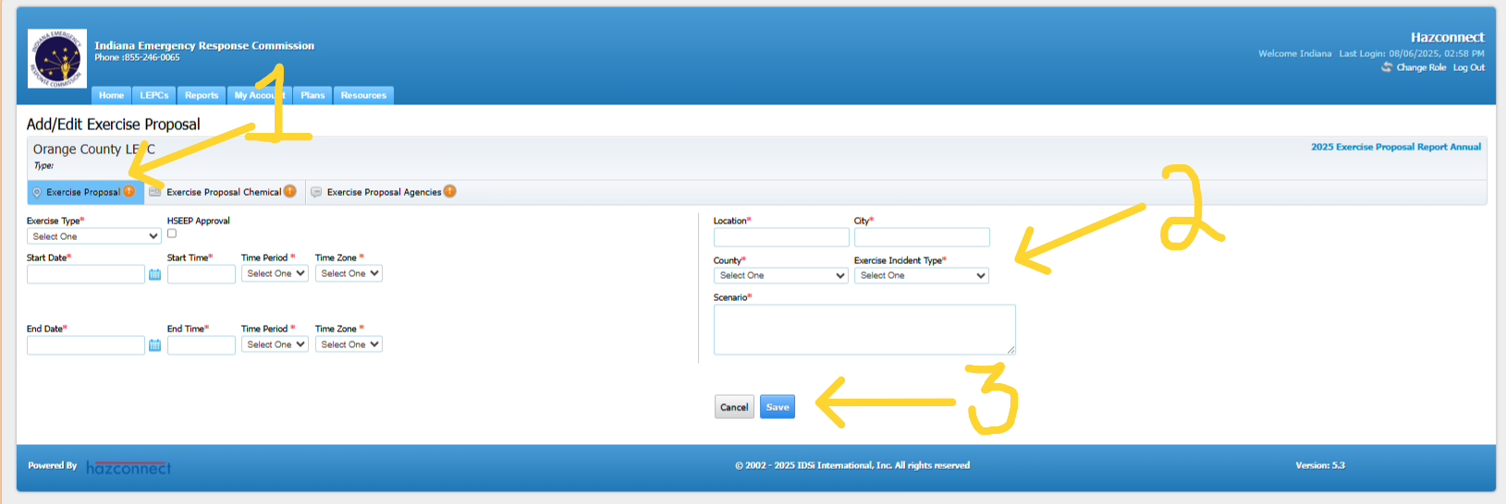
Entering the Exercise Proposal Report, Cont.:
5. Add/Edit Exercise Proposal (1) - Type in all answers (do not copy and paste, the system doesn’t work well with that format.) Fill in all fields with a red asterisks (2). When all information has been entered choose Save (3).

Slide 12
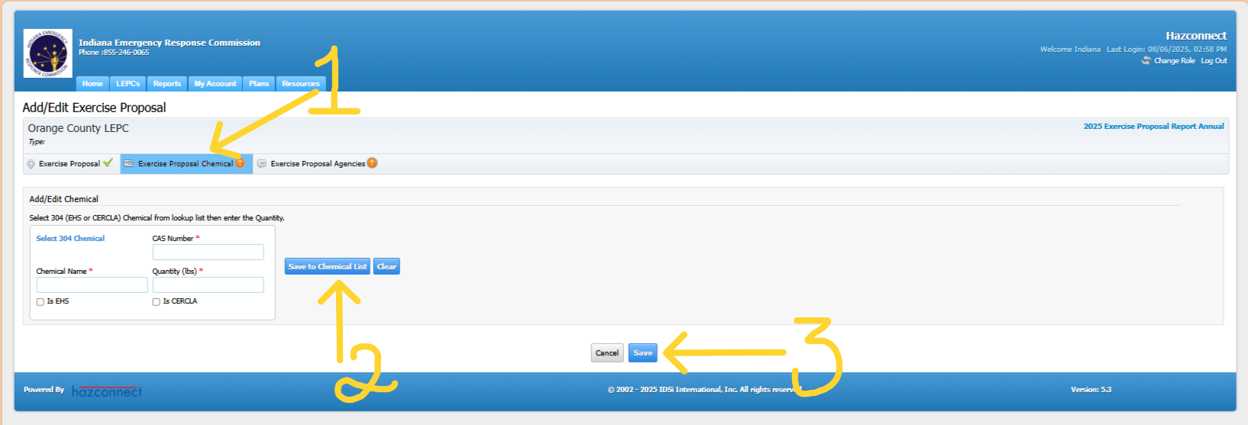
Entering the Exercise Proposal Report, Cont.:
6. (1) The chemical must be an Extremely Hazardous Substance (EHS) from the EPA’s Consolidated List-of-Lists and have a CAS# and include the quantity. Check the EHS and/or CERCLA boxes to correspond with the chemical/s that are being used. Then choose the Save to Chemical List button (2). Then choose Save (3). More than one chemical can be used for the exercise. Repeat these steps to add an additional chemical to the Exercise.

Slide 13
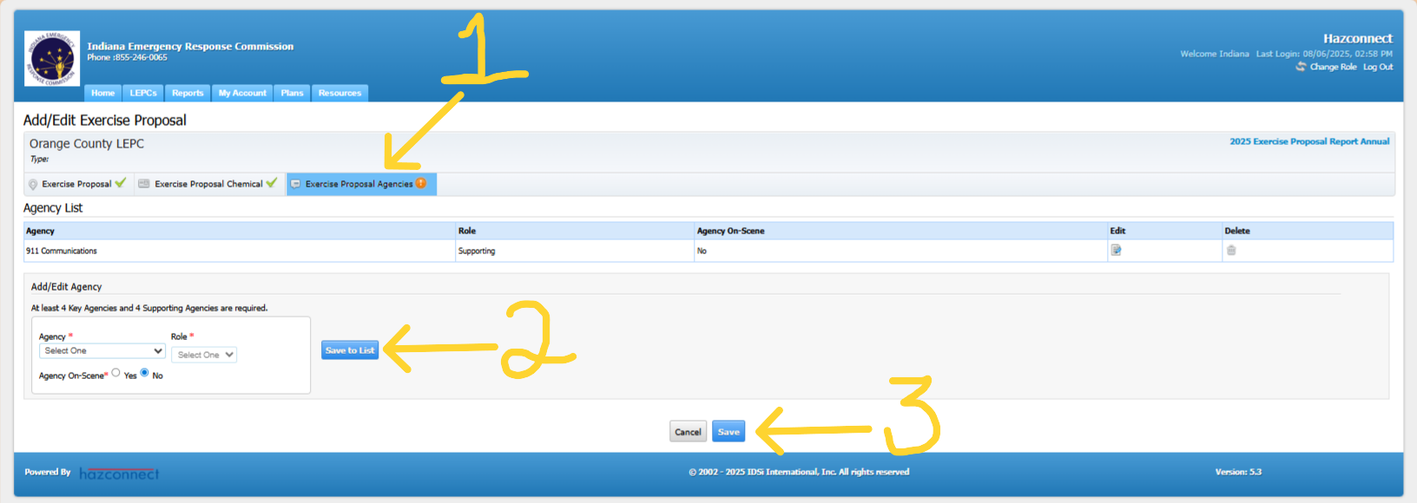
Entering the Exercise Proposal Report, Cont.:
7. Exercise Proposal Agencies (1), go to Add/Edit Agency choose from the drop-down lists to add the Agency, Role and if the agency will be on scene or off scene. Then choose Save to List (2). Repeat these steps to add all agencies that will be participating. Then choose Save (3).

Slide 14
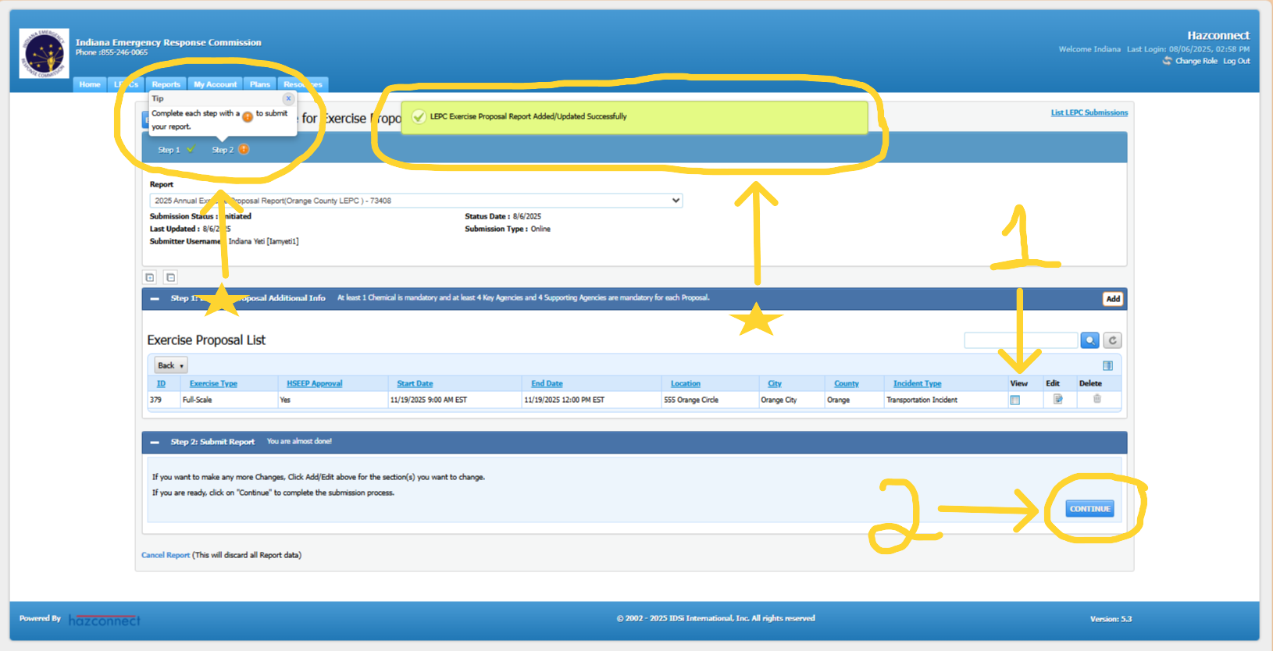
Entering the Exercise Proposal Report, Cont.:
8. At the top left of the page it shows that Step 2 must be completed. At the top of the page in a green box it shows that the previous uploads were successful. You can now View the report to see what it looks like and to check if you need to make corrections (1). To submit the entire report, choose the Continue Button (2).

Slide 15
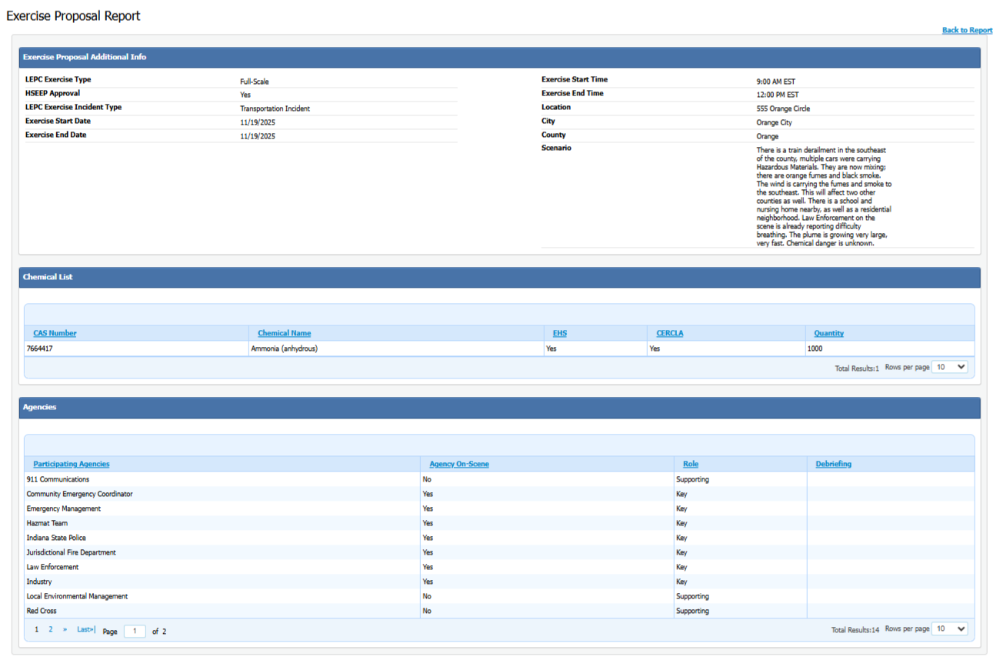
Entering the Exercise Proposal Report, Cont.:
9. The final report should look like this.

Slide 16
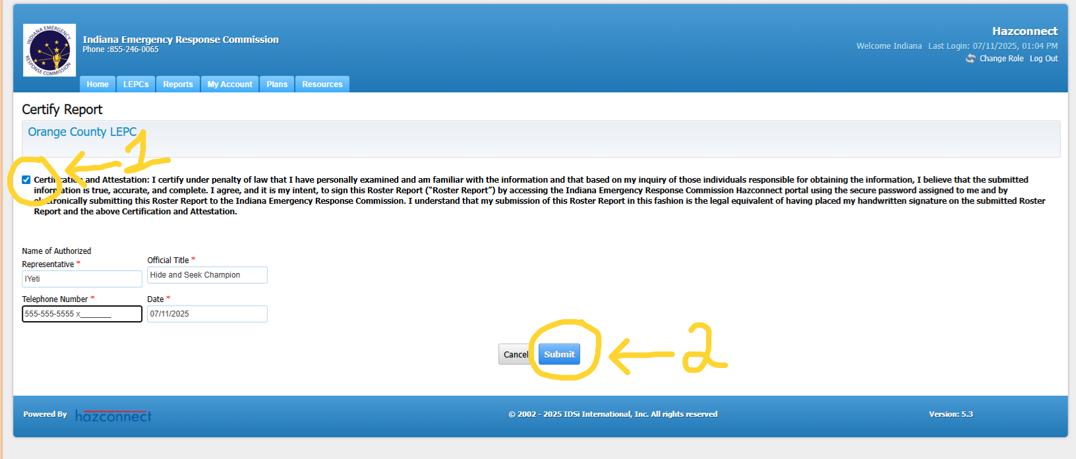
Entering the Exercise Proposal Report, Cont.:
8. When certifying the report Step (1) check the Certify box and fill in the information with the asterisks. Step (2) choose the Submit button.

Slide 17
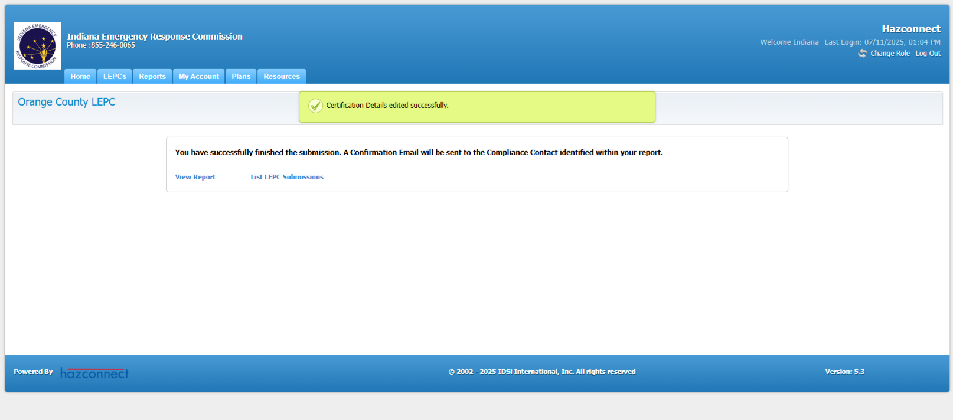
Entering the Exercise Proposal Report, Cont.:
9. After the report has been submitted, confirmation in a green box saying that it was certified successfully will be visible at the top of the page. The report has been completed.

Slide 18





Feedback Is Welcomed
If you have any feedback or questions, contact the IERC inbox or the Indiana LEPC inbox or your LEPC Program Manager:
ierc@dhs.in.gov or
IndianaLEPC@dhs.in.gov

